Slide 1
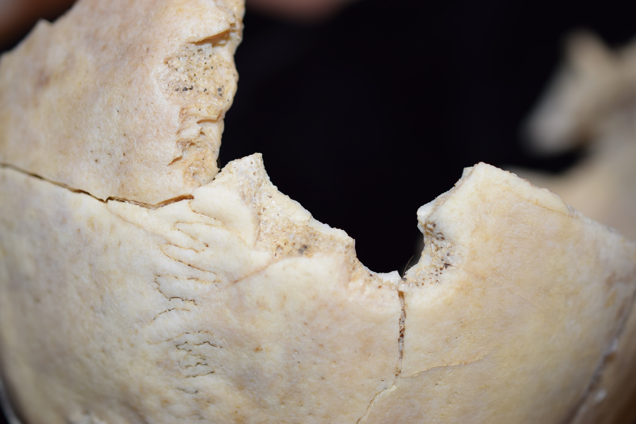
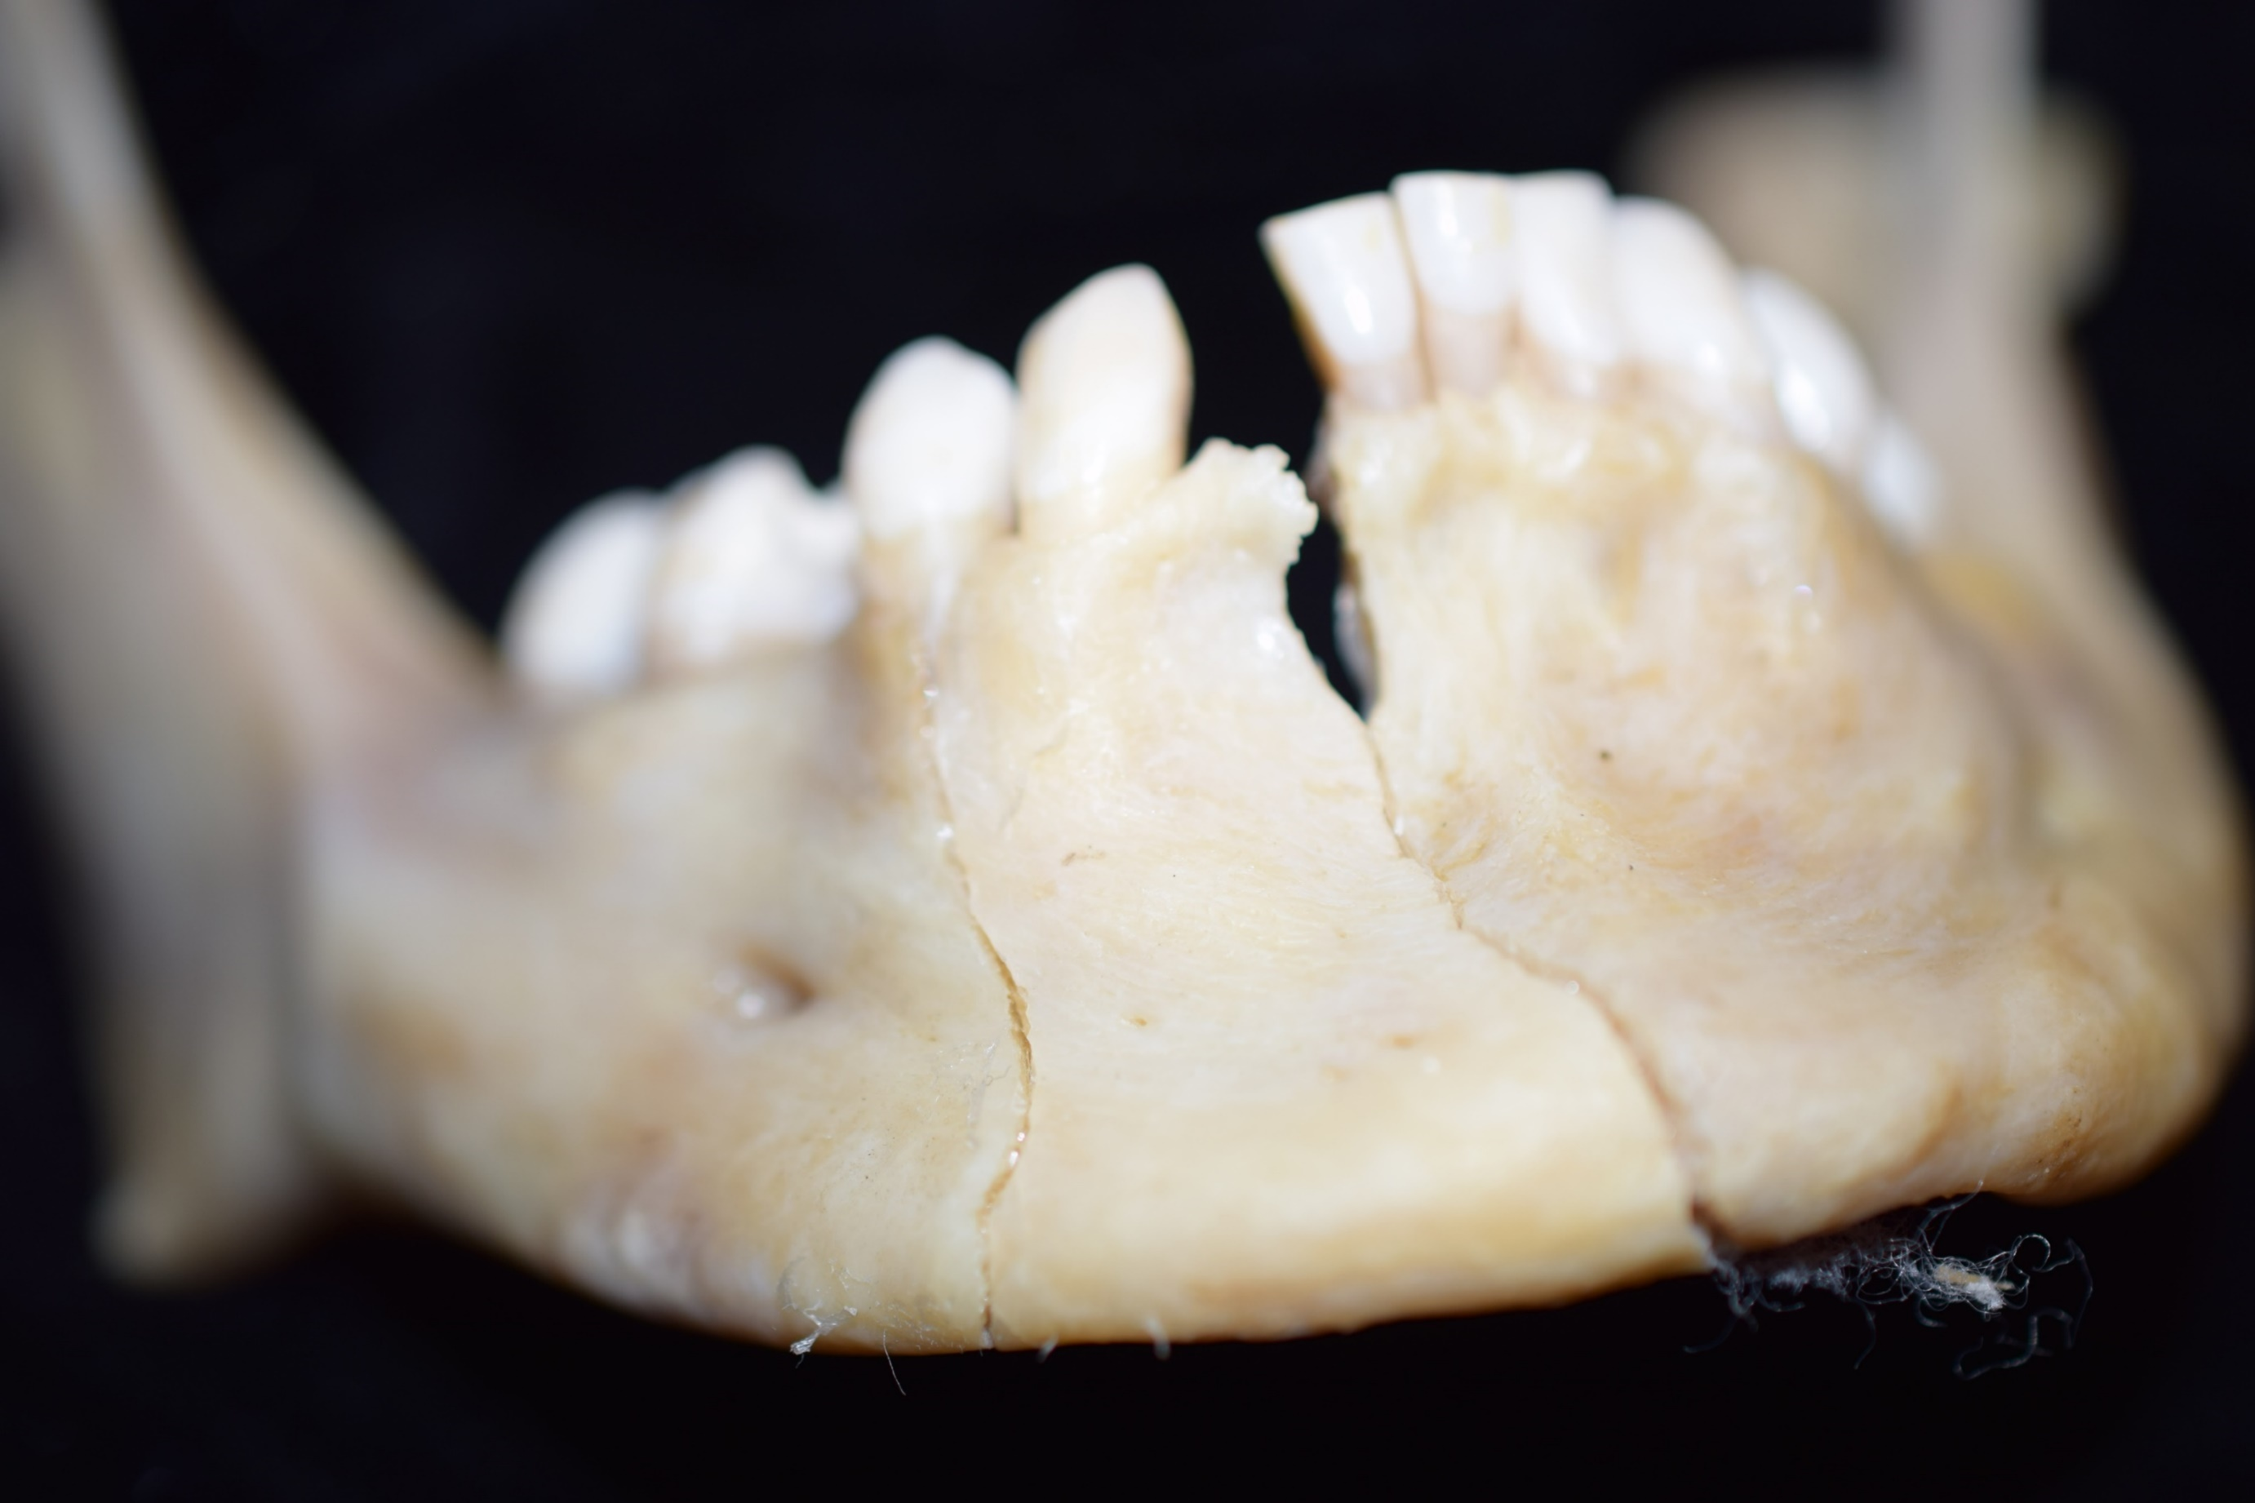
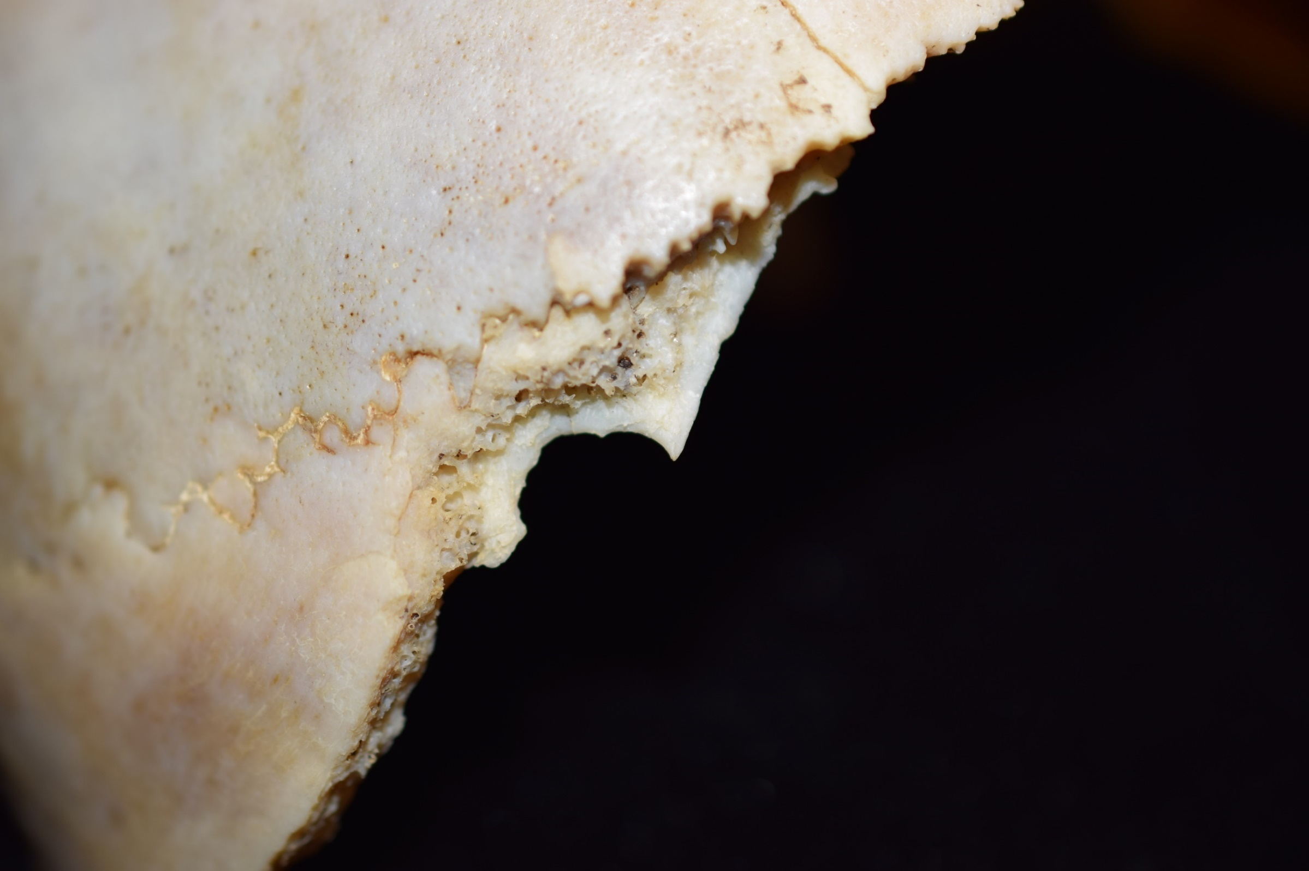
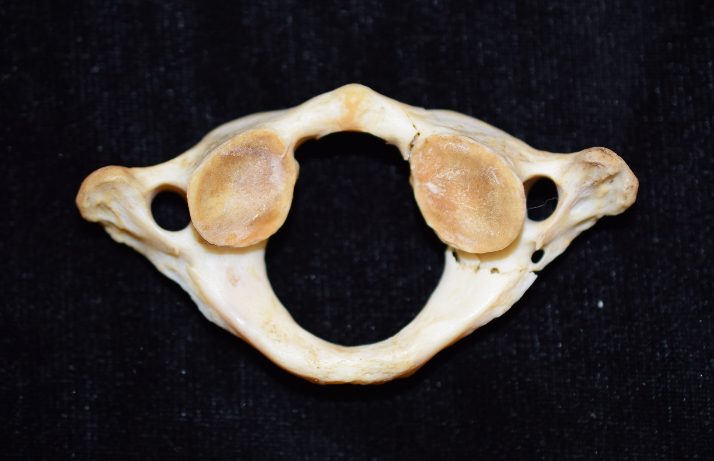
Finding Identity in a Skeletal Cold Case
Katie Jackson, Dr. Ashley Kendell
University of Montana Forensic Anthropology Laboratory
What is Forensic Anthropology?
Forensic anthropology consists of the study and analysis of skeletal remains in a legal context in an attempt to aid in the identification of human remains. A forensic anthropologist’s job consists of identifying human bone versus non-human bone, aiding in the excavation and recovery of human remains, analyzing the remains to create a biological profile, and aiding in the discovery of any information which might help law enforcement to identify a set of skeletal remains. A biological profile consists of an estimation of age, sex, ancestry, and stature.
Discovering Identity and Cause of Death
All cranial wounds were consistent with projectile trauma, however it was unclear why there was only one entrance wound and three exit wounds. Due to the condition of the remains, it also appeared unusual that additional elements were not present for analysis. The elements present were exactly what was needed for a biological profile estimation and analysis of trauma for this individual. These circumstances suggested that the decedent had been previously identified and the remainder of the skeleton had been returned to family. After speaking with the Montana State Crime Lab, it was determined that the case was a Missoula County Sheriff’s Office case from 2012. The original report identified the individual and stated that these elements were those retained as evidence by the Montana State Crime Lab (in the event that this case went to court and evidence was needed), and that the remaining elements had been returned to family and buried. The injuries observed were sustained from a self-inflicted shotgun wound to the head. This mechanism of injury explains the single entrance wound and multiple exit wounds.
A
Image 2. The right parietal, displaying one of the three exit wounds, notice the external beveling around the wound.
Cranial Trauma Analysis
The individual presented evidence of projectile injuries to the facial and basilar skeleton. The entrance wound appeared to be located at the base of the skull, anterior to the foramen magnum, with multiple radiating fractures originating here. There were also a minimum of three exit wounds; two in the right parietal and one in the left parietal. All three exit wounds exhibited ectocranial beveling, consistent with exit wounds caused by bullets. There were also multiple radiating fractures from all exit wounds. There was clear blowout of both orbits and the midface, which is consistent with a gunshot wound to the head. The inferior aspects of both nasals were fractured. There was a diastatic fracture at both zygomaticomaxillary sutures, as well as a diastatic fracture of the intermaxillary suture. There were also fractures of the palate present. The mandible, while complete, exhibited three complete fractures from the alveolar process to the inferior edge of the mandible.
Postcranial Trauma Analysis
The first cervical vertebra exhibits two fractures. One was on the left neural arch, slightly posterior to the superior articular surface. The second was a complete fracture through the left, anterior arch.
Image 1. The mandible, displaying two of the three complete fractures and postmortem loss of the mandibular second right incisor.
S. Grubel
The Cold Case
On February 10, 2017, the University of Montana Forensic Anthropology Laboratory (UMFAL) received the remains of a cold case that had been stored in the Montana State Crime Lab. Our goal was to conduct a re-analysis of a previously documented case, including the establishment of a biological profile and an assessment of trauma. The remains were in excellent condition and included:
Complete cranium (missing portions of the basilar and facial skeleton)
Complete mandible
Complete first cervical vertebra
Complete left innominate
Two complete left ribs
The cranium was highly fragmented and had been previously reconstructed.
Image 4. Ectocranial view of the left parietal, displaying one of the three exit wounds.
Acknowledgements: Thank you to the Montana State Crime Lab, and Heather Krell, for allowing the UMFAL to work cold cases; thank you to Dr. Ashley Kendell, Geni Mielke, and Dani Price for collaboration on the case.
Image 3. the first cervical vertebra, displaying both fractures.
Image 5. An ectocranial view of a portion of the right parietal, displaying one of the three exit wounds.

