Slide 1
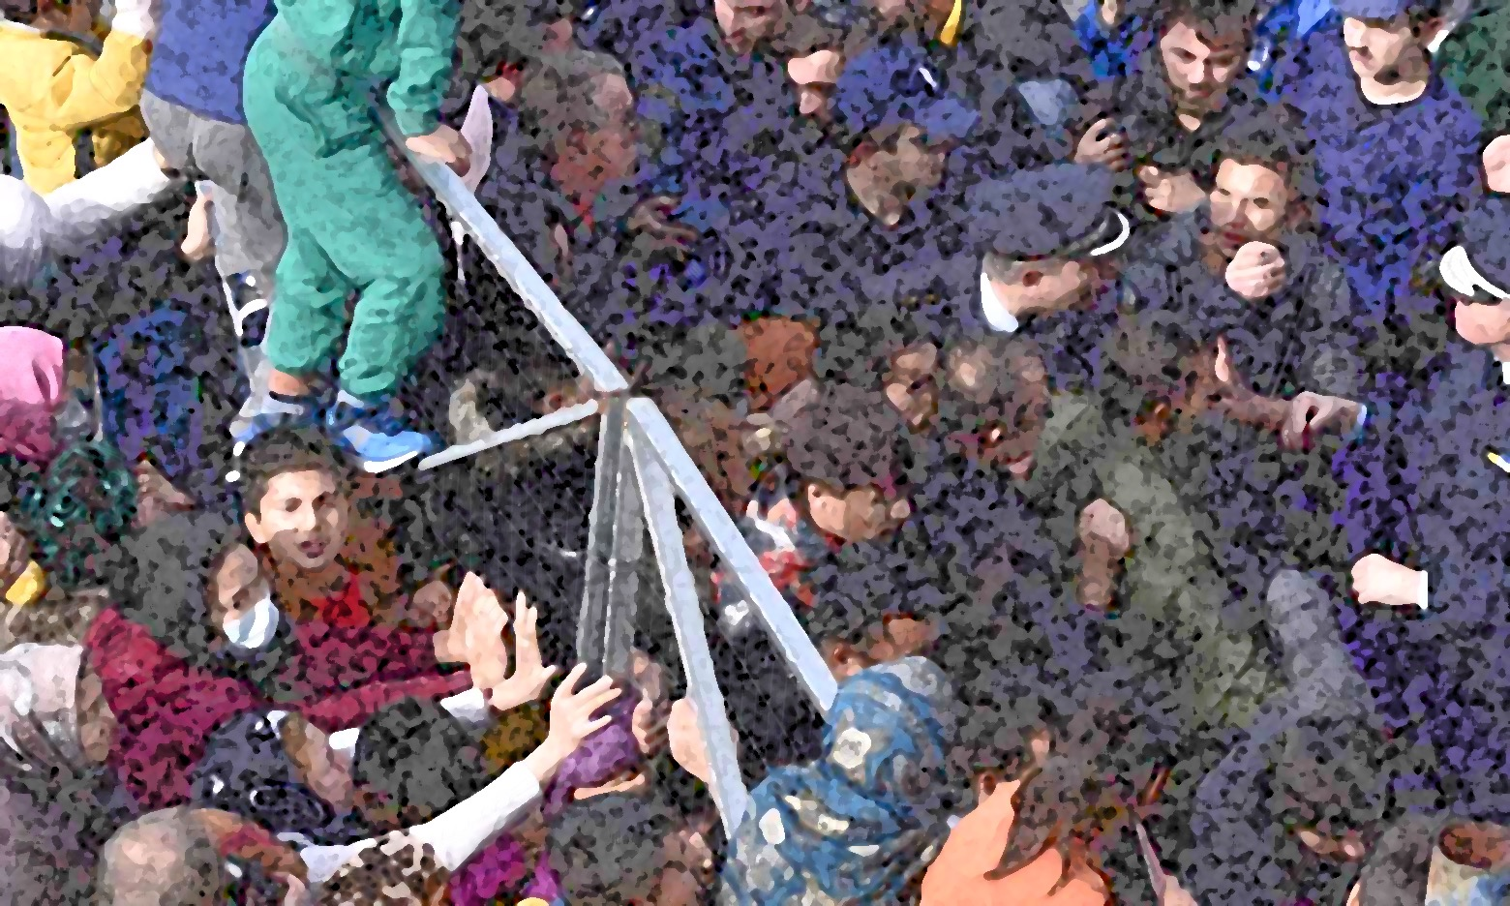
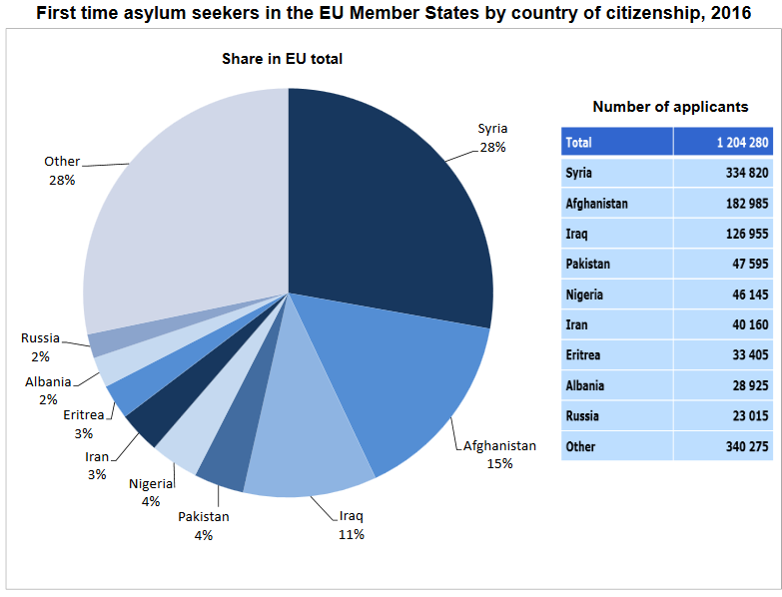
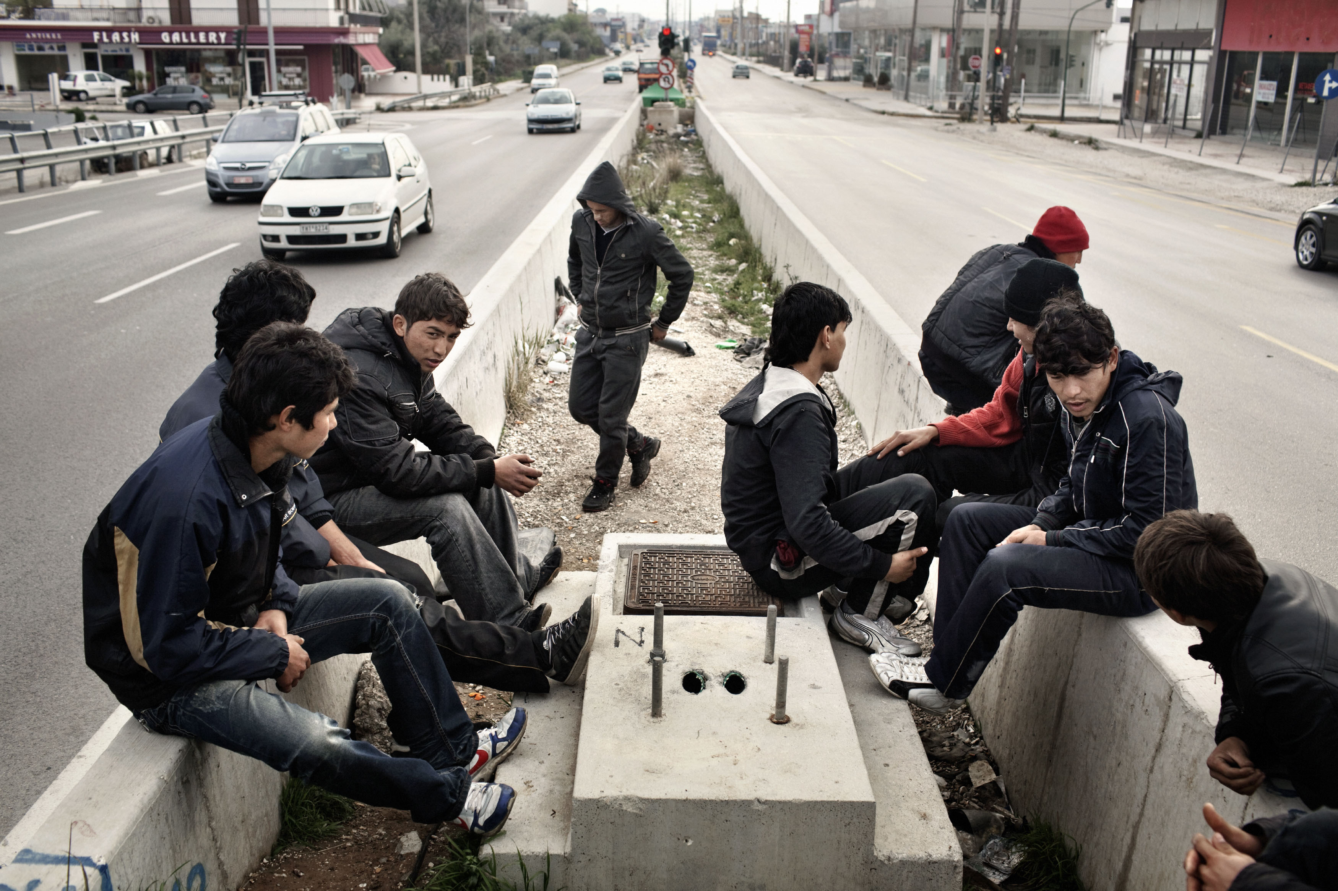
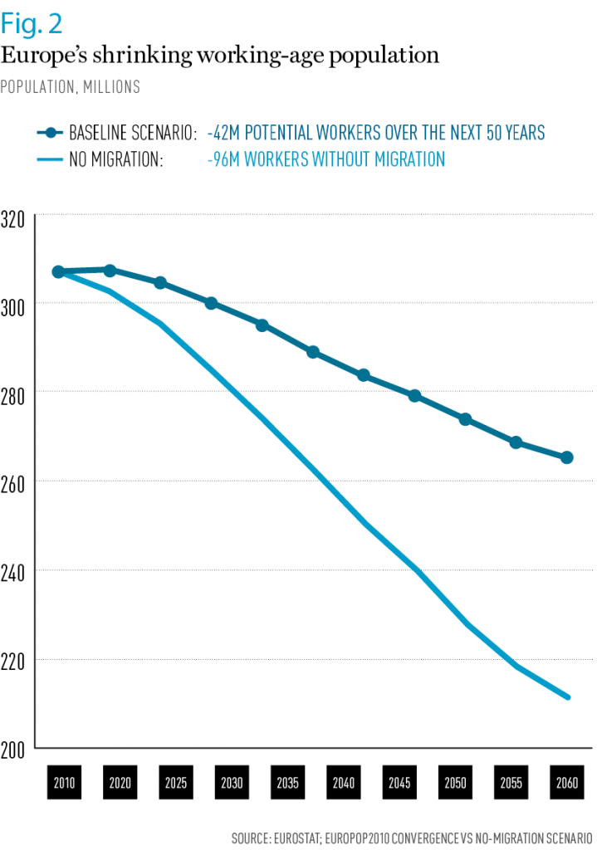
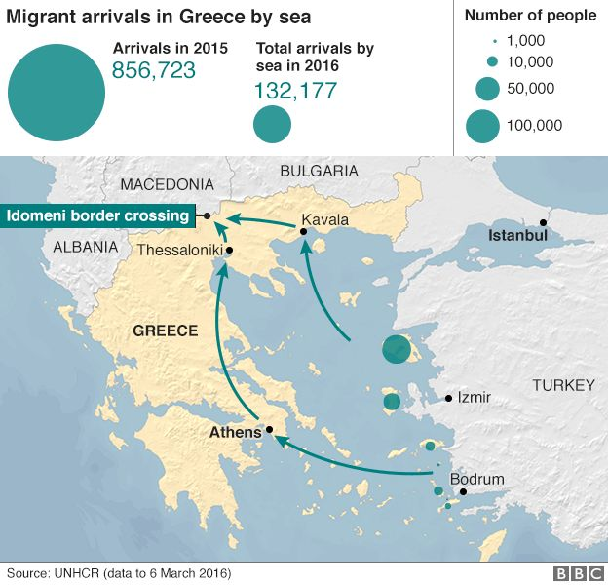
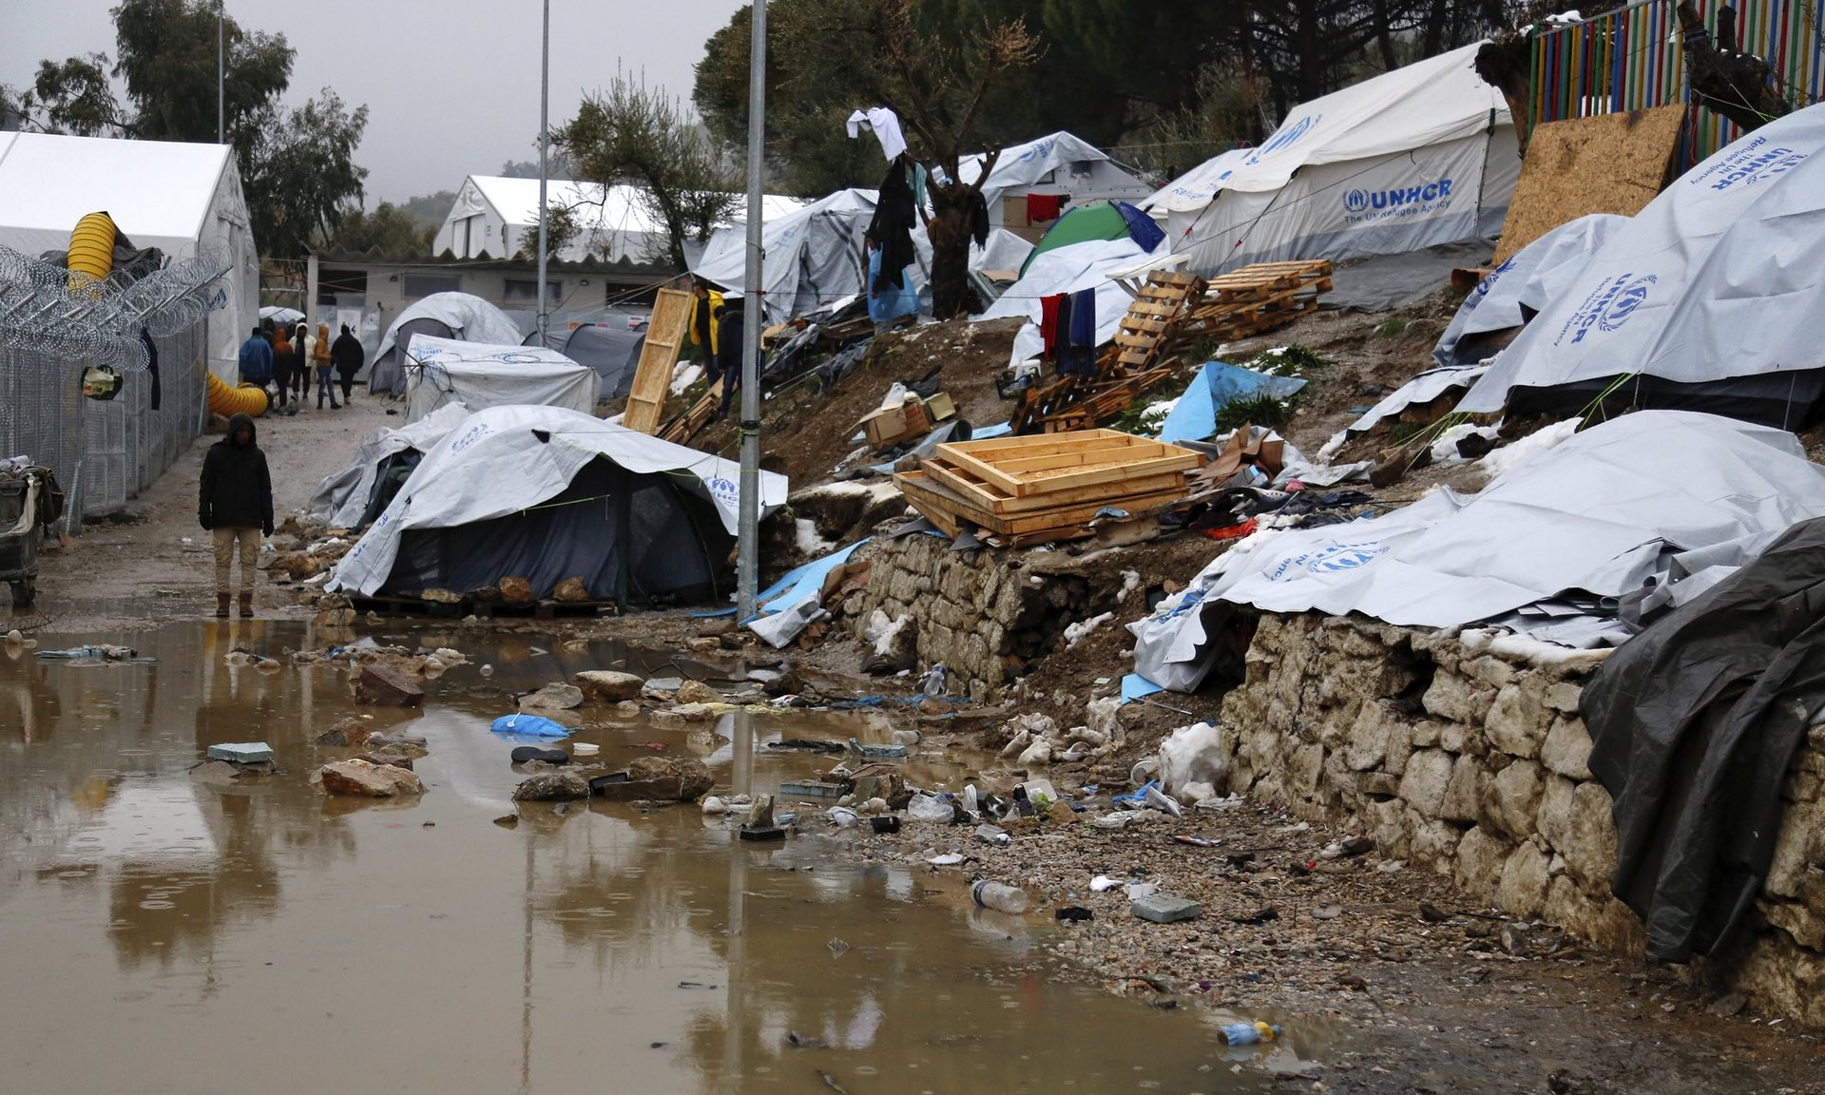
EXCLUSION BREEDS INNOVATION:
Empowering Refugees in Greece through App Technology Training
Laine Bonstein – Global Youth Development, Cohort XIII
ABSTRACT
NEED & CONTEXT
CURRENT STRATEGIES^{1,8}
CONCLUSIONS
Greece has experienced an influx of nearly 100,000 refugees over the past five years, all during a time when the Greek economy lost tremendous stability and the sanctions on refugees seeking asylum throughout the European Union became more rigid.¹ Overpopulation within the archipelago has strained general resources,² created a bureaucratic backlog in asylum application processing and brought a complete arrest to the function, development and livelihood of those inhabiting refugee camps.³ This project intends to provide an opportunity for the inert population by empowering youth. Developing tools in technology, specifically an app, would be a mobile opportunity to prepare the young population for future job markets as well as myriad methods of personal and community innovation. This app would serve as a forum for learning computer code, providing a cumulative curriculum that is tailored to grow along with its users and challenge their knowledge beyond the boundaries of their circumstance.
Governmental Actions
Greek Asylum Office – supported by European Asylum Support Office (EASO)
Asylum Information Database
UNHCR
Independent Non-Profits
Greek Council for Refugees
Greek Forum for Refugees
Hellenic League for Human Rights
Numerous independent non-profits & NGOs
“Our lives are digital now, so the younger generations in particular need digital skills like coding.”
- Neelie Kroes
EU Commissioner for the Digital Agenda
(2010 - 2014)¹¹
Asylum Application Process¹⁰
Much of the debate surrounding the integration of refugees into the greater European Union surrounds the issues of unemployment and economic participation. This app would be a prime chance for young people to build a specialization that would override populist skepticism, further proving refugee labor to incentivize local economy rather than drain it.¹²
Beyond marketability and positive self-worth, this project has potential to incite pro-active behavior amongst camp residents:
Spearhead improved camp infrastructure
Build inter-camp communication network
Organize cooperative scheduling for asylum application
Directly contribute and bolster Greek economy
This population is under tremendous, often uninformed, scrutiny within the global discourse. In order to aid their transition, however long it may take, we need to think with pragmatic empowerment – not sentimental placation.
STATS
1) 74% of first time asylum seekers are male.⁹
82% - below 35yrs.
26% - below 18yrs.
2) Wait time between 3 – 12 months, but varies with applicant’s qualifications.
3) Rejection rate in 2016 ranged up to 71% overall.⁸
4) Closing borders and EU political climate has further slowed application processing.⁵
The United Nations High Commissioner for Refugees (UNHCR) and other independent agents provided refugee aid,¹ ranging from basic needs to renewable technologies. Unfortunately, the basic infrastructures (largely) did not withstand the winter months and were not met with consistent upkeep and repair.²
NEEDS MET:
Building tents and temporary infrastructure for daily life.¹
Limited modes of transportation available.
Implementing temporary water systems/plumbing.³
NEEDS IGNORED:
Shower access/personal hygiene (wait up to 3 days).⁴
Low resupply/cleaning materials.
Disposal of refuse/general site cleanliness.
Alterations/preparation for winter months.⁵
“It's obvious that we're going to stay here for a longer time now. What can I do? I'm doing nothing[…] because of depression and stress, I just think that I'm going to explode sometimes from the situation that I'm living in.”
- Ali Bashar, This American Life ⁴
12
YOUTH (under 25)
UNEMPLOYMENT RATE
March, 2015 ¹⁰
Germany 7.2%
EU28 20.9%
Greece 49.7%
BACKGROUND
Needs denied to the aggregate population generates disparity and overall hopelessness – but needs met can elicit the same effect.⁶ As infrastructure is addressed and living conditions improved, the imperfect refugee camps become a more permanent reality.⁴
The Lost Generation⁶
With future plans uncertain, refugees find themselves in a bureaucratic backlog and without liberty to mobilize; this waiting is creating a new “lost generation” amongst the younger refugee population. Lack of education and low stress socialization can create a developmental flux as well as encourage apathy and hostility within refugee children and adolescents.⁷
INNOVATION & IMPLEMENTATION
With so much unavailable to those in the crossfire of public policy, opportunities need to be offered to ensure the future development, contribution and prosperity for young refugees.¹¹ This proposal offers a forward thinking skill set and potential in both community and individuals: teach young refugees computer coding through the use of an app.
The main goal for the project is two fold:
Construct skills to be utilized in the global market.
Build self-efficacy and develop ingenuity amongst the burgeoning population.
This online app would be multidimensional and adjustable:
Multiple languages
Adaptive age appropriate interface
Adjustable learning pace
Cumulative skill building model.
Refugee camps in Greece are steadily accruing solar panels as a means to generate electrical power⁸, providing ample opportunity for a stagnant population to take advantage of accessible education and instigate intellectual discourse.⁷ In addition, this methodology would put school-aged children in a competitive stride with their European counterparts, as many K-12 schools have begun incorporating computer science as a part of their standing curriculum.¹¹
“Europe should primarily be welcoming refugees because it is a humanitarian and ethical imperative, but it is also in our own economic self-interest.”
Professor Alexander Betts, Director of Refugee Studies Centre,
Oxford University¹²
Several middle eastern nations have suffered sustained political conflict, thereby producing a vast number of refugees seeking asylum. This population influx is most evident in nations that comprise popular refugee routes. As the refugee crisis has continued to build, many EU countries have closed their borders; this exclusion has left thousands in halted transition, without consistent resource or forward trajectory. Greece’s location during this migration has strained its infrastructure and oversaturated its borders.²
Because of its land & maritime borders, Greece has been a hub for asylum seeking refugees¹ arriving by sea:
Total Refugee Arrivals (by sea)
2015 – 856,723
2016 – 355,728
2017 – 4,900*
*April 2017
REFERENCES
1. United Nations High Commissioner for Refugees (2017). Refugee Situations: Mediterranean, Operational Portal. Retrieved from https://data2.unhcr.org/en/situations/mediterranean
2. Kousoulis, A., Ioakeim-Ioannidou, A., & Economopoulos, M. (2017). Refugee crisis in Greece: Not a one-country job. International Journal of Public Health, 62(1), 1-2.
3. Stronger Cooperation Crucial to Ensure Sustainable Refugee Response in Greece - UNHCR. (2017, March 27). Targeted News Service, p. Targeted News Service.
4. Glass, Ira. (2016, July 29). Are we there yet? This American Life. Podcast retrieved from https://www.thisamericanlife.org/radio-archives/episode/592/
5. Strickland, P. & Safdar, A. (2017, January 16). Concern over EU plans to send refugees back to Greece. Al Jazeera. Retrieved from http://www.aljazeera.com/indepth/features/2017/01/concern-eu-plans-send-refugees-greece-170114162243125.html
6. Butler, Declan. (2015). Lost generation looms as refugees miss university. Nature, 525(7570), 433.
7. Moore, Temple (2017) Strengths-based narrative storytelling as therapeutic intervention for refugees in Greece, World Federation of Occupational Therapists Bulletin, 73:1, 45-51, DOI: 10.1080/14473828.2017.1298557
8. Greek Council for Refugees (2017). Asylum Procedure. Asylum Information Database (AIDA). Retrieved from http://www.asylumineurope.org/reports/country/greece/asylum-procedure
9. European Commission, (2016, October). Is the refugee crisis making unemployment worse in Europe. British Broadcasting Corporation. Retrieved from http://www.debatingeurope.eu/2017/01/04/refugee-crisis-making-unemployment-worse-europe/#.WQA19FLMzVo
10. Eurostat (2017, March 16). 1.2 million first time asylum seekers registered in 2016. Eurostat: asylum in the EU member states. Retrieved from http://ec.europa.eu/eurostat/documents/2995521/7921609/3-16032017-BP-EN.pdf/e5fa98bb-5d9d-4297-9168-d07c67d1c9e1
11. Hutchison, A., Nadolny, L., & Estapa, A. (2016). Using Coding Apps to Support Literacy Instruction and Develop Coding Literacy. Reading Teacher, 69(5), 493-503.
12. Matsangou, Elizabeth (2015, November 2). Refugees are an economic benefit, not burden, to Europe. World Finance: The Voice of the Market. Retrieved from http://www.worldfinance.com/infrastructure-investment/government-policy/refugees-are-an-economic-benefit-not-burden-to-europe

