Slide 1
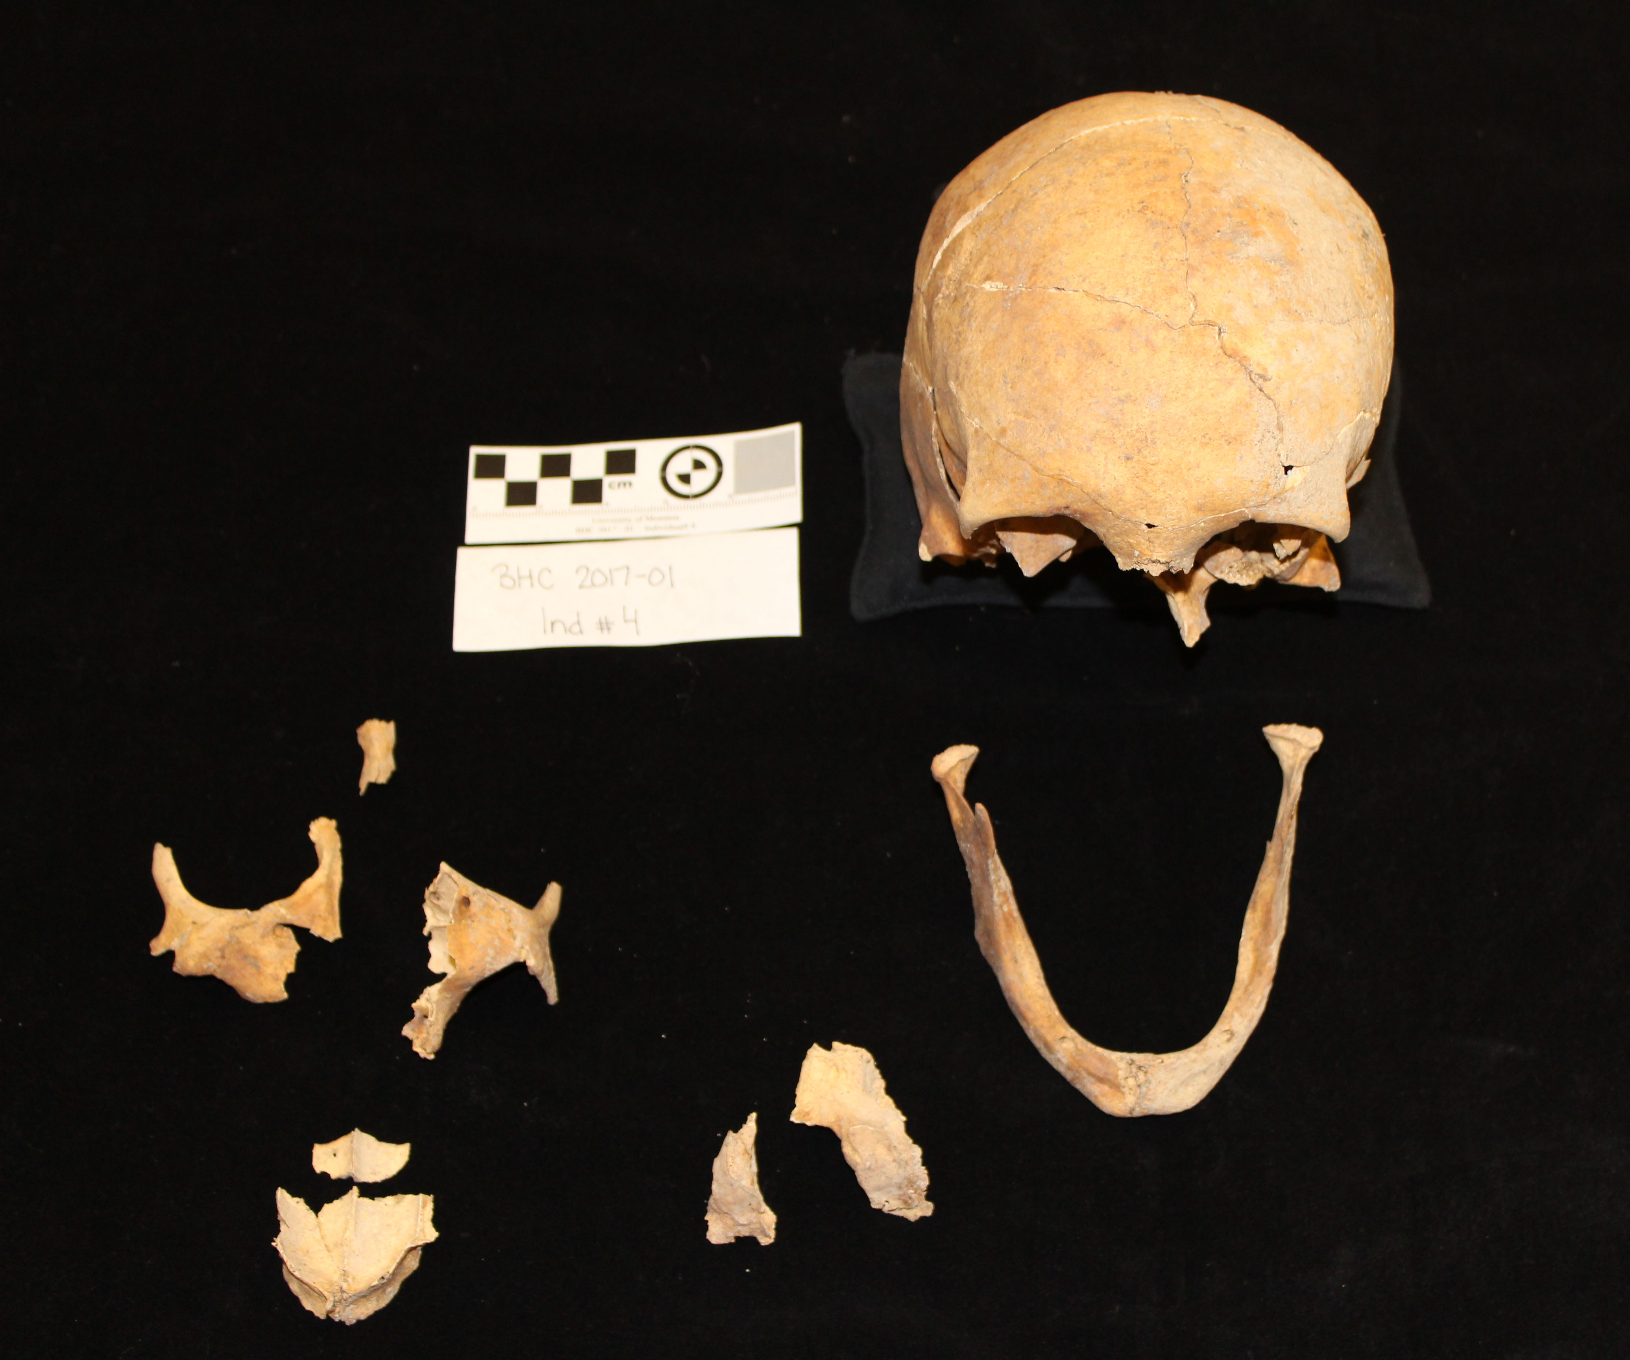
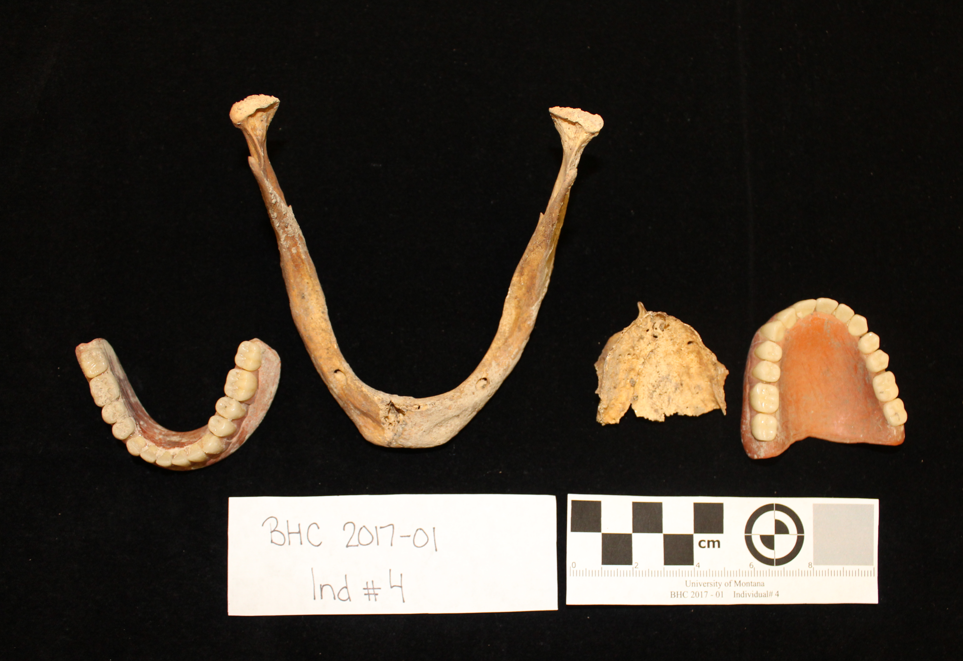
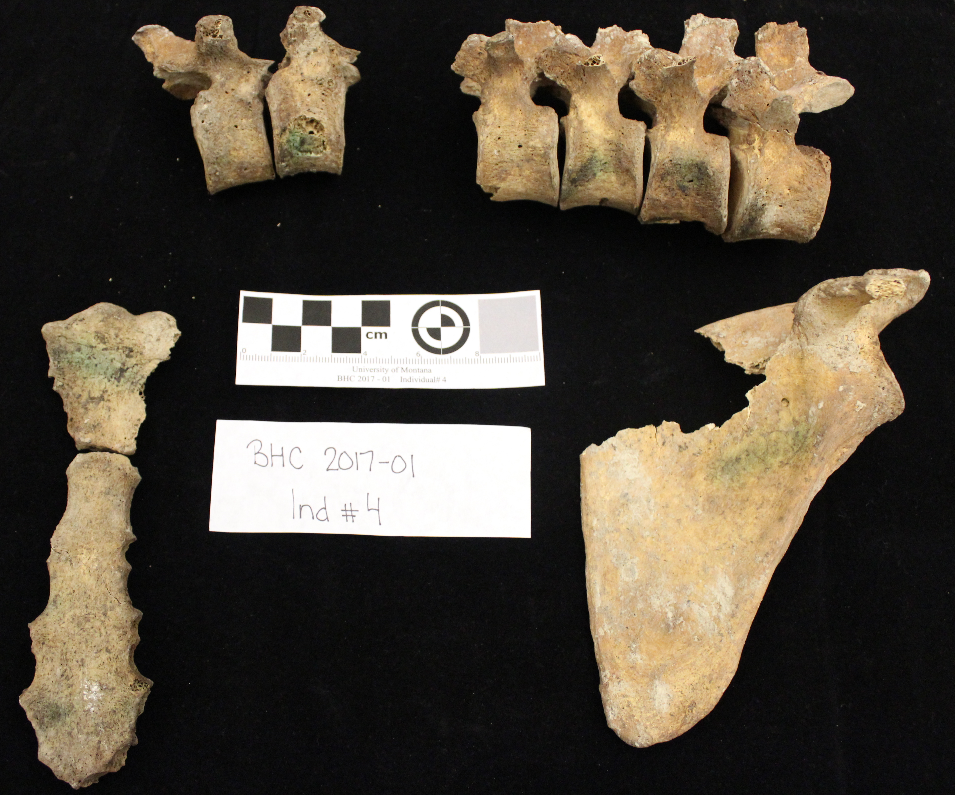
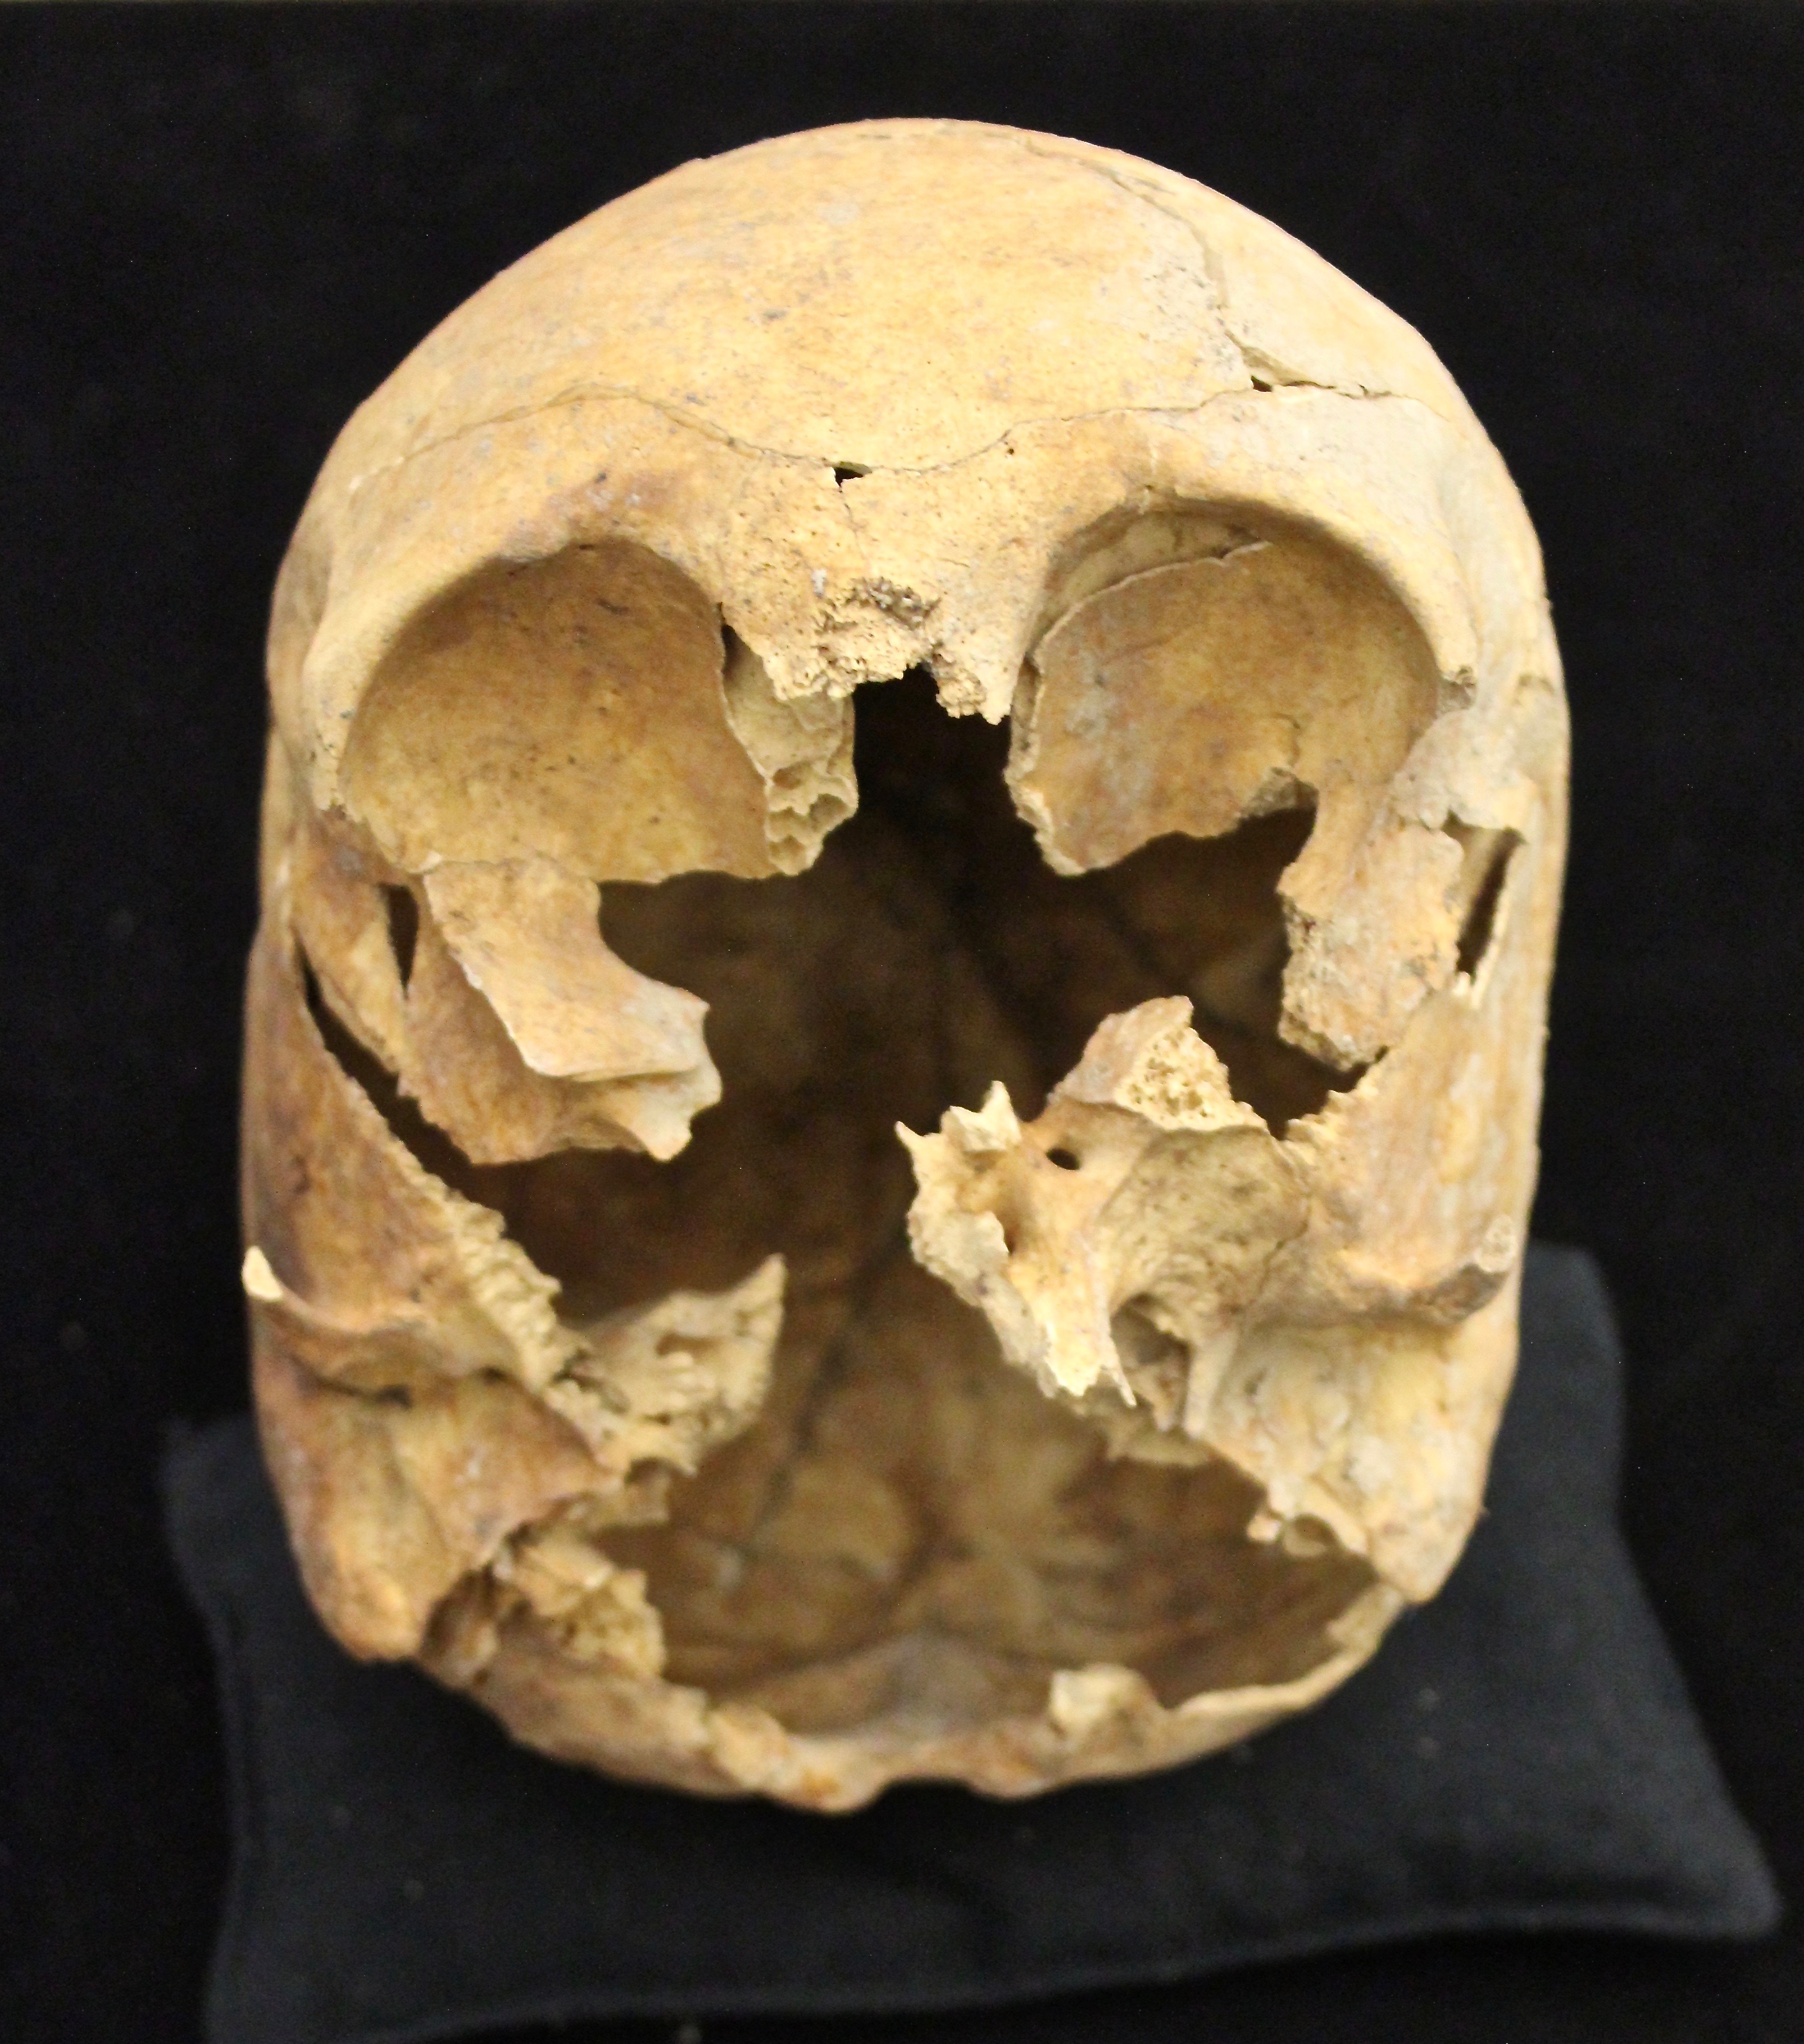
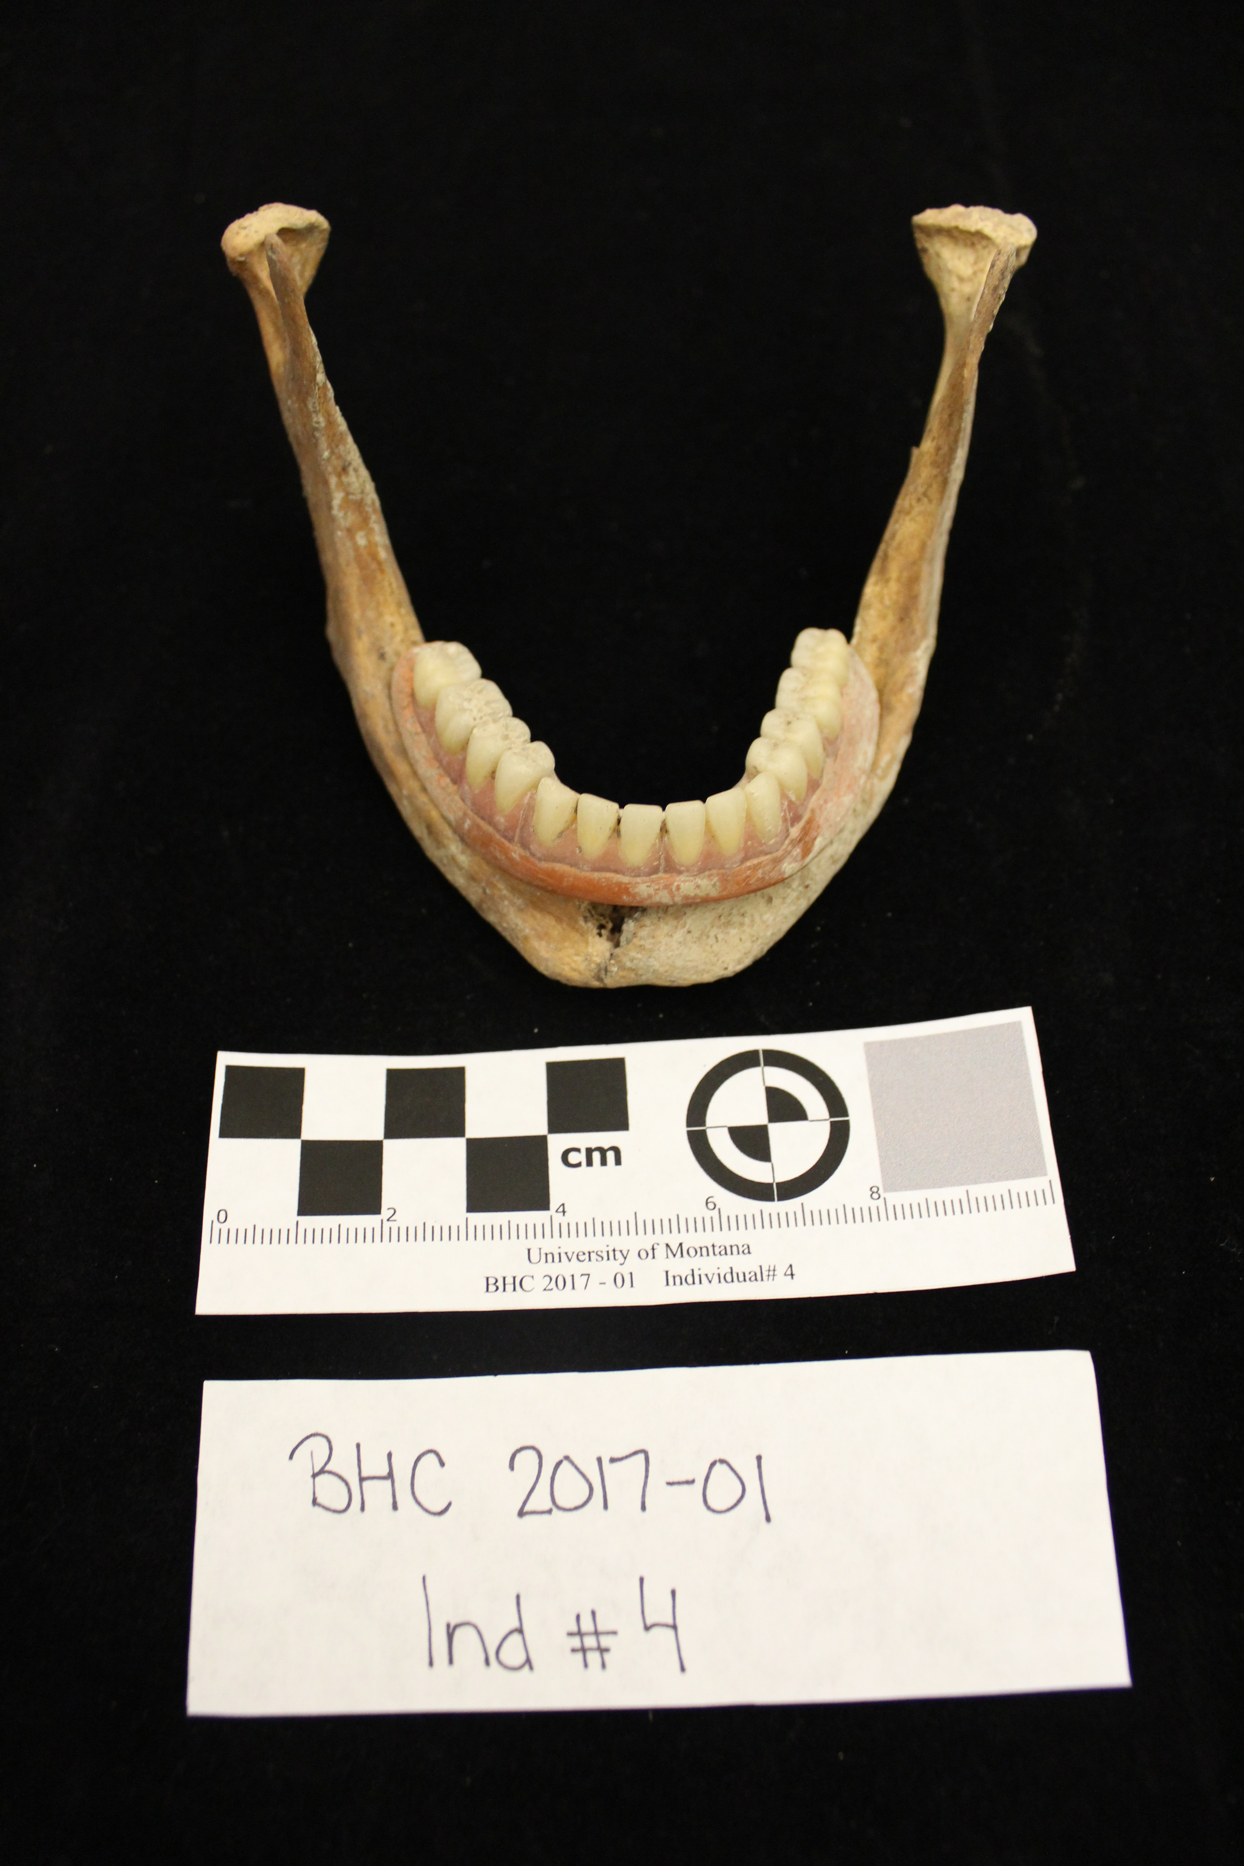
The Use of Forensic Anthropology Outside the Medico-legal Context:
Creating a Historic Biological Profile
Elena Hughes, BS, Kirsten Green, PhD
University of Montana
Our Main Goal:
This research shows how forensic anthropology can be applied to cases outside of the medico-legal context by analyzing the remains of an individual who died and was buried by their family long ago. An old unmarked family plot was exhumed in Beaverhead County, MT on request of a living descendant. While searching for one specific individual five coffins were exhumed from the family plot, but only 3 were occupied. The purpose of this research was to assist in the identification of these individuals in hopes of helping the living family member positively identify them. My analysis focused on the remains of just one of the three individuals recovered.
Creating a Biological Profile
A biological profile provides key physical characteristics of a person from their skeletal remains. These characteristics can include: age at death, biological sex, ancestry, stature, pathology (diseases), and antemortem trauma (trauma that happened before death and has begun the process of healing). To create a biological profile, both a morphoscopic and metric analyses of the bones is performed. For the case presented here the following analyses were completed:
Age at death: morphological traits of the pelvis
Sex: morphological traits of the pelvis and skull
Ancestry: Undetermined due to damage
Stature: Metric analysis of the femur, tibia, humerus, radius
Pathology / Trauma: Morphoscopic analysis
Biological Profile
Female
Approximately 35-48 years old
Unknown Ancestry (due to cranial damage)
5’3” – 5’7” tall
Complete alveolar resorption & probable arthritic issues
No antemortem or perimortem trauma
(Colored-missing ; Line-fracture ; Hashed-detached but present)
Barriers to Analysis
Due to damage obtained by a backhoe during the excavation multiple elements were badly damaged and required reconstruction. Most notable was the damage to the cranium.
Possible Identifying Characteristics
Dentures
Black fabric and buttons
Green staining from copper artifact
Osteological variations / abnormalities / pathologies
Special thanks to the Montana State Crime Lab for assisting in the acquisition of the remains as well as to Kirsten Green and Rachel Summers for their help sifting through and cleaning the bones.

