Slide 1
Probability-based confidence assessment of Transposable Element annotation helps explain confusing annotation results
Kaitlin Carey, Gilia Patterson, Travis Wheeler
Department of Computer Science, University of Montana

Slide 2
Transposable Elements (TEs)
  Sequences of DNA that replicate within a host genome
  Organized into families and subfamilies
  Subfamilies arise from bursts of replication activity
Notes:
Family + burst of replication activity = multiple subfamilies
A subfamily arose in a burst … then one element bursts into another distinct subfamily

Slide 3
The Importance of Transposable Elements
  More than 60% of the human genome can be reliably annotated as coming from TEs
  A large portion of remaining unclassified DNA may be TE derived
  Further classification is difficult because old copies get hidden by a large number of mutations
  Accurate TE annotation is needed to understand genomic structure, regulation and function
Notes:
We can RELIABLY say that more than 60% of the genome is TE derived

Slide 4
Alu Family of Transposable Elements
Most abundant family of TEs in the human genome
Make up ~10% of the genome
31 currently known subfamilies
www.repeatmasker.org
Notes:
Test this image on the projector and see if it is a better image once expanded
Main function is self reproduction
There are over 1 million copies of Alu sequences across the genome
Used to study evolution of primates, including humans
Selfishly replicate
Highly conserved in primates

Slide 5
Annotation
Process of finding DNA sequence locations in a genome
TCTACG
ACTGTCTACGGTCA
TGTACG
ACTGTCTACGGTCA
Notes:
Show a pic for DNA alignment – show the letter on a sequence and how they would match to a genome
Show an image of a sequence alignment here
Show that even when there are mutations and insertions and deletions that it will still align to that region
Because it won’t be an exact match it could be one or the other
What is annotation?
Process of finding DNA sequence locations in a genome
Align TE consensus sequences to a genomic sequence
Sequence with the highest alignment score is selected as the sequence for that location
TE annotation is difficult
TE subfamily sequences can be highly similar
Similar sequences align to the same region of the genome
Difficult to represent the complex relationship between TE subfamilies

Slide 6
Transposable Element Annotation
MIR
AluSx
AluSq
AluSz
Alignment Score
37
12
36
Genome

Slide 7
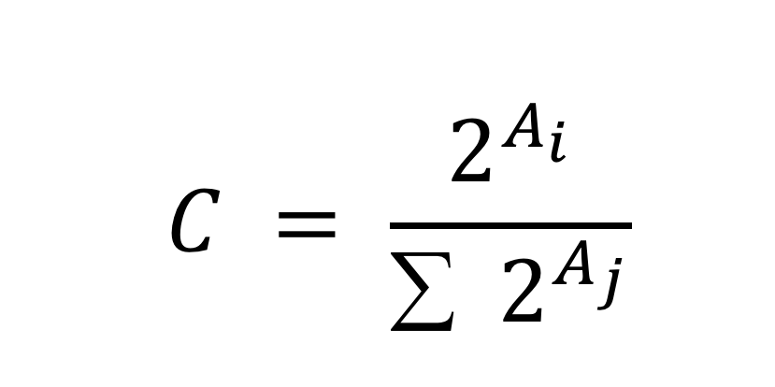
Improving Transposable Element Annotation
Represent alignments using confidence scores
  Apply Bayesian statistics to probabilities underlying alignment scores
  More sophisticated statistical model to represent complex TE relationships
$$C = \frac{2^{A_{i}}}{∑ { 2}^{A_{j}}}$$
C – confidence score
A – alignment score
i – current alignment
j – all instances of the alignment
Notes:
Need a seg way into how confidence score analysis explains discordant classification
Here, it would be good for you to talk a bit about those scores: they are the result of taking a ratio of the probabilities of the alignment being real or random … then taking the log of that ratio. Thus, we can back-convert scores to probabilities by exponentiating the score. (you’ll want to actually highlight which part is the score, and which part is the exponentiation). With all probabilities in hand, the confidence is simply a ratio of the probability of one match to the sum of the probabilities of all matches. We can talk through this on Wednesday.

Slide 8
Transposable Element Annotation
Confidence scores are a more accurate representation of the alignment
MIR
AluSx
AluSq
AluSz
Alignment Score
Confidence Score
37
.66
12
.01
36
.33
Genome

Slide 9
Confidence Scores
Subfamily AluYc3 | Alignment Score 1541
AluJo | 1697
AluSc | 1812
AluSg | 1936
AluSp | 1894
AluSq | 1993
AluSx | 1976
AluY | 1772
AluSz | 1990
AluSz6 | 1932
AluSx1 | 2002
AluSx3 | 1892
AluSq2 | 2011
Confidence Score 9.00E-19
7.10E-13
1.60E-08
7.7E-04
2.0E-04
0.11
0.03
4.90E-10
0.08
5.4E-03
0.24
2.0E-04
0.53
Notes:
Not sure how to finish this slide
more accurate representation of their complex family relationships
Explain what you are looking at here:
-actual TE annotation alignment from chrom 3
-all these TEs aligned to the same region
-yellow have high scores, and blue is the lowest score
-look at just the aligment score and talk about how it’s easy to see that it’s not the blue one, but harder to tell which of the yellow’s it is
-then look at the confidence scores- talk about how this is a more accurate representation of their complex family relationships
Talk about how the other segdup has one of the highest scores

Slide 10
Segmental Duplications (SDs)
Genomic regions with nearly identical sequences
Result from large scale duplications during cell replication
Genome

Slide 11
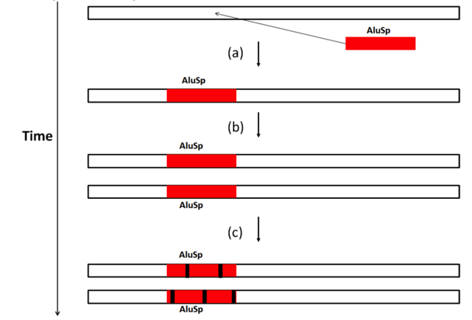
Testing TE Annotation using Segmental Duplications
Discordant classification
  Two exact copies in the genome
  Classified as different subfamilies
Notes:
Testing TE annotation
When TE is included in a segmental duplication two identical copies of the TE are present in different genomic locations
After duplication each instance accumulates mutations, but they should still be classified as the same subfamily
Discordant classification
Current annotation methods find more than 10% of TEs in SDs to be classified as different subfamilies
Similar findings at homologous TE locations shared by humans and chimps
Further solidifies need for more accurate annotation methods

Slide 12

Future Work
Accurate annotations depends on an accurate database of consensus sequences
Dfam
  open access collection of repeat elements
  created by The Wheeler lab and collaborators
Enhance Dfam - confidence score analysis will be built directly into the alignment software
Acknowledgements
  funding from UM ORSP UGP seed grant
Notes:
Talk about how people from the wheeler lab and collaborators developed Dfam and how we will continue improving it by including confidence score analysis
Accurate annotations depends on an accurate database of consensus sequences
The current database has restrictive licenses – limited/incomplete because does not allow input from 3rd parties
Because of this there are a lot of databases that have not been combined
Dfam is an open access collection of repeat elements
Enhance the Dfam - confidence score analysis will be built directly into the alignment software
This will enable improved genome annotation
**MAKE SURE TO DO THANK YOUS

