Slide 1
A Comparative Reconstruction of Proto-Eastern-Algonquian
Dan Gaynes

Slide 2
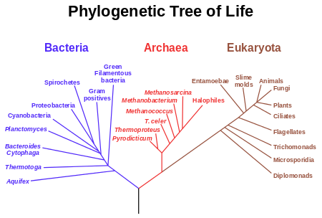
An analogy

Slide 3
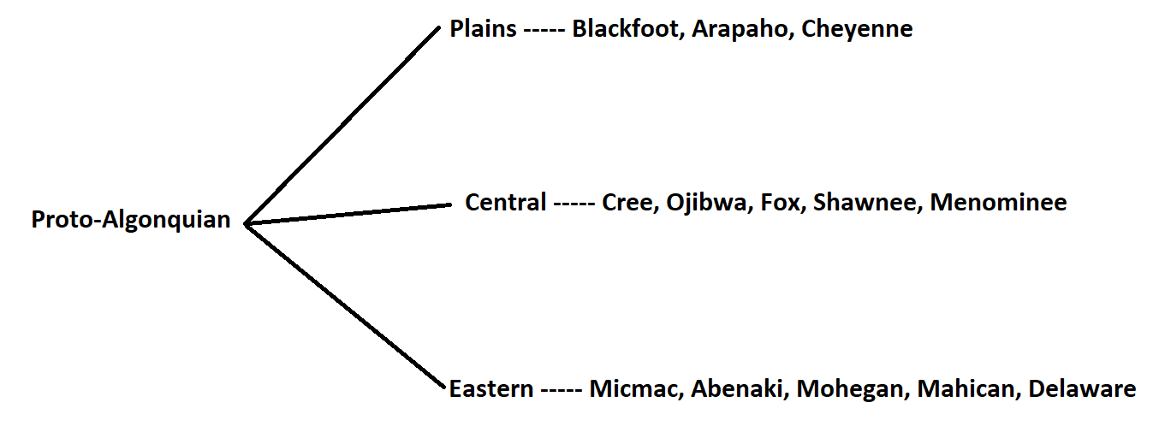
The Algonquian Family Tree

Slide 4
Background
-Largely believed to exist but never actually reconstructed save several words
-Eastern languages are too similar to be coincidence both sound-wise and grammar-wise
-But doesn’t that make sense since they’re in the same family?

Slide 5
Comparison with ‘tree’
Plains Central Eastern
omoxixim mehtekwi mutukw
hohoot meihtuks mihtəkw
mitig maxtok
mehitək
mahteke

Slide 6
How to Reconstruct
Position | Consonant
1 | t,d,t,t,t,t
2 | Ø,m,m,m,m,m
3 | k,h,h,Ø,h,h
4 | k,g,k,k,k,k
5 | Ø,n,n,n,n,Ø
Economy
- Occam’s Razor, the simplest solution is often correct
Sonority
- Sonority hierarchy (p > b > s > n > l > w > a)
Commonness
- Which sound is most common in that position

Slide 7
Reconstruction with ‘woman’
1. Align all cognates by sound correspondence
skʷ a ws
skʷ aː
skʷ a h
skʷ a w
skwa
skwe
skʷ
Ʊxkʷe w
xkʷe
o xkʷa w
skʷ a w
3. Be able to account for changes from language to language.
<s> is a diminutive marker
Vowels can lengthen to compensate for losing a sound next to it
It is a common sound change for anything to become /h/
Sometimes sounds just disappear
Vowels change over time (among other sounds)
Sometimes sounds are added
2. Reconstruct based on:
Economy
Sonority
Commonness
4. Wash. Rinse. Repeat.
If the same changes line up in the same languages, then you are headed in the right direction

Slide 8
Classifying as a Subgroup 1
Initial consonant epenthesis
(adding a consonant to the beginning)
Plains
ksistsoki (different root)
hebes (almost never starts with vowel)
Central
amehkwa
amiskw
amik
pAlgonquian
ameθkwa
Eastern
tumunk
təmõhk
təmok
dəmakwa
təmakwe
tamaikwe

Slide 9
Classifying as a Subgroup 2
The Absentative construction
Used to reference things that are not around or that are dead
My late father...
The dog (that is not currently present)...

Slide 10
Phoneme Inventory (The Sounds)
m | n |  | (ŋ)
p | t | tʃ | k kʷ
 | s | ʃ | (x) | h
 | l | j | w
i i:
e e: | (ə) | o o:
 | a aː

Slide 11
Pronouns
 | Singular | Plural
First Person (I) | ninaw | ninawuna:
First Person inclusive |  | kinawuna:
Second Person (You) | kinaw | kinaw
Third Person (He, she, it) | ne:kama | winawa:w

Slide 12
Numbers
1 – *nəkʷut 6 – *kʷuta:sk
2 – *nisə 7 – *niskʷa:sk
3 – *niʃwə 8 – *nuʃa:sk
4 – *nawa 9 – *pasəkʷənk
5 – *nanan 10 – *mətanatakʷ

Slide 13
Further Research
Obviative marker
Bill saw Tom_{i}. He_{i} said hi.
Sentence structure
Word and phrase stress

Slide 14
Words you already know
sipu – river (Mississippi = big river)
mus – moose
sakwank – skunk
tamahikan – tomahawk
wikuwam – wigwam
mahkəsən – moccasin
pakan – pecan (literally ‘nut’)

Slide 15
NIWAHKWAACÜK ni-wah-kwaa-chuck /ni.wa.hkʷaː.t͡ʃək/ Intrigued? Email me at dgaynes@yahoo.com to learn more!

