Slide 1
Exploring Biographies of Niitsitapi (Blackfoot Confederacy) Moccasins
Michaela A. Shifley, Anthropology
GradCon 2019
University of Montana
Notes:
Good morning everyone. My name is Michaela Shifley, I am a PhD candidate in Anthropology here at the U, and it is my pleasure today here at GradCon 2019 to tell you the story of my dissertation, which is tentatively entitled “Exploring Biographies of NEETS-IT-A-PEE (Blackfoot Confederacy) Moccasins”

Slide 2
What stories could your shoes tell about you?
Notes:
Take a moment to look at the shoes that you’re wearing right now. Consider all of the stories that your shoes could tell about the places that you’ve been, about the experiences that you’ve had as a human being.
If you think of your shoes as being able to tell a story – and not only telling your story, but the stories of your culture, you can begin to understand why it’s important to think about footwear’s presence in our lives, and its production and presence in historic communities’ lives.

Slide 3
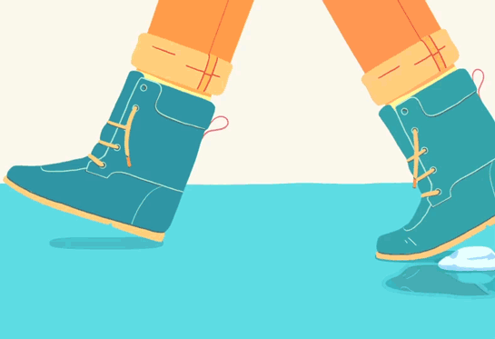
Notes:
Shoes, in one form or another, span the boundaries of both time and culture. Shoes, and moccasins more specifically, at their fundamental level, are about the relationship between you and the ground that you walk on. They are representative of how we move through the world, and we how interact with the world, and for that reason, among others, moccasins matter.

Slide 4
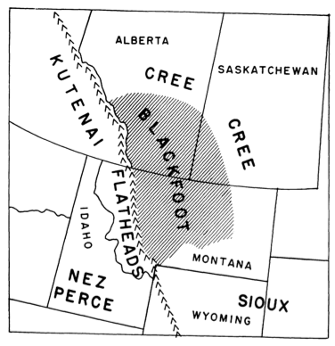
The Niitsitapi (Blackfoot Confederacy)
Kainai, or Blood (Canada)
Siksika, or Blackfoot (Canada)
Piikuni, or Blackfeet
Amasskaapipiikuni (Montana – Southern Blackfeet)
Apatohsipiikuni (southern Alberta, Canada – Northern Blackfeet)
Figure 1: “Outline map to show the area occupied in historic times by the Blackfoot Indians” (Johnston 1970, 302)
(The Blackfoot Gallery Committee 2013)
Notes:
The community that is @ the center of this project is the NEETS-IT-A-PEE (or the Blackfoot Confederacy). Their traditional territory, shown here, spans from Canada into Montana.
The NEETS-IT-A-PEE are composed of four distinct yet interconnected nations. These include the G-AI-NAH, SEEG-SEE-KAH, both of whom reside in Canada, and the Pii-Kuni, who are separated in two by the Canadian border, with half in southern Alberta and half located on the Blackfeet Reservation in northern Montana. Together, the four nations make up what is today known as the Blackfoot Confederacy.
My project is centered around the Niitsitapi for several reasons. For one, there is a lot written about them, but virtually nothing about their moccasins; they have some of the most incredible contemporary beaders and moccasin makers in the world; and I see an opportunity to create a relationship between the NEETS-IT-A-PEE and the University of Montana.

Slide 5
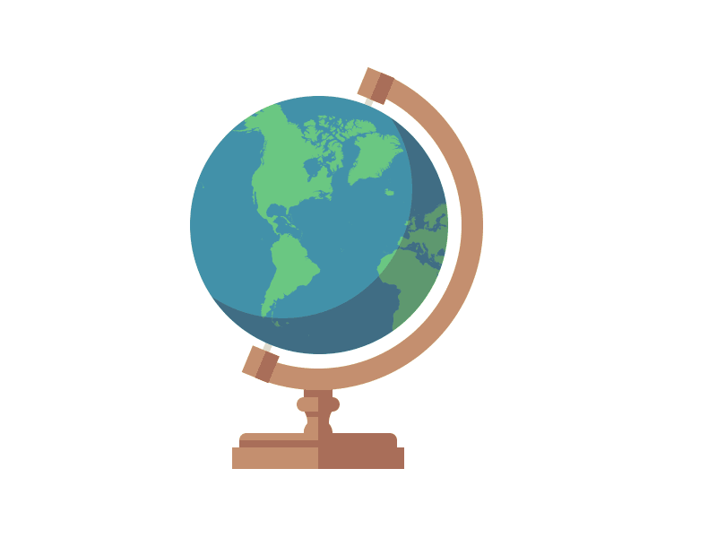
There is more Plains Indian footwear in museum collections across the world than any other Plains Indian artifact (Ewers 1997)
No systematic anthropological investigation of Plains Indian moccasins has ever taken place
Notes:
Many of the older Blackfoot Confederacy moccasins that exist today are sitting in museum collections across the world, but nobody has really ever taken the time to study them. In fact, there is more Plains Indian footwear in museum collections across the world than any other Plains Indian artifact (Ewers 1997). Yet, despite their overwhelming commonness in museum collections, as well as the significant cultural importance of footwear in general, no systematic anthropological investigation of Plains Indian moccasins has ever taken place. This is a significant oversight when we consider that footwear is a fundamental part of the human experience.
I intend to be one of the first people to pull these moccasins out of those dusty glass museum display cases where they’ve been trapped, and take them out of those dark, closed-in museum storage spaces where many of them have been put and forgotten about, and return them not only to the world of research. MUCH more importantly thought, I intend to show that museum objects like moccasins CANNOT and SHOULD NOT stand apart from their living communities.

Slide 6
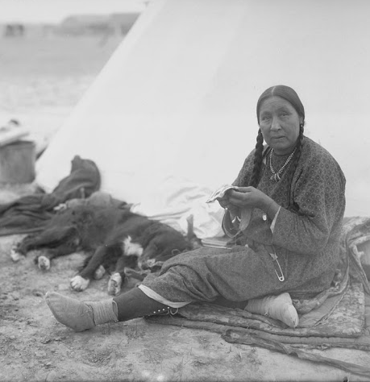
Object Biographies
Objects accumulate histories and stories
Objects can experience birth, life, death, and even rebirth
How are Niitsitapi moccasins born? How do they live? Do they die?
Photo: “Blackfoot woman doing beadwork,” National Anthropological Archives, Smithsonian Institution
Notes:
So how do we get moccasins to talk to us, and to tell us their stories? Anthropologists have actually developed a theory and a method, called the Object Biography approach, to help objects speak. The Object Biography approach says that, just like people, objects have biographies, or stories, that can tell us how they live, and also like people, objects can accumulate all sorts of histories and stories as they move from person to person and place to place over time. Like us, objects can experience birth, life, sometimes death, and even rebirth in some instances.
For my project, I’m taking this theory and applying it to moccasins, and asking questions like: How are moccasins born? How do they live? Do they die? And ultimately, what methods can we use to get moccasins to speak to us?
Approaches considered by: Appadurai (1986); Bell (2017); Coupaye (2009); Hoskins (1998; 2006); Ingold (2012); Joyce and Gillespie (2015); Kopytoff (1986); Martinón-Torres (2002)

Slide 7
How
Notes:
In order to hear the stories that moccasins, have to tell, my project is broken down into three phases, basically:
Working with Community
Working in Archives
Working with Moccasins themselves

Slide 8
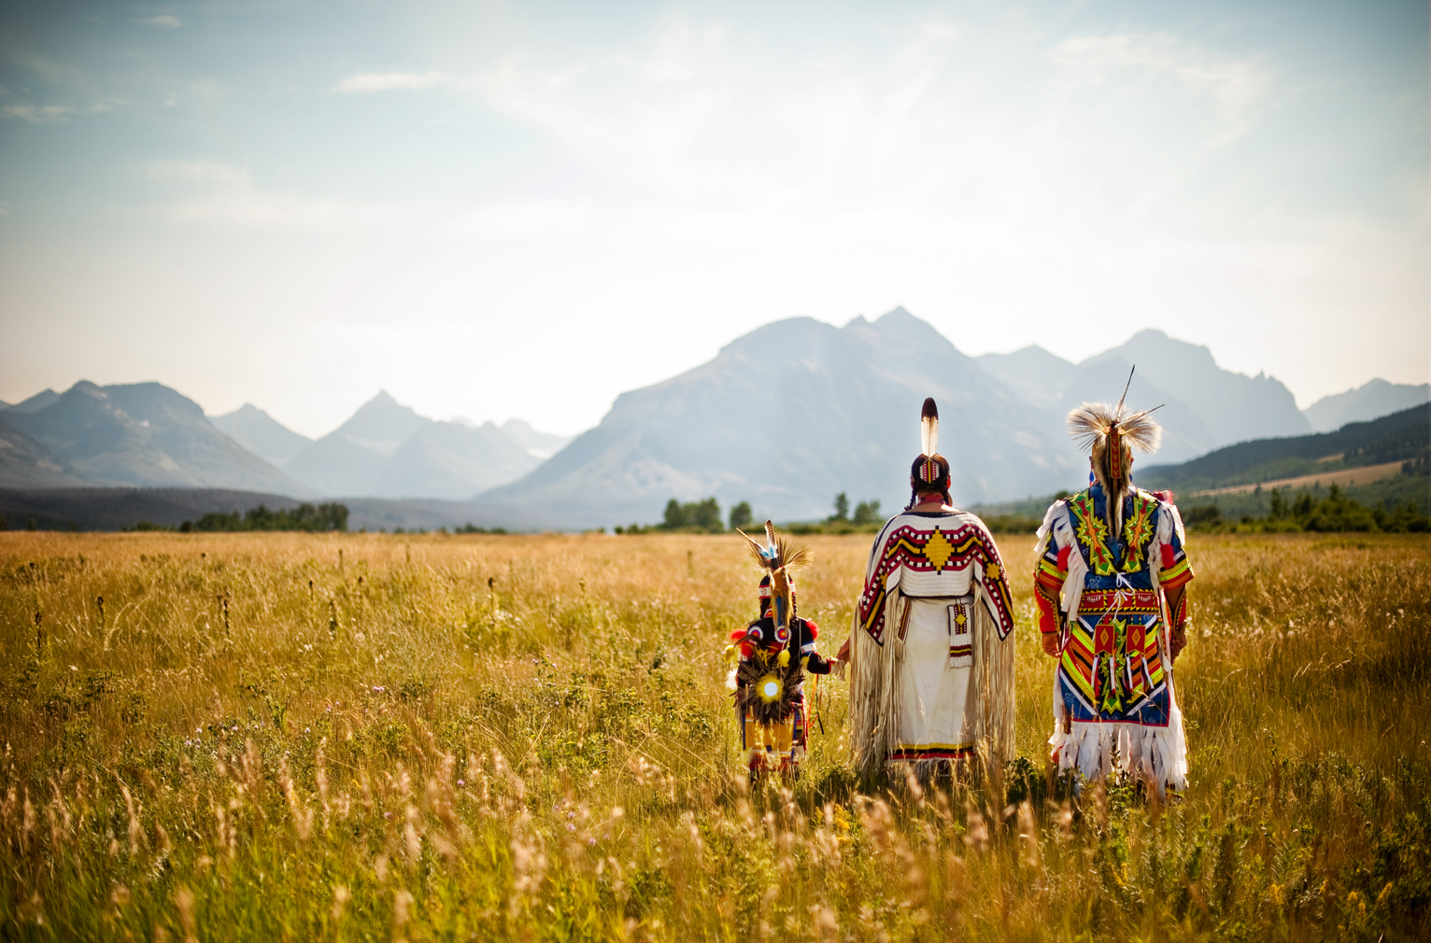
Indigenous Frameworks
Incorporation into anthropology has been addressed by numerous scholars (e.g. Atalay 2012; Colwell 2016; Haas 1996; Kovach 2009; Watkins 2000, etc.)
Critical for the health of the discipline and the future of museums (Ames 1992)
Promote new understandings of the world and redress past wrongs
Photo: “A trio of Blackfeet dancers in Glacier National Park,” Glacier MT Blog
Notes:
Moccasins fundamentally represent the relationships that people have with the grounds that they walk on, and the ways that I understand those relationships are different than how people within the Blackfoot Confederacy, both historically and today, understand those relationships. Therefore, it is critical that Indigenous ways of knowing are incorporated into projects like mine. And I’m not just talking about going to people and asking for them to give me information – I’m talking about giving up a lot of my control as a traditional researcher, and letting the COMMUNITY decided what is and what is not important to talk about.
As past anthropologists have established, approaches like this one, which allows community voices and concerns not only INFORM research but actually SHAPE it, is not only critical for the discipline of anthropology and the future of museums as a whole, but it can also help us come to new understandings of the world, and build bridges for the future.
(e.g. Atalay 2012; Colwell 2016; Haas 1996; Harrison 2005; Karp and Lavine 1991; Kovach 2009; Peers and Brown 2015; Watkins 2000)
https://blog.glaciermt.com/category/blackfeet-indian-reservation/

Slide 9
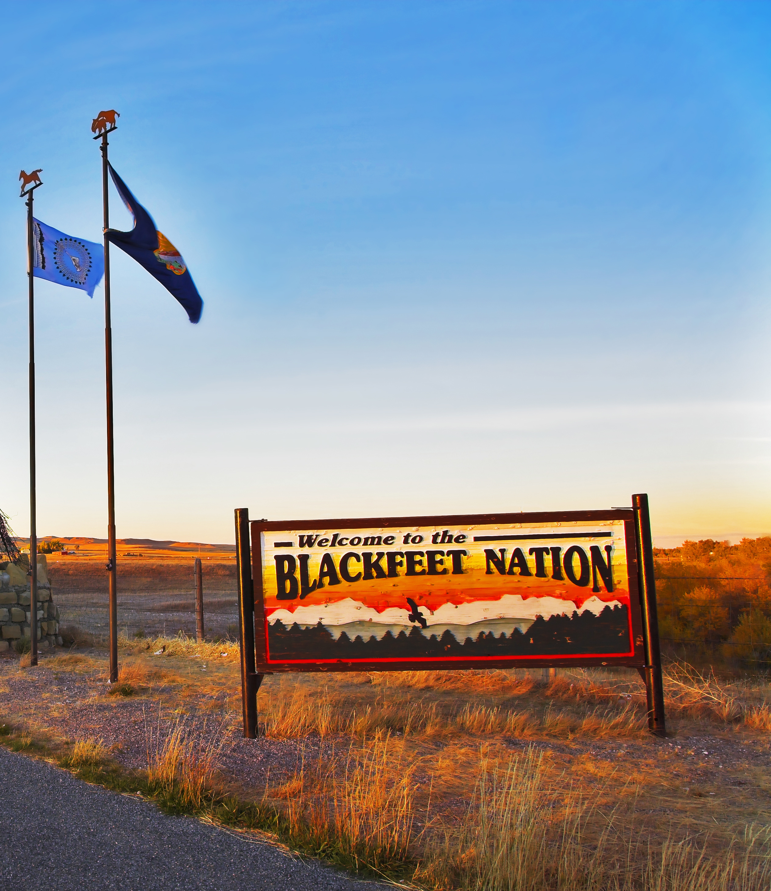
Working with Communities
Highlighting contemporary artists and moccasin-makers through interviews (pending Tribal IRB/Council approval)
Guidance and direction from current community members via a Cultural Advisory Board
Co-producing final products with community members
Photo: Rural Health Quarterly
Notes:
Moccasins’ biographies will never and can never be complete without living community voices involved. I intend to accomplish this through interviews (possibly digitally recorded) with contemporary artists and moccasin-makers, who will not only be able to shed light on the stories of historical moccasins, but who will also be able to tell us about moccasin-making today. I intend to talk to people from all 4 Blackfoot Confederacy Nations.
Before interviews and other work with the community can take place, of course you have to get Tribal IRB, and often Tribal Council, approval, which is pending in this case. I am also in the process of creating a Cultural Advisory Board, which will be made up of people from the community that will be able to guide me in the directions they feel is most appropriate, and who will also hopefully help me come up with a plan for how this project and its outcomes – beyond just my dissertation – will be beneficial and helpful to the community.
I’m also hoping to partner up with a student from the community, potentially at Blackfeet Community College, who will co-produce this final products with me.

Slide 10
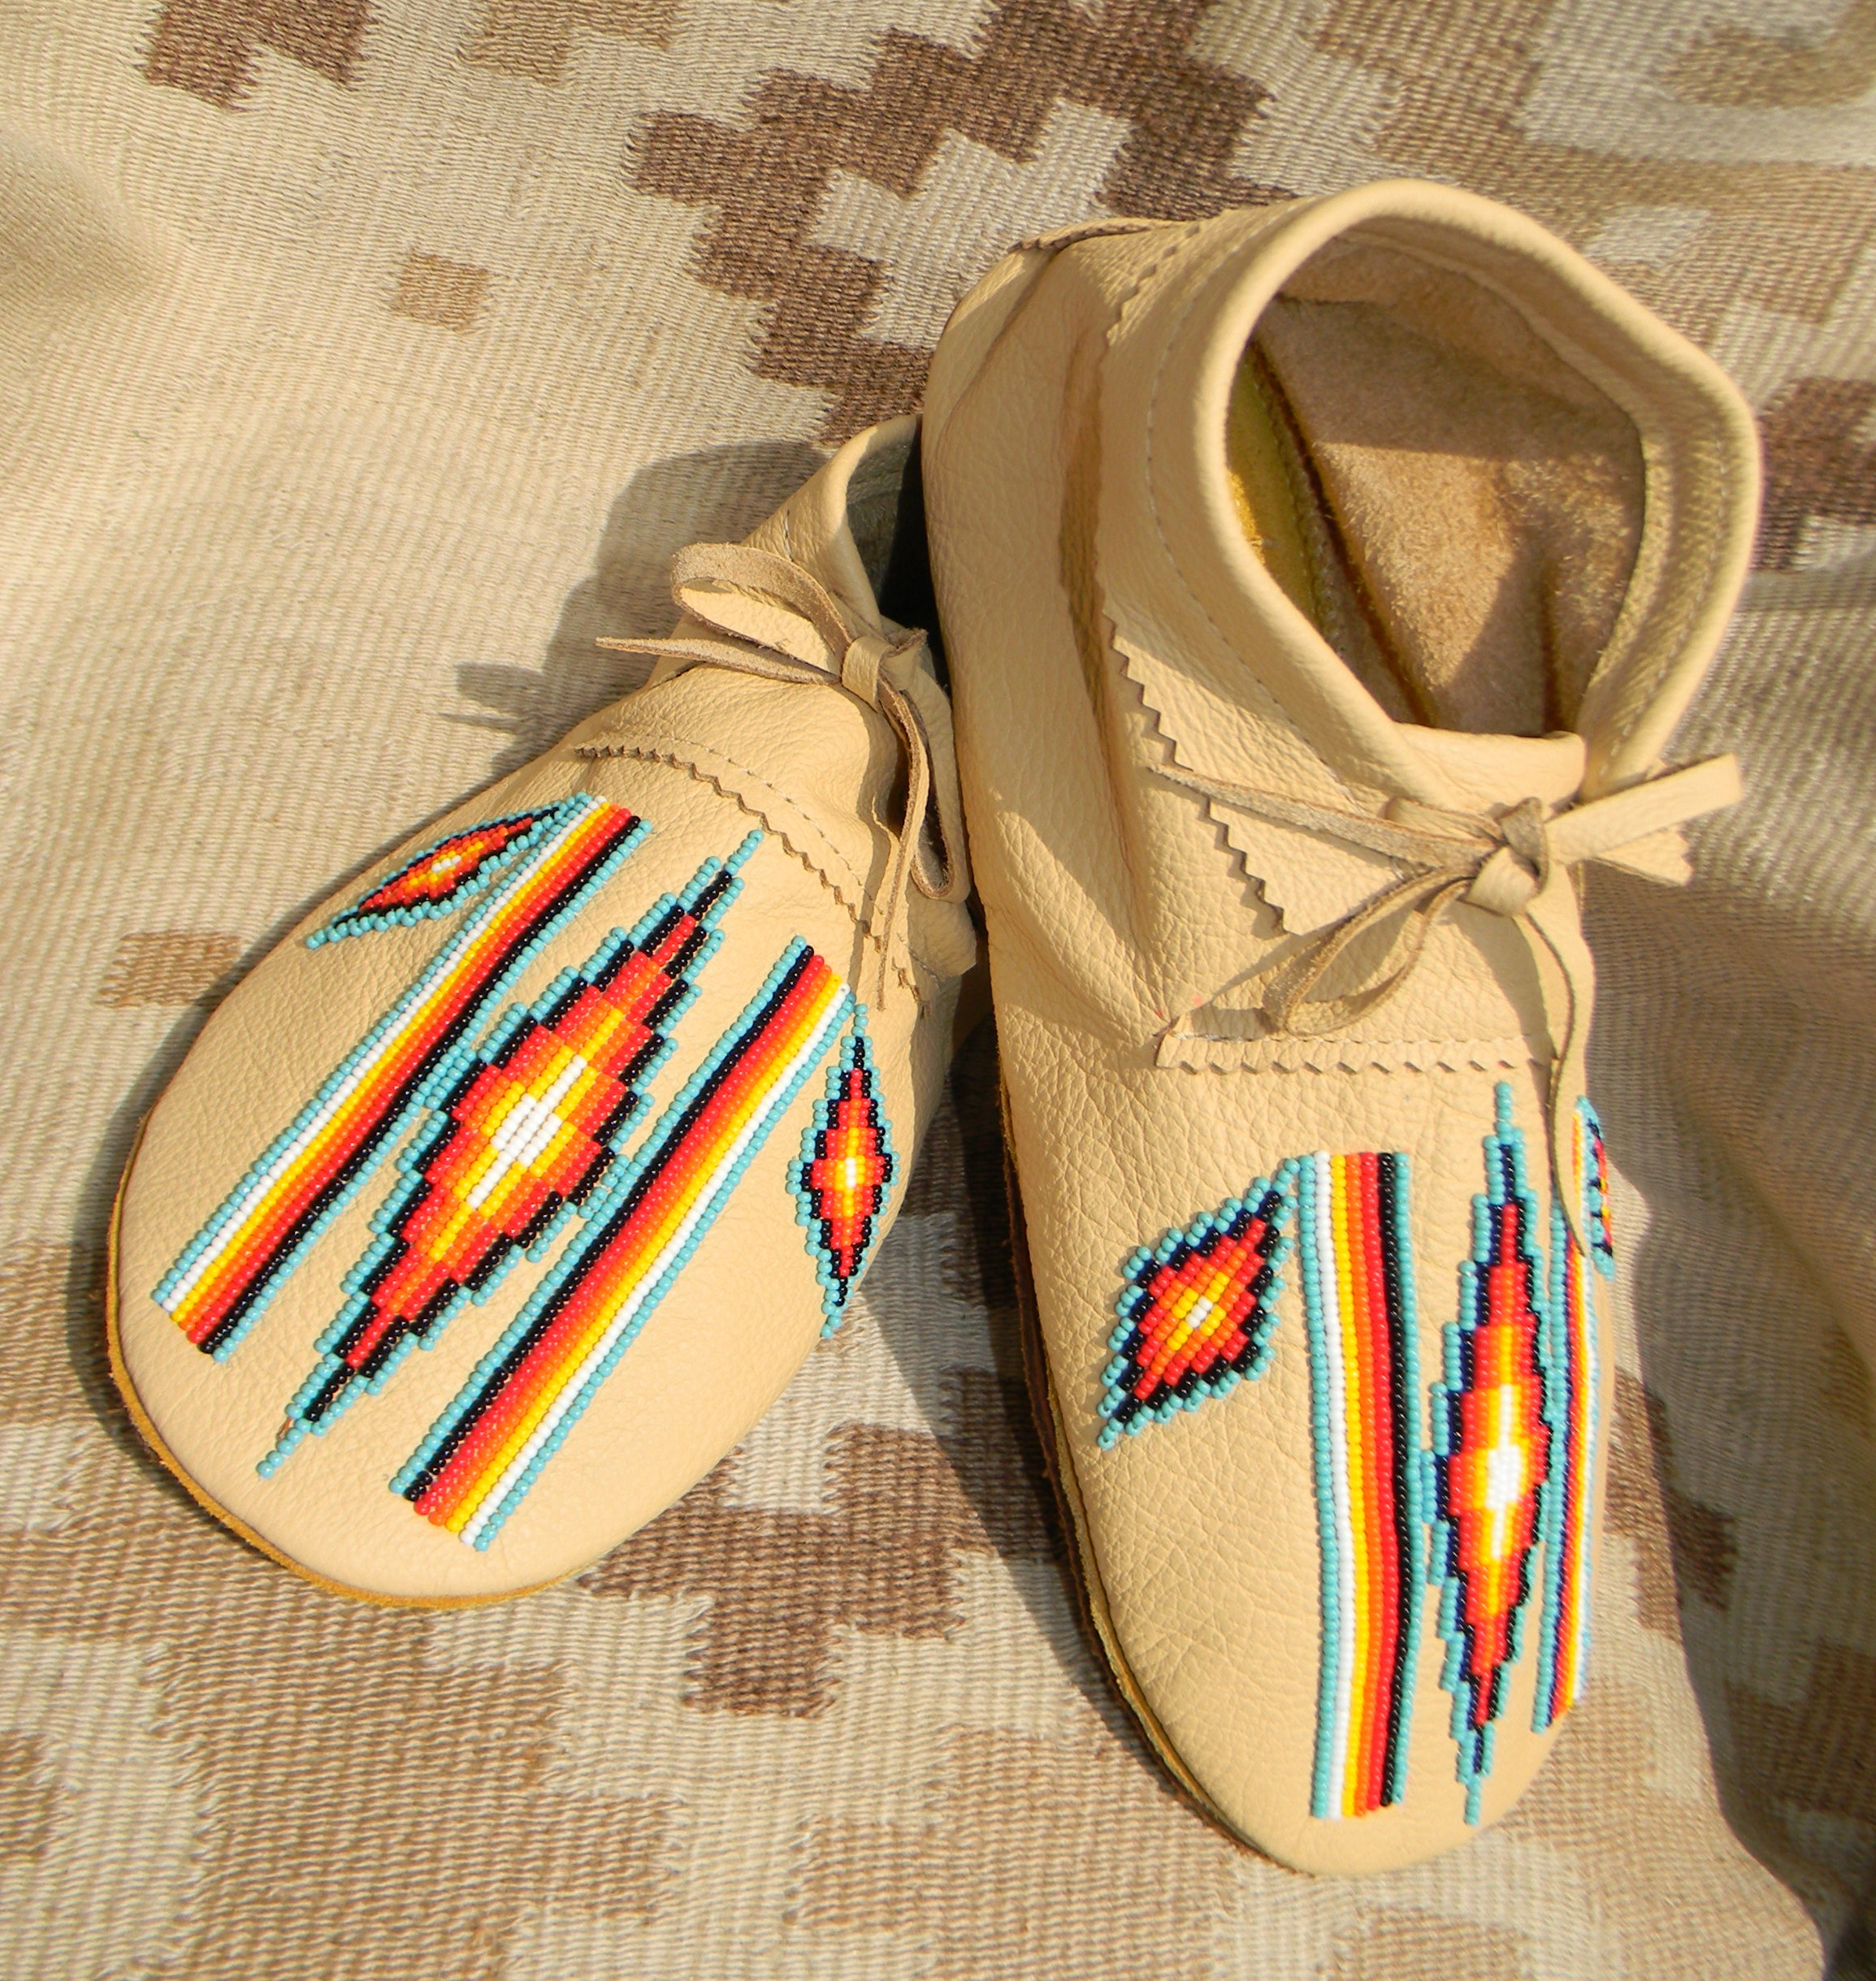
Working in Archives
Historic photographs
Maps
Trade ledgers
Fieldnotes
Historic traders’ accounts
Archives around the country (and Canada)
Photo: “Contemporary Blackfoot moccasins,” https://mocs.ca
Notes:
Moccasins’ biographies can also sometimes be heard in archival materials, which are things like historic photographs, maps, trade ledgers, fieldnotes, historic trader’s accounts, and more, all of which can often show how, and sometimes why, moccasins were produced or “born”. Photographs in particular are helpful for seeing the changes in moccasin designs over time.
The archives included in this study are from around the country and in Canada, and include places like the U of MT archives, the MT Historical Society Archives, and others.

Slide 11
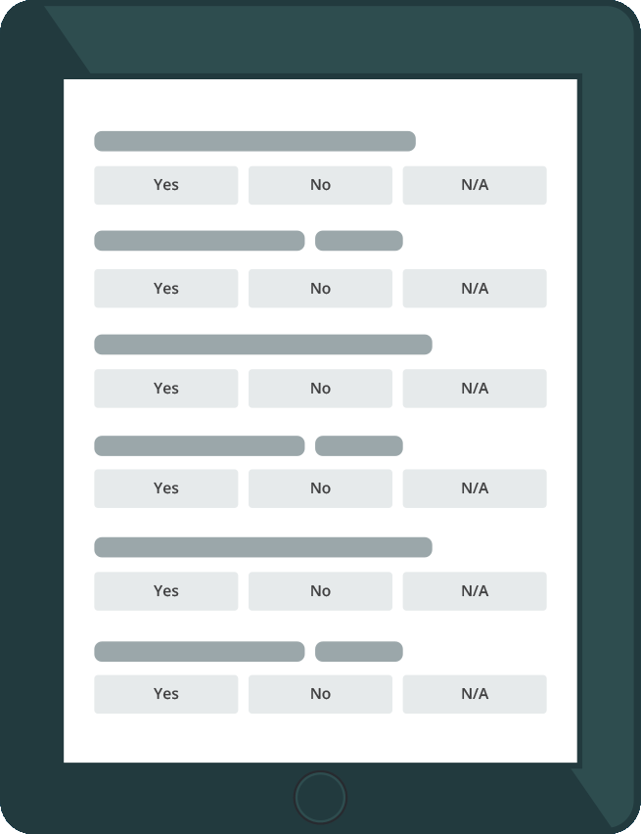
Working with Moccasins
Looking very closely at moccasins and what they’re made of
Construction materials (hide, thread, tools)
Design materials (quills, beads, paint, cloth, thread, tools)
Six museums around the country (and Canada)
Notes:
Finally, moccasins can tell us their biographies through their physical materials, which is why the third part of this project consists of working with moccasins themselves. I am looking at moccasins more closely than any other researcher has ever looked at them before, and this is because the stuff that moccasins are made from – like the construction materials and the design materials - can tell us so much about why and how a moccasin might have been born, and how it lived.
My study includes moccasins from six museums around the country and one in Canada, including @ places like National Museums of Natural History and the American Indian in Washington, D.C. Overall, there will be almost 500 pairs of moccasins included in this study.
Though I don’t have a lot of community or archival data to share yet, I have worked a lot with moccasins already, and I in order to give you a taste for what kinds of stories moccasins can tell us through their physical materials, I’m going to take you through a few examples:

Slide 12
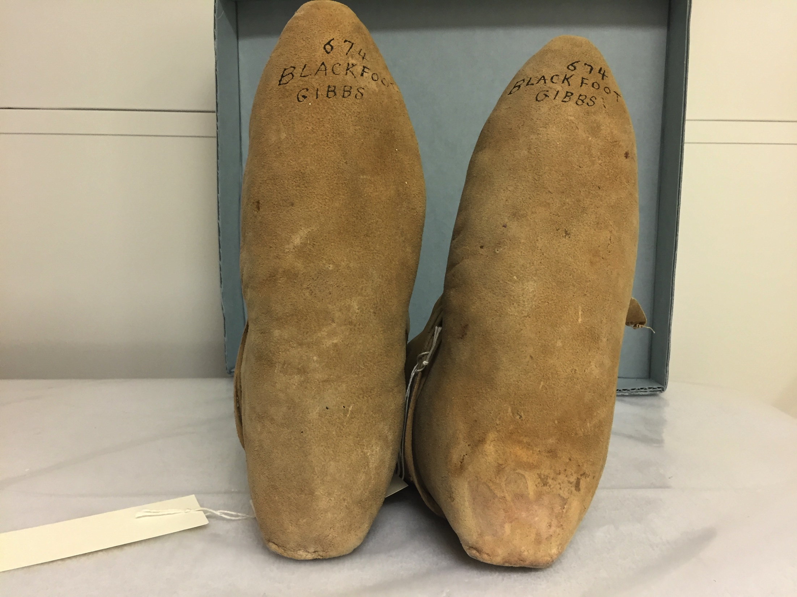
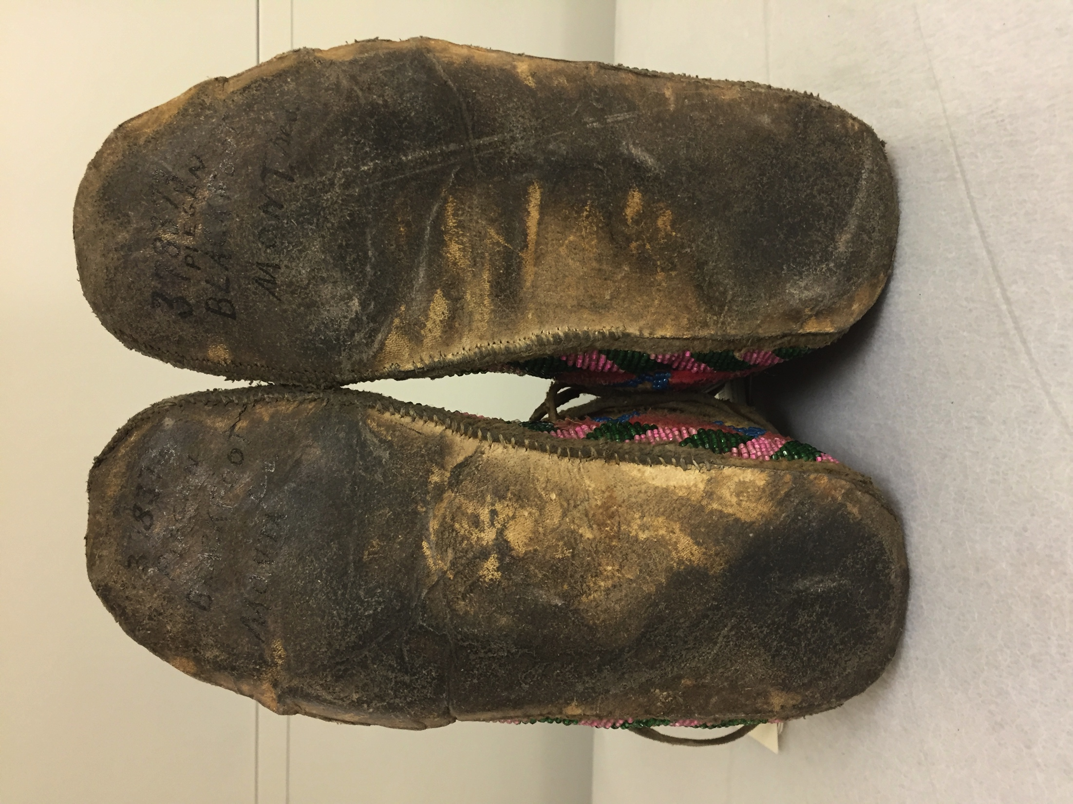
Stories of Age
EE000674, National Museum of Natural History (author photo)
E378373, National Museum of Natural History (author photo)
Soft Soles
Hard Soles
Notes:
For instance, looking at the soles (or the bottoms) of moccasins can often tell us stories about how old a moccasin is. Generally, moccasins with soft soles (basically like what we would think of as thick socks) are older (later 1700s, early 1800s), whereas moccasins with hard soles (more what we think of as shoes) weren’t born until the mid-to-late 1800s (Reservation Era).

Slide 13
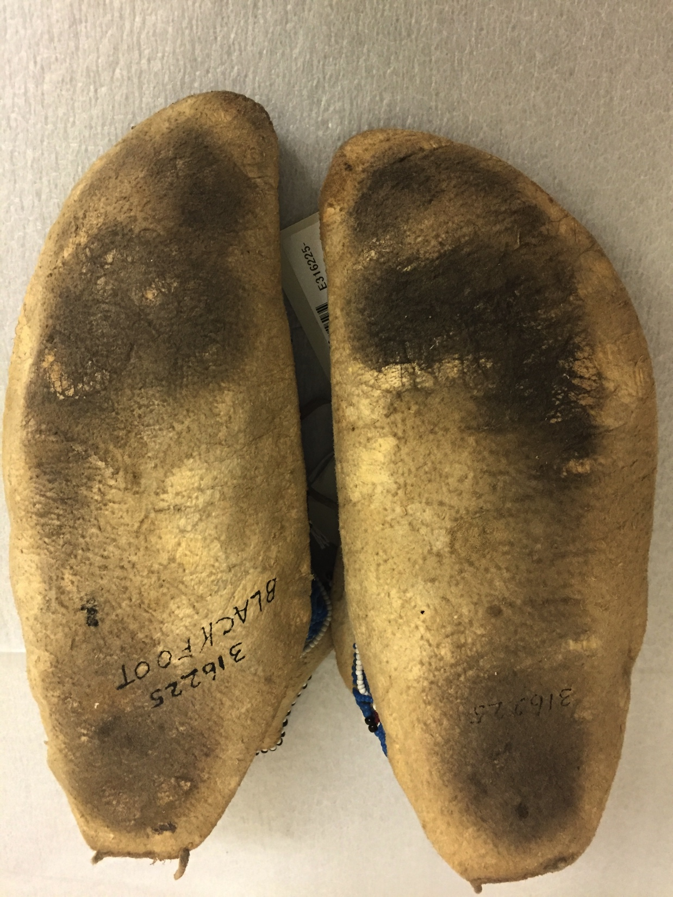
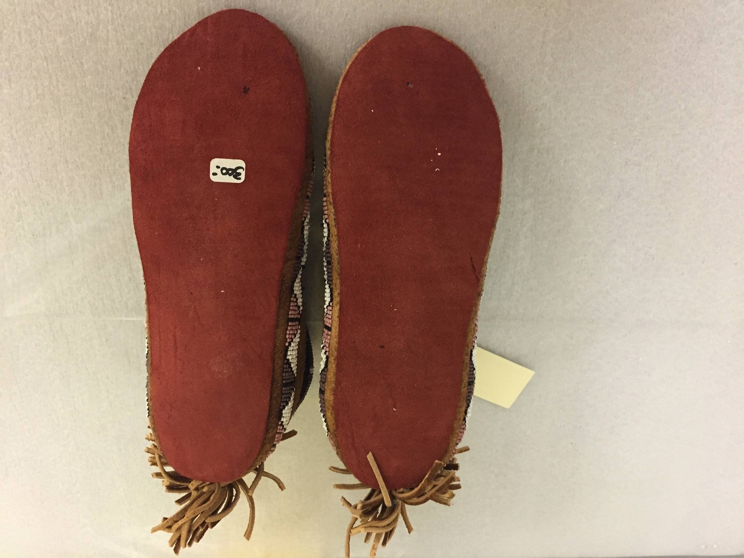
Stories of Use
E316225, National Museum of Natural History (author photo)
E430527, National Museum of Natural History (author photo)
Worn
Not Worn
Notes:
Moccasins’ materials can also tell us stories about use. For instance, looking @ the wear patterns on moccasins can potentially tell us about the kind of life the moccasin may have lived, and even if the moccasin was made to be worn or not. In many cases, when moccasins are clearly not worn at all, which is the case with the red-soled pair up here, it means they were made specifically as a tourist item (and in this case you can also see that the red-soled pair still have a price tag attached).
Moccasins may have been produced or “born” differently depending on what they were intended for, and physical materials can give us clues as to what kind of life the moccasin was intended to lead.

Slide 14
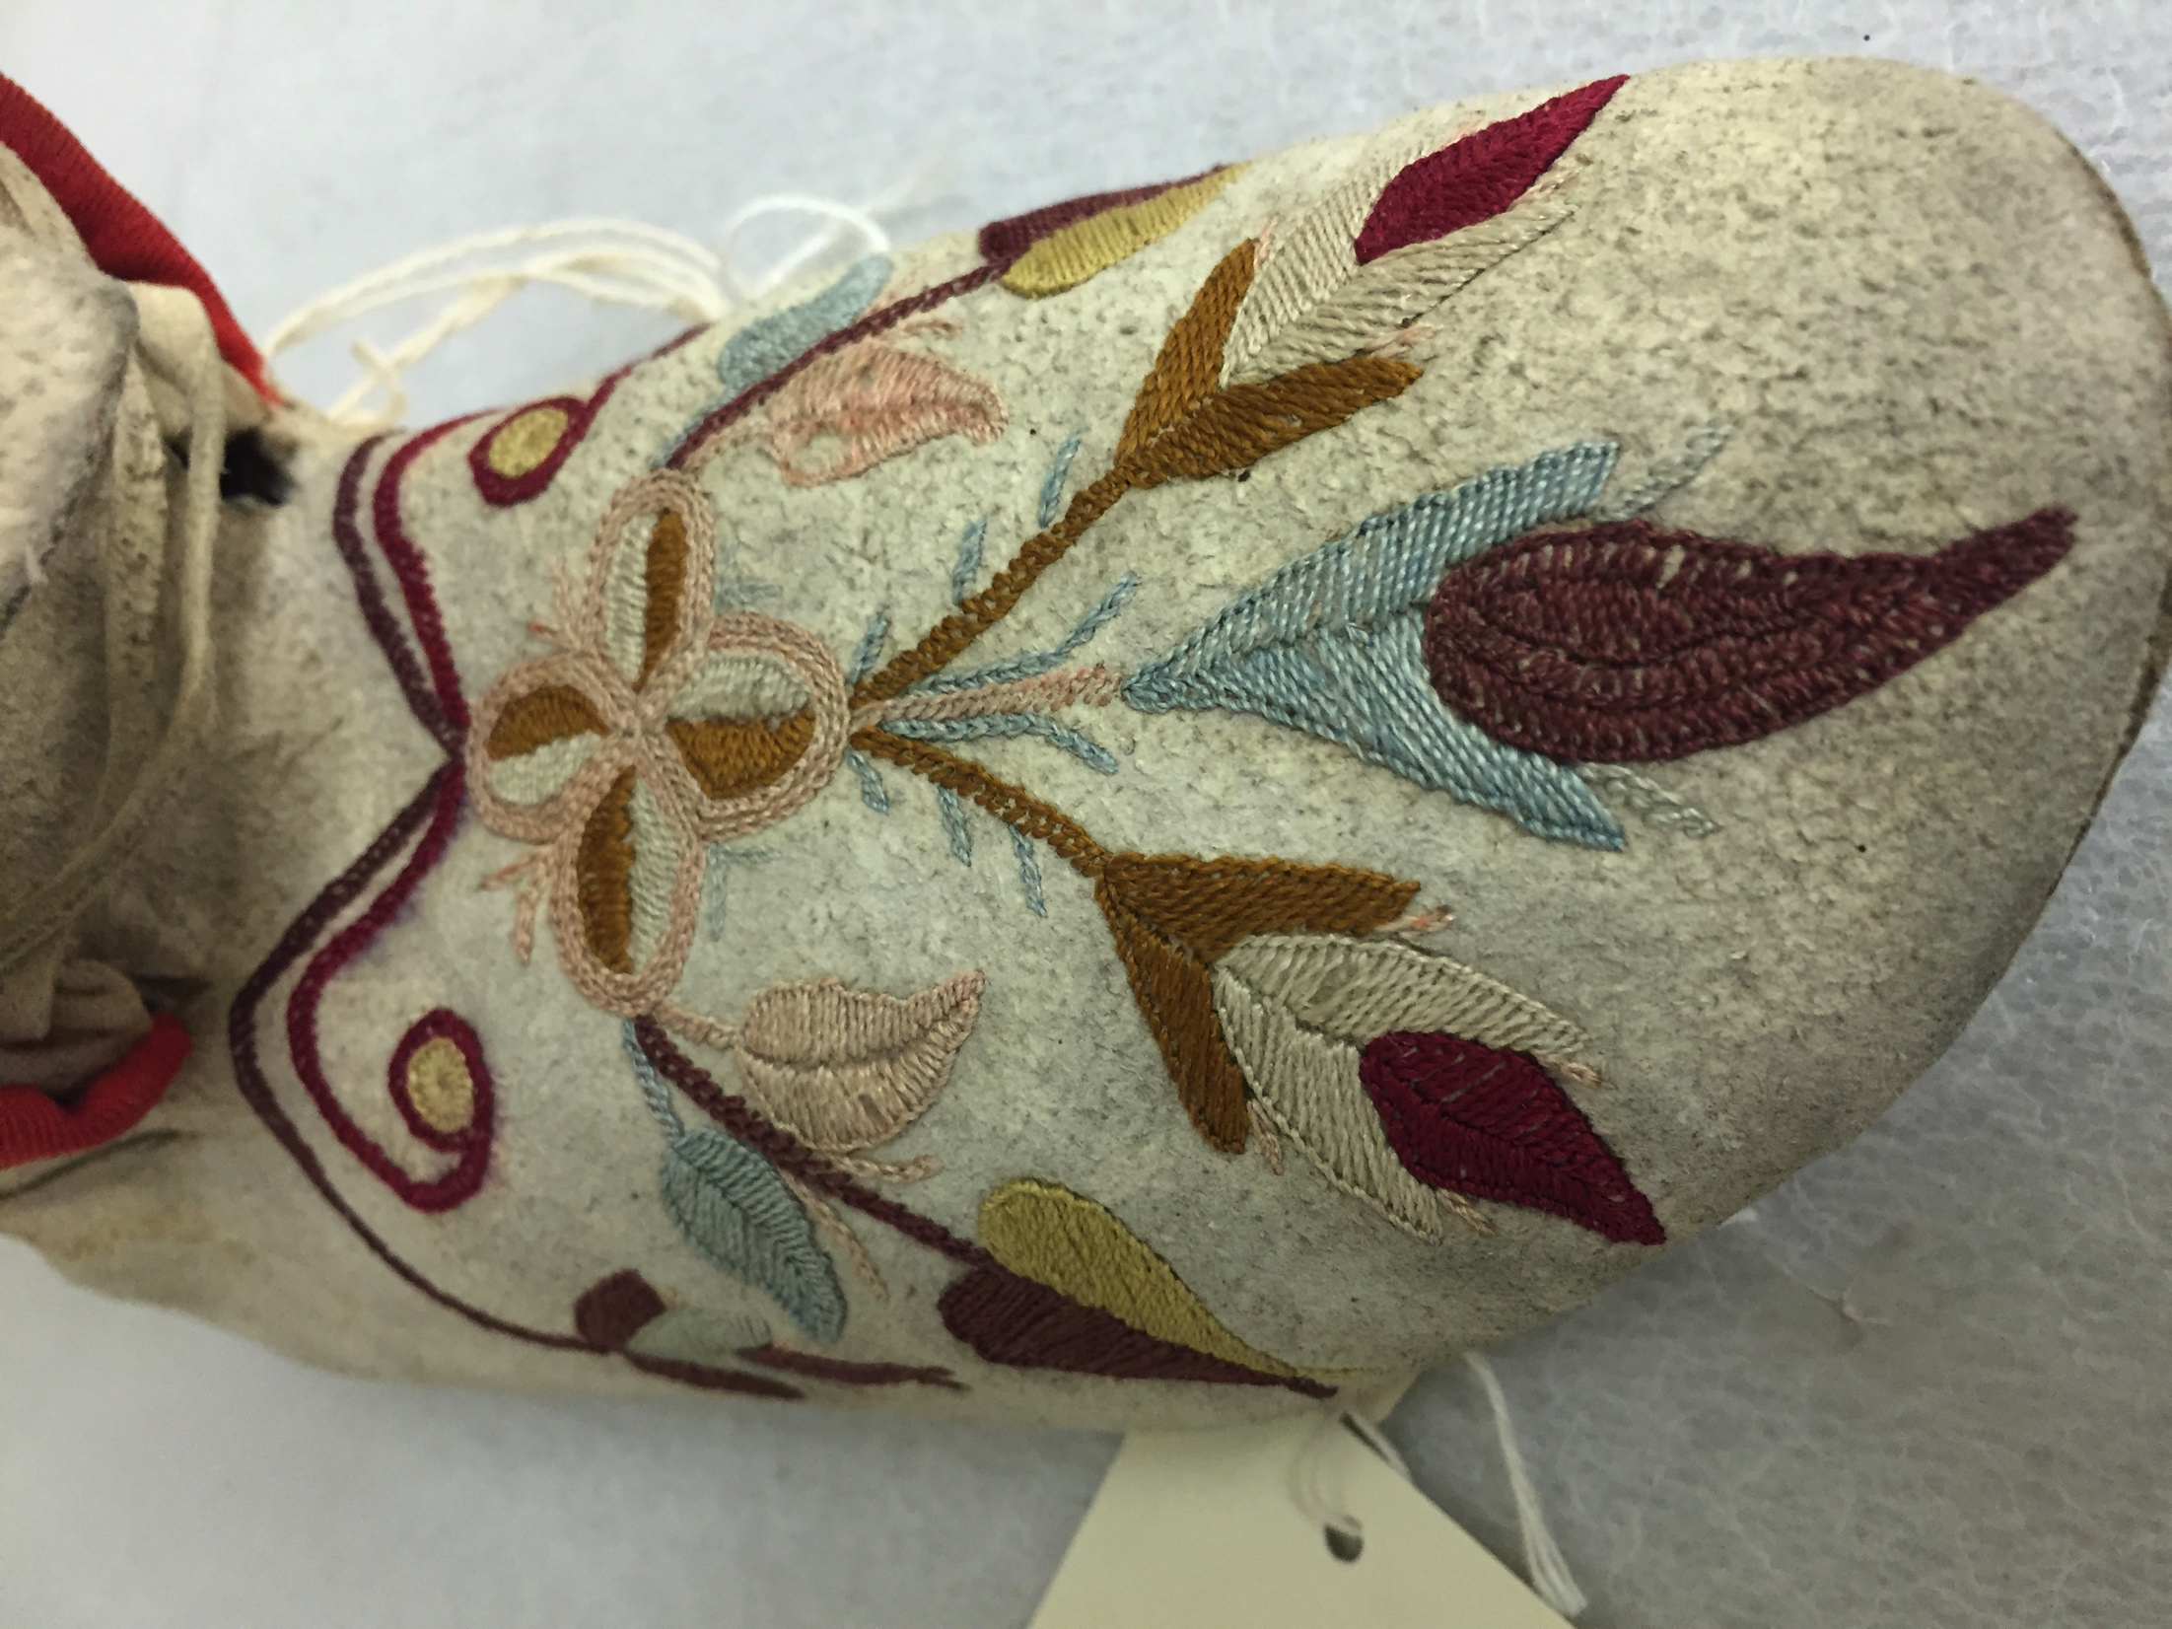
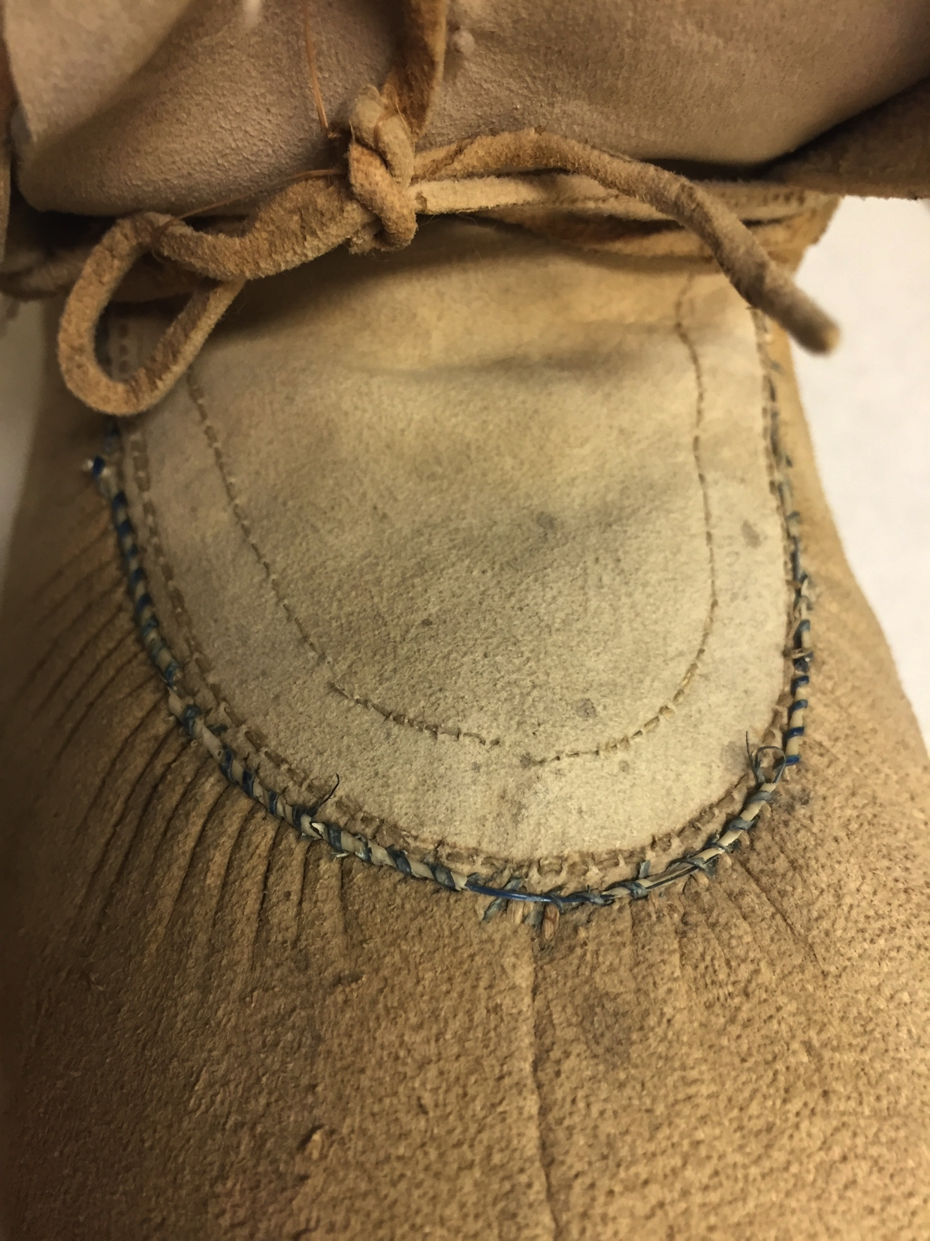
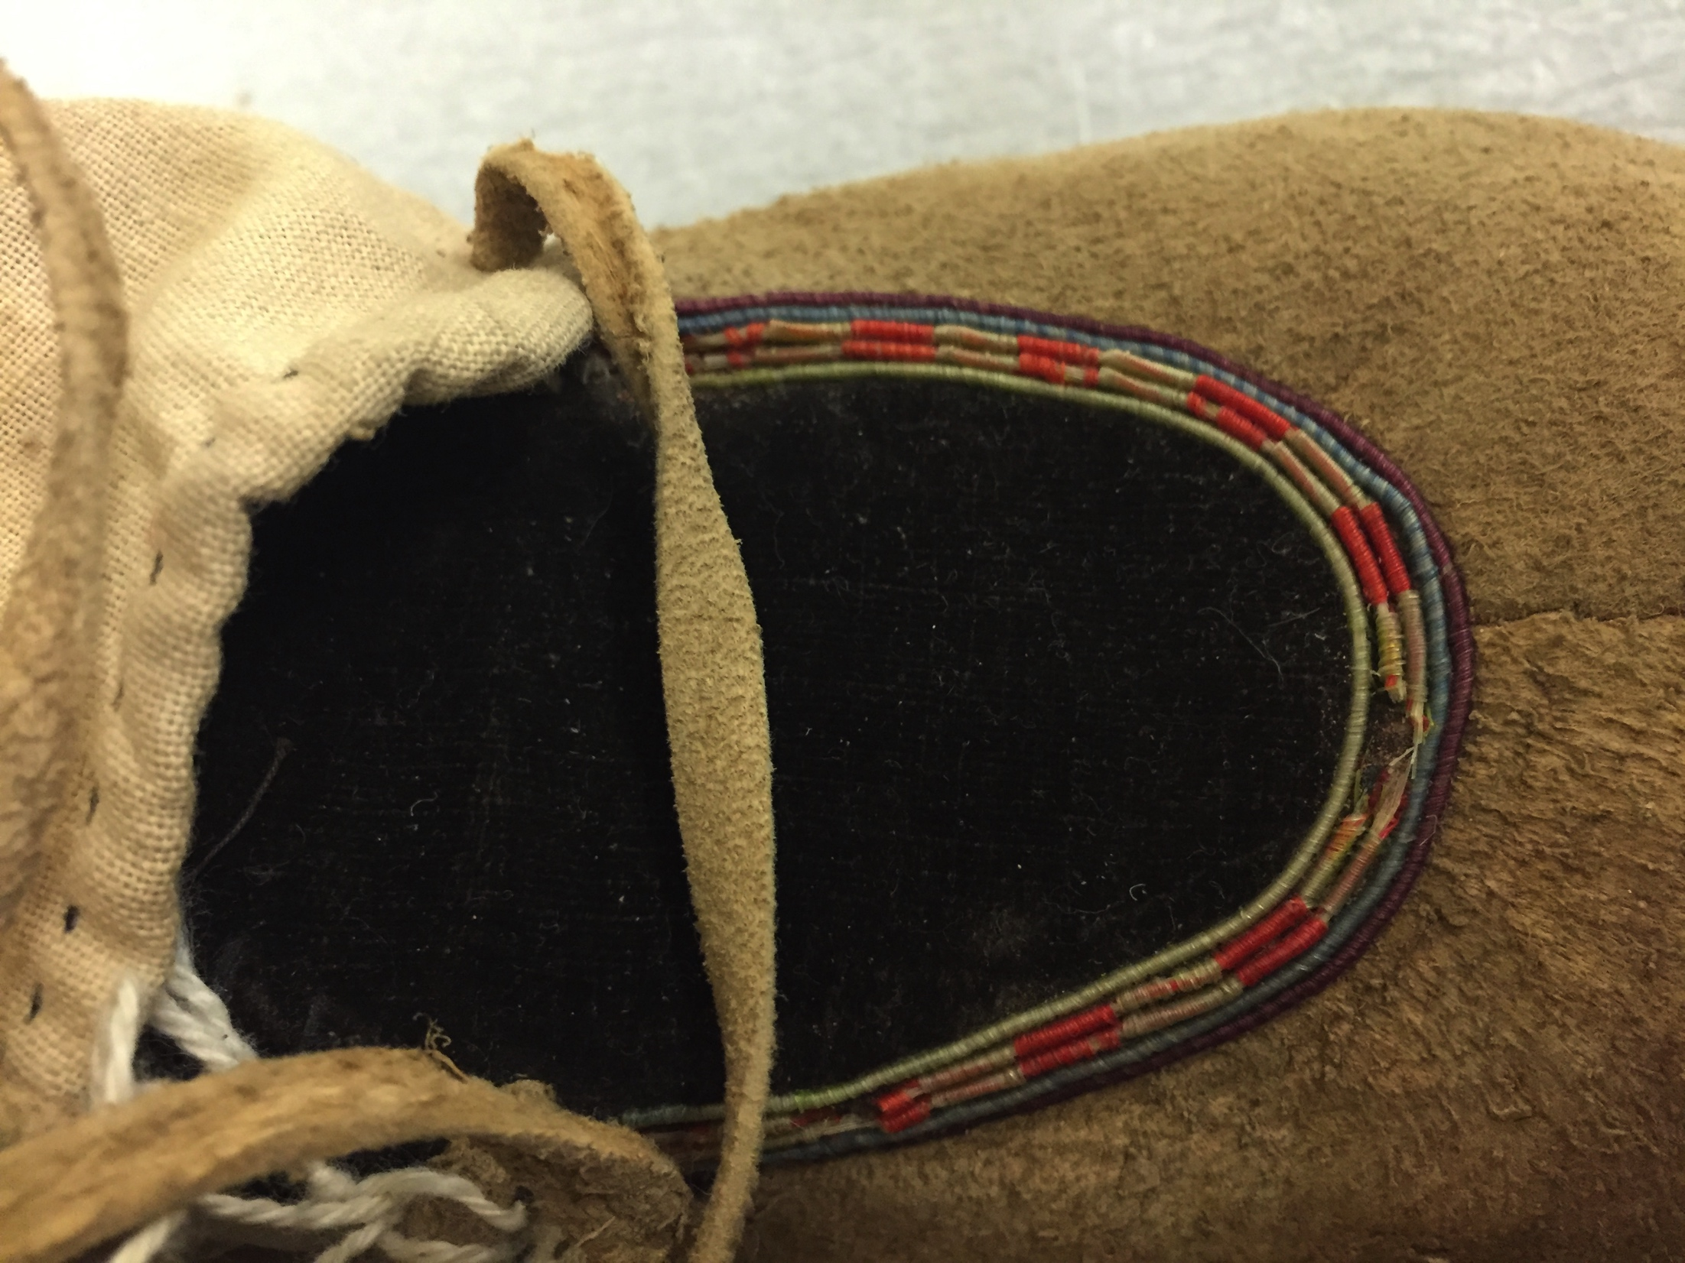
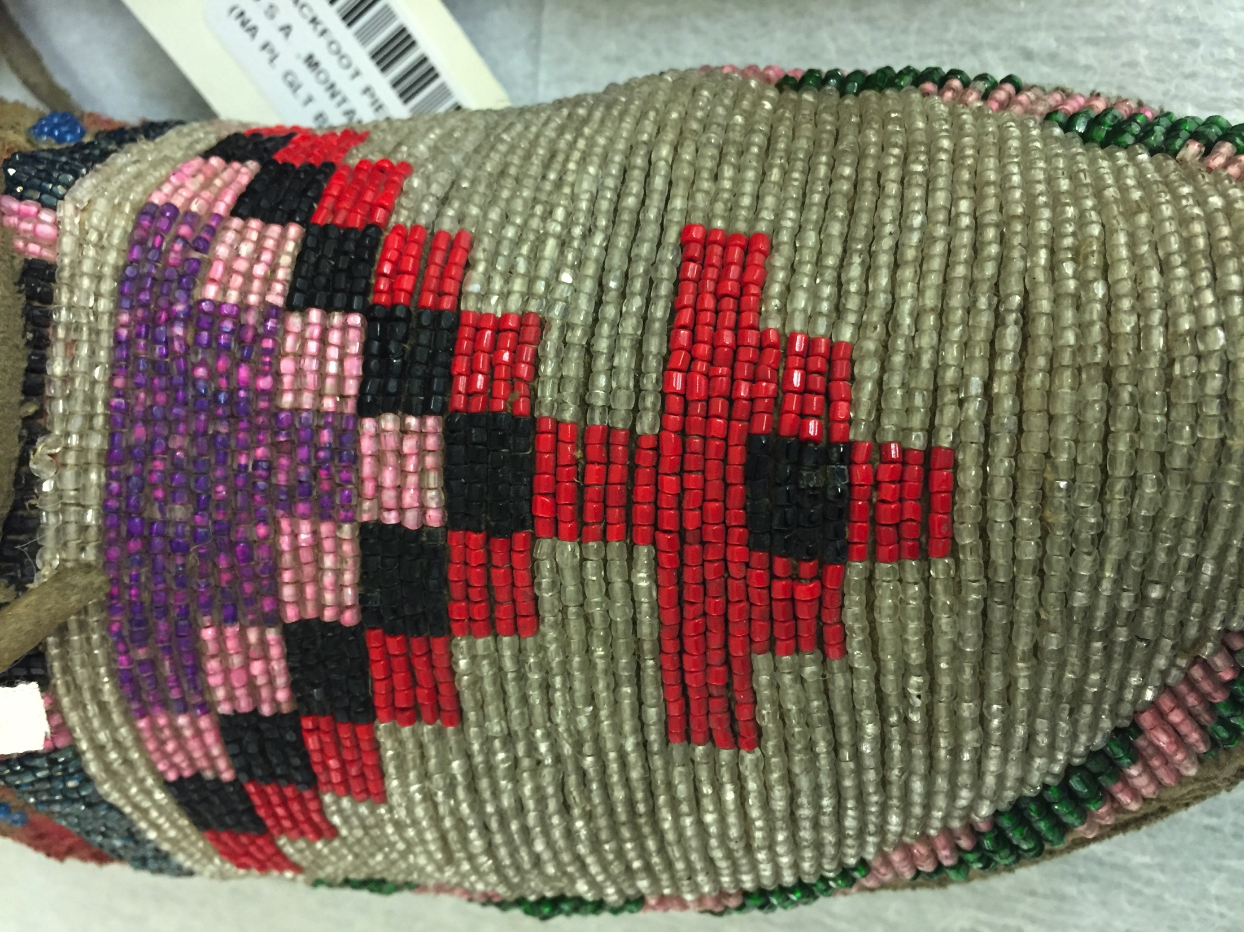
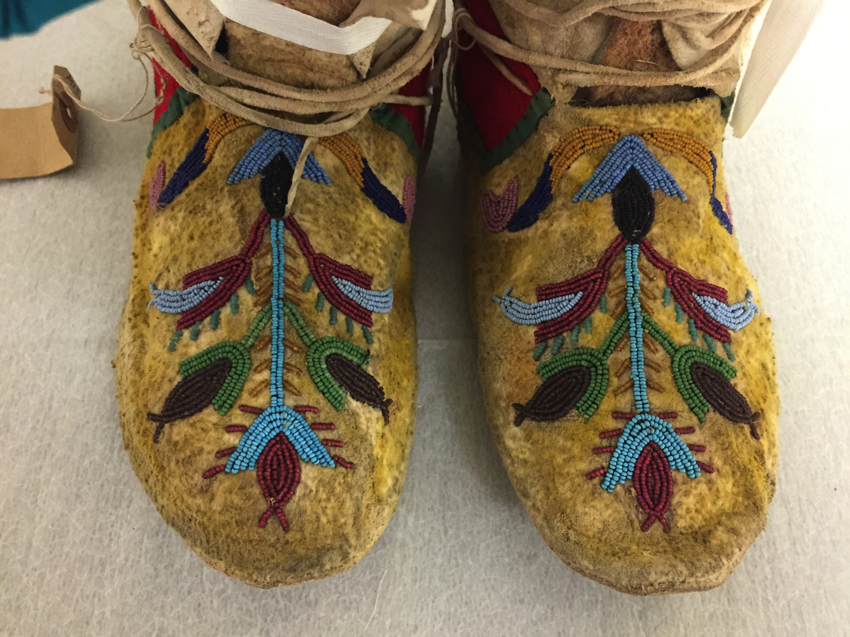
Stories of Change
E000674, NMNH (author photo)
E425907, NMNH (author photo)
Quilled Uppers
E204863, NMNH (author photo)
E378373, NMNH (author photo)
E316227, NMNH (author photo)
Embroidered (cotton thread) uppers
Beaded Uppers
Notes:
And finally, Moccasins can also tell us stories about change. For example, if we look at how moccasin design materials changed over time, going from porcupine and bird quills – to European trade beads – to cotton thread embroidery – we can begin to see a story taking shape that may be able to tell us about the ways Plains Indian societies were adapting to the presence of new people and new trade goods in their territories.

Slide 15
So What?
Notes:
Hopefully by now I’ve shown you why moccasins are important, why working with communities is important, and how I’m envisioning this project taking place, but ultimately, we have to ask the big question: So What? Why does this project matter, and how am I contributing to the bigger conversations that are going on in society?

Slide 16
Benefits of this project:
Foster relationships between communities (campus and otherwise)
Contribute to current discussions in anthropology & museology
Provide opportunities for communities to tell their stories on wider scales
Notes:
Well for one, my research is going to have impacts in my discipline. I’m pushing my field forward because I’m: looking at objects that have historically been ignored; using theories and methods that have never been used together before; and ultimately, unlocking the answers to important questions that my field has been asking for a long time.
Second, My project will foster and strengthen not only the collaborative relationships between the University of MT and the nations of the Blackfoot Confederacy, but will also show how collaboration with communities can pave the way for creating strong, long lasting, positive partnerships between Indigenous communities and anthropology.
And Finally, and perhaps most importantly, the outcomes of this project will provide opportunities for community members to tell their stories on a wider scale, and to showcase their artistry, innovation, and resiliency.

Slide 17
Notes:
Footwear is a fundamental part of the human experience. Moccasins are sitting in museums across the world, just waiting for someone to finally recognize that the stories they hold are important, and I intend to be the first one to listen to what they have to say. Furthermore, As a University of Montana student, as a future anthropologist, and as a fellow citizen in the global community, I am committed to the philosophy that real change happens when we lift people up and provide ways for them to tell their own stories, rather than us, as academics, telling their stories for them.

Slide 18
Questions?
Photo: USA Today – Rock Your Mocs campaign

Slide 19
Bibliography
Augé, C. Riley, Mary Bobbitt, Kelly J. Dixon, and Thomas A. Foor. 2017. “Fur Trade Artifacts at Housepit 54, Bridge River Site.” In The Last House at Bridge River: The Archaeology of an Aboriginal Household in British Columbia During the Fur Trade Period, pp. 107-123. Salt Lake City, UT: University of Utah Press.
Berlo, Janet Catherine, and Ruth B. Phillips. 1998. Native North American Art. Oxford, UK: Oxford University Press.
Blackfoot Gallery Committee, The. 2013. Nitsitapiisinni: The Story of the Blackfoot People. Alberta, Canada: Firefly Books Ltd.
Bradley, James H. 1900. “Affairs at Fort Benton from 1831 to 1869.” In Transactions, Officers, and Members, edited by the Historical Society of Montana, 201-303. Volume 3 of Contributions to the Historical Society of Montana. Helena, MT: Rocky Mountain Publishing Co.
Bundy, Barbara E., Allen P. McCartney, and Douglas W. Veltre. 2003. “Glass Trade Beads from Reese Bay, Unalaska Island: Spatial and Temporal Patterns.” Artic Anthropology 40 (1): 29-47.
Dubin, Lois Sherr. 1987. The History of Beads, from 30,000 B.C. to the Present. New York, NY: Harry N. Abrams, Inc.
Ewers, John C. 1944. The Story of the Blackfeet. Washington, WA: U.S. Indian Service.
­­———. 1945. Blackfeet Crafts. Lawrence, KS: United States Department of the Interior.
———. 1958. The Blackfeet; Raiders on the Northwestern Plains. Norman, OK:
University of Oklahoma Press.
———. 1997. Plains Indian History and Culture: Essays on Continuity and Change.
Norman, OK: University of Oklahoma Press.

Slide 20
Graeber, David. 1996. “Beads and Money: Notes Toward a Theory of Wealth and Power.” American Ethnologist 23 (1): 4-24.
Graeber, David. 2001. Toward an Anthropological Theory of Value. New York, NY: PALGRAVE.
Hamilton, W.T. 1900. “A Trading Expedition Among the Indians in 1858 from Fort Walla Walla to the Blackfoot Country and Return.” In Transactions, Officers, and Members, edited by the Historical Society of Montana, 33-123. Volume 3 of Contributions to the Historical Society of Montana. Helena, MT: Rocky Mountain Publishing Co.
Harrod, Howard L. 1971. Mission Among the Blackfeet. Norman, OK: University of Oklahoma Press.
Hungry Wolf, Beverly. 1980. The Ways of My Grandmothers. New York, NY: Quill.
Johnson, Michael G., and Bill Yenne. 2011. Arts and Crafts of the Native American Tribes. Buffalo, NY: Firefly Books.
Kansas State Historical Society. 1993. Traditions: Native American Beadwork. Topeka, KS: Kansas State Historical Society.
Karklins, Karlis. 1985. Glass Beads: The Levin Catalogue of Mid-19th Century Beads, A Sample Book of 19th Century Venetian Beads, and Guide to the Description and Classification. Ottawa, Ontario: Parks Canada.
Koch, Ronald Peter. 1977. Dress Clothing of the Plains Indians. Norman, OK: University of Oklahoma Press.
Logan, Michael H., and Douglas A. Schmittou. “The Origin of Tribal Styles: An Evolutionary Perspective on Plains Indian Art.” Reviews in Anthropology 24 (2): 65-86.
Lukavic, John. 2012. Southern Cheyenne Orthodoxy: A Study in Materiality. Doctoral dissertation. Department of Anthropology, University of Oklahoma. ScholarWorks, Norman, OK.
McCoy, Elizabeth Mae. 1972. A Descriptive Analysis of Blackfeet Indian Beadwork. Master’s thesis. Department of Anthropology, Montana State University. ScholarWorks, Missoula, MT.

Slide 21
Miller, Donald C., and Stan Cohen. 1978. Military and Trading Posts of Montana. Missoula, MT: Pictorial Histories Publishing Co.
Old Fort Benton, Montana: Early Fur Trading Post with Blackfoot Indians and Head of Navigation on the Missouri River. 1975. Fairfield, WA: Ye Galleon Press.
Peers, Laura and Alison K. Brown. 2015. Visiting with the Ancestors: Blackfoot Shirts in Museum Spaces. Edmonton, AB: AU Press.
Penney, David W. 1991. “Floral Decoration and Culture Change: An Historical Interpretation of Motivation.” American Indian Culture and Research Journal 15 (1): 53-77.
Penney, David W. In press 2018. “Styles, Production, and Collections of Plains Indian Quillwork and Beadwork.” In Plains Indian Art: Created in Community, 1-28. Thomas Gilcrease Museum.
Phillips, Ruth B. 1998. Trading Identities: The Souvenir in Native North American Art from the Northeast, 1700-1900. Seattle, WA: University of Washington Press.
Roberts, Kathleen Glenister. 2007. “Visual Argument in Intercultural Contexts: Perspectives on Folk/Traditional Art.” Argumentation and Advocacy 43: 152-163.
Robertson, R. G. 1999. Competitive Struggle: America's Western Fur Trading Posts, 1764-1865. Boise, ID: Tamarack Books.
Schneider, Mary Jane. 1983. “The Production of Indian-Use and Souvenir Beadwork by Contemporary Indian Women.” Plains Anthropologist 28 (101): 235–245.
Schultz, James Willard. 1973. My Life as an Indian: The Story of a Red Woman and a White Man in the Lodges of the Blackfeet. Williamstown, MA: Corner House.

Slide 22
Wissler, Clark. 1911. “The Social Life of the Blackfoot Indians.” In Anthropological Papers of the American Museum of Natural History, edited by the American Museum of Natural History, 3-64. Volume 7, Part 1 of the Anthropological Papers of the American Museum of Natural History. New York, NY: American Museum Press.
Wissler, Clark. 1927. “Distribution of Moccasin Decorations among the Plains Tribes.” In Anthropological Papers of the American Museum of Natural History, edited by the American Museum of Natural History, 3-23. Volume 29 of the Anthropological Papers of the American Museum of Natural History. New York, NY: American Museum Press.

