Slide 1
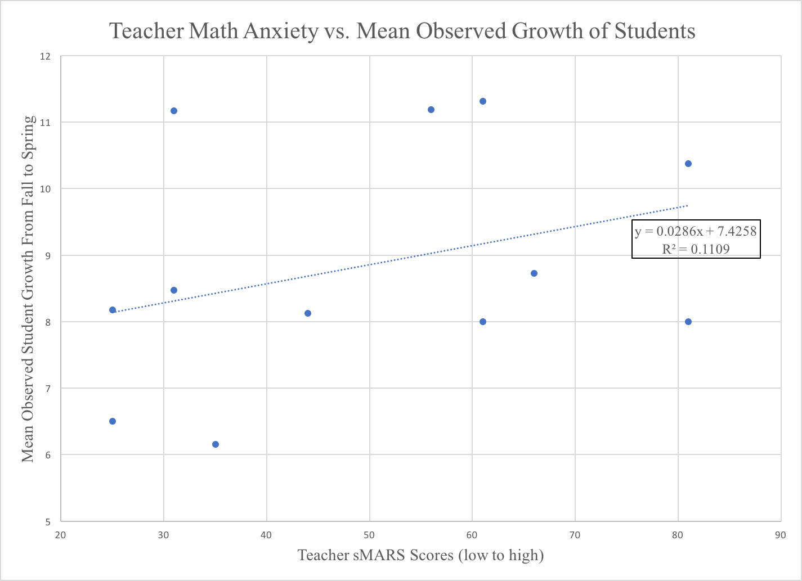
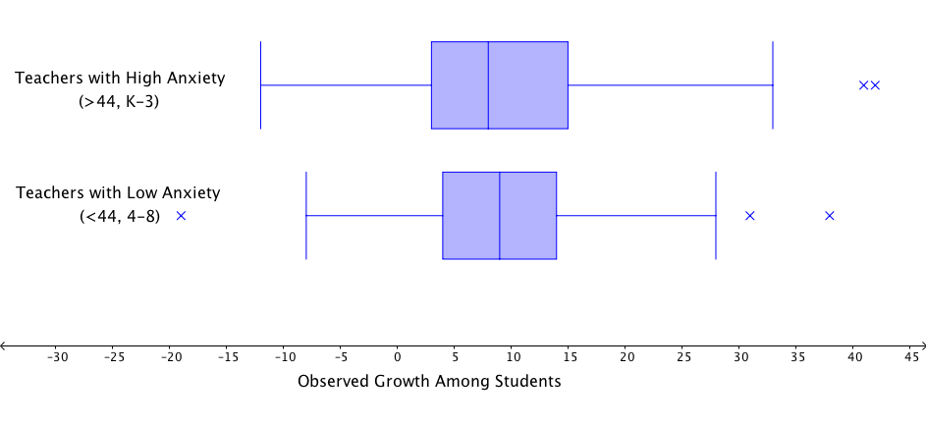
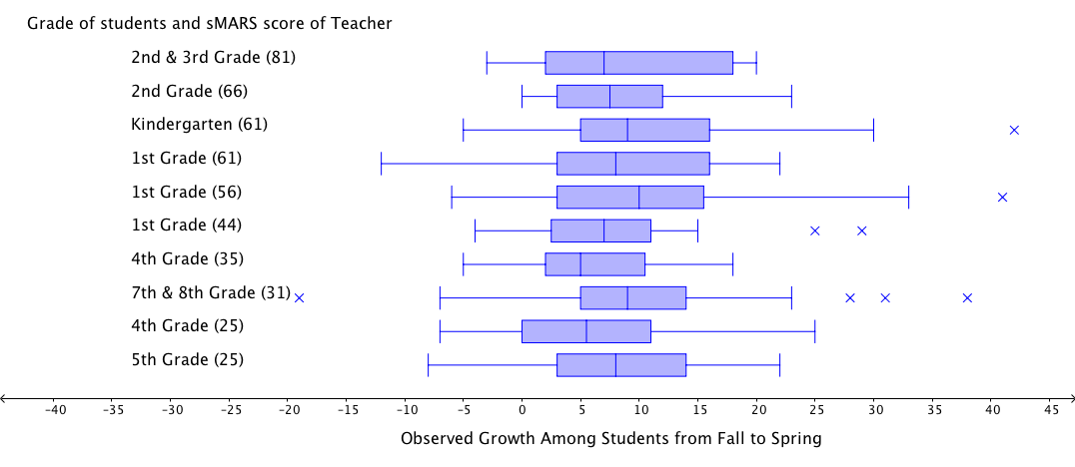
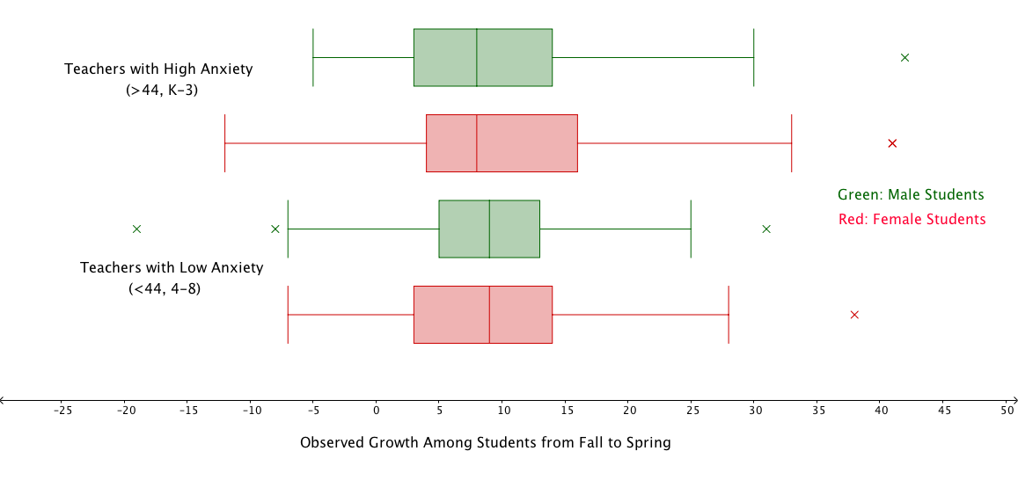
Math Anxiety Among Teachers and Its Impact on Students’ Math Ability
A Case Study Among Ten Elementary School Teachers and their Students
Elina Berglund, Spring 2019
Introduction
Data Analysis and Results
Conclusions and Future Implications
Fear and anxiety about math can impede an individual’s math achievement, and math anxious people tend to perform worse than their abilities would indicate (Hembree, 1990), most often due to working memory deficits (Ramirez, Gunderson, Levine & Beilock, 2012). At most United States universities, elementary education majors have minimal math education requirements, and these students have been found to harbor the highest levels of math anxiety of any college major (Beilock, Gunderson, Ramirez, et al., 2010). When these teachers are charged to teach elementary school students mathematics, their anxieties may impact their students’ math achievements (Banilower, Smith, Weiss, et al., 2013). Children tend to model their behavior after same-sexed adults (Bussey & Bandura, 1984), and as 90% of elementary school teachers in the U.S. are women, female students may be at a greater risk. Previous studies have found a negative correlation between the anxiety levels of teachers and the math achievement of their students among first and second grade female teachers (Beilock et al., 2010). This case study investigated whether or not these trends hold true among K-8 teachers at a rural school in Montana.
As this was a case study, and only ten teachers were analyzed, further research is warranted to see if these trends hold true over time and among a larger sample population. Nonetheless, the trends described in this study raise important considerations that should be further investigated in order to ensure that the needs of all students are being met.
Anxious teachers appear to self-select to teach younger students. There is increased variability among their students, and females tend to be more affected than their male peers.
Early identification and treatment of math anxiety is crucial, as anxieties may compound over time and lead individuals to avoid higher math courses and math-related careers.
Since the anxiety levels of teachers appear to have an effect on their students’ math performance, efforts should be made to decrease the anxieties of math teachers. Further math education and social-emotional training have been successful in this regard (Beilock et al., 2010).
Figure 3: Boxplot showing observed growth among students according to their teacher’s level of math anxiety.
Students with less anxious teachers had a slightly higher median growth score than their peers with more anxious teachers.
The IQR and overall range of the student scores from the less anxious group is slightly narrower than that of their peers. There is, in other words, less variability among the students of less anxious teachers.
Figure 1: Math anxiety among teachers vs. mean observed growth of students.
There appears to be a weak positive correlation between teacher anxiety and mean observed growth, indicating that anxious teachers are more likely to have higher growth scores among students.
Methods
Nine female and one male teacher and their students from kindergarten to eighth grade voluntarily participated in this study. Teachers’ level of math anxiety was assessed using the sMARS, a 25-item Likert scale composed of situations that might arouse anxiety regarding mathematics. Student math ability was assessed using their observed growth score on the MAPS test, a standardized test that all students take in the fall, winter, and spring each year.
Figure 4: Boxplot showing observed growth among students according to their teacher’s level of math anxiety and student gender.
The IQR and overall range of female students is greater than that of male students, especially among highly anxious teachers.
Girls appear to be affected more by the math anxiety of their teachers than do their male peers, potentially due to the fact that most of the teachers in this study were female.
References
Ashcraft, M. & Kirk, E. (2001). The relationships among working memory, math
anxiety, and performance. Journal of Experimental Psychology: General,
130 (4), 224-237.
Banilower, E., Smith, P., Weiss, I., Malzahn, K., Campbell, K., & Weis, A.
(2013). Report of the 2012 national survey of science and mathematics
education. Chapel Hill, NC: Horizon Research, Inc.
Beilock, S., Gunderson, E., Ramirez, G., & Levine, S. (2010). Female teachers’
math anxiety affects girls’ math achievement. Proceedings of the National
Academy of Sciences of the United States of America, 107 (5), 1860-1863.
Bussey, K. & Bandura, A. (1984). Influence of gender constancy and social power
on sex-linked modeling. Journal of Personality of Social Psychology,
47 (6), 1292 – 1302.
Hembree, R. (1990). The nature, effects, and relief of mathematics anxiety. Journal
for Research in Mathematics Education, 21(1), 33-46.
Ramirez, G., Gunderson, E., Levine, S., & Beilock, S. (2012). Math anxiety,
working memory, and math achievement in early elementary school. Journal of
Cognition and Development, 14(2), 187-202.
Figure 2: Boxplot showing observed growth among students according to their teacher’s level of math anxiety.
Teachers with high levels of math anxiety appear to self-select to teach lower grades.
Teachers with higher levels of math anxiety appear to be more likely to have greater variability among the middle 50% of their students.
Department of Teaching and Learning University of Montana
umontana.edu

