Slide 1
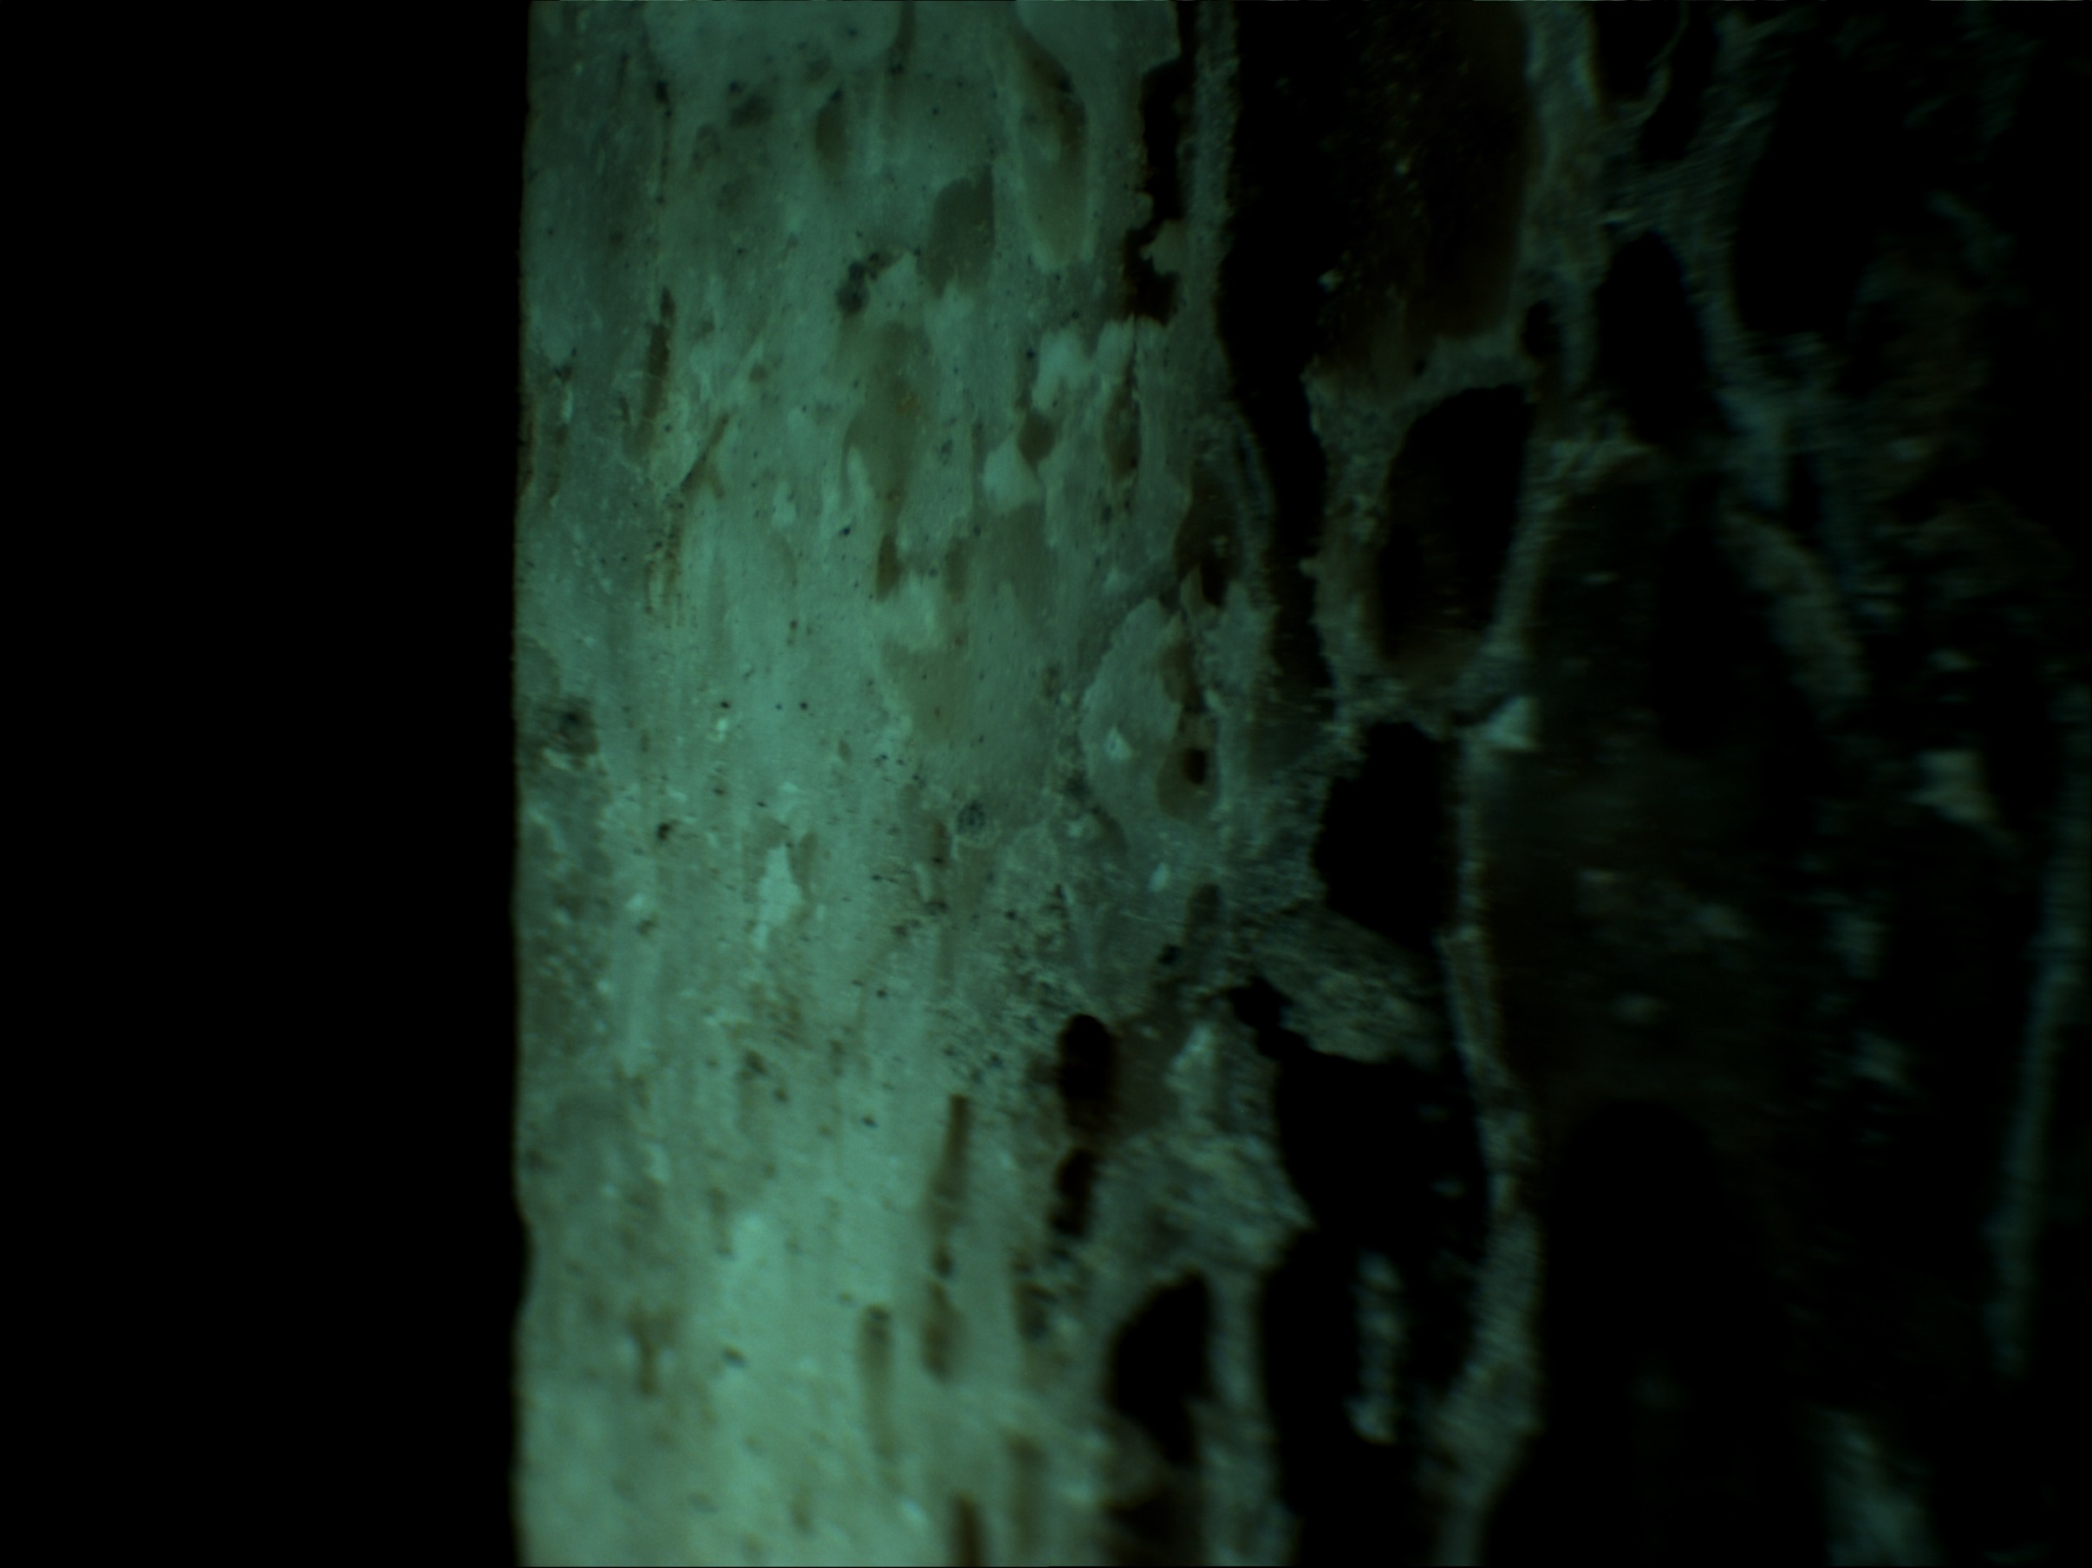
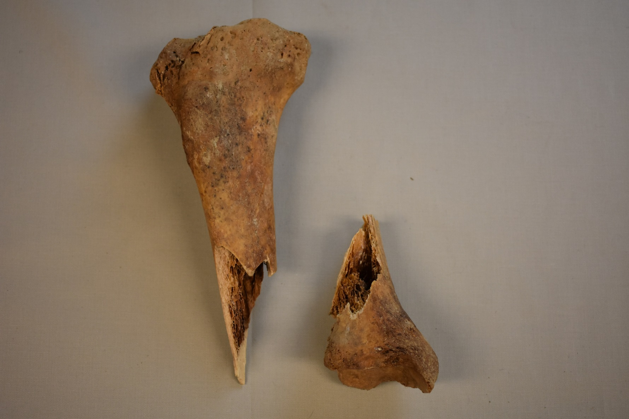
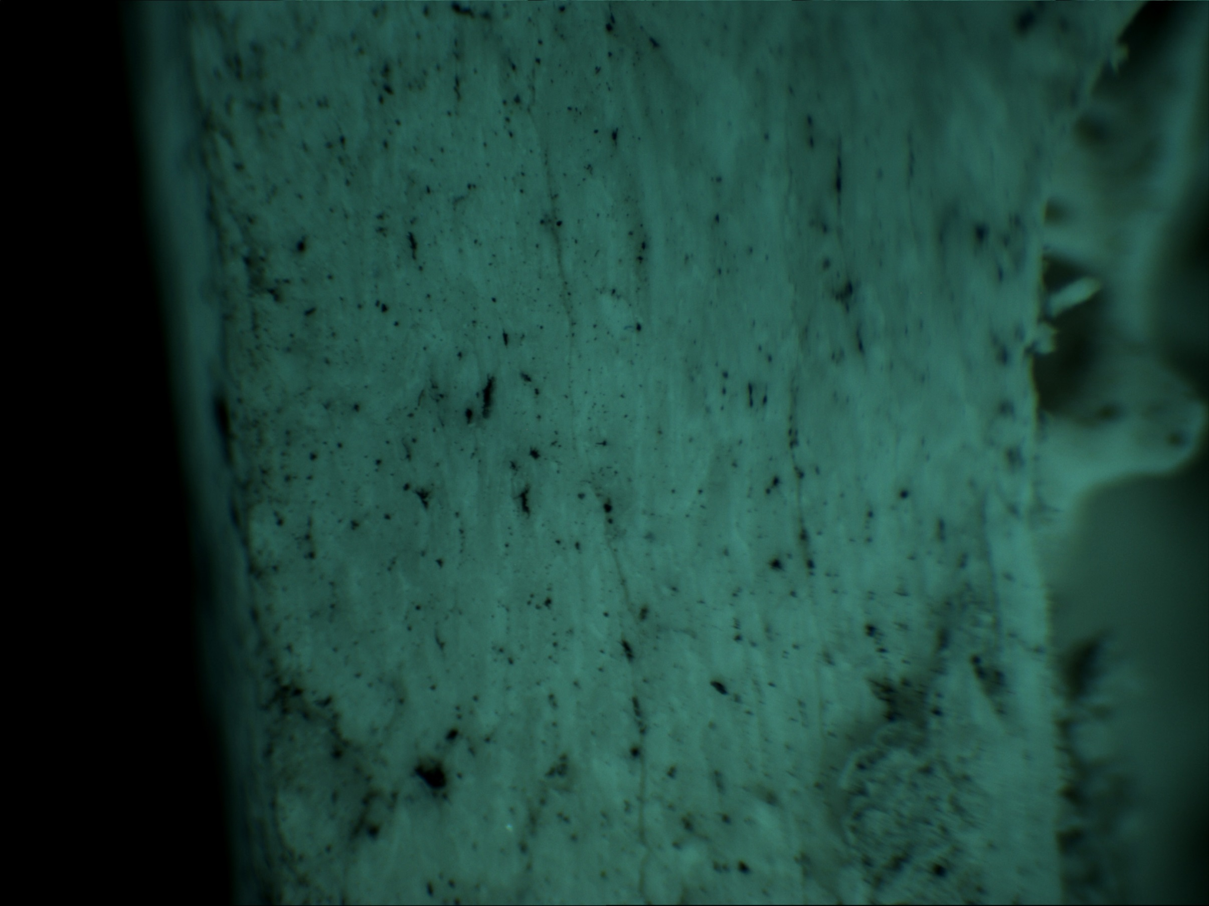
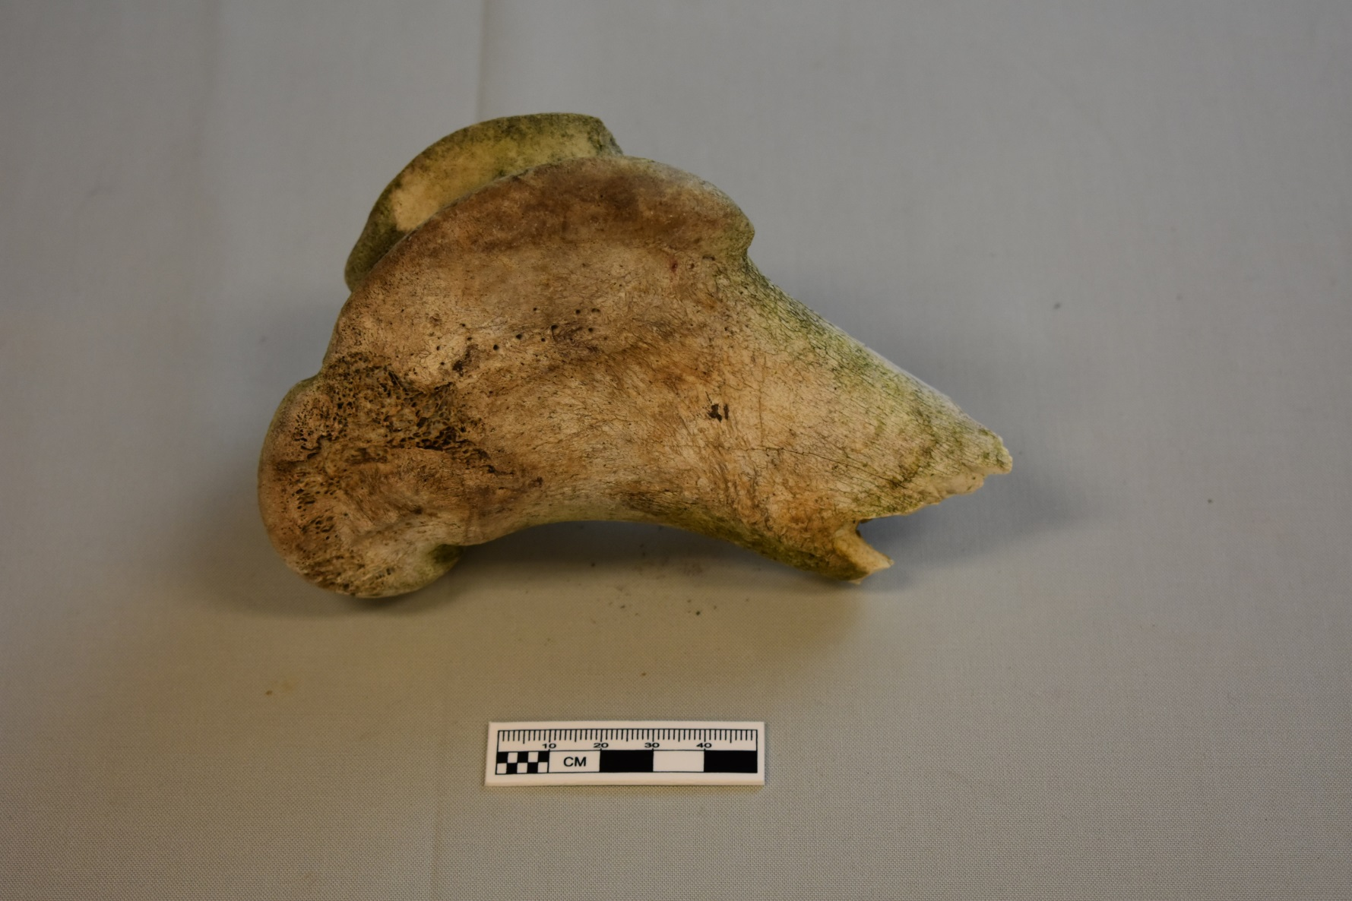
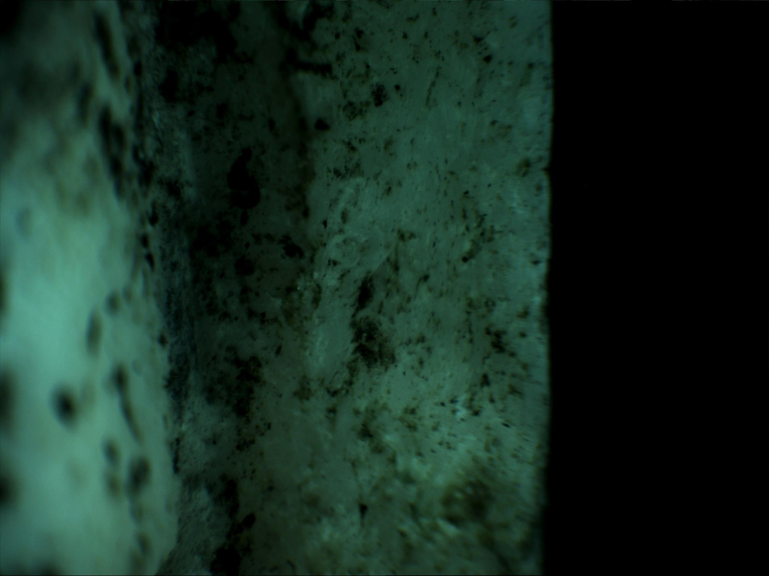
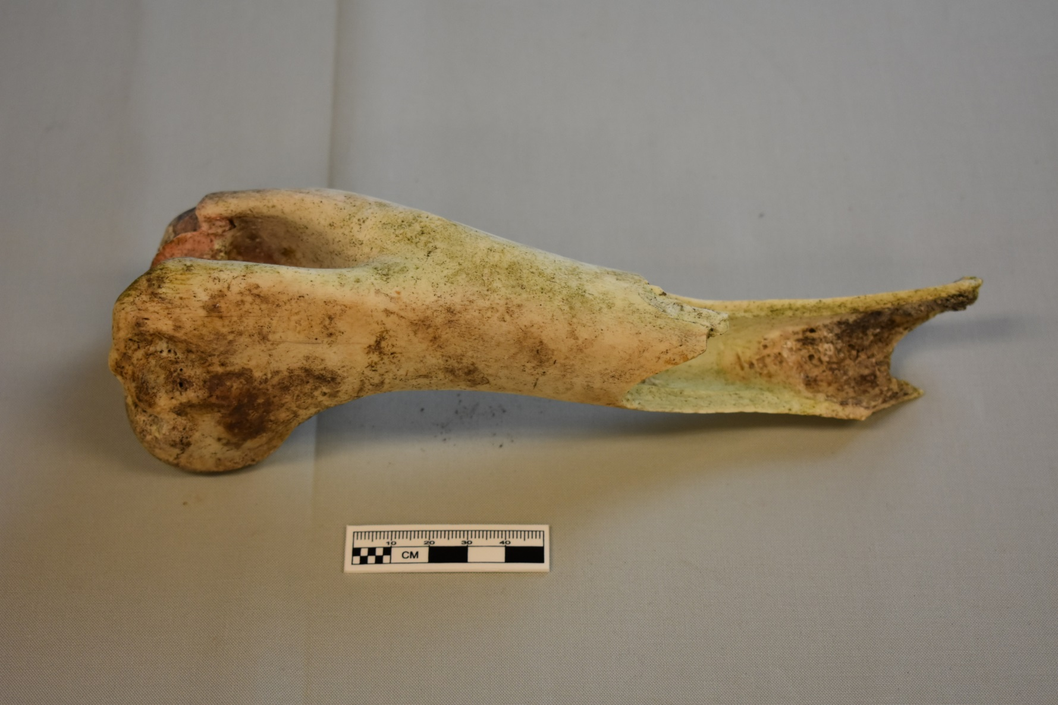
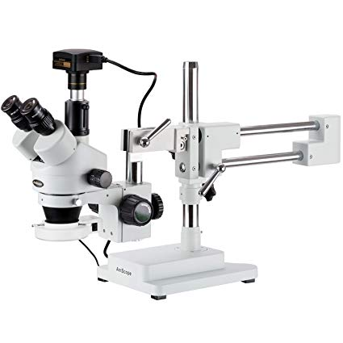
Human vs. Non-human bone: A non-destructive histological method
Project Overview
Within biological, anatomical systems, bone is a connective tissue that acts as the main supporting internal structure of the body. It directly reflects the soft tissues (e.g. muscles) that surround it in what osteologists call “bone morphologies” and is the primary focus of studies in forensic anthropology and zooarchaeology. Within these disciplines, species identification is one of the first steps in the analysis of bone fragments in both forensic and archaeological contexts.
This thesis project focuses on the identification of human vs. non-human bone using a novel, non-destructive histological method assuming a qualitative distinction can be found between species using a high-resolution camera microscope.
Haley O’Brien, BA
Broader Impacts
The results of this study could provide an accessible, affordable, and fast identification method which, in turn, could save time and resources if non-human determinations are made early in a forensic investigation.
Forensic Crime Lab: Someone without extensive histological knowledge in osteology could look for quantitative and basic morphological features to establish forensic significance of remains.
Archaeology: Useful for similar low cost, non-destructive, and efficiency reasons. Additionally, most faunal fragments are regularly too small for taxonomic or element identification beyond possible long bone shaft fragments.
This would additionally help give archaeologists and biological anthropologists a method for human vs. non-human taxonomic identification in known archaeological sites that is respectful to tribal beliefs on how to handle the deceased.
Surface:
Linear ridges (parallel to bone shaft)
Ovular foramen transition to cancellous bone
Thin, dense cortical bone
Human (FSD 0-5174), Right, Proximal Tibia
Materials & Methods
Using an AmScope: MA1000 camera microscope, this method is testing for a notable difference in human vs. bovid vs. cervid endosteal cortical bone without the use of destructive, histological cross-sections.
All bones were already fractured, photographed under 2x-225x resolution, and examined for:
Orientation and pattern of vascularization
Type of primary bone (e.g. lamellar vs. plexiform)
Morphological measures of the transition from cortical to cancellous bone
Robusticity of the cortical bone.
The non-human species were chosen for their common appearance in potential forensic cases that have come through the University of Montana Forensic Anthropology Lab (UMFAL).
Surface:
Porous
Granularity
Robust, thick cortical bone
Bovid (UMFC 85), Right, Distal Femur
Future Research
Expanding the sample size using more collections outside of the University
Comparing more fracture types (e.g. transverse)
Expanding the species analyzed (e.g. Equid, Canid, Ursid)
Doing more blind tests for use by someone without osteological knowledge
Using older, archaeological specimens for comparison with modern remains
Surface:
Granularity
Thin, dense cortical bone
Cervid (UMFC 85), Right, Mid-Shaft Humerus
Contact:
Haley O’Brien, BA
University of Montana: Anthropology Department
haley.obrien@umontana.edu
Acknowledgements: Special thanks to my advisors, the Montana State Crime Lab: Missoula, and the faculty of the University of Montana Anthropology Department for their ongoing support in finding samples for this project and providing feedback at every corner.
References:
Broughton JM, Miller SD. 2016. Zooarchaeology & Field Ecology: A Photographic Atlas. Salt Lake City: University of Utah Press.
Gilbert BM. 1990. Mammalian Osteology. Columbia: Missouri Archaeological Society.
White TD, Folkens PA. 2005. The Human Bone Manual. Elsevier.

