Slide 1
Ancient DNA Extraction and Analysis of Bone Samples from Orton Quarry Ossuary

Slide 2
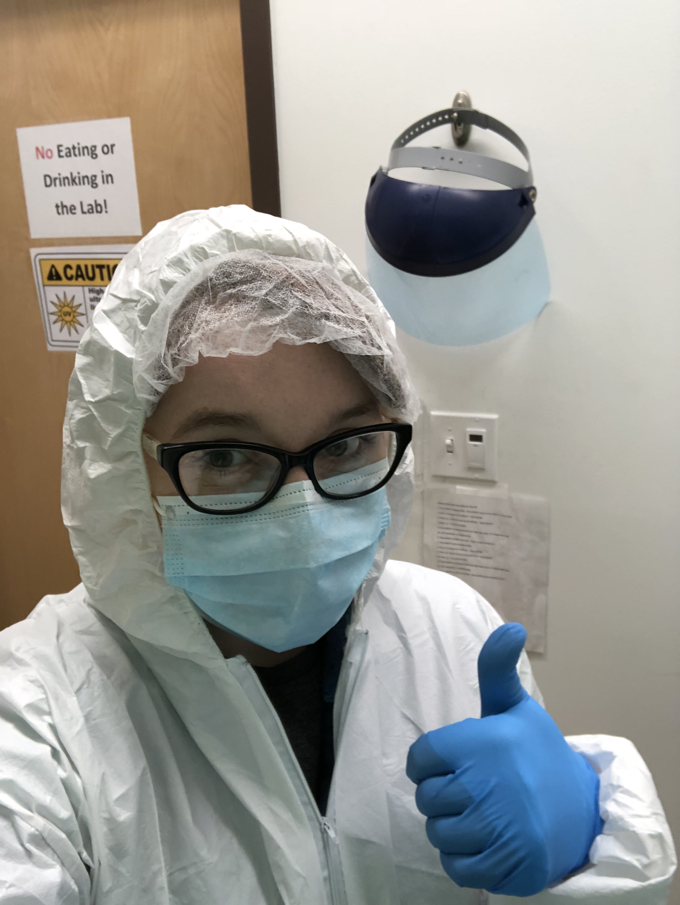
HELLO!
My name is Paige Plattner
You can find me at paige.plattner@umconnect.umt.edu
Notes:
Hi everyone, thank you for joining me today, my name is Paige and I'll be presenting on my molecular anlalyisis of bone samples from the Orton Quarry Ossuary.

Slide 3
Outline
History of the Orton Quarry Ossuary (36ER243)
Feasts of the Dead and associated Ossuaries
Ancient DNA and its challenges
Personal research thus far and what’s next
Notes:
Today we are going to start off with a brief history of the OQ O.
An anthropological review of cultural practice of Feasts of the Dead.
Then moving on to the many challenges molecular anthropologists face working with aDNA and lastly dive into my own research conducted as a graduate student here at the University.

Slide 4
If there were a science of human beings it would be anthropology that aims at understanding the totality of experience through structural context.
Wilhelm Dilthey
Notes:
It is my hope that this quote from Wilhelm Dilthey provides a bit of insight into my love for anthropology and it's broad scope.
...
This illustrates anthropology’s overarching goal to understand inherent human nature of how we have lived our lives in the past as well as today.

Slide 5
1.
The Orton Quarry Ossuary
(36ER243)
Notes:
So moving on to the history of OQ O

Slide 6
History of a little-known site
The Orton Quarry is a Late Prehistoric (A.D. 900 to 1650) site in Northeastern Pennsylvania.
In March 1991, heavy-equipment operators accidentally exposed and destroyed two-thirds of the original ossuary.
Notes:
As archeological sites go, there is very little known about the original context or excavation findings at Orton Quarry. We do know it is a Late Prehistoric site along the coast of Lake Erie and that it was originally excavated in the early 90s after an heavy-equipment accident destroyed 2 3rds of the ossuary, leaving only the eastern third to be excavated by archeologists of Mercyhurst University. In the time since very little has been published on the Orton Quarry site, its importance, or its original inhabitants.

Slide 7
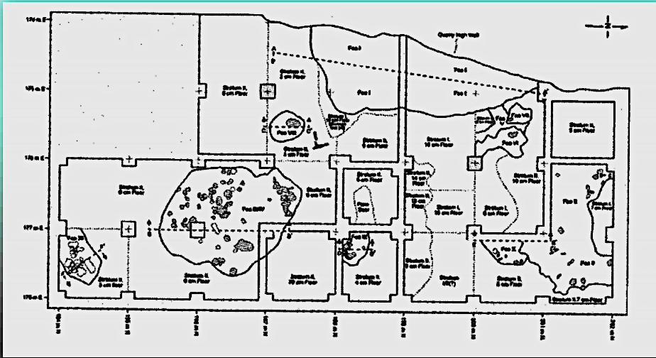
Notes:
here I have included a map of the original arch excavation. The location, in red, is where the ossuary was located and served as a starting point for the rest of the excavation.

Slide 8
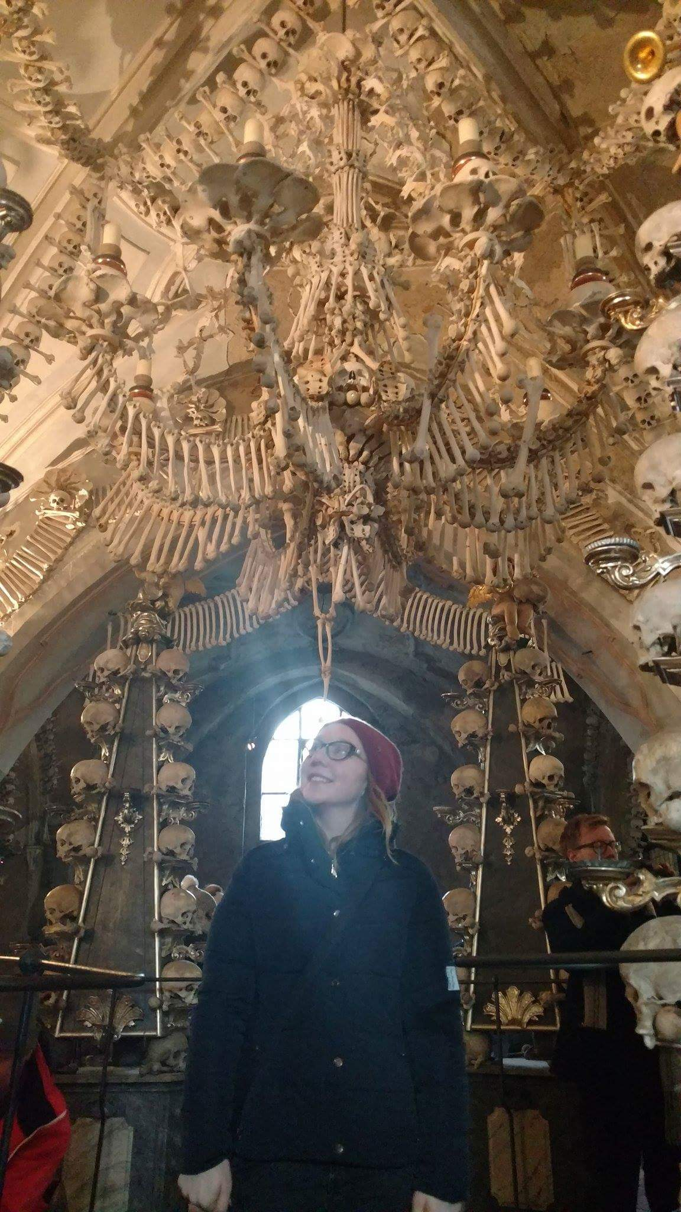
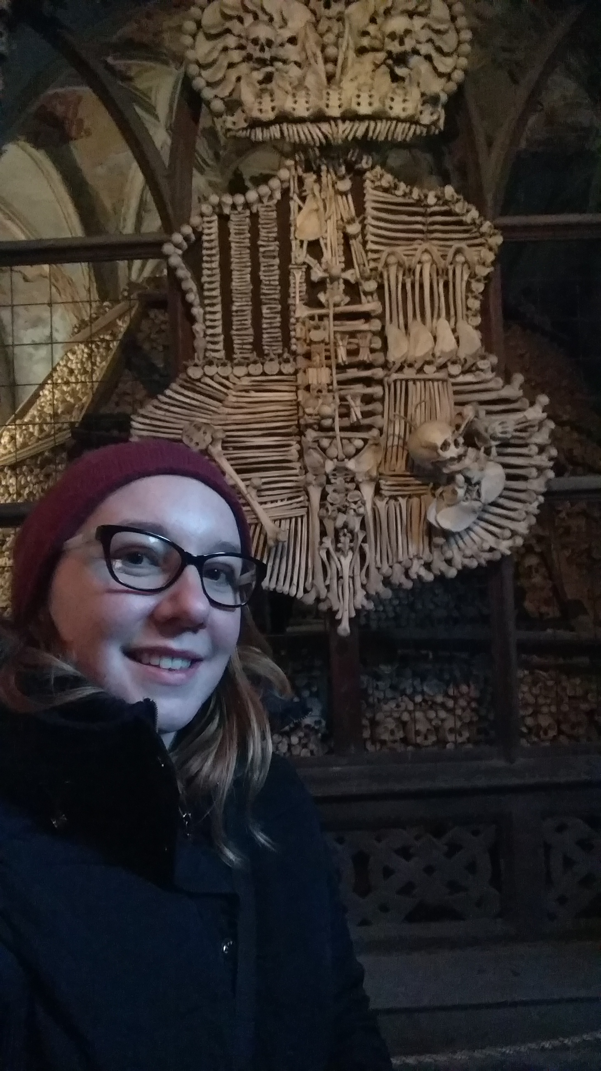
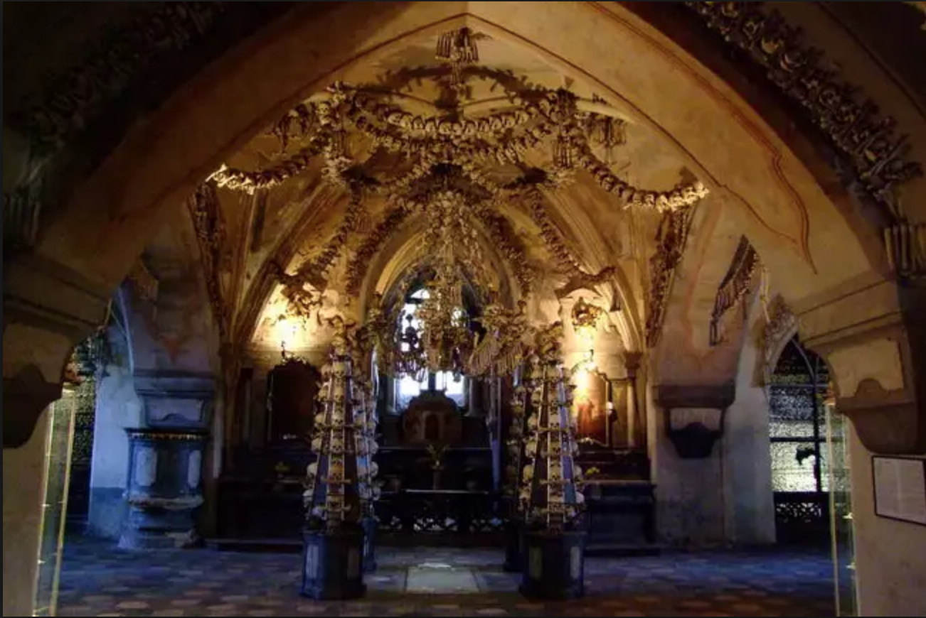
What is an Ossuary?
Notes:
So at this point you may be wondering what an ossuary is, in short, an Ossuary is another term for Mass grave of human remains- a place with many bones.
Here we have a couple of pictures of myself visiting one the most well-known Ossuaries in the world, the Sedlec ossuary- located just outside of Prague in a suburb of Kutná Hora in the Czech Republic.

Slide 9
What are Ossuaries? Why is there one in NE Pennsylvania?
Notes:
However they are many other smaller ossuary throughout the world including the Great Lakes region.

Slide 10
Possible cause:
15th and early 16th centuries’ practice of Feasts of the Dead.
Notes:
One possible explanation for an Ossuary in NE Penn is this is a remnant of the 15th and 16th century practices of Feasts of the Dead.
At this time members of the Iroquois, specifically the Huron-Wendat populations, became the practices secondary burials in these ossuaries.

Slide 11
The Iroquoian culture and their practice of Feasts of the Dead
Maize culture leads to large agricultural system and new social institutions.
This shift to maize is considered the start of recognizably “Iroquoian” material culture.
Villages growth led to the cultural practice of secondary burials in ossuaries.
Notes:
By the turn of the fourteenth century the maize culture had developed into a large agricultural system that resulted in new social institutions for year-round villages.
some anthropologists and historians consider this shift to be the start of recognizably Iroquoian material culture
As villages grew some historic populations such as the Huron-Wendat populations began the cultural practice of secondary burials in ossuaries that have been thought to have included upwards of 500 individuals!

Slide 12
What is ancient DNA?
Notes:
so with the historic background covered lets move into the lab.
Ancient DNA, commonly referred to as aDNA, is DNA that has been subject to time and thus is damaged and more complicated to extract and sequence than modern DNA.
The possibilities are quite wide, currently, We can get ancient DNA from many things including Bones, teeth, coprolites and even chewed tobacco!

Slide 13
ANCIENT DNA AND WHAT CAN GO WRONG
CONTAMINATION IS COMMON DURING EXCAVATION
DNA STRANDS BREAK DOWN OVER TIME
OXIDATION DAMAGES DNA
MISCODING ERRORS: A⇢G
C ⇢T AND G ⇢A
POLYMERASE BLOCKAGE
CROSSLINKAGE
JUMPING PCR
Notes:
With all this amazing science does come some challenges. The root of this is that once an organism dies the DNA repair mechanisms of their body no longer function, this results in aDNA damage. It is important to know that all of this damage is extremely subject to time, environment and chemical activity.
Here we have a flow of all of the potential hazards in aDNA extraction and analysis.

Slide 14
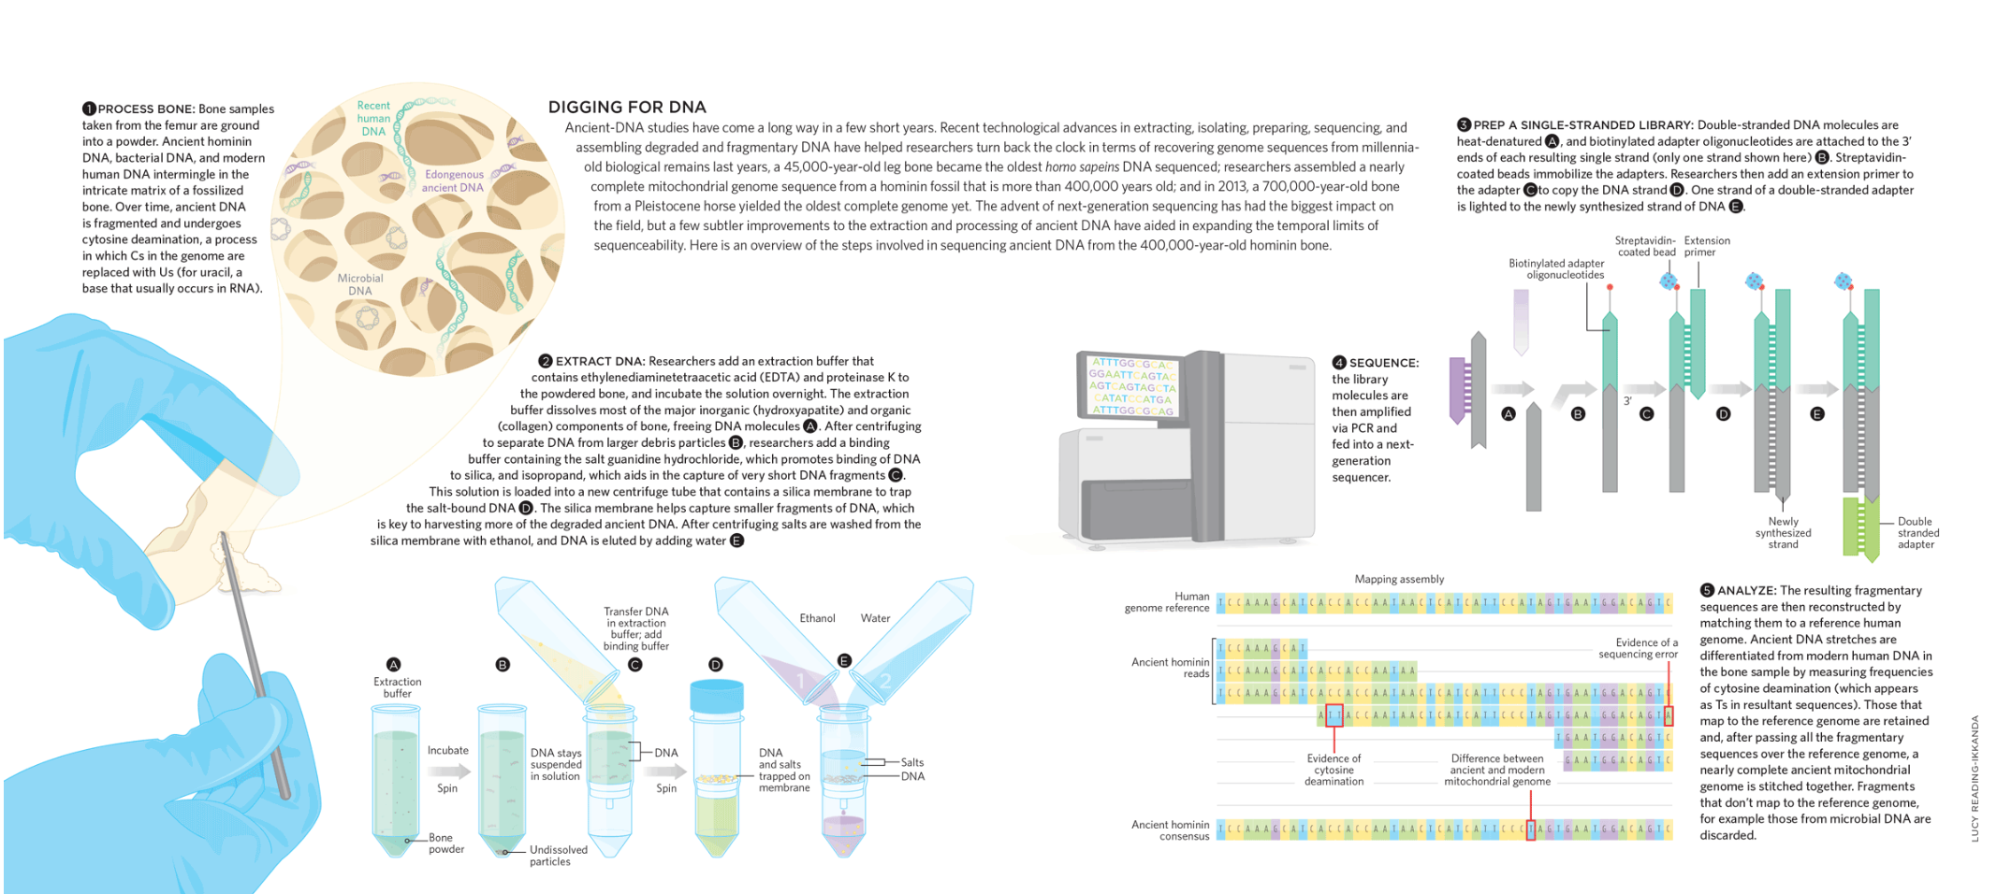
Notes:
Here we have an example of a standard protocol for aDNA extraction from bone, much like the procedures I followed with the Orton Quarry remains.

Slide 15
WHY I AM PASSIONATE ABOUT ANCIENT DNA AND WHY YOU SHOULD BE TOO
Notes:
At this point I would like to cover why I am so passionate about aDNA and have chosen to specialize in this research as a graduate student. In only thirty-FIVE years, ancient DNA has provided a window to look back at the people who existed before us and thus helped better understand our current selves (for example did you know that many people of European decent have Neandertal DNA in their genomes?!)
Ideally, the more we learn about people of the past, the more we can infer about ourselves and our future.

Slide 16
The Results Thus Far
No distinguishing mutations.
All fragments were too small and indistinguishable from the reference mitochondrial genome.
^{No haplotypes can be assigned.}
Notes:
So finally onto my own research.
We know from a similar study conducted by Pfeiffer et al. that this region should have mitochondrial haplotypes- maternal decent patterns, high in types A & B with distinguishing mutations that may link these remains with know sequences of near-by sites and furthermore may allow for identification of modern descendants in populations of the region today.
As of Friday, February 8th the results from a baited run on MiSeq showed no mutations or variation from the refence genome.
Unfortunately all of the extracted DNA from all 9 samples were fragments too small and ultimately undistinguishable; therefore, no haplotypes can be assigned at this point.

Slide 17
So What’s Next?
In classic aDNA fashion: we try again.
Notes:
Despite the original heartbreak of February 8th's results, or lack there of, I must remember that this is the nature of aDNA. Luckily there are other protocols with varying pre-sequencing procedures -referred to as library prep- that can be conducted with the current extracted products that may yield larger and clearer results.

Slide 18
THE BIG PICTURE
Extracting and analyzing the degrading DNA from an otherwise forgotten site allows these remains to tell their story again.
Notes:
With all of that having been said I would like to end this presentation on a positive note by sharing the broader impacts of my thesis research with you all. it is my belief that by extracting and analyzing the degrading DNA from these otherwise forgotten bio-archeological specimens, we as molecular scientist are allowing these bones to tell their story again.

Slide 19
THE BIG PICTURE
After the DNA analysis is completed my professor and I hope to return the remains to their descendants.
Notes:
Furthermore, as the descendants of the original inhabitants of this site remains unknown, the molecular analysis would provide a pathway for us, as anthropologists, to return the remains to their descendants-their families.

Slide 20
THANKS!
Any questions?
You can find me at paige.plattner@umconnect.umt.edu
Notes:
Thank you all for coming, does anyone have any questions?
...

Slide 21
CREDITS
Special thanks to my advisor Professor Meradeth Snow, without her guidance this project would not be possible.
Additional Thanks goes to my colleague Tre Blohm for assistance with the Bioinformatics.
Notes:
Great! and lastly I'd like to give two special thanks to my professor and my colleague

Slide 22
References
Dirkmaat, D. C. (1993). Preliminary analysis of the human remains from the Orton Quarry Site, Erie County, Pennsylvania. American journal of physical anthropology , 16, 81. Retrieved October 9, 2017.
Dirkmaat, D. (2012). A companion to forensic anthropology (Blackwell companions to anthropology ; 16). Malden, MA: Wiley-Blackwell.
Dabney, J., Knapp, M., Glocke, I., Gansauge, M. T., Weihmann, A., Nickel, B., ... & Meyer, M. (2013). Complete mitochondrial genome sequence of a Middle Pleistocene cave bear reconstructed from ultrashort DNA fragments. Proceedings of the National Academy of Sciences, 110(39), 15758-15763.
Pfeiffer, S., Williamson, R. F., Sealy, J. C., Smith, D. G., & Snow, M. H. (2014). Stable dietary isotopes and mtDNA from Woodland period southern Ontario people: results from a tooth sampling protocol. Journal of Archaeological Science, 42, 334-345.

