Slide 1
Death in the Anthropocene: Coping with Loss in the Age of Extinction and Climate Change
By Jensen Lillquist
Supervised by: Ashby Kinch
Notes:
Brief Intro: 2nd year Graduate student in Environmental Literature. This project emerged from a Death and Literature class taught by Ashby Kinch.
Goal: For the next few minutes I will be discussing how death practices can aid in emotionally dealing with the Anthropocene, and how emotional engagement can actually help motivate change. Literary and Cultural Studies is well poised to engage this topic, as it allows consideration of widely divergent conversations surrounding the Anthropocene, ranging from academic to mainstream.
Note: I am going to be moving through this fairly quickly, and I want to acknowledge at the outset that there is an incredible degree of nuance to consider here. My goal is t open a conversation, rather than close one.

Slide 2
The Anthropocene
Coined by Paul J. Crutzen and Eugene F. Stoermer in May, 2000
“Anthropocene,” refers to the idea that humans are a primary geological force, and the naming of the current epoch should reflect this
The reasons for this designation: Human effects on the atmosphere, earth systems, water systems, and nonhuman species

Slide 3
Losses of the Anthropocene
Language of Loss surrounding the Anthropocene
Kolbert on extinction rates: “These losses are occurring all over” (18)
Climate Change
IPCC Report: Not currently on target to hit Paris Agreement goal of 2˚C warming, without drastic action
Loss of loved places
Loss of cultures, countries
Loss of future
Mass Extinction
Loss of nonhuman species
Potential for 1/3 and 2/3 of all currently living species to go extinct (Van Dooren 6)
Living Planet Report: 60% decrease in biodiversity between 1970 and 2014
Notes:
Literature surrounding the Anthropocene is suffused with the idea of Loss → This signifies that changes in atmosphere, earth, and biodiversity have an emotional effect on us. [NOTE KEY POINTS]

Slide 4
How Do We Respond? (Opt. #1: Denial)
Individuals
Avert the Gaze: “A great many of us engage in this kind of climate change denial. We look for split second and then we look away…Or we look but tell ourselves comforting stories about how humans are clever and will come up with a technological miracle” (Klein 3)
Culture
Denial through Political Inaction
“Miracle” technology: “As biological and cultural diversity is threatened across the world by capitalist monoculture and mass extinction, we must build arks: not just biological arks, to carry forward endangered genetic data, but also cultural arks, to carry forward endangered wisdom” (Scranton LTD 109).
Global Seed Vault, Frozen Ark Project, Atlas of the Worlds Languages in Danger
Notes:
[READ SLIDE] When considering denial, it is useful to refer to the anthropologist Ernest Becker’s The Denial of Death, who argues that the “terror of death” is the primary motivator for human activity, and this terror produces either repression or hero projects. The denial the losses of the Anthropocene parallels the denial of death traced by Becker—it is either repressed and ignored, or bypassed through science and technology in a way which does nothing to address the loss itself.

Slide 5
How Do We Respond? (Opt. #2: Acceptance)
Individual
Witness (Level the Gaze)
Artistic and Embodied acts of Mourning
Culture
Public rituals/ceremonies to encourage Mourning
Argument:
Denial through avoidance and denial through technology are non-solutions; moving through the emotions provoked by the Anthropocene allows us to establish greater stakes to the loss and more effectively generate satisfying solutions for humans and nonhumans alike. In short, emotional engagement gives us a reason to change individually and motivation to create change culturally—treating the Anthropocene as death provides a model for emotional engagement with an idea that resists understanding.
Notes:
[READ FIRST BULLET POINTS] Note that these are the ideas I will return to later in the presentation. [READ ARGUMENT]

Slide 6
The Anthropocene as Death
Anthropocene and Death as Unfathomable
Head: “I am as split in my emotions and my head space as everyone else – I cannot quite believe that it is going to be as bad as the evidence suggests. And yet, it is impossible to get away from that evidence. We all have that mental split, even as we contemplate our own deaths in the existential crisis of everyday life” (22).
Anthropocene as Bringing Literal Death
Cunsolo Willox: “We are all vulnerable to climate change, and we are all vulnerable to death and loss from climate change…Mourning is work for us all. Climate change—both its causes and its resulting impacts—is also work for us all” (155).
Notes:
Climate change and mass extinction are often metaphorically and symbolically compared to death—each is almost unfathomable in its impact’s and significance. Prominent Australian Geo-Scientist Lesley Head writes in this vein [READ HEAD] Death is considered differently by Cunsolo Willox, a Canadian researcher in the effects of climate change on mental health. For her, the literal realities of the Anthropocene bring awareness of death, and thus necessitate mourning.

Slide 7
Death Practices and the Potential of Mourning
Death Practices: Loss → Grief → Mourning → Reintegration
Phillipe Ariés: “From the end of the Middle Ages to the eighteenth century mourning had a double purpose. On the one hand, it constrained the family of the deceased to demonstrate…a sorrow it did not always feel…On the other hand, mourning served to protect the sincerely grieving survivor from the excesses of his [or her] grief” (66).
Rossner and Mehere: “Through ritual, collective sentiments are solidified, compromising a felt effect” (200).
Mourning → Change
Butler: “Perhaps…one mourns when one accepts that by the loss one undergoes one will be changed, possibly for ever. Perhaps mourning has to do with agreeing to undergo a transformation (perhaps one should say submitting to a transformation) the full result of which one cannot know in advance” (21).
Notes:
We turn then to how death practices and mourning may be useful in creating change. [READ ARIES from Western Attitudes…] Death practices and rituals are then a way of collectivizing a loss and opening a space for members of a community to allow the loss to have a felt effect and emotionally process the loss, and as political philosopher Judith Butler notes [READ BUTLER]

Slide 8
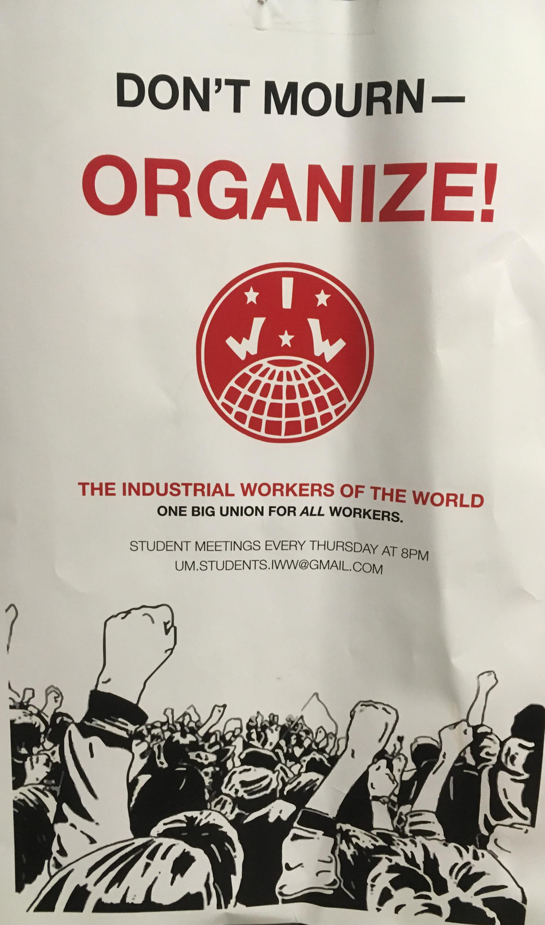
Barriers to grief and mourning
Head: “Grief and mourning are generally seen as negative emotions…Often in discussion about the challenges facing the world, people are very quick to block off negative thoughts and focus on the positive” (6).
Mortimer-Sandilands: “…at the heart of the modern age is indeed a core of grief—but that ‘core’ is more accurately conceived as a condition of melancholia, a state of suspended mourning in which the object of loss is very real but psychically ‘ungrievalbe’ within the confines of a society that cannot acknowledge nonhuman beings, natural environments, and ecological processes as appropriate objects for genuine grief” (333).
Notes:
While mourning may have transformative capabilities, and death practices may collectivize loss and open space for emotional engagement, these are not so easy for us culturally. On the left, we have a popular statement used by various protesters and activists; it suggests that mourning is at cross purposes to activism—a statement which I argue to be incorrect. On the right we have two academic analysis’ of the problems in grief and mourning. Head notes that the drive to be optimistic prevents grief and mourning, while Sandilands calls attention to the way that the environment is often not grievable, or more accurately mournable, which in turn generates melancholia—a state of perpetual and excessive grief. I would argue, however, that attempts are being made to face up to the negative emotions, and to open space for society to acknowledge its environmental losses, and in turn this has created a huge surge in activity surrounding the Anthropocene. This begins with Witness.

Slide 9
Witness → Recognizing Loss
Statistical Witness vs. Storied Witness
Van Dooren: “In the context of extinction, these kinds of stories are not an attempt to obscure the truth of the situation, but to insist on a truth that is not reducible to populations and data: a fleshier, more lively, truth that in its telling might draw us all into a greater sense of accountability” (10).
Work of Witness
Awareness of Loss (Level the Gaze)
Entanglement in a shared world → meaningful loss
Notes:
Early on I noted that witness is the first step in emotional engagement with loss, yet witness has two prominent forms. While statistics are invaluable, they often produce paralysis—perhaps referred to in Roy Scranton’s title We’re Doomed, Now What?. On the other hand [READ VAN DOOREN].
Work of witness: awareness → Entanglement → Meaningful

Slide 10
Witness → Grief (Cathexis)
Cunsolo Willox on Inuit: “[m]any people also reported experiencing a sense of anticipatory grieving for losses expected to come, but not yet arrived” (140).
Kolbert: “I try to calculate how many little plastic vials and vats of liquid nitrogen would be required to store cultures of…the multitudinous species threatened by warming and invasives and fragmentation, and soon I give up; there are too many numbers to keep in my head…Does it have to end this way? Does the last best hope for the world’s…creatures…really lie in pools of liquid nitrogen?” (261)
Notes:
Once a loss is recognized, grief is a common response. Yet this becomes complicated in the Anthropocene, as the grief may be directed towards the future, as Cunsolo Willox notes [READ WILLOX], or it may be too large to emotionally deal with [READ KOLBERT] “Anticipatory grieving” and Kolbert’s inability to conceptualize the loss reflect an unresolved release of emotional energy—or cathexis. Each party is emotionally effected by loss, but unable to process it and turn it into action—this is a passive state.

Slide 11
Grief → Death Practices and Mourning (Catharsis)
Remembrance Day for Lost Species (public ritual, embodied)
Funerary processions, Nov. 30th
US and Western Europe. 2011-
Website: “…the day provides an opportunity for participants to make or renew commitments to all who remain, and to develop creative and practical solutions”
Read: “Grieving is never going to get easier, but it can be shaped.”
The Dark Mountain Project (elegy, private ritual, artistic)
2008-
14+ collections
Uncivilized Art
Notes:
[READ RDLS] Death practices and Mourning are ways to rejuvenate and enable further action.
The Dark Mountain Project broadly speaking, is a project designed to open space for mourning, and to motivate changes to the narrative underpinnings of our culture. They publish collections of prose, poetry and visual art; and hold retreats that focus on emotional responses to the Anthropocene.
These two projects were founded on grief, and are designed to open space for mourning, and from there help create change.

Slide 12
Conclusions
Death Practices: Loss → Grief (Cathexis) → Mourning (Catharsis) → Change
Anthropocene: Loss of place, of species, of future → Grief (Anger?)→ Mourning (Death Practices) → Personal, Communal, Political Change
Klein: “…when the extractive industry’s culture of structural transience bumps up against a group of deeply rooted people with an intense love of their homeplace and a determination to protect it, the effect can be explosive” (344).
Model vs. End Goal
Euro-American vs. Indigenous and Global Responses and Practices
Standing Rock, Palestine Olive Trees, etc.
Notes:
I have argued that the model of: Loss → Grief → Mourning → Change can be applied to the Anthropocene. Here, we have various losses, which produce an emotional effect, which if mourned for can help create personal, communal, and political change.
Death practices are merely a model for mourning in the Anthropocene, they should not be the end goal. Mourning can and should take on different forms for different losses.

Slide 13
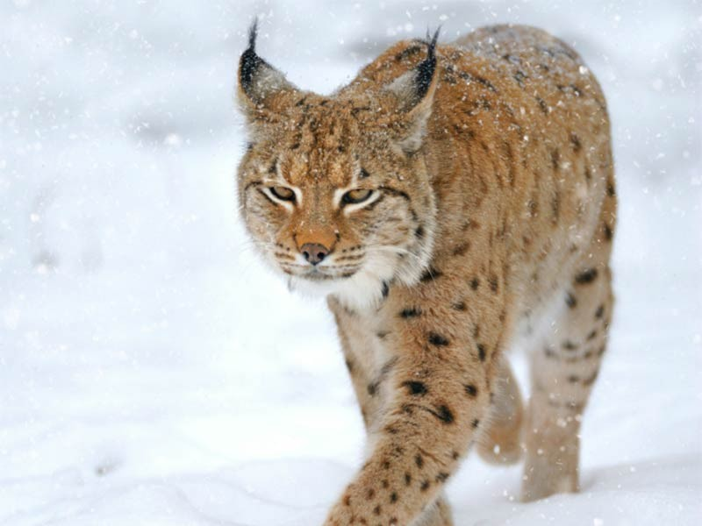
Now What?
Montana:
Climate Change effects on Agriculture, Forests, and Water (Montana Climate Assessment)
Glacier National Park
Loss of loved places
Literature: Rick Bass, Norman Maclean
Loss of outdoor culture?
Species
Grizzly Bear, Bull Trout, White Sturgeon, Ute Ladies’-tresses, Water Howellia, ect.
Missoula Festival of Remembrance?
Notes:
These are some of the losses that have and will effect residents of Montana. The festival of remembrance in November is already concerned with loss, and could be expanded to include nonhuman loss as well. THANK YOU FOR COMING AND QUESTIONS?

Slide 14
Works cited
Aries, Phillippe. Western Attitudes Toward Death: From the Middle Ages to the Present. The Johns Hopkins University Press, 1974.
Becker, Ernest. The Denial of Death. Paperback Edition, The Free Press, 1975.
Butler, Judith. "Violence, Mourning, Politics." Precarious Life. Verso, 2004, pp. 19-49.
Cunsolo Willox, Ashlee. "Climate Change as the Work of Mourning." Ethics and the Environment, vol. 17, no. 2, 2012, pp. 137-164.
Crutzen, Paul J., and Eugene Stoermer. "The 'Anthropocene'" International Geosphere-Biosphere Programme Newsletter, no. 41, 2000, pp. 17-18.
DuBose, J. T. "The Phenomenology of Bereavement, Grief, and Mourning." Journal of Religion and Health, vol. 36, no. 4, 1997, pp. 365-374.
Eng, David L., and David Kazanjian, editors. Loss: The Politics of Mourning. University of California Press, 2003.
Head, Lesley. Hope and Grief in the Anthropocene: Re-Conceptualising Human-Nature Relations. Routledge, 2016.

Slide 15
Works Cited
Klein, Naomi. This Changes Everything: Capitalism Vs the Climate. Simon & Schuster, New York, NY, 2014.
Kolbert, Elizabeth. The Sixth Extinction: An Unnatural History. Picador, 2014.
Mortimer-Sandilands, Catriona. "Melancholy Natures, Queer Ecologies." Queer Ecologies: Sex, Nature, Politics, Desire. Edited by Catriona Mortimer-Sandilands, and Bruce Erickson. Indiana University Press, 2010, pp.331-58.
Read, P. K. "A New Mourning: Remembrance Day for Lost Species." April 10, 2018, https://undark.org/article/new-mourning-species-extinction/. Accessed Dec 7, 2018.
"Remembrance Day for Lost Species." Oct. 13, 2018. https://www.lostspeciesday.org/?page_id=1116. Accessed Dec 7, 2018.
Rossner, Meredith, and Mythily Meher. "Emotions in Ritual Theories." Handbook of the Sociology of Emotions: Volume II. Edited by Jan E. Stets, and Jonathan H. Turner. Springer, 2014, pp.199-220.
Scranton, Roy. Learning to Die in the Anthropocene. City Light Books, 2015.
---. We're Doomed. Now what?: Essays on War and Climate Change. Advance Edition, Soho Press, 2018.
Uncivilisation: The Dark Mountain Manifesto. Paperback, Dark Mountain Project, 2014.
Van Dooren, Thom. Flight Ways: Life and Loss at the Edge of Extinction. Columbia University Press, 2014.

