Slide 1
199Automation
Joshua Thornton
joshua.thornton@umontana.edu
GradCon
Friday, February 22nd, 2019

Slide 4
Notes:
Roughly 233,000K automated machines:
Michigan – 12%; Ohio – 8.7%; Indiana – 8.3%; American West – 13%
Like all capital stock, automation is shaping discrete industries around the country in different ways. These differing effects are attributable to how local industry responds to increased globalization and current tax policies.

Slide 6
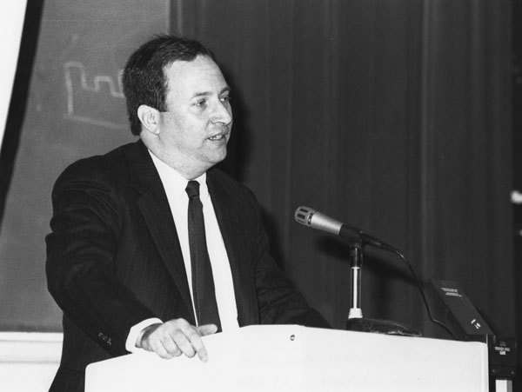
Automation Debate
Notes:
Bill Gates; Lawrence Summers; Ryan Abbott, Bret Bogenschneider
Report short-term and long-term effects of automation.

Slide 7
Automation Tax Implementation
Notes:
2017 policy that downsized past tax deduction benefits for corporate infrastructure investment originally intended to boost productivity.
The provision sets in 2019.
Depending on the size of the business, the policy allows a 3-7% tax deduction for investments in industry automation equipment.
The new policy reduces the deduction rate by 2%.

Slide 8
In America
The threat of automation taking away jobs was “not even on our radar screen…likely 50 to 100 more years away. I’m not worried at all. In fact, I’m optimistic.”
Treasury Secretary Steven Mnuchin. March 24, 2017.
https://www.businessinsider.com/trump-administration-robot-automation-2017-3
Notes:
https://hbr.org/2017/01/why-trump-doesnt-tweet-about-automation

Slide 9
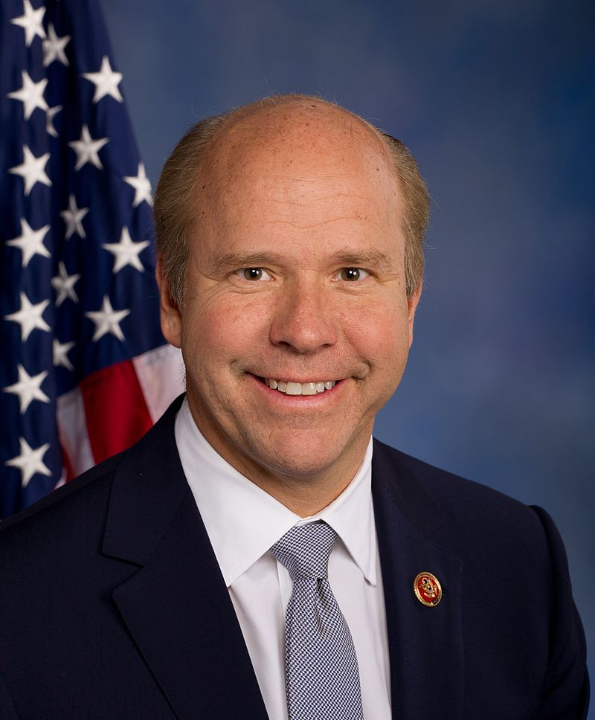
(Looking forward) In America
Notes:
Andrew Yang – NY-D
John Delany – MD-D
Kirsten Gillibrand – NY-D

Slide 10
Tax Cuts and Jobs Act of 2017 – 199A
Deduction equals the lessor of either: Combined Qualified Business Income (CQBI) or 20% of [Taxable Income (TI) – Net Capital Gains (NCG). CQBI can be read as, the lessor of either:
20% of Qualified Business Income (QBI) of a Qualified Trade or Business (QTB), or
The greater of either:
50% of W-2 wages paid (wages), or
25% of wages plus 2.5% of Qualified Property (QP).
Notes:
Put frankly, § 199A implicitly encourages hiring human labor over automated machines because if a § 199A-eligible employer favors automated machines over human labor so much so that automated machines have a value higher than employee wages, its § 199A QBI deduction will be less.

Slide 11
Neutrality
Promotes equity
Avoids economic distortion
Lower administration / compliance costs
What is the elasticity of human labor? Automated machines?
Lack of automation tax policies reduces revenue for social insurance
Distorted choices for choosing automation over human labor?
A shrinking tax base?

Slide 12
Equity
Avoid distortion
Benefits reach beneficiaries
Ability to pay (horizontal and vertical equity)
Automation increases productivity and generates wealth
Automation simultaneously creates jobs
Uneven wealth distribution
Unemployment

Slide 13
Simplicity
Taxation that is certain, non-arbitrary, and clear to all persons
Simple in understanding, administering, and complying
21% corporate tax rate cut - Simple
199A – Not Simple (but fair?)

Slide 14
Conclusion and Proposal
199A implicitly endorses human labor over automated machines.
Use 199A and/or 21% corporate tax rate revenue to promote greater equity and lessen short-term effects caused by automation.

