Slide 1
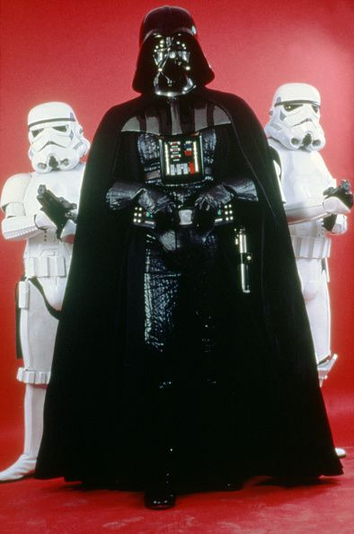
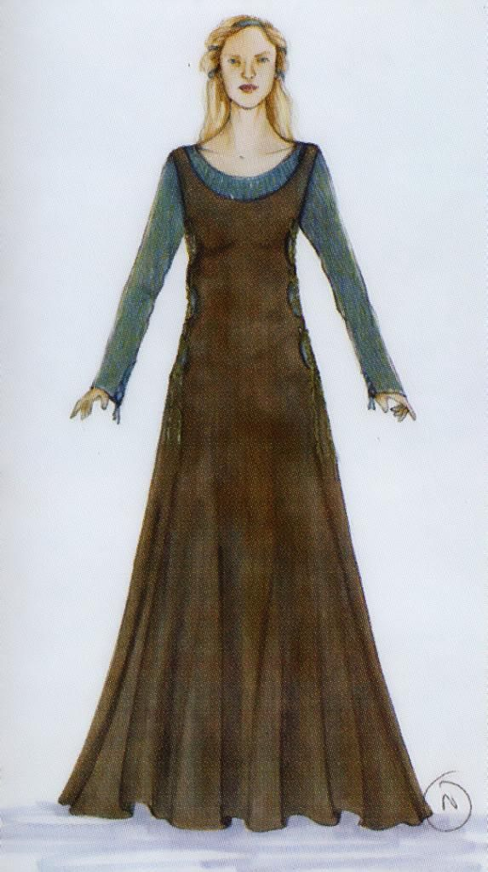
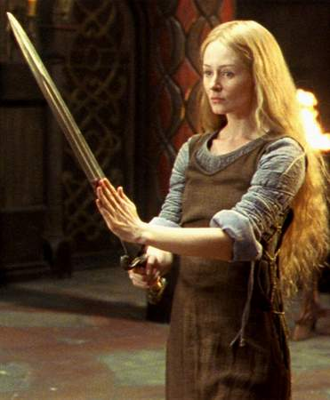
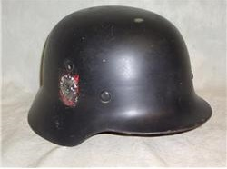
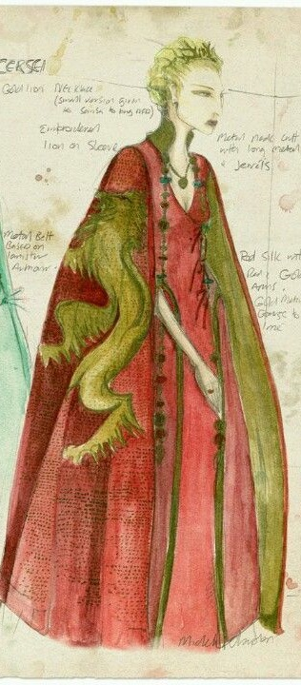
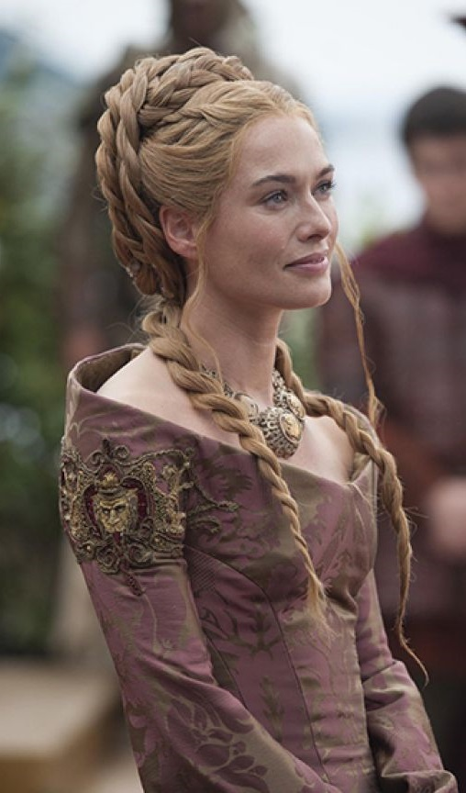
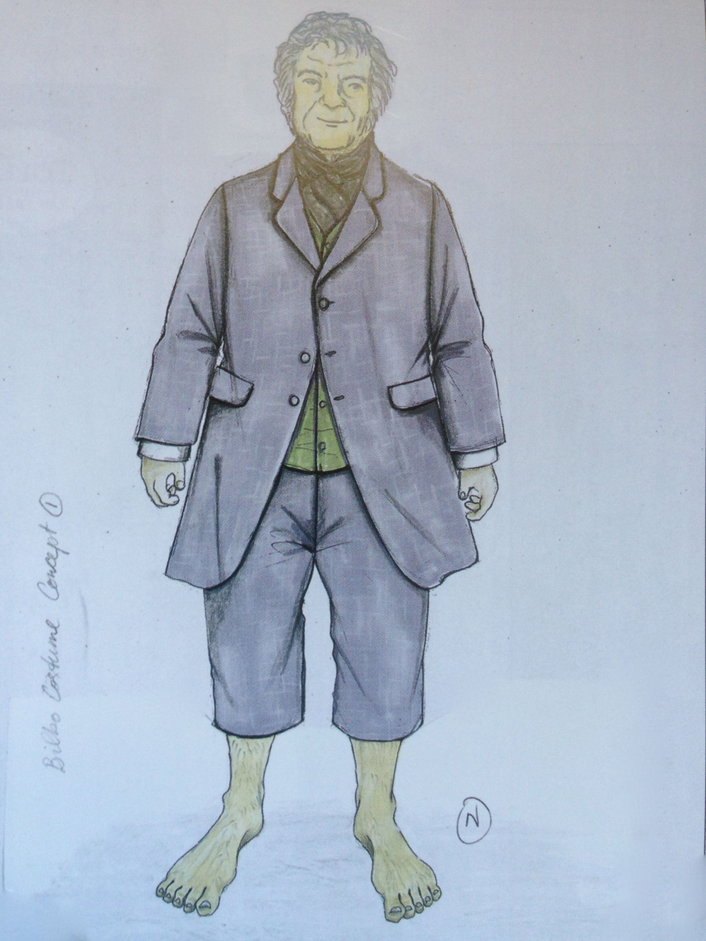
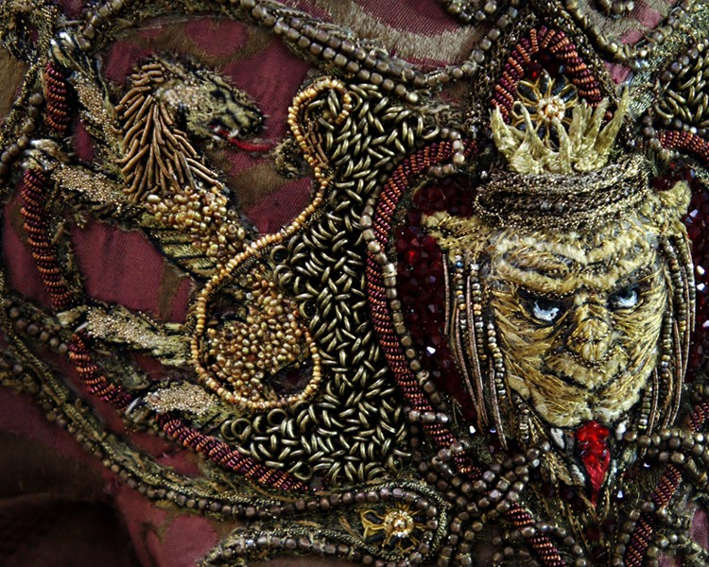
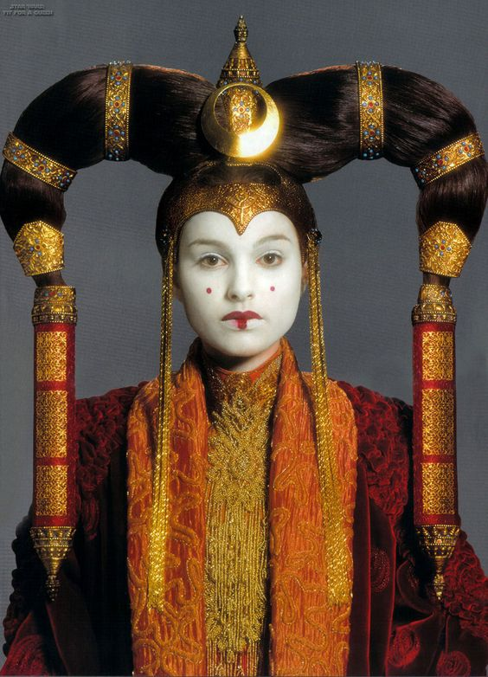
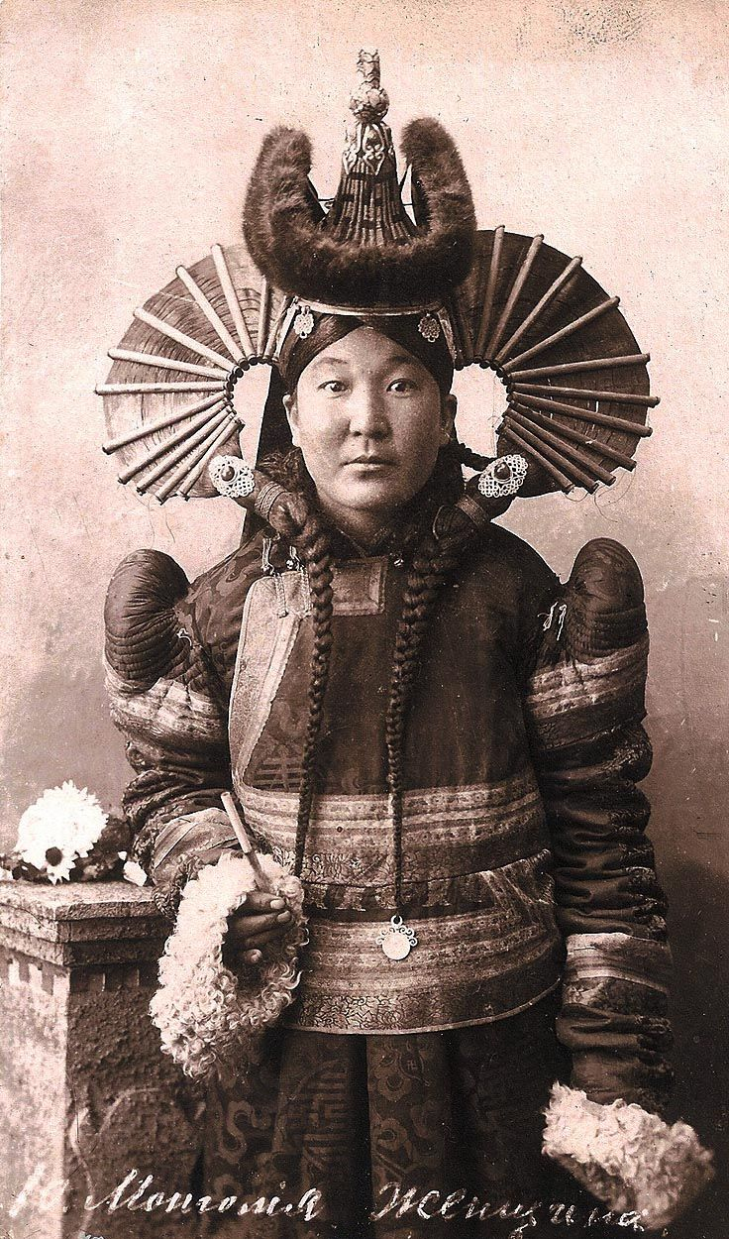
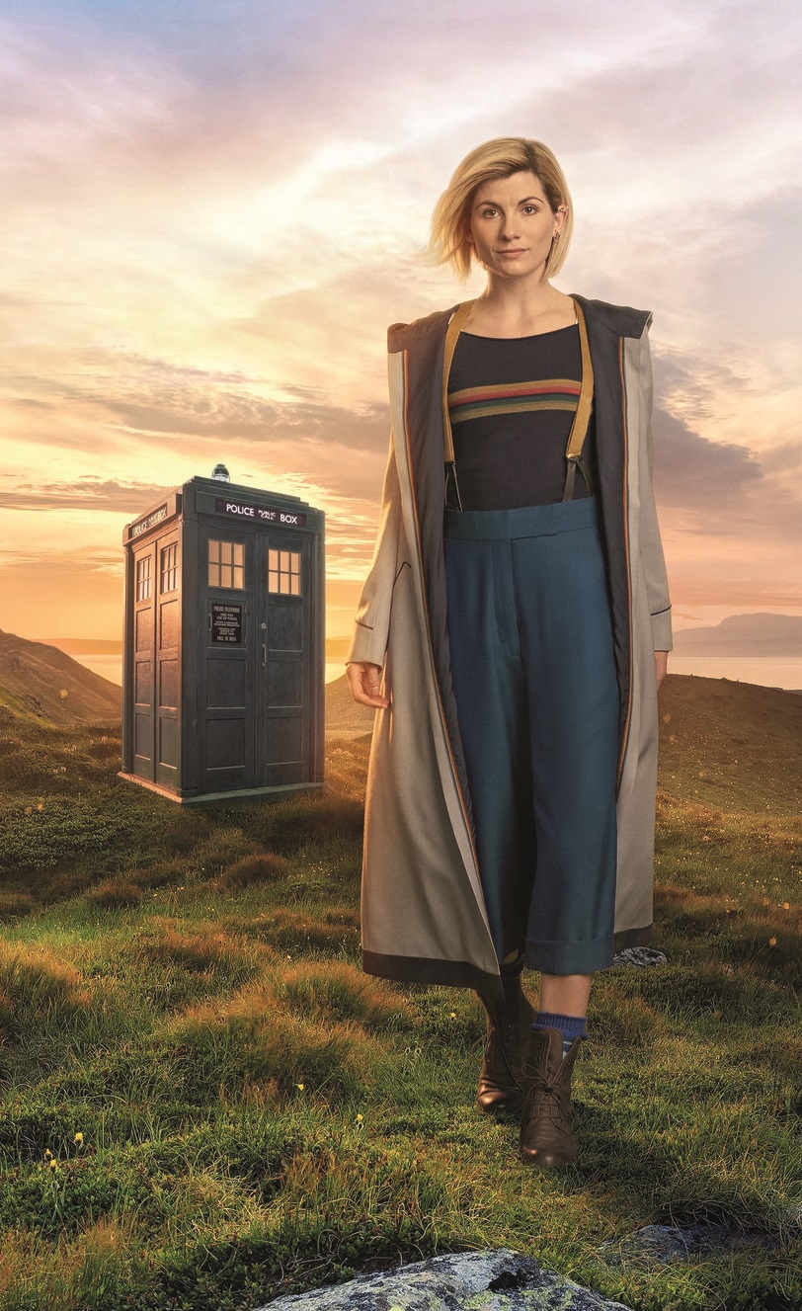
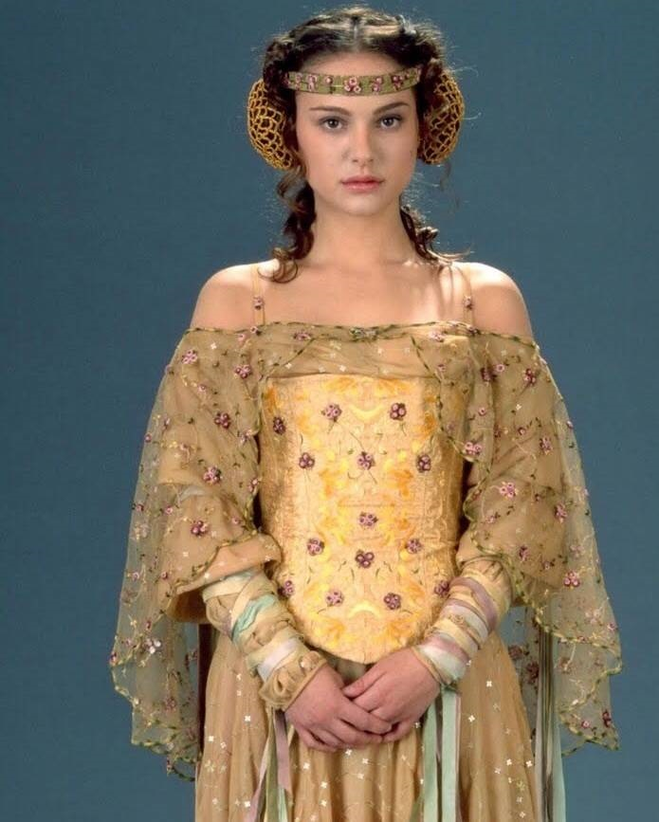
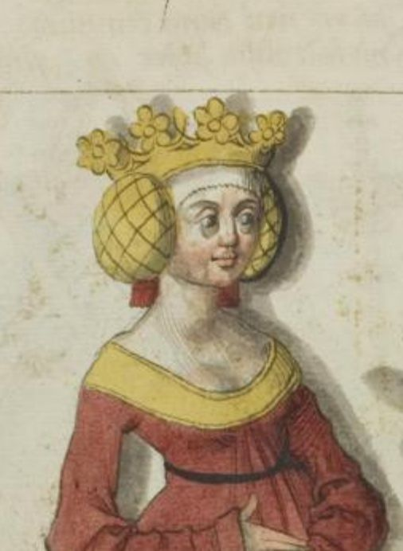
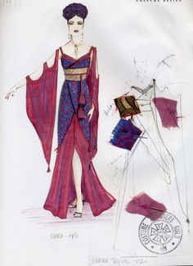
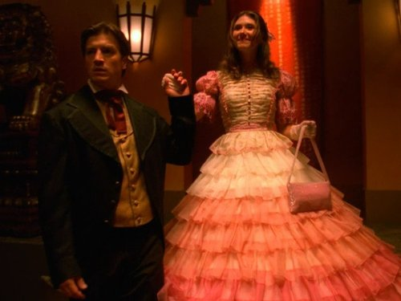
Historic Costume in Science Fiction and Fantasy Film Jennifer Jones MFA Candidate, Costume Design and Technology
John Mollo- Star Wars: A New Hope (1977)
Ngila Dickson: The Lord of the Rings (2001-2003)
John Mollo was brought in to costume A New Hope at the last minute. He appealed to George Lucas due to his background in Military History. The use of a Nazi-styled regalia helped actualize the idea of the Empire as a force of oppression and control.
“For Darth Vader, we put on a black motorcycle suit, a Nazi helmet, a gas mask, and a monk’s cloak we found in the Middle Ages department. We did very little drawing; it was more of a practical make-do amend, because there was already an established style.”
John Mollo
Why we use historic costume in Fantasy and Science Fiction
Use of costumes to create a narrative for the audience to understand the characters
The idea of history as having a cyclic nature or to create a sense of nostalgia
To connect the viewer to a story through things the audience already understands and is familiar with
Lend reality to the hypothetical worlds created by Science Fiction and Fantasy
The Lord of the Rings series is another excellent example of the fantasy genre drawing from medieval historic clothing. The costume shown here is based off of an 11th century sideless surcote with a kirtle beneath. Ngila Dickson was keen on geographical differences.
Screenshot from The Lord Of the Rings: The Two Towers. Directed by Peter Jackson, Costume Designer Ngila Dickson. New Line Cinema. 2002.
Michele Clapton: Game of Thrones (2011-2019)
The majority of costume pieces set in Rohan were based off of 10th and 11th century Norman clothing. The clothing of Gondor is closer to 14th and 15th century French costume; the hobbits in the shire off of 17th and 18th century English folk costume. The costumes most far set from extant costume was that of the elves, which incorporated Japanese elements as well as those from medieval Europe.
Nazi M-40 Helmet. Often, these helmets had longer backs.
Star Wars: A New Hope. Dir George Lucas. Costume Designer John Mollo. Lucasfilm Ltd. 1977. Uncredited Photo.
Heraldry, or use of sigils and colors to denote family or political ties, made a frequent appearance in Game of Thrones. For example, the use of the red three-headed dragon on a black background for the Targaryen family, or the gold Lion on red for the Lannisters.
Eowyn’s traveling gown, original rendering. The Lord Of the Rings: The Two Towers. Directed by Peter Jackson, Costume Designer Ngila Dickson. New Line Cinema. 2002.
Trisha Biggar- Star Wars: The Phantom Menace (1999), Star Wars: Attack of the Clones and Star Wars: Revenge of the Sith
“We do all these sort of secret symbols, color hints about the ways the court is being influenced, They are just little things that people may not notice unless they really look.“ Michele Clapton says to a reporter for Hollywood Reporter,
Ngila Dickson says :"I added a lot of quirks, things to jar the eye. Their trouser legs and sleeves are too short, their buttons are too big, and their collars are out of proportion. I even made their pockets higher than usual for example, so when they put their hands in their pockets it has a very distinctive, funny look to us.“
Over the course of the three Star Wars movies Trisha Biggar designed, one thing was clear: Queen Amidala’s ensembles were highly influenced by traditional Asian costume. Originally, there were 68 or more designs planned for Queen Amidala, costing in excess of $60,000 in materials and labor.
Cersei Lannister: original rendering. “Dragonstone”. Game of Thrones. Creator George R.R. Martin. HBO. 2015
To the right is a picture of a traditional Mongolian headdress called an Ugalz compared side by side with Queen Amidala’s Headdress in Star Wars Episode I: A Phantom Menace. It’s easy to see how Trisha Biggar used Asian influences in her designs.
Cersei Lannister and her gown with Lion embroidery. “Dragonstone”. Game of Thrones. Creator George R.R. Martin. Costume Designer HBO. 2015
Screenshot from The Lord Of the Rings: The Two Towers. Directed by Peter Jackson, Costume Designer Ngila Dickson. New Line Cinema. 2002.
Shawna Trpcic: Firefly (2002)
Louise Page: Dr Who (2018)
Firefly is one of the few shows to bridge the genres of science fiction and western. The show draws heavily on images, which evoke the aftermath of the Civil war and Western expansion in the U.S.
To add a stark contrast the conservative appearance of western aesthetic, Designer Shawna Trpcic used strong East Asian influences on some characters.
Recently, the long-running television series Dr. Who welcomed a new doctor to their ranks in actress Jodie Whitaker. She is the first female doctor in a series of thirteen, and Designer Louise Page leaned heavily on references to 1970’s fashion to connect her to some of the original Doctors.
We see references to the 1970’s with the rainbow on her shirt and the suspenders. Some argue that the rainbow is a reference to previous doctors, including the fourth doctor (Tom Baker)
Queen Amidala, portrayed by Natalie Portman in Star Wars: The Phantom Menace. Directed by George Lucas. Designer Trisha Biggar, Lucasfilm Ltd. 1999
Picture of a Mongolian Woman wearing a traditional Ugalz, Circa 1925
One of the most famous costumes that appeared in Firefly was a frilly pink dress worn by Kaylee (Jewel Staite). The aesthetic of the dress is a strong echo of 1860’s Ballgowns.
Costume Designer Shawna Trpcic says, “The material for the layer cake dress was antique sari material that was dyed the various pink tones that made up the dress layers. “
The inspiration for Queen Amidala’s dresses didn’t stop with traditional Asian culture. A number of European History-inspired designs made their way into later Star Wars Films that Trisha Biggar designed.
" The Woman Who Fell to Earth”. Dr. Who. Directed by Jaime Childs. Costume Designer Louise Page. 2018
Acknowledgements and Works Cited A special thank you to Alessia Carpoca and Dr. Daniel Lawver. “From Hobbits to Elves: The Costumes and Makeup f Lord of the Rings”. Fall 2001. http://www.houghtonmifflinbooks.com/features/lordoftheringstrilogy/movie/part_three.shtml Minutaglio, Rose. “These Original Hand-Drawn Star Wars Costume Sketches Could be Worth $300,000”. Sept 23, 2018. Accessed Feb 1, 2019. https://www.esquire.com/entertainment/movies/a23101456/star-wars-john-mollo-costume-sketches-auction/ Renfro, Kim. “Inside the Battle Ready Looks of ‘Game of Thrones’ Queens”. June 28, 2017. Accessed Feb 2, 2019. https://www.thisisinsider.com/game-of-thrones-costume-designer-michele-clapton-interview-2017-6 Robinson, Joanna. “How Dr. Who’s New Costume Cleverly Leans on History.” Vanity Fair. Nov, 9, 2017. Accessed Feb 12, 2019. https://www.vanityfair.com/hollywood/2017/11/doctor-who-costume-jodie-whittaker-references-13th-doctor Snead, Elizabeth. 'Game of Thrones': Costume Designer Michele Clapton Reveals Subtle Season 3 Color Clues (Video) https://www.hollywoodreporter.com/news/game-thrones-season-3-costume-designer-michele-clapton-reveals-subtle-color-clues-video-431029 Zalban, Alex. “Interview: Shawna Trpcic Helps Torchwood, Firefly and Dr. Horrible Fans Get Dressed”. July 1, 2011. Accessed Feb 10, 2019. http://www.mtv.com/news/2622100/interview-shawna-trpcic-helps-torchwood-firefly-and-dr-horrible-get-dressed/
Queen Amidala, portrayed by Natalie Portman Star Wars: Attack of the Clones. Dir George Lucas. Costume Designer Trisha Biggar. Lucasfilm Ltd. 2002
Section of 14th century manuscript from England Showing Crispinettes, or hair encasings
The use of these historical connections by both designers help the audience to piece together stories about a fictional universe through histories that are already known.
Inara Serra Original Costume Rendering. “Jaynestown”/ Firefly. Dir. Joss Whedon. Costume Designer Shawna Trpcic. Fox Network. 2002.
Kaylee’s Pink Dress. “Shindig”. Firefly. Dir. Joss Whedon. Costume Designer Shawna Trpcic. Fox Network. 2002

