Slide 1
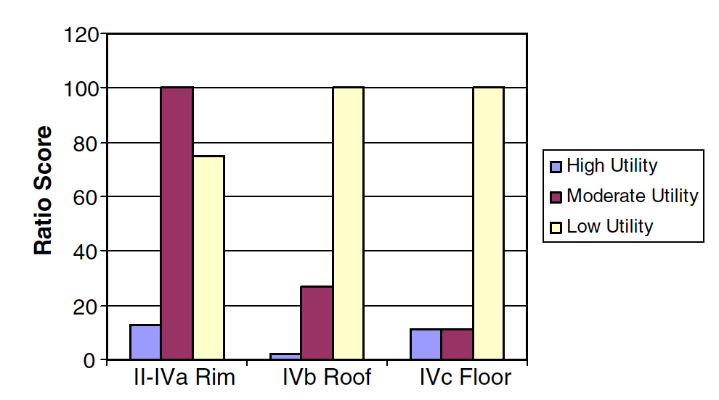
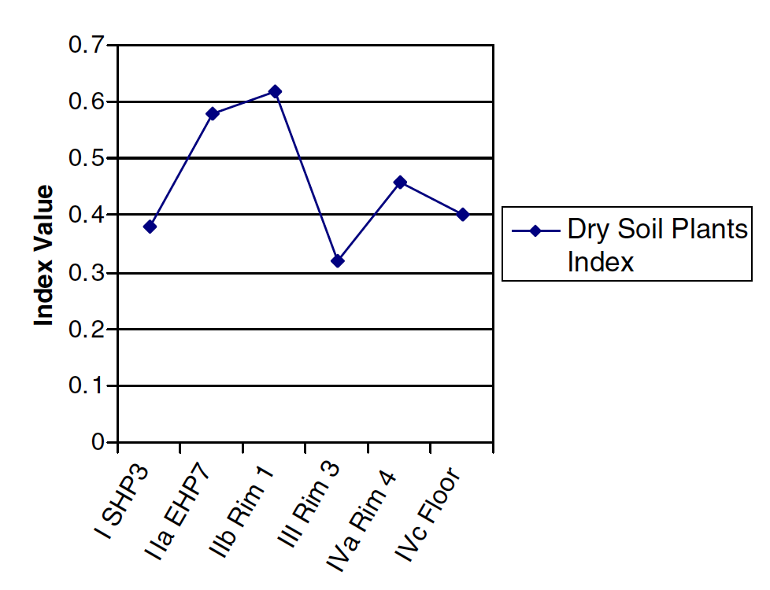
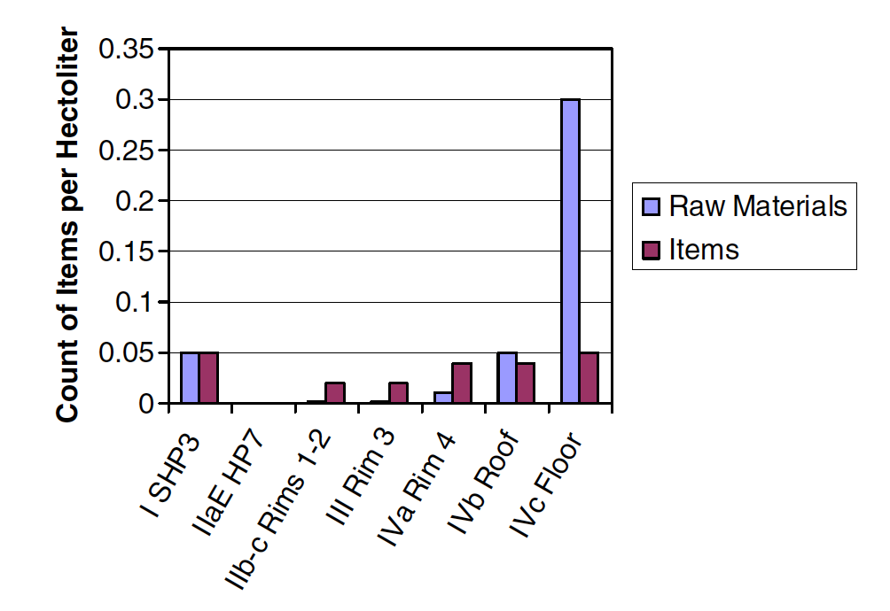
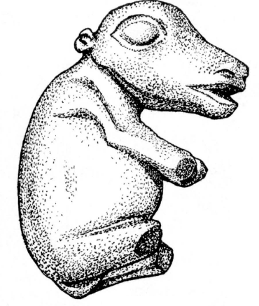
Inter-site Evidence of Social Inequality in the Middle Fraser Canyon, British Columbia
by Rebekah Engelland
INTRODUCTION
The archaeological record of the Middle Fraser Canyon provides abundant evidence of social inequality. While inequality in this region is typically identified on an intra-site basis, it has rarely been examined using inter-site data. By pulling together evidence from three different sites, it is possible to see a pattern of households with differential access to resources including food and prestige items.
Located in south-central British Columbia, the Middle Fraser Canyon is home to a wide variety of environments. The sites being considered here were pithouse villages. A pithouse is a semi-subterranean structure where a pit is dug and then a roof constructed over it and used during the winter. These large pithouse villages were occupied between 1900 and 800 years ago by complex hunter-gatherers who relied heavily on salmon for subsistence. Around 1200 years ago, the population peaked at over 8000 people in the area before a drop in salmon caused the population to decline and the people to abandon the villages. I consider archaeological evidence from the Bell, Bridge River, and Keatley Creek sites.
THE BRIDGE RIVER SITE
THE KEATLEY CREEK SITE
80 housepits
Occupied from 1900-1000 BP, then reoccupied from 500-100 BP.
Between BR 2 and BR 3 the frequency of salmon remains decline while deer remains increase.​
Material wealth-based inequality appeared ca. 1200 BP (Prentiss et al. 2012).
Prentiss and colleagues (2014) compare two houses from BR 2 and 3.
During BR 2, the variation in relative numbers of salmon and deer remains in HP 11 and 20 can be explained by the relative numbers of occupants (Figure 3a; Prentiss et al. 2014).
During BR 3, “Housepit 24 has substantially more deer and slightly more salmon remains than Housepit 16,” even though Housepit 16 has a slightly higher occupation density (Figure 3b; Prentiss et al. 2014).
The differences in prestige items and raw materials between HP 11 and 20 can be explained by the size of the households (Figure 3c).
During BR 3, however, HP 24 clearly has better access to prestige items and raw materials (Figure 3d).
115 housepits
Occupied from 1700-800 BP.
In later times at Housepit 7, mainly lower limbs of deer were brought back to the village and most processing took place in field camps (Figure 4a; Prentiss et al. 2007).
By Rim 3 (ca. 1350-1250 cal. B.P.) there was an increase in the frequency of moist-soil plants, such as blue huckleberries and heather, which are found at higher elevations and greater distances from the village (Figure 4b; Prentiss et al. 2007).
“The steady rise in numbers of artifacts through time indicates the possibility that prestige items played their maximum socio-cultural role during the last two occupations of Housepit 7” (Prentiss et al. 2007; Figure 4c).
Figure 1. Major sites in the Mid-Fraser Canyon (Prentiss and Kuijt 2012:87)
THE BELL SITE
23 housepits
Occupied 1700-800 BP.
Infant burial, age 1.5 years
Grave goods: an antler figurine haft, a carved steatite pendant along with five uncarved pendants, fragments of a pipe bowl, a quartz crystal, an incised antler comb (Figure 2c), 246 Dentalium shells, a siltstone bear figurine (Figure 2b), a split agate pebble, a small fragment of antler, and 24 basalt flakes (Stryd 1973:426).
“Both the location of the burial inside the pithouse and the richness of the grave inclusions suggest that this was very unusual and special mortuary treatment” (Schulting 1995.
The stark contrast in burial treatments between the Bell site, the Fountain site, and the greater region represents different socio-economic or socio-ideological groups (Lull 2000).
We can infer that the individual was of the highest socio-economic class.
Figure 4a. Percentage variation in representation of organized by utility class from the HP 7 rim and final roof and floor (Prentiss et al. 2007:317)
Figure 3a. Indicators of consistency in subsistence and demography between houses during BR 2 times (Prentiss et al. 2014:42)
Figure 3b. Indicators of variability in subsistence and relative demographic consistency between houses during BR 3 times (Prentiss et al. 2014:43)
Figure 4b. Plot of the dry-soils plant index across HP 7 strata (Prentiss et al. 2007:318)
Figure 2a. Photo of the grave inclusions in the Bell burial (Stryd 1973:278)
Figure 2c. Zoomorphic antler comb (Stryd 1973:254)
Figure 3c. Prestige items and raw material levels between houses during BR 2 times (data from Prentiss et al. 2012:15)
Figure 3d. Prestige items and raw material levels between houses during BR 3 times (data from Prentiss et al. 2012:15).
Figure 4c. Frequencies of prestige raw materials and objects from HP 7 rim and final roof and floor deposits (Prentiss et al. 2007:308)
Figure 2b. Siltstone bear figurine (Stryd 1973:258)
Conclusion
References Cited
Hayden, Brian
1995 Pathways to Power. In Foundations of Social Inequality, edited by T. Douglas Price and Gary M. Feinman, pp. 15–86. Plenum Press, New York.
Lull, Vicente
2000 Death and Society: A Marxist Approach. Antiquity 74(285):576–580. DOI:10.1017/S0003598X00059937.
Mattison, Siobhán M., Eric A. Smith, Mary K. Shenk, and Ethan E. Cochrane
2016 The Evolution of Inequality. Evolutionary Anthropology 25(4):184–199. DOI:10.1002/evan.21491.
Prentiss, Anna M., and Ian Kuijt
2012 People of the Middle Fraser Canyon: An Archaeological History. UBC Press, Vancouver.
Prentiss, Anna Marie, Natasha Lyons, Lucille E. Harris, Melisse R.P. Burns, and Terrence M. Godin
2007 The Emergence of Status Inequality in Intermediate Scale societies: A Demographic and Socio-economic History of the Keatley Creek Site, British Columbia. Journal of Anthropological Archaeology 26(2):299–327. DOI:10.1016/j.jaa.2006.11.006.
Prentiss, Anna Marie, Thomas A Foor, Guy Cross, and Lucille E Harris
2012 The Cultural Evolution of Material Wealth-based Inequality at Bridge River, British Columbia. American Antiquity 77(3):542–564.
Prentiss, Anna Marie, Hannah S. Cail, and Lisa M. Smith
2014 At the Malthusian Ceiling: Subsistence and Inequality at Bridge River, British Columbia. Journal of Anthropological Archaeology 33(1):34–48. DOI:10.1016/j.jaa.2013.11.003.
Prentiss, Anna Marie, Thomas A. Foor, Ashley Hampton, Ethan Ryan, and Matthew J. Walsh
2018 The Evolution of Material Wealth-based Inequality: The Record of Housepit 54, Bridge River, British Columbia. American Antiquity 83(4):598– 618. DOI:10.1017/aaq.2018.56.
Schulting, Rick J.
1995 Mortuary Variability and Status Differentiation on the Columbia-Fraser Plateau. Simon Fraser University, Burnaby.
Stryd, Arnoud H.
1973 The Later Prehistory of the Lillooet Area, British Columbia. University of Calgary.
For social inequality to get a foothold, there are different theories. Brian Hayden (1995) proposes the aggrandizer/accumulator idea, where certain ambitious individuals take advantage of surplus resources to further their own designs. However, the fact that inequality is present in all three villages and appears simultaneously at both Keatley Creek and Bridge River makes this an unlikely explanation. A more plausible catalyst for social inequality in the Mid-Fraser is the strain on resources which caused people to adopt different strategies for survival. Around 1200 BP, people in the area faced reduced access to critical resources. Subsequently, cooperation in labor declined, and social inequality appeared.
By drawing data from multiple sites, most specifically large pithouse villages, this study provides insights into social behavior not always recognized in single site studies. Because social inequality is unusual among hunter-gatherers, researching how it gets a foothold can tell us much about the nature of social inequality. The study also provides insight into the cultural history of the indigenous people of the Middle Fraser Canyon.

