Slide 1
How has Marketing been applied to conservation?
A Systematic Mapping of Marketing and Conservation Usage and Opportunities
Hannah Leonard
Master of Resource Conservation
University of Montana

Slide 2
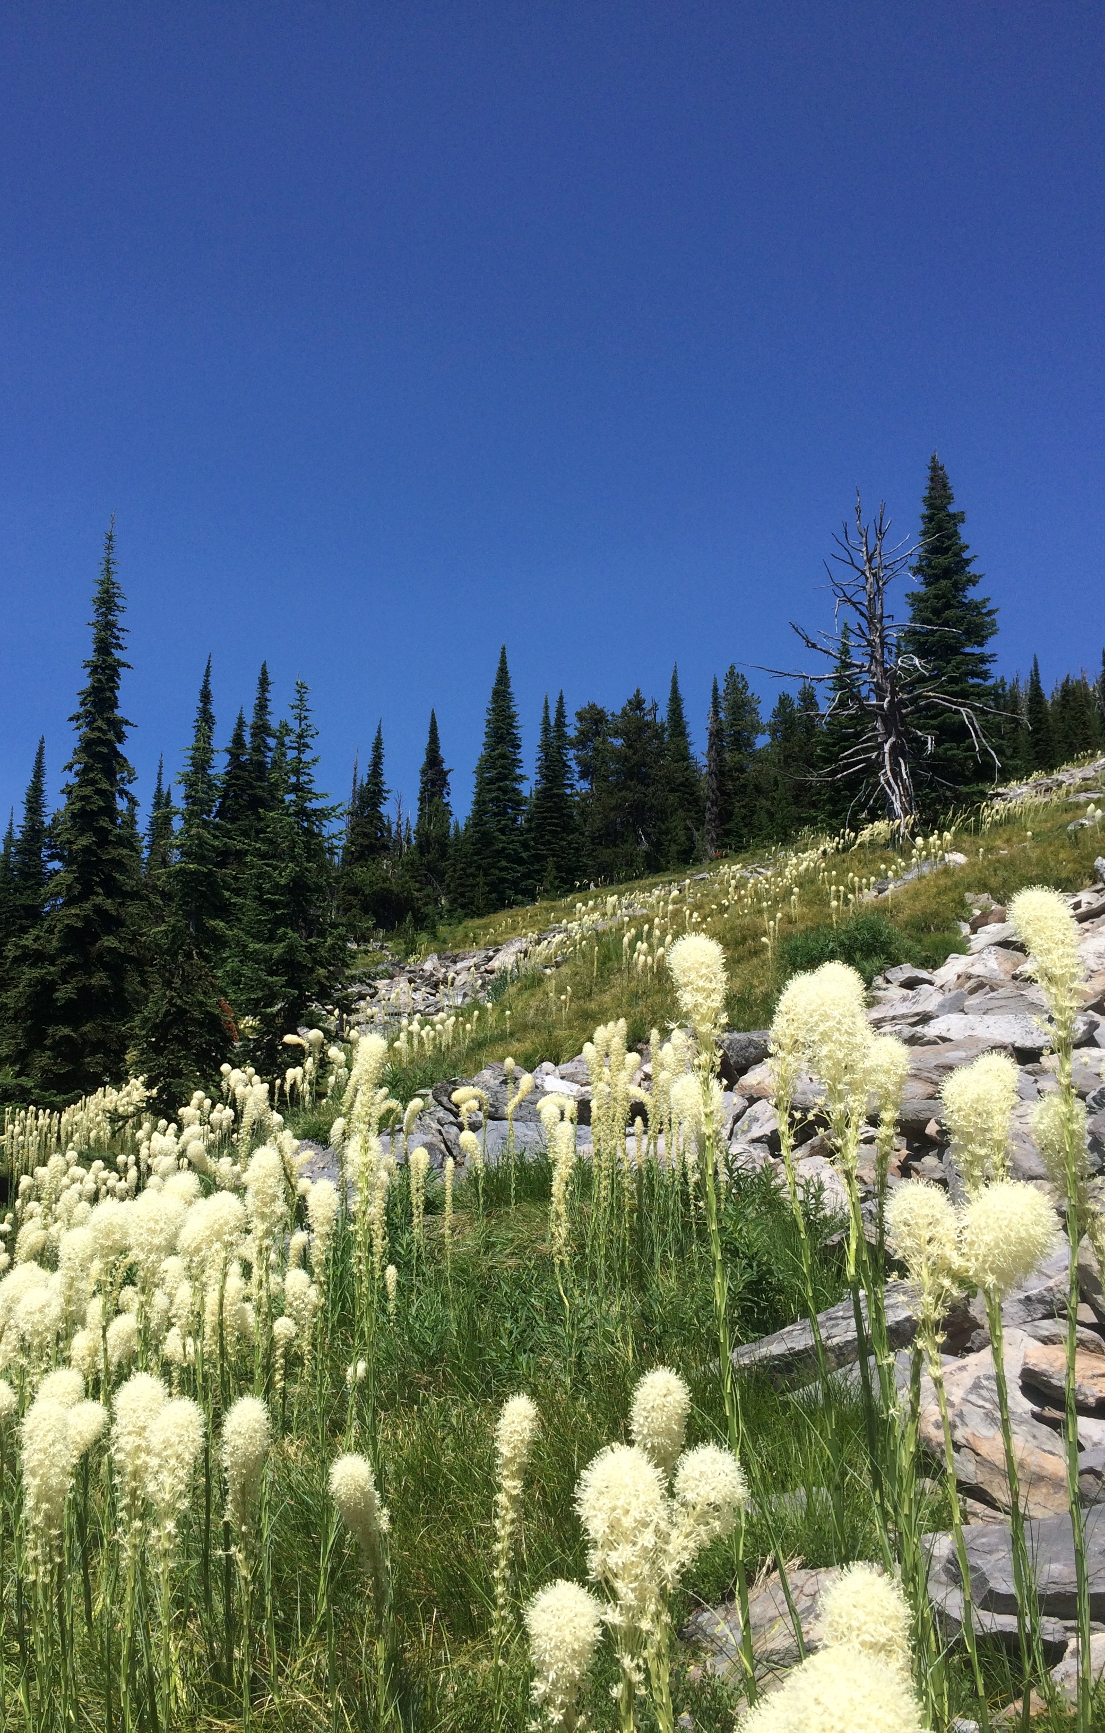
Agenda
Brief Background
What is marketing?
Where has marketing been used in conservation?
Methods
Preliminary Results
What does this mean for conservation?
What’s next?

Slide 3
What is marketing?
The American Marketing Association (AMA) defines marketing as:
“the activity, set of institutions, and processes for creating, communicating, delivering, and exchanging offerings that have value for customers, clients, partners, and society at large.”

Slide 4
What is conservation marketing?
Society for Conservation Biology Conservation Marketing and Engagement Working Group (Cons-Mark) defines conservation marketing as:
“the ethical application of marketing strategies, concepts and techniques to influence attitudes, perceptions and behaviors of individuals, and ultimately societies, with the objective of advancing conservation goals”

Slide 5
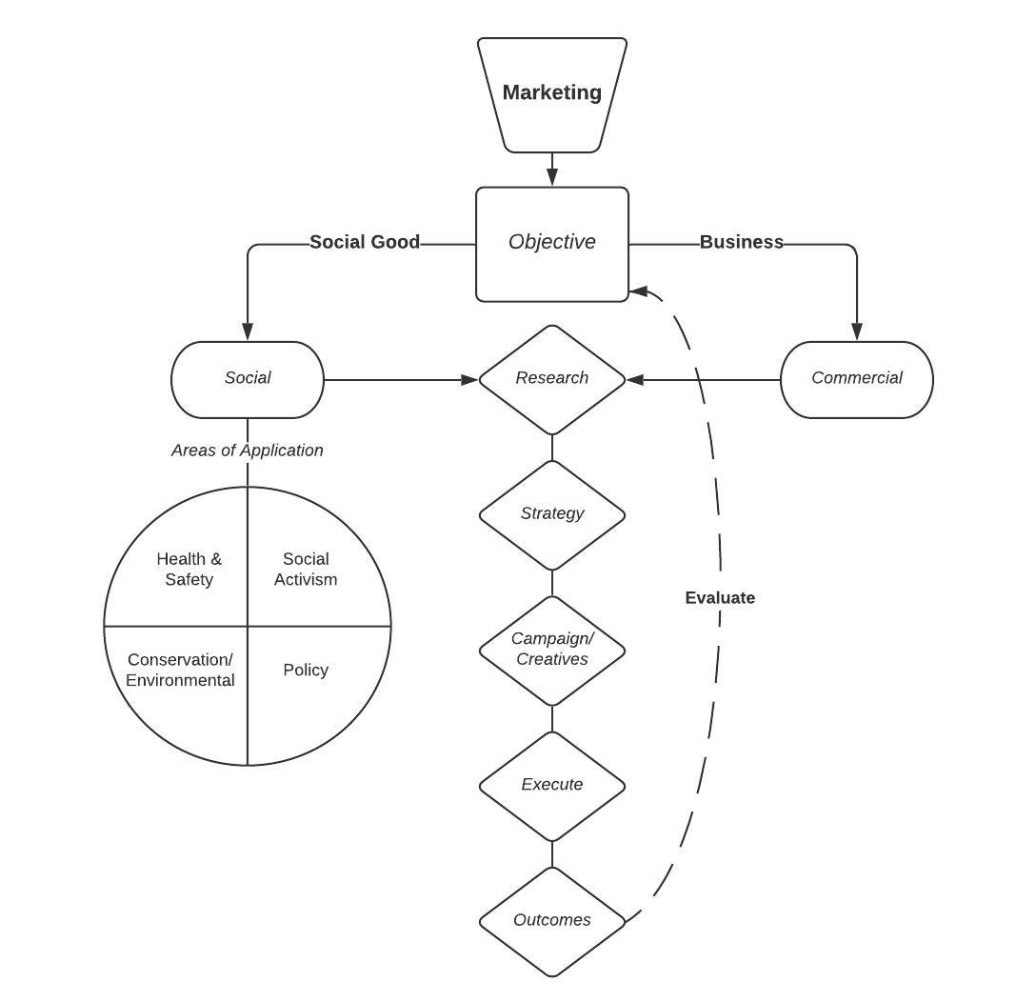
Marketing Process Flowchart

Slide 6
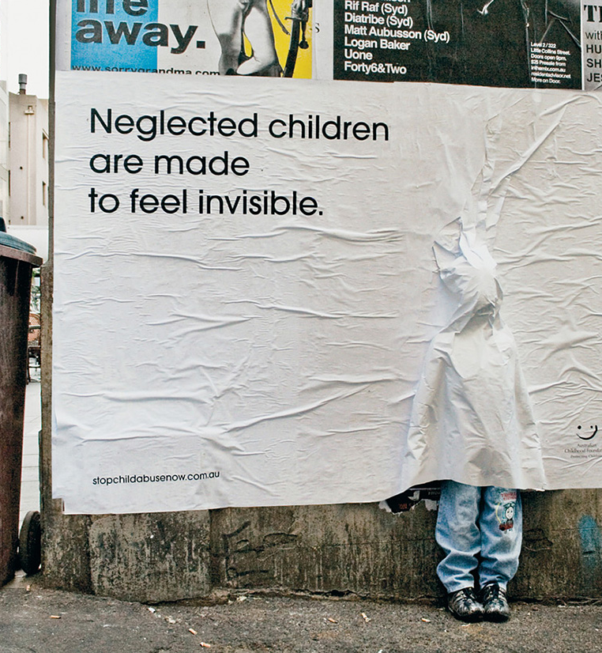
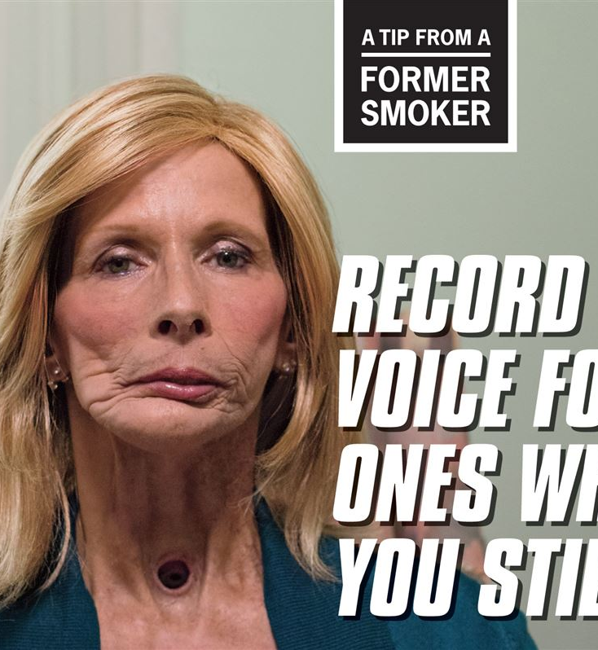
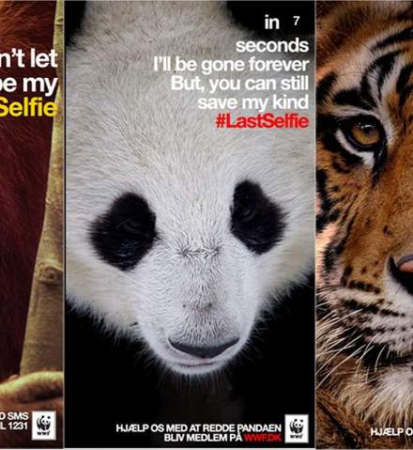

Slide 7
Where has marketing been used in conservation?
Where are the opportunities for marketing techniques in conservation?

Slide 8
Method: Systematic mapping
Systematic review and systematic mapping aim to make evidence synthesis as transparent, objective, and comprehensive as possible
Systematic review is “a form of secondary study that uses a well-defined methodology to identify, analyze, and interpret all available evidence related to a specific research question in a way that is unbiased, and (to a degree) repeatable.”
Systematic mapping is “a broad review of primary studies in a specific topic area that aims to identify what evidence is available on the topic.”
Petersen, K., Vakkalanka, S., & Kuzniarz, L. (2015). Guidelines for conducting systematic mapping studies in software engineering: An update. Information and Software Technology, 64, 1–18. https://doi.org/10.1016/j.infsof.2015.03.007

Slide 9
CONSERVATION MARKETING SYSTEMATIC MAPPING PROCESS

Slide 10
Coarse Title Review
Mechanisms of Communication and Cognition in Chickadees: Explaining Nature in the Lab and Field
OUT – the nature of communication between wildlife.
ConsMark Title Review
Can evoking nature in advertising mislead consumers? The power of ‘greenwashing’
OUT – advertisers using nature, not conservationists using advertising.
ConsMark Abstract Review
Marketing the 'rain forest': Raw Vanilla fragrance and the ongoing transformation of the jungle
OUT – perceived differences between rain forests and jungles in attempts to sell particular 'rainforest’ products.

Slide 11
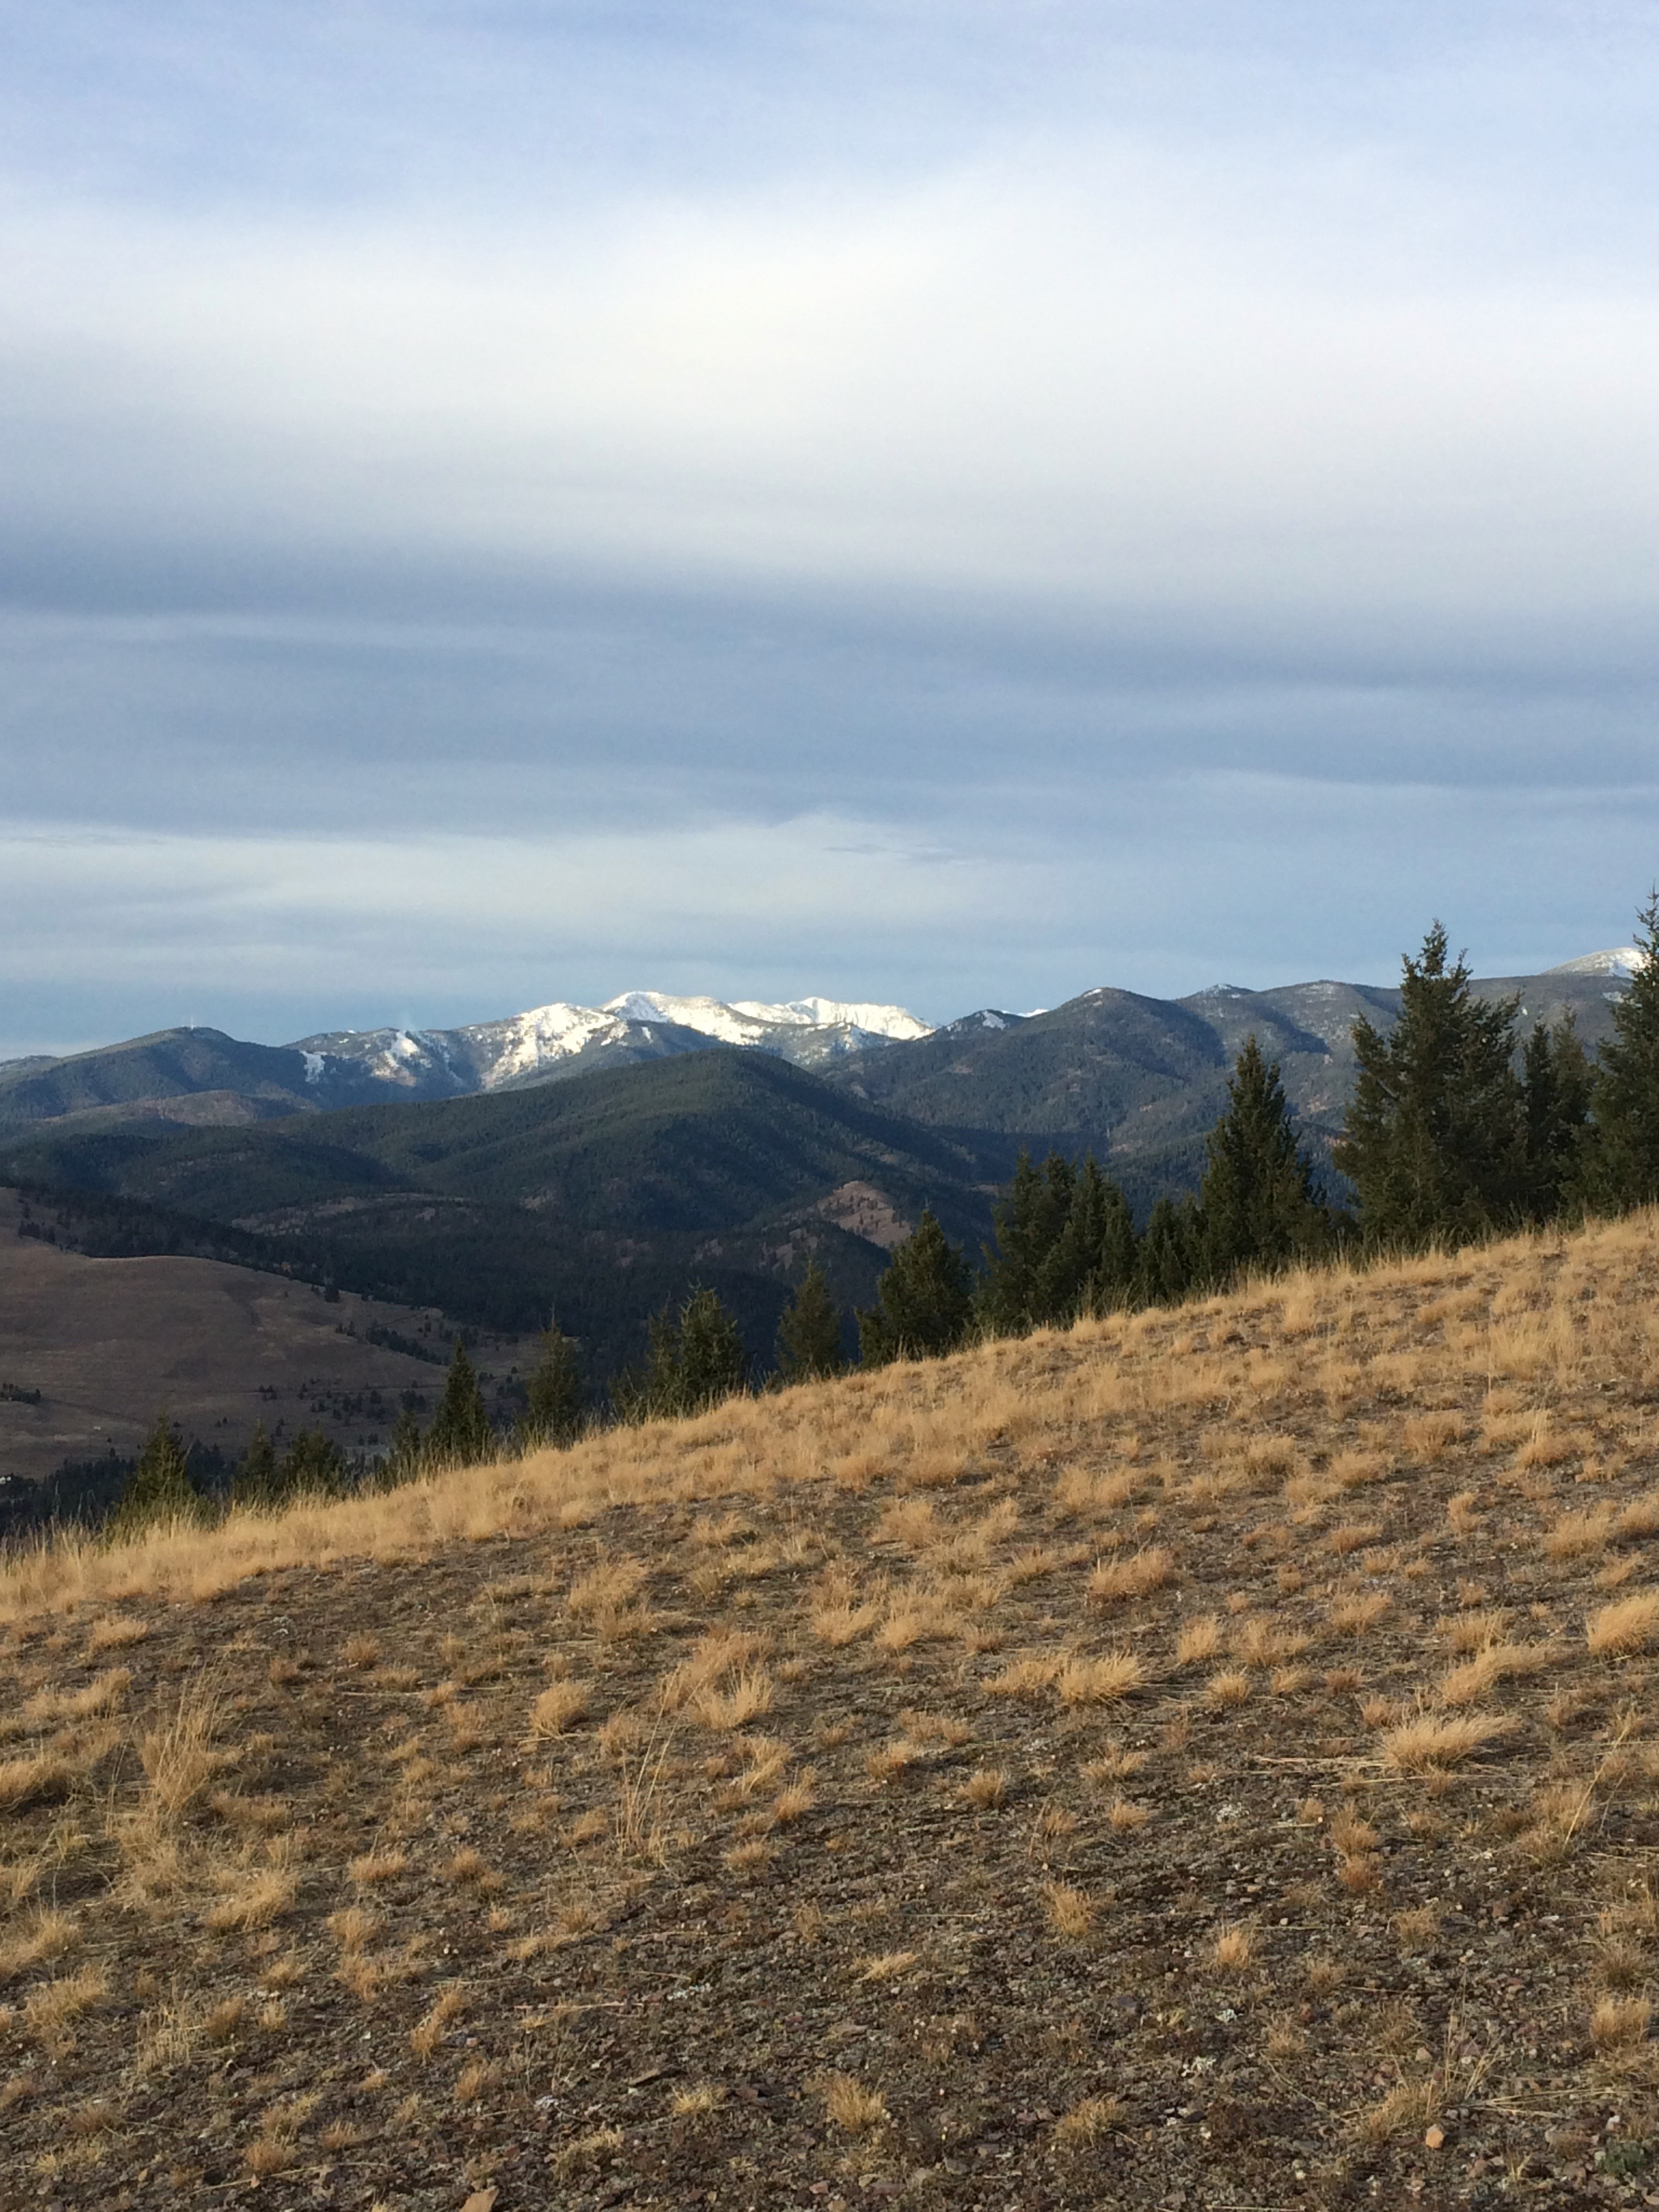
Increased conservation marketing effort has major fundraising benefits for even the least popular species
Ecotourism marketing alternative to charismatic megafauna can also support biodiversity conservation
A Meta-Analysis of Social Marketing Campaigns to Improve Global Conservation Outcomes

Slide 12
Preliminary Results

Slide 13
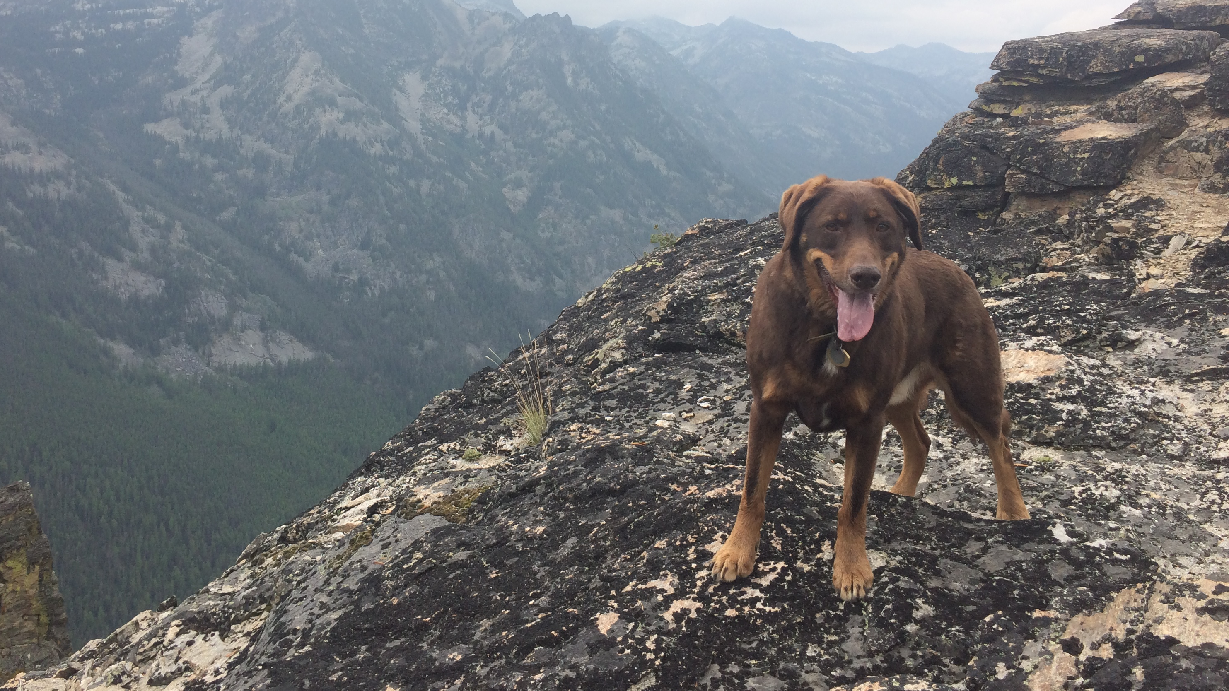
So, What does this mean for conservation?

Slide 14
What’s Next?
Continue analyzing articles
Complete final categorizations
Apply findings to case study: Conservation Easements
Discuss implications of this type of analysis

Slide 15
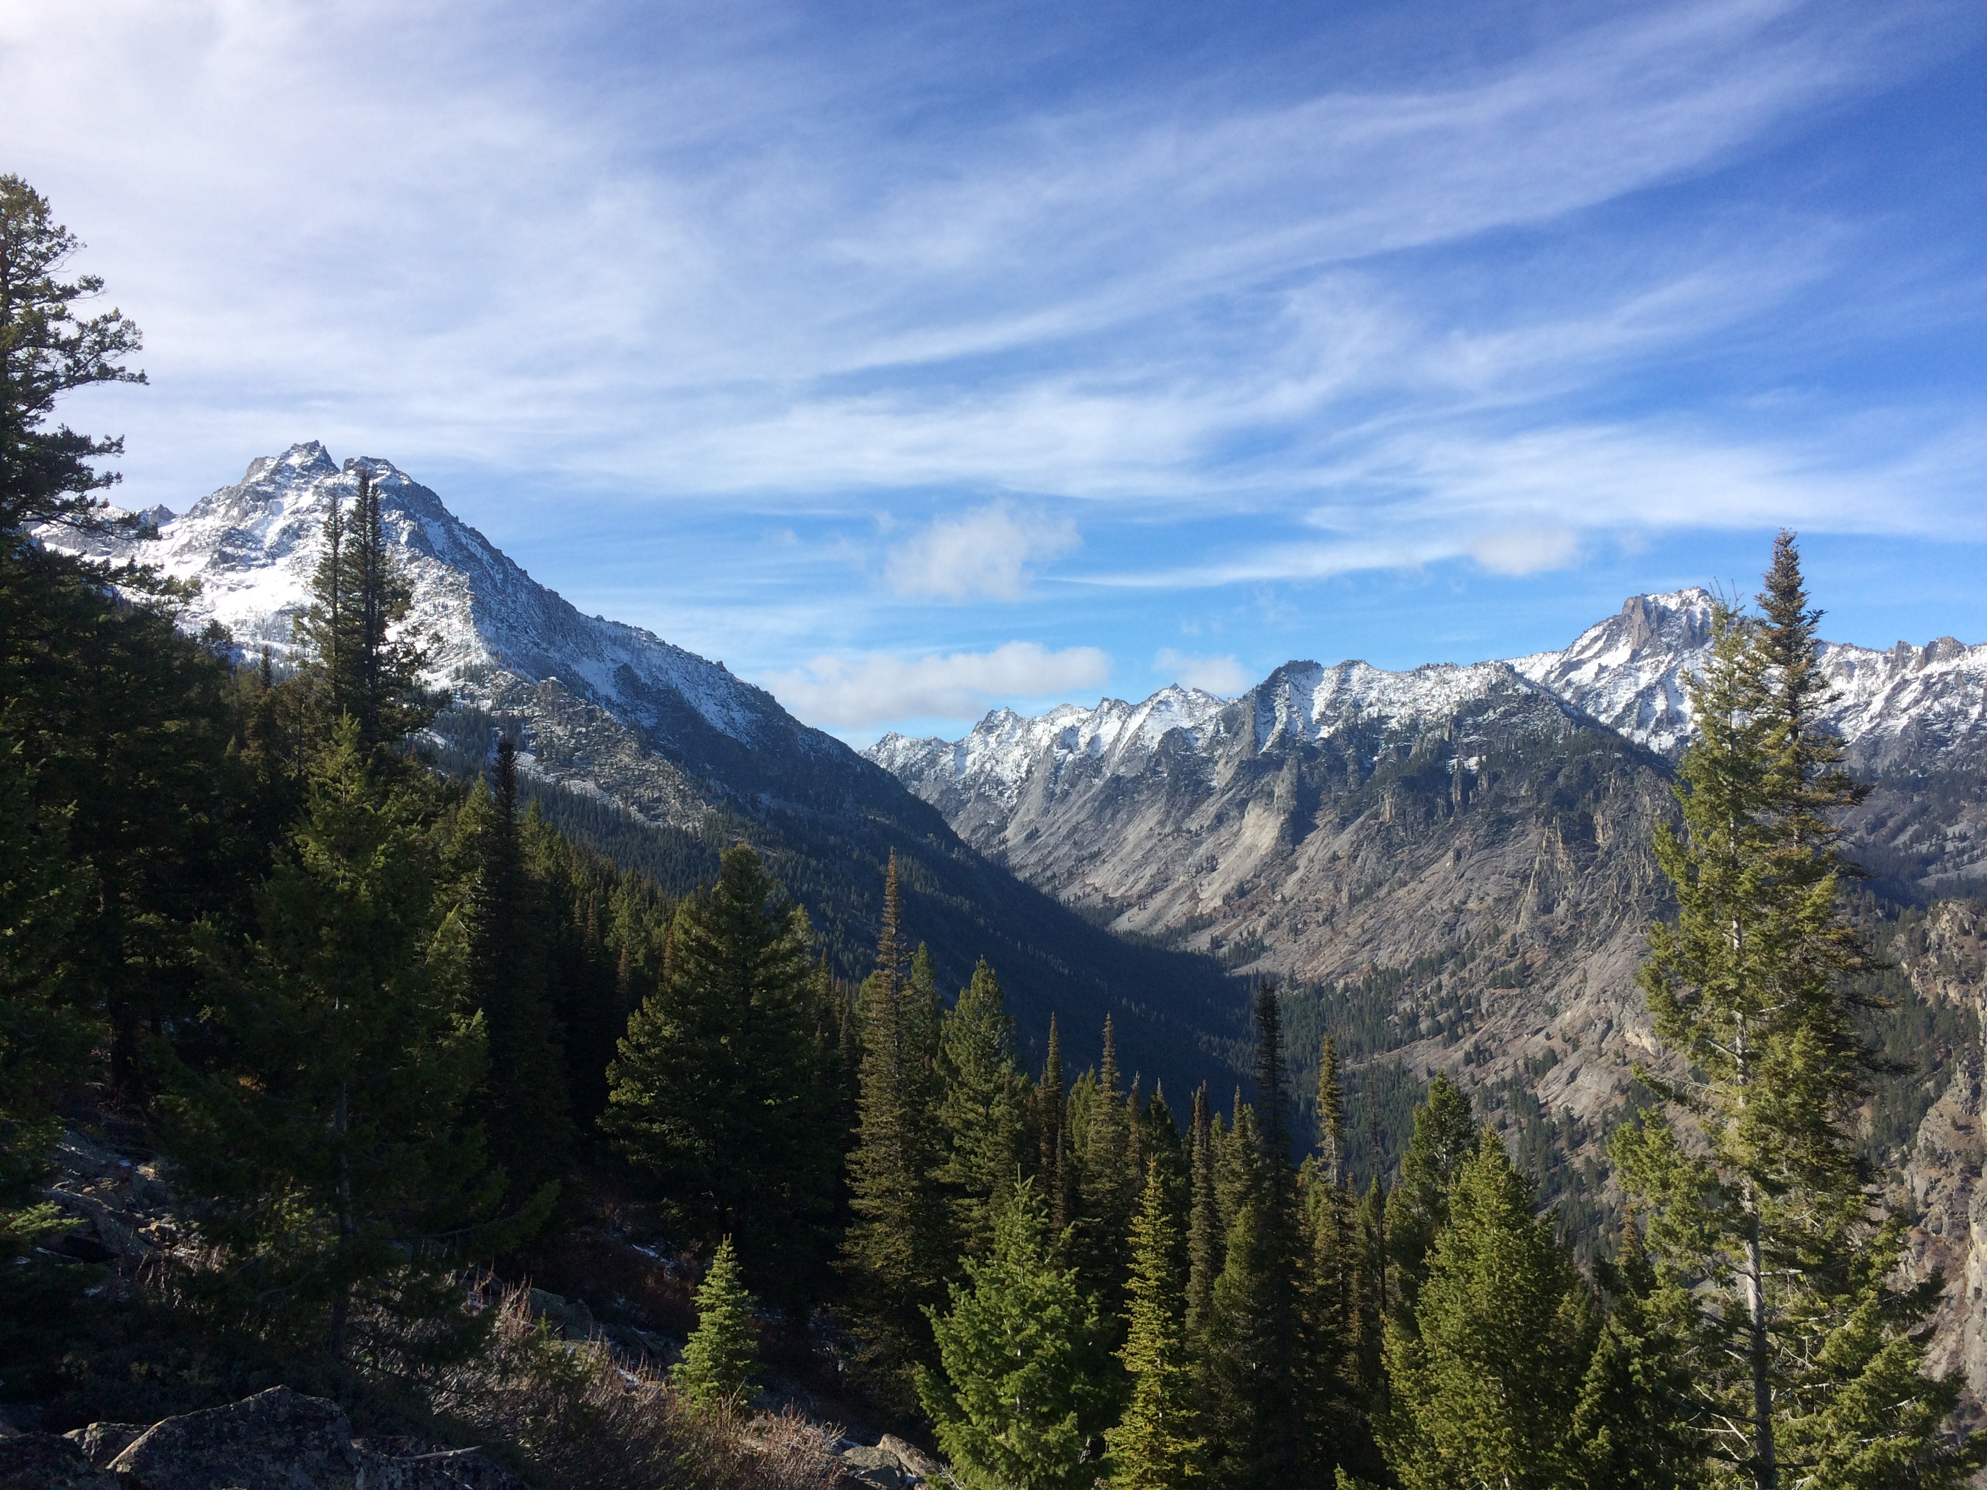
Thank you!
Questions?

