Slide 1
Mountain lakes: physical and chemical drivers of ecosystem development
Joe Vanderwall
Ballantyne and Elser Labs
Wednesday, February 19th

Slide 2
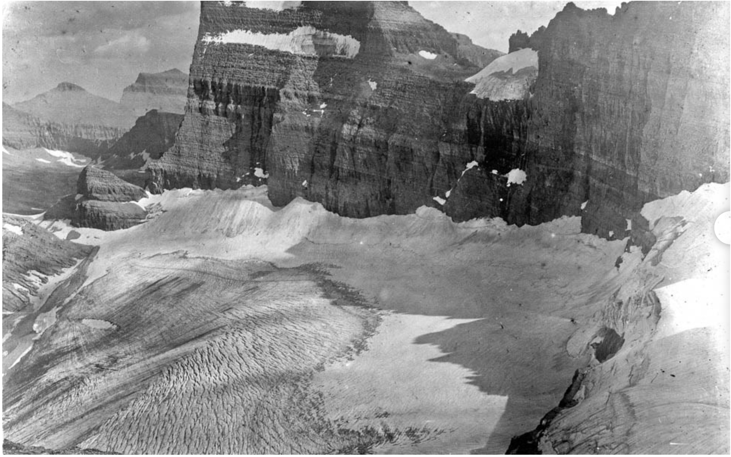
Notes:
And of course, it is also happening in North America. And here in MT right in our backyard. This is a picture of Grinnell Glacier taken by Morton Elrod in 1910. Elrod, as a sidenote, was the head of the biology department and founded the Biological Station in 1899. He took a lot of the photos such as this one that are the basis for a lot of the repeat photography in Glacier National Park. In this shot, we can see Grinnell Glacier on a ledge. Again this picture is in 1910.

Slide 3
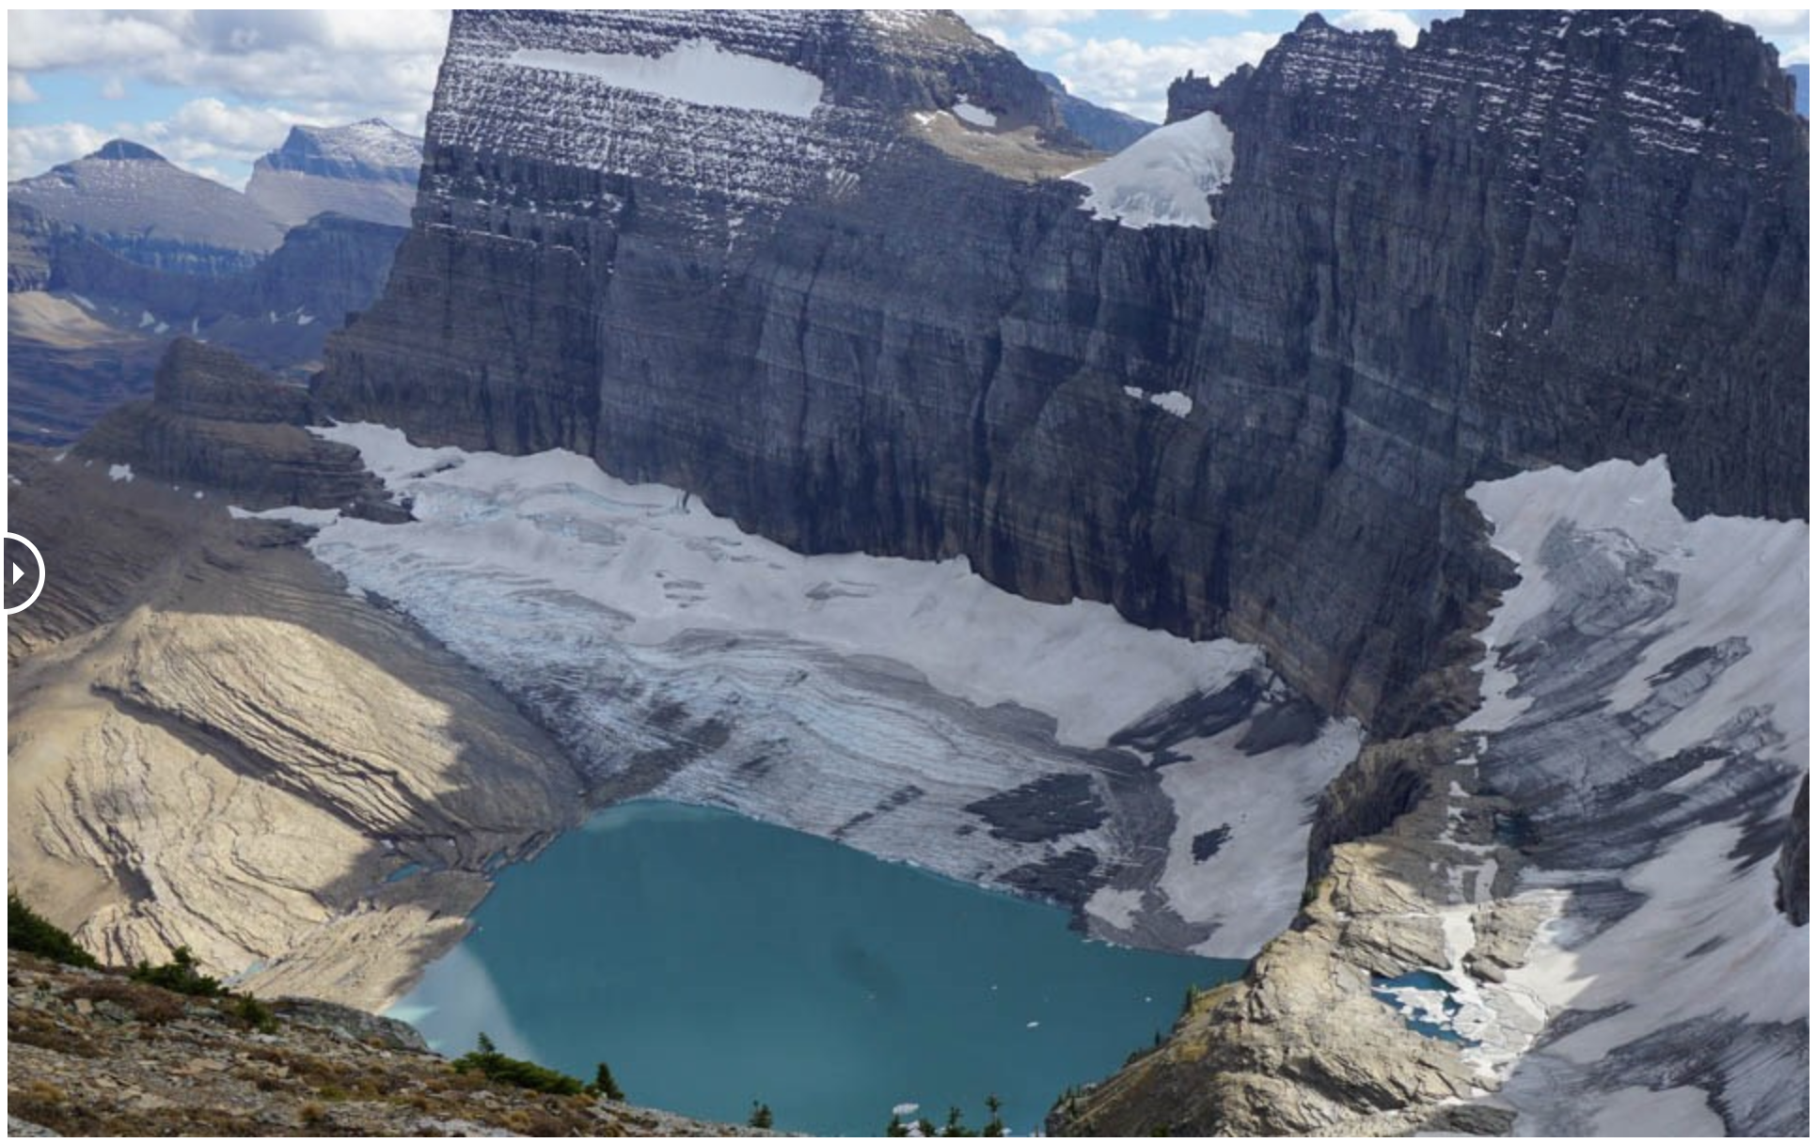
Notes:
This picture was taken in 2017 from the same spot by Lisa McKeon, a USGS scientist. We can see the massive shrinkage of Grinnell Glacier, and it actually separated entirely from this remnant Glacier up here called the Salamander. We can also see the birth of Upper Grinnell Lake, which is directly in contact with the glacier, and the exposure of the ridge bedrock. This is one of the most iconic examples because of the popularity of the hike, but this same thing is also happening across most of the named glaciers in Glacier National Park.

Slide 4
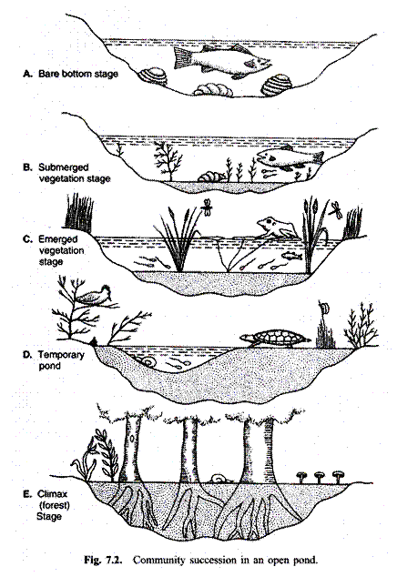
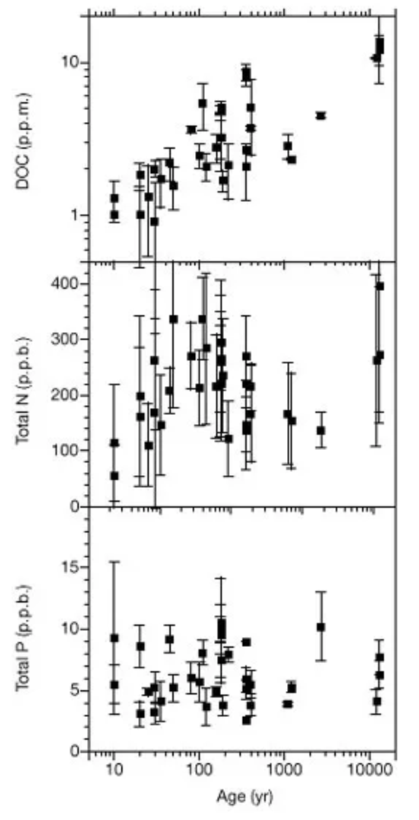
What about aquatic succession?
Engstrom et al. 2000
Notes:
What about aquatic systems? What about lakes? Earliest was Pearsall, who focused on plants in shallow lakes. Subsequent work (Deevey) led to the idea of natural eutrophication, where lakes were thought to become more productive over time as nutrients accumulated, total biomass increases, and the lake eventually fills in with sediment (Walker on the British Isles). But, natural lakes don’t fit this conceptual models However, the processes that shape early lakes are poorly understood. This is for a number of reasons: lake formation is rare - especially compared to terrestrial soil formation and lakes are geologically ephemeral.

Slide 5
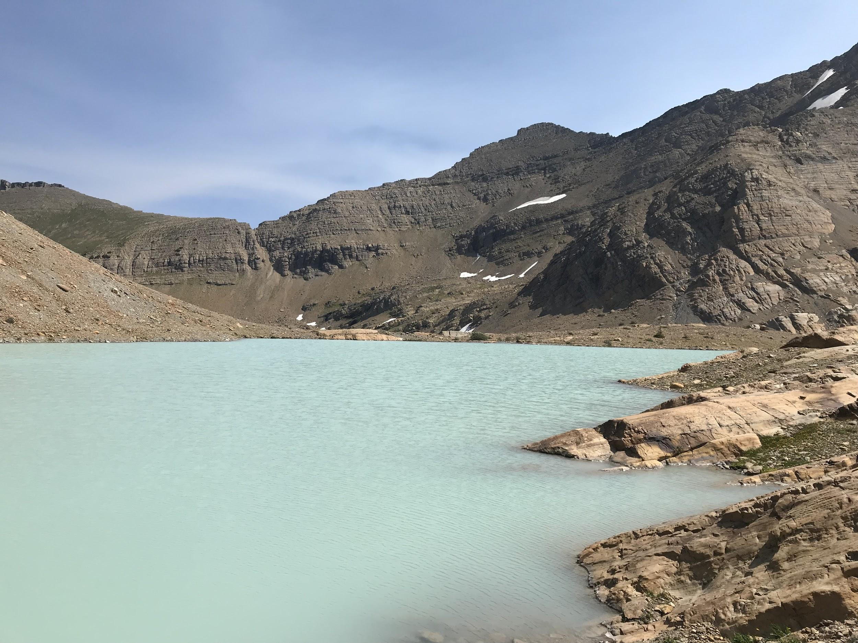
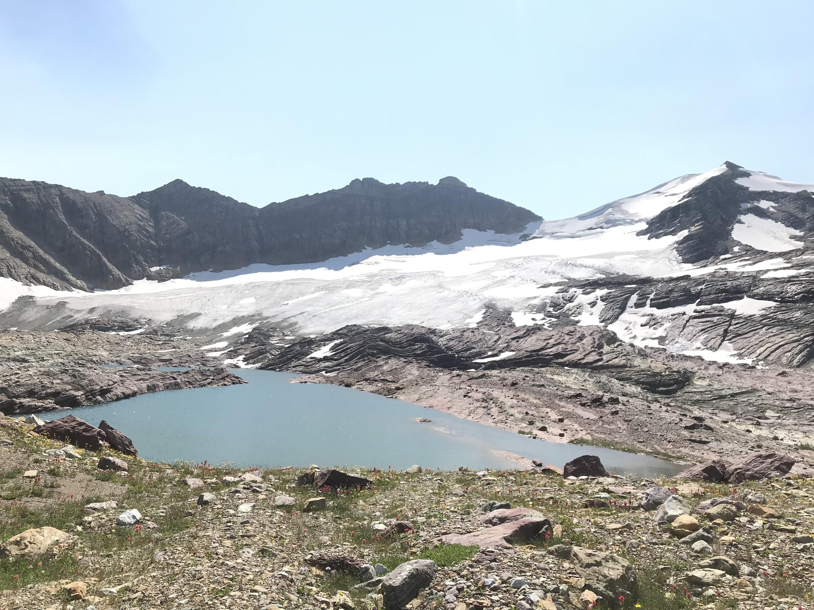
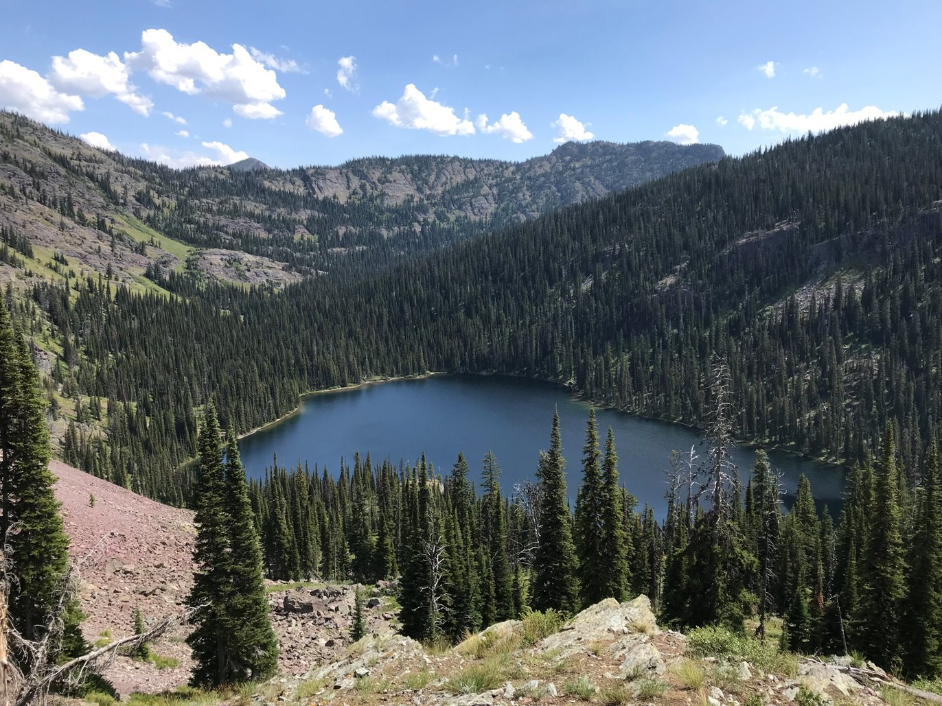
Using elevation as a proxy for lake age, how do crucial physical and chemical lake characteristics change over time? What are the implications for lake biota?
High elevation
Low elevation
Notes:
Recap lake ontogeny as glaciers recede. First, lakes are dominated by glacial melt. These lakes are turbid, cold, and have relatively high amounts of nutrients. This potentially leads to low productivity (low light), low biomass, and low diversity. As the glacier recede, the lake loses the glacial inputs and begins to be dominated by terrestrial inputs as vegetation colonizes the surrounding catchment. But, we do not have the data to back up this conceptual framework yet.

Slide 6
Some Elevational Data
Some Biologic Data
Future Work

Slide 7
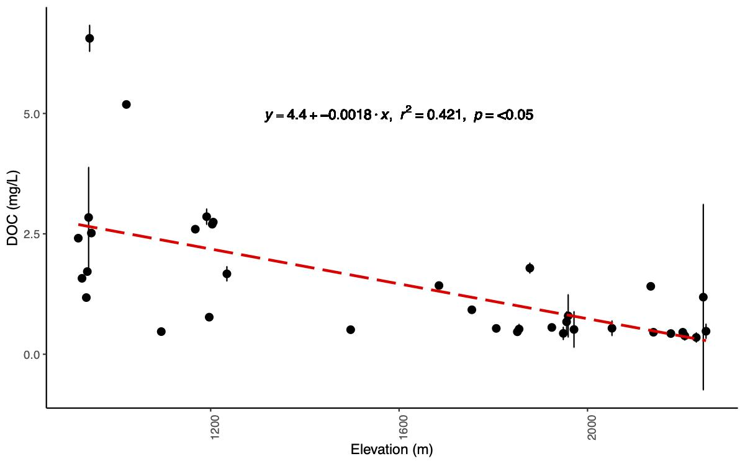

Slide 8
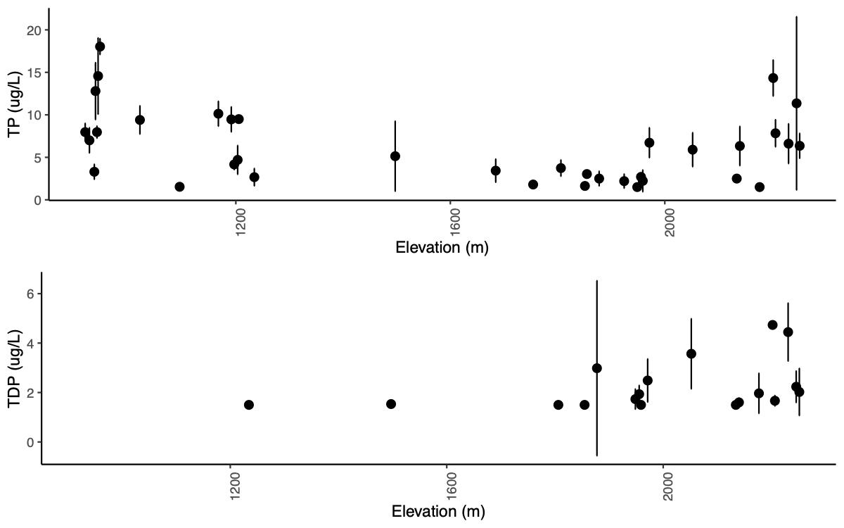

Slide 9
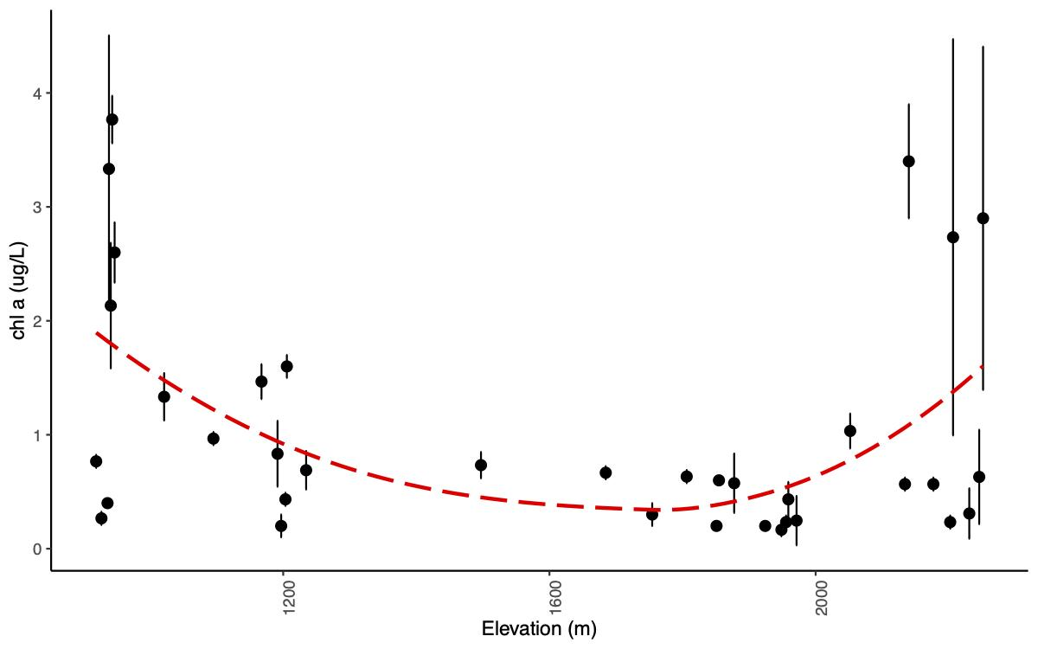

Slide 10
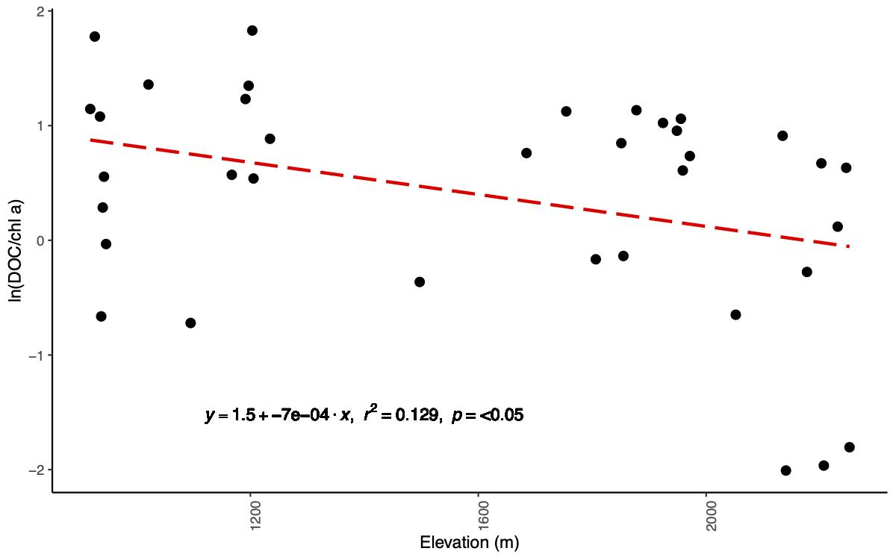

Slide 11
What about lake ecology?

Slide 12
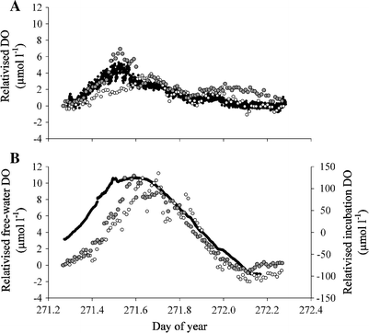
Metabolism Methods
Why dissolved oxygen?
Photosynthesis adds oxygen, respiration removes it.
Estimate balance between gross primary productivity and lake respiration
Gross primary productivity (GPP)
Ecosystem respiration (ER)
Net ecosystem production (NEP)
NEP = GPP - ER
Sadro et al. 2011
Notes:
How does DO tell you? What does it tell you?

Slide 13
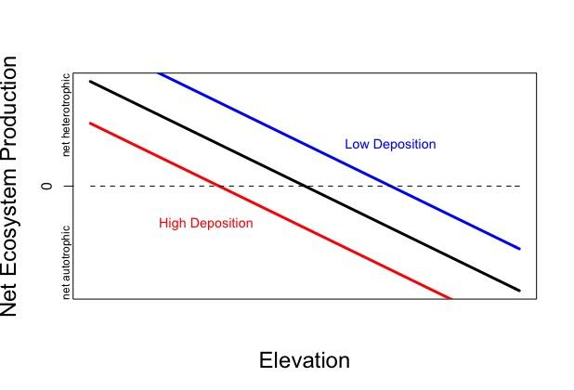

Slide 14
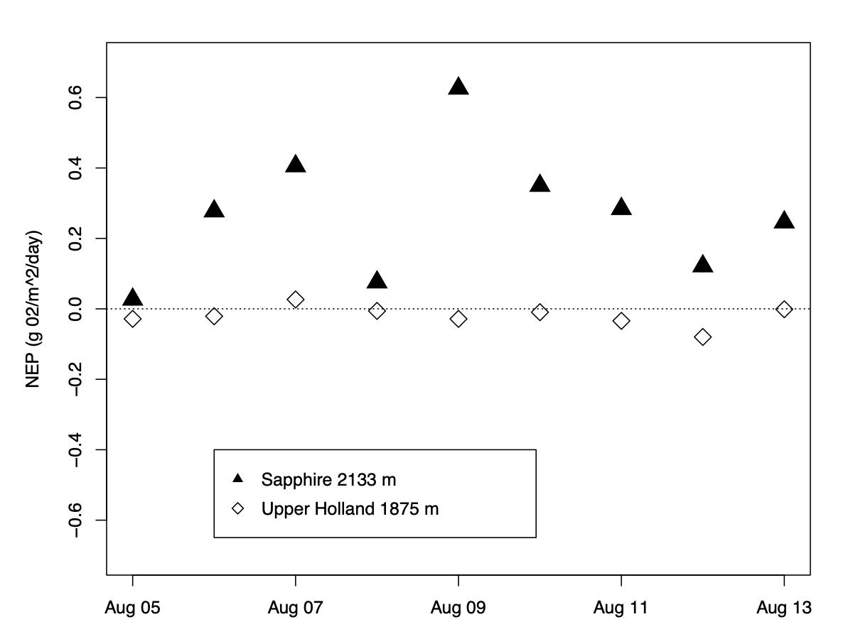
Preliminary Data
net autotrophic
net heterotrophic
net heterotrophic
NEP = GPP - ER
Notes:
Explain Net ecosystem production (NEP) as the balance of gross primary productivity and total respiration in the lake
CHANGE TO GRAMS NOT MG
Degree of Allochthony UPH =
Degree of Allochthony SAP =
DIG INTO GAS EXCHANGE 25 - 75 quartile

Slide 15
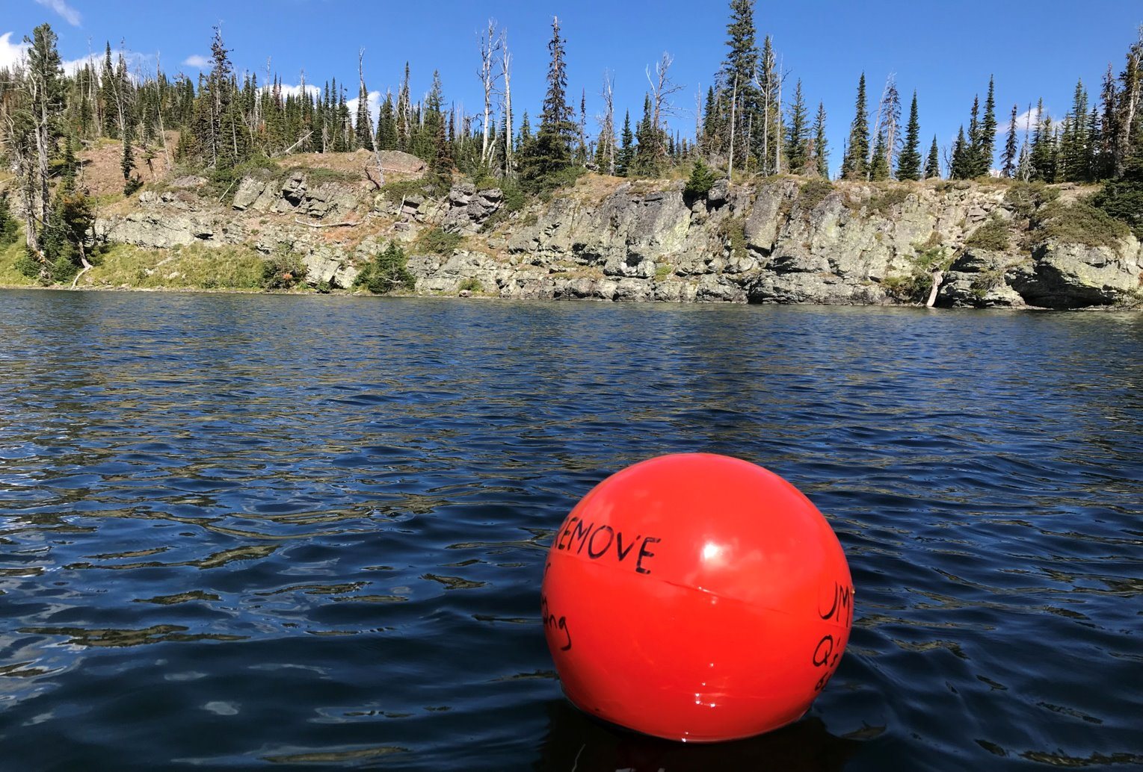
Notes:
The way we measure NEP is through dissolved oxygen data. Photosynthesis creates oxygen, respiration takes it away. So, the daily patterns of dissolved oxygen can be used to model primary production and respiration within the lake. Last summer, I had two buoys up and running, but I am planning to have nine more lakes worth of data for the full chapter. Happy to take questions about it.

Slide 16
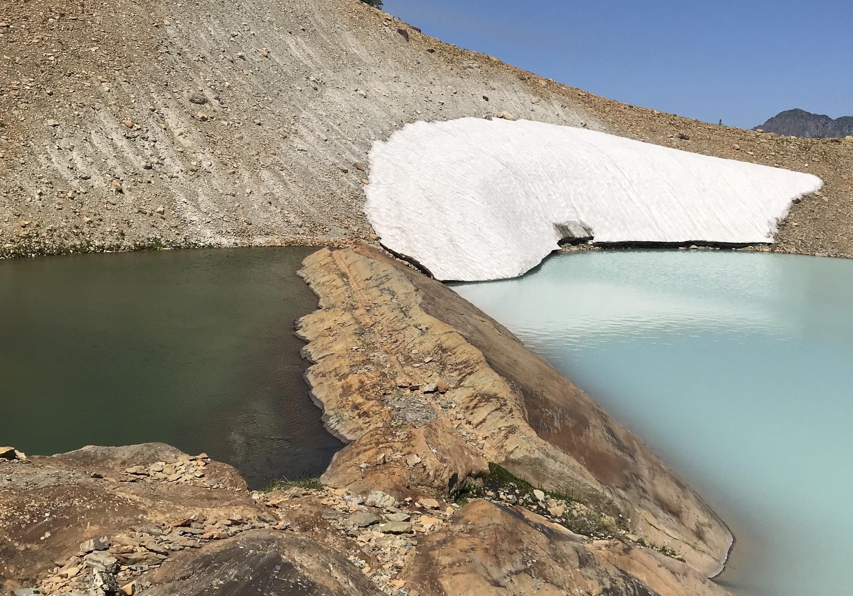
Acknowledgments
Committee
Jim Elser
Ash Ballantyne
Bob Hall
Janice Brahney
Art Woods
Funding sources
NSF
UM BRIDGES
Montana Water Center
Friends and Colleagues
Julia Cotter
Charlie Wainright
Ze Ren
Marie Johnson
Chad Hammer
Ira Moll
OBEE(EE) grad students
BRIDGES grad students
FLBS
Glacier USGS
Notes:
Acknowledgements slide

Slide 17
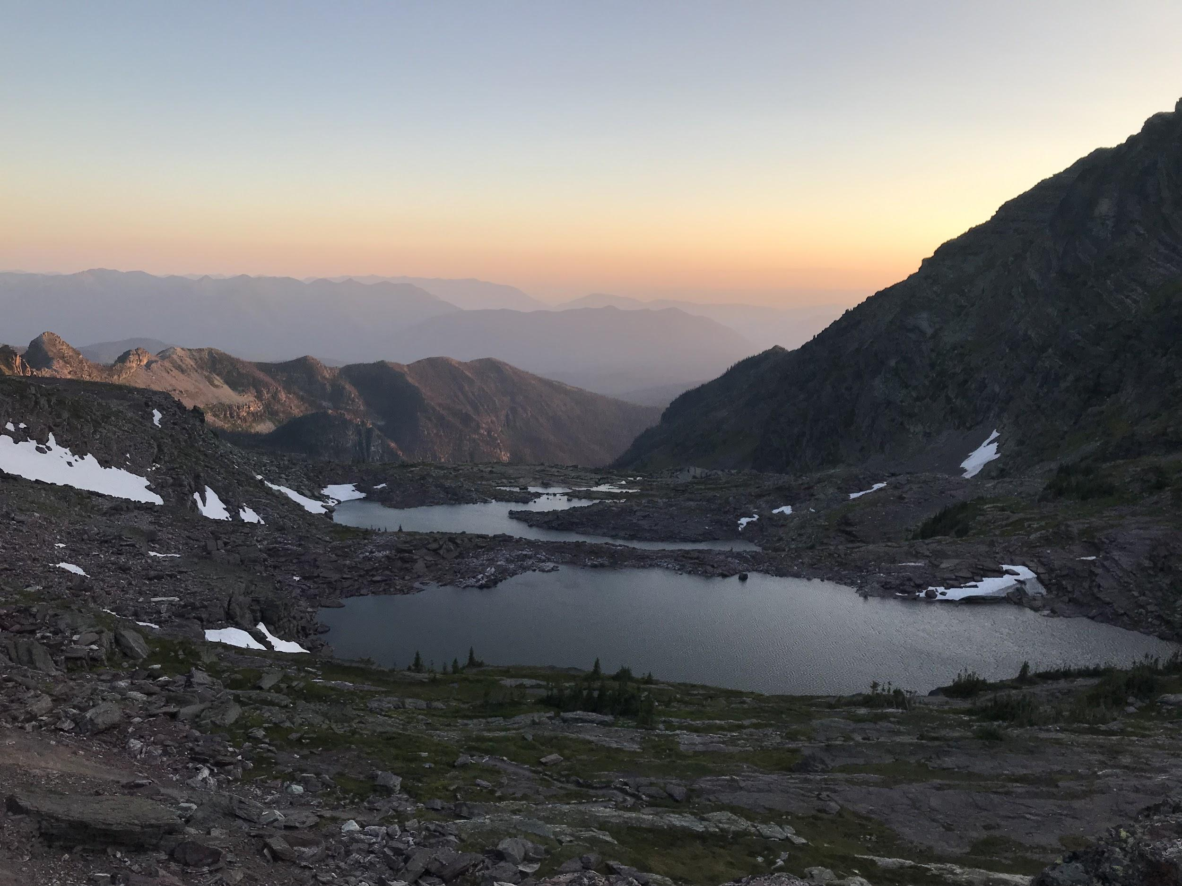
Questions?
Photo J. Elser

