Slide 1
Accounting for the Value of Robustness Analysis Through the Modal Understanding Framework
Gray O’Reilly
M.A. Student - Environmental Philosophy

Slide 2
Presentation Outline
Problem Set Up
What is robustness analysis and why does it matter?
Background on robustness analysis
Problem Solution
Understanding the modal understanding framework
How robustness analysis fits in the picture
The Solution in Action
Case study of antarctic ice sheet models

Slide 3
What is robustness analysis (RA)?
And why does it matter?
Models: “representations that abstract and idealize” (Odenbaugh 2019)
Robust Theorems: “[I]f these models, despite their different assumptions, lead to similar results, we have what we can call a robust theorem that is relatively free of the details of the model. Hence, our truth is the intersection of independent lies” (Levins 1966)
Idealized models are used to inform policies
Robustness analysis is routinely relevant
So we need to account for the value of RA
Notes:
Robustness: when models agree, similar results, share a common property
In other words, when individual models share a common property, this “robustness” is able to tell us something real about the world (Levins 1993). So robustness is taken to have some level of confirmatory power.

Slide 4
Some Background on Robustness Analysis
Richard Levins (1966): RA has confirmatory power
Orzack and Sober (1993): Shared set of mathematical principles between the models
Notes:
Levins: We are able to access truths about nature when we identify robust theorems.
Orzack and Sober: When models produce similar results they are not pointing at something true in the world but rather demonstrating a shared set of mathematical principles between the models

Slide 5
Some champion RA...
Some are less convinced...
Richard Levins (1966)
Jay Odenbaugh (2005, 2011)
Michael Weisberg (2006)
Elizabeth Lloyd (2010)
Orzack and Sober (1993)
Wendy Parker (2011,2013)
Jonah Schupbach (2018)
Notes:
Few philosophers of science want to throw out RA altogether, but some are more skeptical than others.
Odenbaugh: even when model building is predictively inaccurate, it is still successful insofar as models provide scientists with insights and opportunities that are useful and would otherwise be inaccessible. Also, Odenbaugh (2011) argues RA may have the ability to help scientists “de-idealize” models.
Weisberg: RA does not so much empirically confirm results, but rather RA points to a conditional proposition that links a causal structure and a common property of the agreeing models. So ultimately, “robustness analysis helps to identify robust theorems, but it does not confirm them”
Lloyd: Took Weisberg’s account of robustness analysis a step further suggesting that when one employs Weisberg’s technique of examining the structure of the RA, one more readily understands the strengths of models rather than their weaknesses
Parker: the uncertainty of individual models cannot be overlooked. Robust theorems, she says, are not necessarily fit to tell scientists “that the hypothesis is likely to be true or that scientists’ confidence in the hypothesis should be significantly increased or that a claim to have evidence for the hypothesis is now more secure”
Schupbach: When scientists examine individual models with agreeing results, we ought to make sure that the ways in which the models arrived at the results are different enough to warrant any significance

Slide 6
So what’s the problem?
Scientific practices suggest that RA lends epistemic and cognitive value to a proposition
Philosophical analysis suggests that RA does not contribute empirical confirmation
But still, robust theorems are used to inform policies
So the question is: what does robustness analysis do that is epistemically and cognitively valuable?
Notes:
Not to mention that we think we’ve discovered something new when models agree

Slide 7
The Solution: Modal Understanding
What is modal understanding? “One has some modal understanding of some phenomena…”
“... if and only if one knows how to navigate some of the possibility space associated with the phenomena” (Le Bihan 2017)
What is the possibility space?
The “set of representations of some of [the phenomena] and their relations” (Duwell 2018)
And how do we navigate it? By understanding...
How the models represent
How the models relate to one another
How constraints apply to the possibility space
Notes:
In short, my answer to this question is that under the modal view of understanding, robust theorems provide us with navigating power in a couple of different ways, which is epistemically and heuristically valuable.
When we understand any of these various relationships, we have what we can call navigating power. This is crucial to accounting for the value of RA.

Slide 8
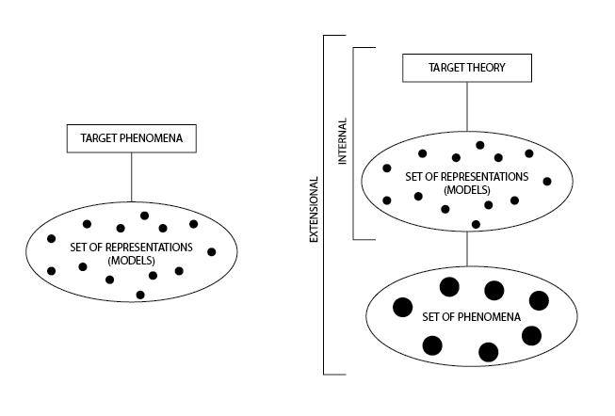
Types of Modal Understanding
Notes:
I lied, modal understanding is a bit more complex. And it changes form just a bit when we are targeting phenomena versus when we are targeting a theory.
(Cover target theory)
Target phenomena: antarctic ice sheet melting
Identify possibility space
If we know how to navigate the possibility space, we have modal understanding of the target phenomena
(Cover target phenomena)
Two types of understanding when we target theory: Internal and Extensional
There is a crucial difference between the internal possibility space and the extensional possibility space. Internal contains representations of theoretical content, whereas extensional contains phenomena that the theory can represent.
Remember, navigating power is when we have the know how to navigate the possibility space.
When we have navigating power of these possibility spaces, we have understanding.

Slide 9
Where does robustness come in?
When understanding target phenomena…
Robustness provides
Navigating power
From which follows heuristic value
When understanding target theory…
Robustness provides
Internal understanding
Extensional understanding
Heuristic Value that can lead to a better understanding of the phenomena
Notes:
Navigating power has heuristic value
Target Phenomena:
When these models agree or share some property, we learn something about how the models relate to one another.
Robustness clearly tells us something about how the models relate (and may even tell us something about boundaries)
So robustness has navigating power.
From Navigating power follows heuristic value. - “Once the relation between a particular dependency structure represented within the model and the specific subset of phenomena recovered is recognized, the ways in which the model can be changed to recover a larger portion of the phenomena may become clearer.” (Le Bihan 2017)
Target Theory:
Over here, however, we can make a slightly more interesting claim.
We have navigating power over here with the target theory for the same reasons, but it works a little bit differently.
Robustness provides us with both Internal and Extensional understanding.
Interestingly, we possibly see heuristic value here because extensional understanding of a theory consists in the ability to navigate phenomena using that theory. So robustness can actually lead to understanding of phenomena.

Slide 10
Case Study: Antarctic Ice Sheet Models
Pollard et. al (2009): grounding-line dynamics
Naish et. al (2009): temperature, CO₂ concentration, and sea levels
Notes:
So we are looking at models and studies pertaining to the melting of Antarctic ice sheets due to anthropogenic climate change and the effects of this melting on sea levels.
Models are uncertain, abstract, idealized
Pollard et. al simulated Antarctic ice sheet variations based on grounding-line dynamics
Naish et. al was a model time series looking at temperature, CO₂ concentration, and sea levels.
What’s important here is that both of these articles claim that the findings of the other make their own claim more credible as the models seem to tell the same story. Also, both Pollard et. al and Naish et. al refer repeatedly to other ice sheet/ice shelf models throughout their articles as “consistent” with findings of their own models or attributes of their own models as further evidence for their claims.

Slide 11
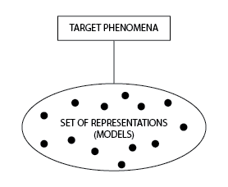
A Modal Understanding of Phenomena: Antarctic Ice Sheet Models
Set up the possibility space
Identify robust theorem
Navigating power
Heuristic value
Notes:
The agreement between these models tell us how the target phenomena may come to be in possible worlds
This helps us understand how particular dependency structures, like ice volume and sea levels, the relation between glacial state and grounding line, and the relation between CO₂ levels and surface temperature, may work in other worlds as well as how the different dependency structures may relate to one another.

Slide 12
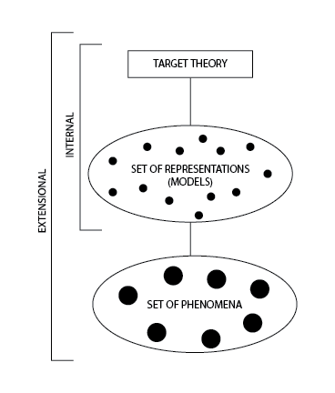
A Modal Understanding of Theory: Antarctic Ice Sheet Models
Internal Understanding
Extensional Understanding
Heuristic value that can lead to understanding of phenomena

Slide 13
Thank you!
Special thanks to Soazig Le Bihan

