Slide 1
“I want you to act as if our house is on fire!” Framing Climate Change: Women Climate Activists’ Collective Action Frames
Sara Humphers-Ginther, M.A. Candidate, University of Montana
Sociology, Rural and Environmental Change
Kathy J. Kuipers, Ph.D., Committee Chair

Slide 2
Committee Members
Kathy J. Kuipers, Ph.D., Committee Chair
Scott G. McNall, Ph.D., Committee Member
Neva Hassanein, Ph.D., Committee Member
Teresa Sobieszczyk, Ph.D., Committee Member

Slide 3
The Complexity of Climate Change
Gender & Climate Change Negotiations
Methodology
Preliminary Results
Significance
Conclusion
Research Objectives

Slide 4
1.5 °C warming will result in damage to human processes. This is an unavoidable result if action is not taken (UNFCCC 2017).

Slide 5
International responses to climate change have been ineffective and slow (Nagel 2015).
Heads of delegations at the 2015 United Nations Climate Change Conference

Slide 6
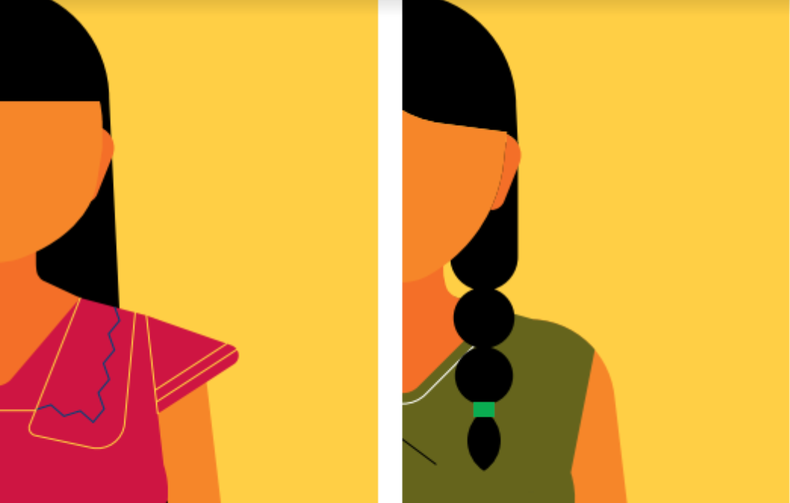
The painstakingly slow pace of international climate responses can be “analyzed based on gender dimensions of the institutions that dominate international climate change research, planning, and negotiations” (Nagel 2015:202).
“More female participation in climate action and decision-making can accelerate progress” (UNFCCC 2018:43).

Slide 7
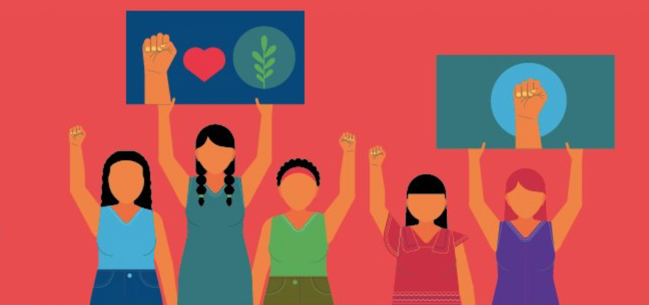
Integrative, rights-based, and community-driven approaches (Alvarez and Lovera 2016)
Performing and leading climate change mitigation and activism
(Haber 2018)
Taking leadership roles within their families and communities (Alvarez and Lovera 2016)
Mobilizing communities to respond (Dankelman 2010)

Slide 8
Women Climate Activists and Collective Action

Slide 9
Social Framing Theory: The Collective Action Frame Benford and Snow 2000
Problem
Blame
Solution
Act

Slide 10
Research Objectives
Identify
Contribute
Explore

Slide 11
Qualitative Research
Recruitment and Properties of Participants
Qualitative and Semi-Structured Interviews
Collective Action Frame Analysis

Slide 12
12%
50%
38%

Slide 18
Policy Agendas
Collective Action

Slide 19
This is real. This is not some fevered imagination of a rabid environmentalist. This is where we are. I have the unfortunate ability to somehow stand in the presence of that knowledge every single fucking day without any relief. I have made my peace with it and reconciled myself to it through taking action and doing whatever I can to move things along and create a different future. I want there to be human beings and a human population, and for people to thrive and have not just an ‘okay’ life, but a thriving, creative, engaged, imaginative and comfortable life, with their needs being met. I want there to be a better world. Better than what we have, and certainly better than it looks like we are engaging with. I think that can be done. It's worth striving for and I am not willing to accept the alternative.
Activist 7: Older Cohort

