Slide 1
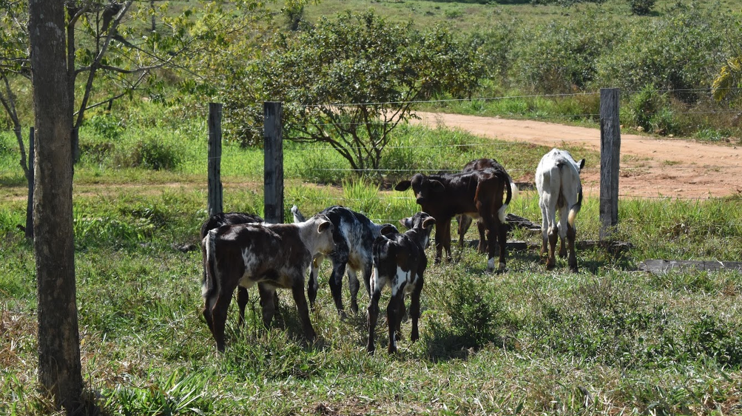
Adoption of Pasture Management Practices in Rondônia, Brazil: The Influence of Information from Social Media
Cassandra Sevigny
Notes:
I am investigating the adoption of various pasture management practices in Brazilian Amazon, and whether the use of social media influences which practices farmers choose.
Note about photos: mine

Slide 2
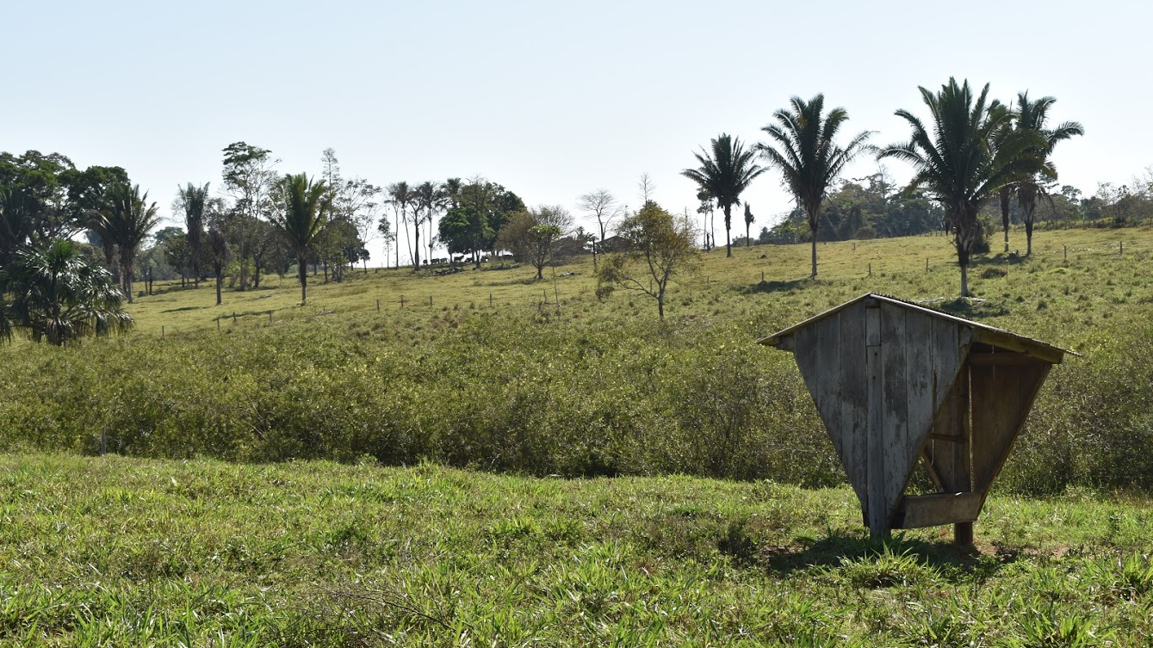
Research Question
Does the use of social media for accessing information increase the adoption of sustainable pasture management practices in Rondônia, Brazil?

Slide 3
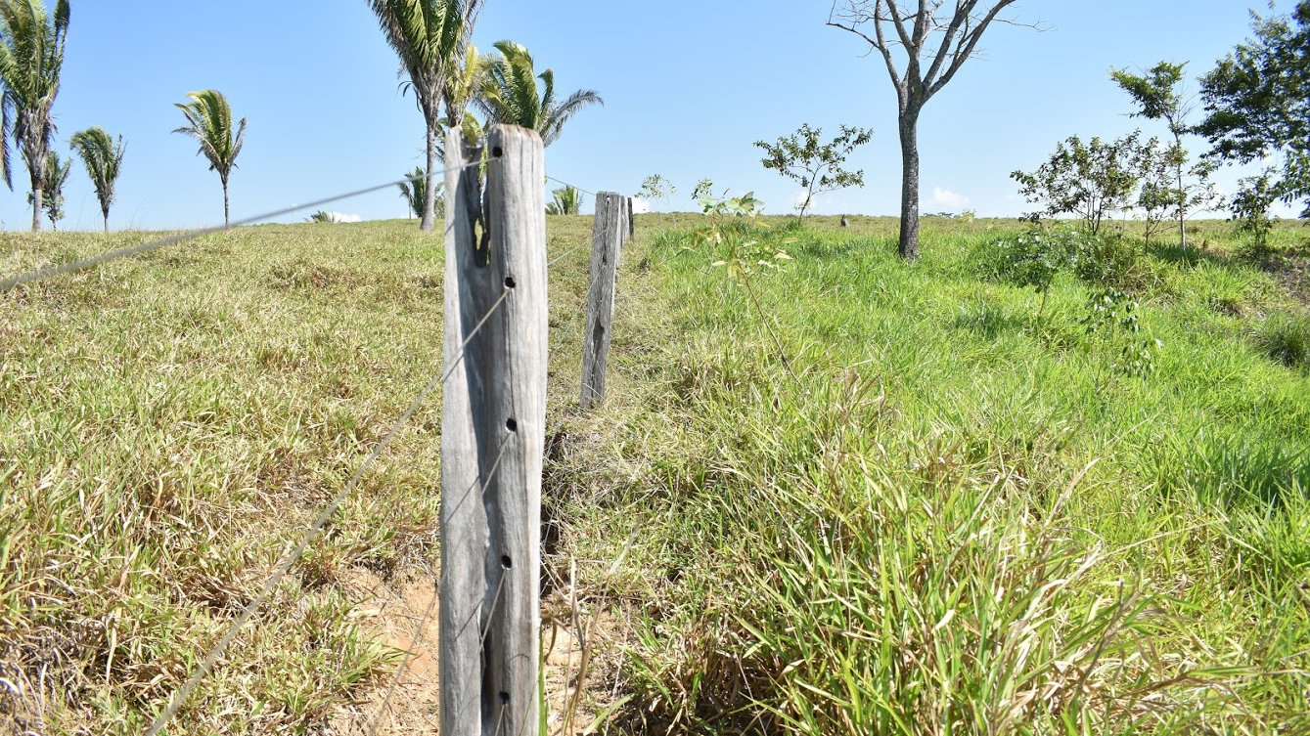
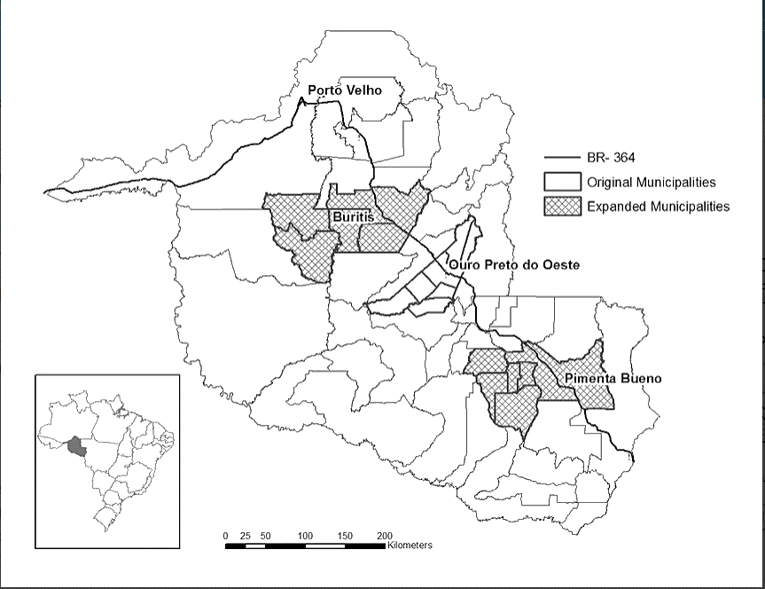
Regional Context
Located in the Amazon frontier
Primarily dairy & cattle farming
Pasture-degrading practices lead to more deforestation
Study region from WaterProductionConnections.hs.umt.edu
Notes:
Located in the Amazon region (rainforest habitat).
Federal gov encouraged migration to the area in 1970’s. Farmers cleared forest in exchange for free land to farm on.
Agricultural origin lead to farming as main source of income for households in this rural state, most of which are small, family-run farms.
Dairy and cattle farming are the predominant forms in the area, so much deforestation is for pasture space.
Traditional cattle farming practices involve little consistent management of the quality of the land.
Let the cattle graze until the pasture degrades, then clear more forest and/or invest in restoring pasture productivity every 8-10 years.
Deforestation comes at the cost of rainforest habitat, and investment in pasture productivity can be expensive.
Alternative management practices may help maintain pasture productivity and reduce costs for small farmers, and potentially reduce deforestation.
Lack of any pasture management more costly in long run.
Traditional pasture management practices (grazing til degraded) also costly, periodically.
Other management practices can maintain productivity consistently, but few adopt them.
May not be adopted because of complexity of implementation or lack of information about the available practices.

Slide 4
Notes:
Example of pasture in process of degrading (left) vs healthy pasture (right)

Slide 5
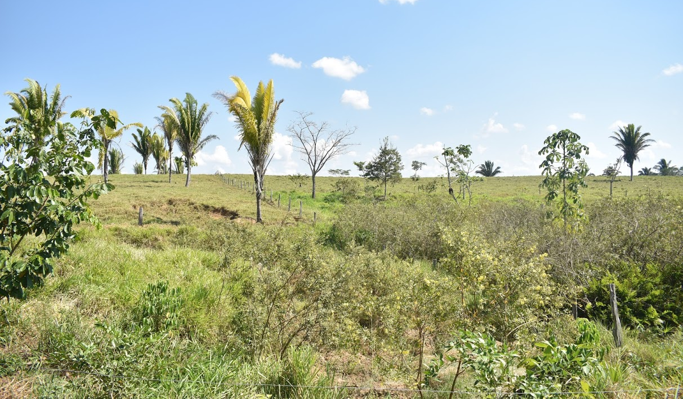
Role of Information
Information promotes awareness
Different types of information are available to farmers
Farmers’ trust of information varies by source
Social media presents a new information platform
Notes:
Info is a key factor
Must be aware of options to adopt
Different sources provide different types of information;
-ag extension provides technical info on implementation
-other farmers provide tips based on practical experience, esp useful for location-specific questions
Farmers tend to trust other farmers most
so improving inter-farmer comms has high potential to influence the adoption of knowledge-intensive practices.
SM provides a new platform for connecting people
Widespread use
Lower cost, efficient info access
Increases development of broad, diverse networks that foster sharing new ideas

Slide 6
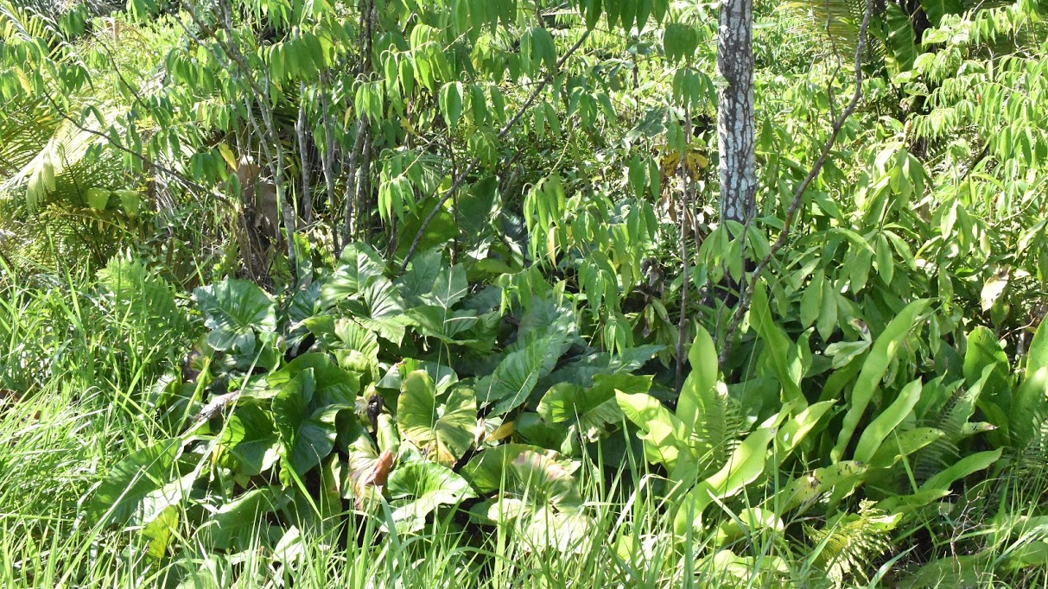
Methods
Control for household characteristics
Identify determinants of social media use
Estimate influence of social media use on various practices
Notes:
In determining causal link, I have to control for the possibility that farmers who adopt social media are more likely to adopt any new technology or practice. If a tendency for novelty or innovativeness is the true reason for use of both social media and nontraditional practices, I will get strong correlations, but without knowing if social media is causing them or just another end effect.
Need to control for things like the size of the operation – land area and number of cattle; financial resources – loans, off-farm income independent from the size of the farm; other information sources – extension, program participation, agricultural unions & associations…
Still determining a strategy for determining causality, but some options are to control for whether a household’s neighbors use SM, bc that gives them incentive to start using it; and the percent of internet access among neighbors/municipality. These things are not under household control but affect their decisions.
I will estimate my model using several methods.
Standard regressions will show relationships between the controls and various practices.
Propensity Score Matching matches up households that have similar likelihoods of using social media. Then it compares the farming practices of those that actually do use social media with those that don’t to see if there’s a difference overall between social media users and nonusers.
Endogenous switching regression controls for factors that might affect the adoption of social media and new practices simultaneously.

Slide 7
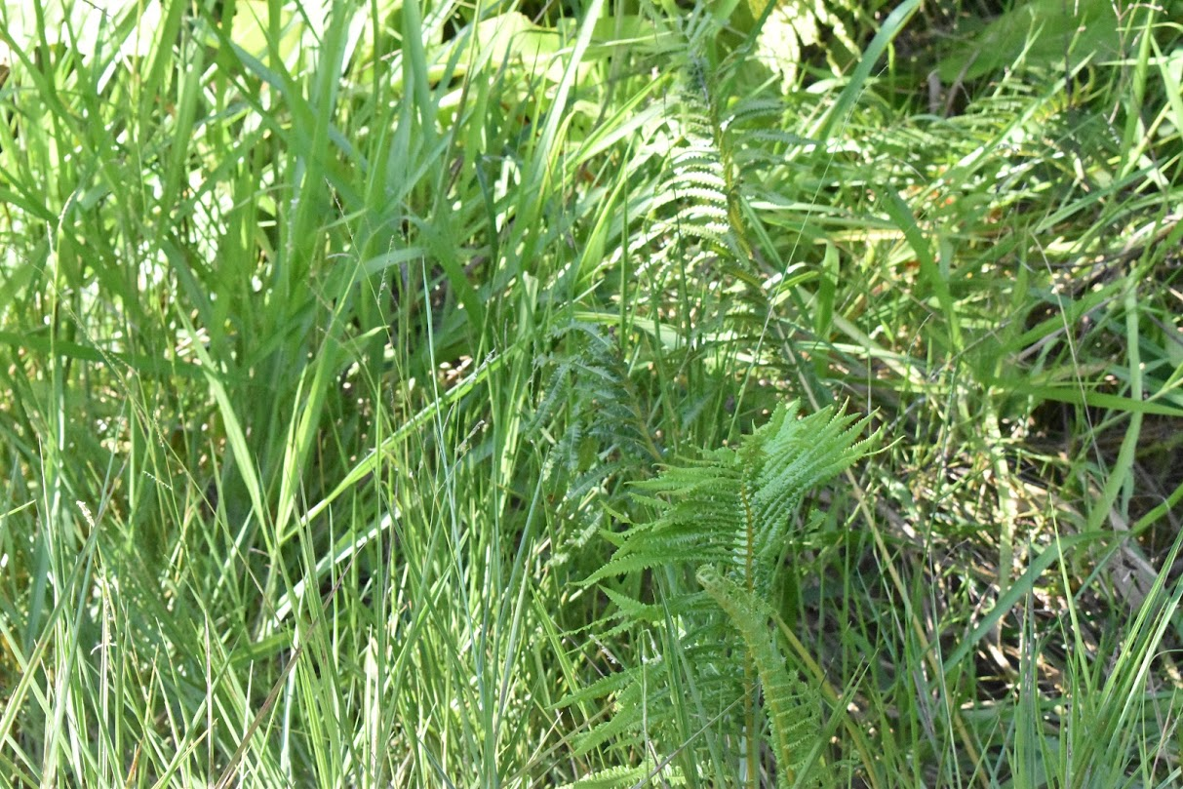
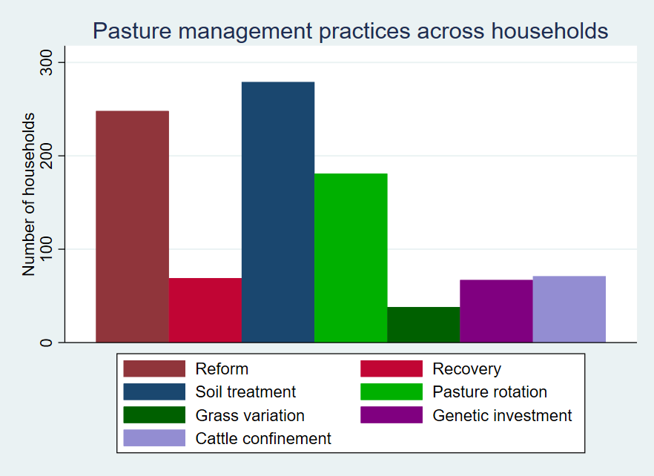
Notes:
Will examine a variety of practices regarding soil, grass, and cattle management [and water?]. These will be categorized according to their sustainability, complexity, and newness. (Still working on this.) 1362 households in total. Reform and recovery are the periodic investments into rejuvenating pasture. Soil treatment includes fertilizers and lime. Grass variation is switching between grass types that affect the soil differently, or switching to a more productive grass type. Genetic investment includes obtaining particular cows for better breeding, or practicing insemination from particular stock. Not yet included is whether they rely on the more productive breeds of dairy cow. Confinement is just like here, keeping cows on smaller area and feeding them instead of allowing grazing on pasture – seen as sustainable to some because it reduces the land required, potentially reducing the need for deforestation or the effects of pasture degradation. (But requires feed to be grown elsewhere.) NOTE: households can be in several of these categories – use several practices. Most use one or two, but some use all 7.

Slide 8
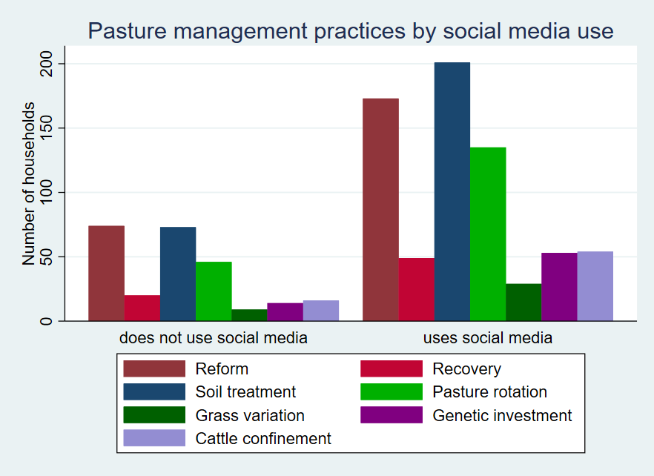
Notes:
Reform, soil treatment, pasture rotation have obviously high social media use. Of note: grass variation, genetic investment, and cattle confinement have high percent increase in social media use – these are practices that require more detailed information. The question is whether these are because most people use social media, regardless of their practices, or if there is a meaningful relationship.

Slide 9
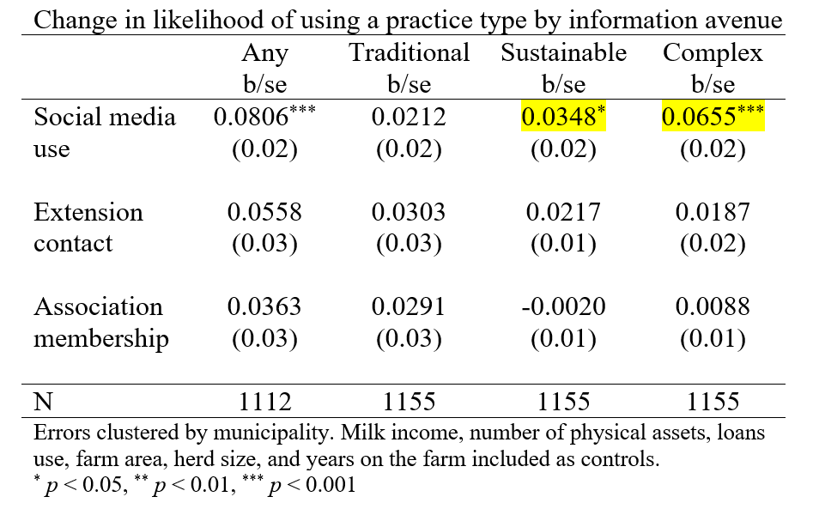
Preliminary results
Social media increases likelihood of using sustainable practices by ~3.5%
Social media increases likelihood of using knowledge-intensive practices by ~6.5%

Slide 10
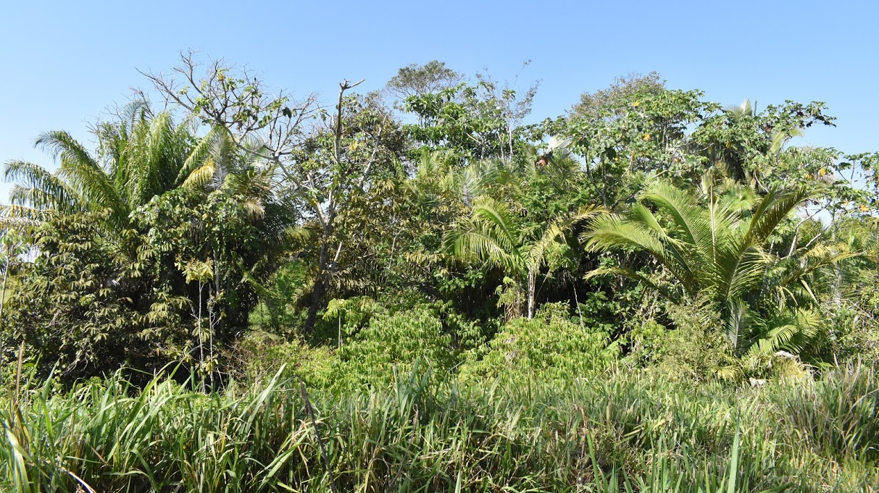
Conclusions
Evidence that social media could influence sustainable and knowledge-intensive practices
Helpful for farmers with little contact with extension, other farmers
Support for social media use by smallholder farmers to reduce costs

Slide 11
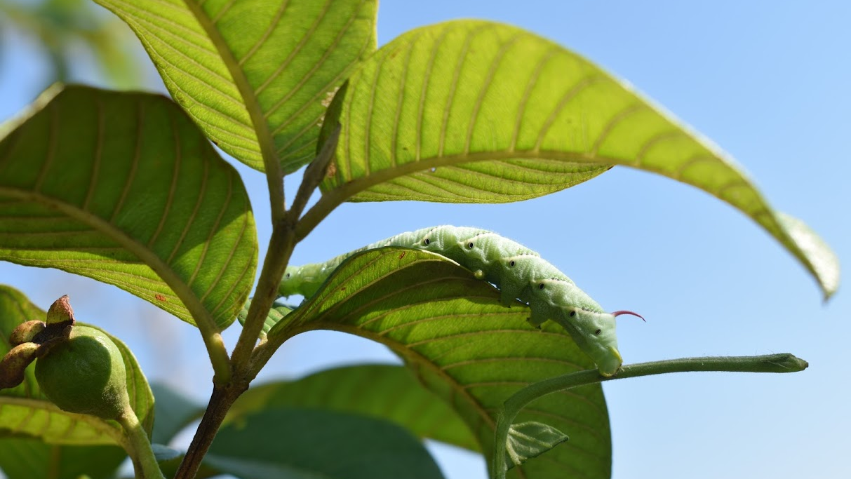
Acknowledgements
This material is based upon work supported by:
The National Science Foundation under Grant no. BCS-1825046.
UM BRIDGES through funding from the National Science Foundation under Grant No. DGE-1633831
Knowledge and expertise of advisor, Katrina Mullan, and Thais Santiago

