Slide 1
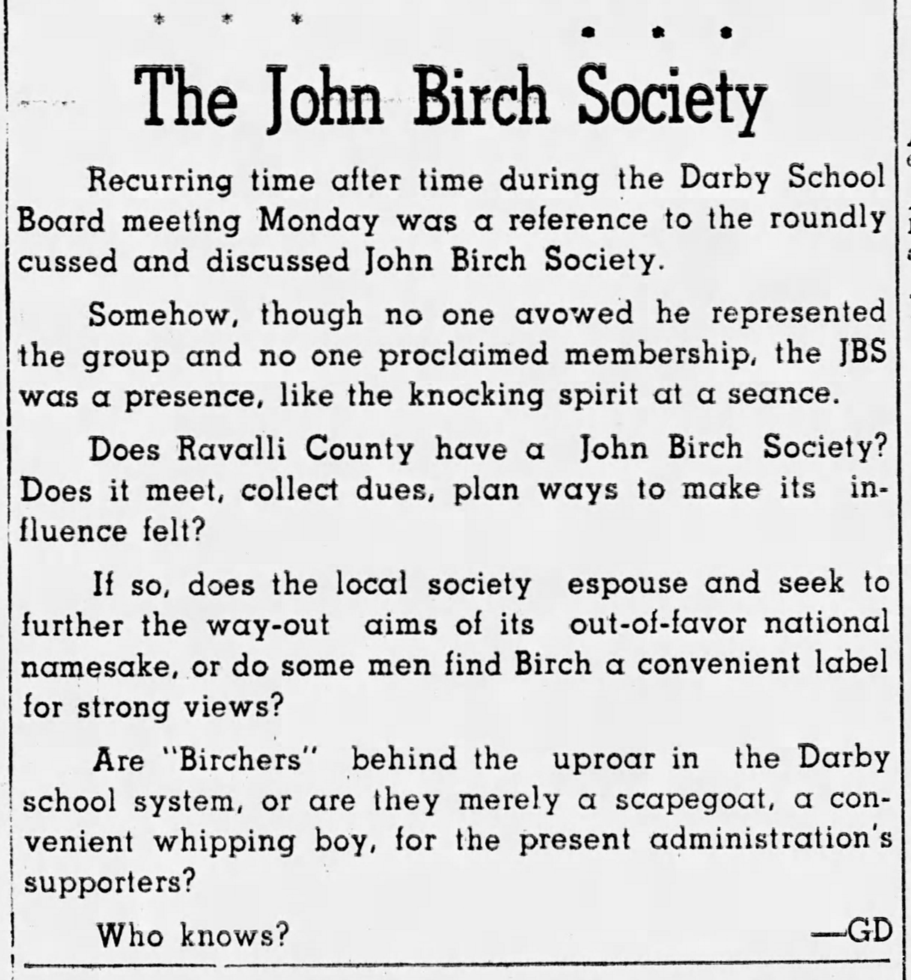
Montana and “the backwater of Birchism”
The Origins of the John Birch Society in the Treasure State, 1960-1964
Presented by Kristin Gates

Slide 2
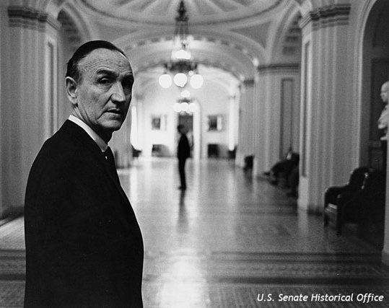
Why the John Birch Society?

Slide 3
Research Questions
Sources
How did right-wing extremism affect education and academic freedom in Montana?
How did the national spread of Birchism, Cold War conspiracy culture, and the politics of division play out on the local level in Montana communities?
What impact did the Society have on state government?
Mike Mansfield Papers
Arnold Olsen Papers
KGVO Radio Records
Educational Cooperative Publishing Company of Montana Records
Newspapers

Slide 4
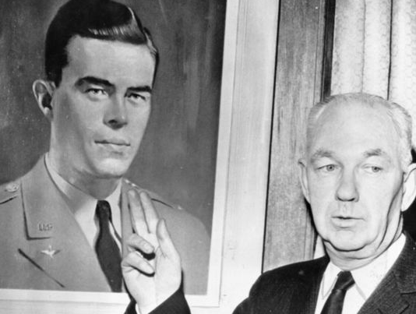
Background
Robert Welch founded the John Birch Society on December 9, 1958
Intended the group to act as a front organization to combat communist takeover of the United States

Slide 5
Birchism in Montana
Bitterroot Valley
State Politics
University
Hi-Line
School district challenges, “colonization”
Influence on State Republican Convention
Challenge to academic freedom
Farmers Union opposition

Slide 6
Additional Questions and Legacy
Suggestion that The Montana Power Company and the Anaconda Company may have had ties to Birch Society activities
New Code of the West/anti-government extremism
Anti-Indian bigotry
Deep State theories

Slide 7
Thank You
Questions?

