Slide 1
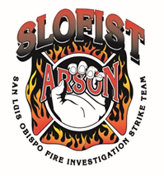
A New Classification System for Analyzing Burned Human Remains
Presented by: Amanda Williams, PhD Candidate
Anthropology Department
UM Grad Con 2020

Slide 2


WARNING!!!

Slide 3
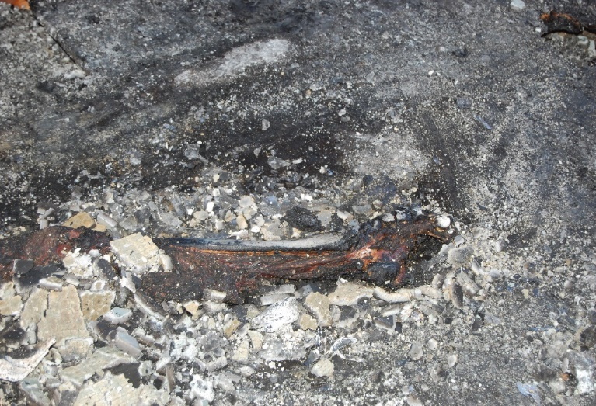
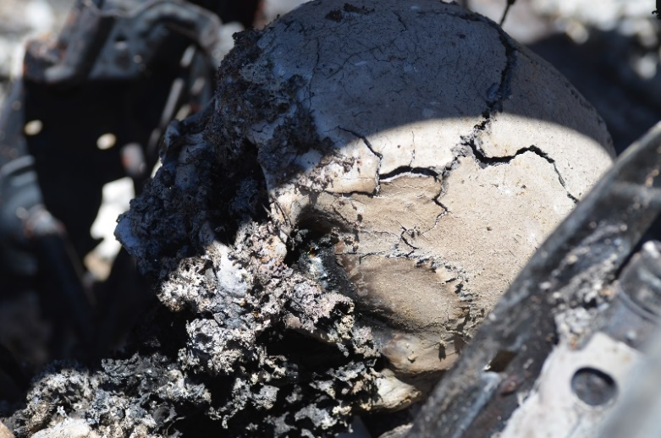
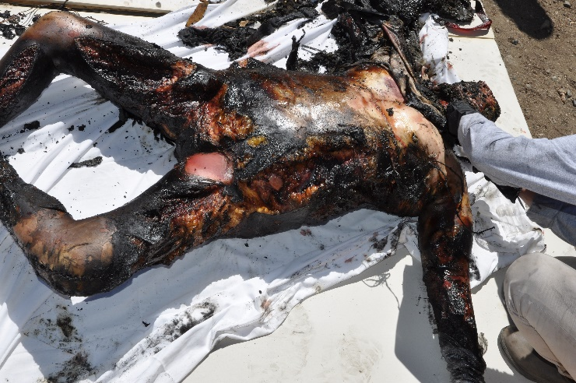
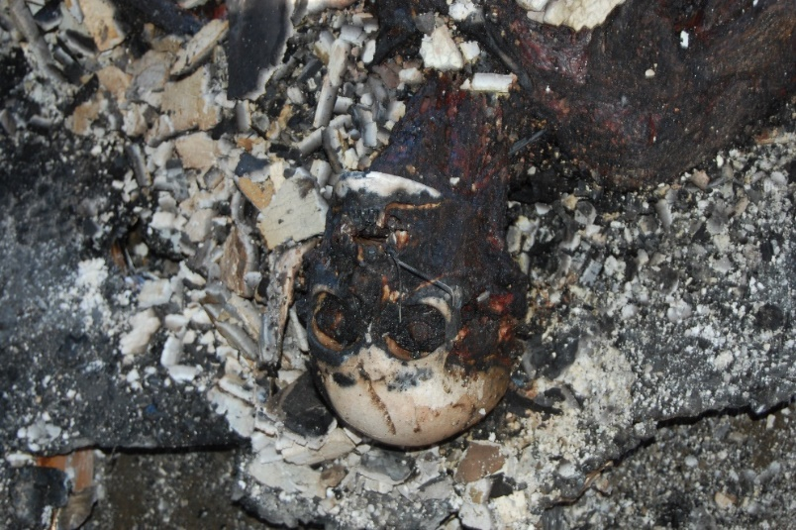
Introduction
Fire can alter human remains
  Ex. Blistering of soft tissue to calcination of bones
Thermal alterations leave patterns that can be studied and analyzed
(Correia 1997, DeHaan 1999, 2008, 2012, Pope and Smith 2004, Symes et al. 2008, Thompson and Chudek 2006)
Photos courtesy of Dr. Elayne Pope and SLOFIST

Slide 4
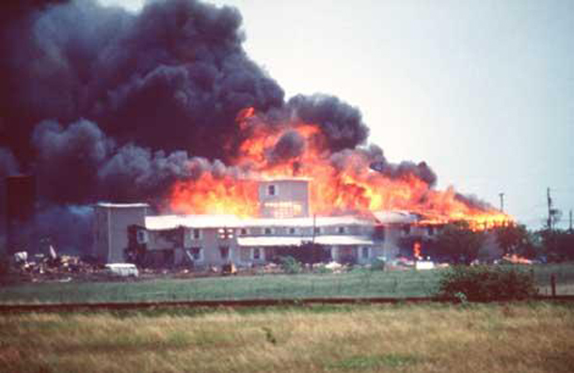
Previous Classification Models
Baby 1954 – based on Hopewell & Adena cremations
Eckert et al. 1988 – based on cremations
Crow & Glassman 1996 – based on events at Waco, TX
All primarily descriptive
  Heavy emphasis on later stages
Photo of Branch Davidian Compound

Slide 5
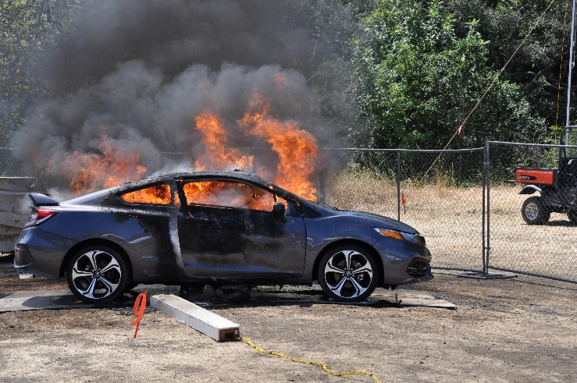
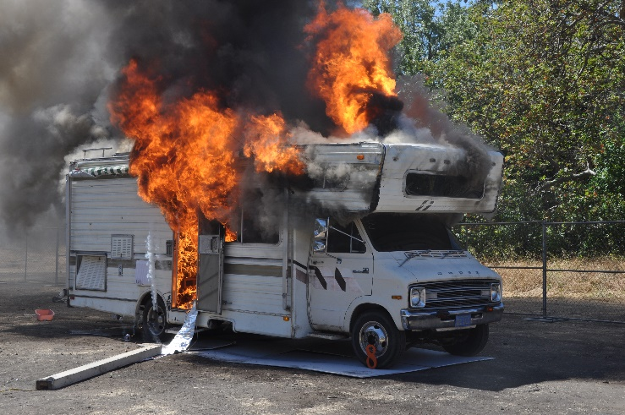
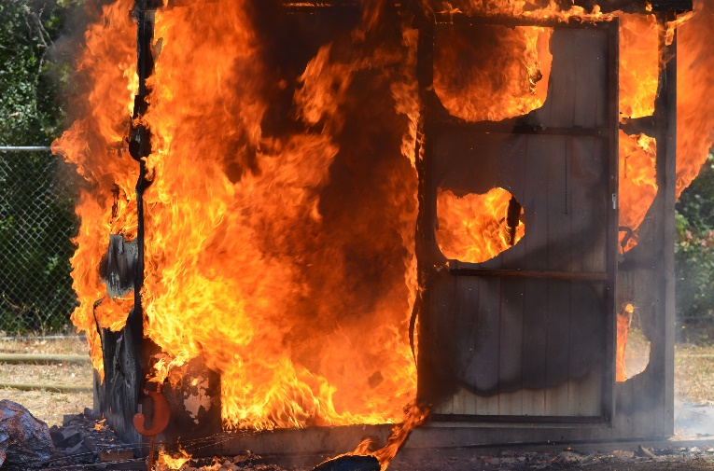
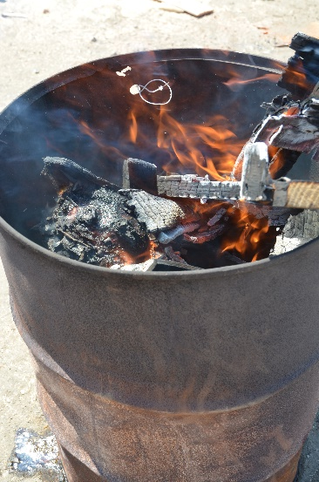
Significance of Study
Develop a method more applicable to remains encountered in fatal fire cases
Create a more quantifiable approach
Create model to predict fire damage
Photos courtesy of Dr. Elayne Pope and SLOFIST

Slide 6
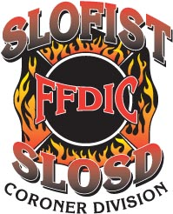

Materials and Methods
Scale -developed based on series of observation experiments (2014-2019)
  90 individuals
Derived from four different fire environments
Thermocouples used to collect temperature data
Time data- recorded in minutes
Notes:
Carried out as part of SLOFIST Training Course (FFDIC)
Involves ~60 individuals

Slide 7
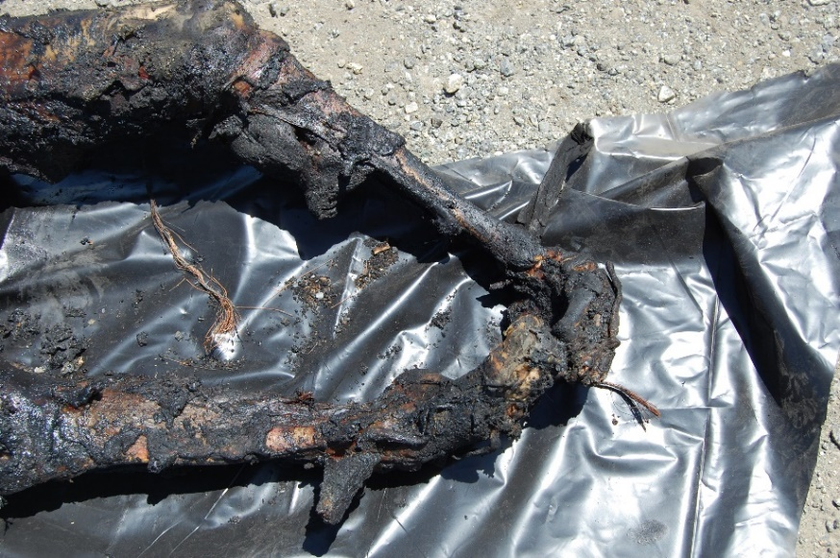
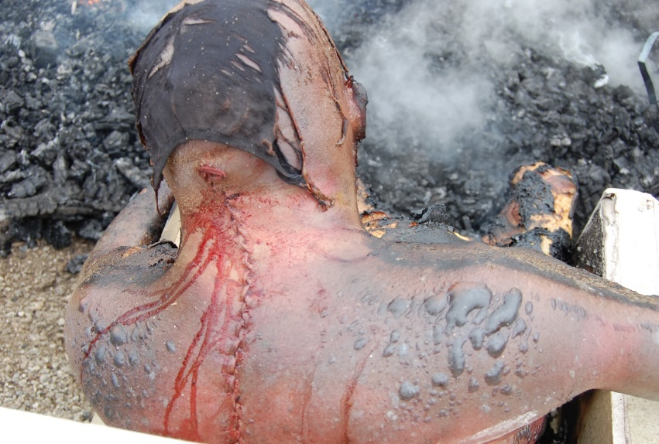
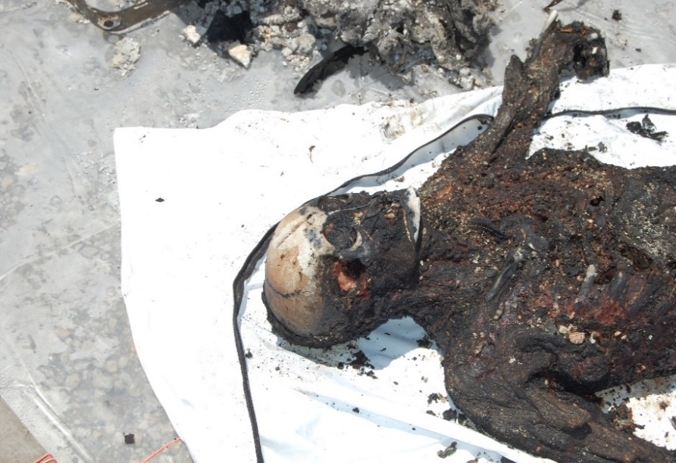
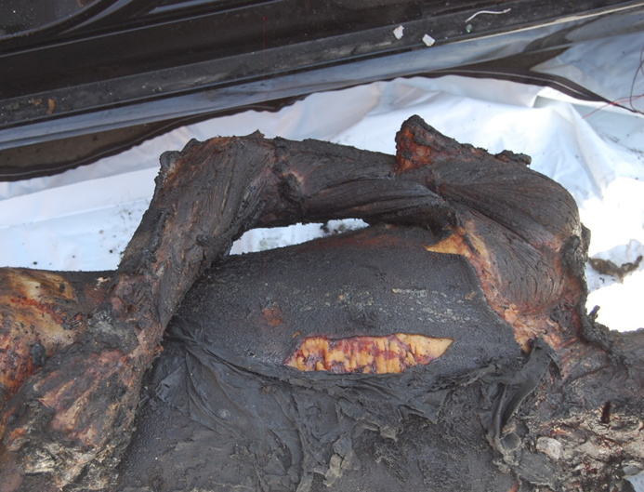
Data Variables
Both soft tissue and skeletal changes:
  Skin blistering
  Skin splitting
  Subcutaneous fat exposure
  Muscle exposure
  Pugilistic posture
  Bone exposure
  Calcination/Fragmentation

Slide 8


PMI Methods/Approaches
Similar approaches in decomposition studies (Bass 1997, Galloway et al. 1989, Megyesi et al. 2005).
Use score to represent condition of remains
Take TBS to estimate time since death
Megyesi et al. 2005:4

Slide 9


New Classification Method
Scored per body region
  Due to regions burn differently
Scoring based on sequence of burning
  Blistering occurs first, followed by skin splitting

Slide 10


New Classification Method
Partial = less than 50% of surface area
Widespread = greater than 50% of surface area
Always use highest score that can be accessed!
Sum all scores to get TBS

Slide 11
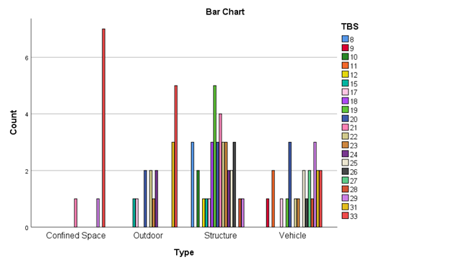
Is there a correlation between Scores and Fire Environment?
Chi-square tests
TBS (Total Body Score)
P= .007
All other sub-categories?
  All less than 0.05

Slide 12
How well is this model adequately classifying individuals?
Multinomial linear regression
All variables included, including TBS (total body score)
Variables were classified approximately 74.7 % (highlighted in blue below) of the time to the appropriate fire environment.

Slide 13
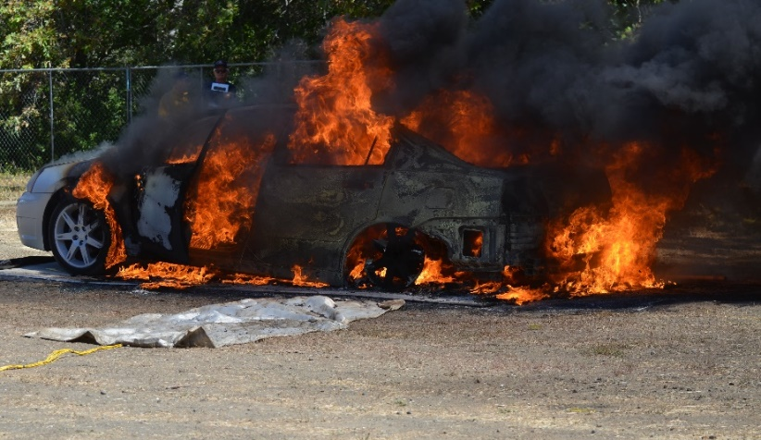
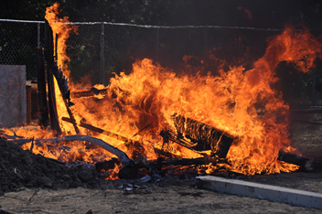
Discussion
Illustrates association between bodily conditions and type of fire environment
Demonstrates possibility to model heat-related conditions
Currently, adding more data (e.g. temperature data), so a model can be created to predict fire damage.
Photos courtesy of Dr. Elayne Pope and SLOFIST

Slide 14
Broader Impacts
Generate a tool beneficial to medico-legal community
Aid investigators building a legal case
Enhances our understanding of thermal alterations

Slide 15
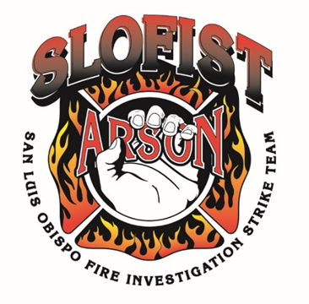

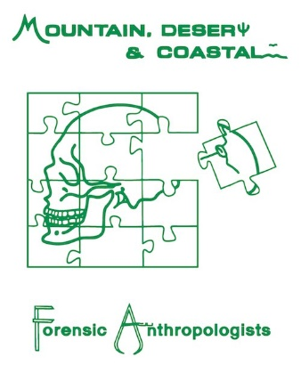
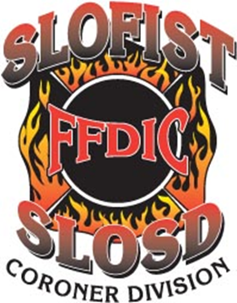
Acknowledgements
San Luis Obispo Fire Investigation Strike Team
Elayne Pope PhD and Alison Galloway PhD
My dissertation committee: Dr. Meradeth Snow, Dr. Randall Skelton, Dr. Kristen Mink, Dr. Christopher Palmer, and Dr. J. Adserias
Research Partially Funded by:
  Alice M. Brues Award- Mountain, Desert, and Coastal Forensic Anthropologists
  Toelle-Bekken Award, University of Montana

Slide 16
References
Ahmed I., Farooq U., Afzal W., Salman M. 2009. Medicolegal aspect of burn victims: A ten years study. Pak J Med Sci 25(5):797-800.
Bass W.M. 1997. Outdoor Decomposition Rates in Tennessee. In Forensic Taphonomy: The Postmortem Fate of Human Remains, edited by W.D. Haglund and M.H. Sorg. CRC Press: Boca Raton, FL. Pp. 181-199.
Bennett J. 1999. Thermal Alteration of Buried Bone. J Archaeol Sci 26: 1-8.
Bohnert M., T. Rost and S. Pollak 1998. The degree of destruction of human bodies in relation to the duration of the fire. Foren Sci Intern 95(1)11-21.
Bonhert M. and Rothschild M. 2003. Complex suicides by self-incineration. Foren Sci Inter 131:197-201.
Correia P. 1997. Fire modification of bone: A Review of the Literature. In William Haglund, Marcella Sorg, editors. Forensic taphonomy: the postmortem fate of human remains. New York: CRC Press. P.275-286.
DeHaan J. 1999. Consumption of animal fat and its implications for the consumption of human bodies in fires. Sci Just 39(1):27-38.
DeHaan J. 2008. Fire and bones. In: Schmidt, Christopher, Symes Steven, editors. Analysis of burned human remains. London: Academic Press. P. 1-14.
DeHaan J. 2012. Sustained combustion of bodies: some observations. J Foren Sci 10:1-6.

Slide 17
References
Department of Treasury. 1993. Report of the Department of the Treasury on the Bureau of Alcohol, Tobacco, and Firearms investigation of Vernon Wayne Howell also known as David Koresh. United States. Congress House.
Dunne MJ. and McMeekin RR.1977. Medical investigation 01 fatalities from aircraft-accident burns. Avaia Sp and Environ Med 48(10): 964-968.
Fanton L., Deed K, Tilhe-Coarlet S., and Malicier D. 2006. Criminal burning. Foren Sci Inter 158:87-93.
Fracasso T., Pfeiffer H., Pellerin P. and Karger B. 2009. The morphology of cutaneous burn injuries and the type of heat application. J Foren Sci Intern 187:81-86.
Galloway A., W.H. Birkby, A.M. Jones, T.E. Henry, and B.O. Parks 1989. Decay Rates of Human Remains in an Arid Environment. J Foren Sci 34:607-616.
Glassman D., and Crow R.M. 1996. Standardization of model for describing the extent of burn injury to human remains. J Foren Sci 41(1):152-154.
Kashiwagi M., Hara K., Takamoto M., Kageura M., Masusue A., Sugimura T., and Kubo S.2009. An autopsy case of suicide by acetylene explosion; a case report. Med Sci Law 49(2):132-135.
Love J.C. and M.K. Marks. 2003. Taphonomy and time: estimating the postmortem interval. In Hard evidence. Case studies in forensic anthropology, edited by D.W. Steadman. New Jersey: Pearson Education. Pp. 160–175.
Mann R.W., W.M. Bass, and L. Meadows 1990. Time Since Death and Decomposition of the Human Body: Variables and Observation in Case and Experimental Field Studies. J Foren Sci 35:103-111.
Martin-de las Heras S., Valenzuela A., Villanueva E., Marques T., Exposito N., and Bohoyo JM. 1999. Methods for identification of 28 burn victims following a 1996 bus accident in Spain. J Foren Sci 44(2):428-431.
Megyesi M., S. Nawrocki, and N. Haskell. 2005. Using accumulated degree-days to estimate the postmortem interval from decomposed human remains. J Foren Sci 50(3):618-626.
Mullins RF., Alarm B., Anwarul Huq Mian M., Samples JM., Friedman BC., Shaver JR., Brandigi C., and Hassan Z. 2009. Burns in mobile home fires-descriptive study at a regional burn center. J Burn Care and Res 30(4):694-699.
Parks J., Noguchi T., and Klatt E. 1989. The epidemiology of fatal burn injuries. J Foren Sci 34(2):399-406.

Slide 18
References
Prahlow J. 2010. Burns and fire related deaths. In: Forensic Pathology for police, death investigators, attorneys, and forensic scientists. Prahlow J. editor, New York: Springer Press. P.481-500.
Pope E.J. and O.C. Smith. 2004. Identification of traumatic injury in burned cranial bone: An experimental approach. J Foren Sci 49(3):1-10.
Swift B. 2010. Methods of time since death estimation within the early post-mortem interval. J Hom Major Incid Inv, National Policing Improvement Agency 6(1):97-112.
Symes S., Rainwater C., Chapman E., Gipson D., and Piper A. 2008. Patterned thermal destruction of human remains in a forensic setting. In: Schmidt Christopher, Symes Steven, editors. Analysis of burned human remains. London: Academic Press. P.15-54.
Tumer A., Akcan R., Karacaoglu E., Balseven-Odabasi A., Keten A., Kanburoglu C., Unal M., and Dinc A.H. 2012. Postmortem burning of the corpses following homicide. J Foren and Leg Med 19:223-228.
Ubelaker D.H. 2009. The forensic evaluation of burned skeletal remains: A synthesis. Foren Sci Intern 183:1-5.
Vass A.A. 2011. The elusive universal post-mortem interval formula. Foren Sci Intern 204:34-40.
Viklund A., Bjornstig J., and Larsson M. 2013. Car crash fatalities associated with fire in Sweden. Traff Inj Preven 14: 823-827.

