Slide 1
Acute depressive symptoms post concussion: A systematic review
Katie Berglund
Masters of Athletic Training Student

Slide 2
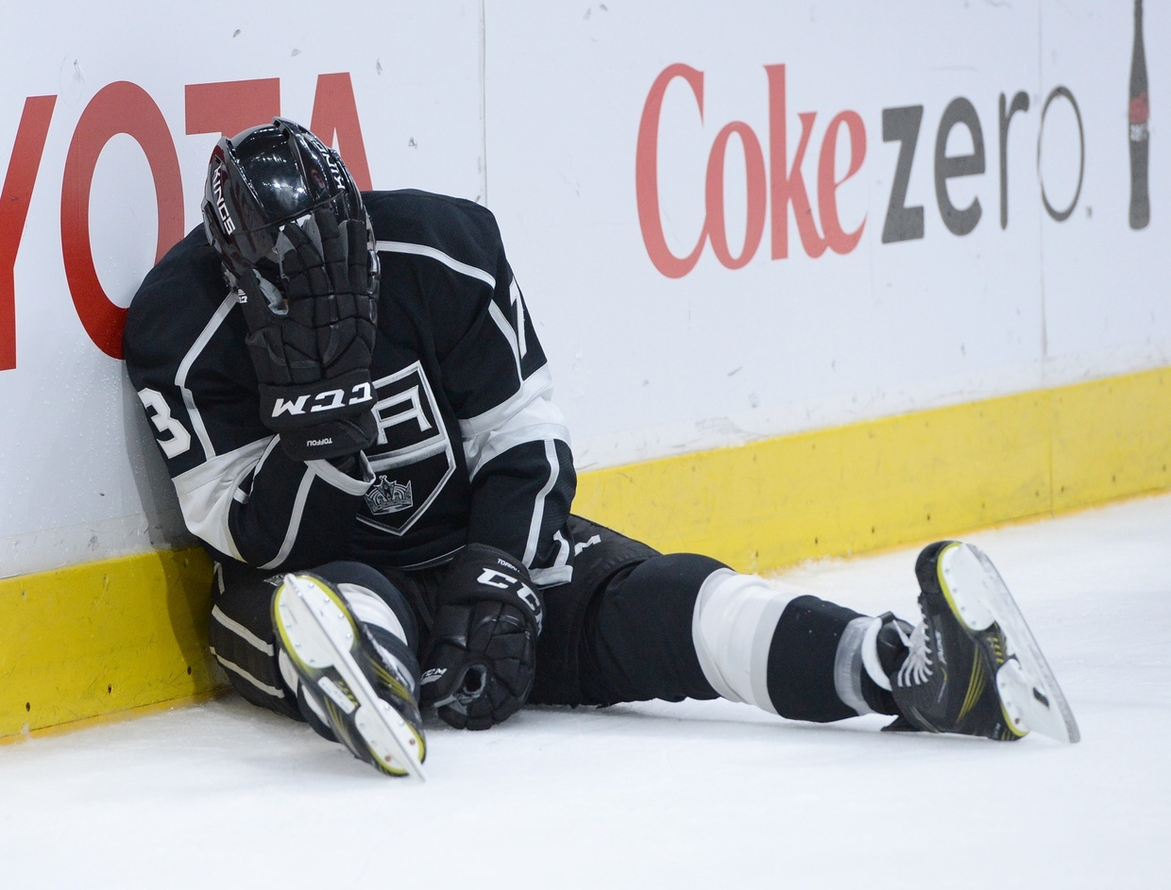
Imagine…
Athlete is hit in the head
They are slow to stand
Clearly not themselves upon coming to you
They become aggressive, upset, and wildly emotional during evaluation
Is this normal?
Vice

Slide 3
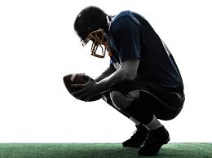
Concussion Background
Introduction
Common sports-related injuries
  100-300 per 100,000 people
Low-velocity injuries causing the brain to shake
  Often classified as mTBI
Concussion symptoms can include
  Headaches
  Dizziness
  Light and sound sensitivity
  Emotional disturbances
BMJ
Choe, 2016; Gardner et al, 2015; McCrory et al, 2013; Rao et al, 2017

Slide 4
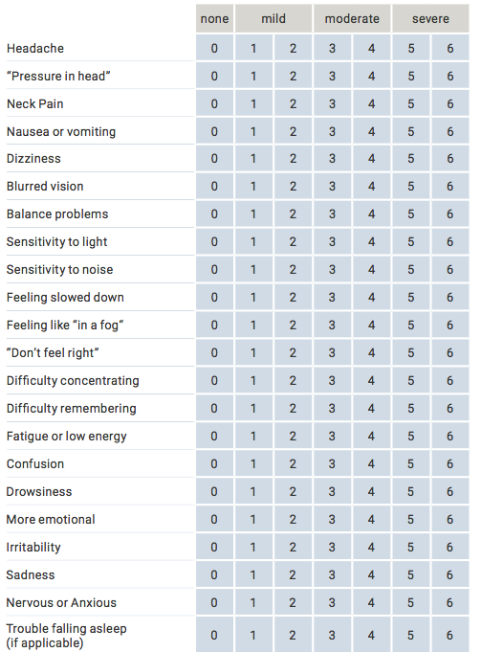
Concussion Symptoms
Introduction
SCAT5 Symptom Evaluation
  0 = none, 6 = severe
13 physical symptoms
6 cognitive symptoms
4 emotional and psychological symptoms
Concussion in Sport Group
Concussion in Sport Group
Brent et al, 2017

Slide 5
Emotional and Psychological Symptoms
Introduction
More emotional
Irritability
Sadness
Nervous or anxious
Concussion in Sport Group

Slide 6
What are depressive symptoms?
Introduction
20% of people are affected throughout lifespan
Twice as common in women than men
85% of depression patients also experience anxiety symptoms
Otte et al, 2016; Tiller, 2013

Slide 7
Methods
Keyword combination:
(depression OR suicide OR apathy)
AND
(MTBI OR "Mild traumatic brain injury" OR concussion)
AND
("acute phase" OR "short-term" OR "short term" OR "early")

Slide 8





Methods
Inclusion criteria:
  Physically active population
  Not elderly patients
  Evaluate depressive symptoms after a sustained concussion

Slide 9
Records identified through database searching
(n = 181)
Additional records identified through other sources
(n = 22)
Identification
Records after duplicates removed
(n = 203)
Screening
Records screened
(n = 203)
Records excluded
(n = 149)
Full-text articles assessed for eligibility
(n = 55)
Full-text articles excluded, with reasons
(n = 42)
Elderly patients (n=3)
Concussions not acute (n=8)
Did not report on depression (n=12)
Sample not physically active (n=19)
Eligibility
Studies included in qualitative synthesis
(n = 13)
Included

Slide 10
Records identified through database searching
(n = 181)
Additional records identified through other sources
(n = 22)
Identification
Records after duplicates removed
(n = 203)
Screening
Records screened
(n = 203)
Records excluded
(n = 149)

Slide 11
Full-text articles assessed for eligibility
(n = 55)
Full-text articles excluded, with reasons
(n = 42)
Elderly patients (n=3)
Concussions not acute (n=8)
Did not report on depression (n=12)
Sample not physically active (n=19)
Eligibility
Studies included in qualitative synthesis
(n = 13)
Included

Slide 12

Results
Initial search: 203 articles
55 articles for full evaluation
13 articles included
  Between years 2009 and 2019
  Identified key areas of depression, anxiety, mood lability, and irritability post concussion
Notes:
What we found generally

Slide 13
Study Characteristics
Author | Title | Year Published | Level of Evidence | Subject Type | Age (Years)
Ellis, et al³ | Psychiatric outcomes after pediatric sports-related concussion. | 2015 | Level 2 | 174 symptomatic (67 female, 107 male) | 14.2 (SD=2.3)
Hutchison, et al²² | Differential emotional repornses of varsity athletes to concussion and musculoskeletal injuries. | 2009 | Level 2 | 34 symptomatic (10 female, 24 male) 19 healthy (10 female, 9 male) | 21.5 (SD=2.19)
Kontos, et al²³ | Depression and neurocognitive performance after concussion among male and female high school and collegiate athletes. | 2012 | Level 2 | 75 symptomatic (24 female, 51 male) | High school 15.74 (SD=1.28) Collegiate 19.68 (SD=1.33)
Mainwaring, et al¹⁹ | Emotional reaction of varsity athletes to sport-related concussion. | 2004 | Level 2 | 16 symptomatic (4 female, 12 male) 353 healthy (134 female, 219 male) | 21.17 (SD=2.94)
Mainwaring, et al¹⁸ | Emotional reponse to sport concussion compared to ACL injury. | 2010 | Level 2 | 23 symptomatic (10 female, 13 male) 28 healthy (20 female, 8 male) | 21.2 (SD=2.94)
Meier, et al¹⁶ | The underreporting of self-reported symptoms following sports-related concussion. | 2015 | Level 2 | 40 symptomatic (8 female, 32 male) | 20.44 (SD=1.41)
Price, et al⁹ | Post-concussion syndrome and pre-existing mood disorder: A case report. | 2019 | Level 4 | 2 symptomatic males | 16.5 + 0.5
Rice, et al¹⁷ | Sport-related concussion and mental health outcomes in elite athletes: A systematic review. | 2018 | Level 2
Roiger, et al²¹ | A longitudinal pilot study of depressive symptoms in concussed and injured/nonconcussed national collegiate athletic association Division I student-athletes. | 2015 | Level 2 | 14 symptomatic 7 healthy | 18-22
Solomon, et al²⁰ | Depression as a modifying factor in sport-related concussion: A critical review of the literature. | 2016 | Level 2
Vargas, et al¹⁵ | Predictors and prevalence of postconcussion depression symptoms in collegiate athletes. | 2015 | Level 2 | 84 symptomatic (19 female, 65 male) 42 healthy (21 female, 23 male) | Symptomatic 18.4 + 0.8 Healthy 18.9 + 0.9
Yang, et al⁷ | Post-concussion symptoms of depression and anxiety in division I collegiate athletes. | 2015 | Level 2 | 71 symptomatic (18 female, 53 male) | Not reported
Yrondi, et al¹⁰ | Depression and sports-related concussion: A systematic review. | 2017 | Level 2

Slide 14
Patient Outcomes
Author | Rating Scale | Scale Type | Severity of Symptom
Ellis, et al³ | Post-Concussion Symptom Scale | Likert | Emotional symptoms: Low
Hutchison, et al²² | Profile of Mood States | Likert | Depression: High Anger: Moderate Vigor: Low Fatigue: High Confusion: Moderate Total Mood Disturbance: High
Kontos, et al²³ | Beck Depression Inventory-II | Likert | Depression: Low
Mainwaring, et al¹⁹ | Profile of Mood States | Likert | Depression: High Confusion: Moderate Total Mood Disturbance: High
Mainwaring, et al¹⁸ | Profile of Mood States | Likert | Depression: High Total Mood Disturbance: High
Meier, et al¹⁶ | Hamilton Depression Rating Scale Hamilton Anxiety Rating Scale | Likert | Psychiatric: Depression: Mild Anxiety: Mild
Price, et al⁹ | Mental health provider | Interview | Anxiety: High
Roiger, et al²¹ | Center for Epidemiological Studies Depression Scale | Likert | Depression: Moderate
Vargas, et al¹⁵ | Beck Depression Inventory-Fast Screen | Likert | Depression: Moderate
Yang, et al⁷ | Center for Epidemiological Studies Depression Scale State-Trait Anxiety Inventory | Likert | Depression: Moderate Anxiety: Moderate

Slide 15
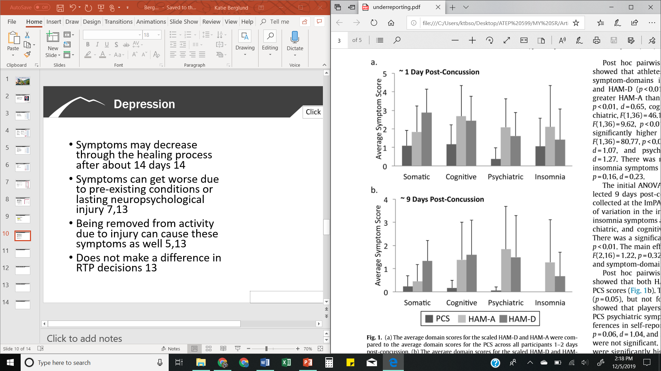
Depression

Slide 16
Depression
Symptoms take between 7-90 days to resolve
  Average of 14 days
Symptoms can get worse due to pre-existing conditions or lasting neuropsychological injury
  Pre-existing depression increases likelihood of post-concussion depression 4.59 times
Hutchison et al, 2009; Kontos et al, 2012; Mainwaring et al, 2004; Mainwaring et al, 2010; Meier et al, 2015; Rice et al, 2018; Roiger et al, 2015; Price et al, 2019; Solomon et al, 2016; Vargas et al, 2015; Yang et al, 2015; Yrondi et al, 2017

Slide 17
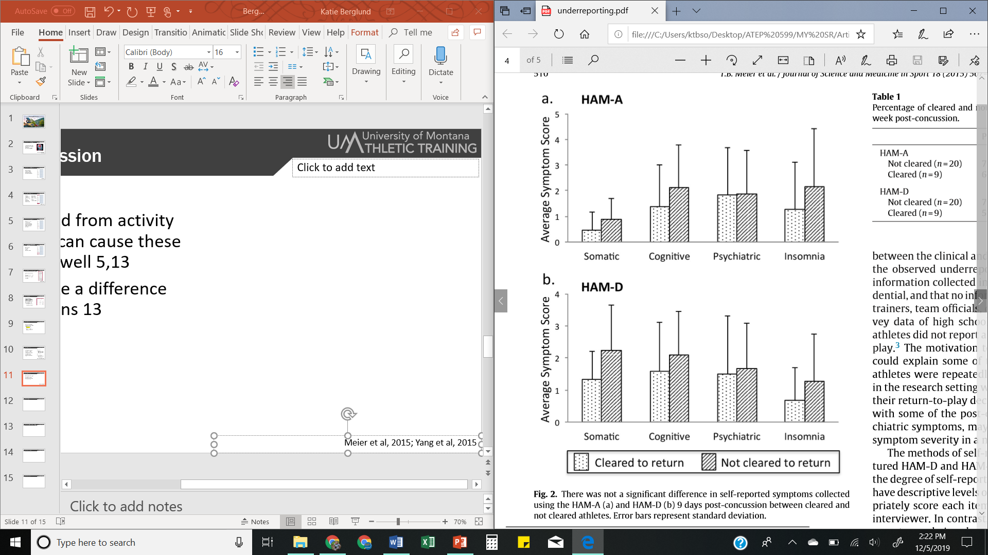
Depression
Does not make a difference in RTP decisions
Being removed from activity due to injury can cause these symptoms as well
  ACL patients respond later and longer with depressive symptoms
Mainwaring et al, 2010; Meier et al, 2015; Yang et al, 2015
Notes:
ACL patients experienced depression later and longer than concussion patients

Slide 18
Anxiety

Slide 19
Anxiety
Common comorbidity of depression symptoms and reported or discussed in four articles reviewed
  Depression at baseline increase likelihood of post-concussion 3.4 times
Effects on classroom and social interactions
Meier et al, 2015; Price, 2019; Rice et al, 2018; Yang et al, 2015

Slide 20
Anxiety
No impact found on delaying return to play decisions
Anxiety surrounding return to play and reinjury
Pre-existing anxiety has no effect on post-concussion psychological symptoms
Meier et al, 2015; Wadey et al, 2014; Yang et al, 2015

Slide 21


Impulsivity & Mood Lability
Resolve between 14-28 days
Lack of focus due to mood swings
Can become persistent symptoms
PsycholoGenie
Calm Clinic
Ellis et al, 2015; Hutchison et al, 2009; Mainwaring et al, 2004; Mainwaring et al, 2010; Price et al, 2019

Slide 22
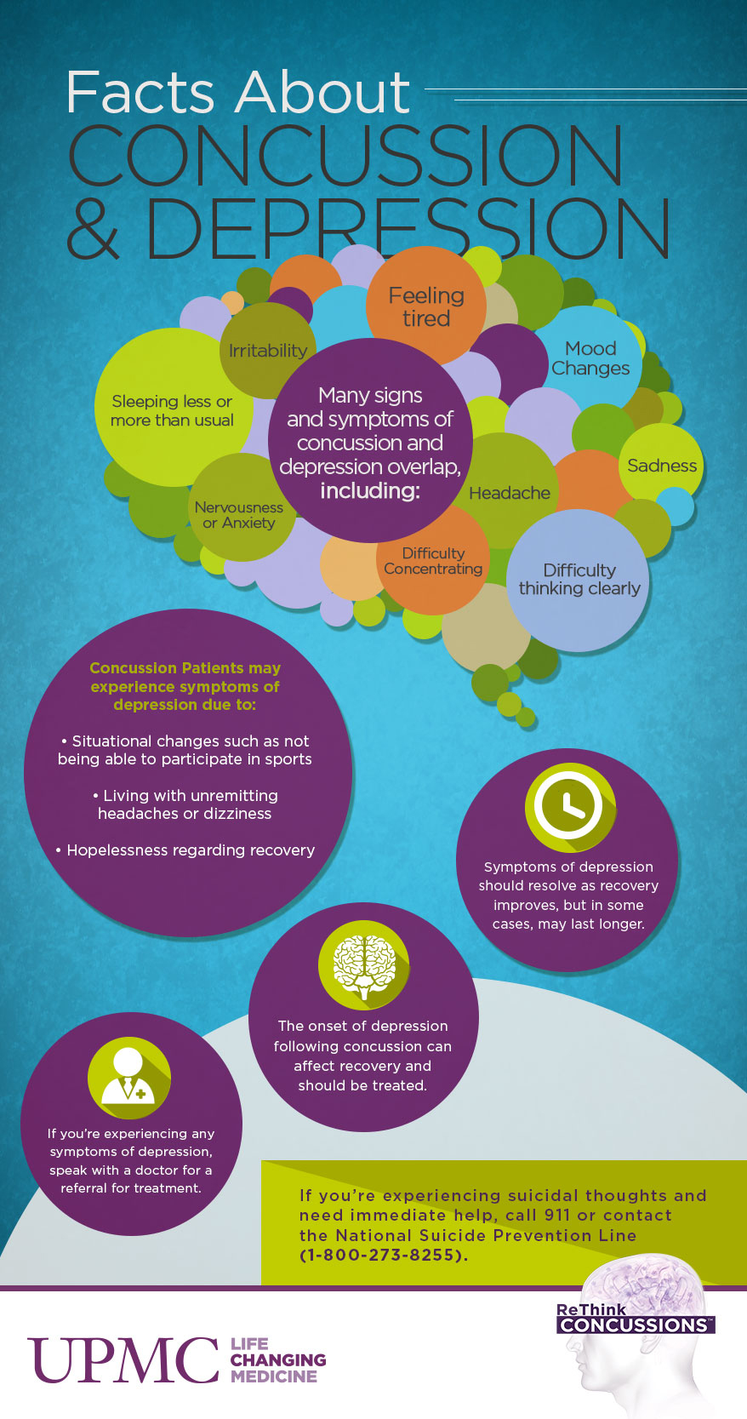
Clinical Pearls
Educating athletes on all symptoms of a concussion
  Depressive and mood symptoms
  Anxiety as a prolonged symptom
RTP decisions that include psychological symptoms
Use of POMS or similar questionnaire in baseline testing and determining return-to-play
Meier et al, 2015; Price at al, 2019; Rice et al, 2018; Yang et al, 2015

Slide 23

Current & Future Research
Limitations
  Single reviewer
  One database
Future Research
  Link between acute anxiety and depression post-concussion
  Dissipation of psychological symptoms before RTP
Medical News Today

Slide 24

It is normal…
We must allow for emotions during any evaluation
Brain injuries can alter the emotional response
Knowing our athletes allows us to understand their emotional responses
Return to play should involve a determination of their return to their regular emotional state
NHL

Slide 25
Conclusions
Psychological symptoms are important considerations in the psychosocial health and wellbeing of athletes with concussions throughout the healing process, and these symptoms should be addressed during return to play protocol.

Slide 26
Questions?

