Slide 1
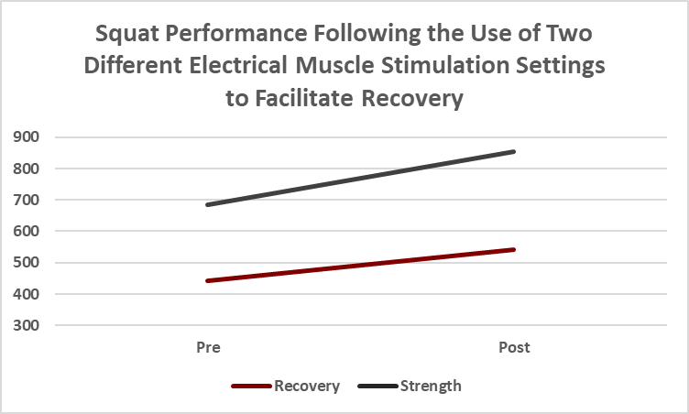
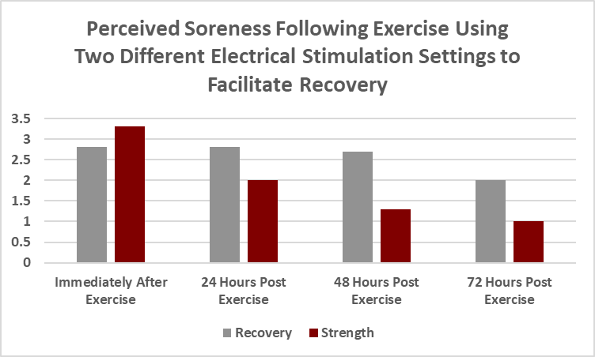
Use of Electrotherapy to Facilitate Post- Exercise Muscle Recovery and Perceived Soreness
Madison Siebenaler, Tyler Hansen, Nicholas Costa, and Valerie Moody
School of Integrative Physiology and Athletic Training, University of Montana, Missoula, MT
Introduction
Methods (Continued)
Results (Continued)
Electrical stimulation is often used to modulate pain and facilitate recovery following injury. However, research is inconclusive regarding the use of electrical stimulation as a means of performance recovery. The purpose of this study was to determine if electrical muscle stimulation following exercise was effective in reducing perceived soreness and improving muscle recovery. Our hypothesis was that the higher intensity protocol would decrease muscle soreness, relative to a low intensity protocol.
The first treatment was delivered to the dominant quadriceps for 20 minutes. Subjects returned at 24, 48 and 72 hours to rate perceived soreness and receive the same Compex treatment.
Upon completion of the final treatment, subjects performed double leg bodyweight squats to failure and the number of squats were recorded. Two weeks passed before subjects returned to complete the other trial following the same procedures.
A 2 x 4 repeated measures ANOVA was conducted for perceived soreness to determine if significant differences exist in recovery between time points.
A 2 x 2 repeated measures ANOVA was conducted for squats to determine if a significant difference exists in squat performance between trials. Microsoft Excel and SPSS 25.0 were used for data analysis.
Purpose
The purpose of this study was to determine if high intensity electrical muscle stimulation following exercise was effective in reducing perceived soreness and improving muscle recovery. A single device was applied using different recovery settings to determine if the change in intensity reduced the amount of overall perceived soreness of the affected muscles after the completion of the treatment.
Methods
Results
A repeated measures design was used for this study, whereby a non-random sample of 7 subjects (4 males, 3 females) participated in two trials (average age 22.3 + 3.0 years; height 64 + 6.8 inches; weight 190.8 + 54.7lbs).
The two trials included a high intensity stimulation protocol and low intensity stimulation protocol using the Compex Sport Elite 2.0 portable electrical stimulation unit.
On the first day, subjects reported a baseline level of soreness (numeric rating scale provided) before performing double leg bodyweight squats to self-reported failure.
A 2x2 (time x trial) repeated measures ANOVA was conducted for squat performance which revealed no statistical significance (p = 0.11).
Similarly, a 2x4 (trial x time) repeated measures ANOVA was completed for perceived soreness and was not statistically significant (p = 0.36).
However, trends suggest that performance and perceived soreness improved with the use of muscle stimulation to facilitate recovery regardless of setting.
Conclusion
While the results of the study suggest that both performance and perceived soreness might improve with the use of electrotherapy, further research is warranted examining this influence on a larger sample size.
A higher intensity setting demonstrated a greater trend in reducing soreness when compared to a lower intensity setting; however, both settings resulted in comparable squat performance.

