Slide 1
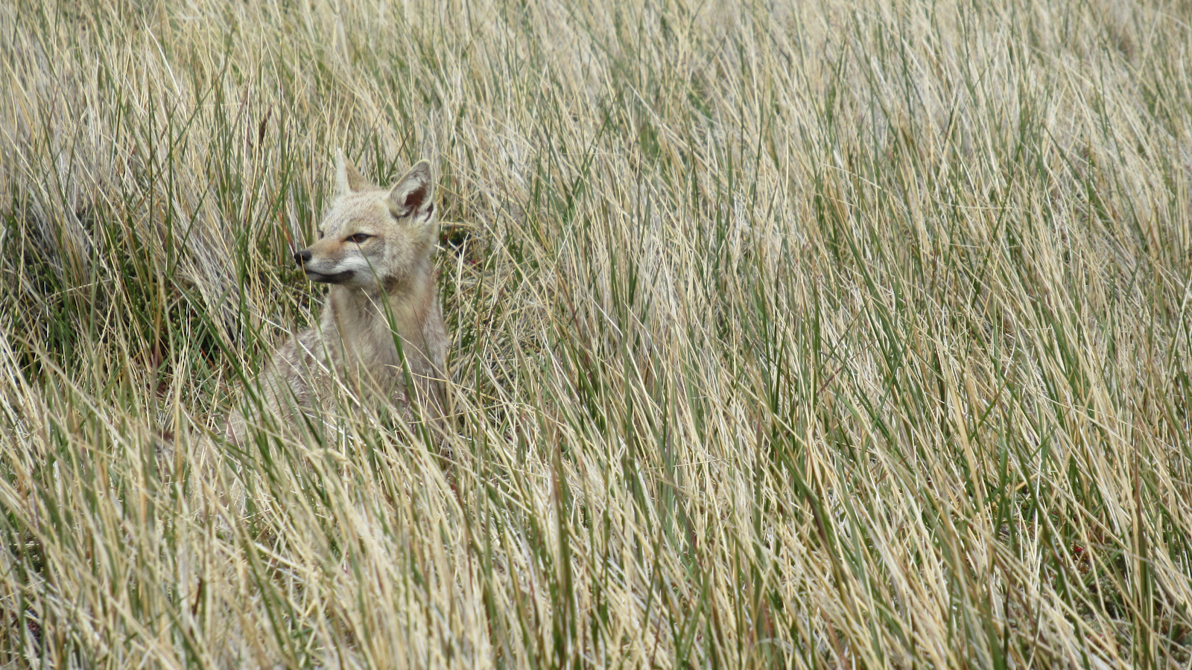
A wolf in fox’s clothing? Using stable isotopes to quantify ecological replacement
T.J. Clark
Notes:
Hello everyone, my name is T.J. Clark, and thank you for inviting me to present at GradCon 2021.
Today I will be presenting on my research titled “A wolf in fox’s clothing? Using stable isotopes to quantify ecological replacement”.

Slide 2
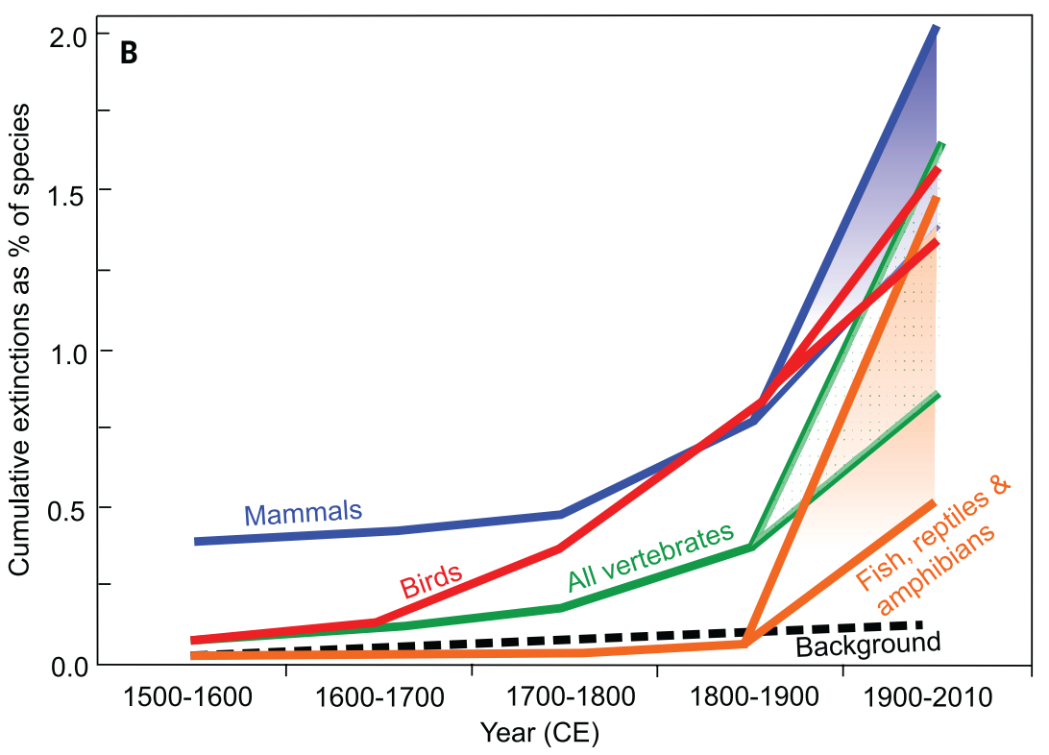
The Sixth Extinction
1000 to 10000 times the extinction rate in the fossil record!
Notes:
Scientists are suggesting that humans are currently in a sixth mass extinction, where the current rate of animal extinction is 1000 to 10000 times the rate found in the fossil record.
Notice that this is most pronounced in mammals, especially large ones.

Slide 3
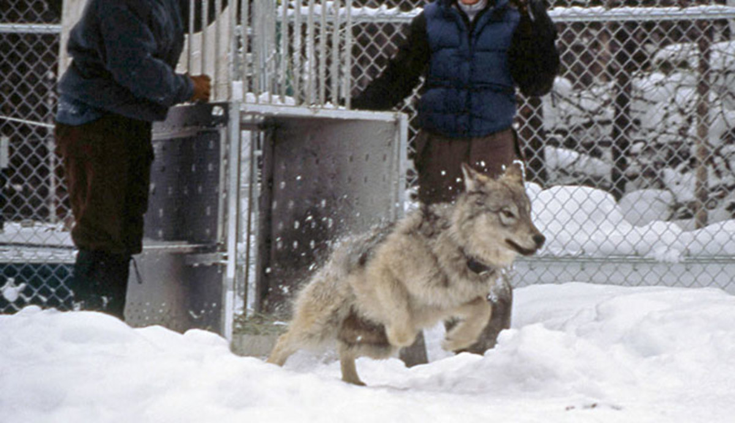
Conservation Biology
Notes:
In an effort to reverse the harm we done and bring back species from the brink of disaster, humans have been increasingly employing conservation biology to save species.
This includes techniques like reintroduction, where we introduced wolves into areas where they weren’t found like central Idaho and Yellowstone. Big successes.

Slide 4
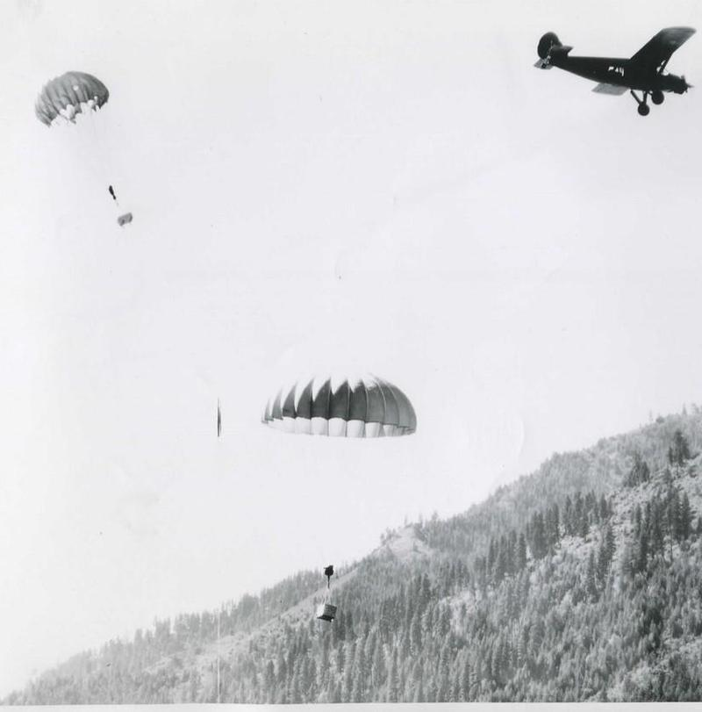
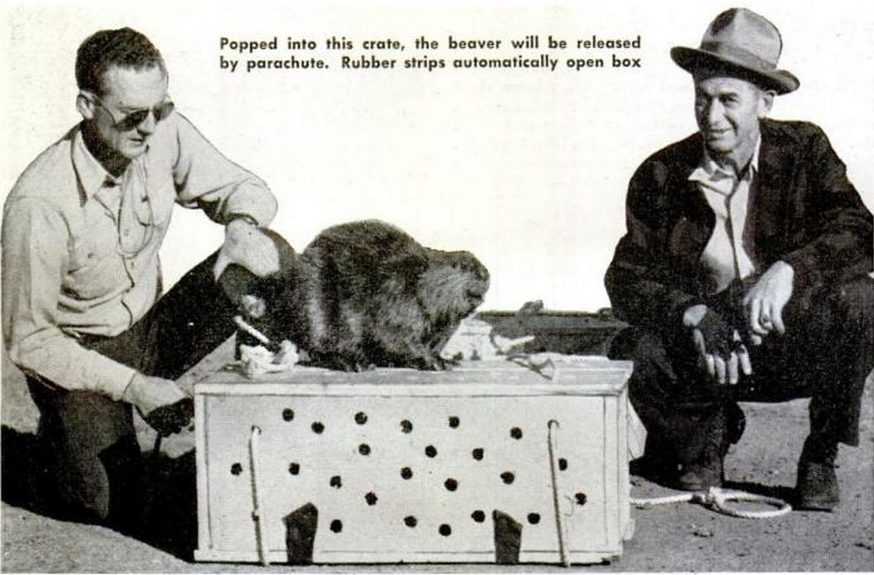
Heter (1950) JWM
Notes:
Humans are also willing to try even more unique and controversial techniques, like moving animals to places they cannot reach naturally.
In this examples, wildlife managers in Idaho in the 1950s transplanted beavers back into their native range in the Frank Church Wilderness using airplanes and parachutes!

Slide 5
What do we do when species go extinct?
ECOLOGICAL REPLACEMENT
The replacement of an extinct species by a functionally similar substitute to restore ecological processes.
Notes:
But what do we do when ecosystem services/functions provided by a species are gone because the species went extinct? How can we try to bring ecosystems back to their pre-Anthropocene state?
- We can use a new tool in conservation biology, ecological replacement. This is the replacement of an extinct species by a functionally similar substitute to restore ecological processes.

Slide 6
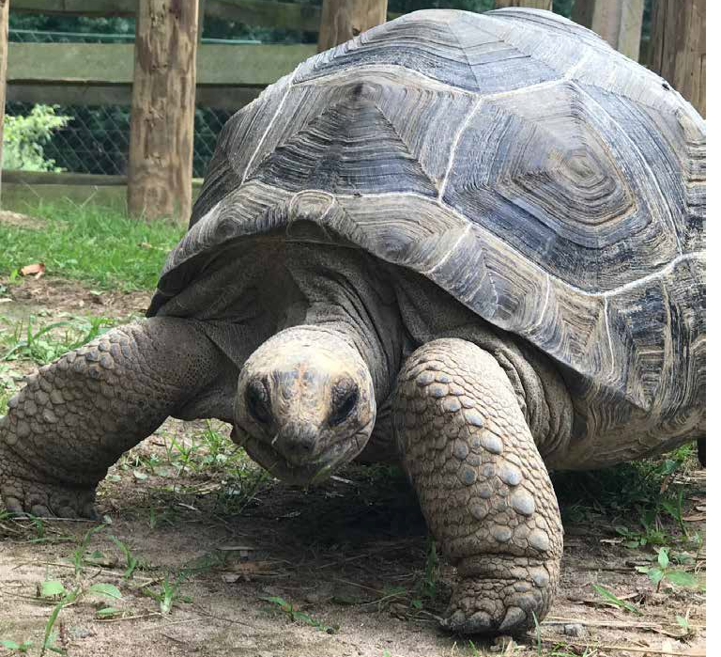
Ecological Replacement with Giant Tortoises!
Notes:
- For example, this idea of ecological replacement is being tested with giant tortoises!

Slide 7
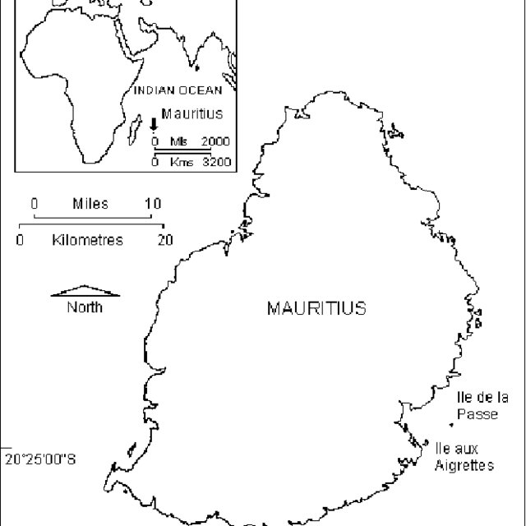
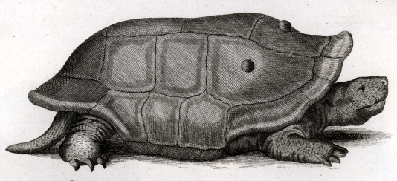
Notes:
Just to put us in perspective, let’s focus on the French island nation of Mauritius off the coast of Madagascar.
There used to be giant tortoises that lived on this island. But they eventually all went extinct due to human hunting and habitat degradation.

Slide 8
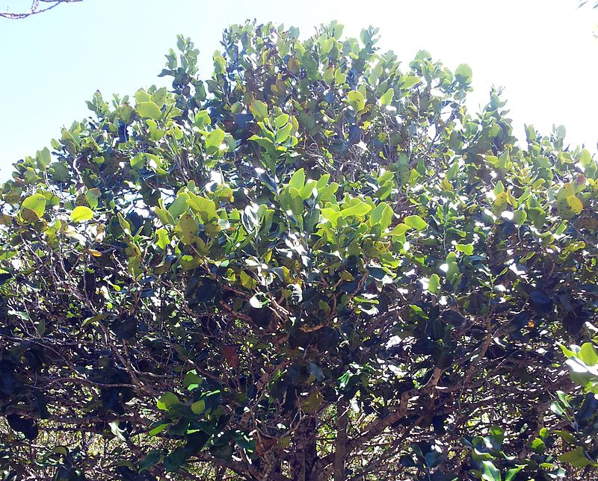
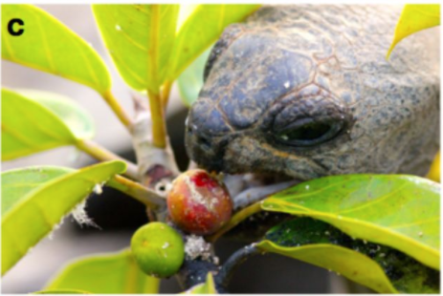
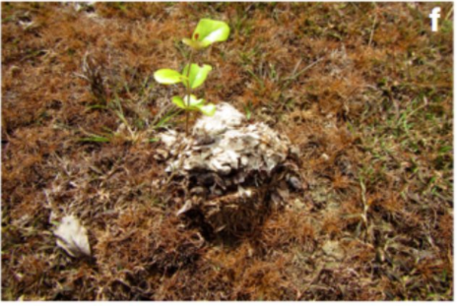
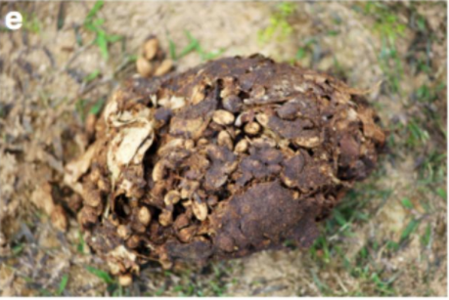
Falcon et al. (2020) Biol. Rev.
Notes:
Which was a problem for the Mauritian ebony tree – whose seeds were only fertilized well by giant tortoises.
Due to the loss of giant tortoises on these islands, the Mauritian ebony tree became threatened and limited in its range.

Slide 9
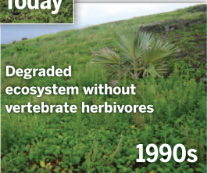
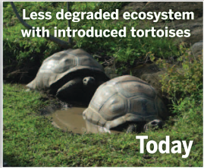
Seddon et al. (2014) Science
Notes:
Eventually, this led to a degraded ecosystem that was dominated by invasive plants. As seen in the picture in the 1990s.
To replace the extinct giant tortoises, conservationists introduced Aldabra giant tortoises to help replace the fertilization function that past extinct giant tortoises performed.
This successfully improved the ecosystem by allowing dispersal and fertilization of the Mauritian ebony tree.

Slide 10
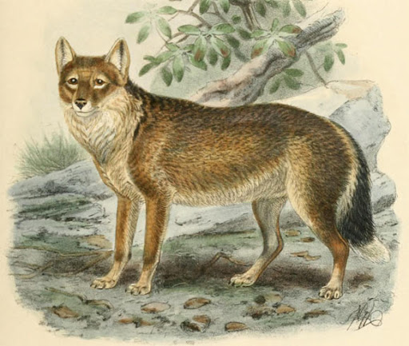
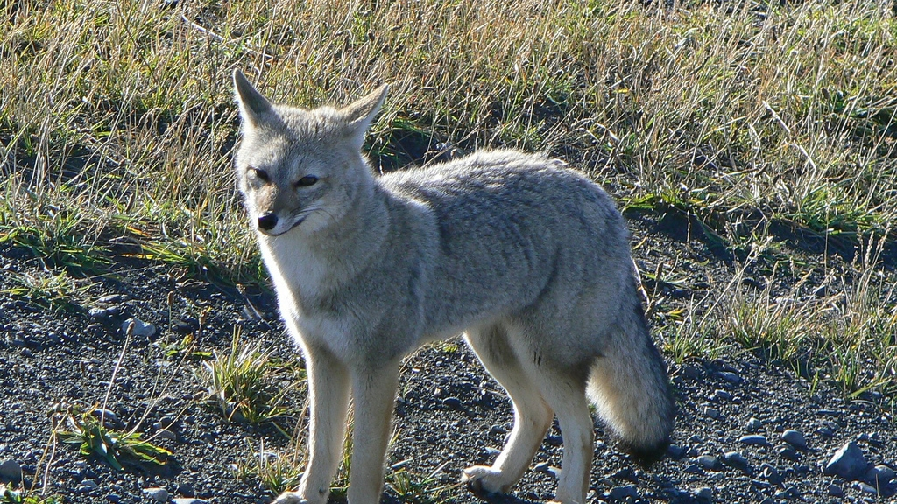
Not all replacements need to be intentional…
Replacement by Invasive Species
South American grey fox (Lycalopex griseus)
Falkland Islands wolf (Dusicyon australis)
Notes:
But not all ecological replacements have to be intentional…
In some cases, introduced or invasive species can putatively replace the ecological role that an extinct species once performed.
We normally think of invasive species as bad things. Think about all the damage that spotted knapweed or zebra mussels are doing in Montana, and our efforts to eradicate them.
But I’m going to tell you about an example of an invasive species, the South American grey fox, that may be replacing an extinct species, the Falkland Islands wolf.

Slide 11
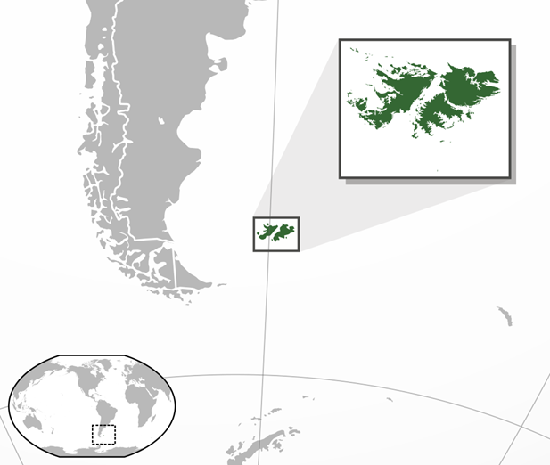
Notes:
To tell this story, let’s set the stage almost 200 years ago on the other side of the world in the Falkland Islands, an archipelago off the coast of Argentina.

Slide 12
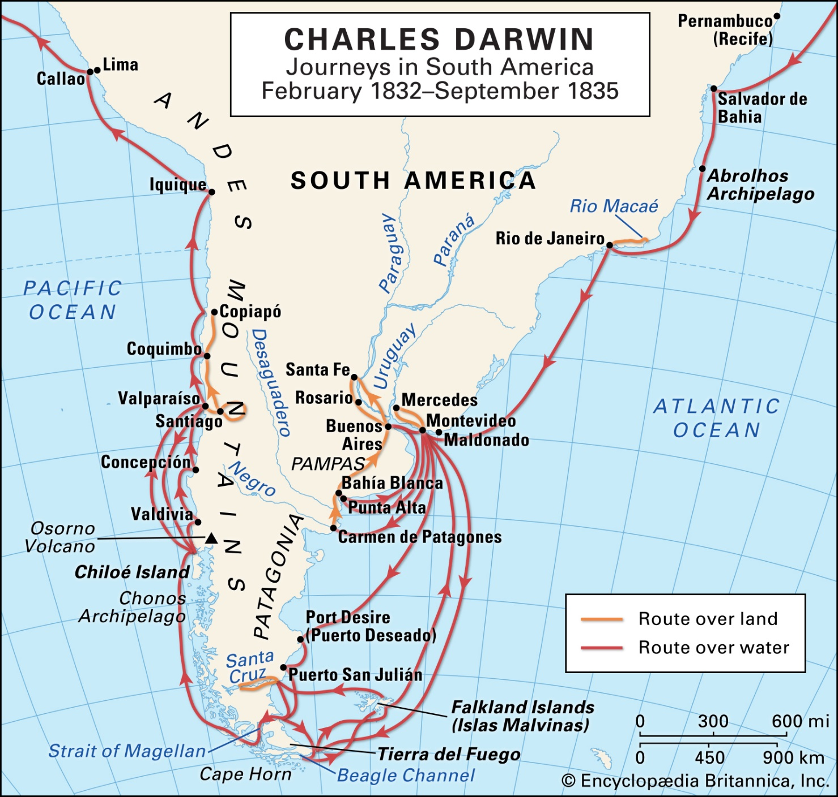
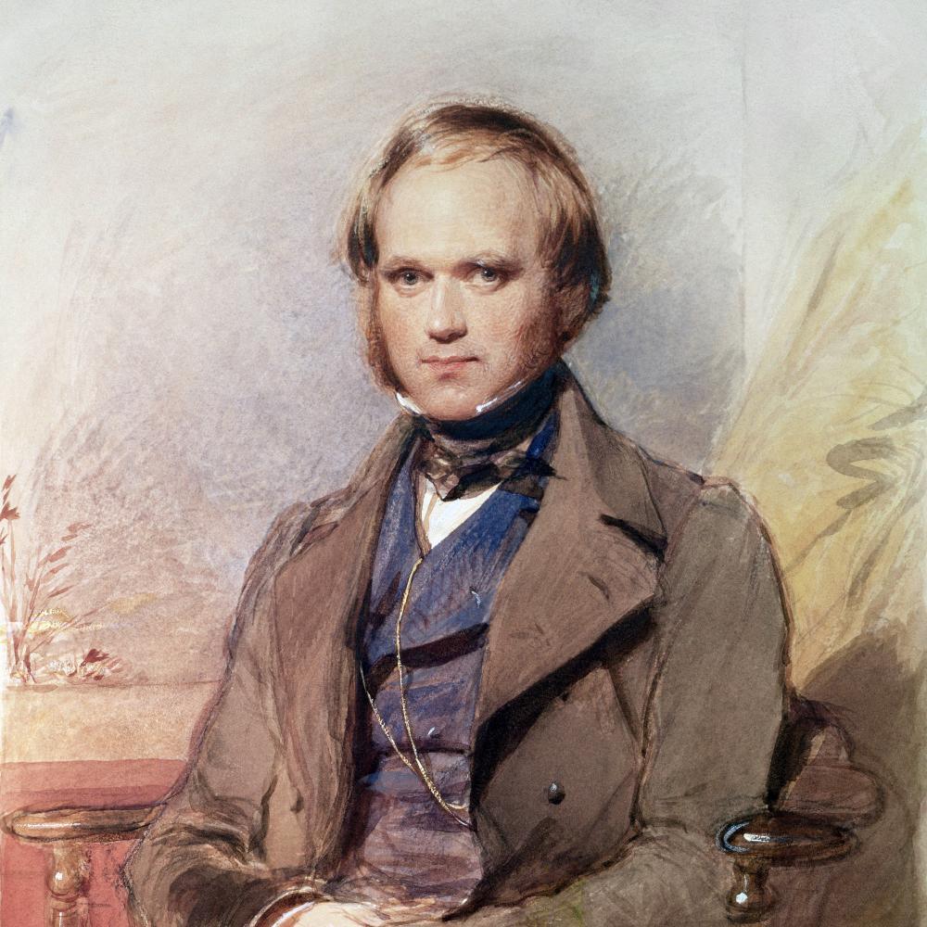
Charles Darwin & the Voyage of the Beagle
Notes:
There in 1833, Charles Darwin landed on the Falkland Islands via the HMS Beagle.
Now, we know of Darwin and his theory of evolution by natural selection. But back in 1833, he was just a young amateur biologist who had just graduated from seminary school. Spurred by a “burning zeal” to conduct science, he jointed the HMS Beagle as a collector while the Beagle surveyed the South American coast for a safe passage around Cape Horn.

Slide 13
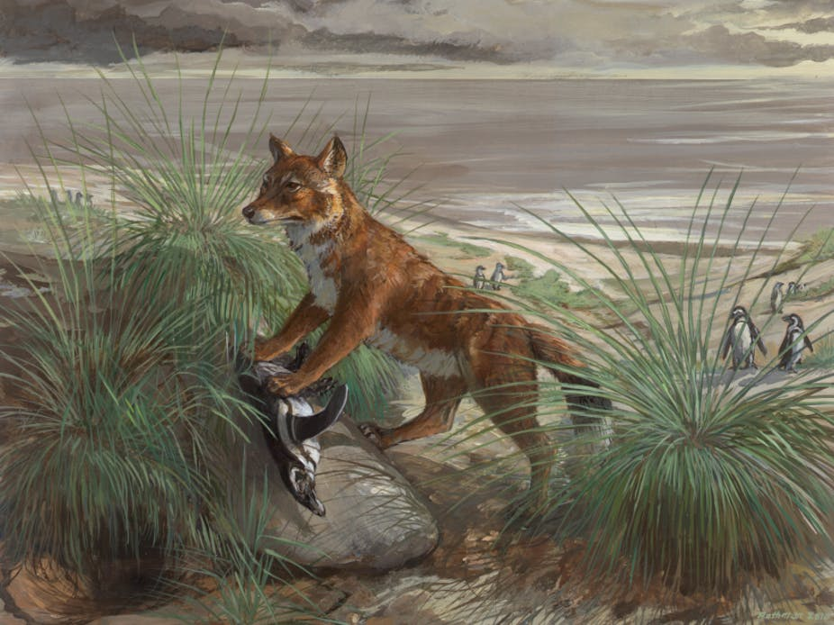
Warrah ~or~
Falkland Islands wolf
(Dusicyon australis)
Credit: Michael Rothman
Notes:
There, Darwin encountered the Falkland Islands wolf, or warrah, illustrated here.
He immediately noted that the large native carnivore of the Falklands was being driven to extinction by overhunting.

Slide 14
Charles Darwin & the Warrah
“Within a very few years after these islands shall have become regularly settled, in all probability this fox will be classed with the dodo, as an animal which has perished from the face of the earth”.
Notes:
To quote: “Within a very few years after these islands shall have become regularly settled, in all probability this fox will be classed with the dodo, as an animal which has perished from the face of the earth”.
So Darwin collected some specimens of the warrah for posterity’s sake before he set back off on the HMS Beagle.
And Darwin was very prescient, as the last Falkland Islands wolf was shot at Shallow Bay, West Falkland in 1876.

Slide 15
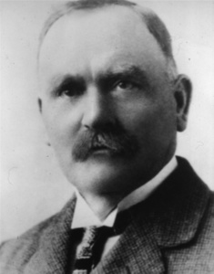
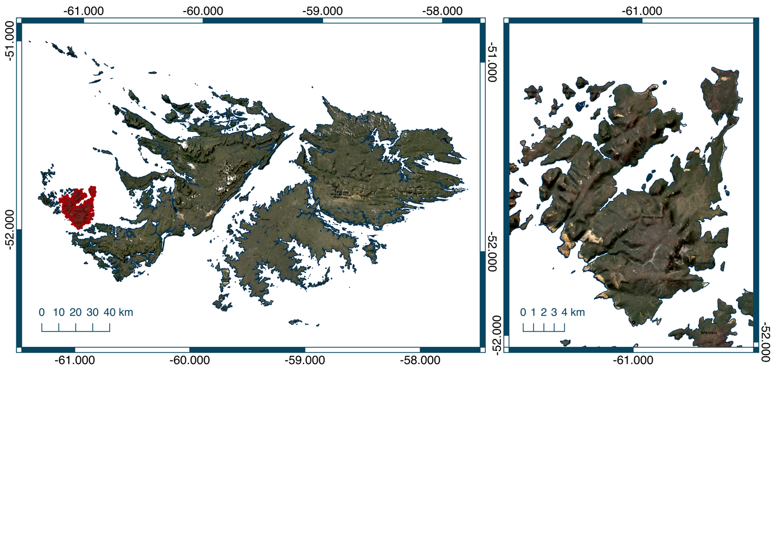
John Hamilton and South American Grey Foxes
Notes:
Almost 100 years later, John Hamilton, a Scottish businessman and entrepreneur, bought Weddell Island in the western Falklands, highlighted in red here.
He was a bit of an experimenter and wanted to try and diversity the Falklands economy, which at that time (and now) relied heavily on sheep farming and wool production.

Slide 16
John Hamilton and South American Grey Foxes
Notes:
And more importantly he introduced many exotic species to the Falklands, including the South American grey fox from mainland Patagonia for fur farming.
This was among other species such as Austral parakeets, buff-necked Ibis, lesser rheas, hog-nosed skunks, sea otters, and guanacos. Also Shetland ponies and highland cattle from his native Scotland.
The only thing that persisted throughout the years, as an invasive, was the South American grey fox. These foxes invaded the islands and have caused declines in native seabirds. They have been eradicated from 3 islands, with complete eradication from all the islands suggested.

Slide 17
Not all replacements need to be intentional…
Replacement by Invasive Species
South American grey fox (Lycalopex griseus)
Falkland Islands wolf (Dusicyon australis)
Notes:
So, in my research, I hypothesizd that South American grey foxes could be unintentional ecological replacements of the extinct warrah.
Although grey foxes are being considered for eradication, if they act functionally like warrahs, then the Falklands ecosystem could be closer to its pre-Anthropocene state with them than without.
Given that these animals effect ecosystems through predation, one tractable way to compare the species to each other is by comparing what they eat. If they eat similar things, maybe foxes can replace warrahs?
Of course, warrahs are extinct, so we have no clue what they eat. How do we figure out what something is eating on that went extinct 100s of years ago?

Slide 18
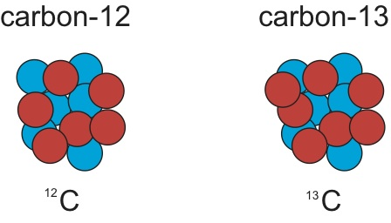
Stable Isotopes!
Light
Heavy
Notes:
-One solution to figure out what extinct species are eating is to look at stable isotope ratios in the hair of the species.
Each type of atom or element has heavy and light versions, most of the atoms in nature are the light versions.
There are also a small amount of some heavy atoms which we can track, as they move through the food chain from plant to herbivore to predator.

Slide 19
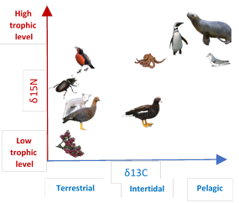
Stable Isotopes!
High
Trophic
Level
Stable isotopes of the elements carbon and nitrogen can show what animals are eating.
Nitrogen
Low
Trophic
Level
Carbon
Terrestrial
Aquatic
Aquatic
Notes:
Stable isotopes occur everywhere, (in you and me) and scientists have figured out that if you look at stable isotopes of the elements carbon and nitrogen, they reliably predict what an animals is ingesting and incorporating into their body, and subsequently, their hair. In other words, you are what you eat!
So if we plot carbon stable isotopes on the x-axis, and nitrogen stable isotopes on the y-axis, we can plot across the range of what an animal would eat.
For example, increasing carbon stable isotopes indicate that the predator is eating more pelagic, or aquatic prey.

Slide 20
Stable Isotopes!
High
Trophic
Level
Stable isotopes of the elements carbon and nitrogen can show what animals are eating.
Nitrogen
Low
Trophic
Level
Carbon
Terrestrial
Aquatic
Aquatic
Notes:
Whereas increasing nitrogen stable isotopes indicate that the predator is eating higher trophic level, or up the food chain.

Slide 21
Stable Isotope Analysis
High
Trophic
Level
Penguins!
Nitrogen
Low
Trophic
Level
Berries!
Carbon
Terrestrial
Aquatic
Aquatic
Notes:
This gives us the ability to measure what animals are or were eating based off of their body tissues like hair.
So let’s say we wanted to compare what foxes and warrahs were eating. We can now plot what these animals could potentially eat in this carbon nitrogen graph.
For example, in the top right corner we have penguins, which are aquatic and eat fish, which are high in the food chain.
In the other corner, we have berries, which are terrestrial and low trophic level since they are primary producers.

Slide 22
Stable Isotope Analysis
Falkland Islands
wolf
South American
grey fox
Notes:
So if we are able to obtain hair from the South American grey fox and Falkland Islands wolf, we can figure out their stable isotope values, and plot them on this graph.
This will then tell us overall what they are eating by their overlap on this graph.
For example in this blue circle, South American grey foxes are eating more terrestrial, lower down on the food chain prey like geese, berries, and insects.
If they don’t line up on this graph, then they aren’t eating similar things, and likely can’t be functionally similar to each other.

Slide 23
Stable Isotope Analysis
Falkland Islands
wolf
South American
grey fox
Notes:
However, if they do highly overlap, than there may be proof that the South American grey fox replicates the Falkland Islands wolf’s role in the Falklands!
So for this research, I went out to test this hypothesis using stable isotope analyses.

Slide 24
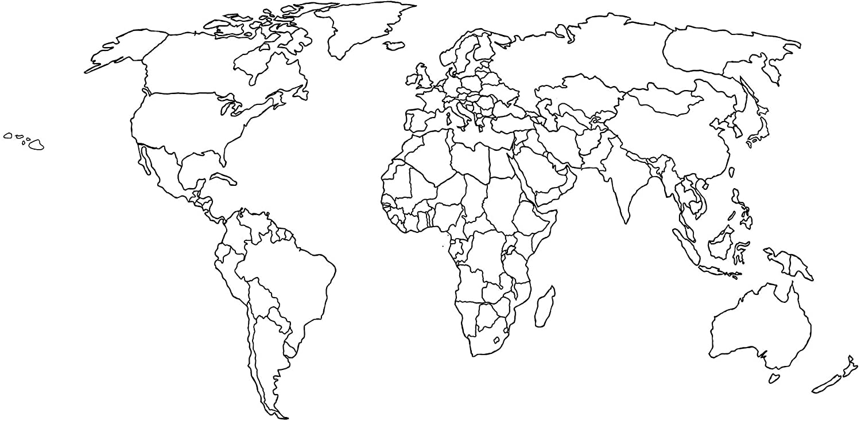
Notes:
First, we had to collect hair samples from the extinct specimens left across the world’s museums.
We were able to collect hair samples for isotope analysis from 8 of the 9 skins held in museum specimens. Generous, generous donation.
Natural History Museum samples were collected by Charles Darwin himself!

Slide 25
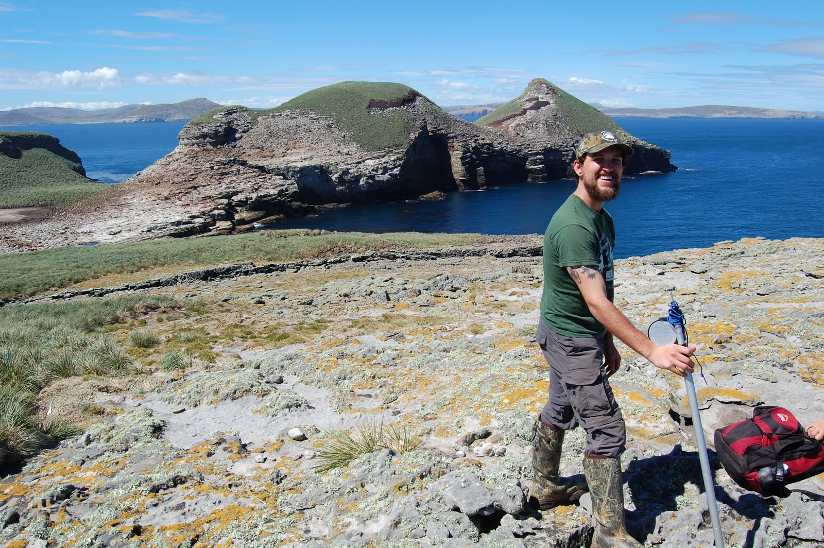
Notes:
I also went down to the Falkland Islands to collect hair samples of the invasive South American grey fox.

Slide 26
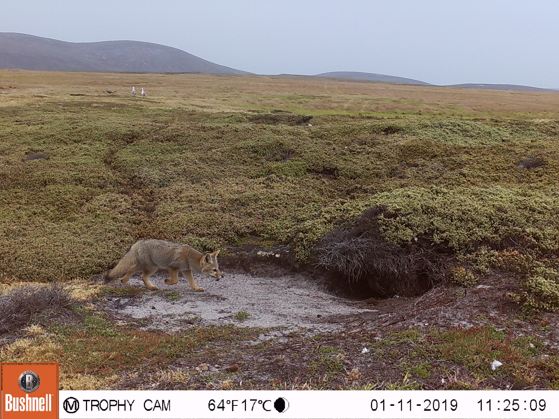
Notes:
And there, we observed the invasive South American grey fox.
Here is one that we pictured on our cameras, near its den.

Slide 27
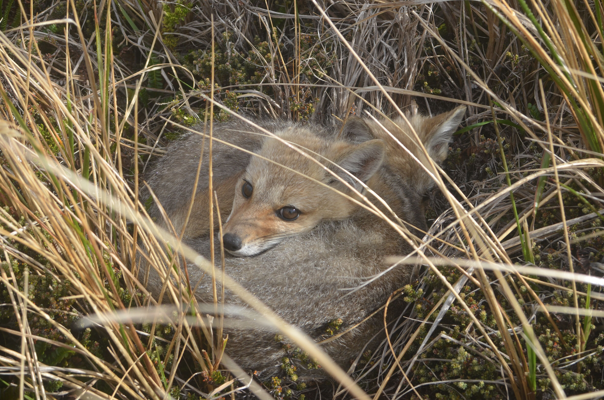
Notes:
- Some fox kits we found.

Slide 28
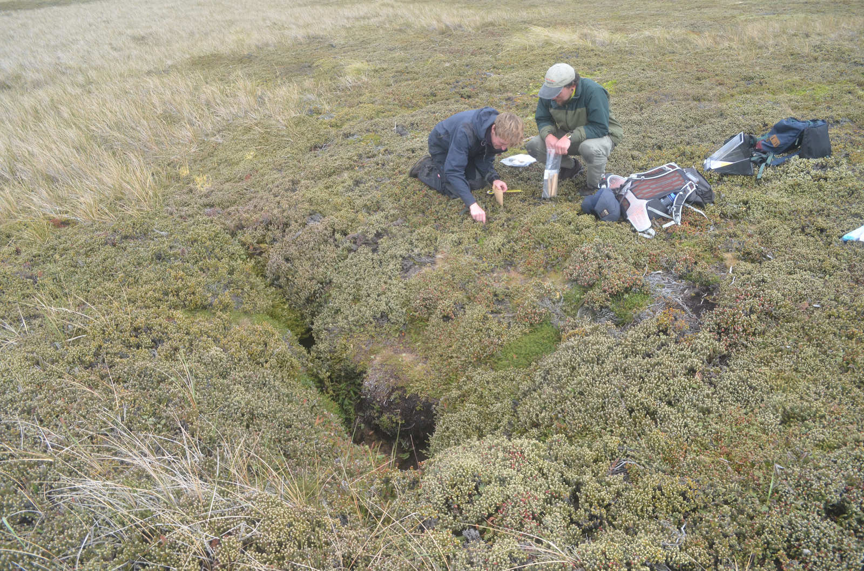
Notes:
- This involved a lot of slowly walking around den sites and collecting hairs. Here is me on the right with a Masters student at the University of Glasgow I collaborated with, Bugge Vick.

Slide 29
Not all replacements need to be intentional…
Replacement by Invasive Species
South American grey fox (Lycalopex griseus)
Falkland Islands wolf (Dusicyon australis)
Notes:
So, once we collected these samples, we ran stable isotope analysis on these samples using mass spectrometry to answer the question of whether foxes were replacing wolves…
Here are our results!

Slide 30
High
Trophic
Level
20
SAGF
15
Fruit
Terrestrial
Invertebrates
Nitrogen
Higher Marine
Predators
10
Marine
Herbivores
Terrestrial
Herbivores
5
Low
Trophic
Level
-25
-20
-15
-10
Terrestrial
Aquatic
Carbon
Notes:
- First, We got stable isotope values from sources that SAGFs eat. This lined up with our previous ideas of where these prey would lie on our carbon-nitrogen graph.
- So if we plot these isotope values on our previous graph of carbon vs. nitrogen – we can see that south American grey foxes, shown with the blue dots, tend to be pretty generalist – tending towards fruit and terrestrial invertebrates in the bottom left corner, and not eating as much of marine herbivores or higher marine predators like penguins in the top right corner.

Slide 31
High
Trophic
Level
20
SAGF
19th c. FIW
15
Fruit
Terrestrial
Invertebrates
Nitrogen
Higher Marine
Predators
10
Marine
Herbivores
Terrestrial
Herbivores
5
Low
Trophic
Level
-25
-20
-15
-10
Terrestrial
Aquatic
Carbon
Notes:
And if we look at the Falkland Islands wolf, we can see that the diet overlaps pretty well with the blue dots, maybe a bit higher up!
This shows that the South America grey fox acts as a functional replacement for the Falklands Islands wolf via predation.
And that the invasive species could fulfill the predatory role in the Falklands, and may be returning the ecosystem to its pre-Anthropocene state.

Slide 32
Not all replacements need to be intentional…
Replacement by Invasive Species
South American grey fox (Lycalopex griseus)
Falkland Islands wolf (Dusicyon australis)
Notes:
So therefore we found evidence and created a quantitative method to evaluate a new conservation tool, ecological replacement.
This won’t resolve the debate over what in our world is natural vs. unnatural, but will move conservation biology towards a more quantitative way of collecting evidence.

Slide 33
What do we do when species go extinct?
ECOLOGICAL REPLACEMENT
The replacement of an extinct species by a functionally similar substitute to restore ecological processes.
Notes:
This gives conservationists, including in Montana, much needed quantitative evidence to consider and use ecological replacement as a tool, especially in circumstances where extinction has left big gaps in our natural ecosystem.

Slide 34
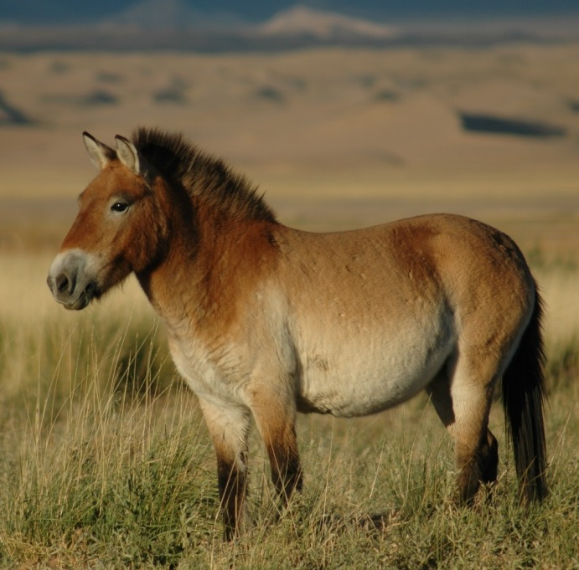
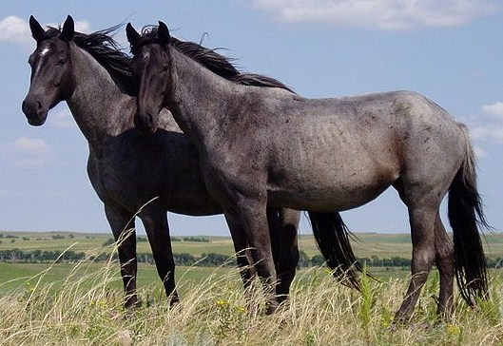
ECOLOGICAL REPLACEMENT
Domesticated, feral horses (Equus ferus caballus)
Wild horses (Equus ferus)
Notes:
And this technique could help answer the role of introduced species belonging on the landscape.
For example, could “invasive” feral horses roaming throughout MT and the American West replace the role of wild horses that went extinct 12,000 years ago?
In sum, our research could provide much needed quantitative evidence to bear on such questions.

Slide 35
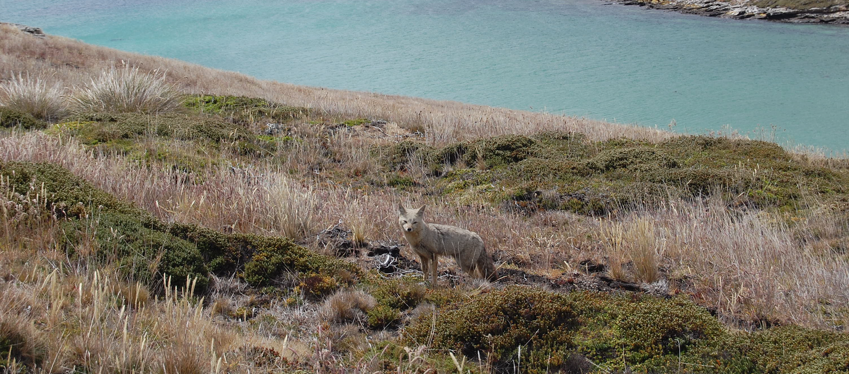
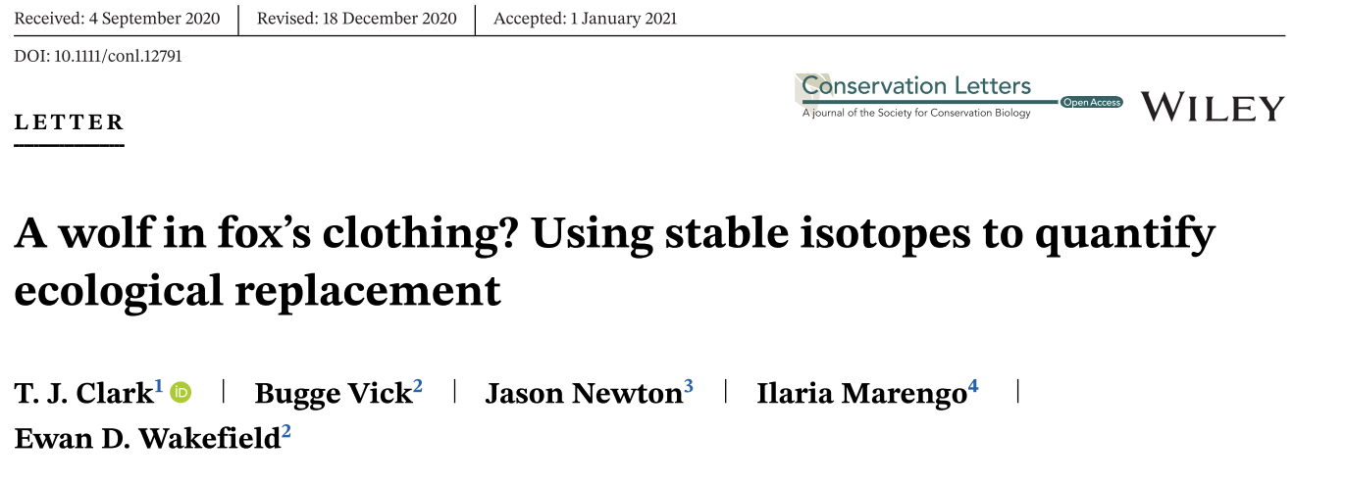
The End!
Notes:
- I’d like to thank my collaborators, Bugge Vick, Jason Newton, Ilaria Marengo, and Ewan Wakefield for their invaluable support on this project.
And the museums that donated samples.
You can find this research in full published in Conservation Letters.
Thanks!

