Slide 1
Dating During COVID-19: Initiating and Negotiating Romantic Relationships
Ashley Arsenault, Maggie Brock, Sheena Brown, Jeremy Miner, and Elizabeth Sholey
Notes:
Lizzy

Slide 2
Main Problem
Initiating and Negotiating Romantic Relationships During a Pandemic
Notes:
Lizzy

Slide 3
Relational Turbulence Theory
Developed by Solomon and Knobloch
How partners negotiate and manage turbulent events have important repercussions for
Developing Intimacy
Managing Relational Uncertainty
Establishing Interdependence
(Theiss, 2005 p. 54).
Notes:
Lizzy

Slide 4
Relational Turbulence Theory
Self-Uncertainty: doubts experienced regarding an individual’s own interest or involvement in a relationship
Partner Uncertainty: concerns partner has about their significant other’s involvement in the relationship
Relationship Uncertainty: abstract concept of the status of the relationship
Notes:
Lizzy
How does the relationship change when the partners are examined as a unit and not individually?

Slide 5
Practical Implications
As relationships increase in intimacy, the amount of turbulence experienced in the relationship will increase as well
Notes:
Jeremy
COVID-19 adds another turbulence to relationships which may make increasing intimacy more difficult than it would be under normal circumstances

Slide 6
Research Questions
RQ1: How have individuals initiated romantic relationships during the course of the COVID-19 pandemic?
RQ2: How are newly established romantic interests negotiating physical closeness in the beginning dating phase of their relationship during the COVID-19 pandemic?
Notes:
Jeremy

Slide 7
Hypotheses
H1: The increase of any of three types of relational uncertainty (self, partner, and relationship) will result in relational turbulence.
H2: The increase of perceived relational turbulence in dating relationships since the onset of COVID-19 will negatively impact disclosure of information (specifically surrounding physical distancing practices, potential exposure to COVID-19, symptoms of illness, and general worries about COVID-19) to social networks.
Notes:
Jeremy

Slide 8
Methods - Participants
147 Participants
Ages 19 – 59; Average 28
Most in U.S.
Notes:
Sheena

Slide 9
Methods - Participants
Notes:
Sheena

Slide 10
Methods - Participants
Notes:
Sheena

Slide 11
Methods - Participants
Notes:
Sheena

Slide 12
Methods - Instruments
COVID-19 Interference
Relational Turbulence
Relational Uncertainty (Self, Partner, Relationship)
Self-Disclosure to Friends and Family
Self-Disclosure to Dating Partner
Confidence in Partner Disclosure
Comfort in Self-Disclosure
Notes:
Ashley
8 of the 9 measures are 5-Point or 6-Point Likert-type Scales
1 of the 9 measures is a 7-point Semantic Differential Scale
COVID-19 Interference 4 items, Relational Turbulence 4 items, Relational Uncertainty 15 items total, Self-Disclosure to Friends and Family 6 items, Self-Disclosure to Dating Partner 5 items, Confidence in Partner Disclosure 5 items, Comfort in Self-Disclosure 5 items

Slide 13
Methods - Procedures
Asked Family & Friends to Post on Social Media
Qualtrics Survey
33 Questions
Under 20 Minutes
Mainly Forced-Answer
1 Open-Ended
Notes:
Ashley

Slide 14
Methods - Procedures
Informed Consent
Inclusion Criteria
18 and Older
Began Dating Relationship March 2020 – Present
Face-to-Face Interaction with Partner
Notes:
Lizzy

Slide 15
Results – RQ1 Quantitative
Participants that disclosed how they met their romantic partner
46 met in-person
86 met online
Tinder (25 participants; 30%)
Bumble (18 participants; 21%)
Hinge (14 participants; 16%)
Notes:
Jeremy: Answered through the demographics section of our survey, not through the measurements…

Slide 16
Results – H1 Quantitative
Support for H1
Predicted that any type of uncertainty would predict relationship turbulence
Conducted a linear regression analysis with all three types of uncertainty as the independent variables and relationship turbulence as the dependent variable
Results indicated an overall effect
But self-uncertainty was the only significant predictor of relationship turbulence
Notes:
Maggie: We predicted that any type of uncertainty would predict relationship turbulence; we conducted a linear regression analysis with all three types of uncertainty as the independent variables and relationship turbulence as the dependent variable. The results indicated an overall effect (R = .51, F = 11.81, p < .001), but self-uncertainty was the only significant predictor of relationship turbulence (ß = 2.40, t = 2.09, p < .05).

Slide 17
Results – H2 Quantitative
H2 Unsupported
Predicted that relational turbulence would negatively impact the disclosure of information
Data analysis found that this correlation was not statistically significant
Did find that turbulence predicted lower levels of confidence in partner disclosure through descriptive analysis
But this was not a part of our original research questions or hypotheses.
Notes:
Maggie

Slide 18
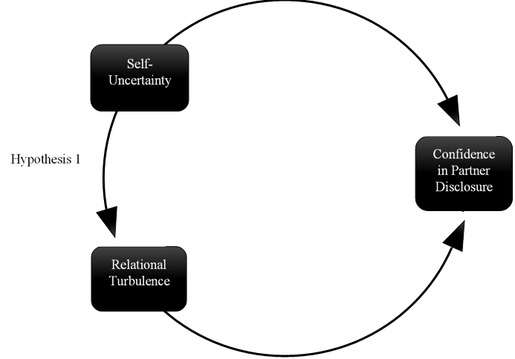
Quantitative Results
Notes:
Maggie: First, self-uncertainty impacts confidence in partner disclosure. If a person doubts their own commitment to a relationship, then they might have lower confidence in their partner’s willingness to discuss pertinent information. Second, relational turbulence impacts a person’s confidence in their partner’s willingness to disclose. If a person has uncertainty about themselves or if the relationship is turbulent, then the participants showed lower levels of confidence in their dating partner’s disclosure.

Slide 19
Results - Qualitative
Notes:
Maggie

Slide 20
Results – RQ2 Qualitative
Newly established romantic couples are negotiating physical closeness by communicating higher levels of COVID-19 and interpersonal disclosure
Notes:
Maggie
Higher levels of COVID-19 and interpersonal disclosure is how newly established romantic interests are negotiating physical closeness in the beginning dating phase of their relationship during the COVID-19 pandemic.

Slide 21
Discussion
Relationships unable to participate in mundane novel experiences
Shared new experiences are associated with high levels of relationship quality
Aron et al. (2000)
Activities are inhibited and/or frowned upon which has the potential to negatively impact relationships
Notes:
Ashley: Being able to trust that a dating partner will disclose information about their COVID-19 exposure that potentially puts those around them at risk is vital since it deals with the health of their social networks. These correlations are significant for two reasons. First, self-uncertainty impacts confidence in partner disclosure. If a person doubts their own commitment to a relationship, then they might have lower confidence in their partner’s willingness to discuss pertinent information. Second, relational turbulence impacts a person’s confidence in their partner’s willingness to disclose. If a person has uncertainty about themselves or if the relationship is turbulent, then the participants showed lower levels of confidence in their dating partner’s disclosure.
newly formed relationships have been unable to participate in mundane novel experiences
According to Aron et al. (2000), “shared participation in novel and around activities was consistently associated with higher levels of experienced and behaviorally expressed relationship quality” (p. 281).
Such activities are inhibited and/or frowned upon which has the potential to negatively impact relationships
“shared participation in novel and around activities was consistently associated with higher levels of experienced and behaviorally expressed relationship quality” (p. 281).

Slide 22
Discussion
If self-uncertainty is high, then relationship turbulence is high
Both partners’ attitudes can contribute to the well-being of the relationship
If one person is feeling uncertain it will add turbulence to the relationship as a whole
COVID-19 turbulence?
Notes:
Ashley: Self-uncertainty as a part of relational uncertainty brings into question the amount that individuals are certain about their own involvement in a relationship (Harvey-Knowles & Faw, 2016).
We were hoping for a direct correlation between COVID-19 as an interference as an explanation for participants' self-uncertainty scores.
However, no viable correlation was found within our quantitative data.
Qual findings indicate that COVID-19 is a turbulence

Slide 23
Conclusions
Limitations
Inconclusive Quantitative Data
Not all Preexisting Measurements
Disclosure is Key
Moderator of Turbulence
Increase Intimacy
Notes:
Ashley: Qualitative data: Comm is a moderator of the turbulence COVID-19 creates

Slide 24
Thank you!
For additional comments or questions contact:
Jeremy.Miner@umconnect.umt.edu
Notes:
Sheena

