Slide 1
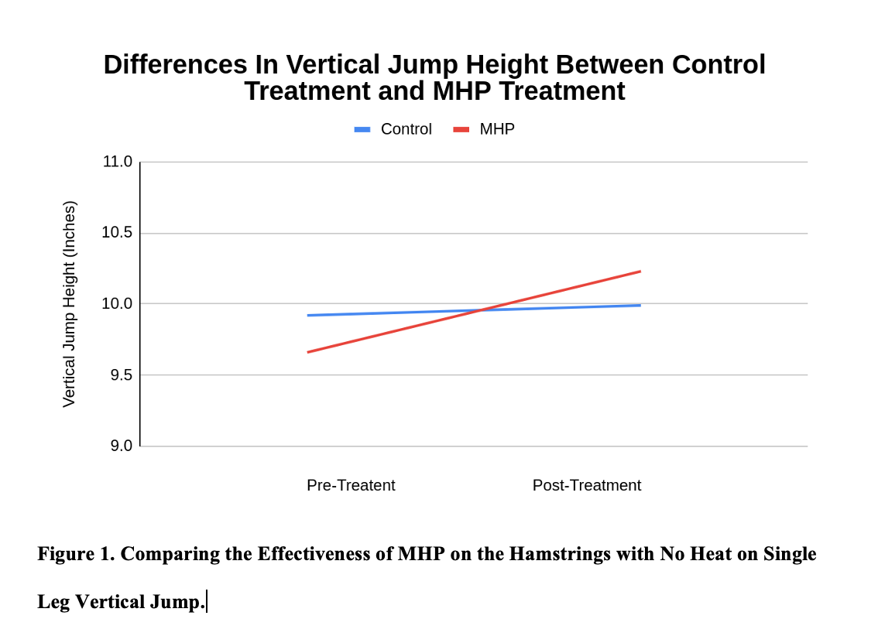
Assessing Effectiveness of Using a Moist Heat Pack
Prior to Single Leg Vertical Jump Performance
TediJo Todd, Sola Yeager, Katlyn Norton, and Valerie Moody
School of Integrative Physiology and Athletic Training, University of Montana, Missoula, MT
Introduction
Methods (Continued)
Results
Thermotherapy techniques, such as moist heat pack (MHP), produce increased circulation and metabolism, decreased pain, decreased muscle spasm, and decreased tissue stiffness. An increase in muscle elasticity causes an increase in flexibility, which can lead to an increase in range of motion. However, there is limited research directly related to the effect of MHP on functional performance since much of the research is indirectly associated with flexibility and range of motion.
When examining the hamstring muscle group, with increased muscle elasticity, flexibility, and range of motion, respectively, it is likely that one will see an increase in performance test scores. For those athletes that wish to increase their power and vertical jump, applying a MHP on their hamstrings before activity may be beneficial.
Procedures
Prior to the start of the study, each participant's age, height, and weight was obtained. Prior to each data collection session, participants were asked if they were still injury free and to confirm if they abstained from exercise that morning.
Jump Instruction
Participants were instructed to jump barefoot, on their dominant leg. Participants were permitted to swing their arms during the jump, but were not allowed to bend their knees and dip to load prior to the jump.
Pre-Treatment
Participants performed three pre-treatment vertical jumps on the Just Jump! Just Run!© mat. The lowest score was eliminated and the average of the two best jumps was taken and recorded. The participants were then randomly selected to receive the moist heat pack treatment or the control treatment using a random number generator.
Control
For this trial, participants laid on the treatment table in a prone position for 10 minutes and received no heating treatment. After 10 minutes, the participants performed three more vertical jumps. The lowest height was eliminated while an average was taken of the remaining two heights. The average was recorded.
Moist Heat Pack
Participants laid on the treatment table in a prone position and the moist heat pack was placed on the hamstring muscle group of the dominant leg for 10 minutes. After treatment, the participants performed three more vertical jumps. The lowest height was eliminated and the average was taken from the remaining two jumps. The average was recorded.
Data Analysis
Microsoft Excel was used to calculate descriptive statistics for each participant’s height, weight, and age along with their vertical jump measurements. A 2 x 2 (trial x time) repeated measures ANOVA using SPSS v26.0 was used to calculate mean difference between the control and moist heat pack trial. Significance was set a priori at p = 0.05.
The 2 x 2 repeated measures ANOVA revealed no statistical difference between the moist heat pack and control groups on vertical jump performance (p = 0.15). While there was a trend for both groups' vertical jump to improve after the intervention, a main effect for time was not demonstrated.
Purpose
The purpose of this study was to explore and assess the effectiveness of a moist heat pack on single leg vertical jump performance. We hypothesized that an increase in vertical jump performance would be observed after the application of the moist heat pack treatment, in comparison to jumping after the control treatment.
Methods
Design
A repeated measures design was used for this study. Each participant received the moist heat pack treatment and the control treatment. Treatment order was randomized using a random number generator. Treatments were administered during two separate days of data collection that were three weeks apart. On the first day of data collection, participants were administered a treatment selected by the number generator. During the second day of data collection, the participants were administered the alternative treatment.
Participants
A convenience sample of five, healthy, 1st year MAT students were selected for this study (age: 23.2 ± 4.38 years, height: 68 ± 4.38 in, weight: 198.2 ± 4.38 lbs). Students were eligible for inclusion into this study if they did not have any current lower extremity injuries which could affect vertical jump performance (ankle sprains, muscle strains, or contusions) and were enrolled in the Therapeutic Modalities course. Students were instructed to abstain from exercising the morning of data collection.
Conclusion
Applying MHP on hamstrings prior to vertical jump does not significantly affect vertical jump performance. The results of this study show that static MHP tissue heating does not improve single leg vertical jump performance. This is important for clinicians as it shows that superficial soft tissue heating does not affect power production. Athletes who regularly apply a MHP to soft tissue in an effort to boost performance should engage in some sort of active warm up exercises and stretching or alternative modality to warm the tissue. By engaging in these systemic warmups, athletes will heat multiple muscle groups which may lead to an increase in performance.

