Slide 1
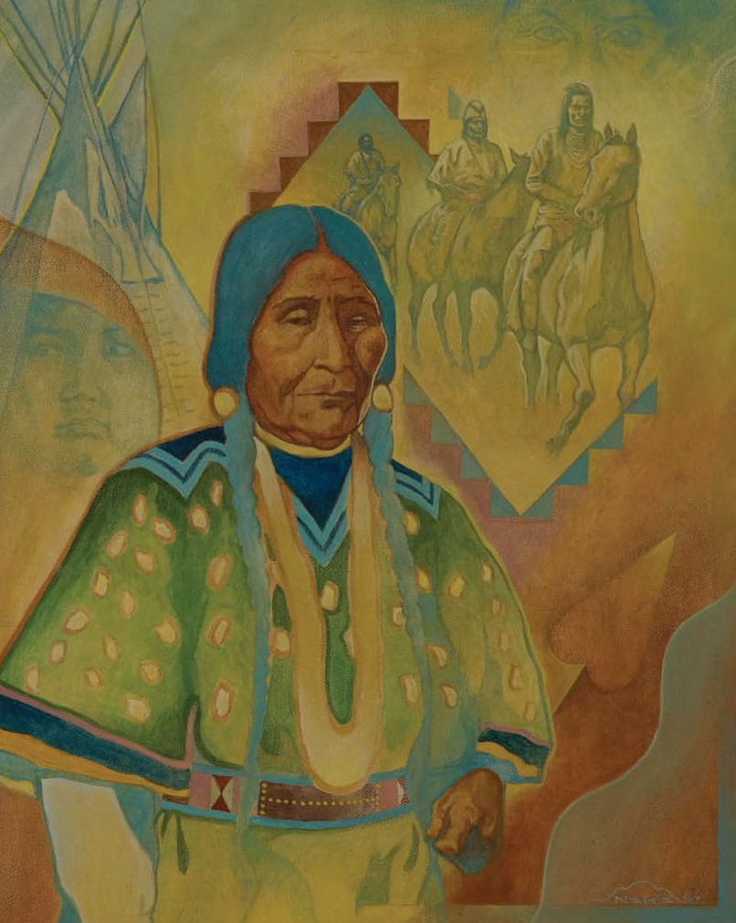
Bitterroot, Bitter History
Heritage along the Nez Perce (Nee-mee-poo) National Historic Trail

Slide 2
What is the NPNHT?
Established in 1986
Memorial to Nez Perce War of 1887
More than 100 signs along the trail
My research as intern

Slide 3
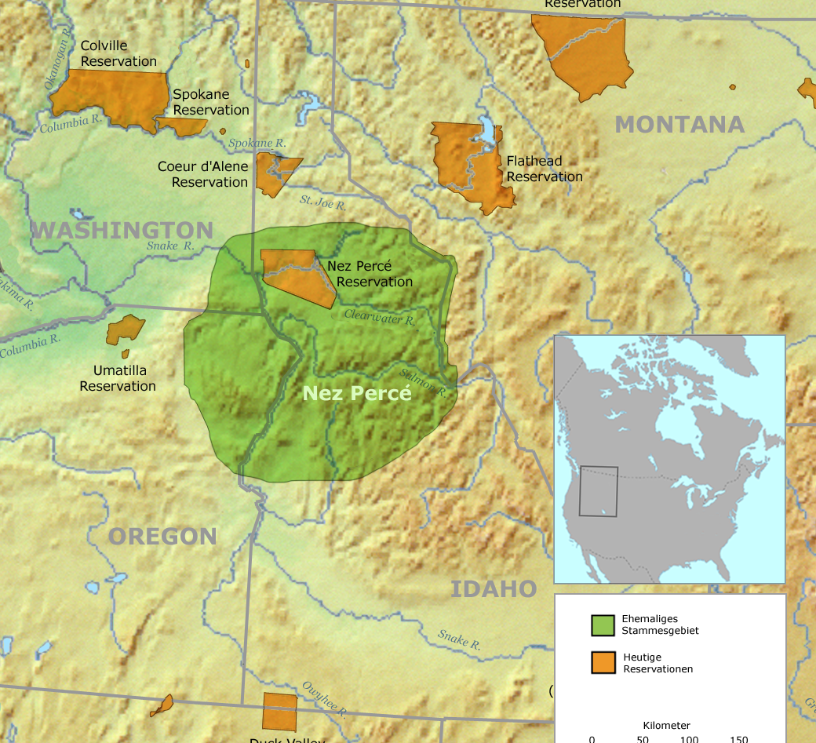
Background
Treaty disputes—some Niimíipuu disagreed
Order to move
Flight
Bitterroot
Surrender

Slide 4
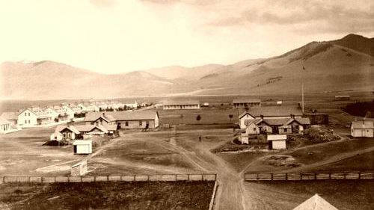
What is Cultural Heritage?
Active, dynamic, communal, and constructed, heritage is composed of the activities that societies perform to create the past in the present (Logan 2007, 34-38; Harrison 2013, 113).

Slide 5
And Why is it Important?
Silverman and Ruggles (2007, 11) note that “the denial or distortion of history/prehistory has proven to be a contributing factor in genocide, ethnic cleansing, and oppression to an extreme degree” so that the “freedom or ability to articulate one’s own cultural heritage and express one’s own identity is vitally important.

Slide 6
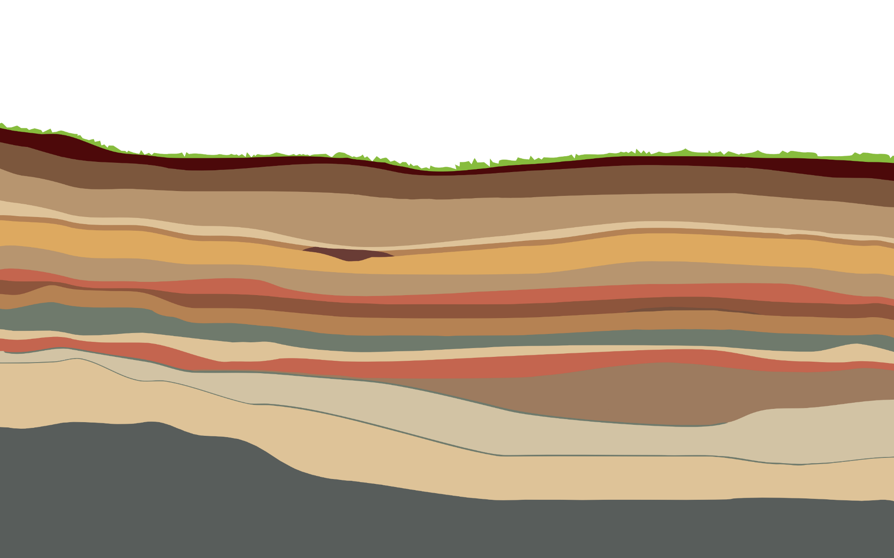
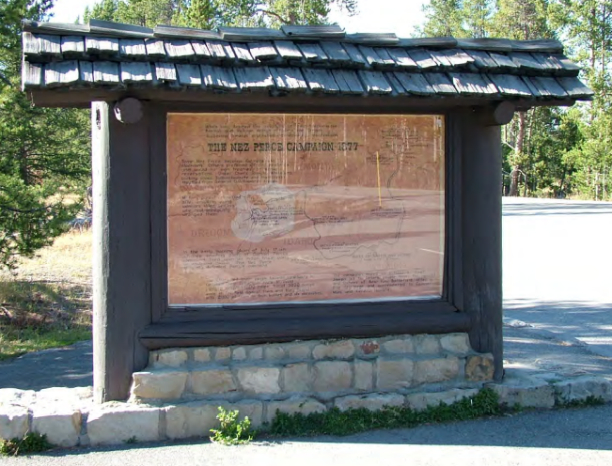
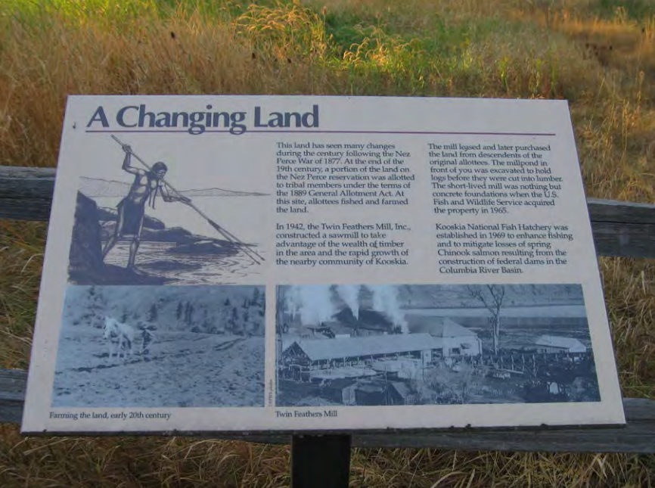
How are signs heritage and why do they matter?

Slide 7
GOVERNMENT/LOCALLY PRODUCED
HISTORICAL MEMORY LEADERSHIP NAMING

Slide 8
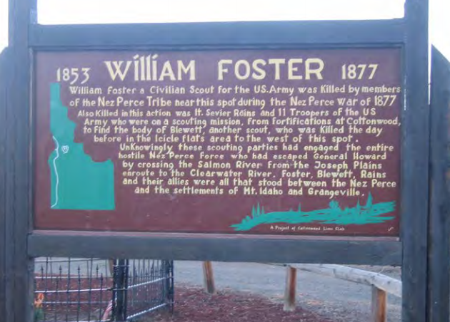
Local
Community groups
Dated
U.S. perspective & bias
Inaccurate or misleading

Slide 9
Government
State/Federal Agencies
Incorporates Niimíipuu perspective
Appeals to common heritage: A native people were forced to flee their homeland in a futile attempt to avoid warfare and live in their own way. A transported European people found themselves fighting neighbors who had been their friends for many years…Reluctant military leaders found little pleasure in an empty victory against an honorable and valiant foe. There’s no better way to get in touch with our common heritage than to retrace the footsteps of the Nez Perce tribe and the soldiers who pursued them over some of the most spectacular country in the Northern Rockies.
Newer signs incorporate Niimíipuu language

Slide 10
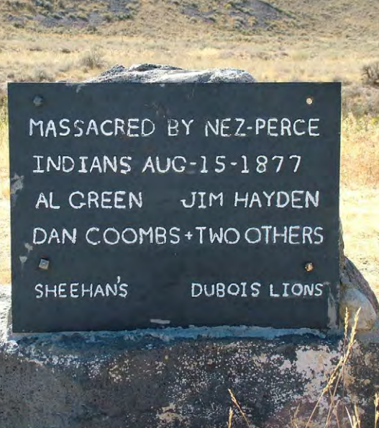
Historical Omission
Omission of consequences
Problematic wording
Focus on American suffering & not Niimíipuu
Figlio 2014: “divergences and conflicts of memory” are not mere difference, but “bespeak the aim of one version to suppress another”—that when “remembering and rebuilding a collective identity, perpetrators forget defensively.”

Slide 11
Portrayals of Leadership
Historically focused on Joseph
Lacking in complexity
Women omitted

Slide 12
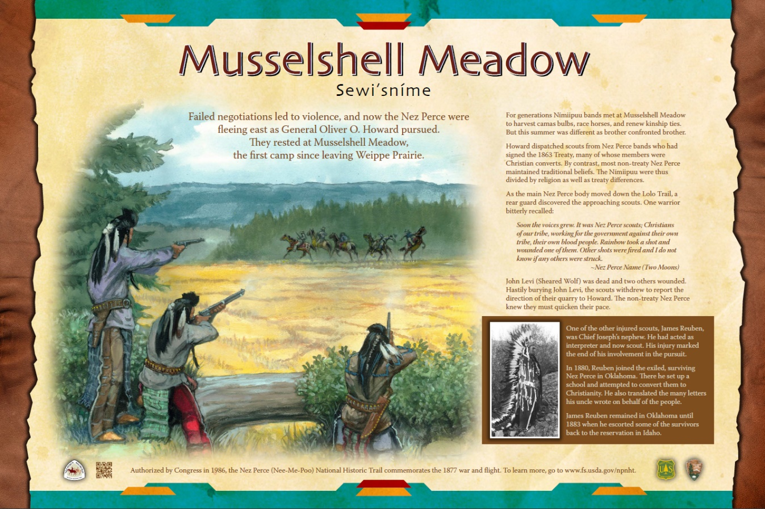
Naming
Names are powerful
Embedded with knowledge
Cash Cash 2015: “to utter words naming a landscape is to evoke deep meanings that have persisted over great lengths of time from a prior perceptual experience.”
Beneficial to Niimíipuu & overall society
Use on trail is increasing

Slide 13
Why Are Old Signs Harmful?

Slide 14
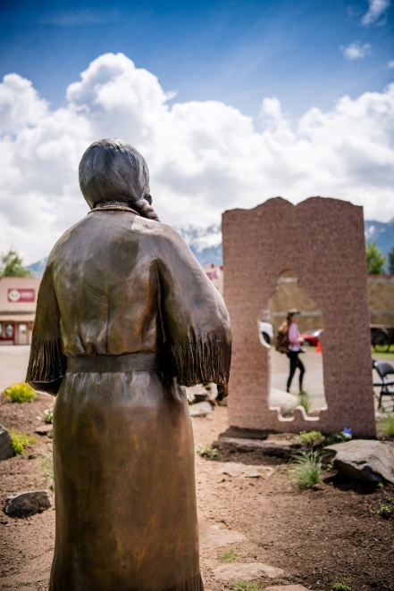
Relevance Today
Niimíipuu
History closely tied to present day identity
Connection to land
Local U.S.
Commercial
Tourism
Select groups interested
etweyé·wise by Doug Hyde

Slide 15
Experimental Sign

Slide 16
Moving Forward
Figlio 2014: “reviving the past through a benign and restorative relationship” that abandons feelings of victory or superiority
Improving, but room to improve
Removal of old signs
Enjoy the trail!

