Slide 1
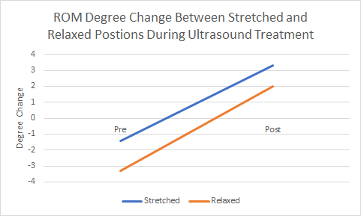
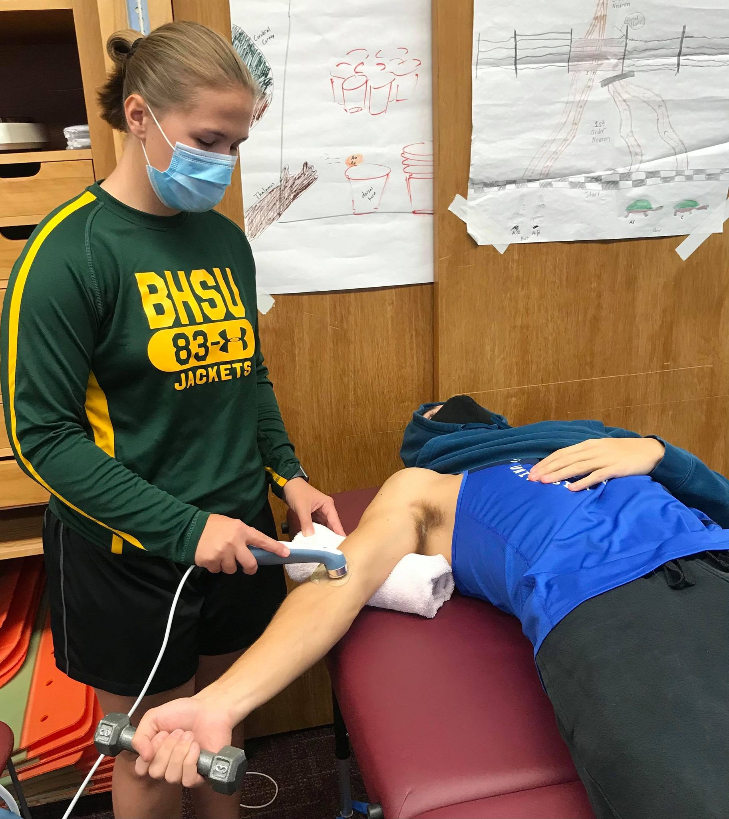
Increasing Range of Motion of the Elbow Considering Optimal Patient Positioning during Ultrasound Treatment
Lexie Mower, Karly Niemann, and Valerie Moody
School of Integrative Physiology and Athletic Training, University of Montana, Missoula, MT
Introduction
Methods
Results (Continued)
A 2 (time) x 2 (trial) repeated measures ANOVA revealed no statistical difference between the resting and stretched positions while delivering ultrasound (p=0.76); however, there was a main effect for time (p=0.00), where both trials demonstrated improved elbow extension range of motion.
Follow up trial comparison demonstrated statistical significance, p = 0.033, where the stretched trial on average improved elbow range of motion 1.5 degrees more than the resting trial.
Ultrasound uses inaudible, high-frequency vibrations to promote blood flow to injured tissue and improve tissue extensibility. A joint may be experiencing decreased range of motion due to a contracted joint capsule, injury to surrounding ligaments, or a buildup of collagenous scar tissue. Ultrasound has been utilized to restore range of motion to the wrist, knee, and ankle joints.
In some research studies, they refer to a time frame called the “stretching window” that follows immediately after the treatment and can last up to ten minutes for maximum effectiveness. However, one study conducted an ultrasound treatment followed by a stretch routine on the calf muscle found that the optimal stretch window only lasted for around three minutes. During this stretching window, static stretches and joint mobilizations are commonly performed. Performing movements during this stretch window has shown positive results in terms of range of motion, but it is not conclusive that results are long lasting.
Since previous studies have shown that the stretching window is very brief following an ultrasound treatment, it is worth examining the effects of applying the stretch when the ultrasound treatment is occurring. There is currently minimal evidence supporting the idea that applying a stretch during an ultrasound treatment facilitates improvement in joint mobility.
Participants
A convenience sample of seven healthy adults were selected for this study (4 females, 3 males; average age 26 + 8 years, height 68 ±4 inches, and weight 180 + 6 lbs.).
Procedures
A repeated measures design was used whereby subjects completed two separate trials with a week between each trial. The two trials included vigorous heating ultrasound treatment for 5 minutes on the subject’s right elbow in either a stretched position or relaxed position.
Elbow extension was measured with a standard 12-inch goniometer before and after each trial. Three measurements were obtained, and an average was recorded.
Treatment order was randomized and spaced out a week apart.
Data Analysis
Microsoft Excel was used to calculate descriptive statistics for each participant’s height, weight, and age along with elbow extension.
A 2 x 2 (trial x time) repeated measures ANOVA using SPSS v26.0 was used to calculate mean difference between the stretched and relaxed position trial.
Significance was set a priori at p = 0.05.
Conclusion
Purpose
Our study showed that there was no statistical difference between the relaxed and stretched positions while delivering ultrasound treatment
For all participants, both positions produced an increase in elbow range of motion with vigorous heating using ultrasound; however, it was unclear if the ultrasound treatment itself or the gravity dependent position of the joint influenced the study outcomes.
The purpose of this study was to compare positioning of the elbow in a stretched and a relaxed position during an ultrasound treatment to determine which produced greater improvements in elbow mobility.

