Slide 1
Damming Celilo Falls: Mourning a Miracle
BY LISA HUNT

Slide 2
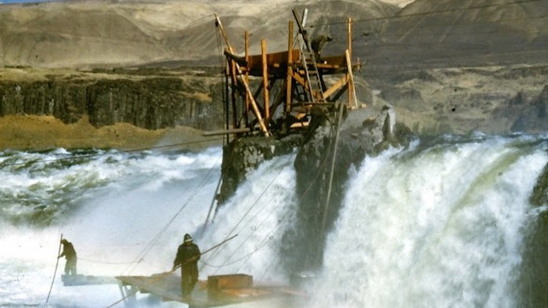

Slide 3
The drowning of Celilo Falls by The Dalles Dam on the Columbia River, which is located 70 miles east of Portland, Oregon, is a heartbreaking tale of loss of culture, land, economic resources, and a sacred way of life for the Native People in the surrounding area. They had depended on the generous number of salmon that had been provided for thousands of years. Celilo Falls, or Wyam, which means the echo of falling water, was the greatest fishing area in the Pacific Northwest, possibly even North America (Barber 2018). Local tribes, as well as others from far and wide, utilized this revered space, to laboriously and religiously bring in literally tons of salmon, daily, over the six-month season. On March 10, 1957, the echoing sounds of falling water upon the rocks was drowned out by the cries of the people. It felt to them as if they too were being flooded under the water of this sacred place.

Slide 4
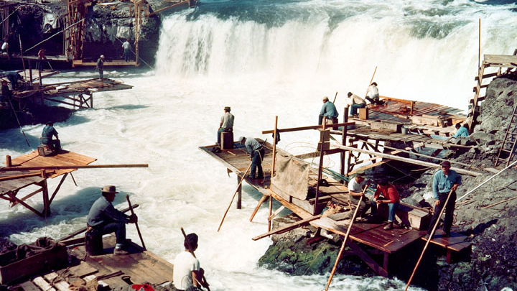

Slide 5
The beauty of what was once Celilo Falls is indescribable. The visions of the jagged cliffs and cascading waterfalls, endure now only in descriptive stories, pictures, videos, and memories. It was an ingenious and incredibly brave way how the Natives fished there, and they were rewarded by repeated catches of 30, 40 and sometimes even 50-pound salmon, by the tons, which is unheard of today. The dry winds and landscape surrounding Celilo Falls, was ideal for the drying and preservation of the salmon. This area was a gift given by the Creator, for the formation was perfect for this livelihood in every way. Catching salmon was a dangerous and rigorous process. Native Americans built wooden planks, platforms, and scaffolds to get out over the rocks, and then would use long spears or dip nets to catch the salmon as they swam up the rapids and waterfalls (Barber 2005).

Slide 6
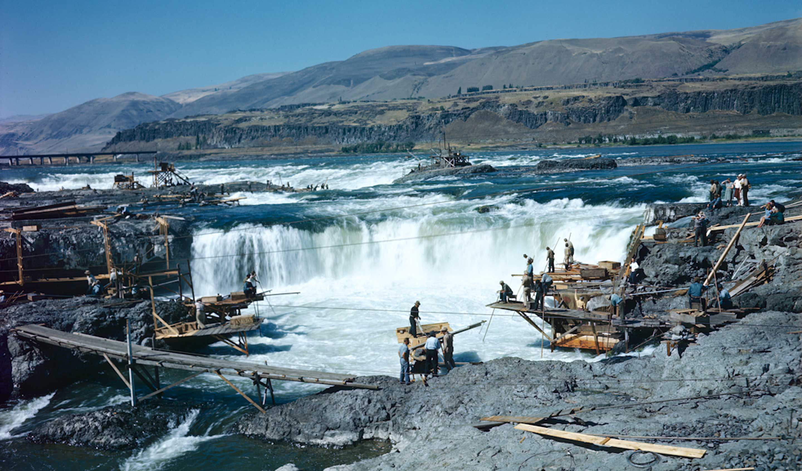

Slide 7
That day in March of 1957, six hours after the floodgates of the dam at the Dalles were opened, the place, the lifeblood, the economic livelihood, and religious significance for generations of people, slowly disappeared. The shock and grief over the loss still runs strong with each generation who remembers it first-hand or hears stories from the past.
When the leaders of the Umatilla, Walla Walla, Yakama, and Nez Perce tribes signed the treaties of 1855, they were guaranteed continued hunting and fishing rights in their ‘usual and accustomed places.’ The treaties altered their lives, but the changes coming to this area, would be far greater than they could have imagined at that time. At the signing of the treaty, Celilo Falls was still the prime hub for fishing and trading. It was a source of wealth and life that was promised and included in the treaties they signed (Barber 2005).

Slide 8
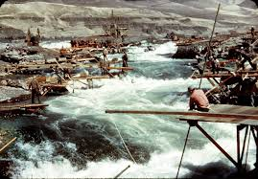

Slide 9
Celilo Village, homeland for mostly federally unrecognized Mid-Columbian River People, was forcibly relocated to the far side of the railroad and highway, away from the river (Barber 2005). The dam not only destroyed this beautiful and bountiful fishing site, it forced relocation and violated treaty rights for the recognized tribal members who fished there. It was also an infringement upon religious, and ceremonial traditions. The federal government had purchased a small allotment of land in 1948, for the relocation of Celilo Village, prior to the construction of The Dalles Dam. Without regard to federal and state statutes over sanitary or quality living conditions, World War II surplus housing was used, along with other faulty construction. This caused rapid deterioration throughout the village homes and other buildings (Fredlund 2007).

Slide 10
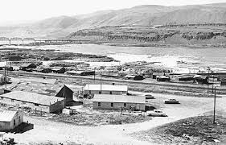

Slide 11
Things over the next fifty years did not improve for the families who chose to remain at Celilo Village. Poverty stricken with the fishing access very limited, families enduring at Celilo Village struggled horribly. Celilo Village is now home to an approximate 100 Native residents. Improvements only began in 2007, 50 years after the drowning of Celilo Falls. The Corps of Engineers built a new village longhouse in 2005, and finally, new homes were built in 2007 (Barber 2018).

Slide 12
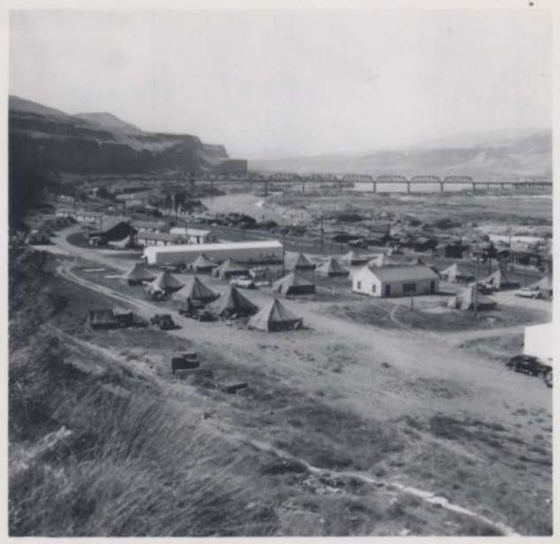
An ethnographic survey of Celilo Village, could be a data instrument that could provide theories of change, and social adjustments under pressure, researching how the inundation of Celilo Falls in 1957, impacted the current residents of Celilo Village. This could also provide statements of their current livelihood, after 50 years of waiting to finally receive necessary renovations. Surveys could contribute qualitative analysis of the opinions and status of individuals, families, and the community, and could offer an opportunity to gage the emotional, physical, and economic impact in their current lives.

Slide 13
Though the abundance of the salmon has rapidly declined along the Columbia River, Native Americans who still fish there are thankful for what they have overcome, and what they have achieved to survive. Native People continue yearly celebrations of thanks to their Creator in the longhouse at Celilo Village and show strong attempts to keep their culture alive. It shows resistance to allow what happened to not completely take away from them what once made them River People. They have and will continue to survive this ordeal, and make sure the following generations never forget the sacredness of their past, and fight to encourage hopefulness for their future.
WORKS CITED
1. Barber, Katrine. 2007. Death of Celilo Falls. University of Washington Press.
2. Barber, Katrine. 2018. In Defense of Wyam. University of Washington Press.
3. Fredlund, Diana. "The Corps of Engineers and Celilo Falls: Facing the Past, Looking to the Future." Oregon Historical Quarterly 108, no. 4 (2007): 688-97.
4. Images found on https://www.oregonlive.com/politics/2016/05/celilo_through_the_years.html

Slide 14
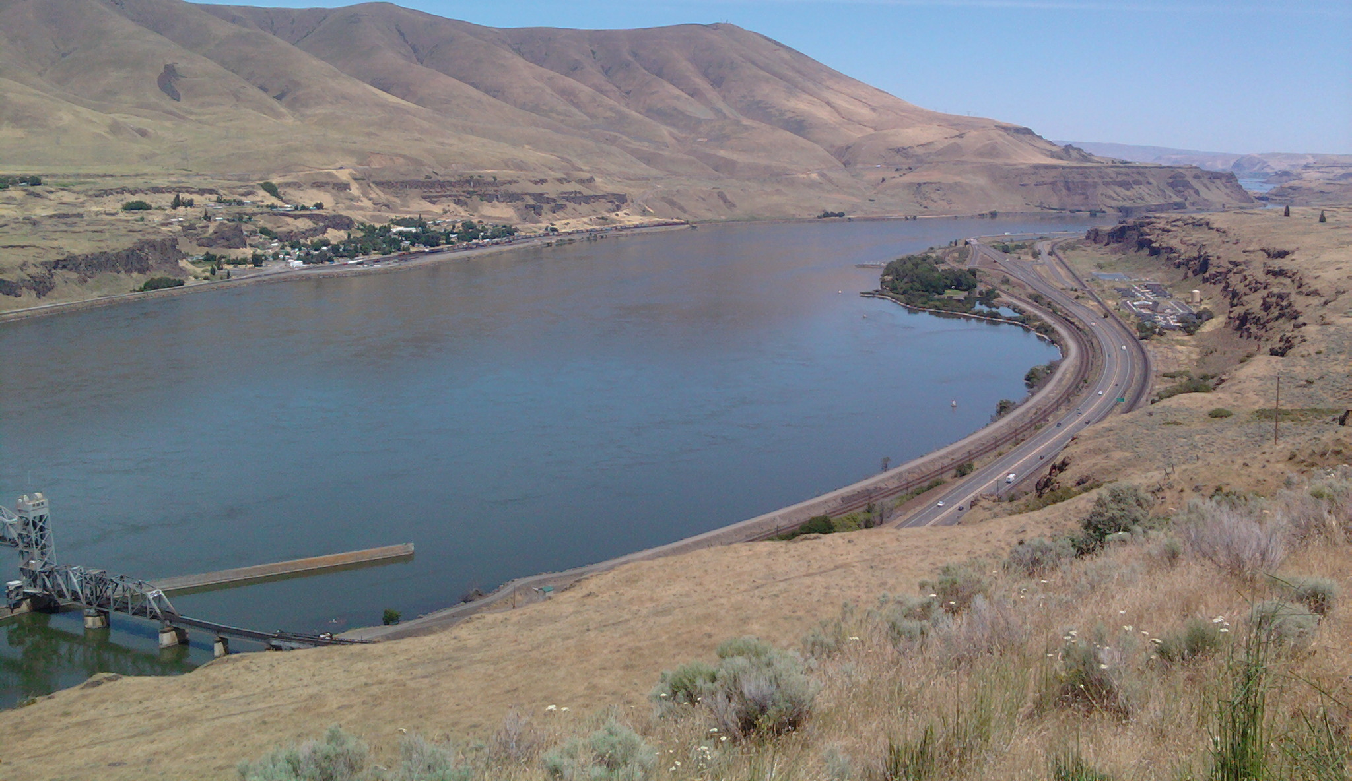

Slide 15
