Slide 1
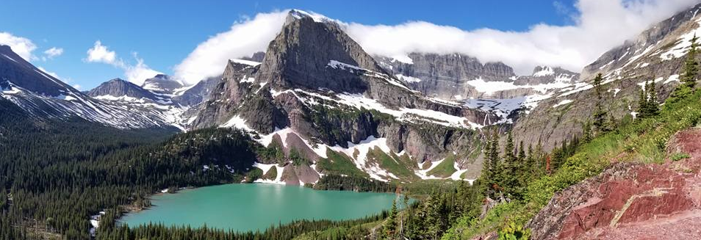
SWOT Analysis of Forest-Based Collaboratives in Montana and Idaho
Shauni Seccombe,
M.S. Candidate in Environmental Studies
Spring 2021
This project was made possible through the generous support of the Idaho Department of Lands, Idaho Forest Group, Montana Department of Natural Resources and Conservations, and the National Forest Foundation.

Slide 2
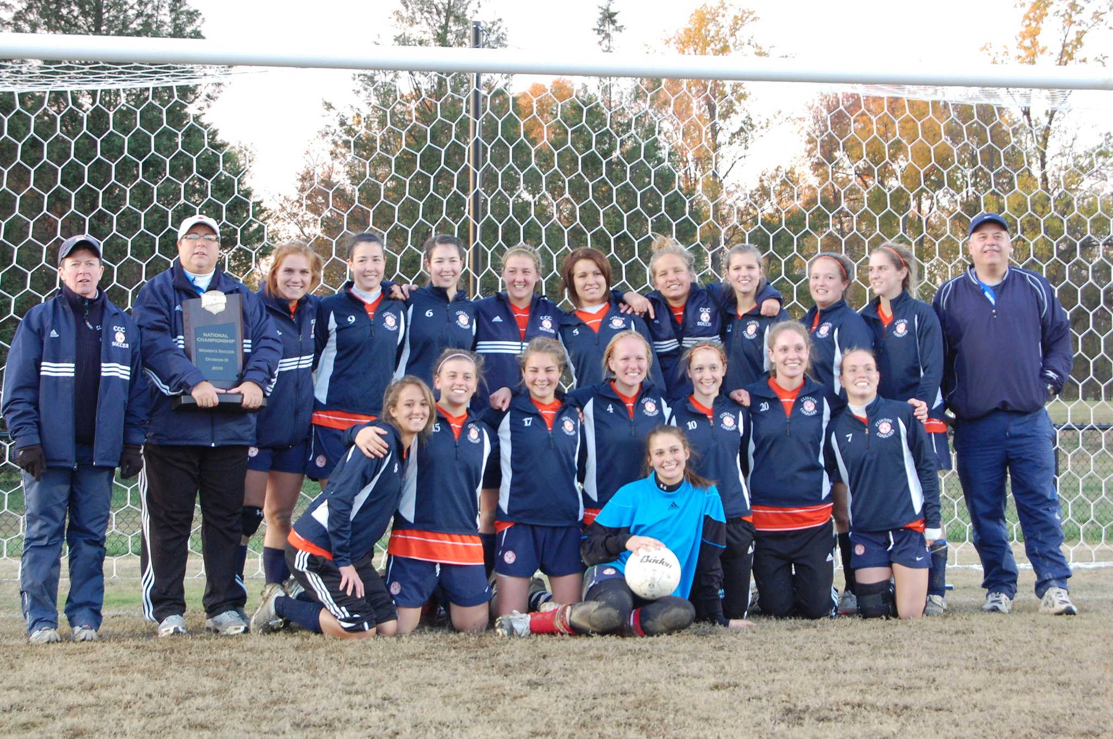
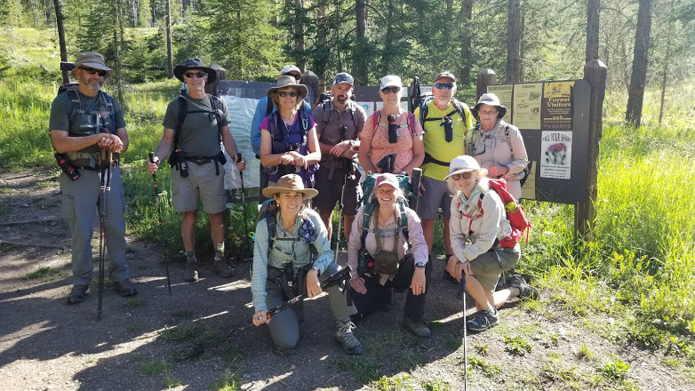
Working with Other People
When have you worked with other people (group, team, club, etc.)?
What allowed your group to work well together?
Who, or what, challenged your group?
How would you try and improve that group?

Slide 3
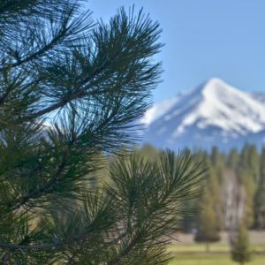
SWOT Analysis: Purpose and Objectives
Purpose: To examine the Strengths, Weaknesses, Opportunities and Threats experienced by forest-based collaborative groups in Montana and Idaho.
Objectives:
Identify the current internal and external factors that influence collaborative groups
Assign values of significance – how prevalent is each factor?
Identify common needs and opportunities
Host conversations to develop recommendations
3

Slide 4
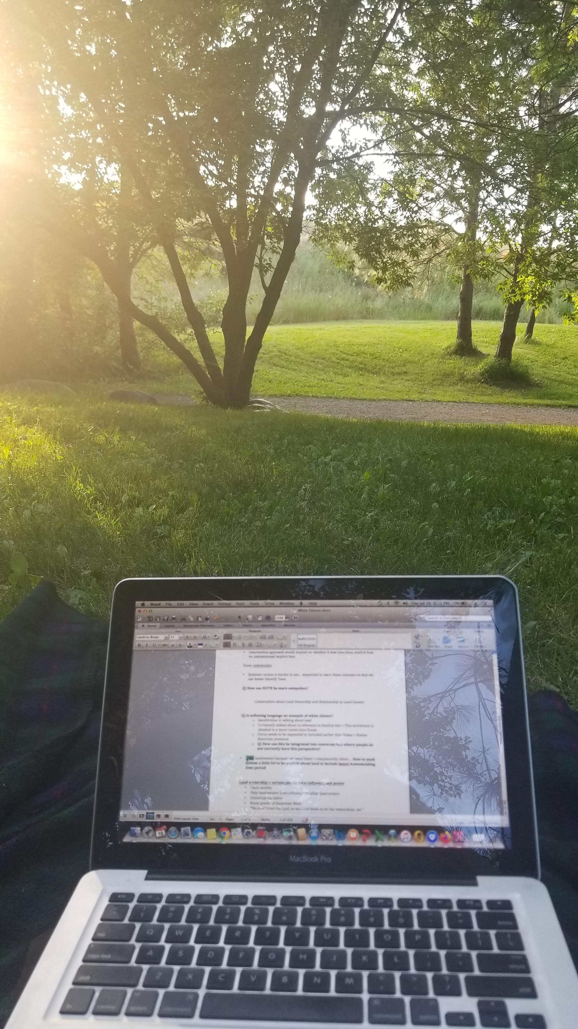
Interview process
Who: 23 total groups: 14 from MT and 9 from ID
  1 declined to participate
  Unable to schedule 4
How: One-on-one interviews; 45 min - 1 hour
  21 over Zoom
  1 via phone call
  1 written response
When: Interviews held in July and August of 2020
What: 13 Questions, 5 SWOT specific
  The interview questions were open-ended and responses were un-prompted (i.e., interviewees did not select a response from a pre-determined list).
  This study highlights the voice of the collaborative members and their self-reported perspectives.
4

Slide 5
SWOT Interview Questions
Strengths – internal: What internal strengths have led to your collaboratives success?
Weaknesses – internal: What internal barriers are experienced by your collaborative currently, and what barriers does it anticipate in the future?
Threats – external: What external challenges have hindered your collaborative process?
Opportunities – external: What resources have you found to be helpful in addressing challenges in the past? What resources would be helpful?

Slide 6

Strengths - Internal
Question: What internal strengths have led to your collaborative’s success?
Table 1: Explanation of Identified Themes – Strengths | Response Rate
Membership: Committed, long-term members; relationships and trust; members that are experts/skilled; diverse interests are represented; ability to reach consensus; members that are decision makers of their organization. | 100%
Agency Participation: Participation from, and good working relationships with, the Forest Service and other agencies, as well as from elected officials. | 59%
Facilitation: Facilitative support; someone focused on fundraising and grants; some or all members are paid to be there. | 50%
Process Elements: (1) Guiding charter and/or bylaws; group meets monthly; willing to go slow; inclusive; effective structure (utilize committees). (2) Shared vision; purpose; focused on core mission. (3) Leadership. | 36% 23% 23%
Past Success: History of success; celebrating successes; good reputation. | 27%
6

Slide 7

Weaknesses - Internal
Question: What internal barriers are experienced by your collaborative currently, and what barriers does it anticipate in the future?
Table 2: Explanation of Identified Themes – Weaknesses | Response Rate
Membership: (1) Low Diversity: Want more diverse and inclusive membership; limited success with outreach efforts. (2) Low Participation: Low/varying degrees of participation. (3) Lack of Knowledge: Varying levels of knowledge and understanding about issues, terminology, government processes, etc. (4) Limited Time: Limited time availability - members work other jobs; challenge to complete collaborative work in-between meetings, etc. (5) Member Burnout: Member burnout; frustration with the process. (6) Opponents: Opponents to collaborative processes; uninformed; unwilling to compromise. | 50% 41% 32% 27% 27% 27%
Funding: Lack of funding; unpaid members. | 32%
Group Functioning: Can be a slow process; want to be more proactive, focused, and relevant. | 32%
Lack of Facilitation: Need to improve/increase facilitative support. | 23%
Response to COVID-19: No longer meeting face-to-face; technological limitations; lack of reliable internet. | 23%
7

Slide 8

Threats/Barriers - External
Question: What external challenges have hindered your collaborative process?
Table 3: Explanation of Identified Themes – Threats | Response Rate
Opponents: Opponents to collaborative processes; don’t understand the value of collaboration; resistant to change; difficult personalities. | 41%
Forest Service: (1) Direction and Transparency: Differing views, values, and priorities; lack of transparency (especially regarding why and how decisions are made). (2) Policies: Regulatory policies and procedures (slow NEPA process; difficult to understand). (3) High Turnover: High turnover rates; loss of established relationships. (4) Limited Capacity: Limited capacity (personnel, time, budget); lacking full participation in collaborative work. | 36% 27% 27% 27%
Community Dynamics: Changing community structure, demographics, and values (ex: second home buyers, out-of-state); social and political tensions. | 32%
COVID-19: Remote work; not meeting as regularly; miss in-person meetings and field trips. | 32%
Litigation: Actual, or threat of, litigation. | 18%
Implementing Partners: Decreasing/lack of engagement from (some or all) FS, BLM, FWP, DNRC, etc. | 14%
Economic Hardships: Loss of jobs; struggling local economy. | 14%
8

Slide 9

Opportunities - External
Question: What resources have you found to be helpful in addressing challenges in the past? What resources would be helpful?
Table 3: Explanation of Identified Themes – Opportunities | Response Rate
Facilitation: Would like to have/increase facilitative support. | 64%
Funding: Need for sustained funding; funding for projects, collaborative work, facilitation. | 59%
Shared Learning: More trainings, webinars, peer-to-peer learning sessions. | 45%
Membership: (1) Diversity & Inclusion: Need to improve community outreach; increase participation; become more inclusive and diverse. (2): Accessibility: Offer technical assistance, travel stipends, etc. | 41% 23%
Strategic Planning: Develop strategic future plan; become more proactive; integrate sustainability. | 36%
Develop Partnerships: Develop/strengthen partnerships; partner with universities, institutes, citizen scientists; cross-boundary partners, etc. | 32%
Expand Work: Include/increase work focused on recreation, trails, restoration work and/or monitoring. | 27%
Agency Participation: Regular, committed attendance from agency personnel; “Agency Liaison.” | 23%
Marketing and Storytelling: Would like to develop own website; establish/enhance social media presence; more effective storytelling. | 23%
Support Local Economies: Focus on economic stability in local communities; rural development; businesses. | 14%
9

Slide 10
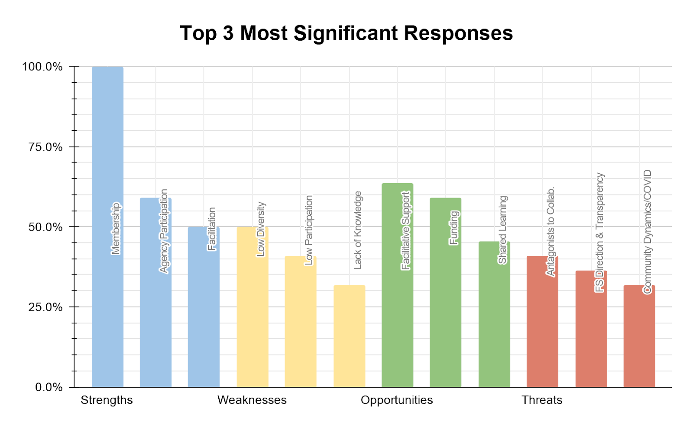
10

Slide 11
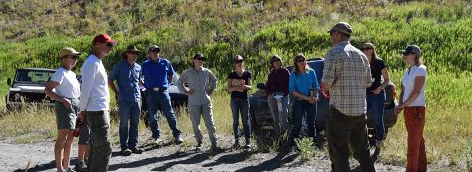
Next steps - NFF
Timeline
Share report (blog, webinars, peer-learning session) January - March
Host conversations to identify resources/services March - April
Develop recommendations April - May
A Collaborative Process
Share report with interview participants, partners, agencies, funders, etc.
Garner collective wisdom to jointly develop recommendations
Goal: To strengthen the capacity of
forest-based collaborative groups and
to enhance their ability to achieve
desired outcomes.
11

Slide 12
Questions?
I’d be happy to share my research with you in more detail, and I welcome any feedback, comments or questions! Thanks for watching!
Shauni Seccombe,
M.S. Candidate, Environmental Studies
shauni.seccombe@umontana.edu
12

