Slide 1
Death and the Maiden
Incorporating the Chilean Experience into the Analysis and Design
of Ariel Dorfman’s Death and the Maiden
By Hannah Gibbs

Slide 2
Synopsis
Set in a coastal home in 1990, Paulina Escobar is convinced the man her husband, Gerardo, brings home after having car trouble, is the same man who kidnapped, tortured and raped her when she was a political prisoner many years ago. She holds the guest, Dr. Miranda, at gunpoint as she accuses him, and tries to reason with her husband with her retelling of the tragic events that happened to her. She then convinces her husband to act as his lawyer to have him prepare a confession of his crimes. The final scene of the play is many years down the line, when the couple happens to attend the same symphony as Dr. Miranda.
Death and the Maiden, written by Ariel Dorfman, had its world premiere in 1990.

Slide 3
Pinochet Era of Chilean History
September 11th 1973: Democratically elected socialist government of Salvador Allende was overthrown in a military coup, leading to a military dictatorship by Augusto Pinochet
Dorfman, reflecting on the dictatorship: “[17 y]ears of torture and executions and disappearances and exile.”
The Pinochet era for Chile is surrounded by rhetoric of silence to remain safe.
Many of those who suffered at the hands of this administration went on to have two lives, one they lived on the day to day after being released, and their “deep memory” life, where they recall their own torture inside their minds while remaining silent about it.
Others had to go into hiding for almost 20 years to avoid being disappeared and lived in constant fear of being found out.
Notes:
The real-life experiences of the Chilean people can inform so much more deeply the logic behind the choices being made by Paulina, Gerardo and Dr. Roberto Miranda.

Slide 4
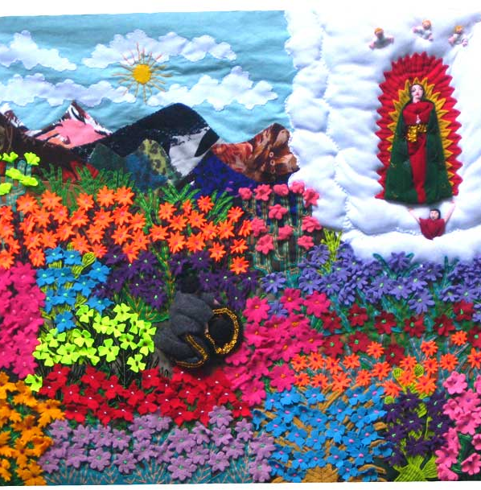
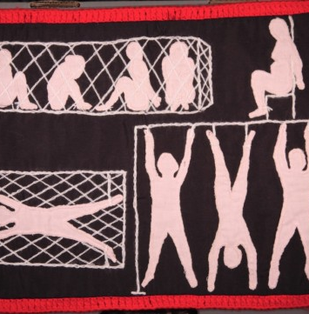
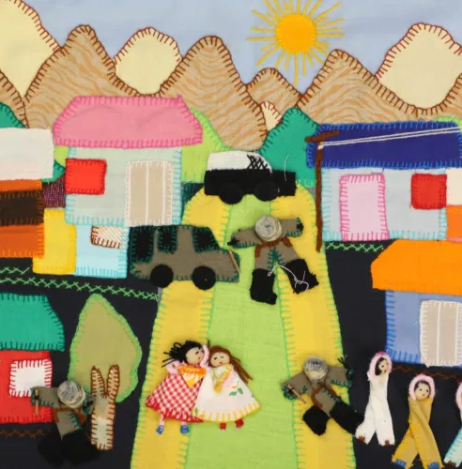
Chilean Arpilleras
An art form repurposed by the impoverished women of Chile who were relatives of those who had been disappeared, as well as survivors of political torture themselves.
Arpilleras were then collected at the churches these women constructed them in and sold internationally to raise funds for these women, but also to increase awareness of the tragedies occurring in Chile.
Notes:
Chilean arpilleras- the art form taken up by Chilean women across their nation as their fathers, brothers and sons disappeared without a trace. In church basements and other safe gathering places across Chile, women would come together to create arpilleras, images created from found cloth and embroidery.

Slide 5
Gerardo Escobar
His new job of being a member of the truth commission parallels a real commission created in 1990 with the end of the Pinochet Era: The Rettig Commission.
The Rettig Commission sole objective was to identify those who were dead or disappeared at the hands of the administration with verifiable evidence.
A lawyer in the governmental sector in Chile, and he is probably between his mid 30’s or 40’s. While emotional at times, he’s very logical and rational.

Slide 6
Paulina Escobar
Leading up to the climax of the play, Paulina reveals to her husband the extent of her trauma and how it still affects her to that day. She relives her own trauma constantly, whenever Schubert’s Death and the Maiden is played, to even having sex with her own husband.
The torture Paulina describes is real, and happened to over thirty thousand people. In a commission from 2004, over 27,000 told their stories, and were on average imprisoned for over 180 days. While only 12.5% of these survivors were women, almost all women sustained sexual violence in addition to the other torture tactics used against them.
Paulina’s own isolation from the world- it’s mentioned in the play she only speaks to her mother and her husband.
Previously known as Paulina Salas, she is housewife, married to Gerardo, in her mid 30’s. She’s a very nervous person, and often becomes trapped inside her own past traumas.
Notes:
“... what I’ve been thinking all these years, when you would catch me with a look that you said was- abstract, fleeting, right? - you know what I was thinking of? Doing to them, systematically, minute by minute, instrument by instrument, what they did to me. … I was horrified at myself. That I should have so much hatred inside- but it was the only way to fall asleep at night, the only way of going out with you to cocktail parties in spite of the fact that I couldn’t help asking myself if one of the people there wasn’t… and so as to not to go completely off my rocker…. well, I would imagine pushing their head into a bucket of their own shit, or electricity, or when we would be making love and I could feel the possibility of an orgasm building, the very idea of currents going through my body would remind me and then- and then I had to fake it, fake it so you wouldn’t know what I was thinking…”

Slide 7
Dr. Roberto Miranda
In his admission of guilt to being responsible for many women in the camp Paulina was in, it is unclear if Dr. Miranda is being led to this conclusion or if he is uncovering his own memories through Paulina’s testimony.
Many memories from this time period were skewed. Many people who remained in Chile during this time had to put aside the harsh realities around them to continue surviving in their own worlds- Ariel Dorfman recalled being told by a friend that his own parents claimed he had never been in prison and had no need to see a doctor over any injuries he sustained.
The combination of a state of silence and lost memories creates a hostile world for victims to live in, even after the administration was no longer in power.
A doctor, and a father living on the coast of Chile. It is unclear as the play develops what his motives are or who he was in the past.

Slide 8
Previous Design Ideas

Slide 9
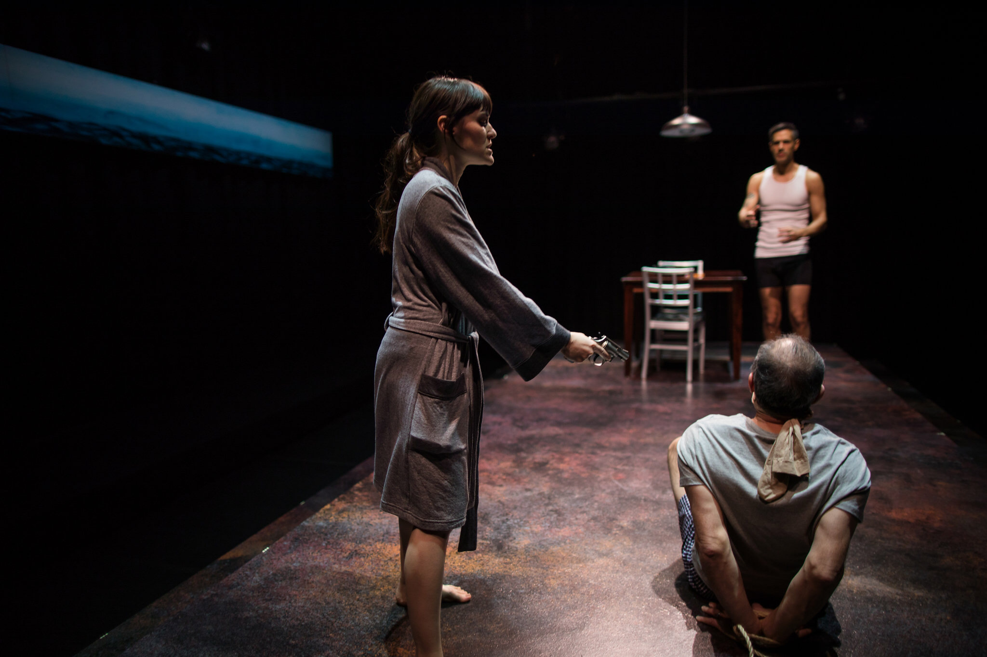
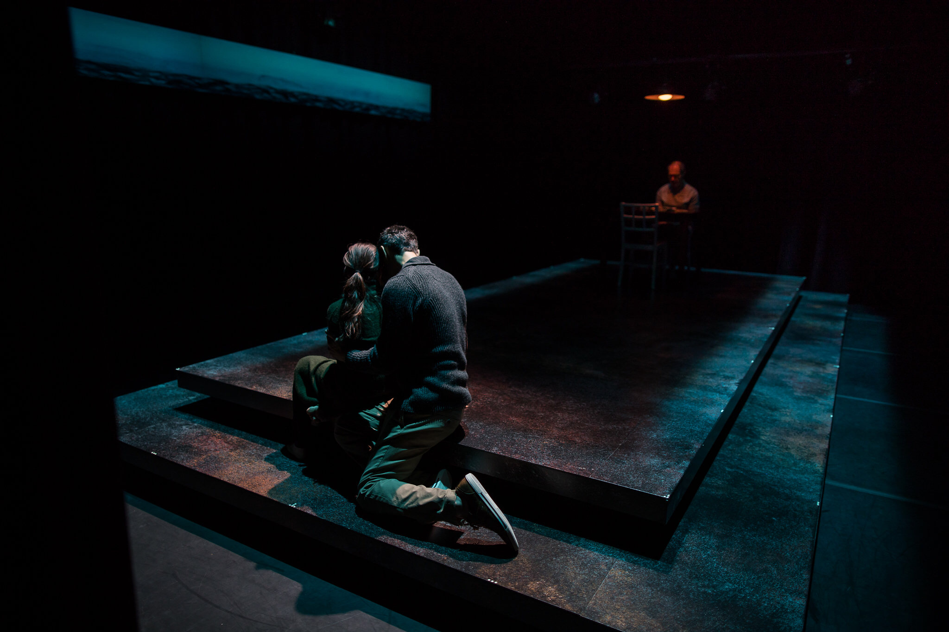
Commonwealth Shakespeare Company
Directed by Steven Maler
Scenic and Costume Design by Clint Ramos

Slide 10
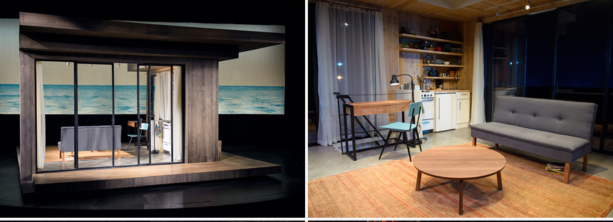
Victory Gardens Theatre
Directed by Chay Yew; Scenic Design by William Boles

Slide 11
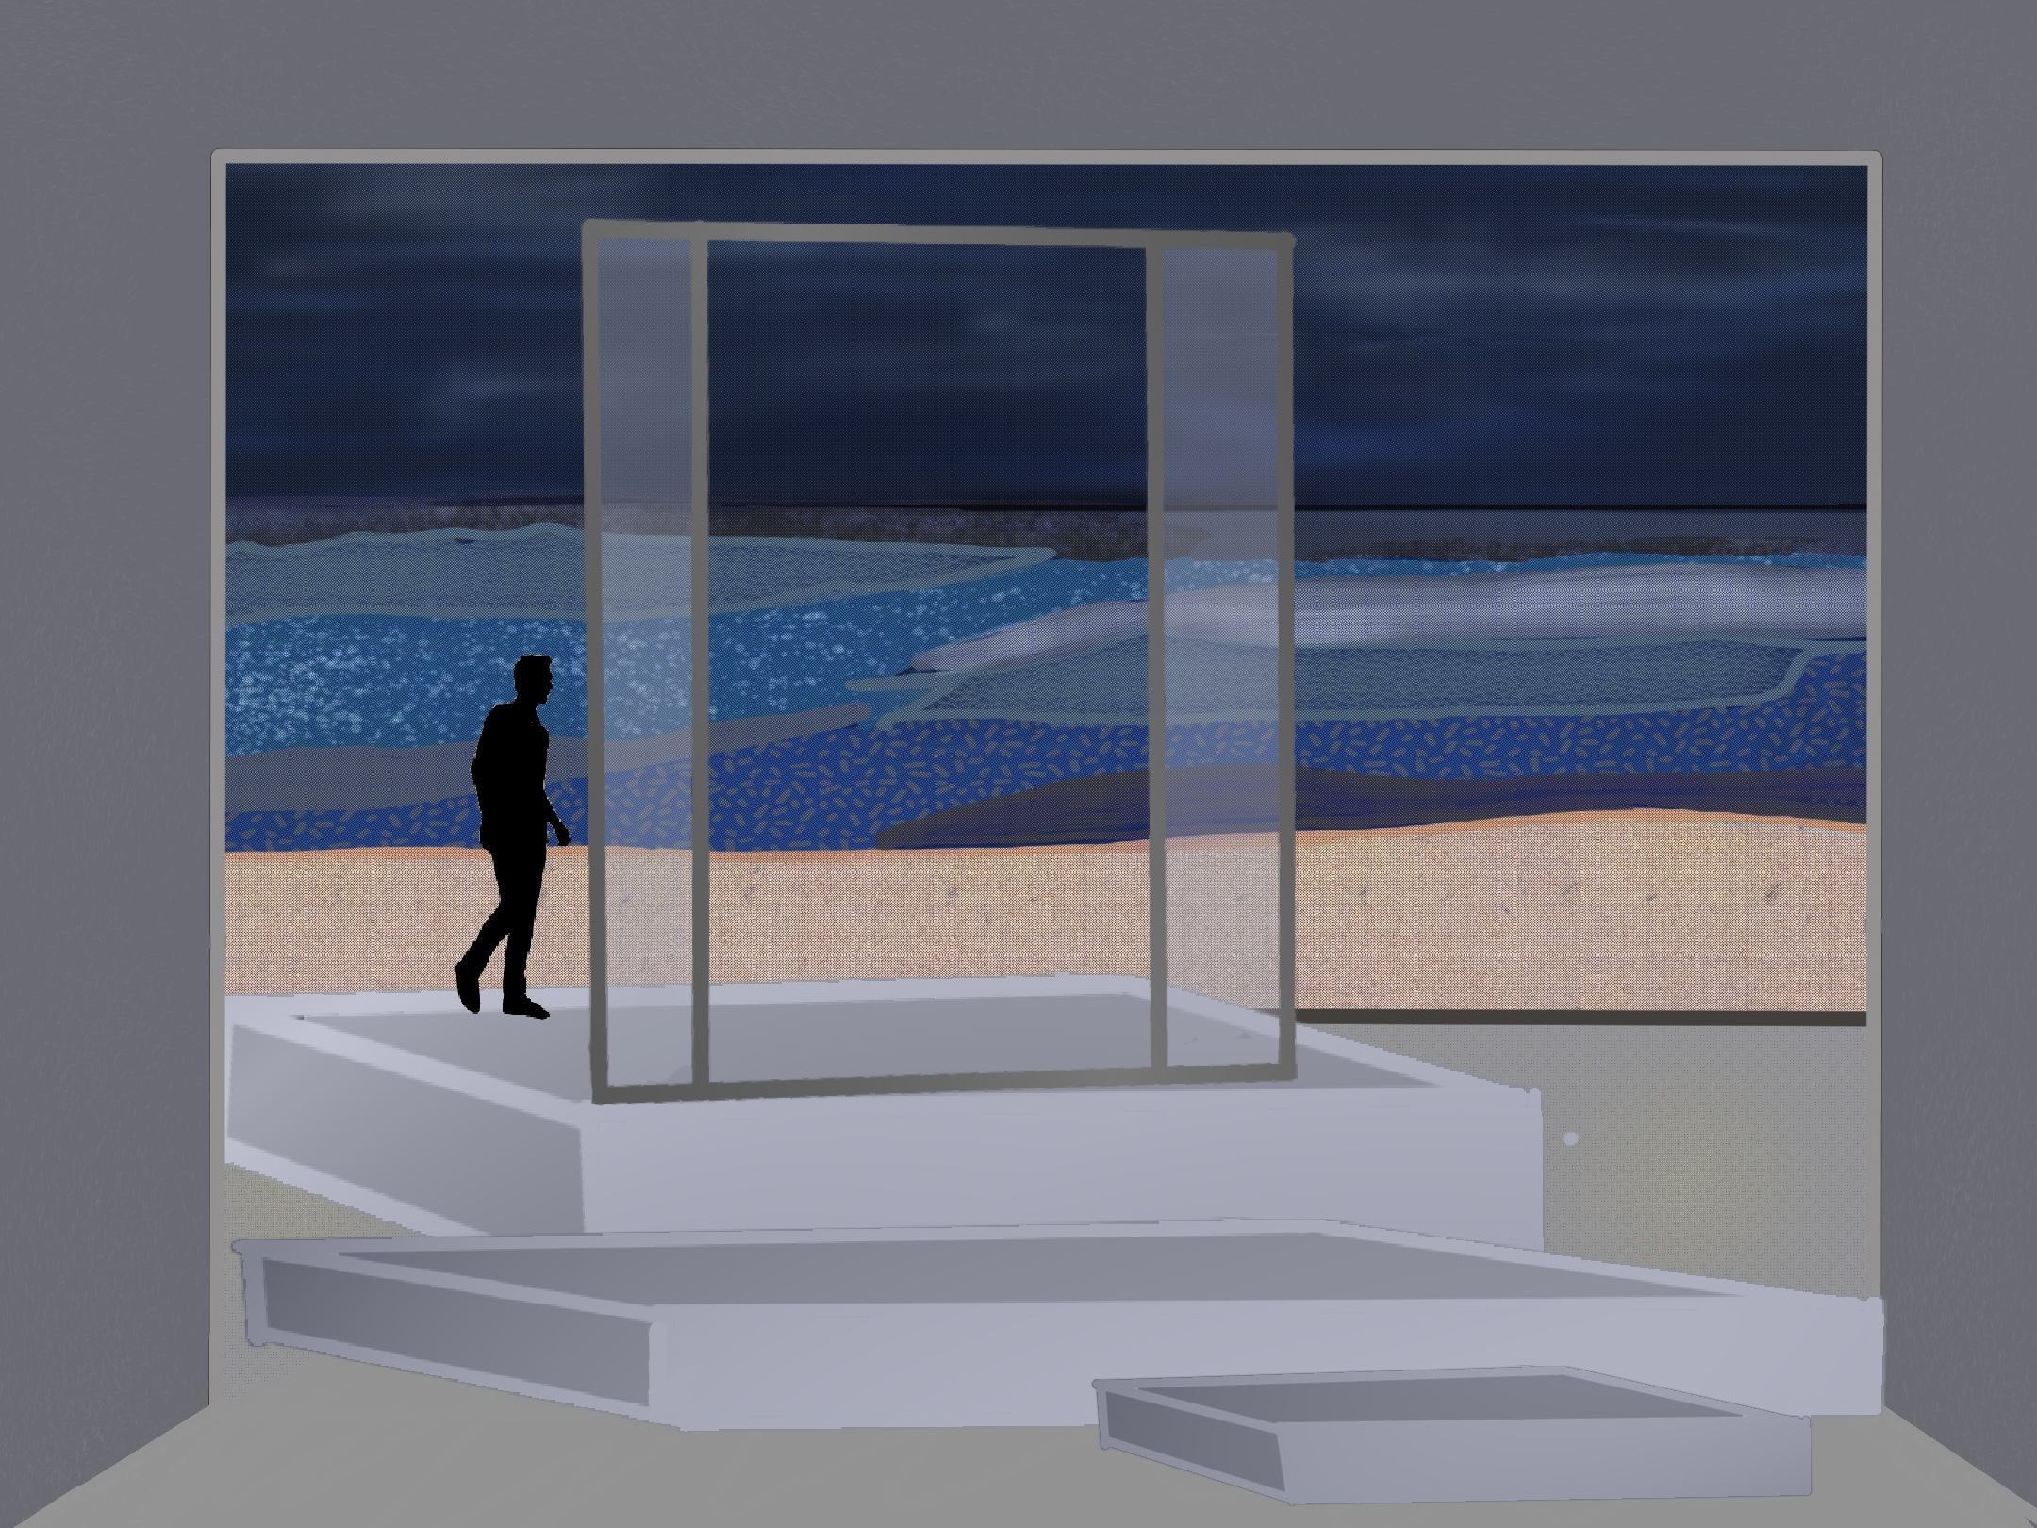
Scenic Rendering
Death and the Maiden

Slide 12
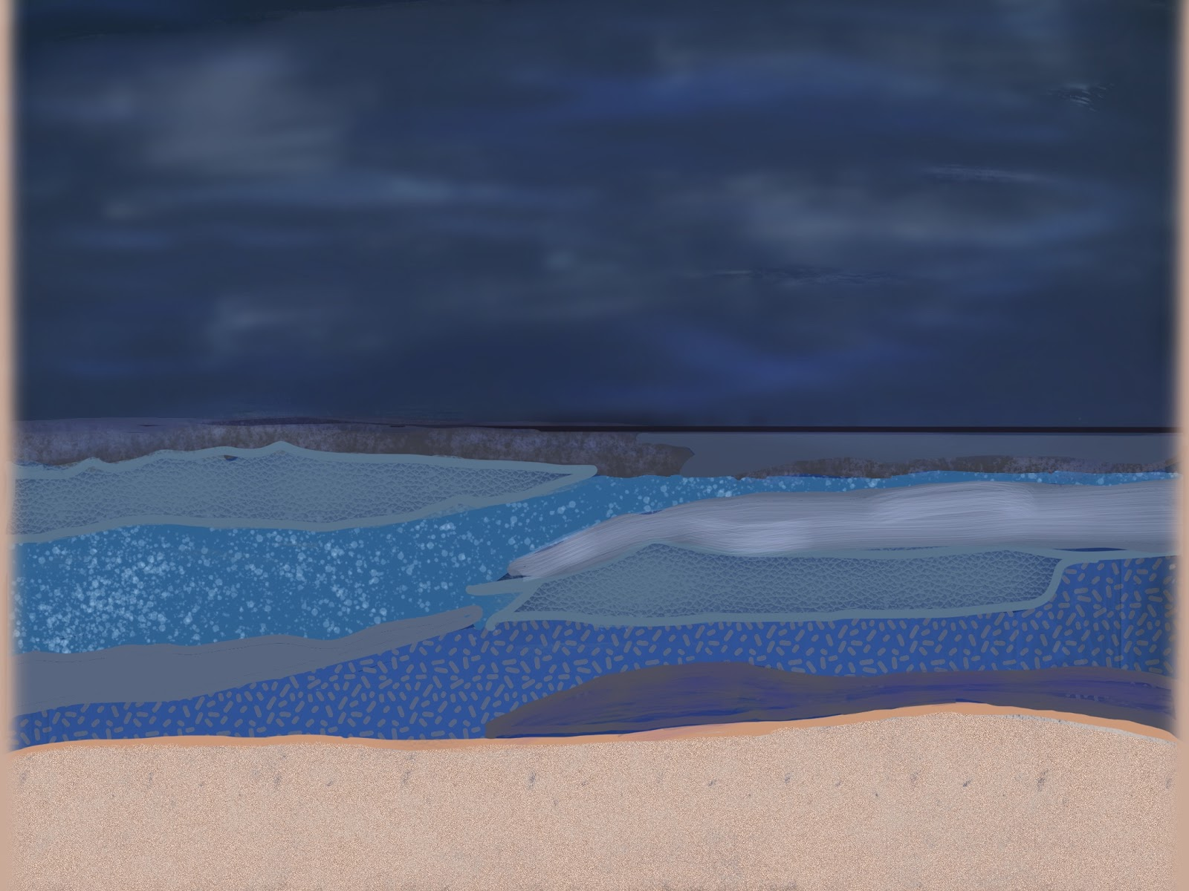

Slide 13
Thank You

Slide 14
Bibliography
Agosin, Marjorie. Scraps of Life Chilean Arpilleras: Chilean Women and the Pinochet Dictatorship. Translated by Cola Franzen. London, England: Zed Books, 1988.
Agosín, Marjorie. Ashes of Revolt: Essays on Human Rights. Fredonia, NY: White Pine Press,1996.
Courier, Michael. Death and the Maiden. August 9, 2014. Michael Courier Photography. http://www.michaelcourier.com/blog/2014/08/09/death-and-the-maiden/.
Dorfman, Ariel. Death and the Maiden. 1st ed. London, England: Nick Hern Books, 1991.
Dorfman, Ariel. “Now, America, You Know How Chileans Felt.” The New York Times, December 17, 2016, New York edition, sec. A.
Fried, Olivia Snow. “Truth Telling and Transitional Justice in Chile: Healing for Women Survivors of Trauma Through Testimonial Art Collectives.” Thesis, Bates University, 2019.
Gianturco, Paola, and Toby Tuttle. The Story of the Virgin of Guadalupe Arpillera. Arpilleras from Peru. The FolkArt Gallery, 2000. http://www.thefolkartgallery.com/arpilleras.htm.
Goldner, Liz. Arpillerista A.P.A Arrests and Raids, 1976, Embroidered Textile, 15 x 19 ½ Inches (Courtesy of Margaret Beemer | MOLAA). ARPILLERAS FROM CHILE: TEXTILES BORN FROM REPRESSION AND MADE FROM THE HEART. LA Weekly, January 9, 2020. https://www.laweekly.com/arpilleras-from-chile-textiles-born-from-repression-and-made-from-the-heart/.
Hawver, Nile. Image of Actor Portrayals of Paulina, Gerardo and Roberto in Commonwealth Shakespeare Company's Production of Death and the Maiden. 2018. Commonwealth Shakespeare Company. https://commshakes.org/production/death-and-the-maiden/.
Morales, Violeta, and Colin Peck. Sala De Torturas/Torture Chamber. Art of Conflict Transformation Gallery. University of Massachusetts at Amherst, 2011. https://blogs.umass.edu/conflictart/political-textiles/08-sala-de-torturas-cp-resized/.
Paulette, Brian. Death and the Maiden- Portrayed by Vanessa Severo, Rusty Sneary, & Robert Gibby Brand. 2019. Kansas City Actors Theatre. http://www.kcactors.org/shows/death-and-the-maiden/.
Rohter, Larry. “THEATER; Dorfman’s ‘Maiden’ Cries Out.” The New York Times, March 8, 1992, sec. 2. https://www.nytimes.com/1992/03/08/theater/theater-dorfman-s-maiden-cries-out.html.
Shayne, Julie. They Used to Call Us Witches: Chilean Exiles, Culture, and Feminism. Lanham, MD: Lexington Books, 2010.
Stern, Steve J. Reckoning with Pinochet: the Memory Question in Democratic Chile, 1989-2006. 3 of The Memory Box of Pinochet’s Chile. Durham, NC: Duke University Press, 2010.
Stern, Steve J. Battling for Hearts and Minds: Memory Struggles in Pinochet's Chile, 1973-1988. 2 of The Memory Box of Pinochet’s Chile. Durham, NC: Duke University Press, 2006.

