Slide 1
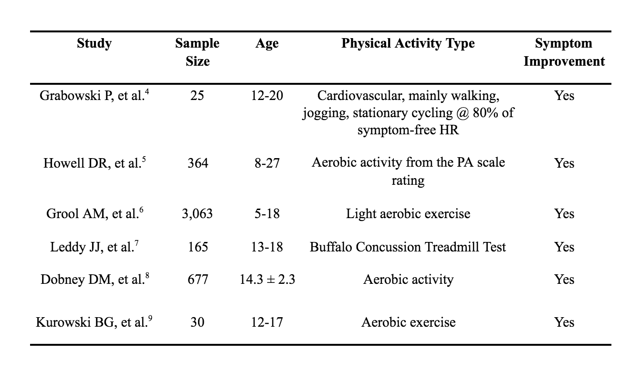
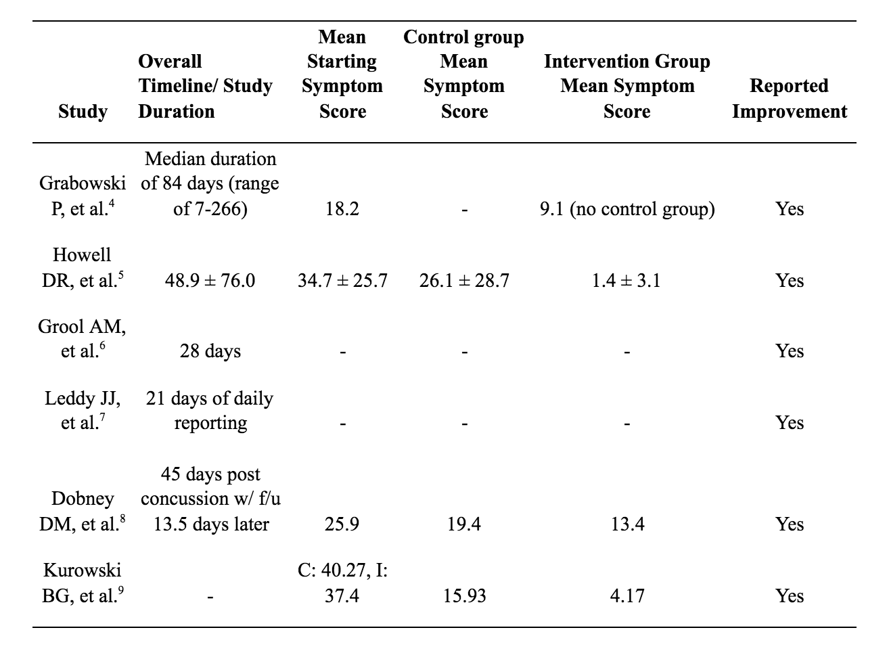
The Effectiveness of Prescribed Physical Activity for the Treatment of Post-Concussive Symptoms in an Athletic Population: A Systematic Review
Nicholas Costa, Kayla Schmidt, Shane Murphy PhD.
School of Integrative Physiology and Athletic Training, University of Montana, Missoula, MT
Introduction
Methods
Results
Discussion
Sports related concussions account for 5-9% of all sports related injuries each year. It is estimated that 1.6 to 3.8 million sports related concussions and traumatic brain injuries occur each year. These concussions are classified as a Mild Traumatic Brain Injury and have associated symptoms affecting cognition, vestibular motor, and musculoskeletal function.
There is no gold standard of care or management of concussions. Current best practice incorporates a long rest period. New research suggests that this may not be the best course of action to return athletes to play. Low level physical activity following a concussion is a new treatment being tested. The initial feedback shows improvement and shorter symptom duration when physical activity is introduced at earlier phases of concussion management.
The reasoning behind the improvement is still unknown. Several studies look at the hormone Brain Derived Neurotrophic Factor (BDNF) and its effects on the recovery of neurons after injury. BDNF has been shown to aid in repairing injured neurons, improve mood and sleep, and increase cerebral blood flow. These studies also show that BDNF is increased with higher levels of physical activity.
If a new treatment modality for concussions is implemented that returns athletes to play in half the current timeframe it would become a gold standard of care. The benefits of low-level physical activity is still being researched but the initial reports are showing a significant change in symptom duration and severity.
A PubMed database search was completed in October of 2020. The key words use in the search included “Physical activity” or “PA” or “exercise” or “training” and “Concussion*” or “MTBI” or “mild traumatic brain injury” and “Symptom Treatment*” or “management*” or “Score*”
The studies that were included must have reported a sports related concussion that was diagnosed. There must be some record of symptom scores. The study needed to include physical activity as a treatment for the intervention group. Lastly, all studies were written in English.
There were 168 articles that met initial inclusion criteria. After review, 6 studies were included in the final analysis. (Table 1) Data extraction looked at the time to recovery, symptom scores, and whether improvement was noted. (Table 2)
Table 1.
Currently, the standard of care reduces or completely stops physical activity during the recovery period following a concussion and is only reintroduced when symptoms are diminished. Physical activity at low levels has been observed to improve symptoms over an extended period when compared to the standard care plan. While in most cases, symptoms of a concussion should lessen on their own, by adding in physical activity, this process may be sped up.
A lack of a gold standard of care and the relatively new treatment of concussions makes it important to test different ways of treating concussions. Concussion management is still in its infancy and there is a constant stream of new research to support different treatments. Each head injury is unique but there may be a way to standardize care and speed up the recovery process. This systematic review has shown the positives of using physical activity as a concussion management tool.
Moving forward, research should focus more on the timeline to return to activity using physical activity as a management strategy. As of now, most studies focus on the overall outcome of symptoms after a specific time period, but do not report the timeline for returning to activity. This research may be useful in changing the “gold standard” for care of an athlete following a concussion.
PRISMA Flowchart
Table 2.
Records identified through database search (n =168)
Additional records identified through other sources (n = 0)
Identification
Records after duplicates removed (n = 168)
Screening
Records excluded with reasons (n =138)
Irrelevant title and abstract
Conclusions
Records screened
(n =168 )
Athletes who engage in low levels of physical activity post-concussion were able to return to their sports faster than the athletes who did not. Future research is necessary to determine the type of physical activity that may be most helpful and to track which symptoms are affected the most by physical activity. Physical activity at a subthreshold level may help to decrease symptoms of a concussion, therefore decreasing the overall return to learn/return to play timeline.
Purpose
Eligibility
Full-text articles assessed for eligibility (n =30)
Full-text articles excluded with reasons. (n =24 )
To determine if low levels of physical activity are a viable treatment option for concussion symptoms
Included
Studies included in qualitative synthesis (n =6)

