Slide 1
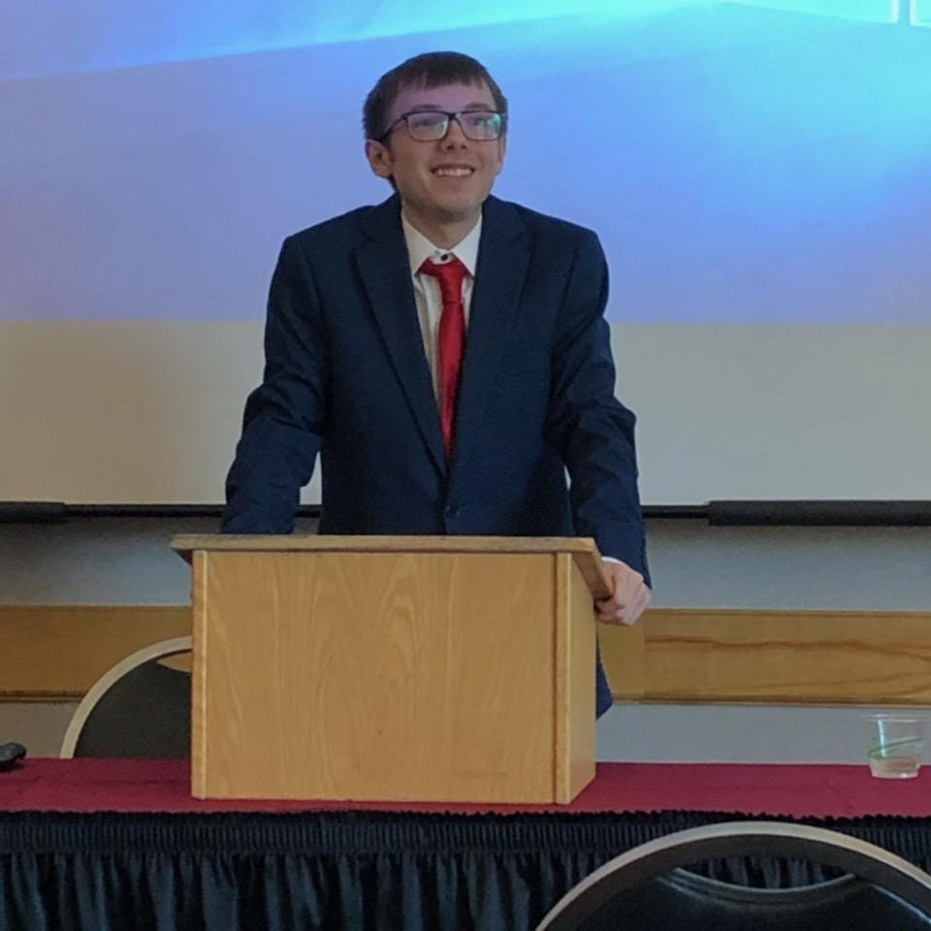
Creating and Destroying History: Butte, Montana’s Model City Program, 1968-1975
John Stefanek
Ph.D. Student
University of Montana History Department
john.stefanek@umontana.edu

Slide 2
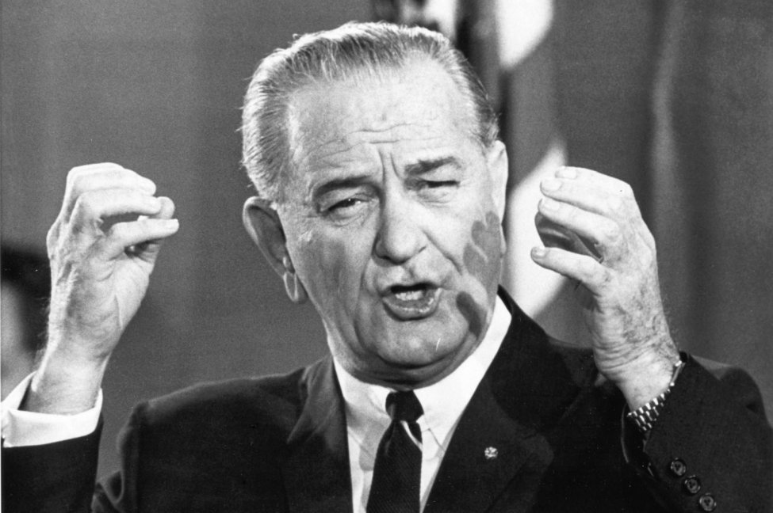
The Model Cities Act
Notes:
“Nineteen-sixty-six can be the year of rebirth for American cities,” declared President Lyndon Johnson in January of 1966. LBJ recommended that Congress approve his administration’s latest Great Society program, the Model Cities Act. The law’s most ambitious initiatives funded urban renewal programs throughout over 150 U.S. cities. Model Cities sought to renew all aspects of society and included anything from the creation of parks and recreational facilities to increasing funding for senior citizen programs. Model Cities’ goals varied from city to city, but in the city of Butte, Montana, the program sought to save its people from impending doom.

Slide 3
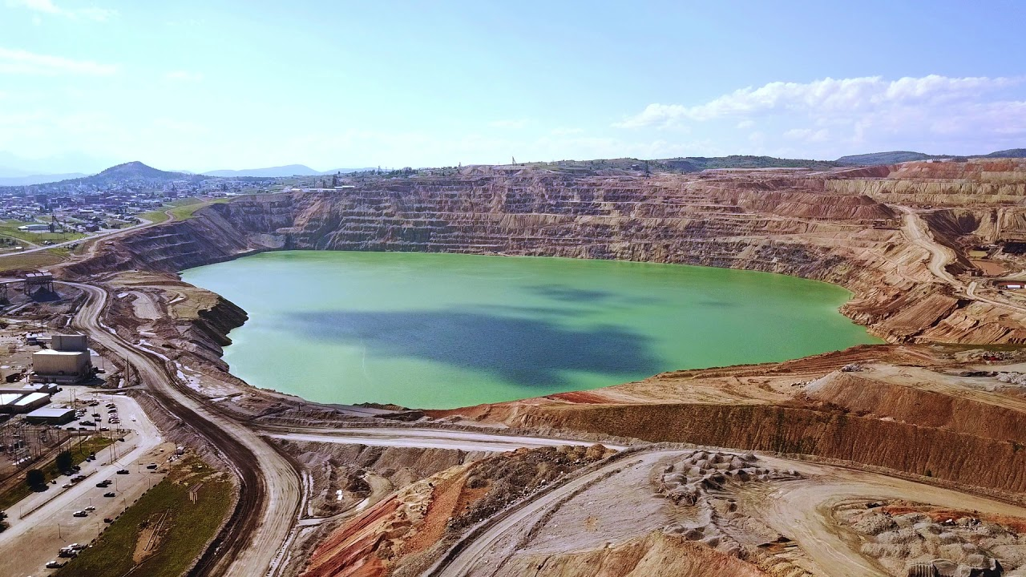
“This is the richest hill on earth. But there have been hard times when those words were a bitter mockery.” –Lyndon Johnson, 1964, Butte Civic Center
Notes:
Once a source of pride for Montana, Butte’s title as the “richest hill on earth” became an ironic symbol of economic depression and environmental destruction. Open pit mining eroded the city’s natural features and chances to become an attractive urban space. Butte is home to one of the most severe environmental disasters in the country. The Berkeley Pit, opened in 1955 by the Anaconda Mining Company, promised the continuation of the mining industry through open-pit methods, but at the cost of further environmental damage. By 1975, the Berkeley Pit swallowed entire neighborhoods, dislocating a significant number of Butte’s population. The threats to public safety caused by mining and the dire need for economic rehabilitation secured Butte’s place in the federal Model Cities program.

Slide 4
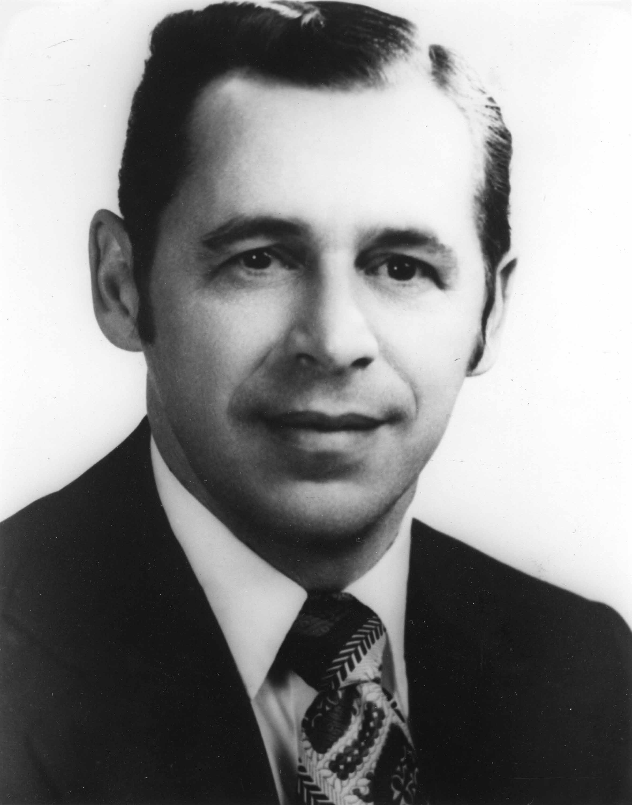
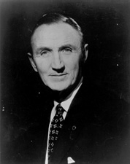
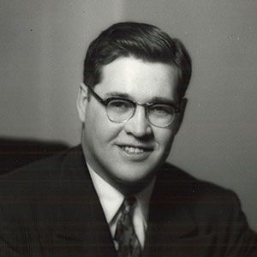
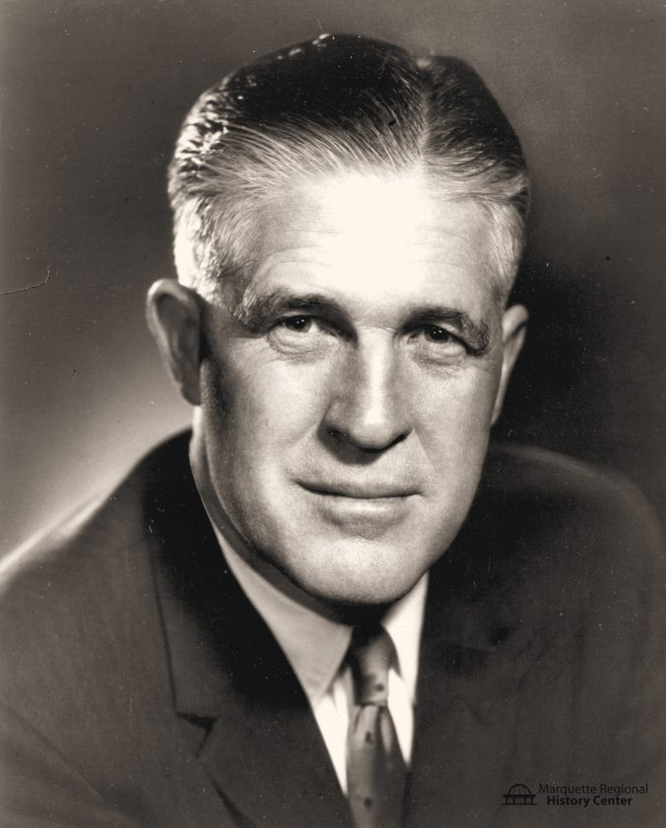
Butte, A Model City
“I am confident we can drag this community, kicking and screaming, into the Twentieth Century,” –James Murphy
Mario Micone Mike Mansfield Lee Metcalf George Romney
Notes:
Butte also faced cultural destruction. “I am confident we can drag this community, kicking and screaming, into the Twentieth Century,” declared Butte Model Cities Director James Murphy. Teaming up with Butte Mayor Mario Micone, Montana Senators Mike Mansfield and Lee Metcalf, and with the assistance of Housing and Urban Development Secretary, George Romney, these public servants sought to save Butte by creating a new environment and culture. But to create a new society, an old one had to be destroyed.

Slide 5
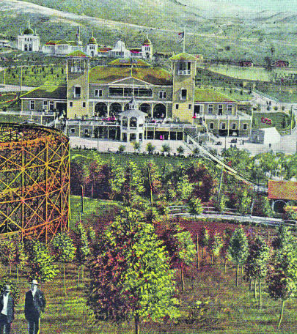
We’ve got a plan to build a new Butte. The question is whether the city wants it.” –Mayor Mario Micone
Notes:
To create a new image for Butte, some of its identity and nostalgia had to be destroyed. Urban business centers could become the new symbols of Butteian pride, replacing the mines that had given Butte so much success but now served as a reminder of Butte’s deterioration. Butte, in the process of being absorbed by the Berkeley Pit and being terrorized by a series of unsolved fires earlier in the 1960s-70s, could not escape destruction.
I argue that the Butte Model Cities program is the most significant urban renewal effort in Butte’s history. The program brought modern infrastructure to a city that greatly lacked it but amplified physical and cultural destruction. The Model Cities program left physical and invisible scars on Butte, but also created social services and programs still in place today. Butteians were conflicted over the program. Some praised its social programs, others thought it needlessly destroyed historic buildings, and as a result, their history. The Butte Model Cities program officials, in dealing with a resistant mining culture and rampant destruction, engaged in a battle for the soul of Butte. Despite Berkeley Pit expansion and Model Cities demolition, Butte ultimately prevailed in preserving its culture and pride. However, Model Cities saved Butte’s economy and introduced modern urban planning.

Slide 6
Methodology
Program lasts from 1968-1975
Planned Variations expansion, 1971
Model City goals
1. Economic Development
2. Physical Environment
3. Social Services
Archives
University of Montana, K. Ross Toole Archives
Montana Historical Society
Butte-Silver Bow Public Archives
Notes:
This research is a thematic reconstruction of the Model Cities program in Butte from 1968-1975. This project examines three key focuses of the program: economic development, physical environment, and social services. This paper places the program’s beginning in 1968 as Butte’s application to the program received the green light and officials started drafting a comprehensive plan for its first year of operations in 1969. Butte received funding that would cover Model Cities projects up to 1975, and it also received additional funding through Planned Variations, a federal expansion of Model Cities, in 1971 under the Nixon administration. The 1968-1975 timeframe encompasses the Butte Model Cities program in its entirety and political changes between the outgoing Johnson administration and incoming Nixon administration.
Most essential in examining these themes are primary sources from the archival collections at the University of Montana, Montana Historical Society, and the Butte-Silver Bow Public Archives. These repositories contain the papers of Montana Senators Mike Mansfield and Lee Metcalf, who were the most active players in the program outside of Butte. Additionally, oral histories of Butte Mayor Mario Micone and his staff at the Butte-Silver Bow Public Archives provide an on-the-ground analysis of Model Cities. Within these collections, constituent letters regarding the program, newspapers, Butte’s application to Model Cities, and development plans piece together a coherent timeline of events.

Slide 7
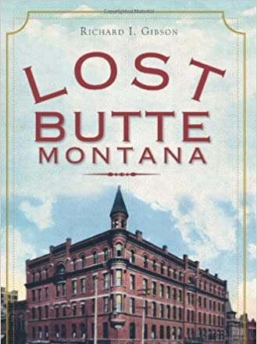
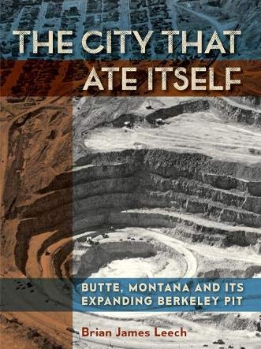
Historiography
Political and urban history
Historic memory
Cultural and physical destruction
Berkeley Pit
Notes:
The Butte Model Cities program and its legacy have been overlooked by historians. If mentioned at all, the Butte program is often described as a political favor to Montana Senate Majority Leader Mike Mansfield without any discussion of the program’s merits to a smaller city. My research is the first to cover the themes of physical and cultural destruction. Further, historians have diverted much attention towards the Berkeley Pit. The pit has dominated Butte’s historic memory of the second half of the twentieth century, but Model Cities hardly receives scholarly attention. The pit and Model Cities are both critical historical events in this telling of Butte’s history.

Slide 8
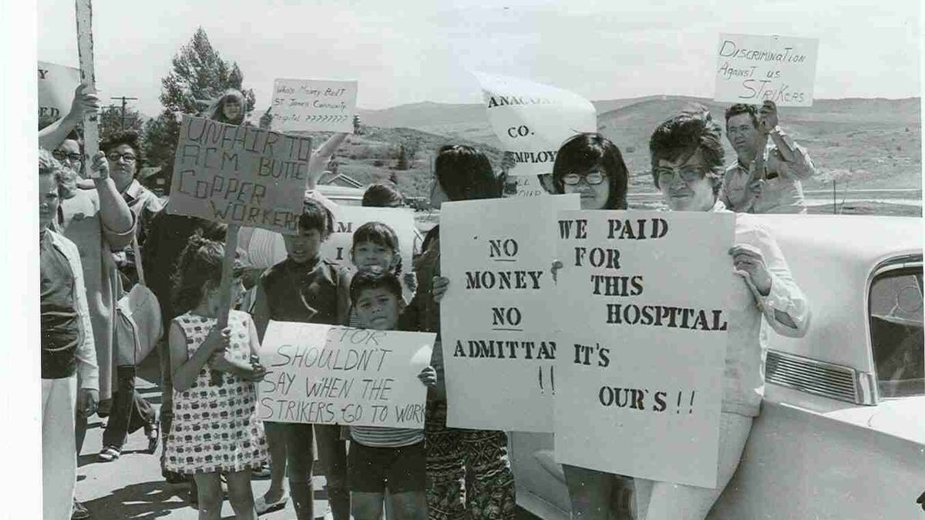
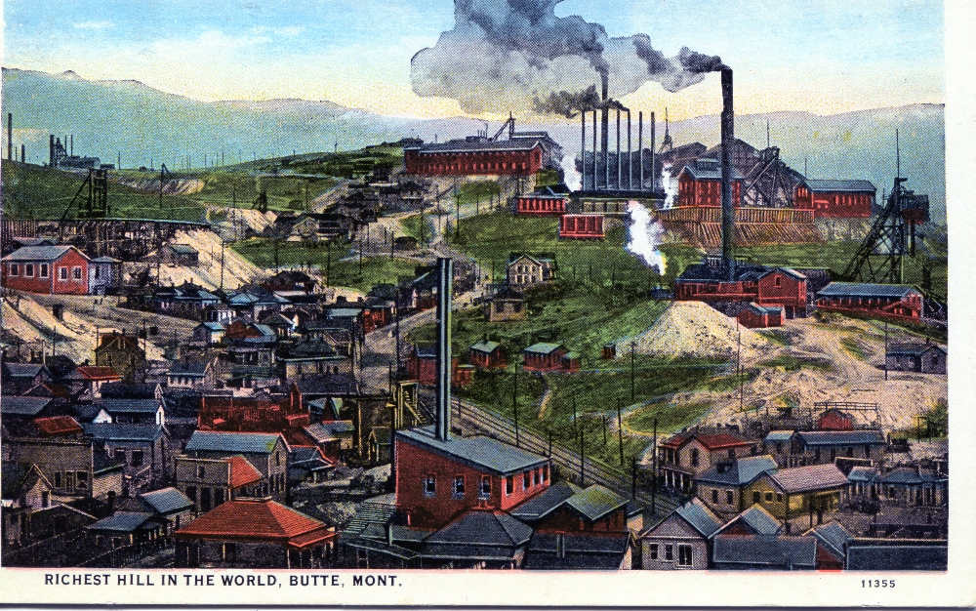
Economic Development
“...it is only in times of stress, such as the strike which we are now experiencing, that we are recognized as the economic stabilizers of the State, and only then is it acknowledged that when Butte’s economy is ‘down’, that of the state is likewise adversely affected” –Butte couple, letter to Mike Mansfield, 1967
Notes:
The first step in creating a healthy environment in Butte needed to address the systemic issues that wounded Butte’s economy. “...it is only in times of stress, such as the strike which we are now experiencing, that we are recognized as the economic stabilizers of the State, and only then is it acknowledged that when Butte’s economy is ‘down’, that of the state is likewise adversely affected” said a Butteian couple in 1967. Butte built streets and neighborhoods with the sole goal of ensuring that miners could walk to work. Mining dominated almost all aspects of life in Butte, especially city-planning. In addition to the expansion of mining that devoured neighborhoods, this also separated miners from the city.

Slide 9
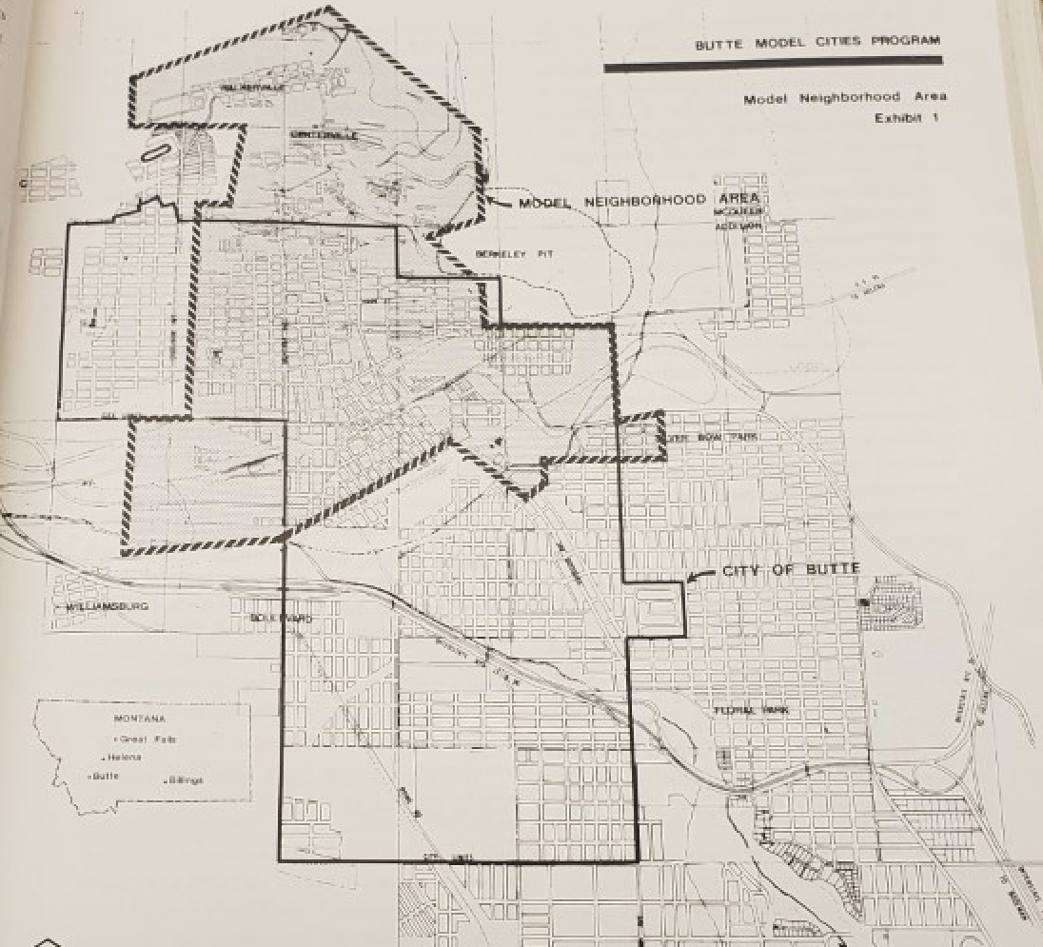
Model Neighborhood
Notes:
The first year of Model Cities allowed cities to designate a “Model Neighborhood” for urban and economic rehabilitation. In its 1967 Model Cities application, Butte’s Model Neighborhood started in northern Butte close to the town of Walkerville and expanded south into the heart and most urban area of the city. The oldest and poorest region of the city, the Model City program sought to address the economic downturn by integrating the area’s indigent regions with the rest of the city. Only by addressing the needs of its most overlooked citizens–the miners and their families–could Butte achieve economic prosperity.

Slide 10
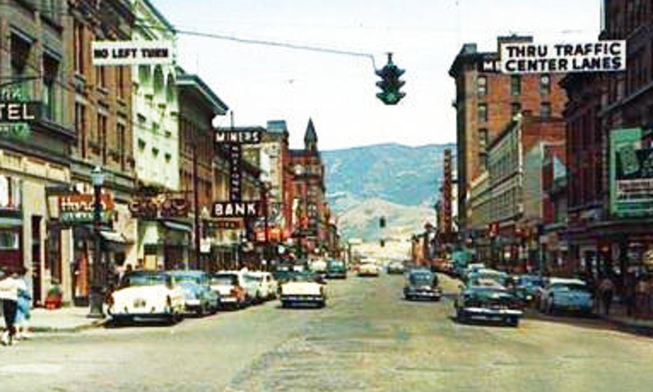
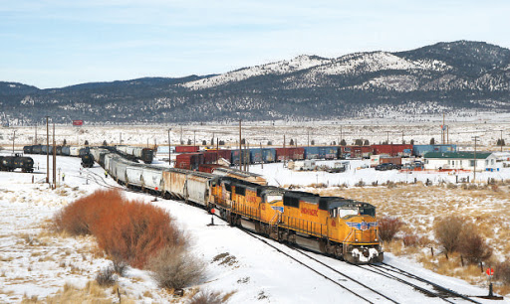
Port of Butte
Notes:
In fulfilling its goal of reconnecting the Model Neighborhood with the rest of Butte, the first comprehensive plan focused on replacing lost mining jobs. With the mining industry’s future uncertain, the Model Cities program looked to modernizing Butte’s economy. In addition to supplying immediate public works jobs, the Model Cities program initiated the Local Development Corporation (LDC) to focus on long-term economic projects. The LDC oversaw the construction of an industrial park, the Port of Butte. The program believed that an industrial plant could better connect Butte with cities like Seattle to bring much-needed business to Butte. The Port of Butte lives on today as the Port of Montana.
A key figure in attempting to achieve this goal emerged in 1969. Running a platform of anti-corruption, the hardy Mario Micone defeated incumbent Mayor Tom Powers for the office of Mayor of Butte. Micone heavily campaigned on the Model Cities program. Figures who worked with Micone, such as Don Peoples believed that Micone and the program developed a “can-do” attitude in Butte. Micone believed that the development of the LDC and the Port of Butte were the program’s great economic accomplishments in their goals of diversifying the economy. Most importantly, the port allowed Butteians to be proud once again that their city was now not only providing jobs but contributed to the well-being of its people. The port signified the program’s desire to bring an “uptown” and modern feel to the outskirts of Butte.

Slide 11
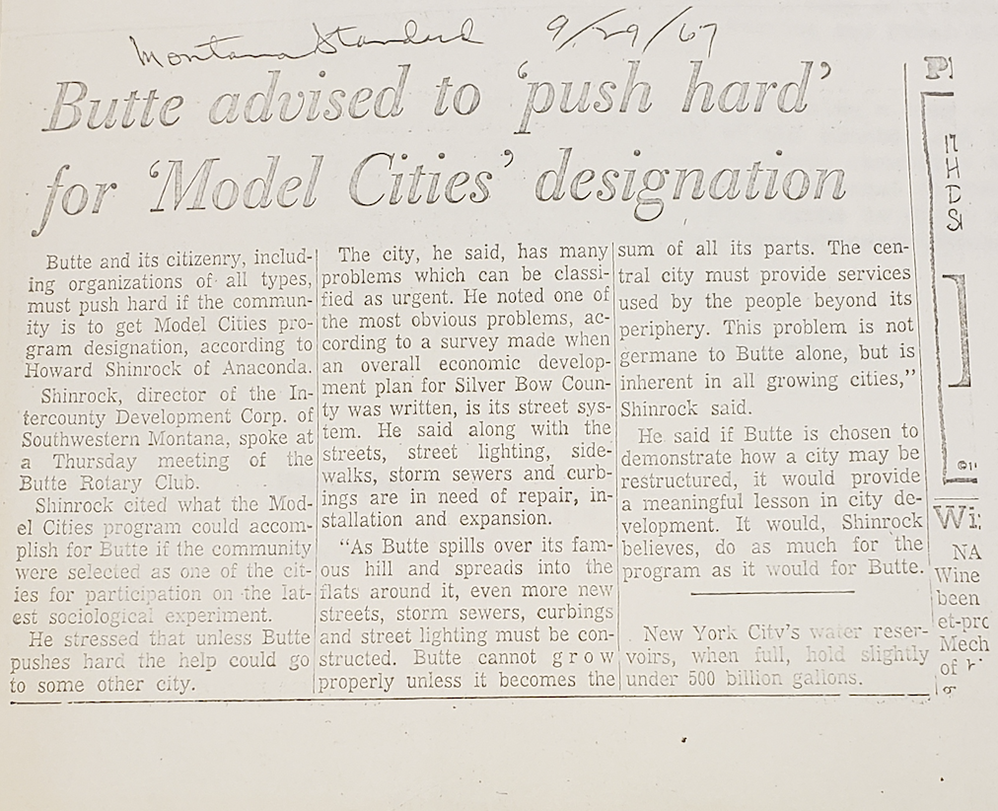
Physical Environment
“As Butte spills over its famous hill and spreads into the flats around it, even more new streets, storm sewers, curbings and street lighting must be constructed. Butte cannot grow properly unless it becomes the sum of all its parts.” –Montana Standard, 1967
Notes:
Butte’s dilapidated infrastructure supplied the nation an image of a place to avoid. The above quote from the Montana Standard illustrated the dire need for the city’s most neglected people and houses to receive ample care. The 1967 Model Cities application reported that 65% of houses in the Model Neighborhood zone were in substandard condition.

Slide 12
Berkeley Pit
Overview of Butte and the rapidly expanding Berkeley Pit in 1954
Notes:
Additionally, the expansion of open-pit mining in Butte marked difficult challenges for the environmental goals of Model Cities. By 1969, the Berkeley Pit had already proved to be a threat to the well-being of the public. The pit had swallowed three schools and over 1,000 housing units. Now it was only two blocks away from Butte’s central business district. Further the pit on average erased 7 million tons of the richest hill’s earth every month. “Today there can be no such compromises between mining and a living environment” declared the first Butte Model Cities comprehensive plan.
The physical environmental goals posed the greatest problems for the Butte Model Cities program. Feuds with the powerful Anaconda Mining Company put the program’s physical environment goals in limbo. The program needed to first achieve economic successes to illustrate to Butteians that Model Cities remained the best option for a healthy, prosperous Butte. Housing goals were the first to be addressed. The establishment of City-County Comprehensive Planning sought to address one of Butte’s long-neglected issues: the absence of long-term urban planning. This project encompassed nearly every physical environment and housing goal of the second-year plan
The demolition of substandard houses occupied most of this program’s attention and remains the most controversial legacy of the Butte program. While constituent letters to Montana Senators Mike Mansfield and Lee Metcalf generally supported the Model Cities program, the demolition project by far was the most ill-received. Some constituents argued that the relocation project did not seek the approval of the populace of Butte and endangered the people it tried to aid the most. Reportedly, relocated elderly couples were reportedly moved into fire hazards. However, the negative responses to the demolition projects also show how Butteians became more active in reshaping their communities. This community involvement would later stop the expansion of the Berkeley Pit, saving the city. Indeed, Mayor Micone considered the increased community involvement one of the program’s greatest successes.

Slide 13
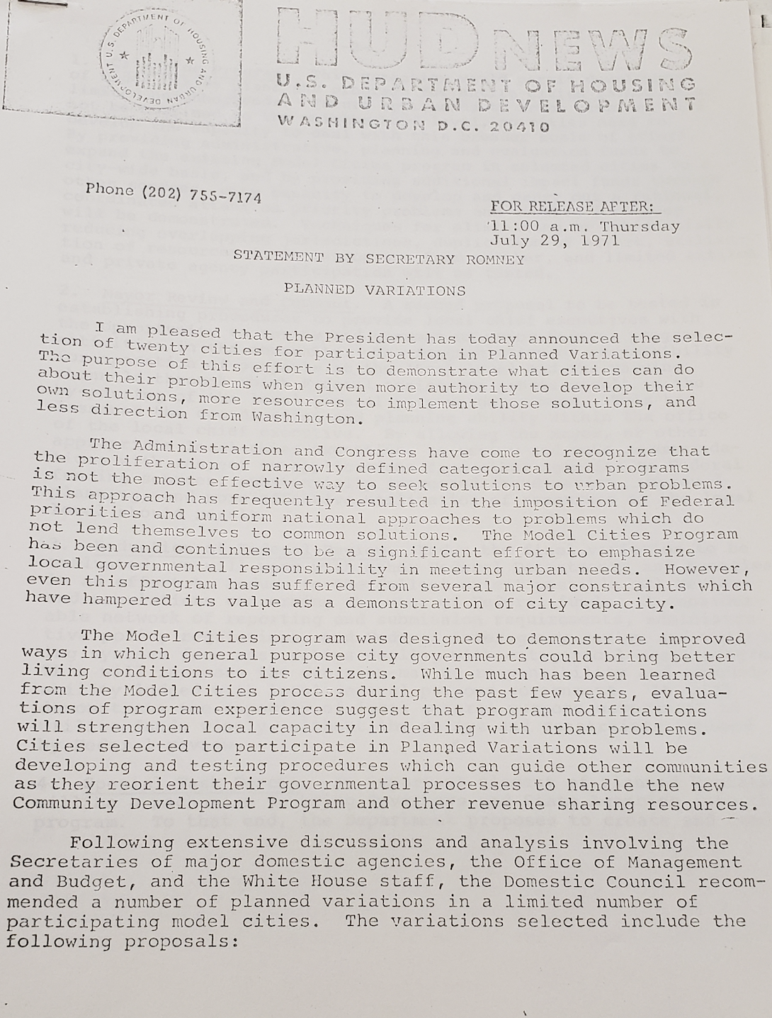
Nixon Administration and Planned Variations
Notes:
One federal development that aided the Butte program emerged at the beginning of Richard Nixon’s presidency. While Nixon had little enthusiasm for Model Cities, his Housing and Urban and Development Secretary, George Romney did. Thanks to Romney, Butte saw an annual increase in funding from $1.5 million, to $3.2 million in 1971, and became part of a Model Cities extension called Planned Variations. But was one of only 20 cities to be included in this extension, and one of the smallest cities in terms of population to make the cut. Butte’s inclusion meant that despite Nixon’s hands-off approach to city affairs, it continued to receive federal assistance. The extension enhanced the power of the local executive in city-planning, expanded the Model Neighborhood area to include the entire city, and reduced federal oversight of individual projects. The extension allowed officials like Micone and James Murphy to continue their vision of destroying the past Butte and making a new one. But this came at the cost of increasing the reach of the program’s demolition projects. As the program’s staff found hope in the increased lifespan of the program, Butteians worried that Micone’s vision would destroy the pride and independence of Butte.
By December 1974, the Butte Chamber of Commerce reported that the Model Cities program demolished over 600 “dilapidated” buildings while erecting over 400 units of government subsidized housing. These demolitions further signify the program’s desire to destroy an unsustainable culture in Butte and replace it with a more modern one. However, the most important contribution of the program to Butte’s physical environment and housing was the awareness it sparked in the community. The program hired citizens to work in its cleanup and urban renewal projects, which taught the community the steps necessary to prevent environmental disasters.

Slide 14
Social Services
Butte struggled with:
Unemployment
Health issues
Welfare
Low median income
Butteian pride
Notes:
Of the four urban counties in Montana, Butte ranked highest in unemployment, health issues, need for welfare, and the lowest median income. Butte simply lacked in providing adequate social services to its people. The first comprehensive plan attributes this to its mining culture. Years of hard mining work proved to be toxic to the welfare of its people due to the deadly working conditions. Mining also demonstrated a toxic attitude towards social services. Due to the independent, hard-working nature of mining, Butteians rejected social services in fear of forming dependence on them. Butte believed it could only rely on itself, and as Montanans outside of Butte mocked the crumbling richest hill on earth, their independence and pride amplified.

Slide 15
Senior Citizens and Health
In 1969, Butte had
No neurosurgeons
One pediatrician
No alcoholism treatment centers
Senior Citizens
Old population
3,500 lived in Model Neighborhood zone
Notes:
Model Cities came to Butte in a time of great need of these services. In 1969, Butte had no neurosurgeons, one pediatrician, no alcoholism treatment centers, and overall a poor understanding of basic health procedures. Further, Butte lacked the proper health infrastructure to assist the 3,500 senior citizens–double the number of a typical urban population–who lived in the Model Neighborhood area. Additionally, in 1970, Butte had twice as many persons 65 years old or older than it did in 1930 despite losing half the total city population between these years. Butte did not even have a senior citizen’s center. The senior citizen’s center became one of the most desired programs desired not only by Butte officials, but by the general population. While Butteians still remained cautious of social services, the senior citizens program marked an important step forward in the city’s desire in creating a healthier urban environment.

Slide 16
Education
Significant number of Butteians lacked a high school or college education
Schools lacked funding
Berkeley Pit consumed several elementary schools
Notes:
Education marked another area in which Butteians demonstrated a shift in attitudes regarding social services. The first-year comprehensive plan acknowledged that little opportunities for education resulted in a significant number of the populace lacking a high school or college education. Additionally, the comprehensive program plan articulated that due to the economic downturn, schools lacked access to adequate funding to address these issues. The enthusiasm and public input on the issues of education and senior citizen care illustrate that Butteians supported social services to aid its most needy residents: children and the elderly. In allowing the protection of its most vulnerable people, Butte made a significant step forward in modernization. However, Butte remained skeptical of federal aid, and issues such as alcoholism continued to plague the community. While still worrying of becoming too dependent on social services, these educational and senior citizen programs became among the first social services that Butteians believed could provide the city with a better, safer future.

Slide 17
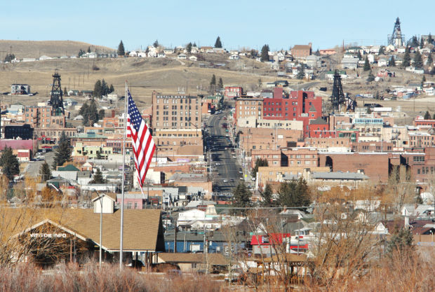
Conclusion
Notes:
One year after the Model Cities program’s expiration in 1975, the Butte City Council rejected a measure to move Butte’s uptown business district to make way for the ever-hungry Berkeley Pit. In doing so, Butte simultaneously fought to keep its culture and history alive, but also cut off the mining industry it long depended on. Model Cities proved to be instrumental in this decision. On one hand, the program contributed to the ongoing destruction that threatened Butte’s lifespan. But on the other end, the program provided tools to halt destruction and left a legacy of community activism. Model Cities had both the potential to help destroy Butte or save it. In the end, it proved to be more helpful than detrimental. Model Cities' unitentional antagonistic actions reinforced Butteian pride and directed its resistance towards the Berkeley Pit. While failing in fully reshaping Butte, Model Cities’ most important legacy is the Butteian activism that killed the Anaconda Mining Company, the primary antagonist of most of Butte’s history. In 1975, Butte was reborn.

Slide 18
Archival Sources
Butte-Silver Bow Public Archives, Butte, Montana.
Conavad, Rita - Vertical Files.
Don Brunell Collection.
Karen Marchioro Collection.
Paul Eno Collection.
Vertical File / Government & Politics / Model Cities.
Vertical File / Government & Politics / Model Cities Human Resources Council Indian Alliance & Com. Org. 1971.
Montana Historical Society, Helena, Montana.
Lee Metcalf Papers
Montana Department of Environmental Quality, Director's Office Records.
Montana Department of Planning and Economic Development Records.
Montana State Department of Public Welfare Records.
Montana Governor (1969-1972: Forrest H. Anderson) Records.
University of Montana – K. Ross Toole Archives, Missoula Montana.
Arnold Olsen Papers.
Mike Mansfield Papers.
John Melcher Papers.

Slide 19
Thank You!
Have information or questions on the Model Cities program? Contact me at john.stefanek@umontana.edu

