Slide 1
Effect of home-based Tai Chi, Yoga or conventional balance exercise on functional balance and mobility among persons with idiopathic Parkinson's disease: An experimental study
Authors: Arva Khuzema PT, A. Brammatha, Dr. Arul Selvan
Presented by: Arva (Khuzema) Gadly

Slide 2
INTRODUCTION
Parkinson’s disease (PD) is a chronic progressive neurodegenerative disorder of insidious onset characterized by the presence of predominantly motor symptoms and a diversity of non-motor symptoms.
Motor Symptoms
Muscular rigidity
Tremors
Postural Instability
Bradykinesia
Gait Impairment
Non-Motor Symptoms
Insomnia/ Daytime sleepiness
Urinary incontinence/ Constipation
Cognitive Impairment
Depression/ Apathy
Hallucination/ Psychosis

Slide 3
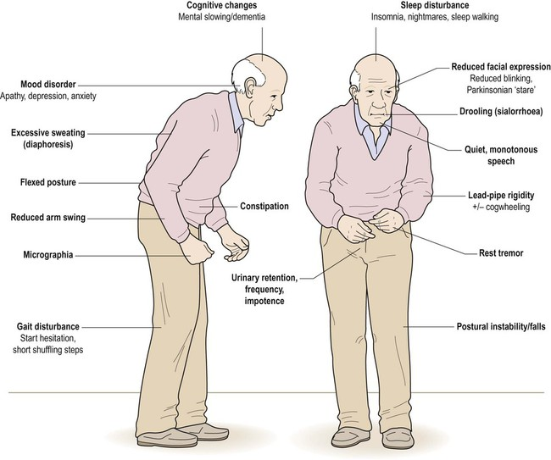

Slide 4
Incidence & DALY
PD is a universal disorder, with a crude incidence rate of 4.5–19 per 100,000 population per year and the
In a door-to-door survey of the Parsi community in Bombay, the crude prevalence estimates were 328 per 100,000.
Daily Adjusted Life Years (DALY) globally in 2015 was 1.76 million (0.12%) and is expected to increase up to 2.01 million (0.13%) in 2030.

Slide 5
Physical Therapy for Individuals with PD.
Moderate evidence that support physical activity and exercise improves postural instability balance in persons with mild to moderate PD.
There is insufficient evidence to support the use of one approach of physiotherapy intervention over another for the treatment of PD
A recent survey showed Tai Chi and Yoga were the 2nd most prevalent complimentary therapies utilized by individuals with PD
Home-based exercises for a minimum 150 min per week for at least six weeks improved balance-related activities in people with Idiopathic Parkinson’s disease, .

Slide 6
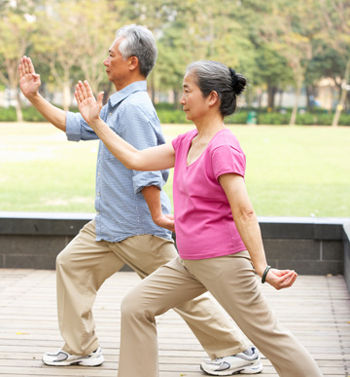
Tai Chi
According to a survey perceived effectiveness of Tai Chi was reported to be 60.9%
Traditional Chinese martial art that involves slow and graceful movements that can improve postural balance, flexibility, and mood.
Yoga
Yoga is a popular mind-and-body exercise originated in ancient India. It concentrates on meditation, stretching, breathing, and balancing postures.
According to a survey perceived effectiveness of Yoga was reported to be 73.8%

Slide 7
Need for the study.
Lack of adequate evidence
Different protocols
Mind and Body exercises
Home based exercise program

Slide 8
STUDY CRITERIA
INCLUSION CRITERIA | EXCLUSION CRITERIA
Subjects within age 60–85 years including both male and female. Subjects who were in stage 2.5 and 3 of Modified Hoehn and Yahr’s Parkinson’s stage. Patients who were able to understand and follow the instructions. Patients who were interested to participate and were not undergoing any other treatment other than medication | Severe co-morbidity influencing mobility or life-threatening disease. Not interested to participate in any form of exercises. Visual and vestibular disorder affecting balance. History of osteoporosis, fracture or ankle instability, falls. No care giver supervision or support.

Slide 9
PROCEDURE
All patients underwent neurological examination, (UPDRS) and sternal nudge test to classify the Modified Hoehn and Yahr’s stage of PD in the “on” phase of medication by the Neurologist and then were referred to the Physiotherapist for the study.
Twenty seven subjects who satisfied the selection criteria participated in this study and a written informed consent was obtained. These 27 patients were blinded to the groups and were randomly allocated by the alternate number method to the three groups.
9 patients were allocated to Group A: (Experimental Group I) who received Home-based Tai Chi exercise program,
9 patients were allocated to Group B: (Experimental Group II) who received Home-based Yoga exercise program
9 Patients were allocated to Group C: (Control Group) who received Home-based General Balance exercises

Slide 10
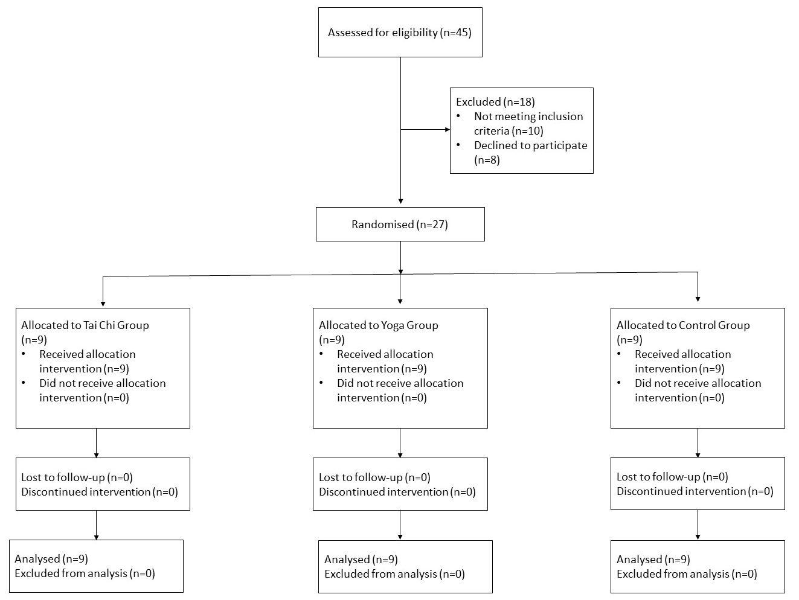
FLOWCHART

Slide 11
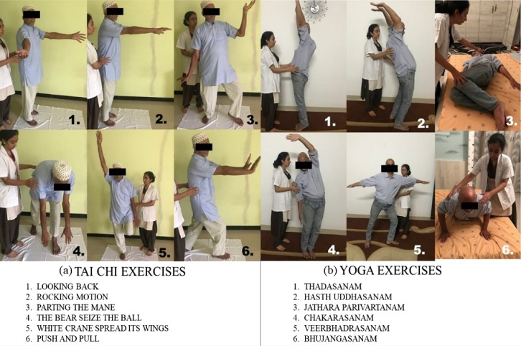
Conventional Balance exercises includes:
Standing back extensions
Standing trunk rotations
Backward walking
Side-ways walking
Tandem walking
Single limb stance
Each session lasted for about 30–40 min and it included six exercise poses (Tai Chi/Yoga/Conventional Balance exercises) for 8 weeks.
Each pose was repeated about five times initially and were gradually increased to 10 repetitions according to the subject comfort.
All the exercises were performed in a slow pace with abdominal breathing pattern.

Slide 12
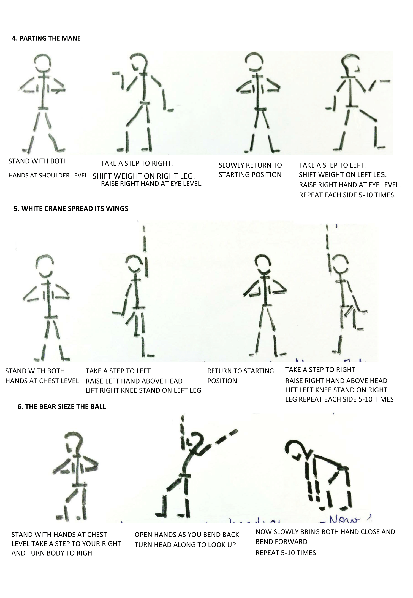

Slide 13
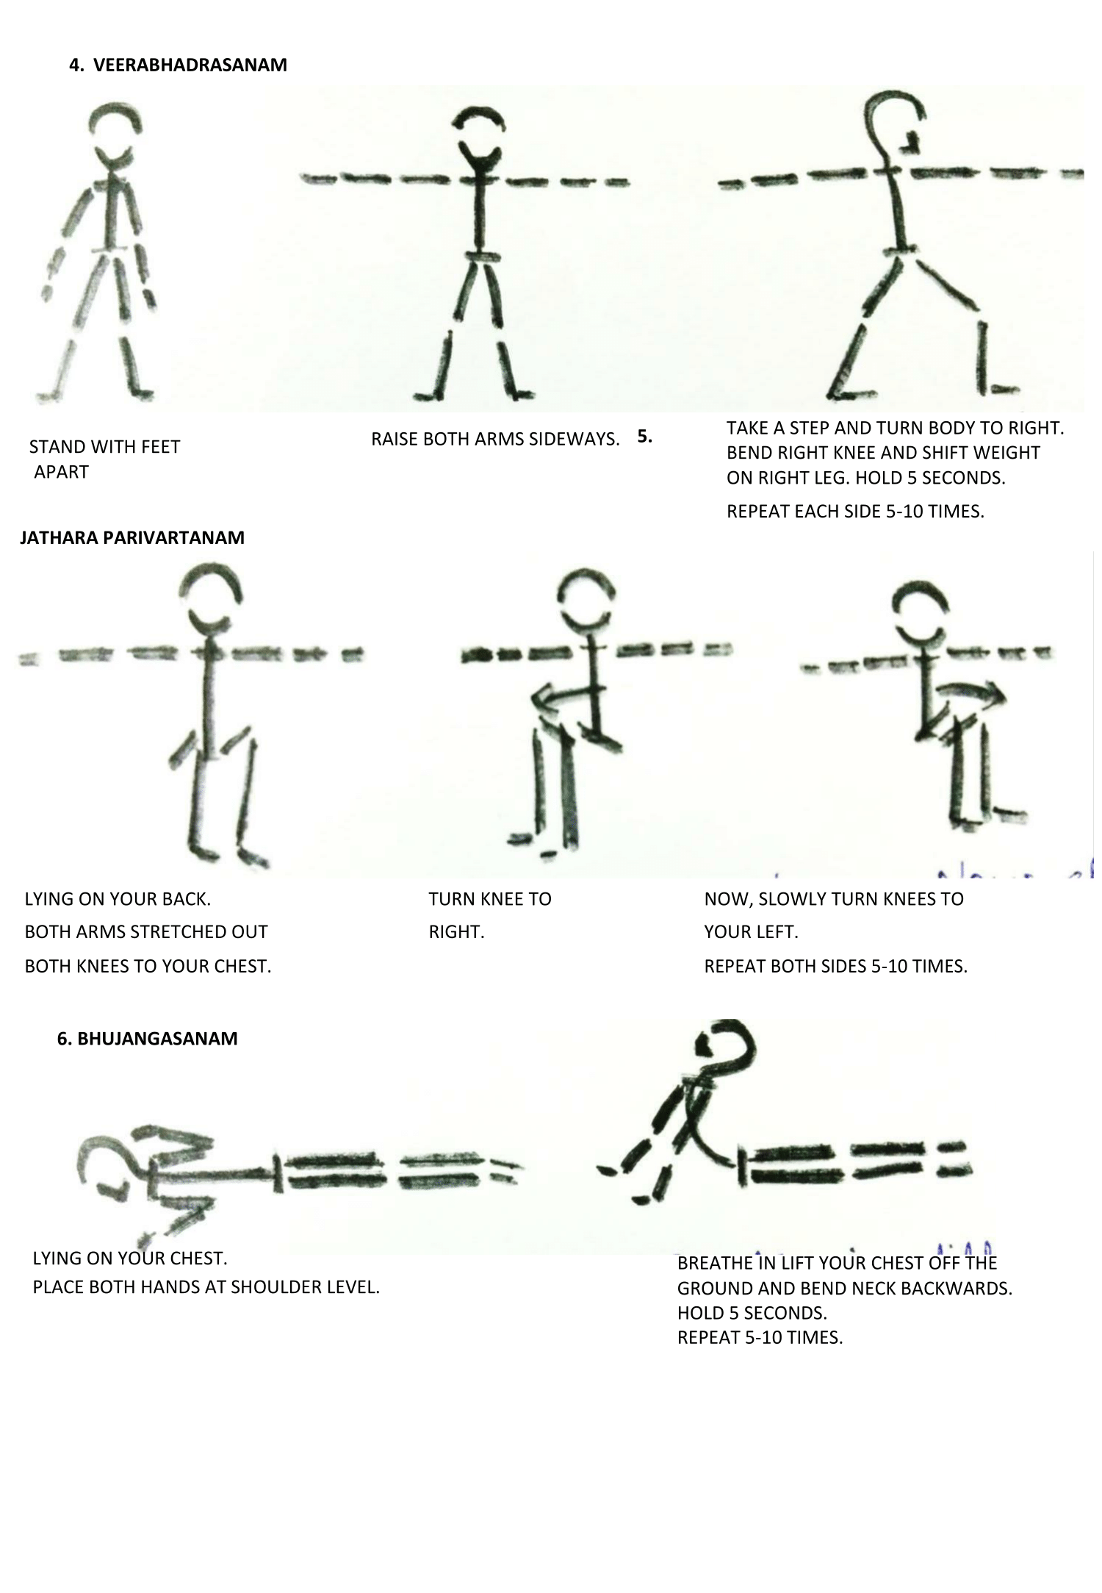

Slide 14
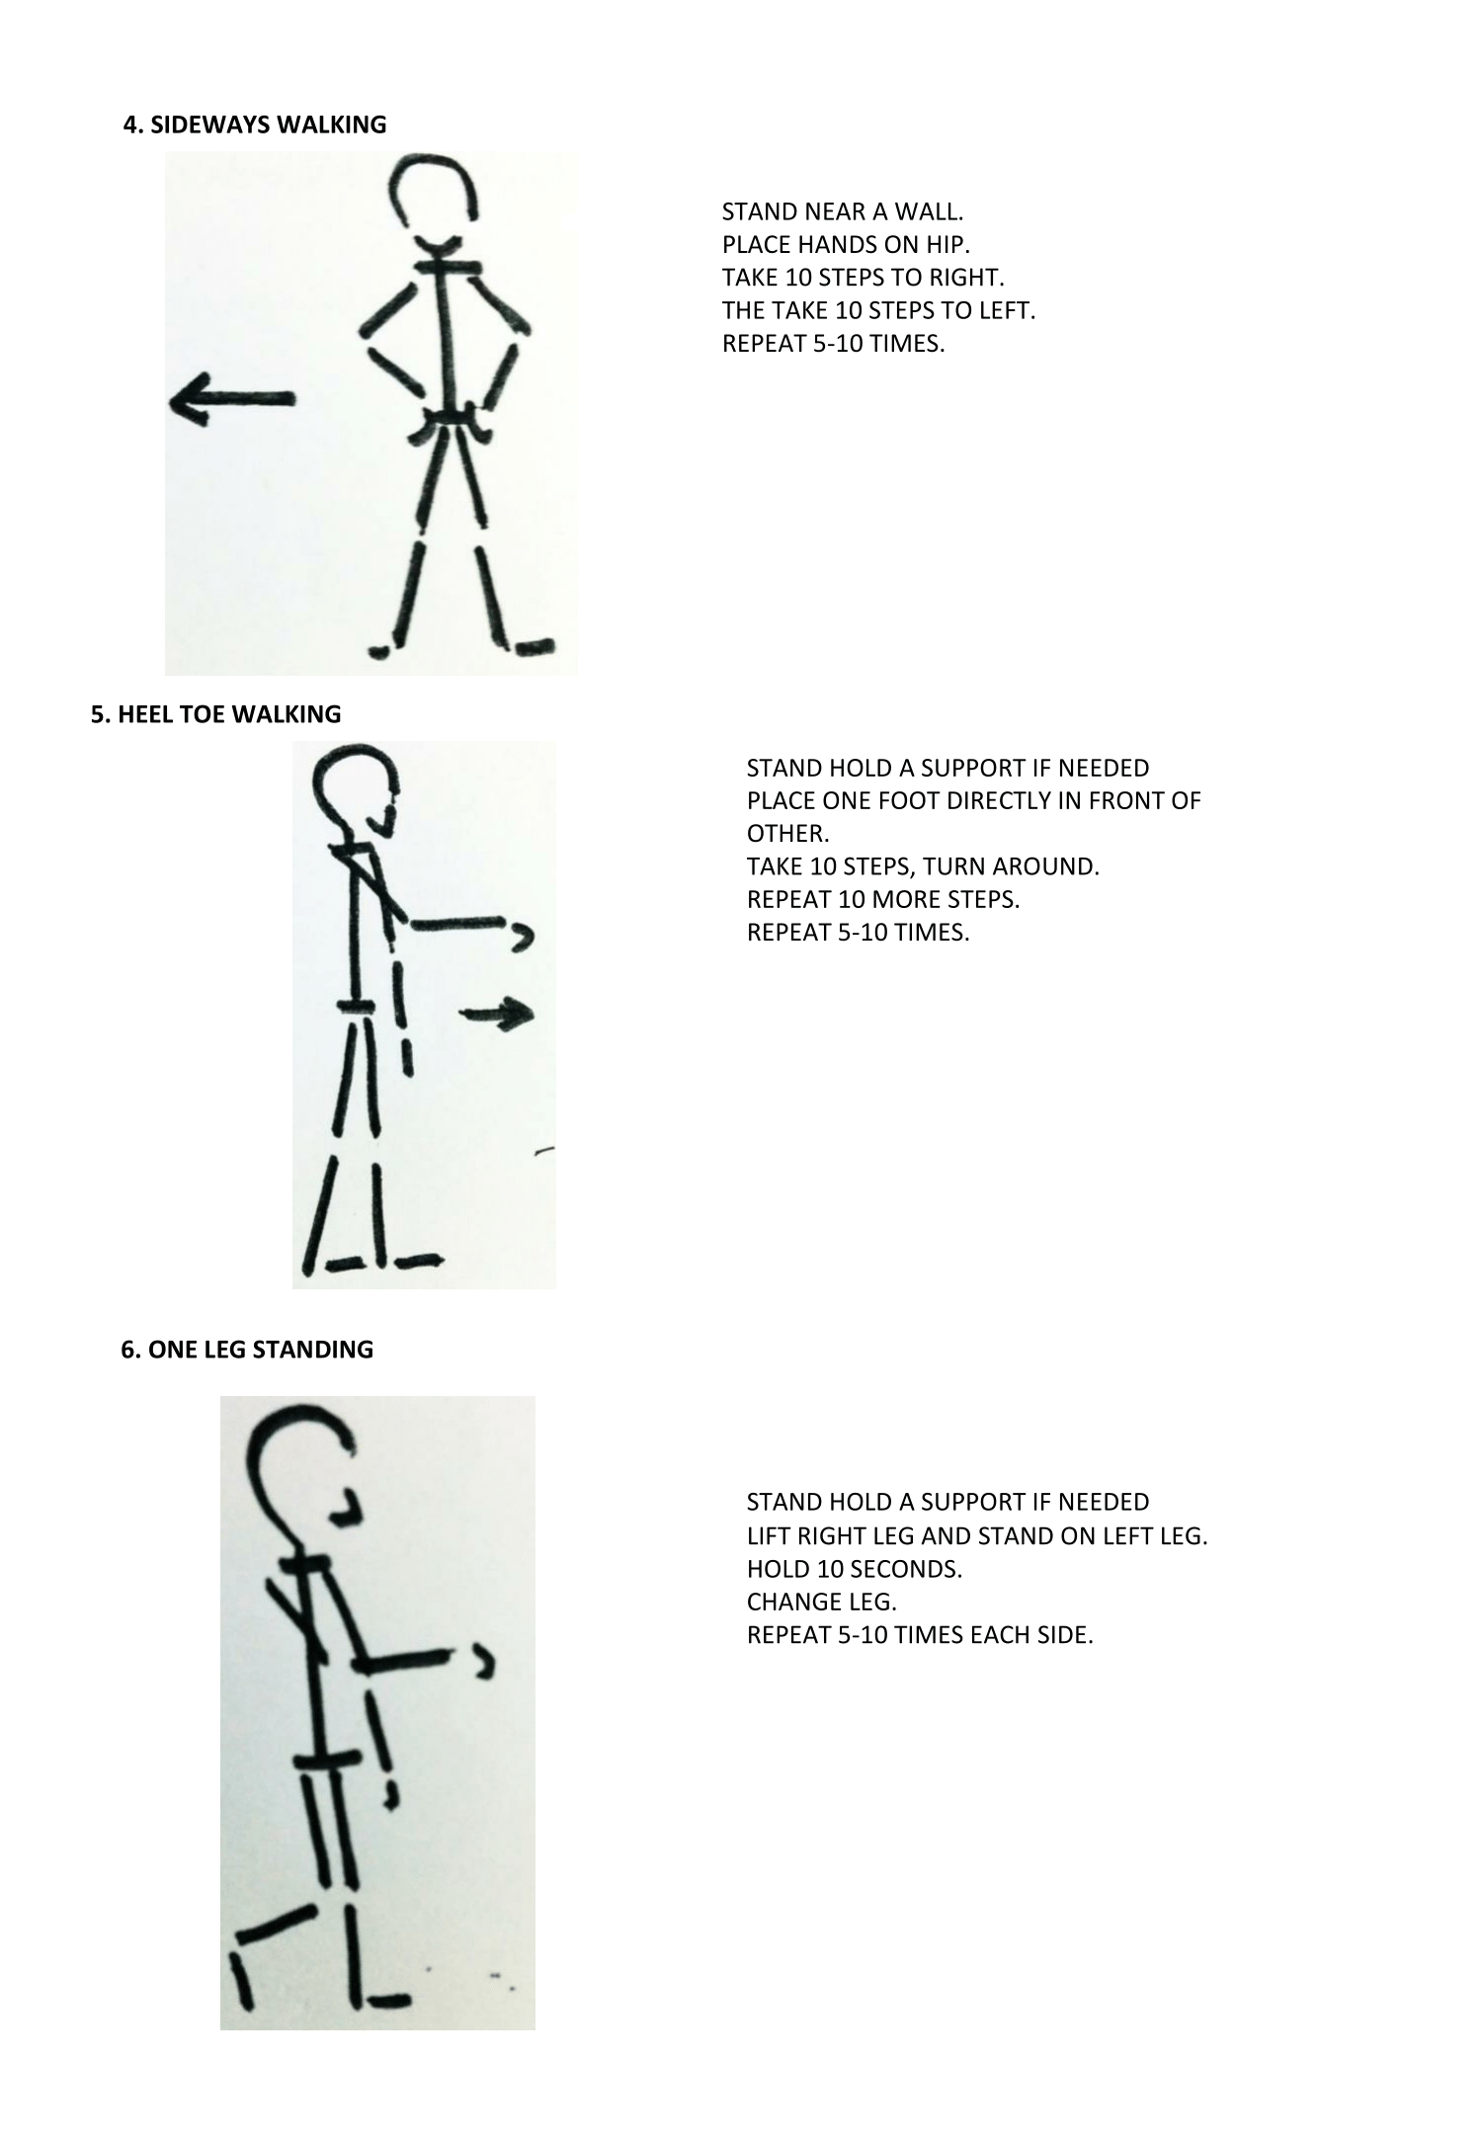

Slide 15
OUTCOME MEASURES
All the outcome measures were assessed by the researcher who was not blinded.
The balance was assessed by the Berg Balance Scale.
The functional mobility was assessed by the Timed 10-m Walk test and Timed Up and Go test.

Slide 16
Data Analysis
Data analysis was performed using SPSS Software (version 25).
Mixed model (3 X 2) ANOVA was performed with Alpha level of significance set at 0.05.
There was no difference in the baseline for age, UPDRS motor score, Modified Hoehn and Yahr’s stages, sex, time with PD, Balance score, timed up and go time and 10 m walk time analyzed using Mixed Model ANOVA.

Slide 17
RESULTS
The Two-way mixed ANOVA analysis for overall balance in Berg Balance Scale scores showed that there was a significant main effect for time as F(1,24)=74.18, p=0.000, ηp2=0.76.
There was also a significant main effect of time on mobility overall as F(1, 24) =77.78, p=0.000, ηp2=0.76 in Timed Up and Go test and F(1, 24) =48.24, p=0.000, ηp2=0.67 for 10 meter walk test.
With respect to mobility, the values F(2, 24) =5.92, p=0.008, ηp2=0.330 in Timed Up and Go test and F(2, 24) =10.40, p=0.001, ηp2=0.464 in 10 m Walk test showed a significant interaction.
There was no significant main effect for group with F(2, 24) =0.583, p=0.566, ηp2=0.046 on balance. Similarly, there was no significant main effect found between groups for mobility with F(2, 24) =0.699, p=0.507, ηp2=0.055 in Timed Up and Go test and F(2, 24) =0.667, p=0.523, ηp2=0.053 in 10 m Walk test. Further, Post Hoc analysis was not done as there was no significant group effect

Slide 18
GRAPHICAL REPRESENTATION
The mean Berg Balance score increased significantly by 26.414%, 8.193% and 14.339% in Tai Chi, Yoga or Conventional balance exercise group, respectively (p<0.05).
The mean Timed up and go time decreased significantly by 22.695%, 7.187% and 8.902% in Tai Chi, Yoga and Conventional balance exercise group, respectively (p<0.05).
The mean 10-m Walk Time decreased significantly by 24.469%, 5.914% and 8.986% in Tai Chi, Yoga and Conventional balance exercise group, respectively (p<0.05)

Slide 19
CONCLUSION
The home-based Tai Chi, Yoga or Conventional balance exercise program for eight weeks (40 sessions) showed no significant difference in balance and functional mobility between the three groups. However, all the three groups showed statistically significant improvement after eight weeks in balance and functional mobility.
All the subjects reported good adherence with a 92.78% compliance in Tai Chi group, 90.28% compliance in Yoga group and 71.94% compliance in control group. All the participant (100%) completed the program with 0% adverse events, injuries or falls.
Both home-based Tai Chi or Yoga could be a potential therapy for improving Balance and Functional mobility for individuals with mild to moderate Idiopathic Parkinson’s disease.

Slide 20
LIMITATIONS | SUGGESTIONS
There were several limitations of this study that includes being mind and body exercises, the psychological aspect of Tai Chi and Yoga were not assessed. The researcher was not blinded to the groups of participants. The exercises were needed to be performed under supervision for an initial period. The entire study was performed in the “on” phase. A long-term follow-up was not done. | Future research should focus on the effects of Tai Chi and Yoga therapy on non-motor symptoms of Parkinson’s disease. Integrated exercise program for Balance can be established which can include either Tai Chi and Yoga together or separately. Future research should also focus on the effects of supervised versus unsupervised mode of exercise or group versus individualized therapy.

Slide 21
REFERENCES
1. DeMaagd G, Philip A. Parkinson’s disease and its management: Part 1: Disease entity, risk factors, pathophysiology, clinical presentation, and diagnosis. P T. 2015;40(8):504–32. [PMC free article] [PubMed] [Google Scholar]
2. National Institute for Health and Care Excellence (NICE) Parkinson’s disease: Diagnosis and management in primary and secondary care. NICE clinical guidelines 35. June 2006. Available at: http://www.nice.org.uk/guidance/cg35/resources/guidance-parkinsons-disease-pdf. [Accessed September 29, 2019].
3. World Health Organization Neurological disorders: Public health challenges. Geneva, Switzerland: World Health Organization: 2006.
4. Verma AK, Raj J, Sharma V, Singh TB, Srivastava S, Srivastava R. Epidemiology and associated risk factors of Parkinson’s disease among the north Indian population. Clin Epidemiol Glob Health 2017;5(1):8–13. [Google Scholar]
5. Park JH, Kang YJ, Horak FB. What is wrong with balance in Parkinson’s Disease? J Mov Disord 2015;8(3):109–14. [PMC free article] [PubMed] [Google Scholar]
6. Tomlinson CL, Herd CP, Clarke CE, Meek C, Patel S, Stowe R, et al. Physiotherapy for Parkinson’s disease: A comparison of techniques. Cochrane Database Syst Rev 2014(6):CD002815 10.1002/14651858.CD002815.pub2 [PMC free article] [PubMed] [CrossRef] [Google Scholar]
7. Dibble LE, Addison O, Papa E. The effects of exercise on balance in persons with Parkinson’s disease: A systematic review across the disability spectrum. J Neurol Phys Ther 2009;33:14–26. [PubMed] [Google Scholar]
8. Donley S, Mcgregor S, Wielinski C, Nance M. Use and perceived effectiveness of complementary therapies in Parkinson’s disease. Parkinsonism Relat Disord 2019;58:46–9. [PubMed] [Google Scholar]
9. Choi HJ, Garber CE, Jun TW, Jin YS, Chung SJ, Kang HJ. Therapeutic effects of Tai Chi in patients with Parkinson’s disease. ISRN Neurol 2013;2013:548240 10.1155/2013/548240 [PMC free article] [PubMed] [CrossRef] [Google Scholar]
10. Li F, Harmer P, Fitzgerald K, Eckstrom E, Stock R, Galver J, Batya SS, et al. . Tai Chi and postural stability in patients with Parkinson’s disease. N Engl J Med 2012;366(6):511–19. [PMC free article] [PubMed] [Google Scholar]
11. Song R, Grabowska W, Park M, Osypiuk K, Vergara-Diaz G. O, Bonato P, et al. . The impact of Tai Chi and Qigong mind-body exercises on motor and non-motor function and quality of life in Parkinson’s disease: A systematic review and meta-analysis. Parkinsonism Relat Disord 2017;41:3–13. [PMC free article] [PubMed] [Google Scholar]
12. Hackney ME, Earhart GM. Tai Chi improves balance and mobility in people with Parkinson disease. Gait Posture 2008;28(3):456–60. [PMC free article] [PubMed] [Google Scholar]
13. Ni X, Liu S, Lu F, Shi X, Guo X. Efficacy and safety of Tai Chi for Parkinson’s disease: A systematic review and meta-analysis of randomized controlled trials. PLoS One 2014;9(6): e99377 10.1371/journal.pone.0099377. [PMC free article] [PubMed] [CrossRef] [Google Scholar]
14. Tran MD, Holly RG, Lashbrook J, Amsterdam EA. Effects of hatha yoga practice on the health-related aspects of physical fitness. Prev Cardiol 2001;4(4):165–70. [PubMed] [Google Scholar]

Slide 22
15. Büssing A, Michalsen A, Khalsa SB, Telles S, Sherman KJ. Effects of yoga on mental and physical health: A short summary of reviews. Evid Based Complement Alternat Med 2012;2012:165410 10.1155/2012/165410. [PMC free article] [PubMed] [CrossRef] [Google Scholar]
16. Colgrove YS, Sharma N, Kluding, Potter D, Imming K, Vandehoef J, et al. Effect of yoga on motor function in people with Parkinson’s Disease: A randomized, controlled pilot study. J Yoga Phys Ther 2012;2:2 10.4172/2157-7595.1000112. [CrossRef] [Google Scholar]
17. Sharma NK, Robbins K, Wagner K, Colgrove YM. A randomized controlled pilot study of the therapeutic effects of Yoga in people with Parkinson’s disease. Int J Yoga 2015;8(1):74–9. [PMC free article] [PubMed] [Google Scholar]
18. Flynn A, Allen NE, Dennis S, Canning CG, Preston E. Home-based prescribed exercise improves balance-related activities in people with Parkinson’s disease and has benefits like centre-based exercise: A systematic review. J Physiother 2019;65(4):189–99, 10.1016/j.jphys.2019.08.003. [PubMed] [CrossRef] [Google Scholar]
19. Penko AL, Barkley JE, Koop MM, Alberts JL. Borg scale is valid for ratings of perceived exertion for individuals with Parkinson’s disease. Int J Exerc Sci 2017;10(1):76–6. [PMC free article] [PubMed] [Google Scholar]
20. Qutubuddin AA, Pegg PO, Cifu DX, Brown R, McNamee S, Carne W. Validating the Berg balance scale for patients with Parkinson’s disease: A key to rehabilitation evaluation. Arch Phys Med Rehabil 2005;86:789–92. [PubMed] [Google Scholar]
21. Morris S, Morris M, Iansek R.. Reliability of measurements obtained with the Timed Up and Go test in people with Parkinson’s disease. Phys Ther 2001;81:810. [PubMed] [Google Scholar]
22. Lang JT, Kassan TO, Devaney LL, Colon-Semenza C, Joseph MF. Test-retest reliability and minimal detectable change for the 10-meter walk test in older adults with Parkinson’s disease. J Geriatr Phys Ther 2016;39(4):165–70. [PubMed] [Google Scholar]
23. Gao Q, Leung A, Yang Y, Wei Q, Guan M, Jia C, He C. Effects of Tai Chi on balance and fall prevention in Parkinson’s disease: A randomized controlled trial. Clin Rehabil 2014;28(8):748–53. [PubMed] [Google Scholar]
24. Yang Y, Li XY, Gong L, Zhu YL, Hao YL. Tai Chi for improvement of motor function, balance and gait in Parkinson’s disease: A systematic review and meta-analysis. PLoS One 2014;9(7):e102942 10.1371/journal.pone.0102942 [PMC free article] [PubMed] [CrossRef] [Google Scholar]
25. Steffen T, Seney M. Test-retest reliability and minimal detectable change on balance and ambulation tests, the 36-item short-form health survey, and the unified Parkinson disease rating scale in people with parkinsonism. Phys Ther 2008;88(6):733–46. [PubMed] [Google Scholar]
26. Liu XL, Chen S, Wang Y. Effects of health Qigong exercises on relieving symptoms of Parkinson’s disease. Evid Based Complement Alternat Med 2016;2016:5935782 10.1155/2016/5935782 [PMC free article] [PubMed] [CrossRef] [Google Scholar]
27. Sherman KJ. Guidelines for developing Yoga interventions for randomized trials. Evid Based Complement Alternat Med. 2012;2012:143271 10.1155/2012/143271 [PMC free article] [PubMed] [CrossRef] [Google Scholar]
28. Cheung C, Bhimani R, Wyman JF, et al. Effects of Yoga on oxidative stress, motor function, and non-motor symptoms in Parkinson’s disease: A pilot randomized controlled trial. Pilot Feasibility Stud 2018;4:162 10.1186/s40814-018-0355-8 [PMC free article] [PubMed] [CrossRef] [Google Scholar]

Slide 23
THANK YOU
For further questions please reach me at arva24x7@gmail.com

