Slide 1
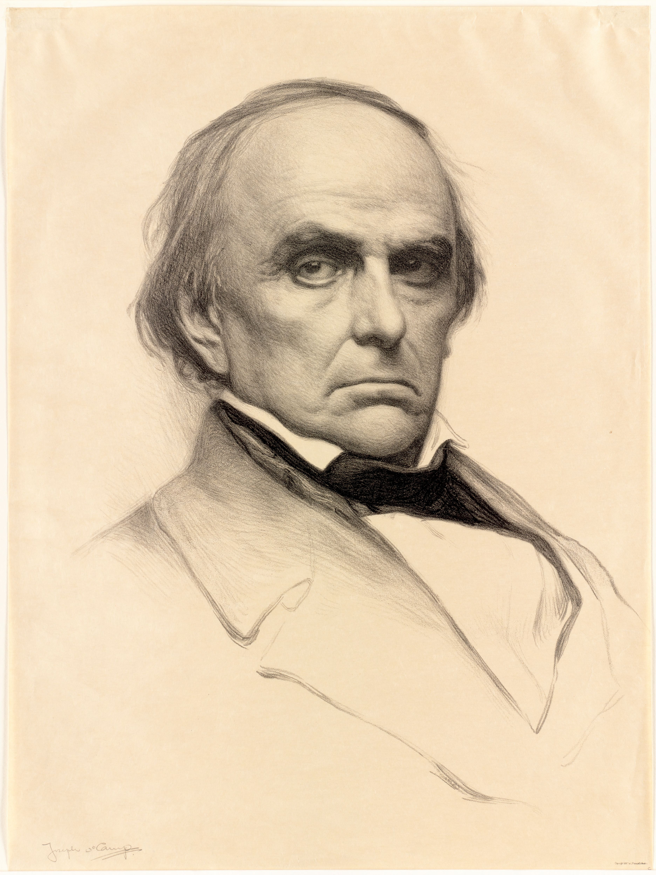
“The Statue Must be removed!"
The Politics of commemorating compromise, 1853-18612021
Presentation by Michael Larmann
Doctoral Student - History Department
University of Montana - Grad Con 2021

Slide 3
Argument and Contribution
Subjects: Memorialization of Daniel Webster, Northern Compromiser
Time period: 1853-1861
Argument: Over time the American public changed its memorialization of Daniel Webster, and by extension how it commemorated Northern compromise with the slave south.
  Daniel Webster statue controversy became connected with public and political debates about the Fugitive Slave Law.

Slide 4
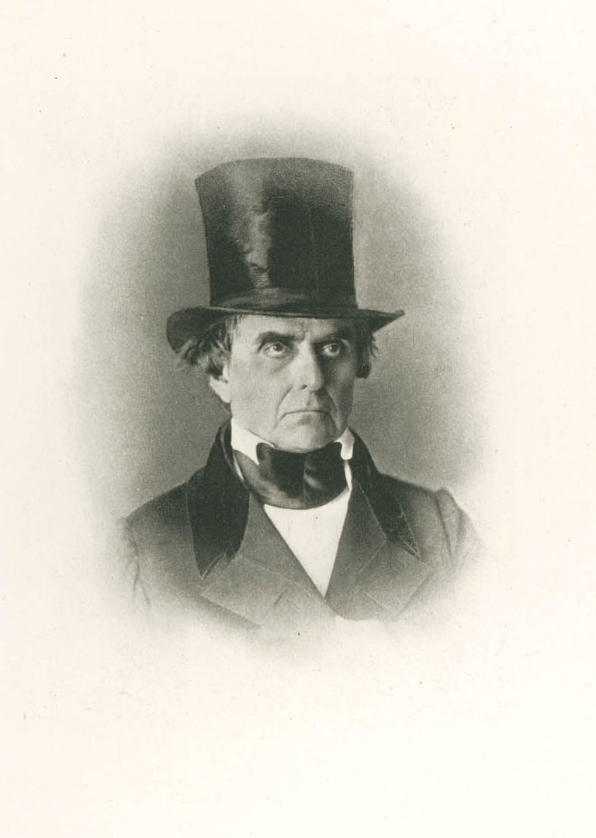
Daniel Webster – Defender of the Constitution
Daniel Webster (1782-1852)
US House of Representatives (1813-1817, 1823-1827)
US Senate (1845-1850)
Secretary of State (1841-1843, 1850-1852)

Slide 5
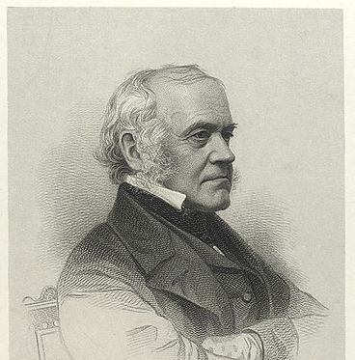
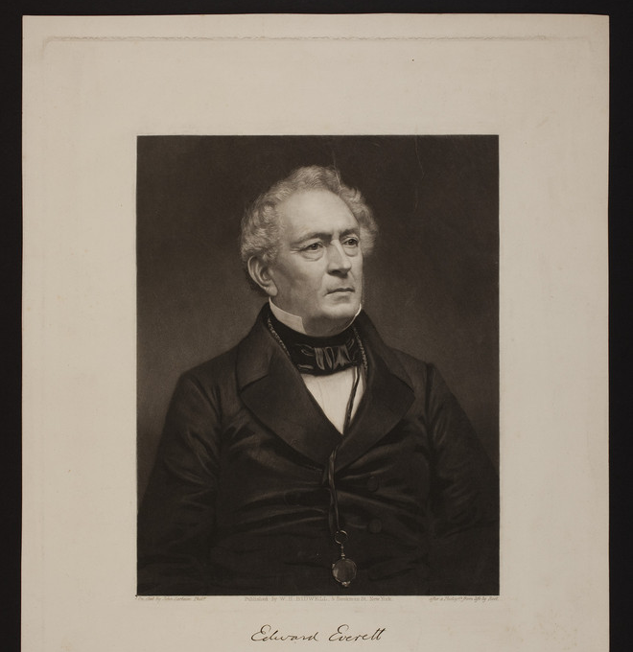
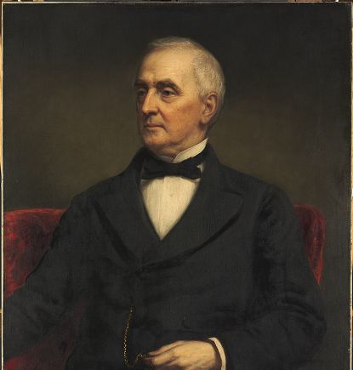
Webster Statue Committee
George Ticknor
Edward Everett
William Amory

Slide 6
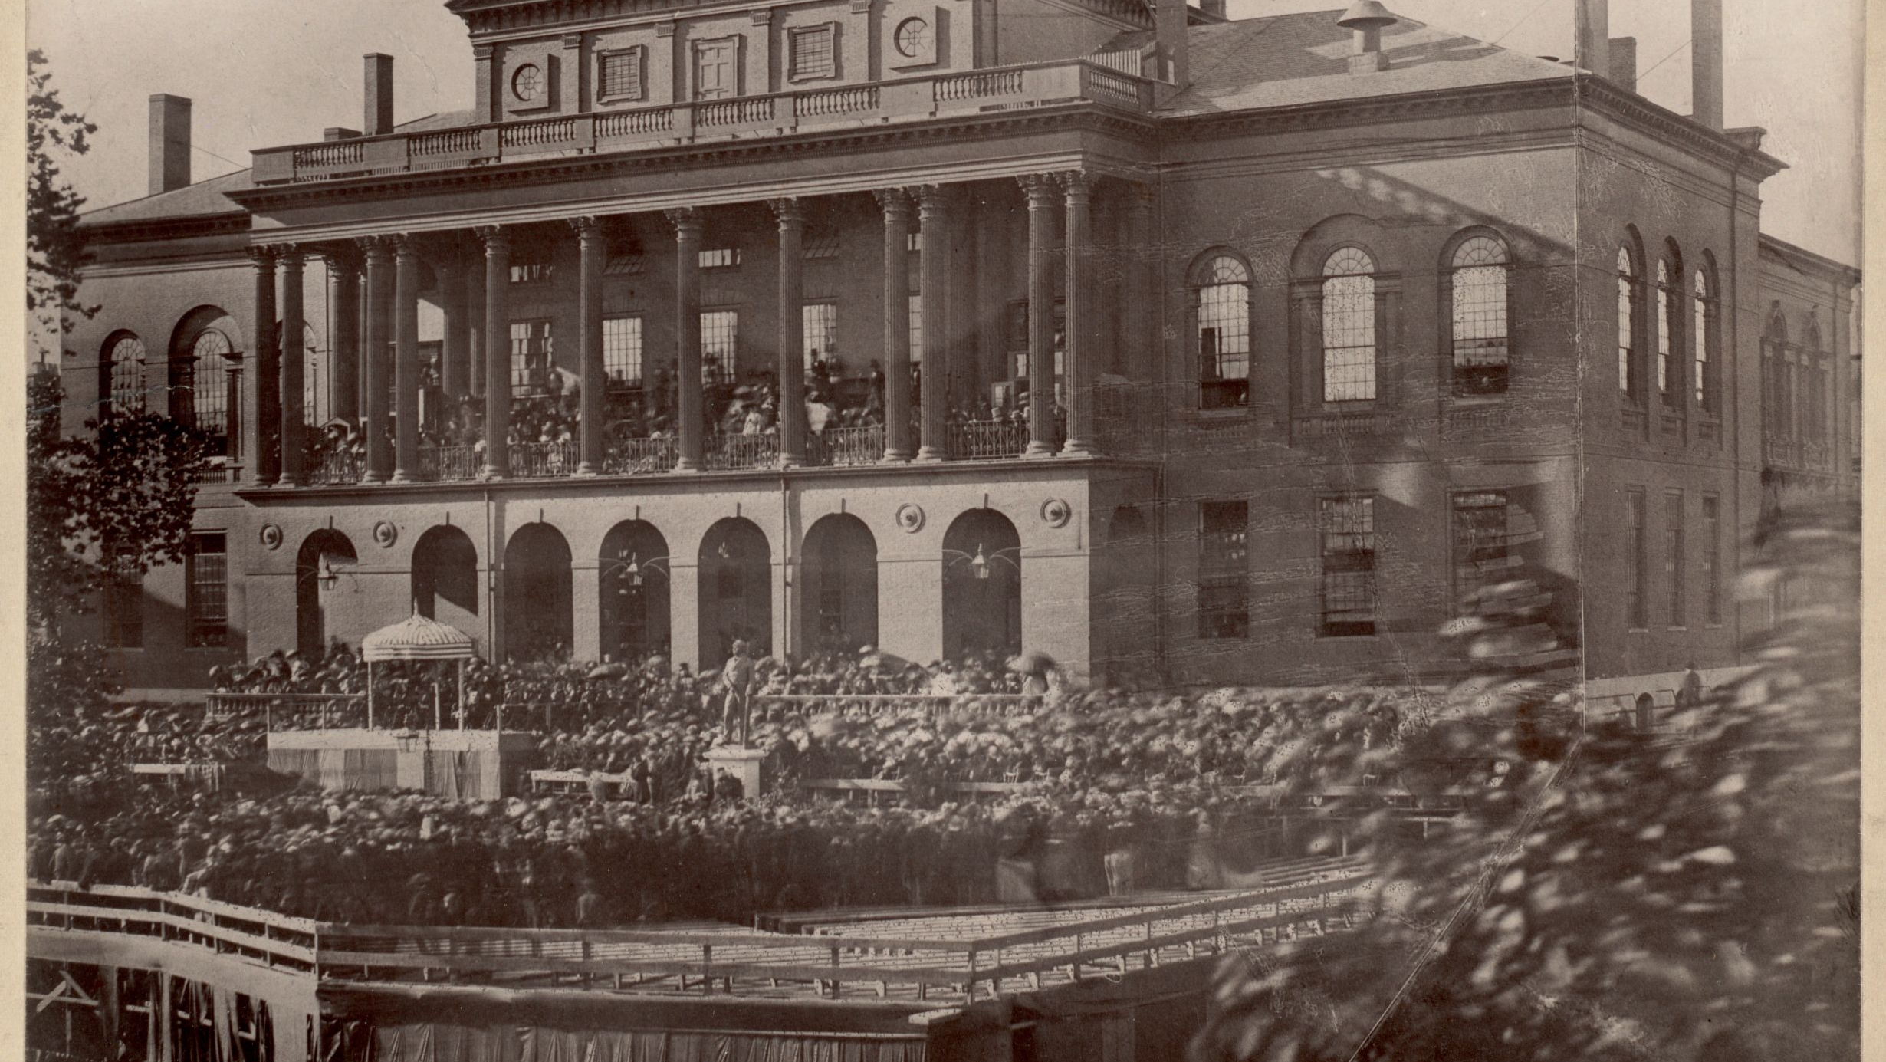

Slide 8
Timeline
1850-52
1854
1859
1861
Webster Statue Inauguration
Webster’s Death
Civil War Begins
Compromise of 1850
Anthony Burns Trial
Harper’s Ferry Raid
Thomas Sims Trial

Slide 9
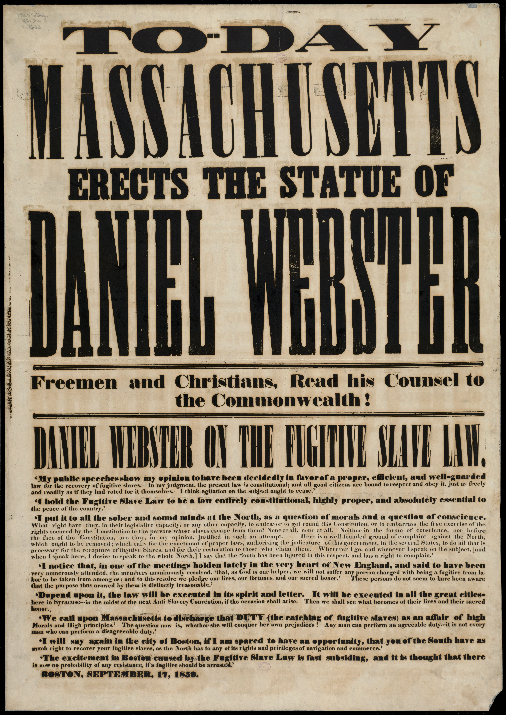

Slide 10
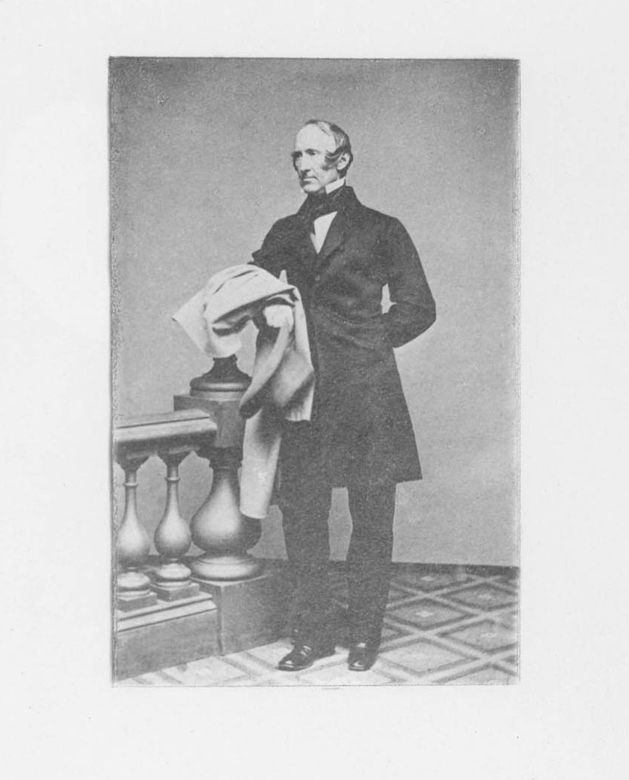
“At Reval, one of the Hanse towns, they will show you, in their treasury, the sword which, 200 years ago, beheaded a lawless Baron for daring to carry off his fugitive slave from the shelter of the city's wall. Our great slave hunter is beyond the reach of man's sword; but if any noble soul of the state will stir our mother Massachusetts to behead this image, we will cherish the name of that true Massachusetts boy as sacredly as they keep the brave old sword at Reval.”
-Wendell Phillips

Slide 12
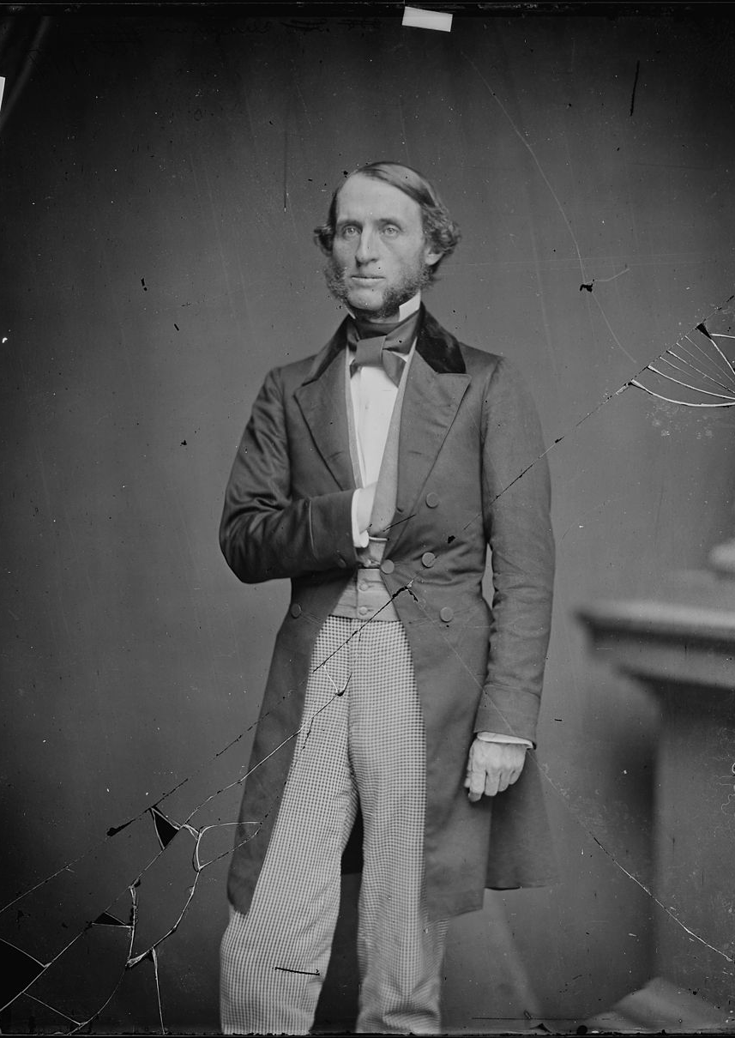
In Congress: Feb. 4, 1861
“The anti-slavery current can then run its course unchecked and untrammeled. It has already demanded, at Boston, the removal of the statue of Daniel Webster because he was willing to compromise with the South. How long will it be until it reaches that stage when it will require that the statues of such slaveholders as Washington and Jackson shall be thrown into the Potomac, the monument of the former razed to the ground, and the very name of this city changed the one in harmony with the anti slavery feeling?”
- Sen. Thomas L. Clingman of NC

Slide 13
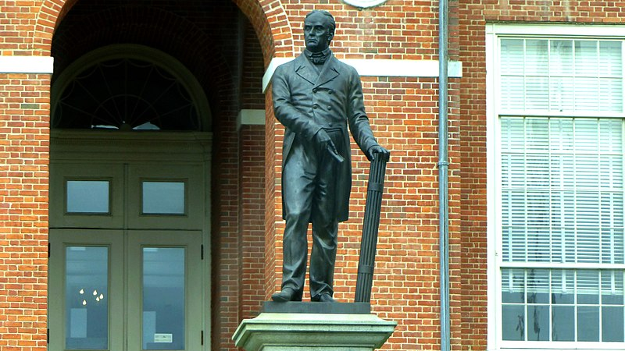

Slide 14
Image Citations
Slide 1: DeCamp, Joseph. Daniel Webster. 1897. Boston Public Library. Arts Dept. Digital Commonwealth. https://www.digitalcommonwealth.org/search/commonwealth:w6634546p. Accessed Feb. 14, 2021.
Slide 2: Harper’s Weekly. Oct. 10, 1859.
Slide 4: Daniel Webster. 20.9 cm x 13.3 cm. Massachusetts Historical Society. Portraits of American Abolitionists Collection. http://www.masshist.org/database/viewer.php?old=1&item_id=1582&ft=Collection%20Guides&from=/collection-guides/view/fap014. Accessed Feb 14. 2021.
Slide 5:
  Sartain, John. Portrait of Edward Everett, Governor of Massachusetts from 1836-1840. 17 x 12.5 in. Historic New England. Prints and Engravings Collection, 1830s-1920s. https://www.historicnewengland.org/explore/collections-access/gusn/250106/. Accessed Feb 14, 2021.
  Henry W. B. Smith. George Ticknor. 1867. New York Public Library Digital Collections. https://digitalcollections.nypl.org/items/510d47db-c5d3-a3d9-e040-e00a18064a99. Accessed Feb 16, 2021.
  Daniel Huntington. William Amory (1804-1888). 1881. 91.8 x 74.5 cm. Painting. Harvard Art Museums. https://harvardartmuseums.org/art/31173. Accessed Feb. 16, 2021.
Slide 6: Dedication of the Daniel Webster Statue. September 27, 1859. 11 x 10 1/4 in. Boston Public Library. Digital Commonwealth. https://www.digitalcommonwealth.org/search/commonwealth:ht24xf36n. Accessed Feb. 14, 2021
Slide 7: Everett and Webster. A scene in Congress in 1826!. Broadside. Library of Congress. Broadsides, leaflets, and pamphlets from America and Europe
https://www.loc.gov/item/rbpe.06003200/. Accessed Feb. 14, 2021.
Slide 8: Today Massachusetts Erects the Statue of Daniel Webster. 1859. Broadside. 108 x 75 cm. Boston Public Library. Digital Commonwealth. https://www.digitalcommonwealth.org/search/commonwealth:70796c53j. Accessed Feb. 14, 2021.
Slide 10: Wendell Phillips. 22.8 cm x 15.3 cm. Massachusetts Historical Society. Portraits of American Abolitionists Collection. http://www.masshist.org/database/1366. Accessed Feb. 14, 2021.
Slide 11: “The Webster Statue After a Design by Mr. Wendell Phillips” Vanity Fair . Dec 31, 1859.
Slide 12: Hon. Thomas L. Clingman, N.C. 1860-1865. National Archives Catalogue. Mathew Brady Photographs of Civil War-Era Personalities and Scenes, 1921 – 1940. https://catalog.archives.gov/id/528409. Accessed Feb. 14, 2021.
Slide 13: Boston - Massachusetts State House - Statue Daniel Webster. Photograph. Internet Archive Way Back Machine. Photograph taken by user giggle. https://web.archive.org/web/20161101191335/http://www.panoramio.com/photo/126976691. Accessed Feb. 16, 2021. Image cropped from original.

