Slide 1
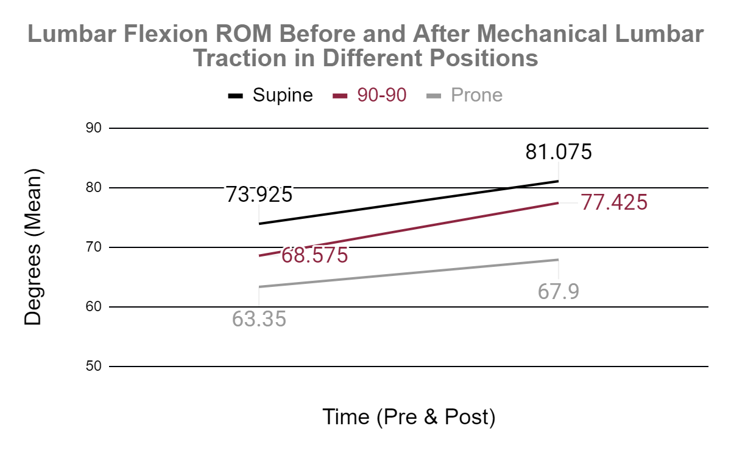
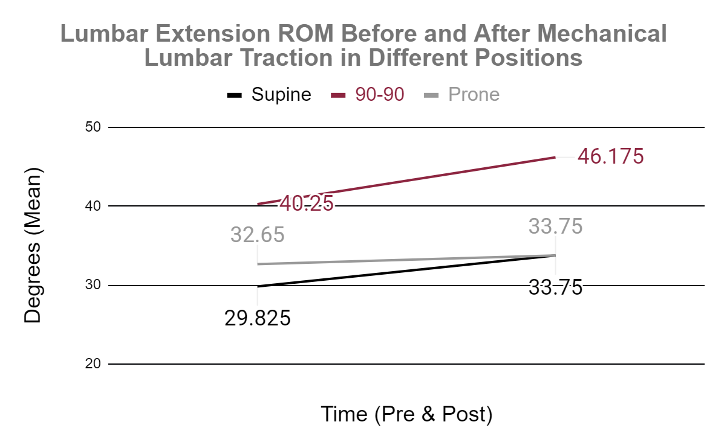
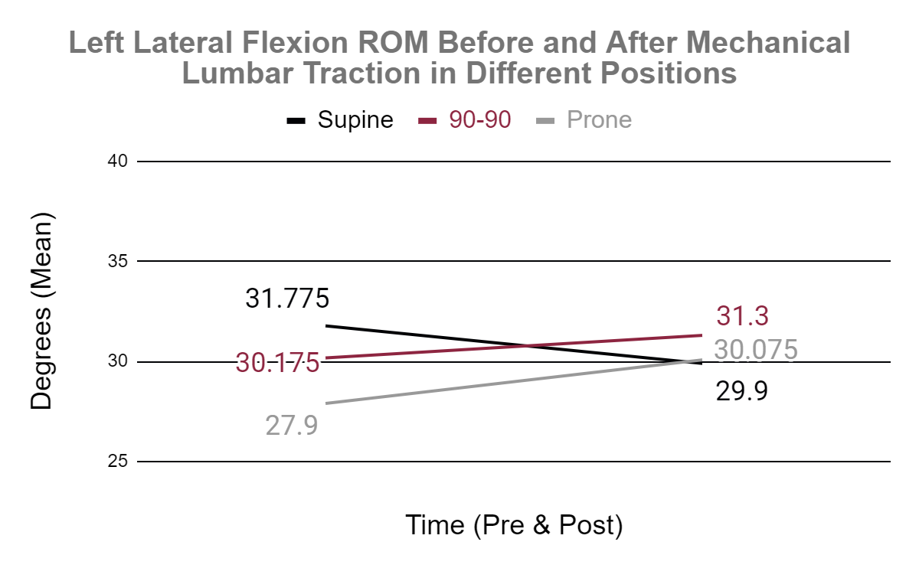
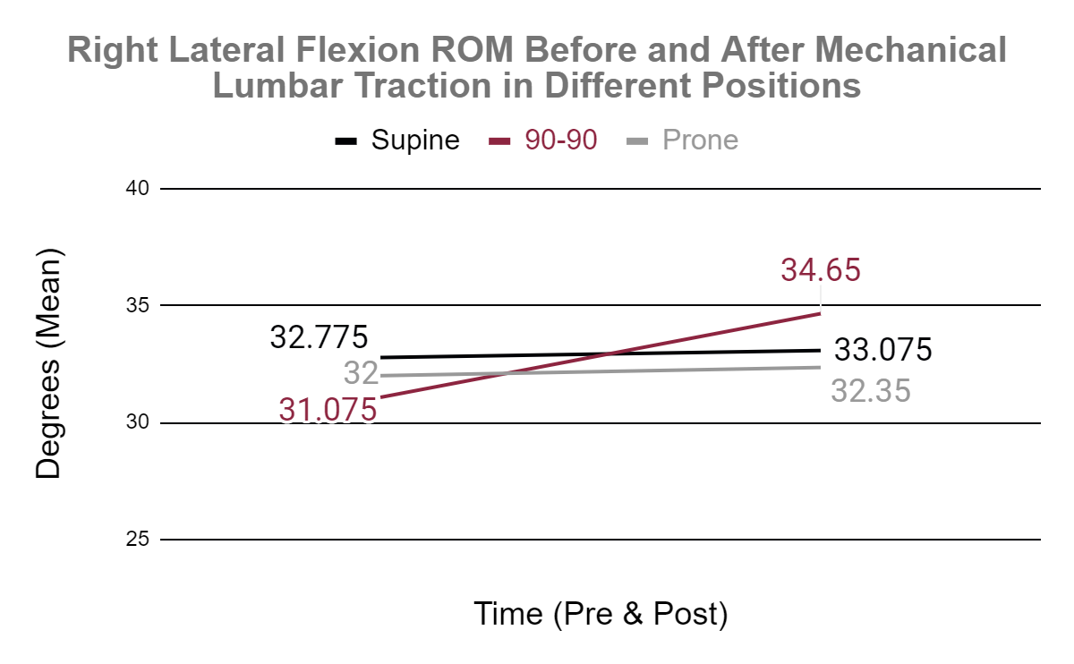
Exploring the Influence of Patient Position During Mechanical Traction on Lumbar Mobility
Valerie Moody
Isa Ortman, Kevin Garifi, and Valerie Moody
School of Integrative Physiology and Athletic Training, University of Montana, Missoula, MT
Introduction
Methods (Continued)
Results (Continued)
Mechanical traction uses a motorized device to apply a selected traction force to slowly elongate the spine. Research demonstrates the ability of sustained distraction forces to increase the length of spinal tissues by creep and hysteresis, with effects remaining longer in tissues of older individuals. The lengthening of ligaments and muscles around the spine can produce physiological adaptations of increased spinal movement either overall or between each vertebra. There are three primary positions that a patient can be in for mechanical lumbar traction: supine, prone, and 90/90. The choice of position is driven by patient comfort, however, there might be differences in effectiveness based on resting lumbar curvature.
Lumbar flexion, extension, right lateral lumbar flexion (RLLF) and left lateral lumbar flexion (LLLF) was measured with a standard 12-inch goniometer before and after each trial.
Three measurements were obtained, and an average was recorded.
Treatment order was randomized and spaced out at least a week apart.
Microsoft Excel was used to calculate descriptive statistics for each participant’s height, weight, and age along with lumbar flexion, extension, RLF, and LLF.
Separate 2 x 3 repeated measures ANOVA using SPSS v26.0 was used to calculate the mean difference in lumbar ROM between the supine, prone, and 90/90 trials for lumbar flexion, lumbar extension, RLLF, and LLF. Significance was set a priori at p = 0.05.
Purpose
The purpose of this study was to compare the effects of supine, prone, and 90-90 mechanical traction on lumbar mobility. We hypothesized that our participants' lumbar mobility would increase the most after 90/90 traction relative to other positions.
Methods
Results
A 2 x 3 (time x trial) repeated measures ANOVA revealed no statistical significance between patient positions during traction (prone, supine, 90/90) for lumbar flexion (p=0.813), extension (p=0.146), RLLF (p=0.170), and LLLF (p=0.107).
The main effect for time was noted for lumbar extension (p=0.004), where a further analysis revealed a significant difference between the supine and 90/90 position (p=0.037).
However, a trend for an improved lumbar range of motion was noted across all three positions after receiving mechanical traction.
Conclusion
A convenience sample of four healthy adults were selected for this study (2 females, 2 males; average age 23 + 2 years, height 69 ±4 inches, and weight 224 + 17 lbs).
A repeated measures design was used whereby subjects completed three separate trials with a week between each trial.
The three trials included 3 separate lumbar mechanical traction treatments in either a supine, prone, or 90-90 (hip flexion, knee flexion) position for 15 minutes.
The primary finding of our study was a trend of increased lumbar ROM following mechanical traction, regardless of position.
Statistically significant improvement in lumbar extension was seen, but a large standard deviation in this measurement adds caution to clinical interpretation.
Additional research is needed to support the clinical use of traction to improve lumbar ROM absent of symptomatic lumbar pathology.

