Slide 1
Physical Activity, Injury, and Burnout in Collegiate Esports Players
Hailee M. Eckman, LAT, ATC & Shane P. Murphy, PhD, LAT, ATC

Slide 2
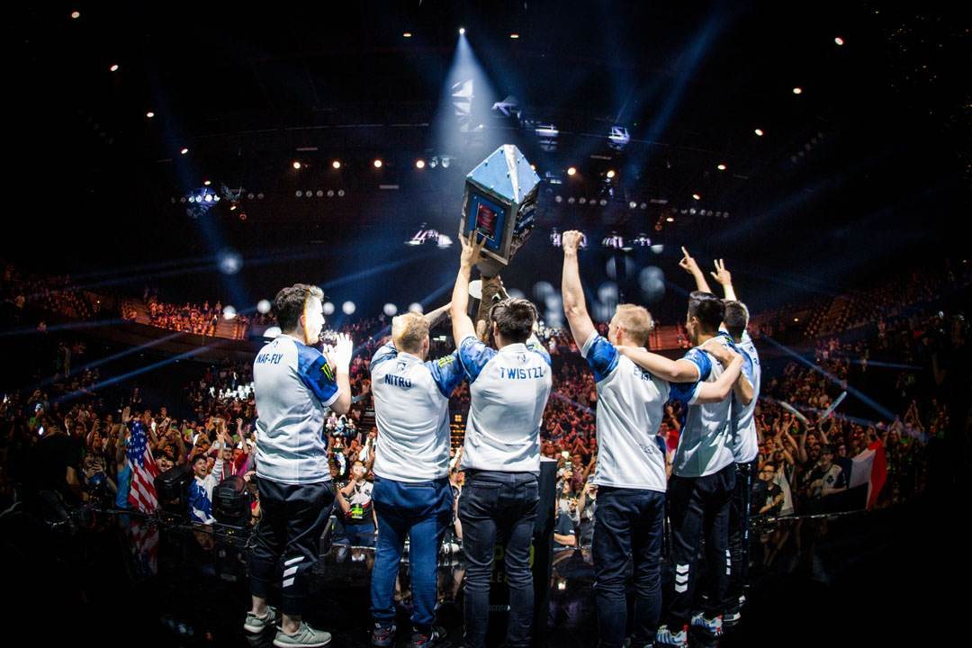
The Growth of Esports
Defined: the competitive application of various video games, where teams or individuals compete against one another with varying levels of skills
Gaining significant popularity worldwide
Professional players and teams
Training is similar to those of their traditional athletic counterparts
Multiple hours of structured drills and competitive scrimmages
DiFrancisco-Donoghue et al., 2019; Nagorsky & Wiemeyer, 2020; Polous et al., 2020
Notes:
Estimated audience of 395 million in 2018
Like their traditional athletic counterparts, pro gamers are beginning to focus more on their physical and mental training to improve gaming performance. The potential to lead to physical injury and burnout.

Slide 3
Collegiate Esports
Steadily increasing in popularity
Wide variety of skill levels
Focus on community over competition
Minimal literature on this group
Morrison, 2019
Notes:
Over 130 college varsity programs in the United States as of 2019

Slide 4
The purpose of this study is to explore the training habits, physical activity levels, burnout, and esports related injuries of collegiate esports players
Notes:
Gain a better understanding of the physical and mental toll of deliberate training in esports
and determine the relationship, if any, of the previously mentioned variables

Slide 5
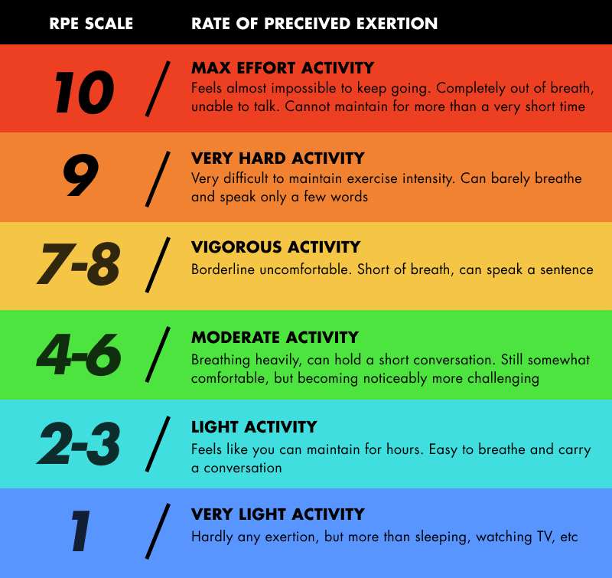
Definitions
Physical Activity
Activity requiring physical effort, carried out to improve or sustain health and fitness
Injury
Physical pain or loss of function for a prolonged period of time
Burnout
State of emotional, physical, and mental exhaustion caused by excessive and prolonged stress
Notes:
ACSM recommends 150 minutes of moderate intensity aerobic exercise every week (30 minutes per day). RPE, how intense the physical activity is.

Slide 6
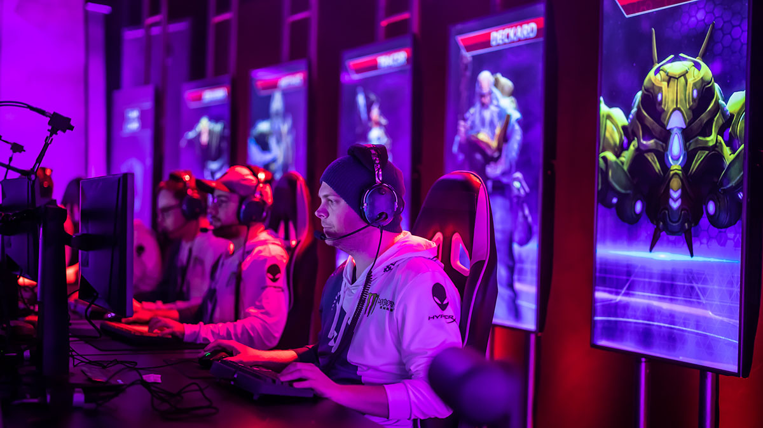
Methods
Anonymous, online survey via Qualtrics
Team representatives distribute survey link to their players
Inclusion criteria
Must be part of a college/university esports team
Age 18 or older
Notes:
Use team reps to add another level of anonymity

Slide 7
Survey Questions
Demographics (5 questions)
Esports training (8 questions)
Burnout (15 questions)
Physical activity (6 questions)
Esports related injuries (8 questions)
Notes:
Give example questions

Slide 8
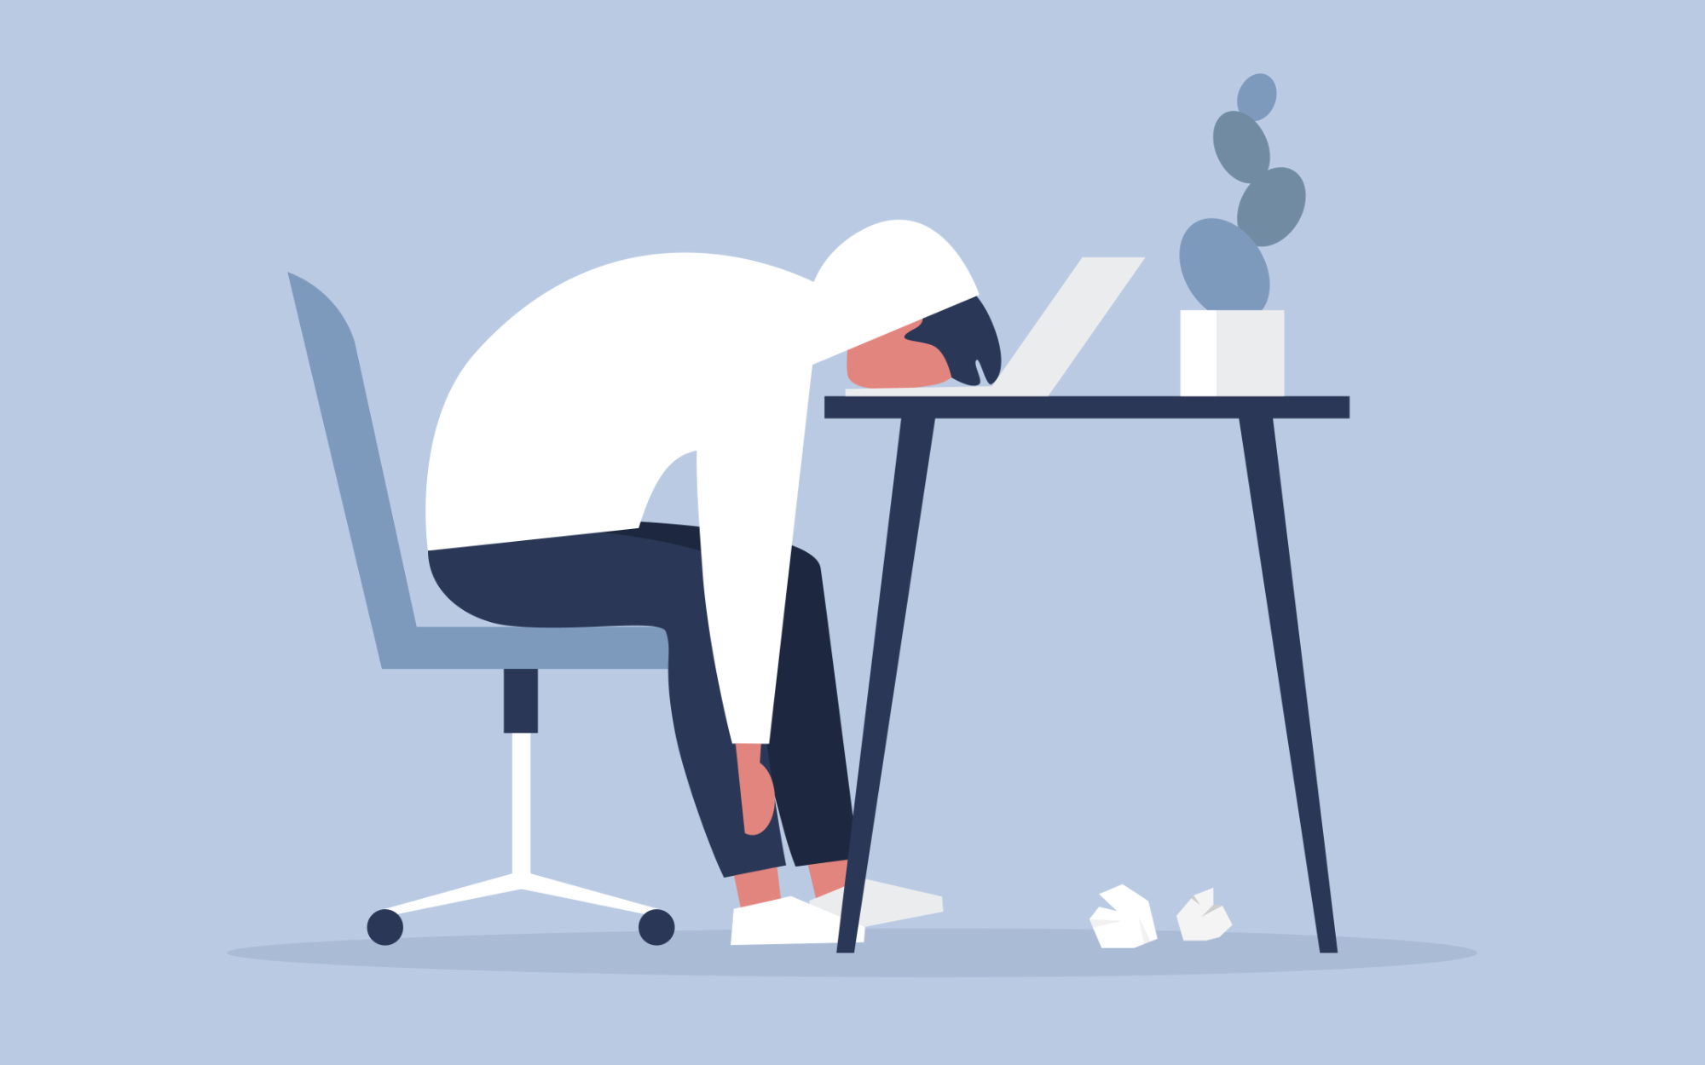
Athlete Burnout Questionnaire
I feel extremely tired from esports participation
I am not meeting my personal interests with esports
No matter what I do in esports, I do not perform as well as I should
I am exhausted by the physical and mental demands of the sport
Raedeke & Smith, 2001
Notes:
Example questions asked were adapted from the Athlete Burnout Questionnaire. Measured via a five point Likert scale (always, most of the time, about half of the time, sometimes, never). Scored 1-5 the lower the score, the less burnout

Slide 9
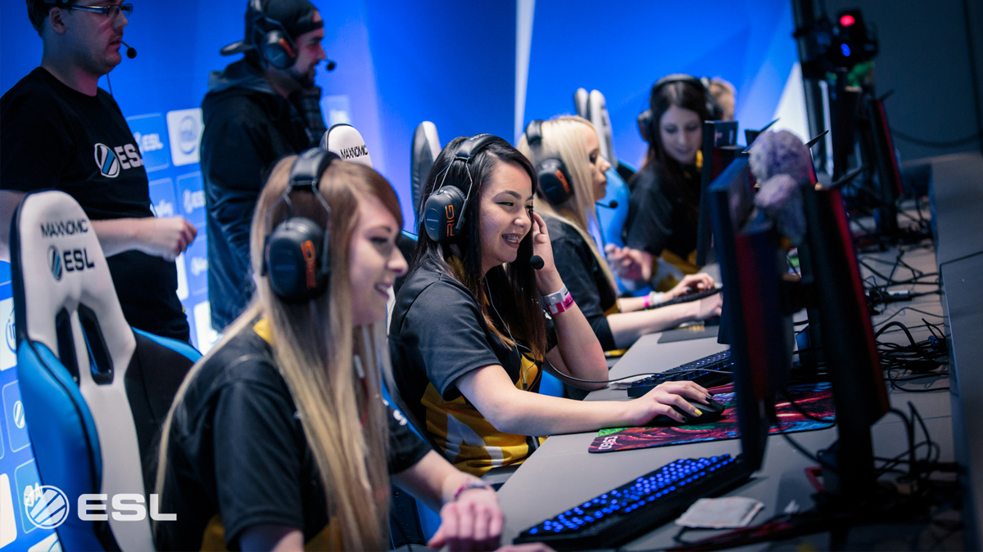
Data Analysis
Descriptive statistics
Demographics
Time spent gaming/being physically active
Injuries sustained
Plans for future analysis
Relationships between variables

Slide 10
Preliminary Results
Notes:
Survey was first distributed in December to the UM esports team.
At this point, we have mostly descriptive statistics, showing some of the common responses we got.

Slide 11
Demographics
Notes:
31 participants. Average age of 21.2 years. Average of 2.9 years in higher education.
Wide variety of game genres…will vary depending on what each university offers

Slide 12
Playing Time
Notes:
Broken down into hours spent gaming for fun and hours spent gaming to train or compete
Average of 5.8 competition days per month with competitions lasting an average of two hours

Slide 13
Physical Activity Levels
Notes:
Wide range of responses, but almost everyone was physically active in some capacity

Slide 14
Injury
Notes:
So far, uncommon to have an esports related injury.

Slide 15
Burnout
Notes:
Average scores for everyone were 1.8, so very low overall.

Slide 16
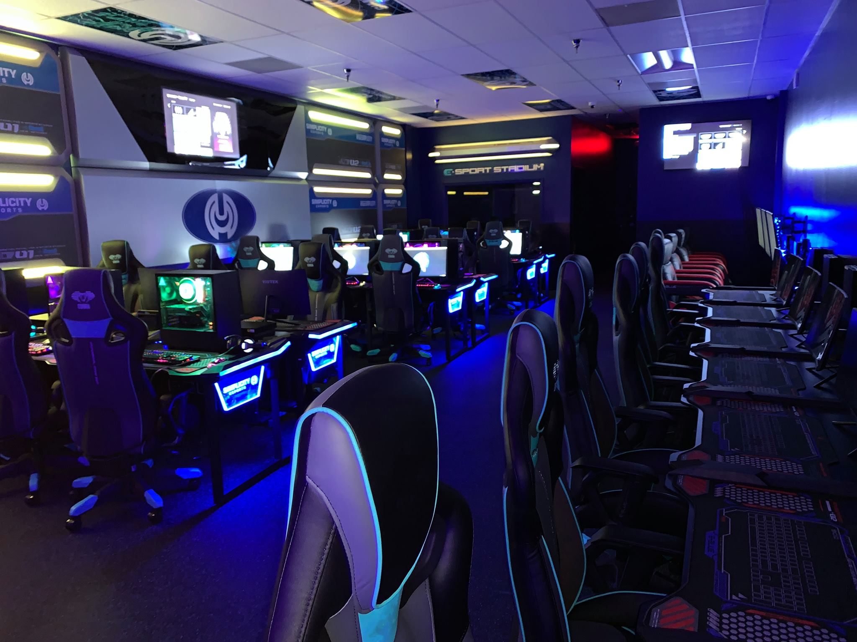
Discussion
Reasons for playing
Competition vs community
Physical activity and mental health
40-45% of college students exercise at least three days per week
Better mental health in those who exercise regularly
Leslie et al., 2001; Snedden et al., 2019
Notes:
Connect back to analysis to be done in the future when we get more responses.
Studies show that physical activity leads to better mental health

Slide 17
Significance
Utilizing athletic trainers
Growing need in non-traditional settings
Injury evaluation and rehabilitation
Identifying burnout
Notes:
As collegiate esports grows, there may come a time where they utilize athletic trainers to provide services to team members. Tie back to the comparison with traditional college athletes. ATs are specialists at identifying and rehabilitating injuries, but also preventing them from occurring in the first place. Make recommendations about taking breaks, ergonomic equipment like chairs, etc. Identifying burnout. Seeing athletes regularly and noticing changes. Can also refer to other mental health professionals.

Slide 18
Special thanks to Professor Michael Cassens for his help in developing this study

Slide 19
Contact
Principal Investigator: Dr. Shane Murphy
shane.murphy@mso.umt.edu
Research Assistant: Hailee Eckman
hailee.eckman@umontana.edu

