Slide 1
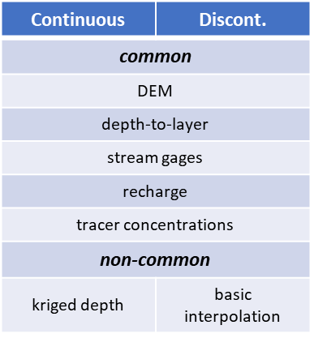
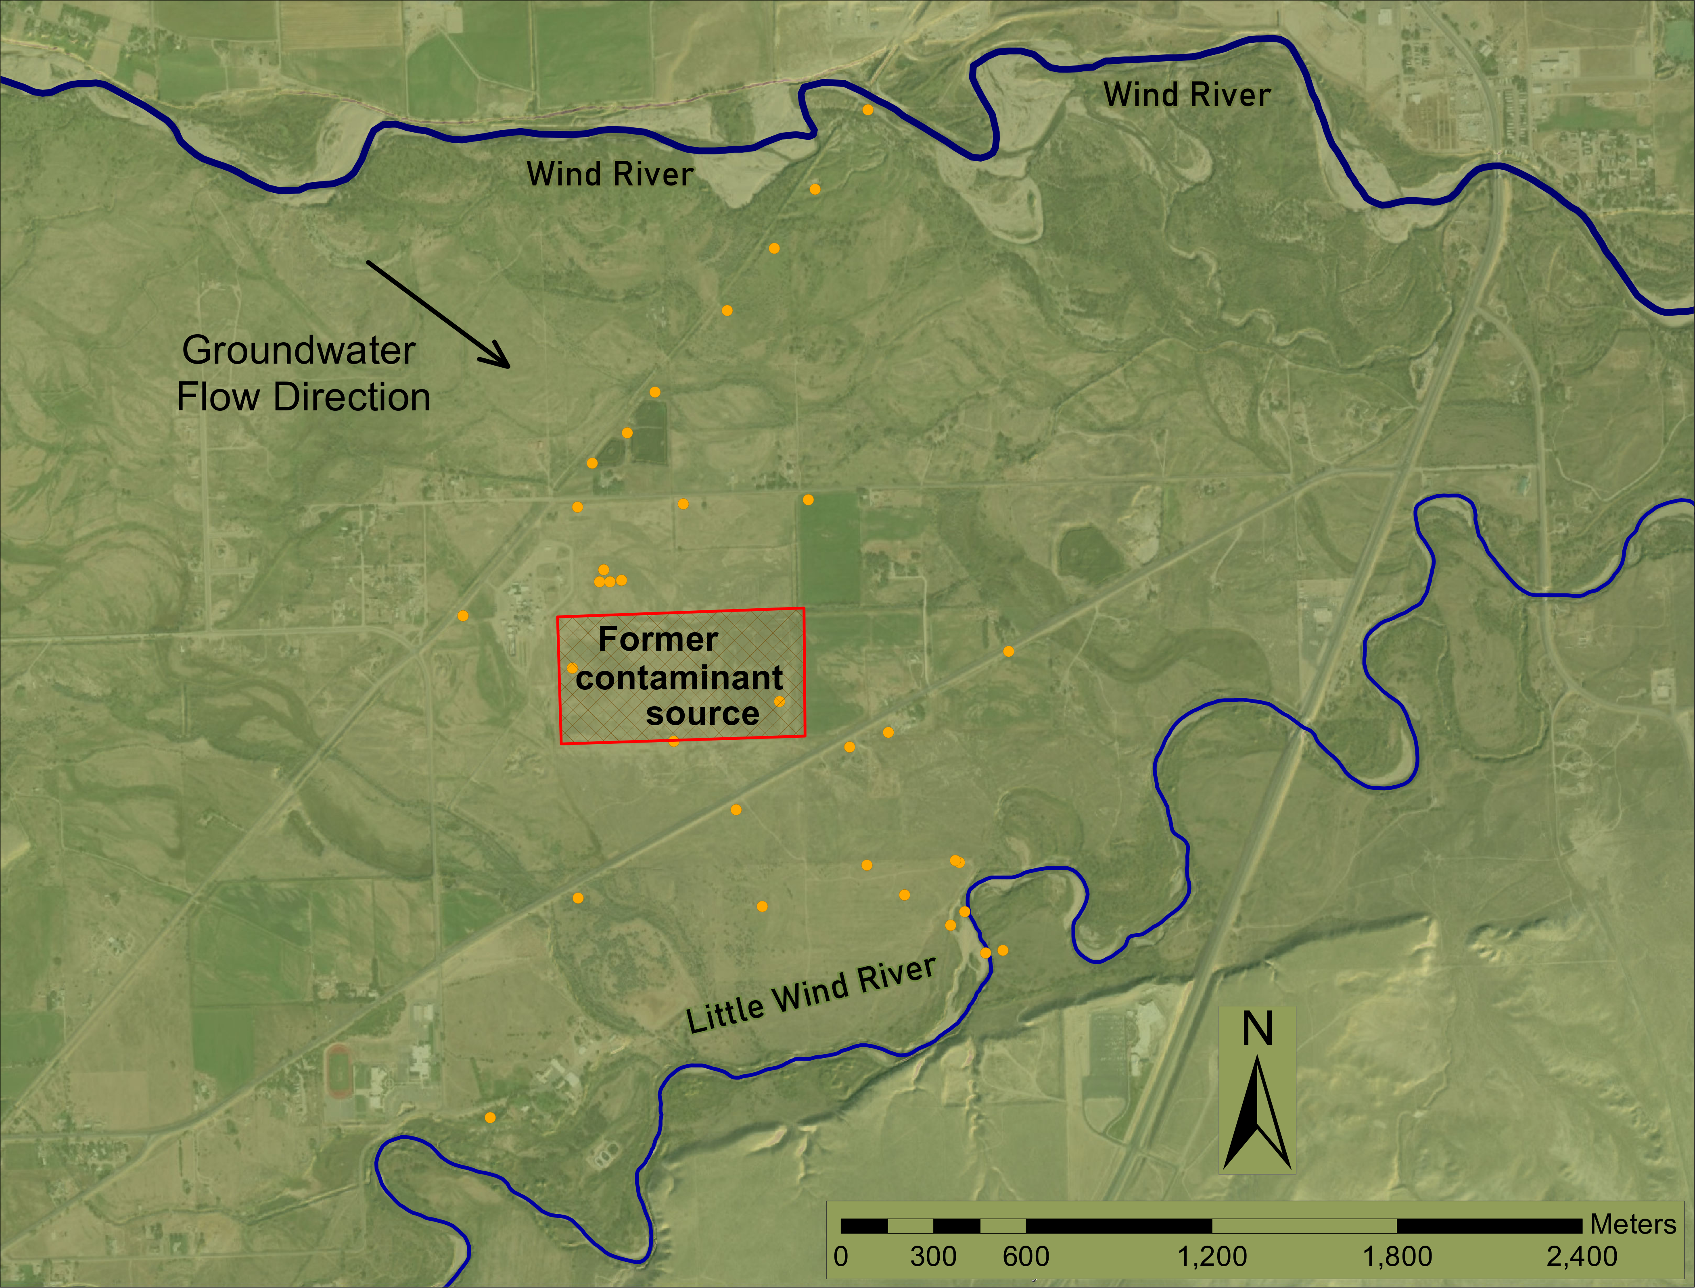
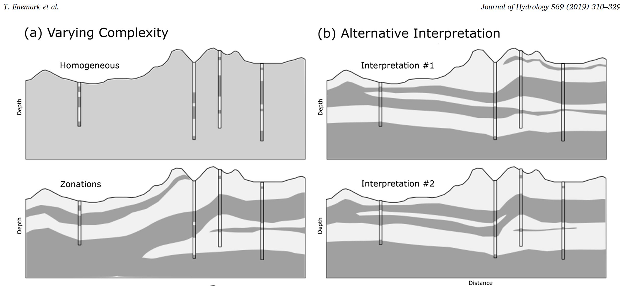
Evaluating the use of Environmental Tracers to Reduce the Conceptual-Geologic uncertainty of Hydrogeologic Models
Introduction
Andrew Nordberg, PhD student
Department of Geosciences, University of Montana
Conclusions
Water resource management decisions are based on groundwater models which may contain uncertainty due to unknown subsurface structures and their extent. Alternate conceptual models are tested and compared to show differences in groundwater flow patterns. Our hypothesis states that environmental tracer data will inform subsurface structure to obtain better forecast predictions.
Methods cont.
% Difference between alternate structures is larger than detection limit
Environmental tracer concentrations can differentiate between alternate physical structures
Conceptual model ingredients
Contaminant Site: Riverton, WY
Results
Current: Transient groundwater flow and transport models are created with common boundary conditions to calculate hydraulic head distribution and simulate tracer recharge. Comparison shows very subtle differences of the groundwater flow direction in the upper layer.
Broader Impacts
The use of environmental tracers may be applied in this way for a variety of possible configurations, including identifying fracture networks or channel geometry. With these tools, hydrogeologists and resource managers can better assess uncertainty of alternate subsurface conceptualizations and confidently make informed decisions.
Methods
Two alternate conceptualizations are made based on site-specific data:
C1: Two layers are separated by a continuous low-permeability layer
References
C2: Two layers are separated by a discontinuous low-permeability layer
Enemark, T., Peeters, L. J. M., Mallants, D. & Batelaan, O. Hydrogeological conceptual model building and testing: A review. Journal of Hydrology Volume 569, 310–329 (2019).
Gascoyne, M., Wuschke, D. M., & Durrance, E. M. (1993). Fracture detection and groundwater flow characterization using He and Rn in soil gases, Manitoba, Canada. Applied Geochemistry
Oster, H., Sonntag, C., & Muennich, K. O. (1996). Groundwater age dating with chlorofluorocarbons. Water Resources Research
VARNI, M. and CARRERA, J., 1998. Simulation of groundwater age distributions. Water Resources
Research.
LERAY, S., GAUVAIN, A. and DE DREUZY, J., 2019. Residence time distributions in non-uniform aquifer recharge and thickness conditions – An analytical approach based on the assumption of Dupuit-Forchheimer.
These are tested using groundwater flow and transport code, where simulated concentrations are sampled and compared to the analytical detection limit.
Future: Improve model detail and use tracer information to further assess their usability

Slide 2
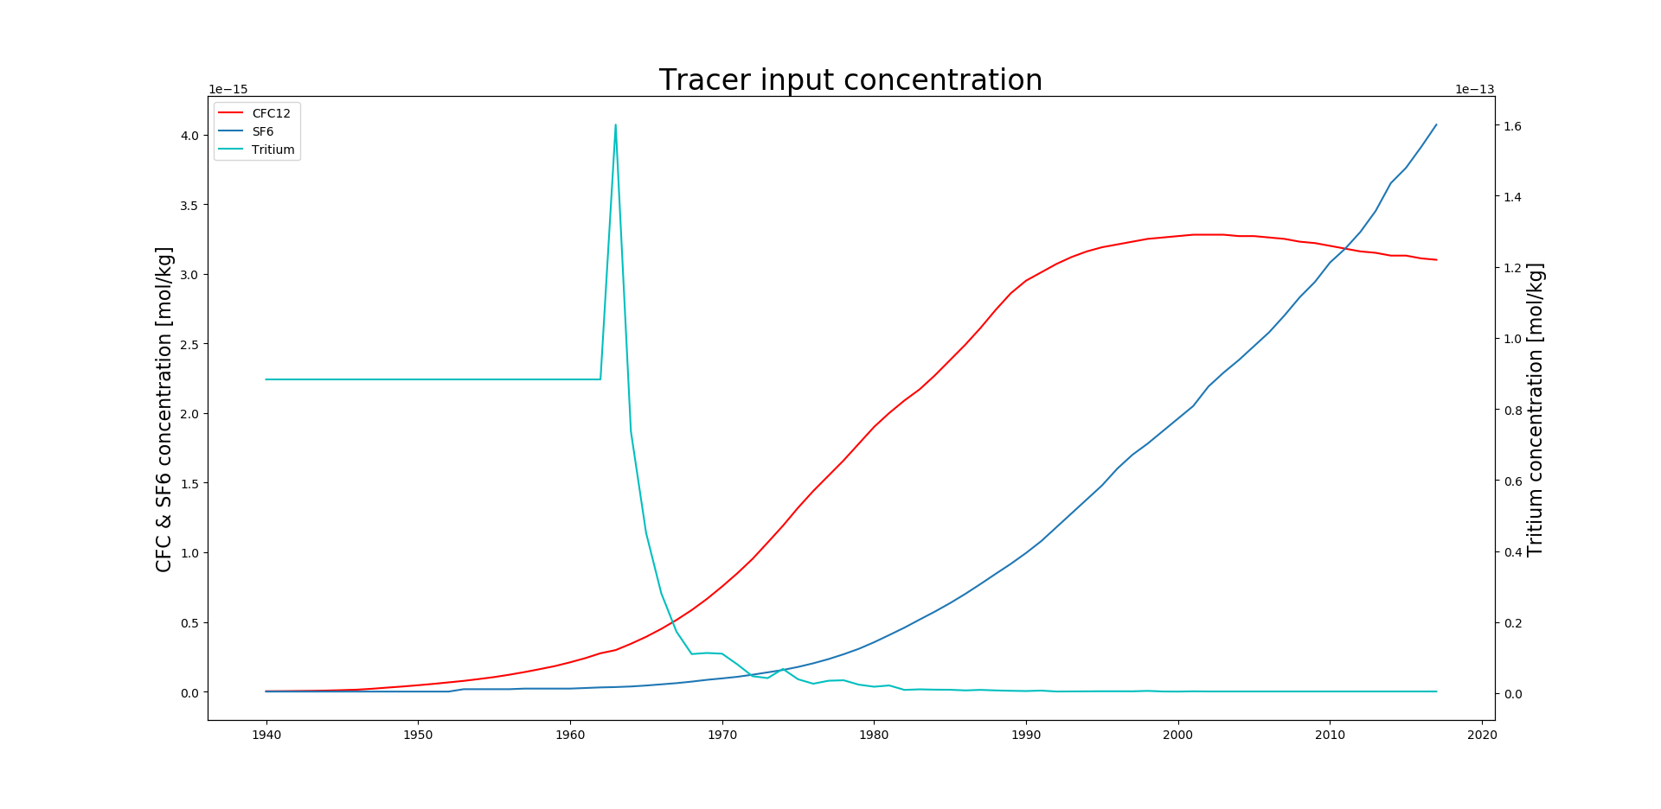
Alternate conceptualizations:
Examples
continuous
Drinking water
Draining an upper aquifer
Contaminant transport
discontinuous
Introduction
Water resource management decisions are based on groundwater models which may contain uncertainty due to unknown subsurface structures and their extent. Alternate conceptualizations are tested and compared to show differences in groundwater flow patterns. Environmental tracers give water age and transport fate information. Our hypothesis states that environmental tracer data will inform subsurface structure to obtain better forecast predictions.
Time

Slide 3
Conceptual model ingredients
Methods
Continuous | Discont.
common
DEM
depth-to-layer
stream gages
recharge
tracer concentrations
non-common
kriged depth | basic interpolation
Riverton Site
Two alternate conceptualizations are made based on site-specific data
These are tested using groundwater flow and transport code, where simulated concentrations are sampled and compared to the analytical detection limit
C1: Two layers are separated by a continuous low-permeability layer
C2: Two layers are separated by a discontinuous low-permeability layer
Results
Current: Transient groundwater flow and transport models are created with common boundary conditions to calculate hydraulic head distribution and simulate tracer recharge.
Comparison of map view shows very subtle differences of the groundwater flow direction in the upper layer. Need contour bar
Should have cross section diagram to show difference in flow
% Difference = $\frac{\left|C_{1} − C_{2}\right|}{\frac{C_{1}+ C_{2}}{2}}$(for N = 24) = 147% >> 5%
Future: Improve model detail and use tracer information to further assess their usability

Slide 4
Conclusion
Broader Impacts
% Difference between alternate structures is larger than detection limit
Environmental tracer concentrations can differentiate between alternate conceptual structures
Environmental tracers may be applied to a variety of possible configurations, including identifying fracture networks or channel geometry. With these tools, hydrogeologists and resource managers can better assess uncertainty of alternate subsurface conceptualizations and confidently make informed decisions.
References
Enemark, T., Peeters, L. J. M., Mallants, D. & Batelaan, O. Hydrogeological conceptual model building and testing: A review. Journal of Hydrology Volume 569, 310–329 (2019).
Gascoyne, M., Wuschke, D. M., & Durrance, E. M. (1993). Fracture detection and groundwater flow characterization using He and Rn in soil gases, Manitoba, Canada. Applied Geochemistry
Oster, H., Sonntag, C., & Muennich, K. O. (1996). Groundwater age dating with chlorofluorocarbons. Water Resources Research
VARNI, M. and CARRERA, J., 1998. Simulation of groundwater age distributions. Water Resources
Research.
LERAY, S., GAUVAIN, A. and DE DREUZY, J., 2019. Residence time distributions in non-uniform aquifer recharge and thickness conditions – An analytical approach based on the assumption of Dupuit-Forchheimer.
Batlle-Aguilar, J., Banks, E. W., Batelaan, O., Kipfer, R., Brennwald, M. S., & Cook, P. G. (2017). Groundwater residence time and aquifer recharge in multilayered, semi-confined and faulted aquifer systems using environmental tracers. Journal of Hydrology, 546, 150–165.
Rojas, R., Kahunde, S., Peeters, L., Batelaan, O., Feyen, L., & Dassargues, A. (2010). Application of a multimodel approach to account for conceptual model and scenario uncertainties in groundwater modelling. Journal of Hydrology, 394(3–4), 416–435.
Linde, N., Ginsbourger, D., Irving, J., Nobile, F., & Doucet, A. (2017). On uncertainty quantification in hydrogeology and hydrogeophysics. Advances in Water Resources, 110(October), 166–181.
Mattle, N., Kinzelbach, W., Beyerle, U., Huggenberger, P., & Loosli, H. H. (2001). Exploring an aquifer system by integrating hydraulic, hydrogeologic and environmental tracer data in a three- dimensional hydrodynamic transport model. Journal of Hydrology, 242(3–4), 183–196.

