Slide 1

International Relations Theory and Global Refugee Policies
By Rachel Willcockson
Graduate Conference

Slide 2
Background
According to the UNHCR in 2019, 79.5 million people were displaced from their homes. This is 1% of the world population and includes people displaced within their countries and people displaced in other countries.
There are now more displaced people worldwide than ever before, including during and after World War II.
The Pew Research Center conducted a study, finding that until 2017, the United States was the top host country; however, after President Trump changed the refugee policy, we quickly dropped to having the lowest refugee ceiling since 1980 when the US implemented the refugee resettlement program.
According to the Department of Homeland Security and the Associated Press, during the 4 years of the Trump administration, 117,826, refugees were admitted, an average of 29,457 per year, compared to 69,683 per year during President Obama’s administration.
Notes:
Jens Manuel Krogstad, Key Facts About Refugees to the U.S., (Pew Research Center, 2019), https://www.pewresearch.org/fact-tank/2019/10/07/key-facts-about-refugees-to-the-u-s/.
Ibid.
Global Trends: Forced Displacement in 2019, (UNHCR, The UN Refugee Agency, 2019), pp. 2.

Slide 3
Types of displaced persons
According to the UNHCR there were 86.5 million people of concern in 2019 worldwide
Refugee: someone who has been forced to flee his or her country because of persecution, war or violence. They have a well-founded fear of persecution for reasons of race, religion, nationality, political opinion or membership in a particular social group. – UNHCR
Asylum: “the protection granted by a nation to someone who has left their native country as a political refugee” – Oxford Dictionary
Notes:
https://reporting.unhcr.org/sites/default/files/gr2019/pdf/GR2019_English_Full_lowres.pdf#_ga=2.186153449.1577789385.1613332331-1929979993.1613332331

Slide 4
25 States that accepted the most refugees from 2010-2019

Slide 5
Refugee/asylum seeker and global population percentages

Slide 6
President Biden's refugee policy
  According to the White house briefings, President Biden intends to increase the United States refugee cap to 125,000 per year.
    This is four times the amount of President Trump’s final cap, and 15,000 more than President Obama’s cap.
  125,000 a year is approximately 4.25% of the global refugee and asylum seeker population
    Which is the roughly the same as the United States population compared to the global population
Notes:
https://www.whitehouse.gov/briefing-room/presidential-actions/2021/02/04/executive-order-on-rebuilding-and-enhancing-programs-to-resettle-refugees-and-planning-for-the-impact-of-climate-change-on-migration/

Slide 7
Question and importance
  Question: Why do states adopt certain refugee and asylum policies?
  Importance: Based on the UNHCR Global Report of 2019, 1 in 97 people worldwide are currently displaced from their homes.
    Internal displacement within states has increased over 60% in the last decade.
    The Institute for Economics and Peace released their Ecological Threat Register which predicts that over 1.2 billion people could be displaced worldwide by 2050.
    By understanding states’ current refugee asylum policies and the causes of those policies, we may begin to understand their motivations and hopefully learn how to persuade them to be more supportive towards displaced people.
Notes:
https://www.cnn.com/2020/09/10/world/climate-global-displacement-report-intl-hnk-scli-scn/index.html

Slide 8
The Theories
Classical Realism: The basic idea of this theory is that people will do something that will benefit themselves, over doing something that is morally right.
  For this test, I am examining if states with lower birth rates are more likely to accept refugees and asylum seekers since it would benefit their economy and their work force, rather than states that have higher birth rates.
  In the U.S. a study was conducted that found that refugees contribute billions of dollars annually through “consumer spending and business start-ups.”
Structural Realism: The basic idea of this theory is that weaker powers will be influenced by a greater power.
  For this test, I am examining if states are influenced by the shifts in the United States’ policy changes over the last 10 years.
Notes:
Immigrants as Economic Contributors: Refugees are a Fiscal Success Story for America, (National Immigration Forum, 2018), https://immigrationforum.org/article/immigrants-as-economic-contributors-refugees-are-a-fiscal-success-story-for-america/.

Slide 9
Classical Realist Hypothesis
Classical Realism: Classical Realists would predict that there will be a correlation, and states that benefit would in fact accept more people than states that wouldn’t directly benefit.
  The theory presumes that people are driven by their own self-interest, therefore regardless of the morality, states are more likely to accept refugees and asylum seekers if they gain something rather than complying to moral obligations.
Notes:
Immigrants as Economic Contributors: Refugees are a Fiscal Success Story for America, (National Immigration Forum, 2018), https://immigrationforum.org/article/immigrants-as-economic-contributors-refugees-are-a-fiscal-success-story-for-america/.

Slide 10
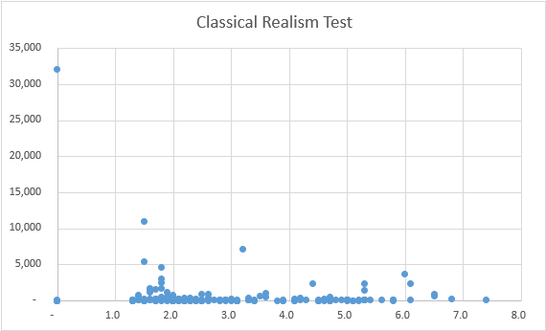
Classical Realism Results
Accepted Refugees per Million Population
Each of the blue dots represents one of 193 UN member states from 2010-2019.
The CR hypothesis is depicted by the red line: countries with lower birthrates should accept more refugees.
Birthrate

Slide 11
Structural Realist Hypothesis
Structural Realism: Structural Realists would hypothesize that states would be influenced by the United States’ dramatic shift in refugee policy, and that they would also decrease in acceptance rates.
  However, structural realists would also be aware of the possibility of a security dilemma. Understanding that some states may have to increase their acceptance rate in order to compensate for the U.S’ lack of contribution to assisting in the crisis of the refugees.

Slide 12
Structural Realism Results
Of the top 25 states from 2011, 44% did not follow the U.S. trend, and did the opposite and increased their acceptance rate, 40% did follow the U.S., and 16% barely shifted and stayed neutral
The United States did not influence the majority of states to follow their trend and decrease acceptance.

Slide 13
Conclusions
Through my test, my Classical Realism hypothesis was supported, states are more likely to assist refugees and asylum seekers if there is a benefit to themselves.
Through examining the results of the test of Structural Realism, it was found that the United States federal policy does not carry a heavy influence amongst other states in regarding the shift of policy changes.
  However, Structural Realism was correct in predicting a security dilemma, states were found to have increased their acceptance rate to compensate for the United States’ change of policy.

