Slide 1
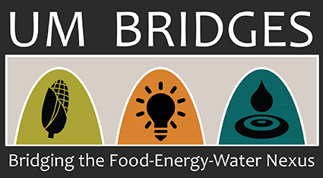
Protecting Life and Lung: Protected area impacts on local respiratory health in Brazilian Amazon Biome.
Derek Sheehan
Master of Economics degree candidate, University of Montana
This thesis is supported by a National Science Foundation grant administered by the UM Bridges program.

Slide 2
Structure of Presentation
Introduce how Brazilian policies aimed at ecosystem conservation could have human health benefits through the reduction of forest fires and particulate matter (PM 2.5).
Methods for connecting protected areas to respiratory health outcomes.
Preliminary results.
Conclusions and Significance.
Introduction
Background
Methods
Results
Conclusions

Slide 3
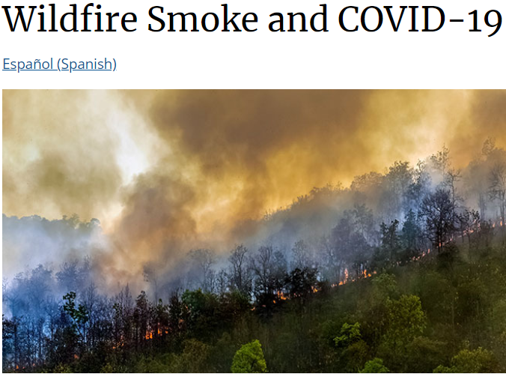
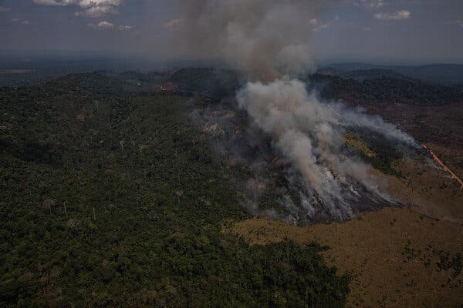
Brazilian Fires and Respiratory Health
Wildfire smoke can irritate your lungs, cause inflammation, affect your immune system, and make you more prone to lung infections, including SARS-CoV-2, the virus that cause COVID-19.
Background
Introduction
Methods
Results
Conclusions

Slide 4
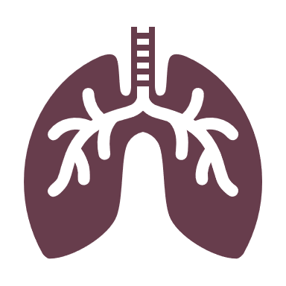
UN Sustainable Development Goals
Protected Areas
Are protected areas a conservation intervention that unites SDGs 15 and 3?
Background
Introduction
Methods
Results
Conclusions

Slide 5
Research Question
What is the impact of protected areas on local respiratory health in the Amazon Biome?
Pm2.5
Policy
Environment
Health
Background
Introduction
Methods
Results
Conclusions

Slide 6
→
Respiratory disease hospitalizations
(municipality of residence) (ICD-10 codes JXX)
Change in area of protected area surrounding municipality (km2)
Methods
Introduction
Background
Results
Conclusions

Slide 7
Upwind Area of Protected Area
Wind from NNE (0° to 44°)
Wind from ENE (45° to 89°)
$$PM {2.5}_{t+s}$$
$${Hosp}_{t+s}$$
$$PM {2.5}_{t}$$
$${Hosp}_{t}$$
Introduction
Background
Methods
Results
Conclusions

Slide 8
Preliminary Results for the Southern Amazon
$$PM {2.5}_{it} \sim Upwind_Protection_{it−3s}+Downwind_{protection}_{it−3s}+controls+e_{it}$$
Why would upwind protection have a delayed response on PM 2.5?
UPWIND
3, 6, and 9 months prior
DOWNWIND
Results
Introduction
Background
Methods
Conclusions

Slide 9
Preliminary Results for the Southern Amazon
$${Resp Hosp}_{it} \sim Upwind_protection_{i(t−3s)}+Downwind_protection_{i(t−3s)}+…+e_{it}$$
A 1% increase in upwind protection results in an expected decrease in hospitalizations rate of 0.07%
Main fire season (July, August, September) occurs 9 months prior to most respiratory hospitalizations (April, May, June)
UPWIND
3, 6, and 9 months prior
DOWNWIND
Introduction
Background
Methods
Results
Conclusions

Slide 10
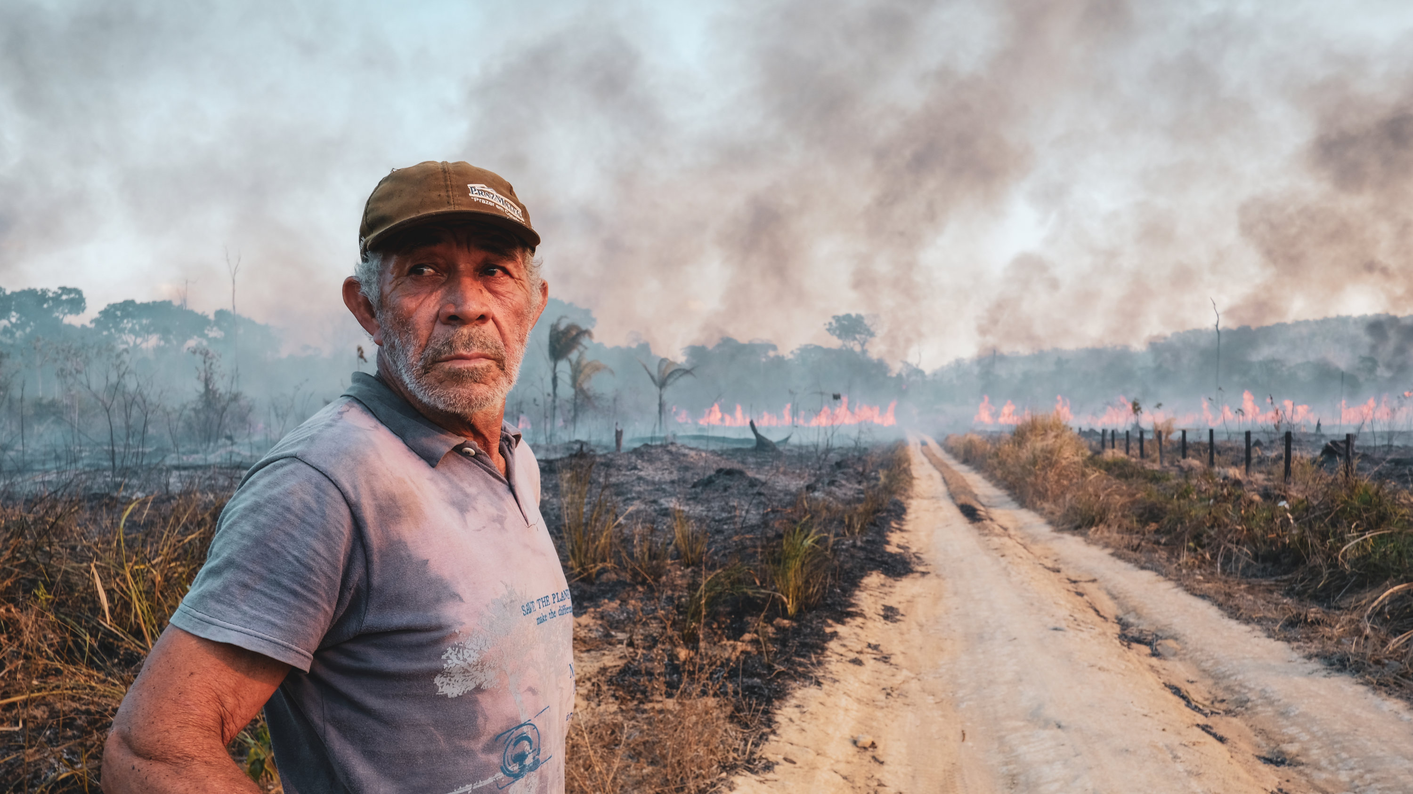
Conclusions
Upwind protected areas may have delayed impacts on respiratory diseases.
“Burnings increase the inflammatory processes in the lungs, which become open doors for microorganisms to enter, such as the severe acute respiratory syndrome coronavirus 2”
Respiratory diseases disproportionally effect already vulnerable populations such as children, elderly, and indigenous peoples.
https://www.nytimes.com/2019/10/10/world/americas/amazon-fires-brazil-cattle.html
Conclusions
Introduction
Background
Methods
Results

Slide 11
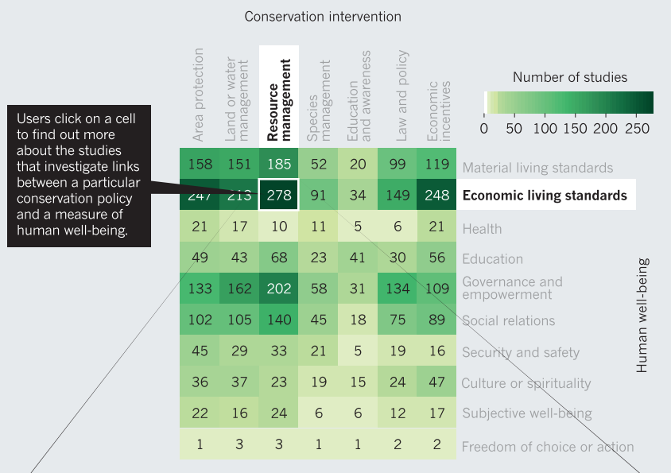
Significance
“…empirical evidence for impacts of PAs on human well-being remains thin: Only 8% of studies examining impacts on material living standards” (Naidoo et al. 2019).
“…and 1% of studies analyzing impacts on health used rigorous, quantitative methods and data” (Naidoo et al. 2019).
This is the first known PA impact study in which wind direction has been used to isolate the impacts of protected areas on respiratory diseases.
Introduction
Background
Results
Conclusions
Methods

