Slide 1
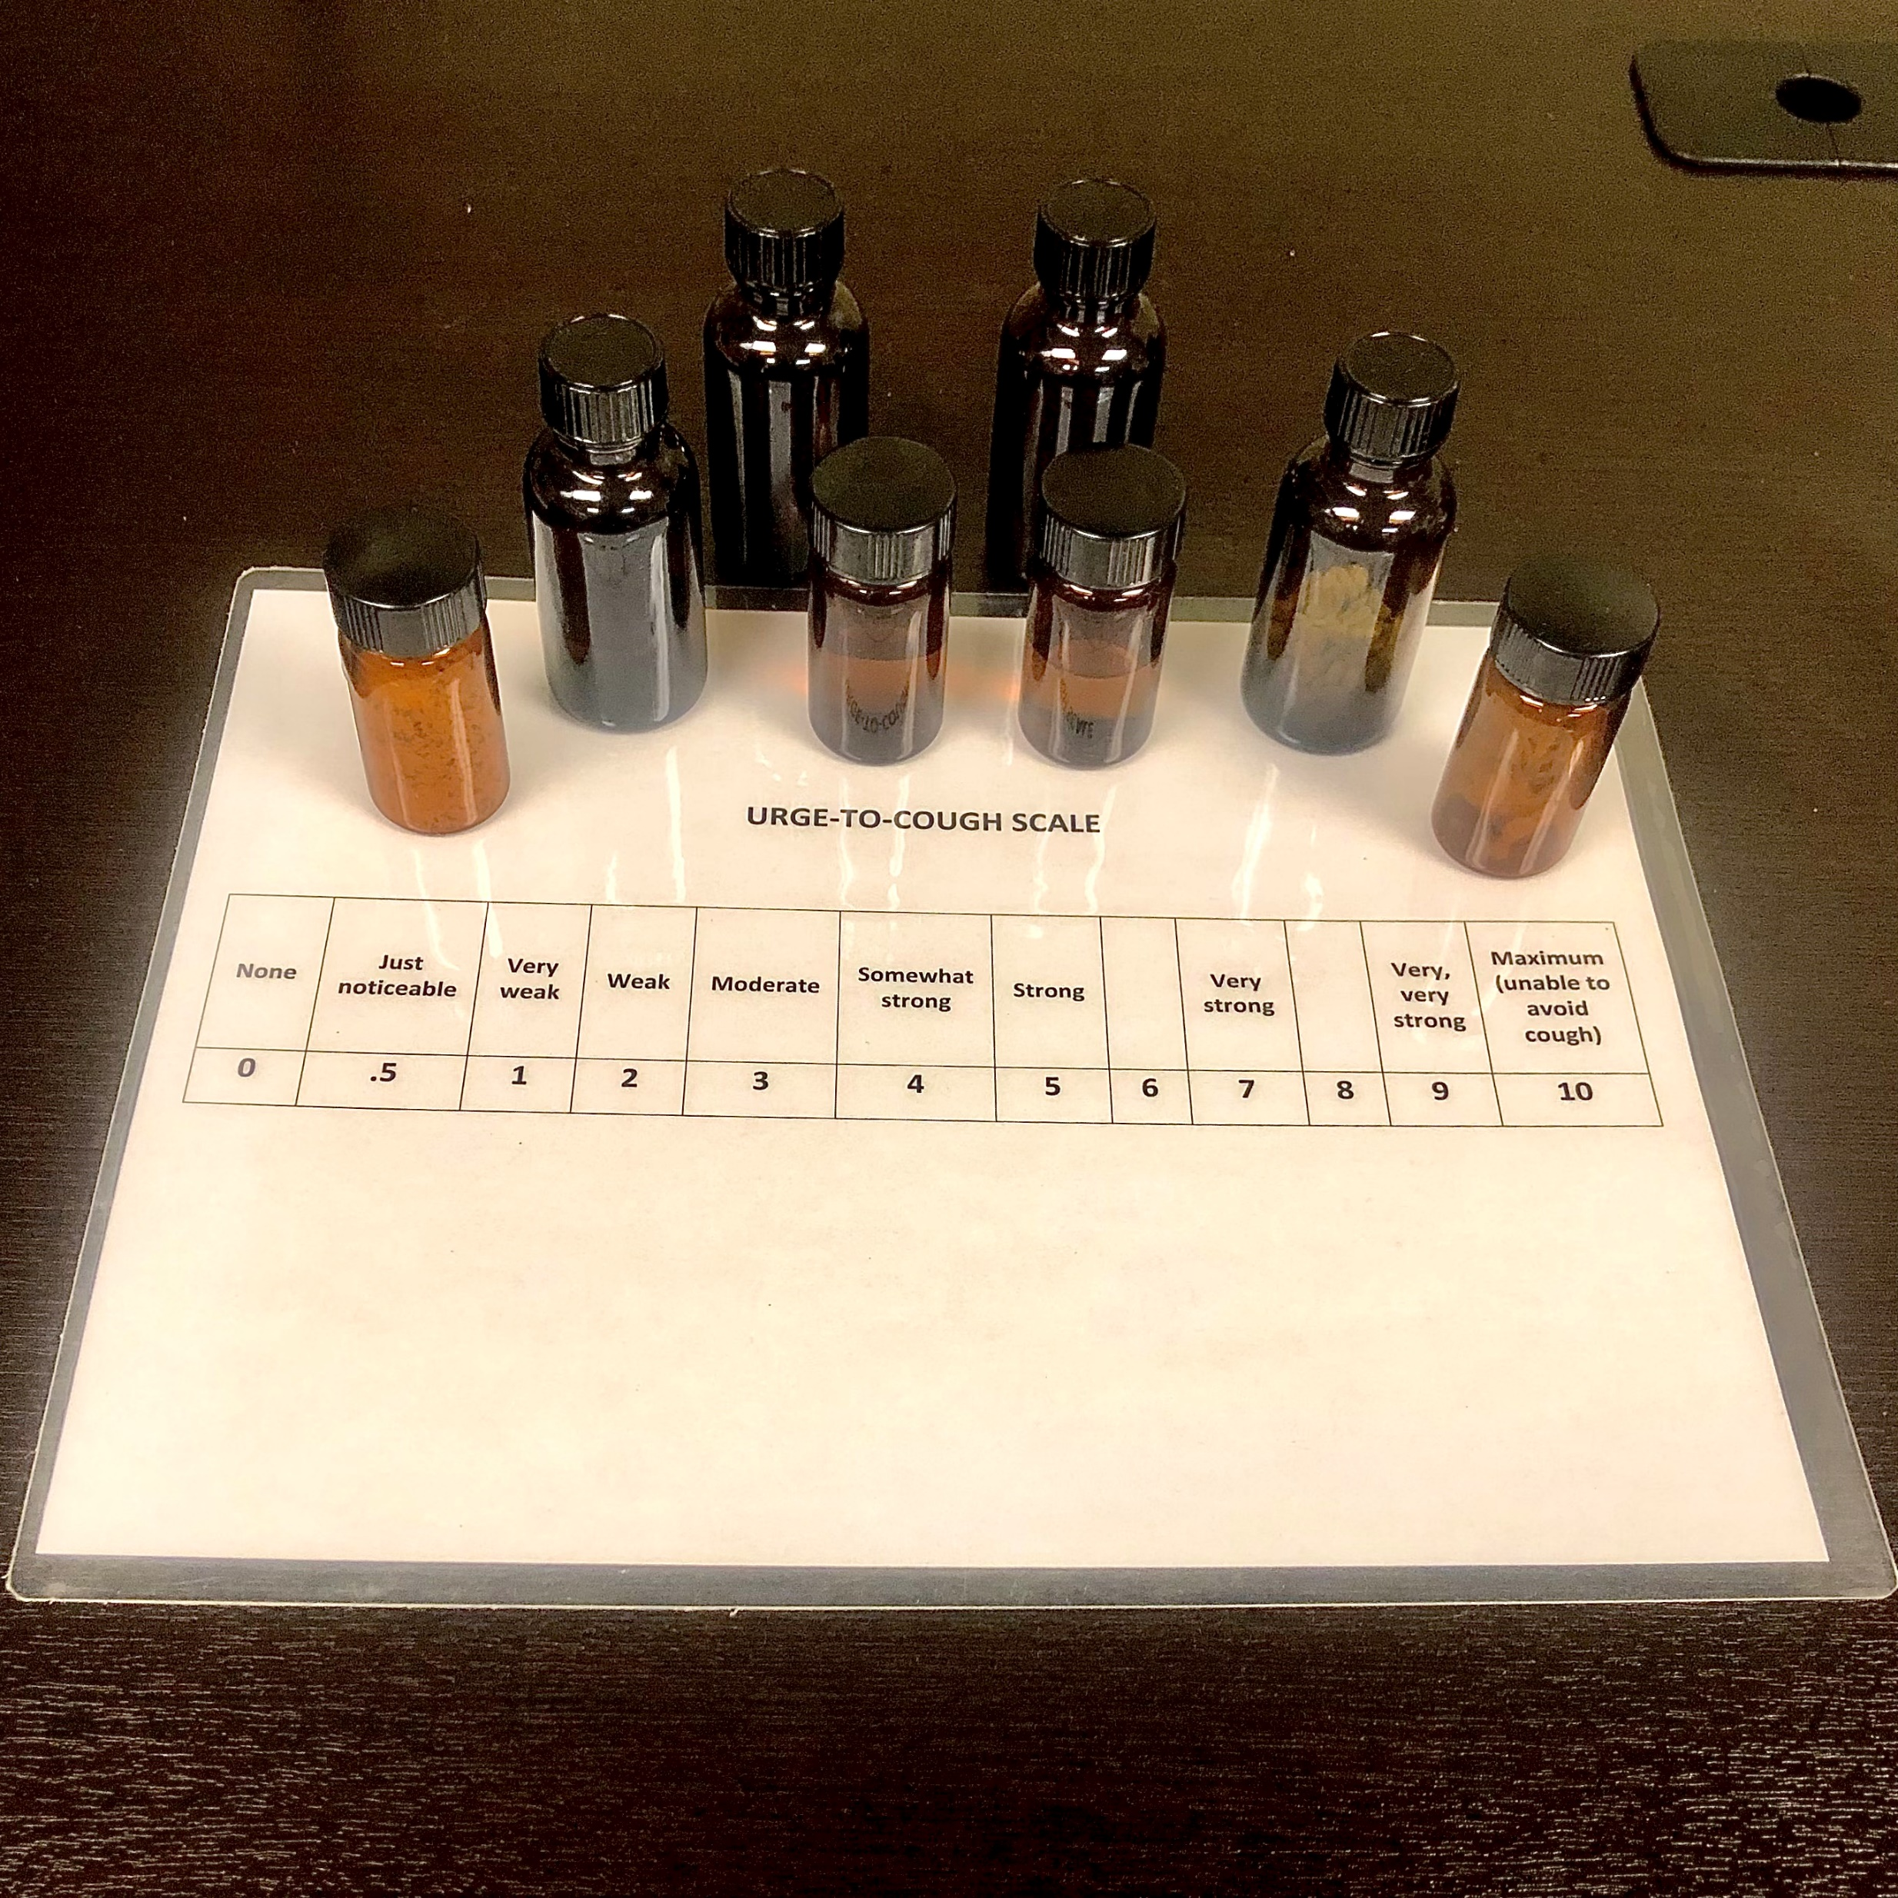
Reliability of Urge-to-Cough (UTC) Testing Laurie Slovarp Ph.D., CCC-SLP, Jane Reynolds, M.S, CCC-SLP, Sarah Campbell, B.A
Introduction
Methods
Early Results (n=1)
Chronic Cough (CC), a cough that persists for more than 8 weeks, accounts for millions of visits to physicians each year. Researchers who study chronic cough rely on multiple measures to gauge if an intervention effective in reducing coughing. An assessment called Urge-to-Cough (UTC) Testing has been proposed to determine a patient’s sensitivity to stimuli that commonly trigger coughing in patients with cough hypersensitivity (e.g., strong scents, projecting the voice). While UTC testing is commonly administered and repeated over time, there is no published data on the reliability of UTC Testing. Without knowing the reliability of UTC Testing, researchers and clinicians who administer this test may be inappropriately drawing conclusions about a patient’s change in cough sensitivity.
Participants:
Up to 25 participants
Nonsmoking adults ≥ 18 w/ CC ≥ 8 weeks
Absence of pulmonary conditions other than asthma.
Referred for a CC evaluation with a speech-language pathologist
Method:
Two separate UTC Testing sessions before beginning cough therapy
Administration time approx. 10 minutes
Exposed to 8 safe stimuli for up to 15 seconds and 4 vocal tasks in randomized order.
Measures:
Subjective “urge-to-cough” sensation rating using a 10-point Likert scale.
The researchers record number of coughs produced by stimuli.
Results from the two testing opportunities will be analyzed to determine the reliability of UTC Testing.
We hypothesize that UTC Testing is a reliable assessment of a patient’s cough sensitivity and is therefore a useful clinical and research tool.
Purpose
Future Directions/Clinical Implications
Determine if UTC Testing is can be used in clinical and research scenarios to conclude if a patient’s cough sensitivity is changing in response to intervention.
Obtain data from 25 CC participants
Formulate standardized instructions for UTC Testing for the clinical setting
Definitions
References
Chronic Cough (CC) = a cough that persists for more than 8 weeks. Typically, a dry, non-productive cough
Urge-to-cough (UTC) = feeling the need to cough (e.g. “none”, “barely noticeable”, “mild”)
Cough Hypersensitivity Syndrome = an increased urge to cough in the presence of daily stimuli due to the increased expression of sensory receptors within the airway.
Centers for Disease Control and Prevention. (2017). National Hospital Ambulatory Medical Care Survey. https://www.cdc.gov/nchs/data/nhamcs/web_tables/2017_ed_web_tables-508.pdf
Vertigan AE, Gibson PG. Urge to cough and its application to the behavioural treatment of cough. Bratisl Lek
Listy. 2011;112(3):102-8. PMID: 21452759.
Vernon M, Kline Leidy N, Nacson A, Nelsen L. Measuring cough severity: development and pilot testing of a
new seven-item cough severity patient-reported outcome measure. Therapeutic Advances in Respiratory Disease. August 2010:199-208. doi:10.1177/1753465810372526

