Slide 1
Quantifying Subsurface Parameter Uncertainties with Surrogate Modeling and Environmental Tracers
Nicholas E. Thiros
W. Payton Gardner
Geosciences Department
Notes:
Today, I am going to present my work on using environmental tracers and machine learning surrogate models to evaluate uncertainties in groundwater models.

Slide 2
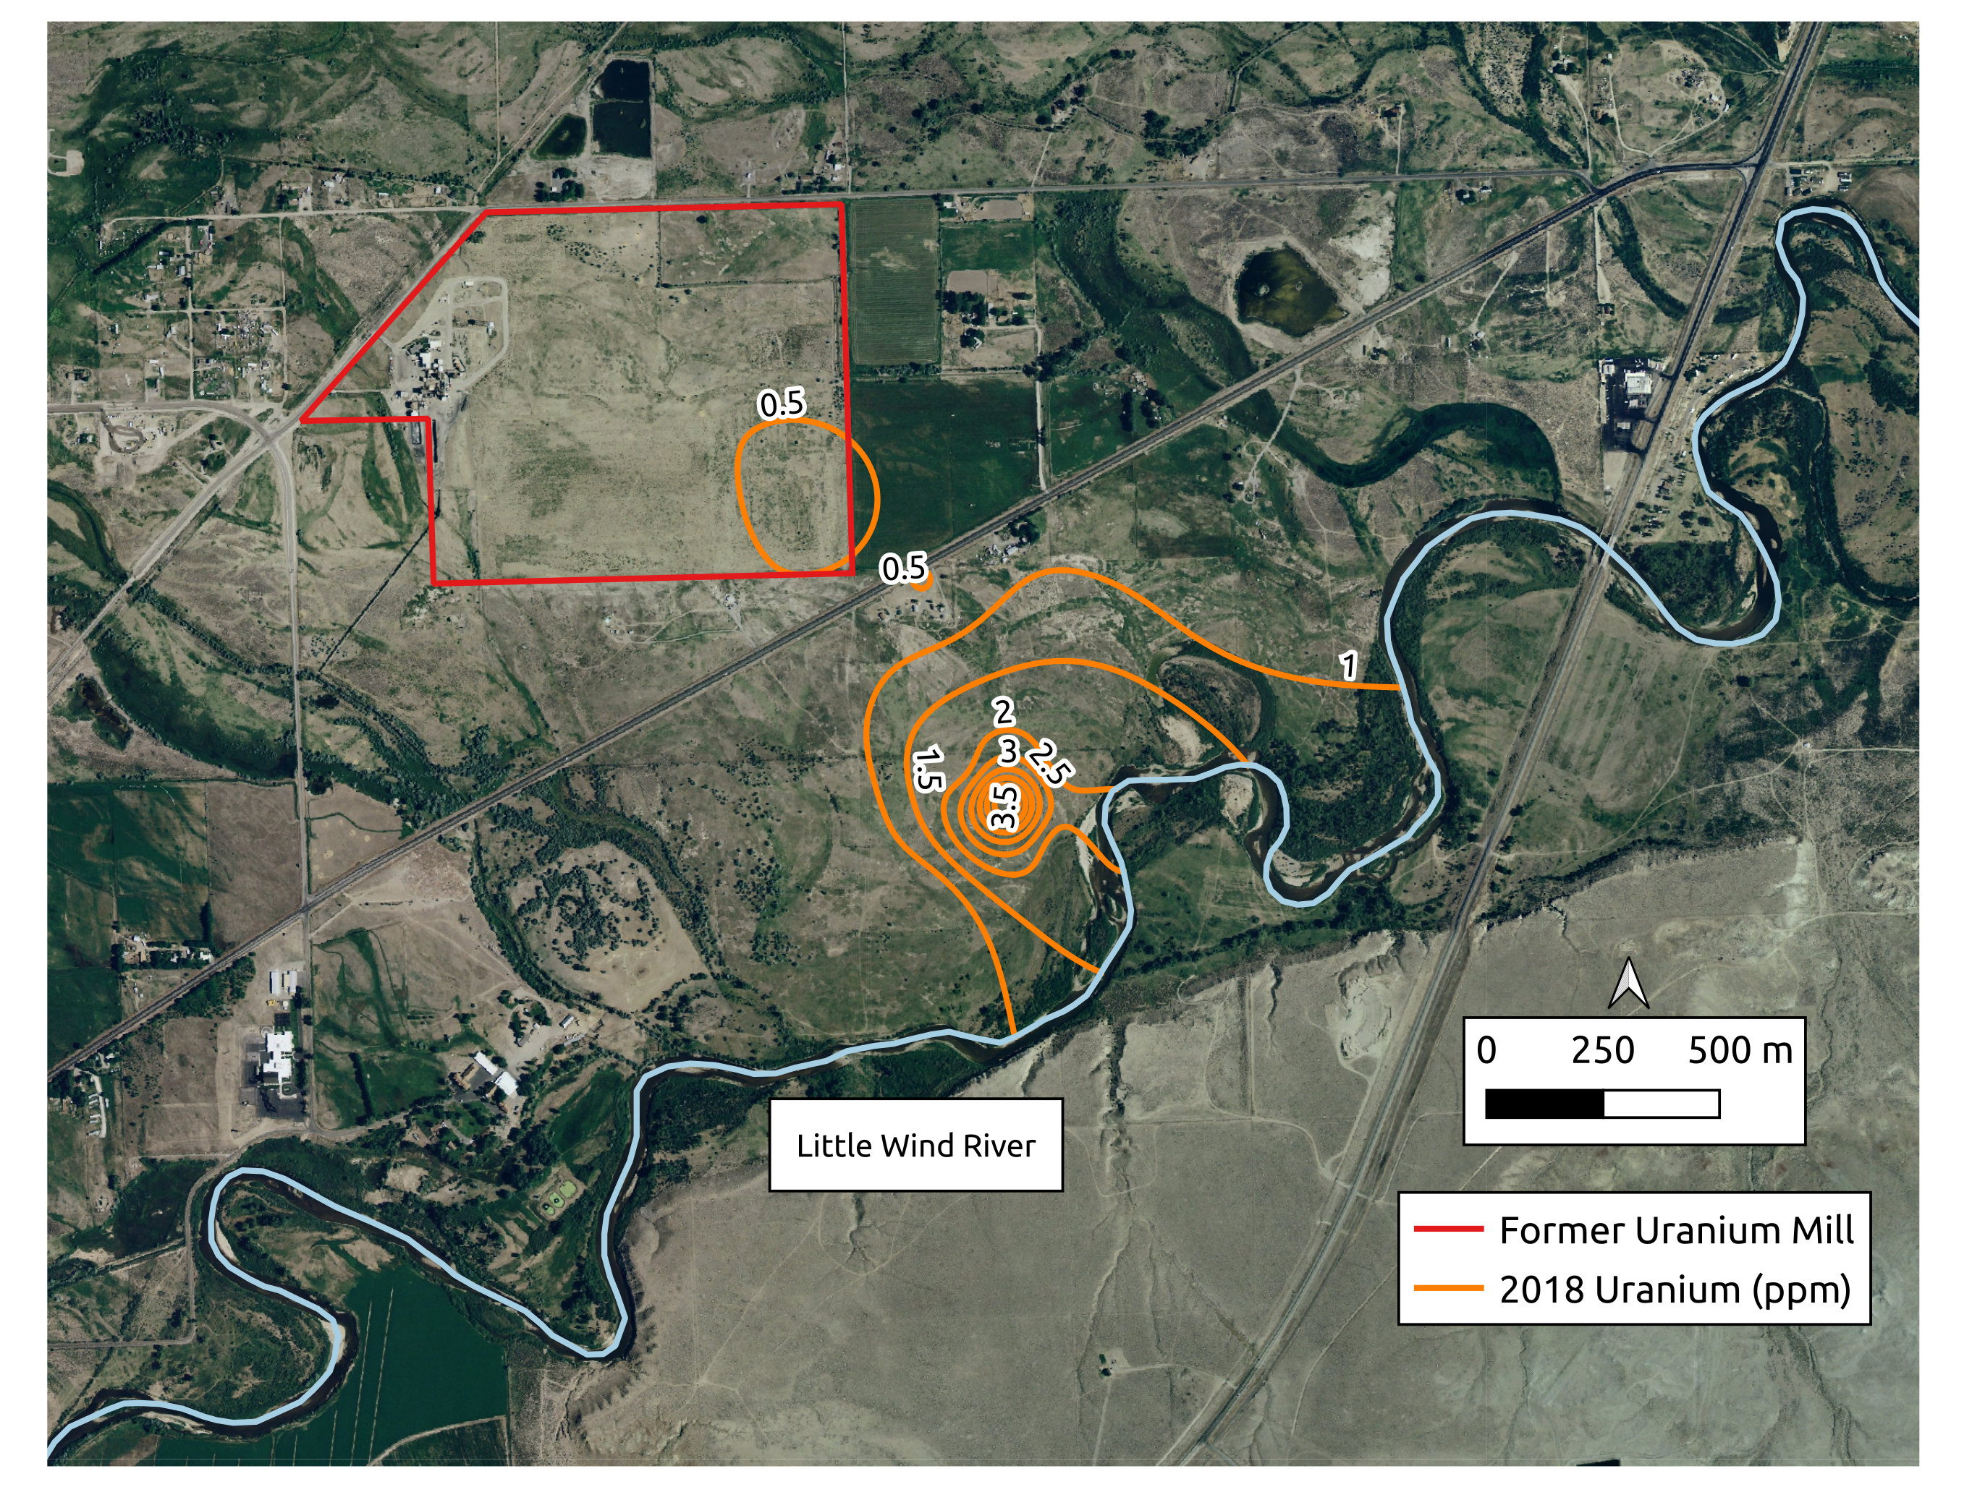
Groundwater Transport Forecasts
Background = 0.005 ppm
EPA MCL = 0.03 ppm
Notes:
Here I am showing an areal view of a site in west-central Wyoming that contains an extensive groundwater Uranium plume, which is shown by these orange concentration contour lines. This uranium originated more than 70 years ago but is still causing water degradation today.
Accurate predictions of how this plume is moving, how fast it is moving, and where it will discharge to the Little Wind River are examples of key predictions that are needed to properly assess the biological and environmental impact of this contaminant and future remediation efforts.
Using a process-based numerical groundwater model is the most powerful tool we have to make forecasts of this system.
However, as with all models of complex systems, these forecasts will inevitably be wrong and contain uncertainties.
Quantifying these uncertainties is a critical part of the modeling process, yet is very to do challenging in practice.

Slide 3
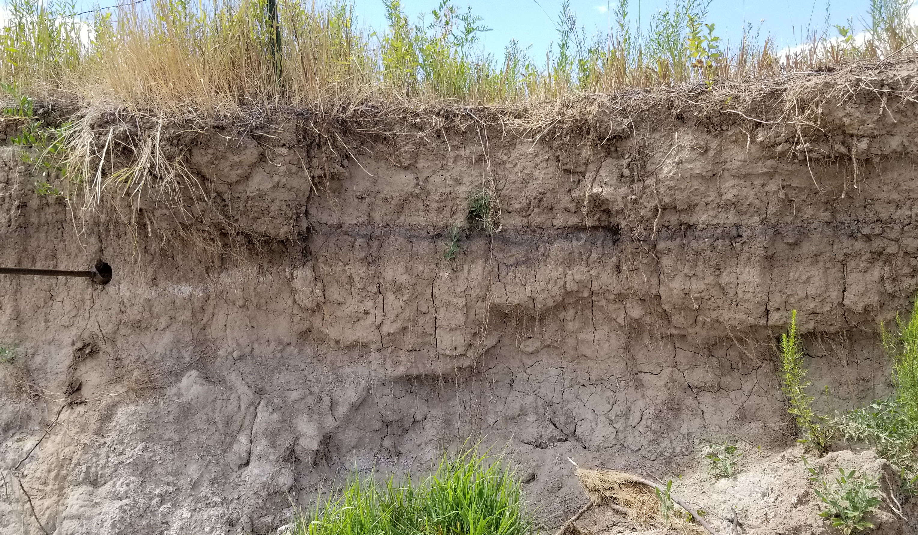
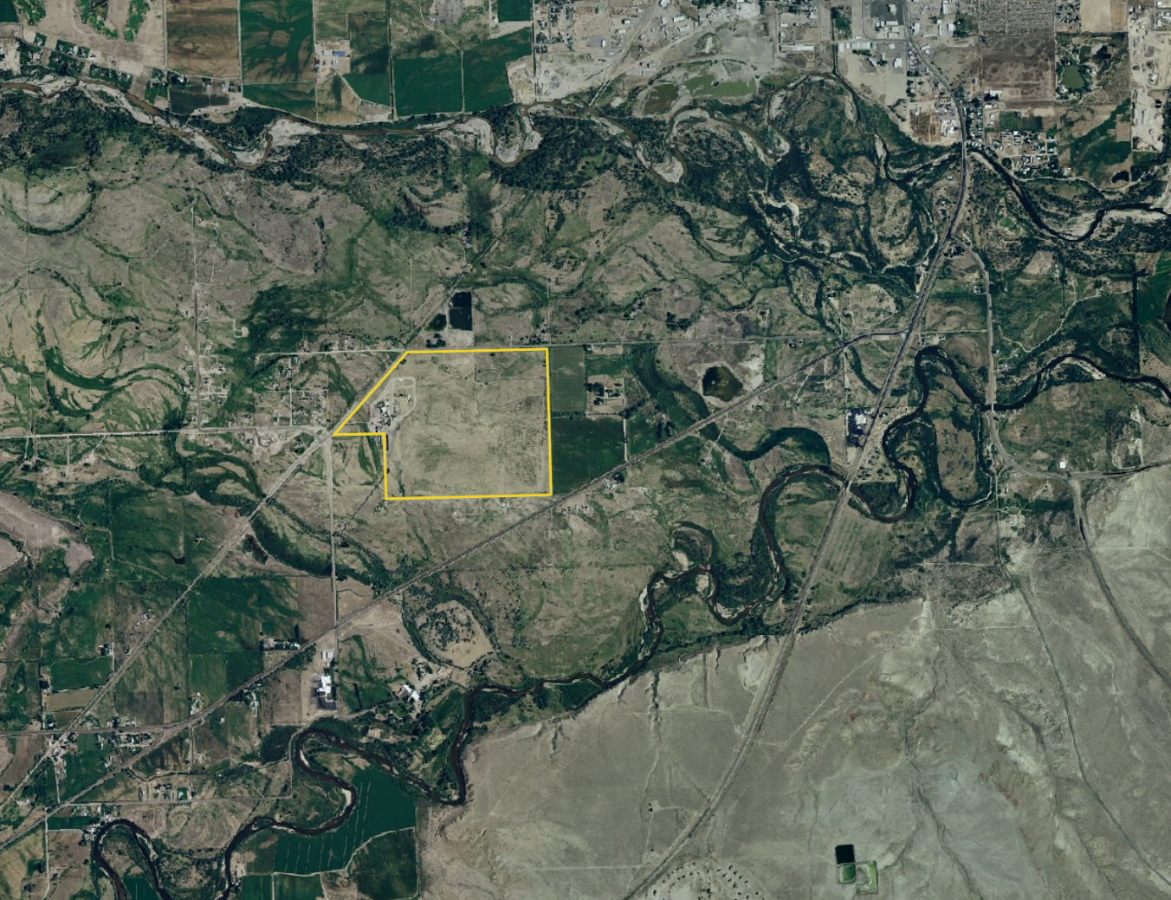
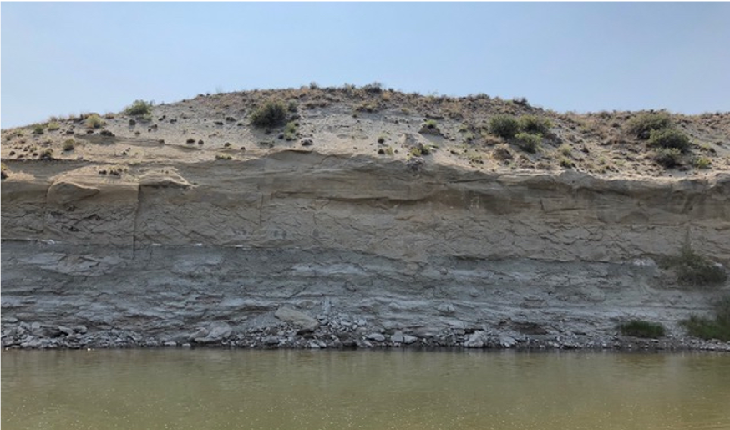
Uncertainties in Numerical Model Forecasts
m scale
km scale
10’s m scale
Notes:
The prediction problem is difficult and uncertain because the true complexities of the system far exceed what we can measure and include in our models.
If we again consider the areal image on the left, we can see that there are all these paleo channels running through the site. The properties of the subsurface that control groundwater flow and the movement of uranium likely vary depending if you are in an old channel location or not.
Now considering the z dimension and this outcrop image, we can see important details on the layering structure, which will also influence fluid movement through the system.
Zooming in again to a cutbank shown in the top right image, there is complex and small-scale property heterogeneity.
While all these processes are important, we have no hope of measuring all the heterogeneities of the system and must rely on alternative methods to identify the parameters needed by our predictive models.

Slide 4
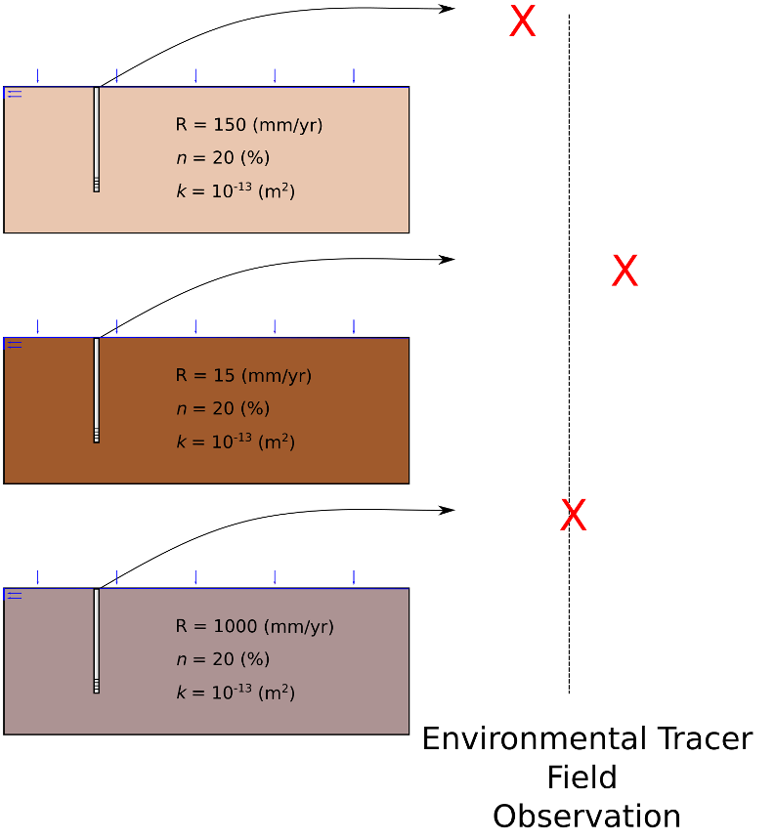
The Inverse Problem

Slide 5
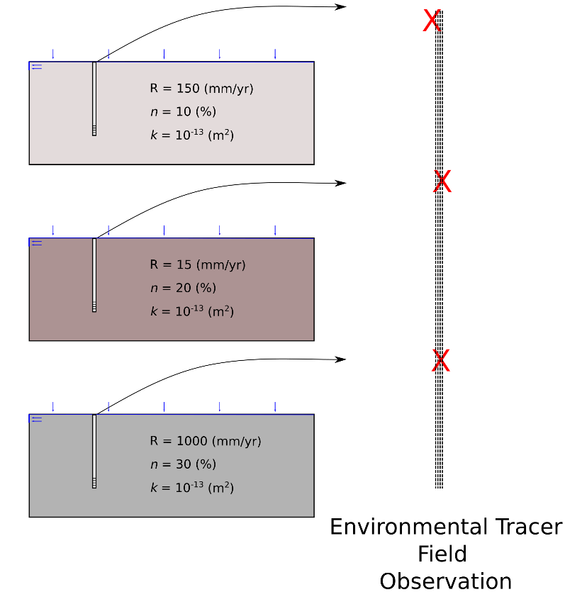
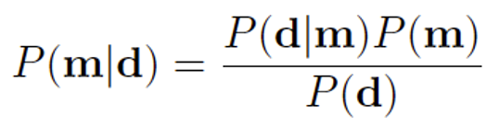
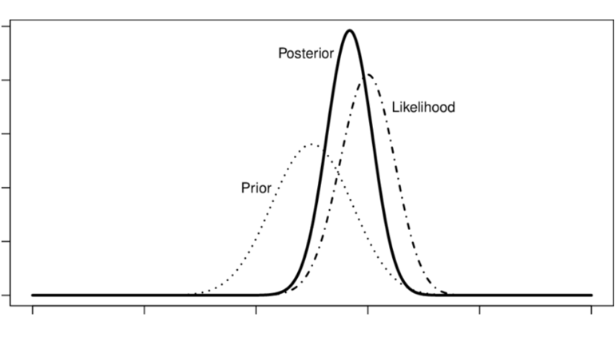
The Inverse Problem

Slide 6
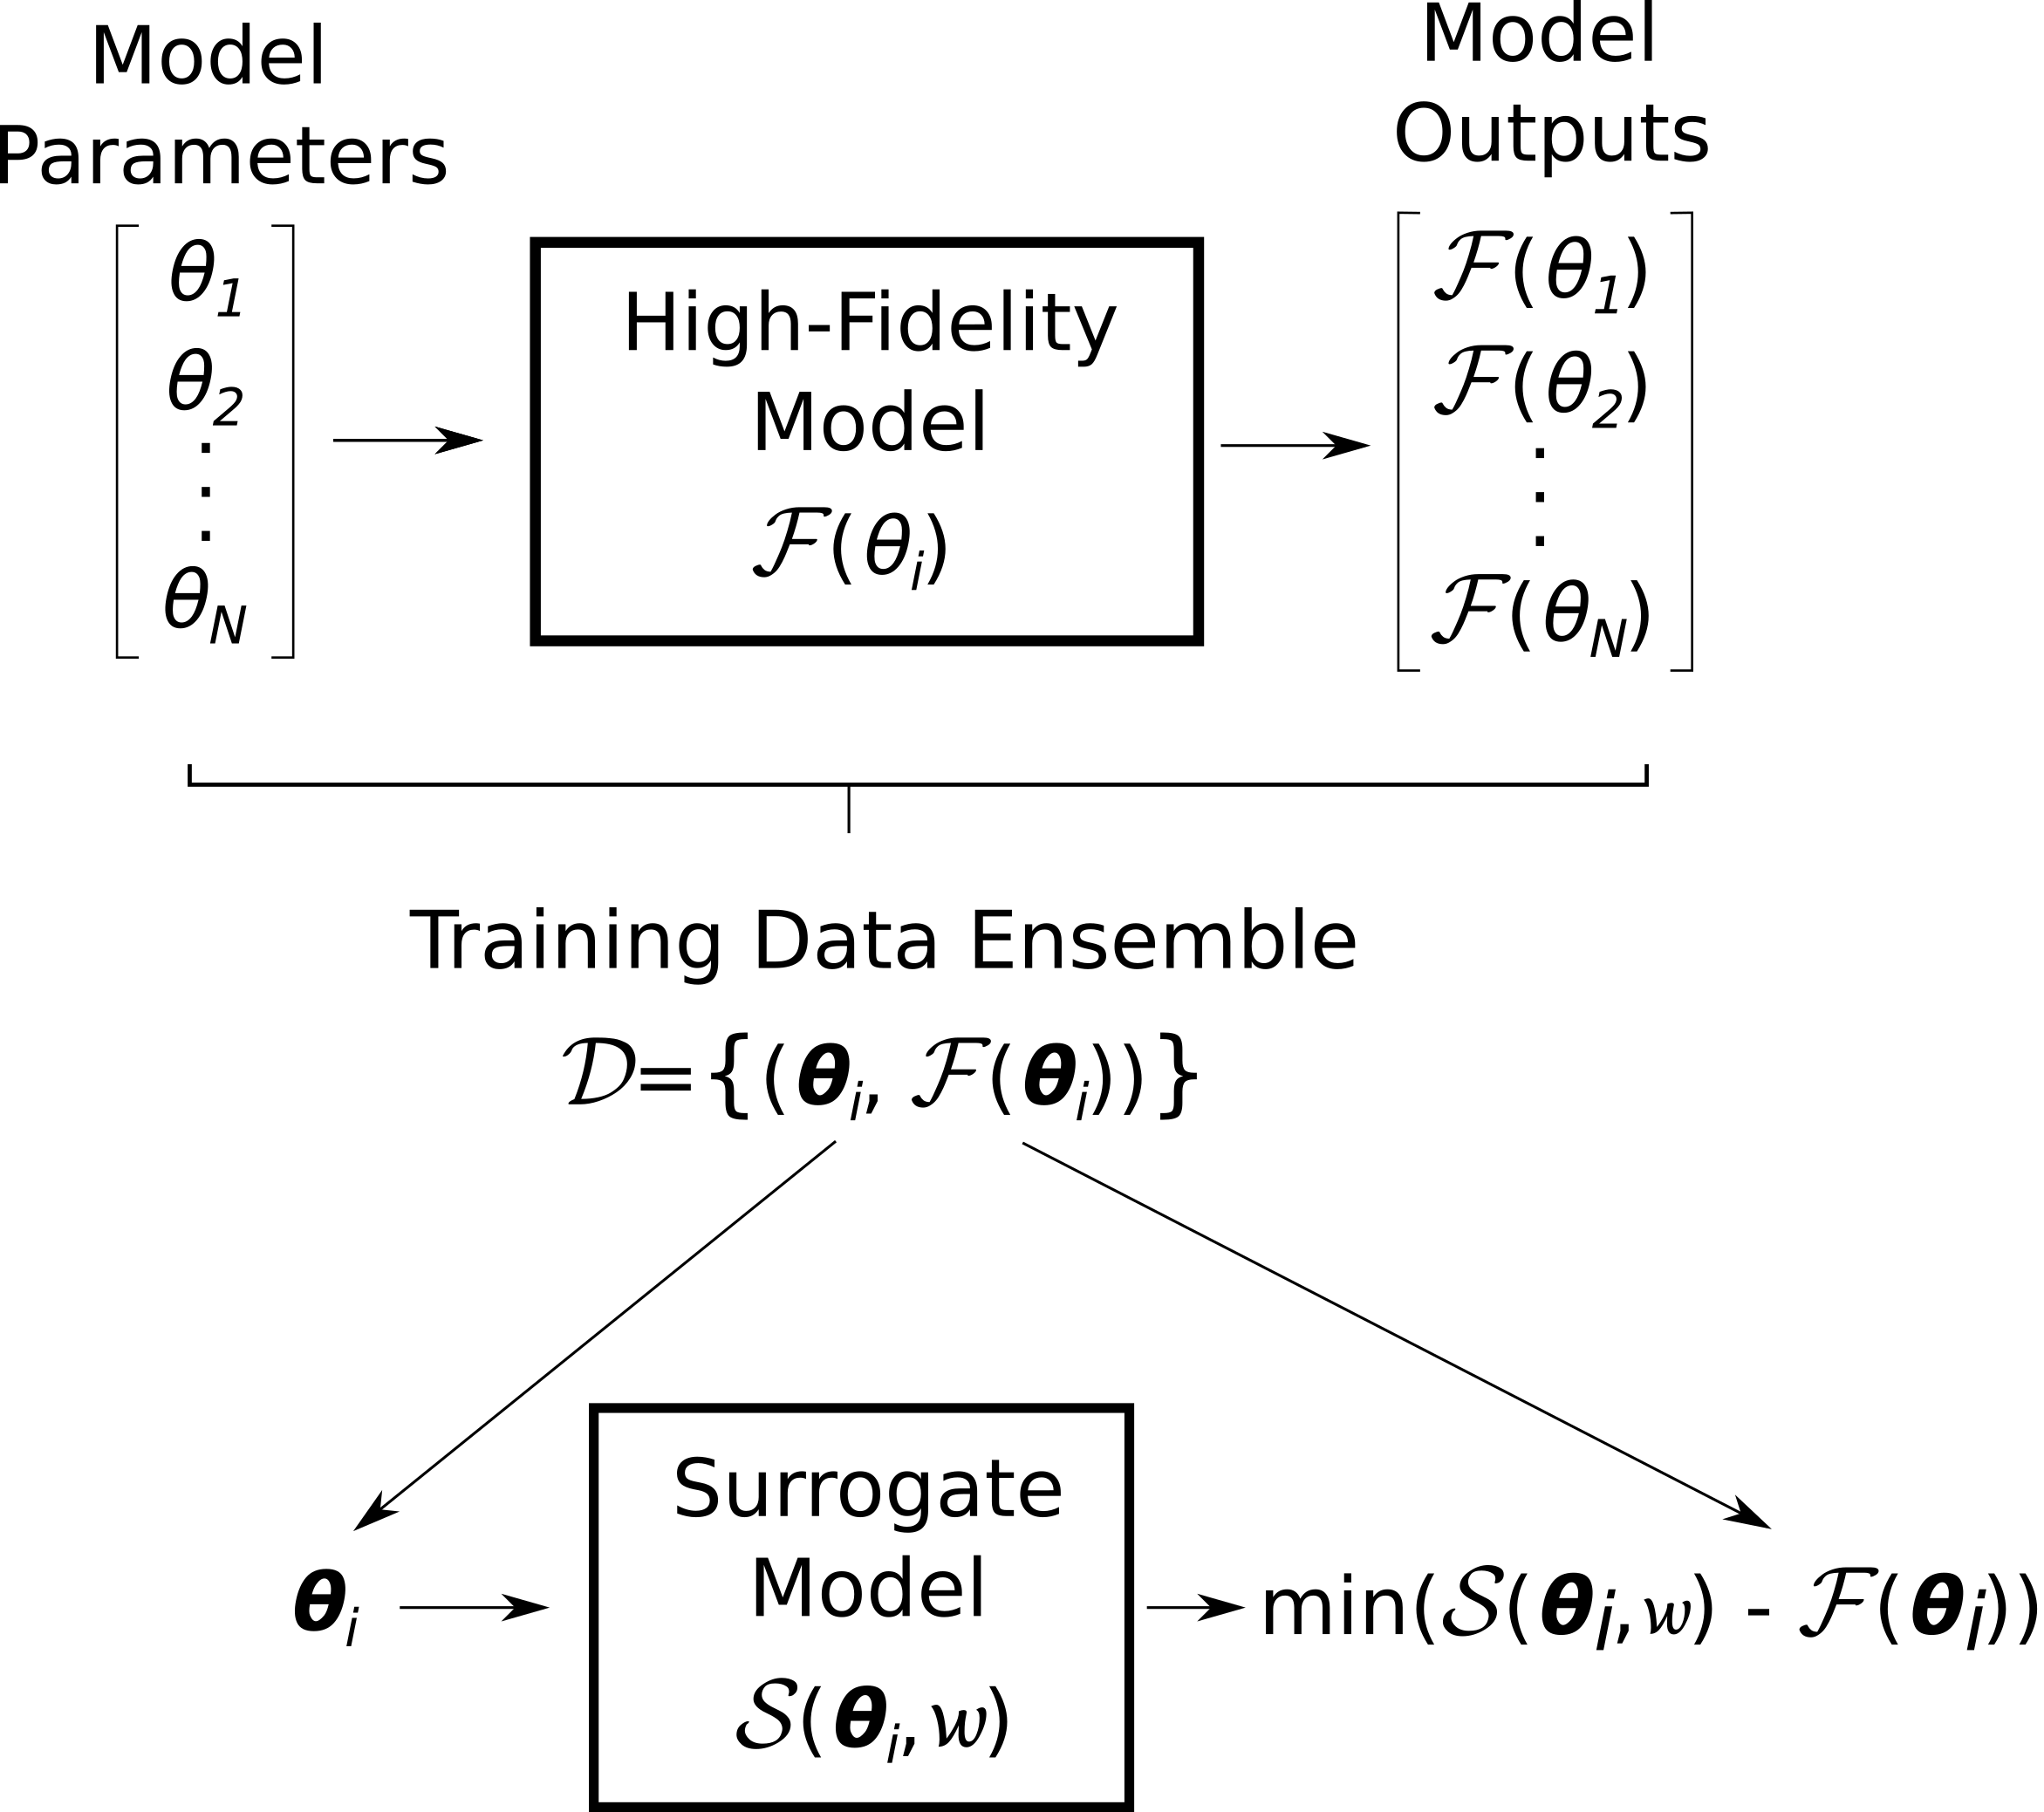
Parameter Estimation with Surrogate Models

Slide 7
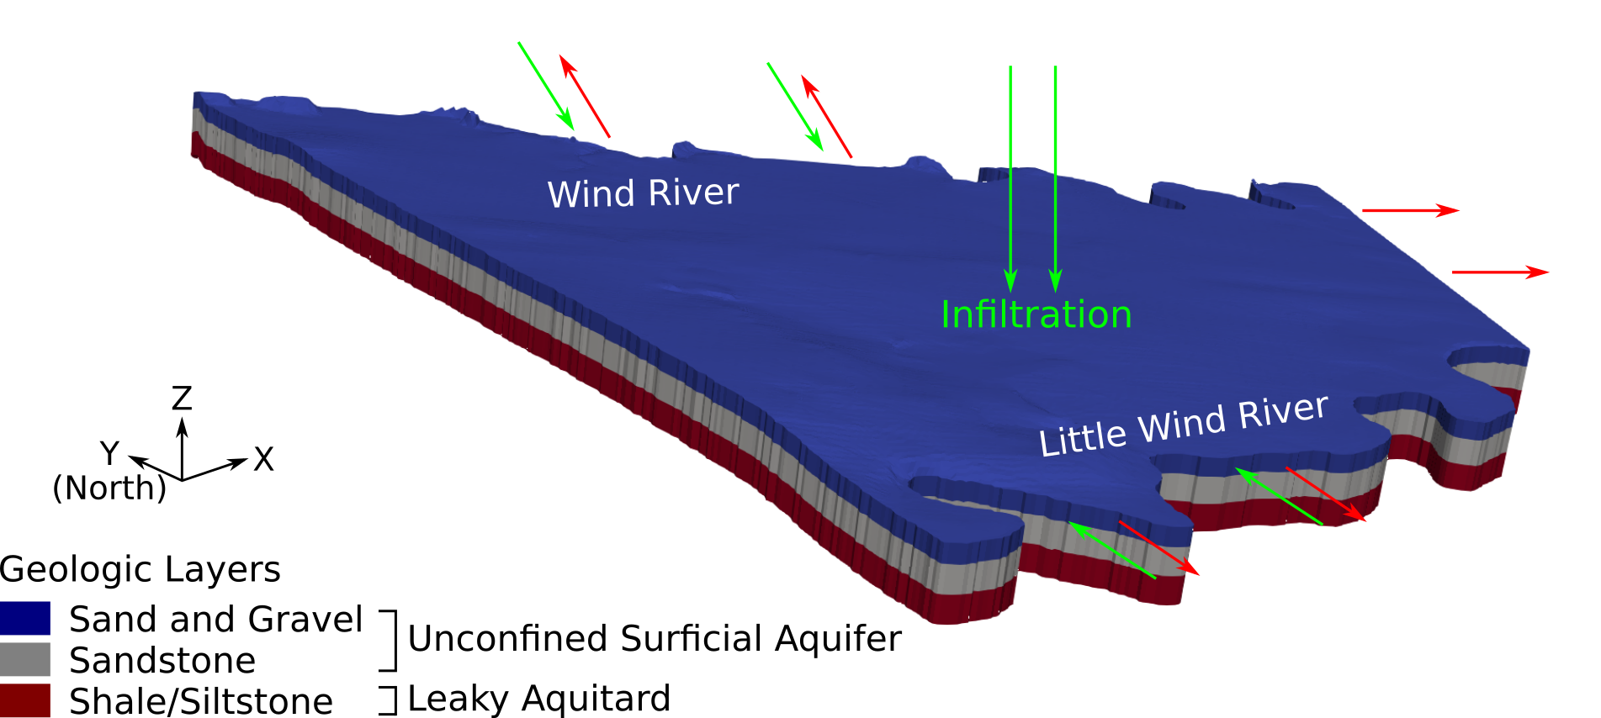
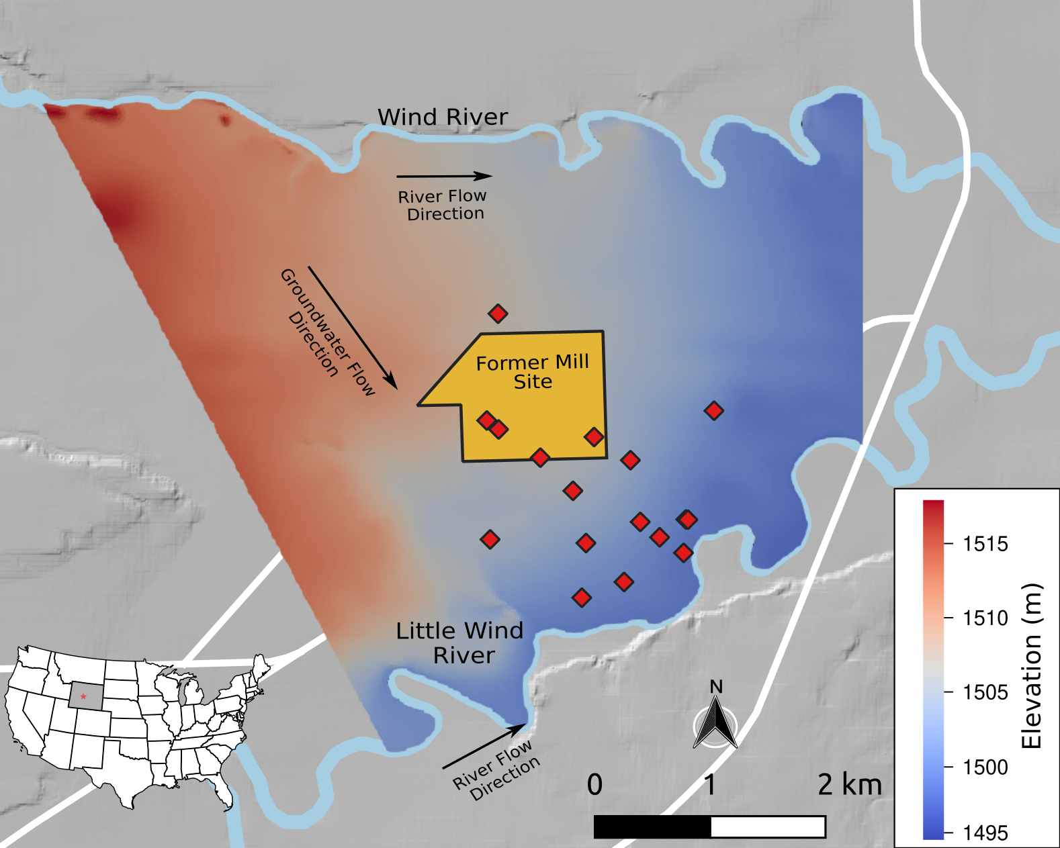
High-Fidelity Model

Slide 8
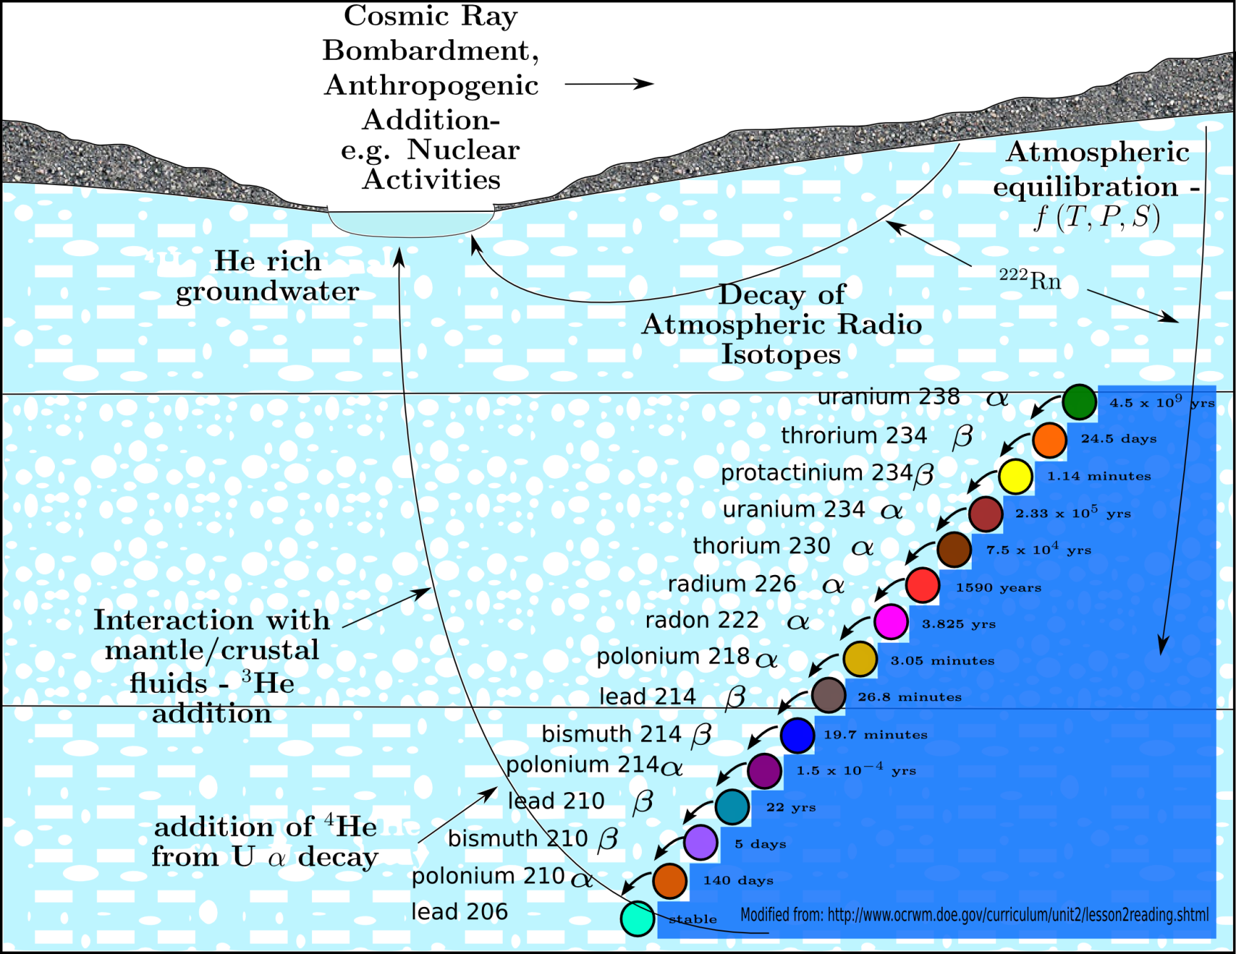
Site Observation Data
Environmental Tracers
  2 SF₆
  2 CFC-12
  13 Tritium
Water Levels: 124

Slide 9
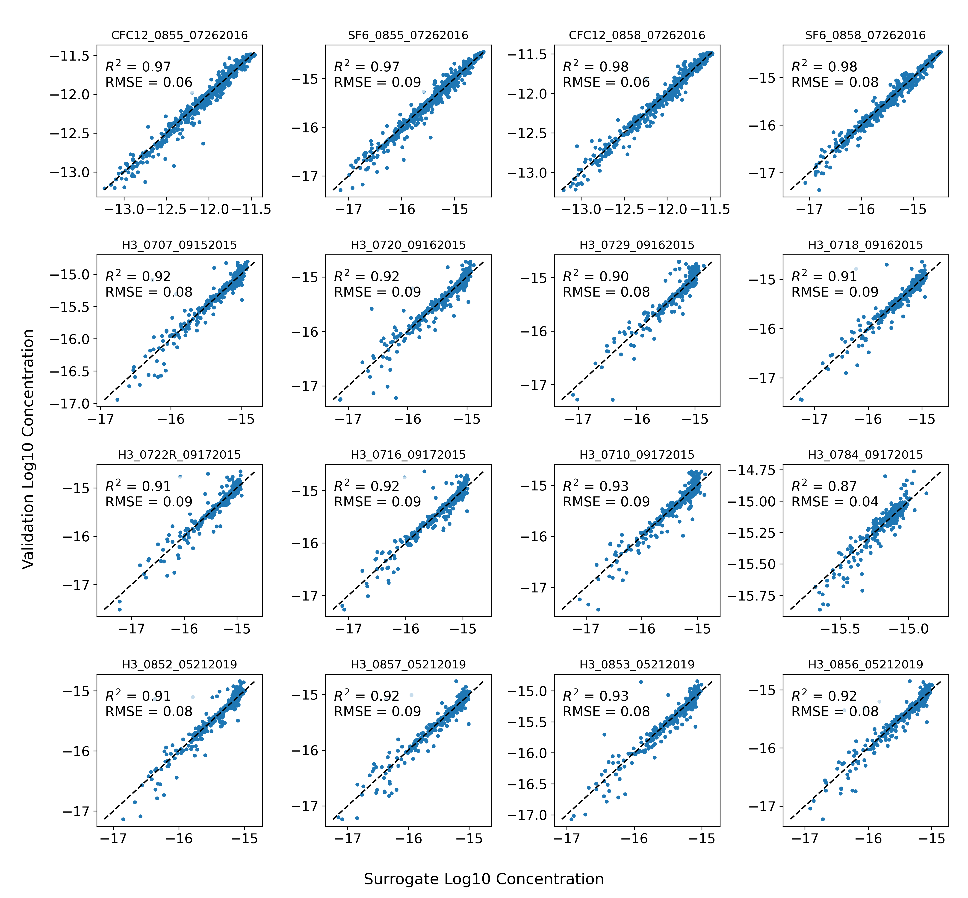
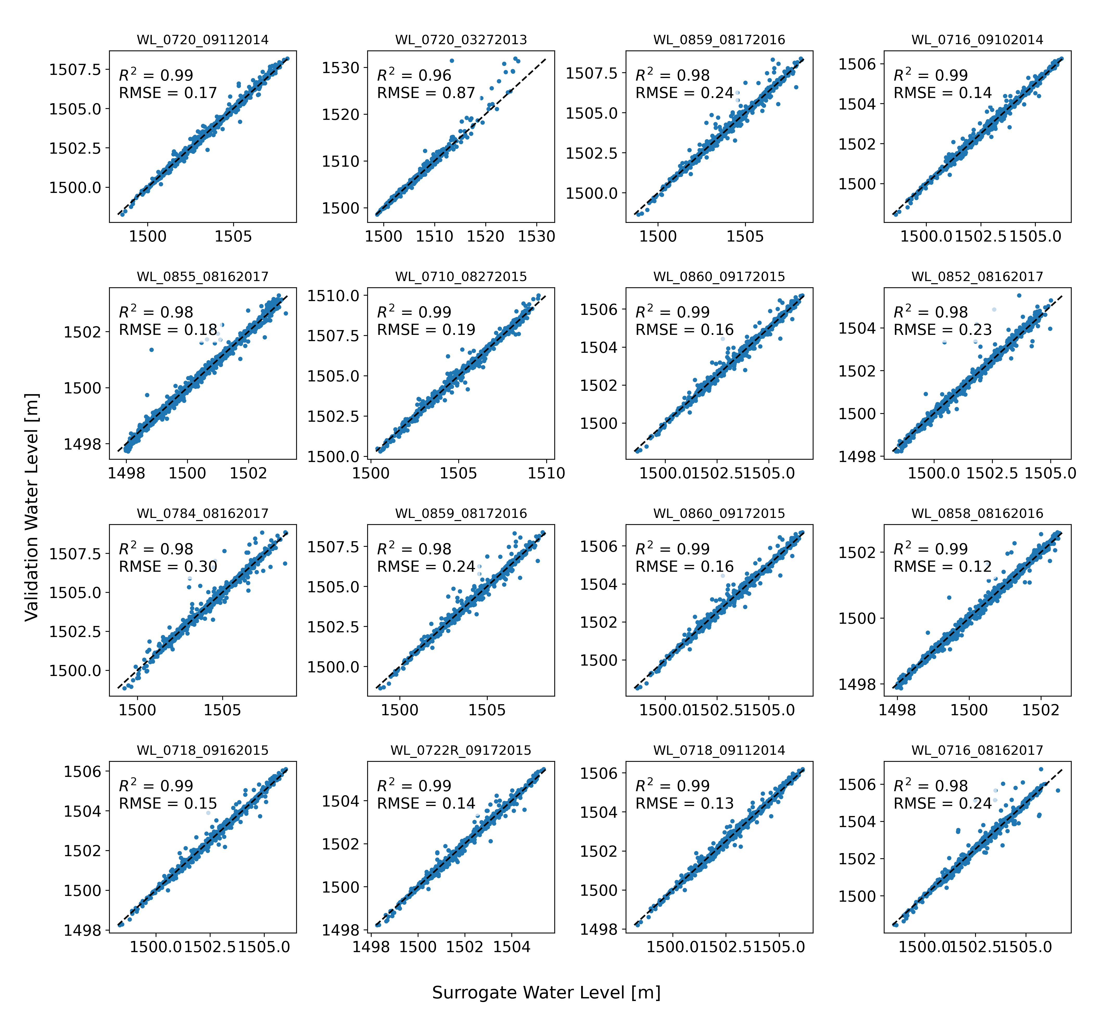
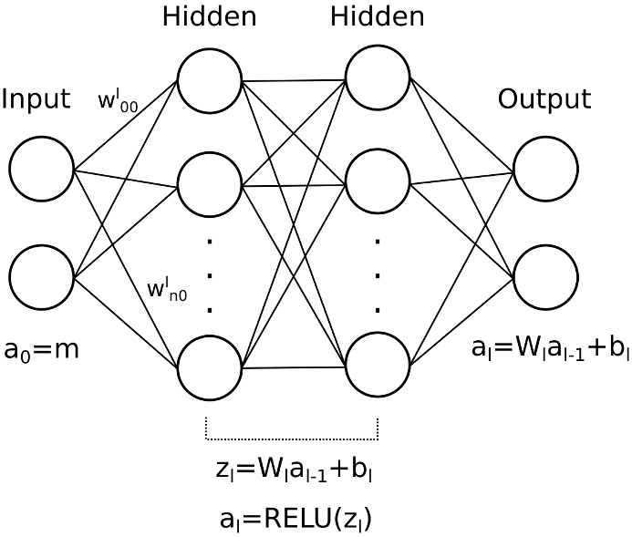
Artificial Neural Network
Notes:
6 Hidden Layers
528 Nodes/Units

Slide 10
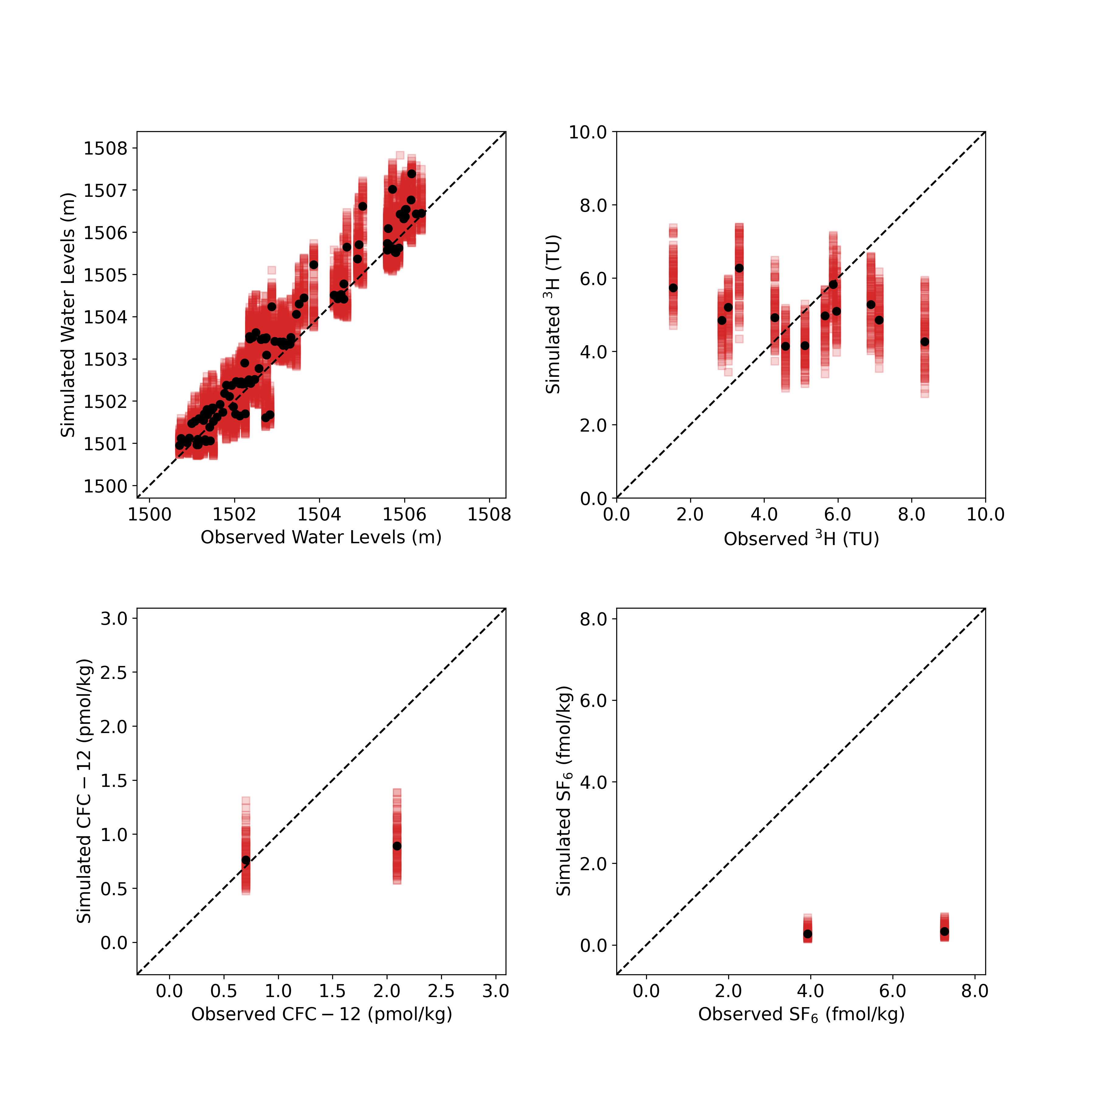
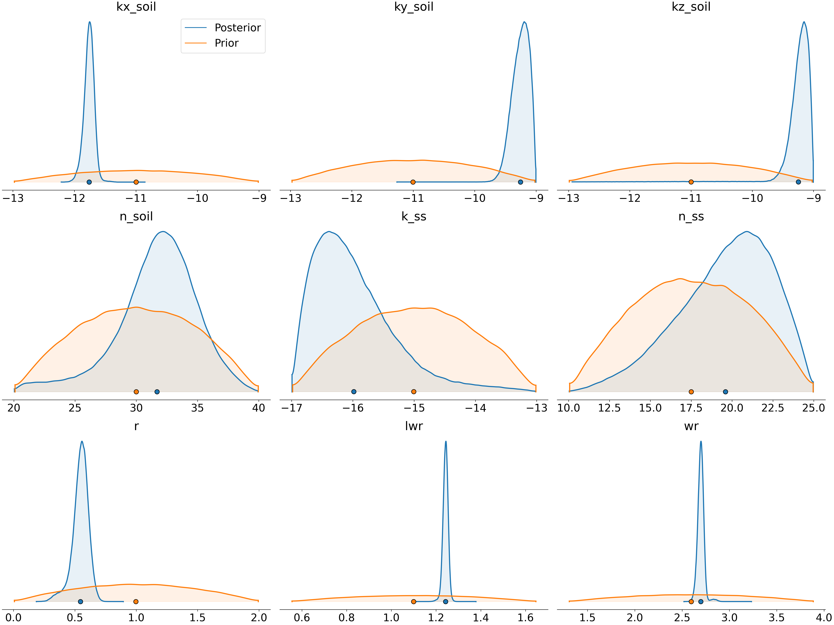
MCMC Posteriors

Slide 11
MCMC Posteriors

Slide 12
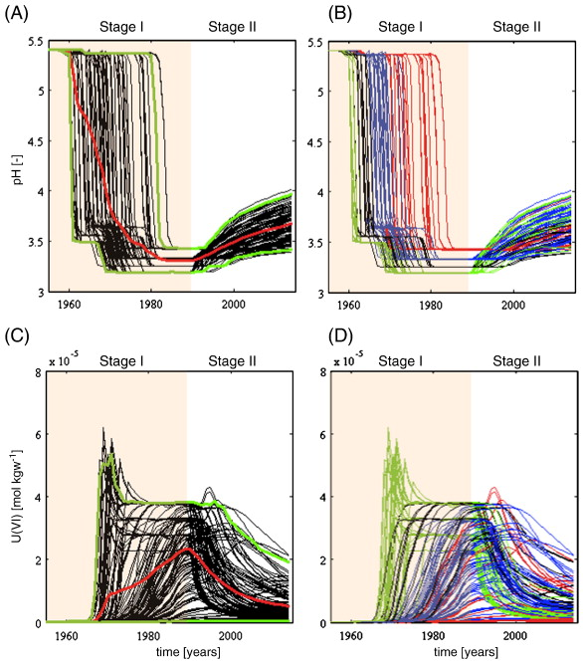


Conclusions
Generating the full posteriors with the high-fidelity model is challenging.
Artificial Neural Network surrogate models can aide in hydrogeologic parameter calibration and uncertainty quantification.
Bea, et. al. (2015)
Savannah River DOE Site

