Slide 1
Blocking a specific ion channel reduces inflammation in lung cells
Becky Kendall
University of Montana: GradCon 2021

Slide 2
Chronic Inflammation
Furman et al., 2019

Slide 3
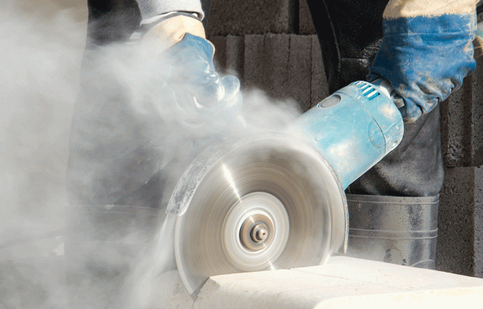
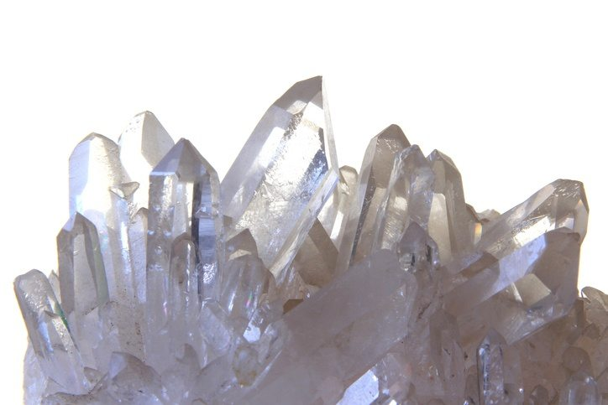
Crystalline Silica
Occupational hazard: construction, mining, artificial stone countertop manufacturing
Atcgroupservices.com

Slide 5
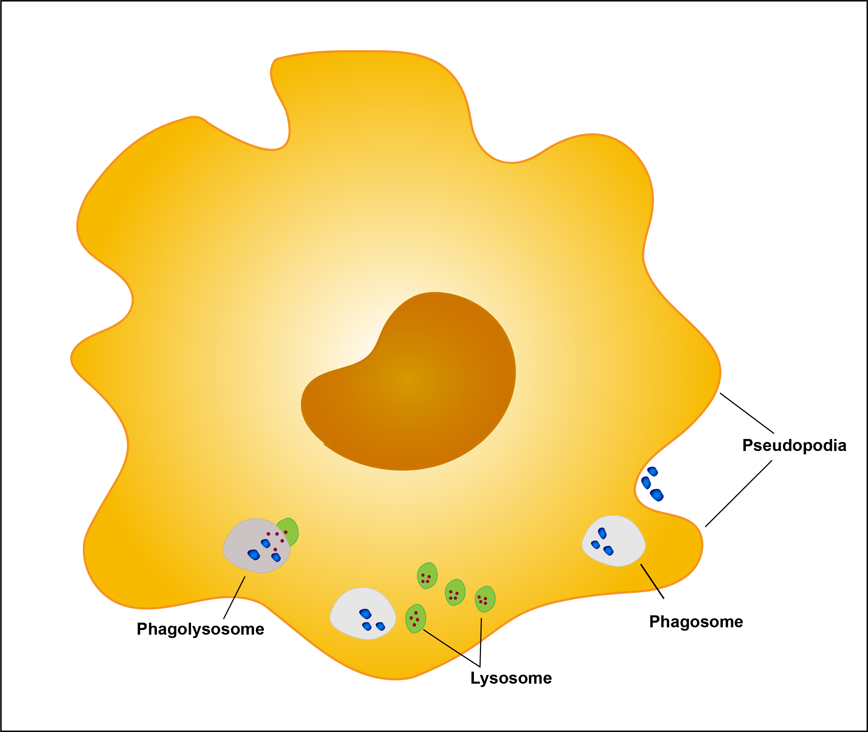
Macrophages
Within the lungs, the silica particles are taken up by the immune cells responsible for clearing foreign material from the lungs
Cell death leads to a cycle of inflammation
Kendall

Slide 6
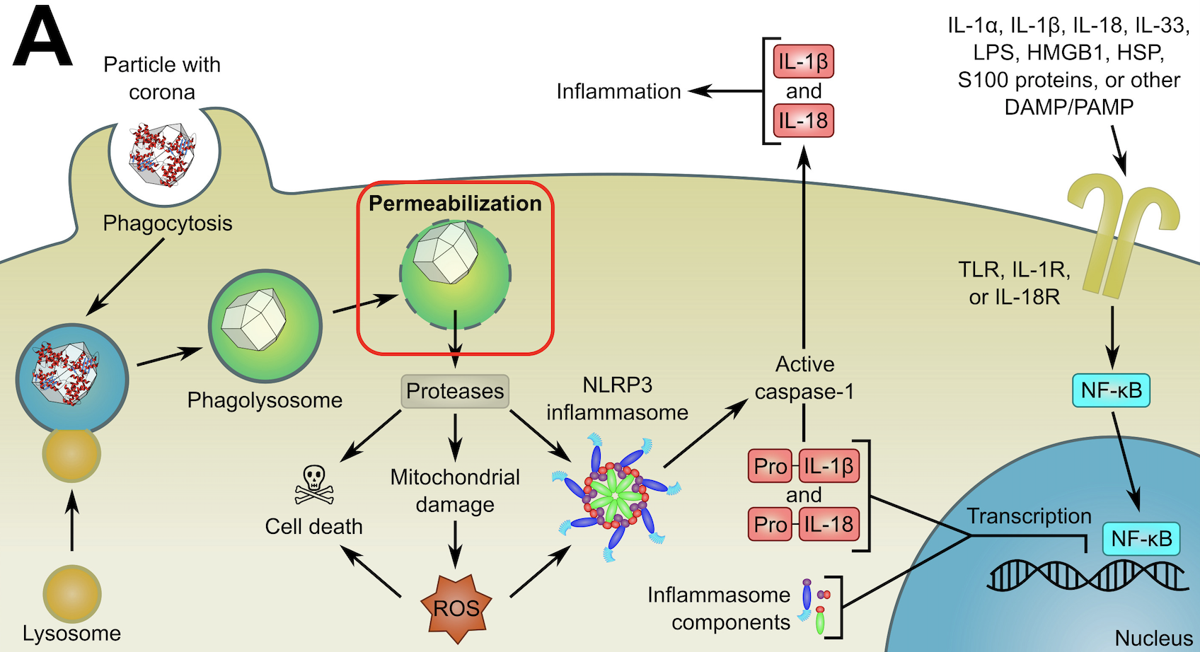
Inflammasome Activation
(Bunderson-Schelvan et al, 2016)

Slide 7
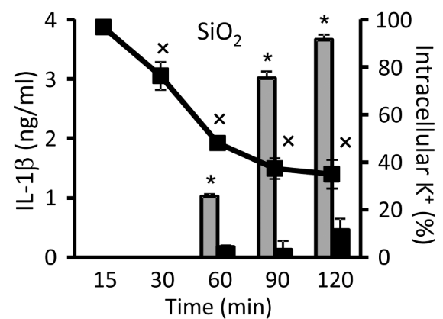
K⁺ in inflammation
Silica causes IL-1B release and decrease in intracellular potassium
(Muñoz-Planillo et al., 2013)

Slide 8
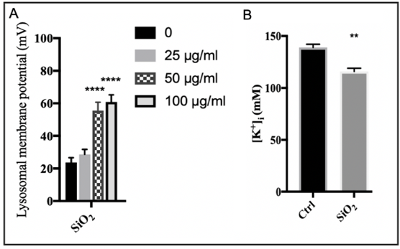

Slide 9
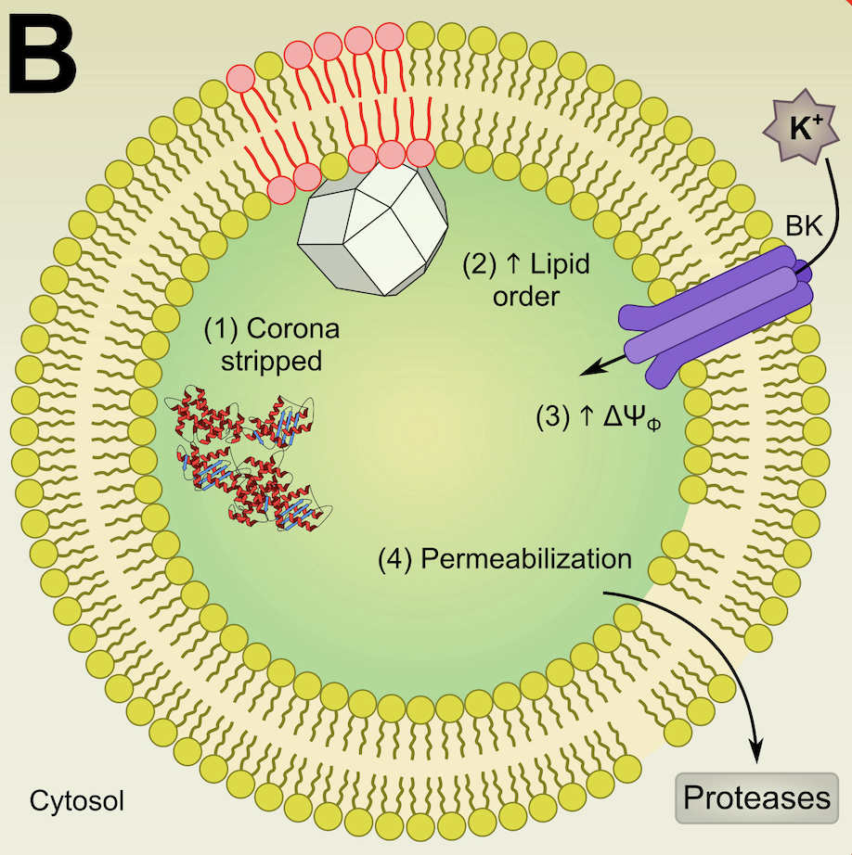
Potassium moves into lysosome, causing lysosomal damage that results in lysosome contents released into cell

Slide 10
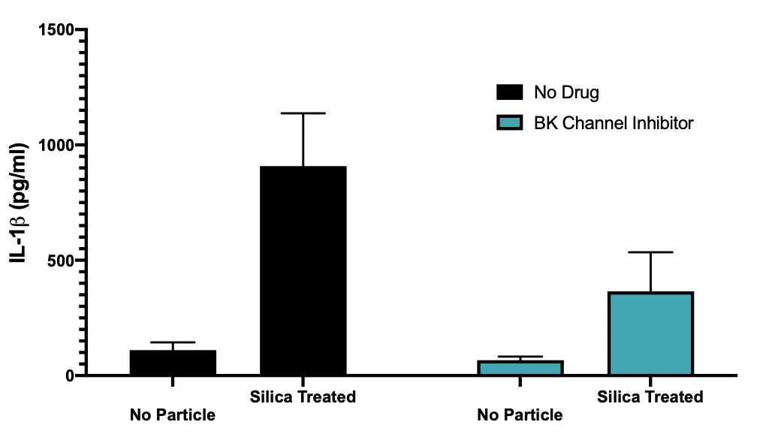

Slide 11
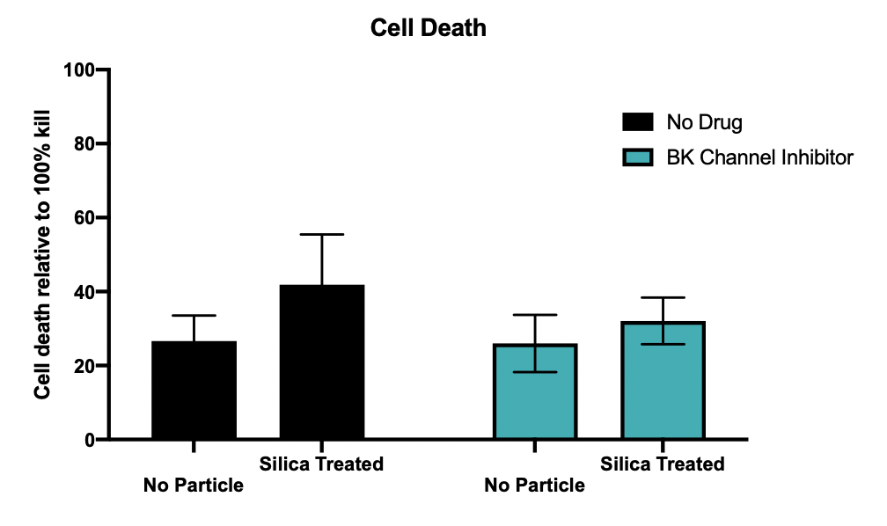

Slide 12
Conclusions, Impact & Future Directions
Blocking potassium movement into the lysosome prevents inflammation
Provides mechanistic insight into inflammation caused by silica
Therapeutic target in treatment of silicosis as well as broader treatments for other chronic inflammation diseases

Slide 13
References

