Slide 1
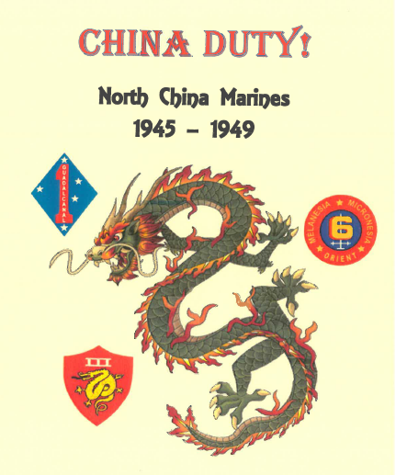
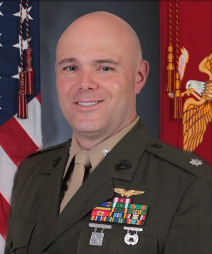
Montana Voices: Military, Congressional, and Popular Resistance to U.S. Intervention in the Chinese Civil War from 1945-1949
James R. “Tuck” Compton, LtCol, USMC (ret.)
MA candidate, University of Montana, Department of History
james1.compton@umontana.edu
February 16, 2021
Notes:
Hello and Good Day, I’m James Compton, a History M.A. candidate here at the University of Montana. The title of my presentation is “Montana Voices: Military, Congressional, and Popular Resistance to U.S. Intervention in the Chinese Civil War from 1945-1949.

Slide 2
Sources / Images
Mike Mansfield Papers, University of Montana
US Congressional Record
US State Department Digital Archives
Harry S. Truman Presidential Digital Archives
Franklin D. Roosevelt Presidential Digital Archives
U.S. Marine Corps History Division Archives
Montana Newspapers
Notes:
The vast majority of my research was conducted in the Mansfield Papers here at the University of Montana’s K. Ross Toole Archives. I also utilized online access to State Department, Congressional, Presidential, and Marine Corps archives as well as Montana Newspapers. Citations and photo credits are included in the speaker notes.

Slide 3
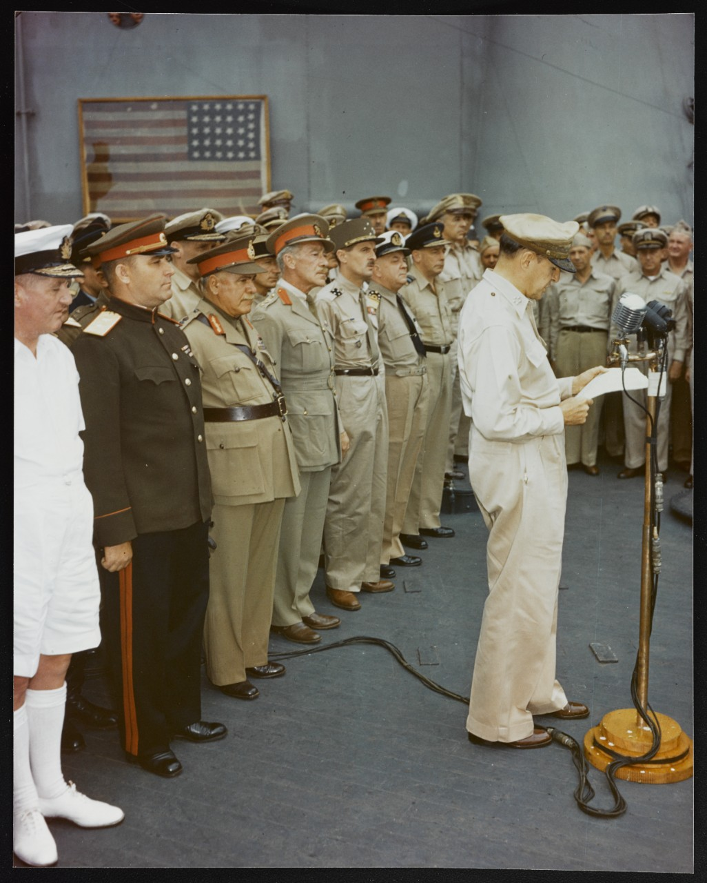
Securing the Peace
World War II ends suddenly
War consensus
New political order
General Douglas MacArthur and Allied representatives accept the surrender of the Japanese Empire aboard the USS Missouri in Tokyo Bay, September 2, 1945.
Notes:
On September, 2nd 1945, General Douglas MacArthur accepted the surrender of the Imperial Japanese Government in Tokyo Bay on the deck of the USS Missouri on behalf of the Allied Powers. The Pacific war had begun—for the United States at least—with a shocking Sunday morning attack at Pearl Harbor, Hawaii on December 7th, 1941—and ended just as abruptly in August 1945. The Allies had won the war, but now faced an equally daunting task—how to secure the peace.
A common struggle to defeat the Japanese Empire had bound the Allied forces together, but the political differences masked by war would soon reappear.
US Signal Corps. “General Douglas MacArthur Speaking Aboard USS Missouri, Tokyo Bay, Japan, 2 Sep 1945, 2 of 4,” 1945, US National Archives, Item C-2716.

Slide 4
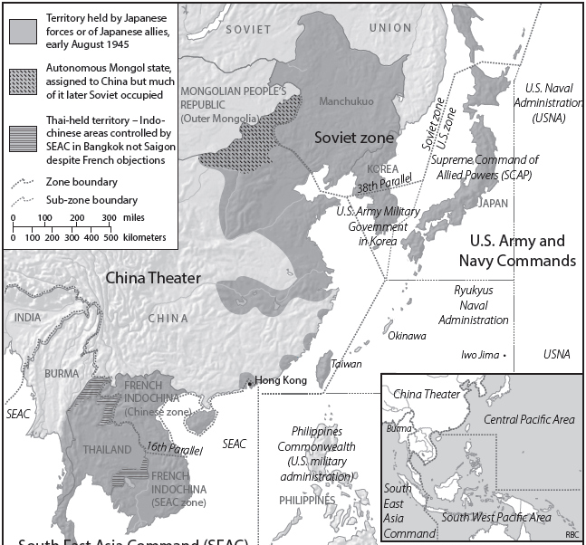
Decolonization
Allied zones of occupation
Colonial pre-war possessions
Soviet ambitions
Chinese disunity
U.S. Marines to North China
Peiping (Beijing), Shanghai, Tientsin
^{53,000 Marines}
^{1st Marine Division}
^{6th Marine Division}
^{1st Marine Aircraft Wing}
Japanese Occupied territory and areas of responsibility at the war’s end in Sept 1945. The U.S. Marines III Amphibious Corps was responsible for the area roughly depicted by the red box.
Notes:
The Imperial Japanese forces still possessed vast territory beyond mainland Japan—including nearly 3 million troops in Manchuria, North and Coastal China, and Indo-China. On one hand, it was practical to divide up the vast Japanese Empire into Zones of Allied Occupation—but it was also biased towards pre-war European colonial possessions. Additionally, the behavior of the Soviet Union in occupied Eastern Europe raised concerns with British and American officials on potential Soviet territorial expansion in the Far East.
The political divisions between the Allies were not exclusively geo-political. In China, the internal political situation was very much divided. The war between Japan and China had begun in Manchuria in 1931, expanded to the remainder of China in 1937 and interrupted a Chinese Civil War that had begun ten years earlier. As a result, the Nationalist government had little forces or practical control of North China—but the communists did. If Chiang-Kai-Shek were to reassert sovereignty, he’d need the help of his long time American Ally.
Just as MacArthur signed the instrument of surrender, 1600 miles away on Guam, the veteran United States Marines of the Third Amphibious Corps (IIIAC) received the order to embark the 53,000 man force and prepare to deploy in mid-September. Their destination: North China.

Slide 5
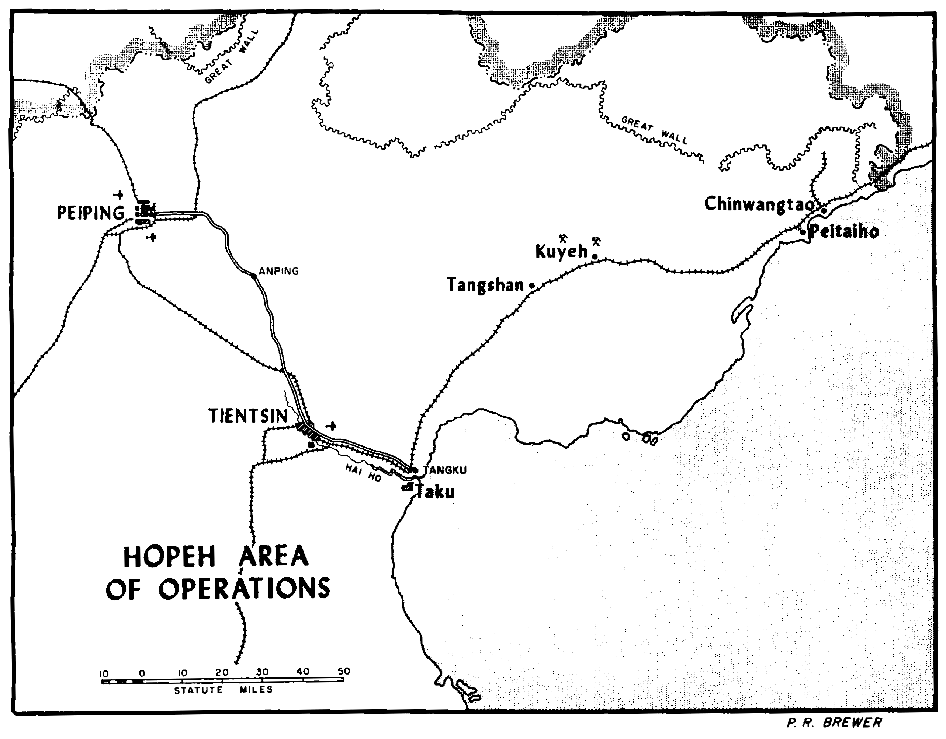
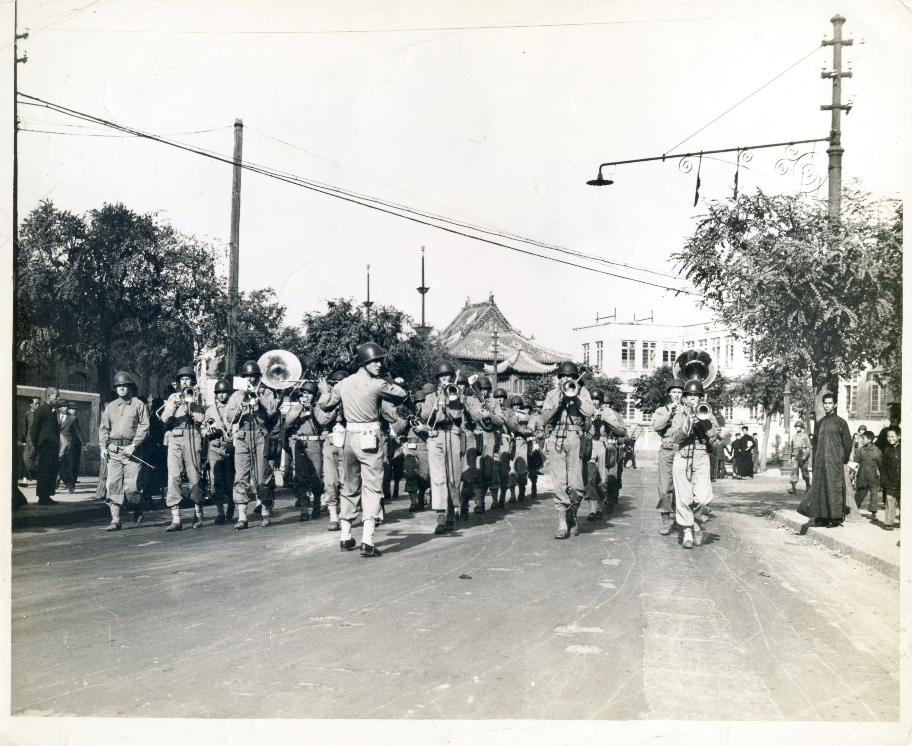
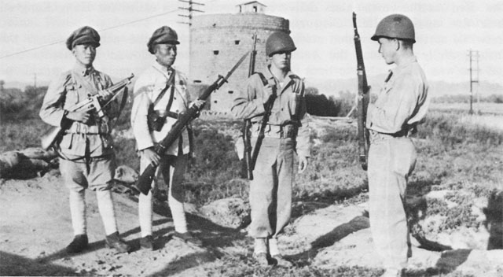
Triumph to Tension
Oct 5
30 Sep
Marine sentries guarding railroad posts conduct turnover and training with Nationalist Chinese soldiers.
US Marine parade celebrating the Japanese Surrender in Tientsin October 1945
Notes:
In the early morning hours of September 30th, the 7th Marine Regiment, including Marine Warren Peterson from Helena, Montana embarked in their landing craft and proceeded up the river to Taku. They were welcomed by a warm and raucous crowd. The Marines noted the stark contrast with their previous Pacific landings—especially Iwo Jima and Okinawa earlier that year.
A Parade in Tientsin in October 1945 marked the happy occasion.
This, however proved to be a short-lived feeling—and soon the Marines would find themselves with a front row seat to a renewed Chinese Civil War. They wondered just what their part would be in that war. Just 6 days after arrival in North China, Marines would come under fire from Chinese Communists and suffer three casualties while guarding the railway 20 miles north of Tientsin.
The political, economic, and military situation in North China in October 1945 was dire. The Marines faced an unclear mission, for an undetermined amount of time, protecting and repatriating former mortal enemies, only to face new amorphous—but equally as deadly adversaries. To further complicate matters, the Soviet Far East Army had occupied Manchuria and Korea to the 38th Parallel. Just what was the U.S. interest in North China? Protecting infrastructure? Enabling the Chinese Nationalist regime? Fighting Communist insurgents?
The trap lines that would embroil the United States in future foreign quagmires all complicated the North Chinese situation. This amorphous uncertainty and ugly potential was not lost on the American people.
Suspicious of the United States’ motives in China, military, congressional, and popular resistance emerged as a significant force against American intervention into Chinese internal affairs.

Slide 6
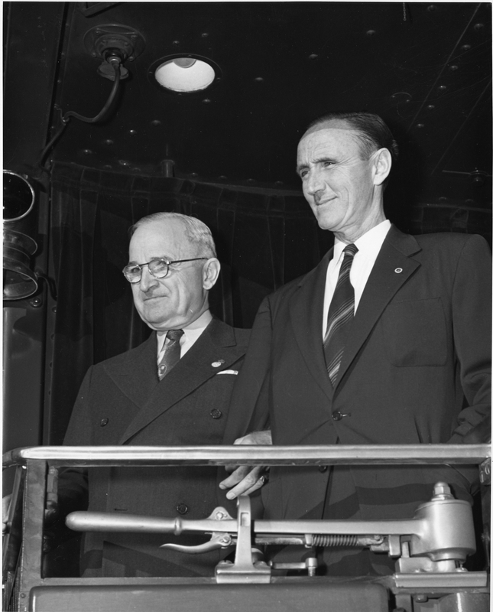
Mike Mansfield’s Opposition
3 House Speeches, Oct-Dec 1945
White House correspondence
State Department letters
Media engagements
“The real issue in China, in the minds of the American people, is intervention…If we decide to intervene, which I pray we do not, we must be prepared to maintain armed forces in China for years to come…We must act promptly to clarify our foreign policy so that we may know…what is going on, why it is being done, and what we expect to accomplish.”
-Rep. Mike Mansfield
House of Representatives Speech 11 Dec 1945
“The sending in of over 50,000 United States Marines to North China…is potentially explosive…our troops…should be withdrawn from China at once.”
-Rep. Mike Mansfield
Letter to President Truman
7 Nov 1945
Notes:
One clear and credible congressman’s voice rose immediately in opposition: Montana’s Mike Mansfield.
Mansfield carried out a media and policy blitz in Congress, with President Truman, numerous state and war department officials, and across the media.
Mike Mansfield took to the floor of the House of Representatives and delivered 3 impactful speeches from October to December 1945 objecting to U.S. policy in East Asia. Mansfield sensed strategic confusion and bureaucratic dysfunction, wondering if the State Department had any understanding of what the War Department was trying to do and vice versa.
In a letter to President Harry S. Truman on November 7th, Mansfield firmly implored the President to act, noting that
“The sending in of over 50,000 United States Marines to North China…is potentially explosive…our troops…should be withdrawn from China at once.”
In the House of Representatives on December 11th, 1945, Mansfield distilled America’s China policy down to a single question.
“The real issue in China, in the minds of the American people, is intervention…if we decide to intervene, which I pray we do not, we must be prepared to maintain armed forces in China for years to come…We must act promptly to clarify our foreign policy so that we may know…what is going on, why it is being done, and what we expect to accomplish.”

Slide 7
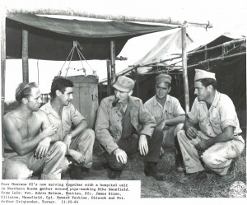
Mike Mansfield
Respected Foreign Affairs Voice
Personal envoy for FDR to China in 1944
Rep. Mike Mansfield visits with Montana Soldiers during his official mission to Burma and China in November 1944.
Notes:
Mike Mansfield had good reason to be concerned, he was one of the few members of government with actual experience on the ground in China. In 1922, Mansfield was a Marine Corps Private stationed with the U.S. Asiatic Fleet and visited Shanghai and other ports. He studied and taught Far East History at the University of Montana. Mansfield’s reputation for foreign affairs expertise was so extensive, that even as a freshman congressional representative, President Roosevelt selected Mansfield to travel as his personal emissary to China from October to December 1944. There Mansfield would sit down with American military leaders and Chinese officials—including President Chiang Kai-Shek. Mansfield captured his frank thoughts in a trip diary—and presented a report to President Roosevelt upon his return.
Mansfield was concerned with the political situation in China and doubted the prospects of Chinese political unity via peaceful means. Mansfield wrote:
“…the continued growth of a strong Communist Government uncontrolled by Chiang…creates difficulty for China…the present method of trying to come to terms is not liable to produce results…What happens in China during and after the war will affect the peace of Asia…”

Slide 8
Montana Marines’ Voices
“There has been more firing at various points up and down the railroad…as many as five Marines have been shot. I want to know why they have been killed. I want to know why we are here. I want to know why the American people are not told what we are doing here…is this an Archangel Expedition to save China from communism?”
-PFC Warren A. Peterson, USMC
1st Battalion, 7th Marines Helena, MT
December 6, 1945
Notes:
In addition to his personal expertise, Mike Mansfield also received a deluge of letters from American servicemen overseas—many from Montana Marines with blunt assessments and serious reservations about what the future would hold for them.
Private First Class Warren Peterson of Charlie Company, 1st Battalion, 7th Marines, was a candid and frequent pen pal with Mike Mansfield.
Peterson, from Helena, was skeptical of American motives from the outset and kept Mansfield updated with Articles from overseas papers and feedback from enlisted Marines.
Drawing a parallel to the Marine incursion into Russia in 1919, Peterson wrote:
“There has been more firing at various points up and down the railroad…as many as five Marines have been shot. I want to know why they have been killed. I want to know why we are here. I want to know why the American people are not told what we are doing here…is this an Archangel Expedition to save China from Communism.”

Slide 9
Montana Women’s Voices
“I gave my son proudly to fight for our country but not to fight China’s Civil War, that is exactly what they are going to have to do if they are kept there…my son tells me nineteen Marines have been killed outside the city of Tientsin and he says he has seen enough war and hell...I feel the voice of Montana Mothers should be enough to command your attention.”
-Mrs. R. M. Wonnacott Stevensville, MT
December 9, 1945
Notes:
Not only did Mansfield get numerous letters from deployed servicemen, he more frequently heard from their parents and especially mothers. These Montana women did not mince words.
Writing from Stevensville in December 1945, Mrs. R. M. Wonnacott reminded Mansfield that mothers wanted their sons back—and that they vote.
“I gave my son proudly to fight for our country but not to fight China’s Civil War, that is exactly what they are going to have to do if they are kept there…my son tells me nineteen Marines have been killed outside the city of Tientsin and he says he has seen enough war and hell…I feel the voice of Montana Mothers should be enough to command your attention.”
“Letter from Mrs. R. M. Wonnacott,” Dec 9, 1945. Mansfield Papers. Series IV, Box 26, Folder 4.

Slide 10
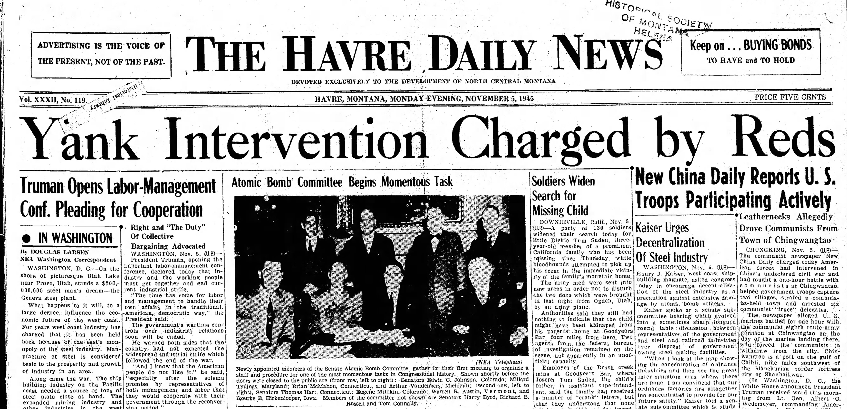
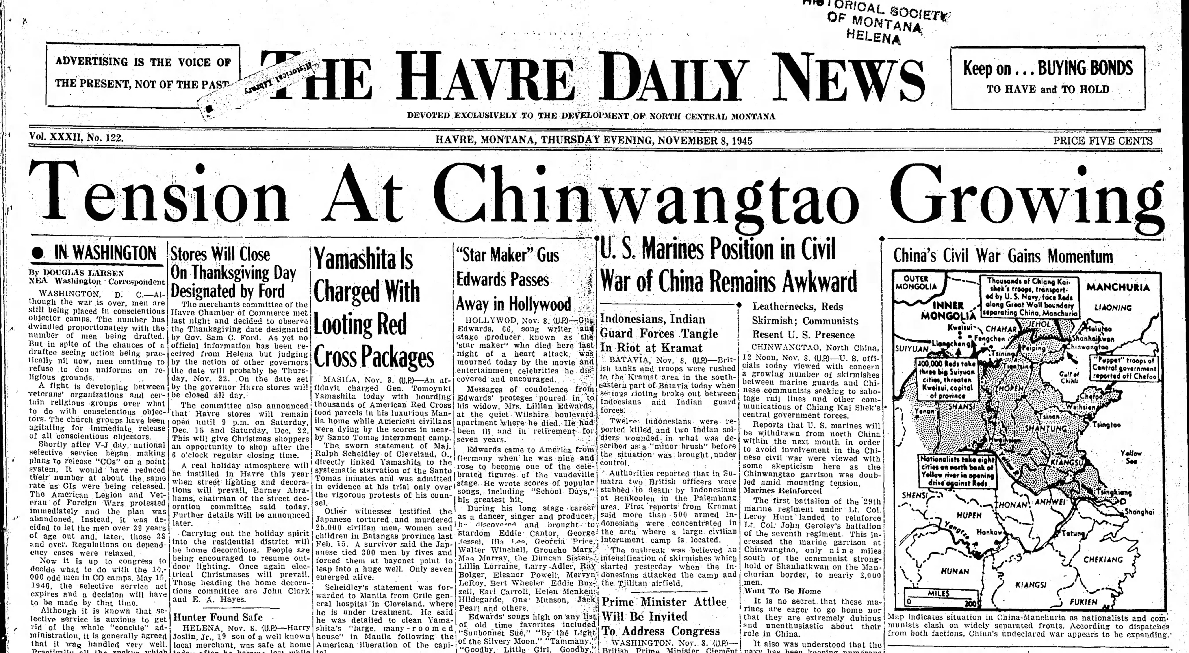
Montana Voices
Newspaper Headlines / Stories
Editorials and Letters to the Editor
Labor Unions
Farmer’s Cooperatives
“We demand the immediate withdrawal of all our military forces in China…we demand an immediate stop to any further military aid to the Chinese Central Government.”
-McElroy Local No. 359 Farmers Educational & Cooperative Union of America Westby, MT
November 24, 1945
Notes:
In periodic headlines and front page stories from October-December 1945, Montana Newspapers delivered the United Press and Associated Press’ stories from North China that emphasized the complicated position the Marines were in.
The Havre Daily News on November 5th and 7th, displayed two representative headlines:
“Yank Intervention Charged by Reds, New China Daily Reports U.S. Troops Participating Actively.”
“Tension at Chinwangtao Growing, US Marines Position in Civil War of China Remains Awkward.”
Montana citizens also wrote letters to the editor, Editorial newspaper boards came out in opposition, and Labor Unions and Farmer’s Cooperatives wrote Congressman Mike Mansfield.
“The Cascade County Trades and Labor Assembly went on record in support of the movement to remove U.S. Marines from North China.”
Farmers in tiny Westby were even more blunt. The McElroy Local No. 359 of the Farmers Educational & Cooperative Union of America on November 24th wrote
“We demand the immediate withdrawal of all our military forces in China…we demand an immediate stop to any further military aid to the Chinese Central Government.”
Mansfield took these opportunities to quickly correspond with his constituents and highlight his thoughts and actions.
Mansfield wrote back 3 days later saying: “About the Marines in China, I am enclosing for your consideration copies of speeches I made on the Floor of the House covering this subject. I am certain we should get all the boys out of the Far East as soon as possible and have them return home to their loved ones.”

Slide 11
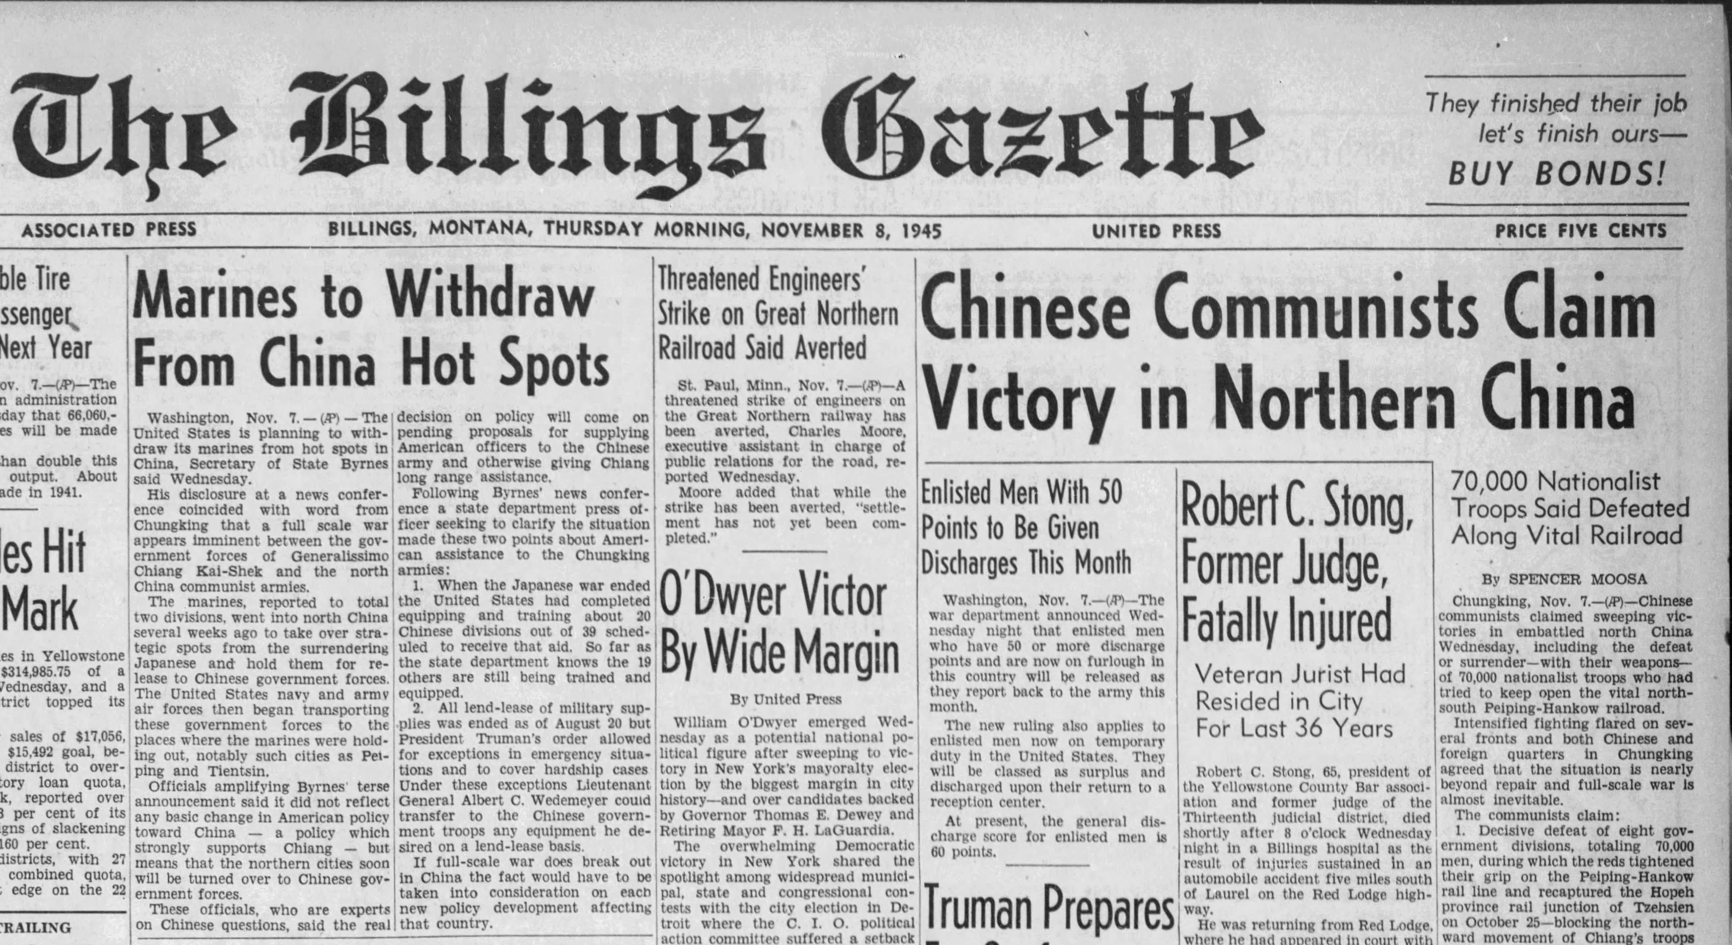
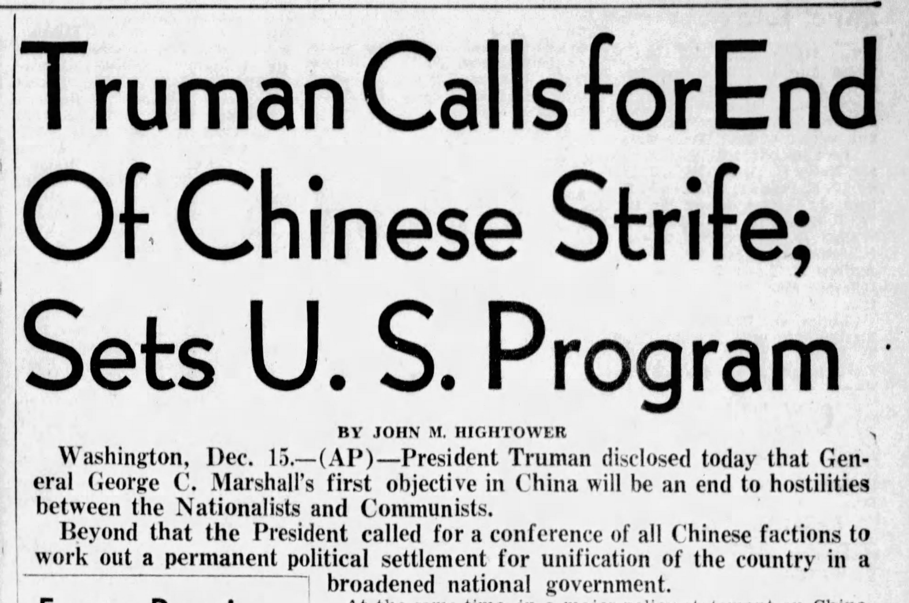
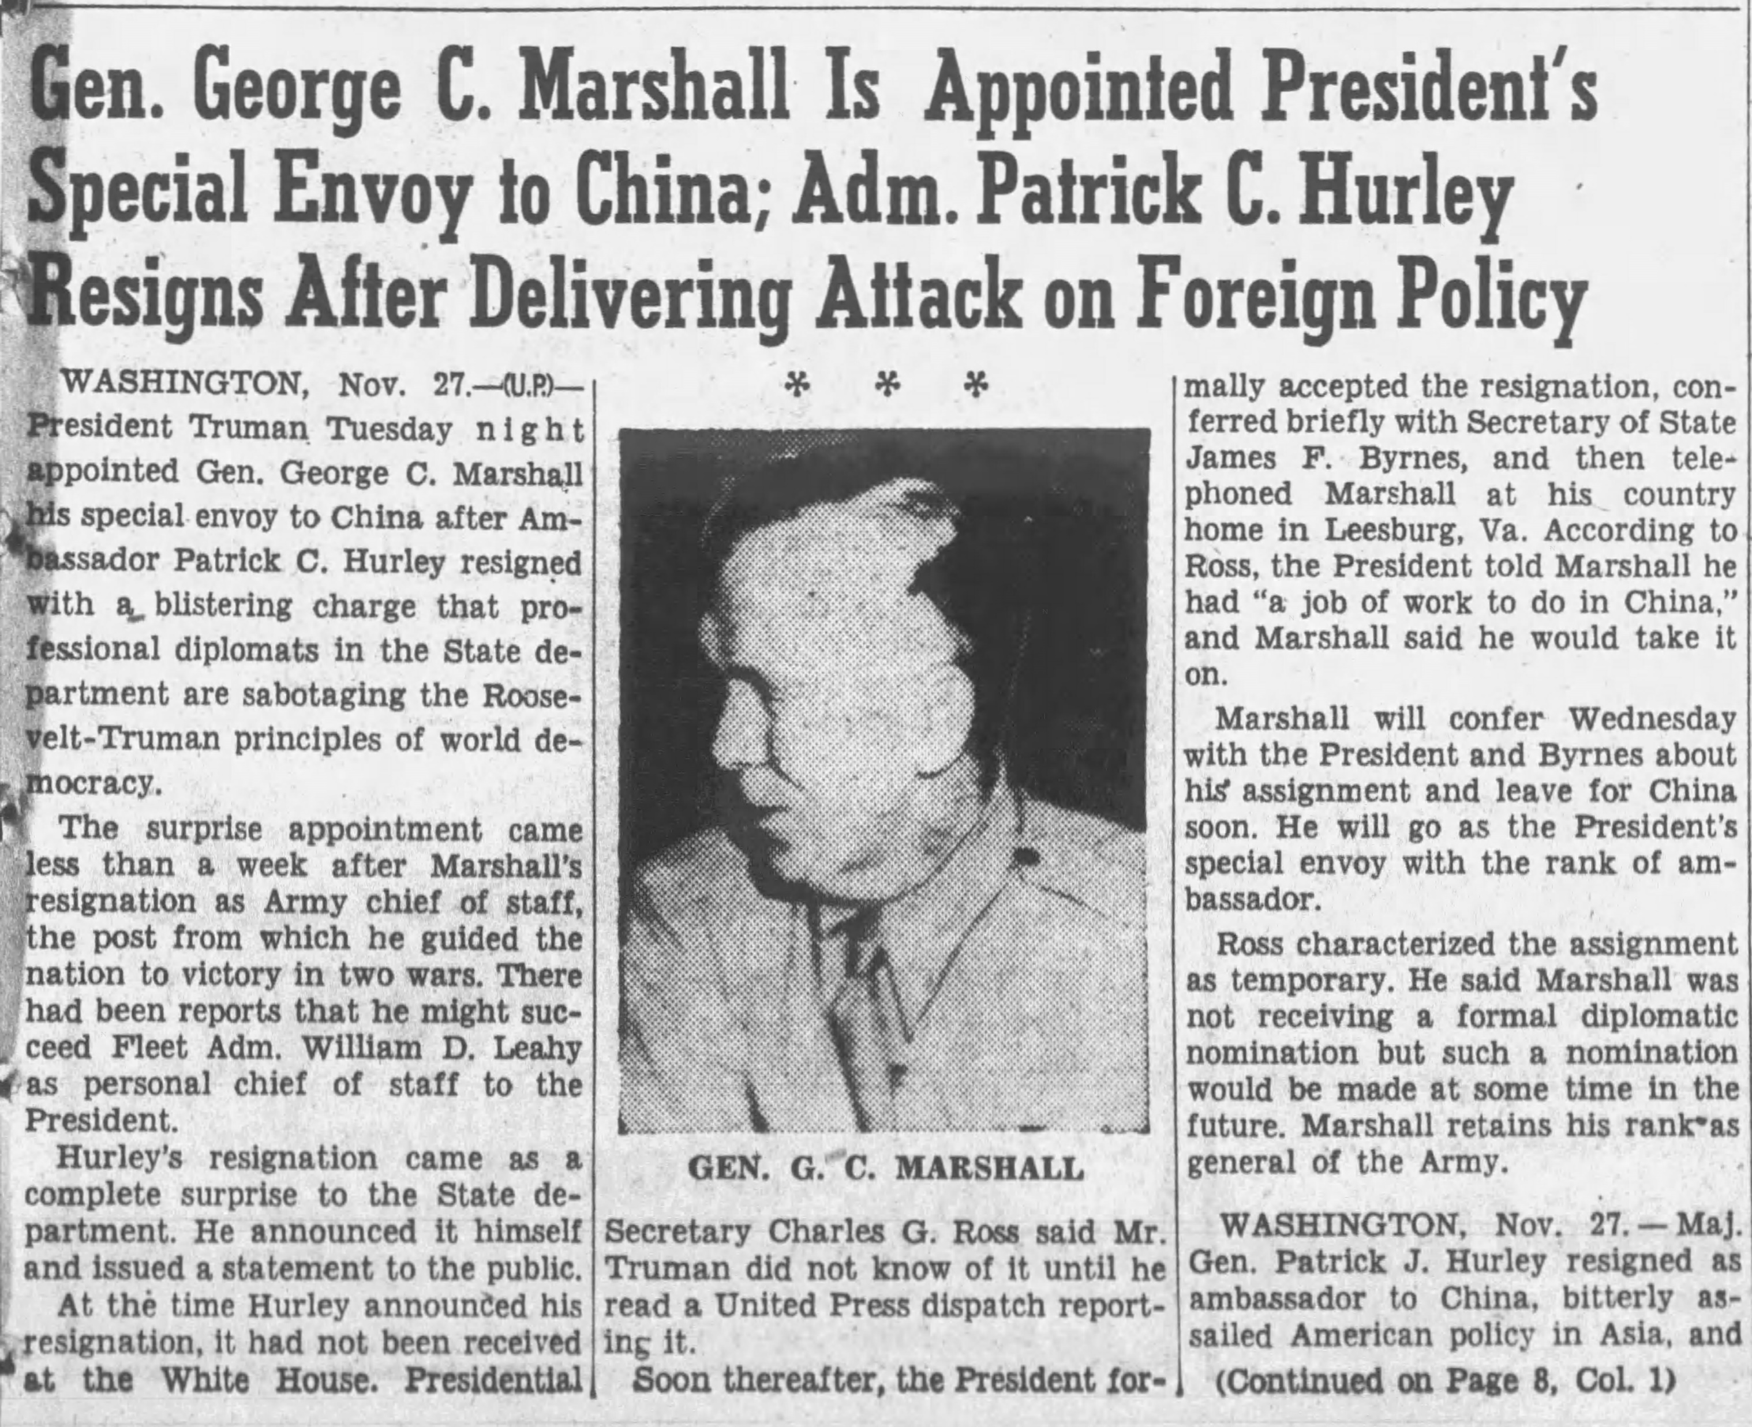
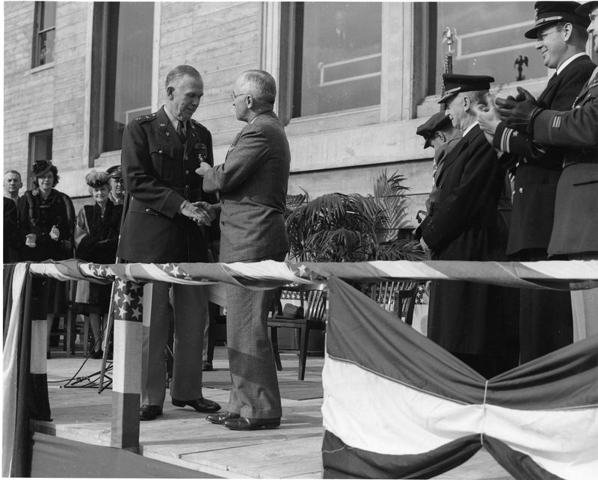
Policy Changes
Secretary of State Byrnes’ Statement
General Marshall appointed special envoy to broker peace by President Truman
US Pres. Harry S. Truman awards Gen.George C. Marshall at the Pentagon on Nov. 26, 1945. The next day Pres. Truman would appoint General Marshall special envoy to China.
Notes:
As the popular and Congressional resistance to intervention in North China grew steadily from October to December 1945, the Truman Administration began to clarify the murky U.S. Position.
On November 8th, Secretary of State James F. Byrnes announced that the U.S Marines were in China only to disarm and repatriate the Japanese and would “Withdraw from China Hot Spots.”
President Truman considered sending Mike Mansfield to China again, but instead appointed 5-star General George C. Marshall as special Envoy to China.
While aware that his name was in contention as Ambassador, Mansfield humbly armed General Marshall with information from Mansfield’s China report in January.
“It was with real pleasure that I heard of your appointment as Ambassador to the Republic of China and I want at this time to extend to you my best personal wishes for your success in this arduous job before you...I have only one suggestion to make, if I may be allowed that liberty, and that is: if you could find the time to look over once again the copy of the report I made to President Roosevelt on my return from China in January of this year.”

Slide 12
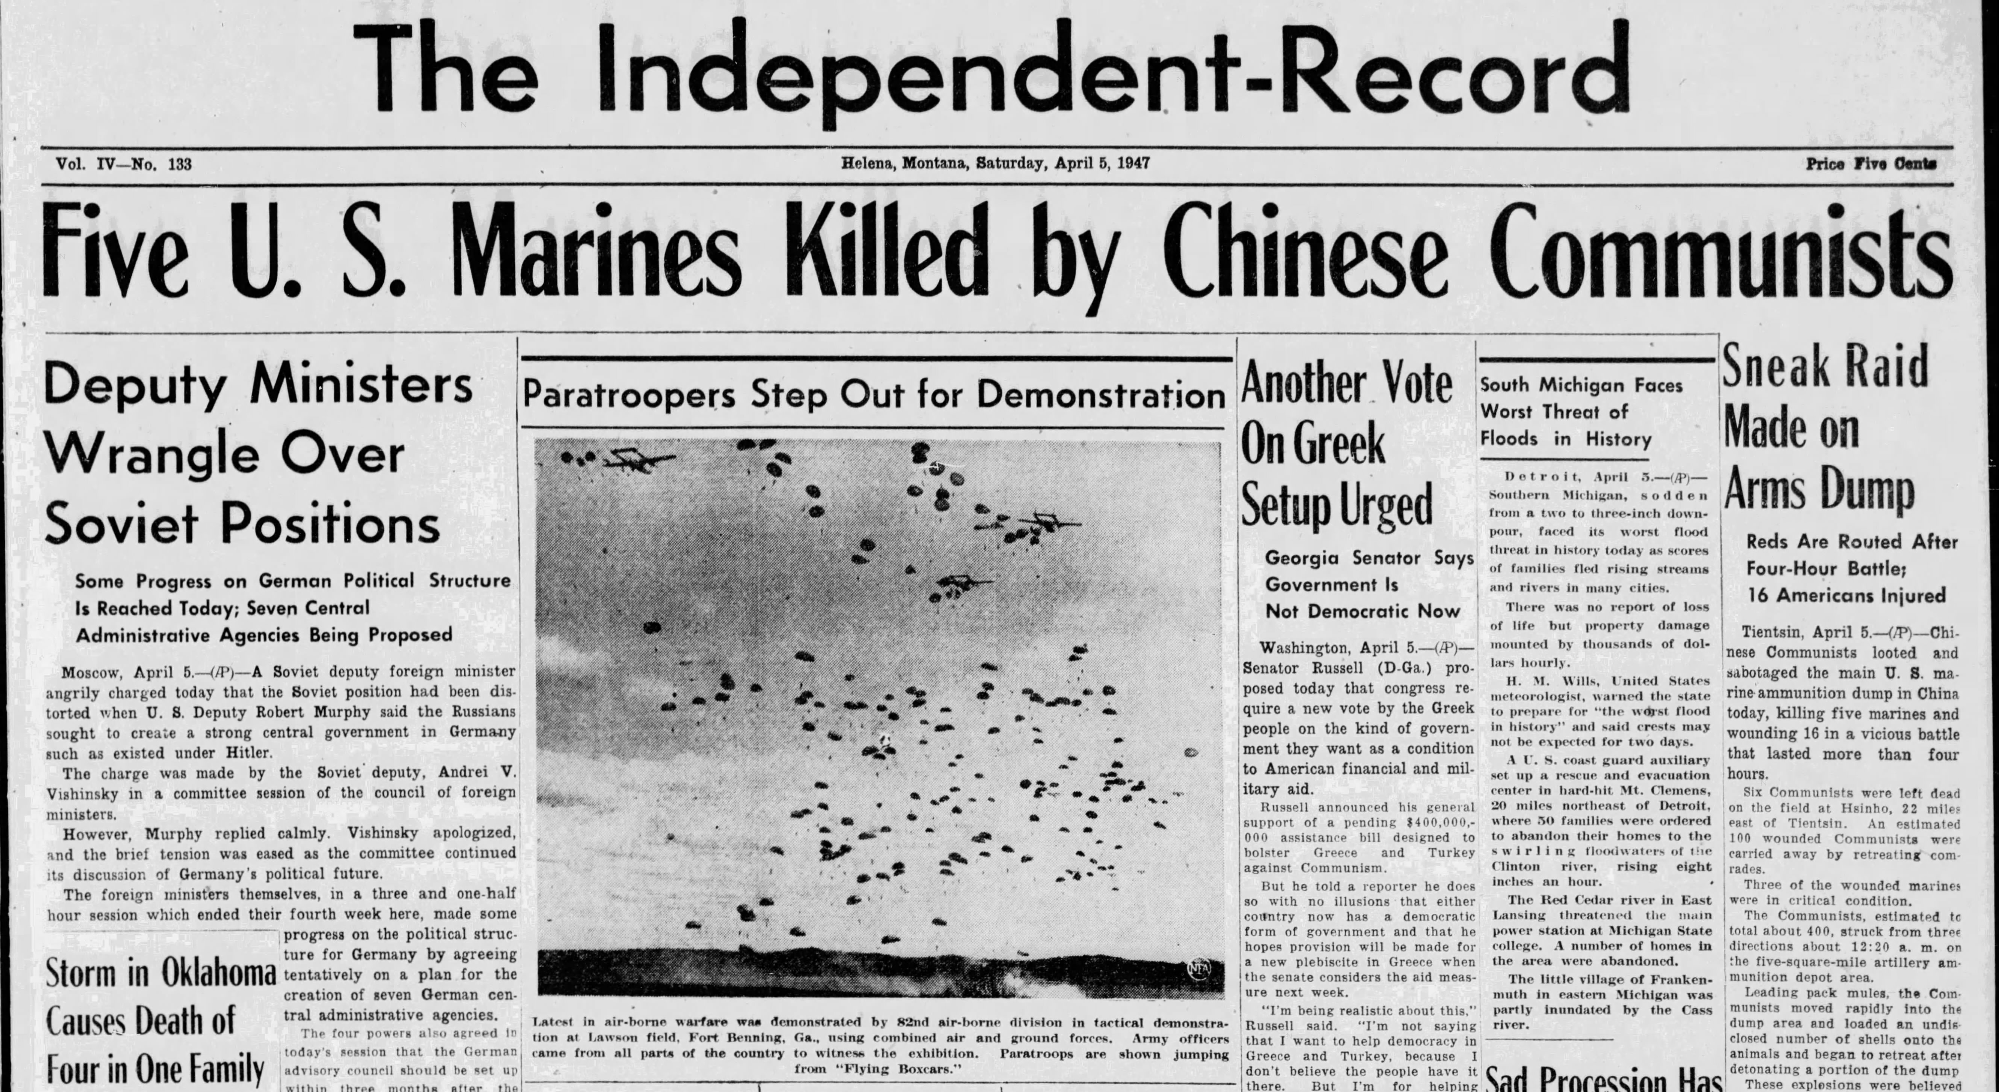
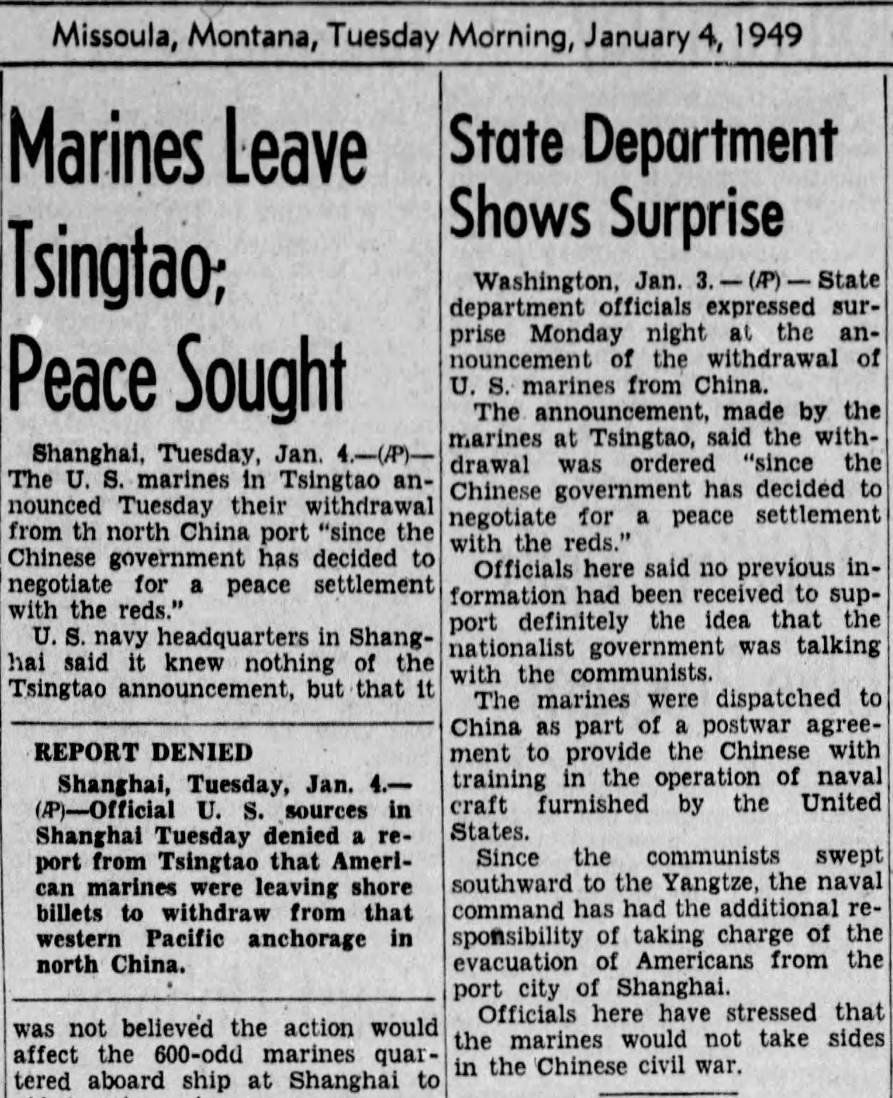
Conclusion
Resistance shaped policy and reduced numbers, but some Marines remained in China until 1949
Mike Mansfield’s gravitas, connections, and engagement impacted national policy
Montana’s Marines and citizens loudly opposed intervention in China
Notes:
Over the next 3 years, the Chinese Communists would be involved in periodic clashes with Marines, with the worst violence culminating in April 1947 shortly after the failure of the Marshall mission. Despite occasional violence major combat operations had been avoided.
The Marines had arrived with tanks, artillery, and fighter planes in September 1945 and in May 1949, 200 Marines departed Shanghai for the final time. Ironically the last unit to leave was Montana Marine Warren Peterson’s Charlie Company, 1st Battalion, 7th Marines—which had been among the first to land in September 1945.
Mike Mansfield’s gravitas, government connections, and personal engagement impacted national policy towards China at a key moment in late 1945. While the Marines didn’t immediately return to America, a much more limited role in China emerged and President Truman sent perhaps the most respected man in America to China in a diplomatic rather than a military role.
Finally, Mike Mansfield’s views towards American non-intervention in China were shared by many vocal Montanans including deployed Marines, Mothers and Citizen groups.
These Montana Voices were heard.

Slide 13
Questions
Please send questions or comments to james1.compton@umontana.edu
Notes:
Thank you for your time and for the opportunity to present at Grad Con 2021.
If there are any questions or comments, I can be reached at james1.compton@umontana.edu.
Slide 1:
U.S. Marine Corps “LtCol J. R. Compton, USMC Official Command Photo,” May 2018.
Slide 3:
US Signal Corps. “General Douglas MacArthur Speaking Aboard USS Missouri, Tokyo Bay, Japan, 2 Sep 1945, 2 of 4,” 1945, US National Archives, Item C-2716.
Slide 4:
Dayna L. Barnes, Architects of Occupation. (Ithaca: Cornell University Press, 2017). 20-29.
E. B. Hooton, The Greatest Tumult. (London: Brasseys, 1991). xvi-xix, 14-18.
Slide 5:
PFC Warren Peterson Letter to Mansfield with unit identification, Dec 6, 1945. Series IV, Box 26, Folder 4. Mike Mansfield Papers, Archives and Special Collections, Mansfield Library, University of Montana.
“Parade After Japanese Surrender, 1945,” John C. McQueen Collection, US Marine Corps History Division Archives, Collection 64.
“Chingwantao Marines and Nationalist Soldiers 1946.” US Marine Corps History Division Archives.
Henry I. Shaw, The United States Marines in North China 1945-1949. (Quantico: U.S. Marine Corps Historical Branch, 1960). C2 (Map)
Slide 6:
Various Speeches, Letters, Notes on Truman China Policy. Oct-Dec, 1945. Series 19, Box 510, Folder 9, Mike Mansfield Papers, Archives and Special Collections, Mansfield Library, University of Montana.
“Truman and Mansfield in Montana,” October 1, 1952, Truman Library, Item: 2013-1416
Letter to President Truman, Nov 7, 1945. Series IV, Box 26, Folder 5. Mike Mansfield Papers, Archives and Special Collections, Mansfield Library, University of Montana.
9 US Congress. Congressional Record 91, No. 210. 11 Dec 1945, 12031-34.
Slide 7:
China Report to President Roosevelt. Jan 4, 1945. Series XIX, Box 510, Folder 9. Mike Mansfield Papers, Archives and Special Collections, Mansfield Library, University of Montana.
Vital Speeches of the Day, Mansfield Papers, Series XIX, Box 510, Folder 9, Mike Mansfield Papers, Archives and Special Collections, Mansfield Library, University of Montana.
“Mike Mansfield with Montana GIs in Burma,” K. Ross Toole Archives, Archives & Special Collections, Mansfield Library, The University of Montana, 1945, Item 98-833.
Slide 8:
Redeployment (CBI), Series IV, Box26, Folders 5-7. Mike Mansfield Papers, Archives and Special Collections, Mansfield Library, University of Montana.
Letter from PFC Warren Peterson, USMC, Dec 6, 1945. Series IV, Box26, Folder 5. Mike Mansfield Papers, Archives and Special Collections, Mansfield Library, University of Montana.
Slide 9:
Letter from Mrs. R. M. Wonnacott, Dec 9, 1945. Series IV, Box 26, Folder 4. Mike Mansfield Papers, Archives and Special Collections, Mansfield Library, University of Montana.
Slide 10:
Billings Gazette, Great Falls Tribune, Helena Independent Record, Daily Interlake (Kalispell), Missoulian, Montana Standard (Butte) Oct-Dec 1945.
“Yank Intervention Charged by Reds,” Havre Daily News, Nov 5, 1945.
“Tension at Chingwantao Growing,”Havre Daily News, Nov 7, 1945
Letter from the Cascade County Trades and Labor Assembly, Nov 4, 1945. Series IV, Box 26, Folder 5, Mike Mansfield Papers, Archives and Special Collections, Mansfield Library, University of Montana.
Letter from the Farmers Educational & Co-operative Union of America, Local 359, Nov 24, 1945. Series IV, Box 26, Folder 5. Mike Mansfield Papers, Archives and Special Collections, Mansfield Library, University of Montana.
Mansfield letter to Cascade County Trades and Labor Assembly, Nov 7, 1945. Series IV, Box 26, Folder 5, Mike Mansfield Papers, Archives and Special Collections, Mansfield Library, University of Montana.
Slide 11:
“Gen George C. Marshall is Appointed President’s Special Envoy to China
Adm. Patrick C. Hurley Resigns After Delivering Attack on Foreign Policy,” Montana Standard, Nov 28, 1945
“Marines to Withdraw from China Hot Spots” Billings Gazette, Nov 8, 1945.
“Truman Calls for End of Chinese Strife; Sets U.S. Program,” Missoulian, Dec 16, 1945.
Memorandum from Mansfield about Meeting with Amb. Hurley, Nov 26, 1945, Series XIX, Box 511, Folder 2. Mike Mansfield Papers, Archives and Special Collections, Mansfield Library, University of Montana.
Mansfield Papers. “Personal and Confidential letter to Gen. George C. Marshall,” Nov 29, 1945. Series XIX, Box 511, Folder 2.
Slide 12:
“Five U.S. Marines Killed by Chinese Communists,” Helena Independent Record, April 5, 1947.
Daniel Kurtz-Phelan, The China Mission (New York: W.W. Norton and Company, 2018), 327-334.
Henry I. Shaw, The United States Marines in North China 1945-1949. (Quantico: U.S. Marine Corps Historical Branch, 1960). 1-3, 24-26.
Slide 13:
“MajGen Rockey and BGen Jones dine with Madame and Chiang Kai-Shek after Japanese Surrender” Louis R. Jones Collection, Marine Corps History Division Archives, 1945.

