Slide 1
What Does It Mean to Argue Well?
Greg Friedman
Doctoral Student
Collaborative Reasoning Lab
Department of Teaching and Learning
College of Education
University of Montana
Advisor: Dr. Jingjing Sun

Slide 2
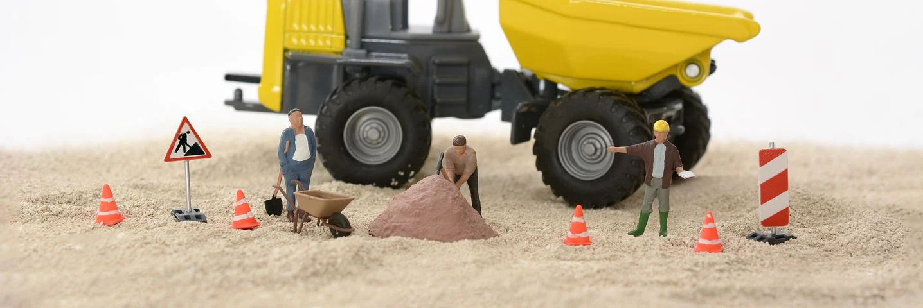
Disclaimer: Study Under Construction
The slides that follow are in reference to a study currently being undertaken.

Slide 3
Abstract:
Significance
Argumentation entails both cognitive and social aspects. This study seeks to gain a deeper understanding on children’s understanding and expression of the social aspects of argumentation.

Slide 4
Abstract:
Significance
Methodology
Argumentation entails both cognitive and affective aspects. This study seeks to gain a deeper understanding of children’s understanding of the social aspects of argumentation.
This is a qualitative phenomenological study that makes use of post-experience student interview transcripts to identify emergent themes around the social constructs of argumentation.

Slide 5
Abstract:
Significance
Methodology
Relevance
Argumentation entails both cognitive and affective aspects. This study seeks to gain a deeper understanding of children’s understanding of the social aspects of argumentation.
This is a qualitative phenomenological study that makes use of post-experience student interview transcripts to identify emergent themes around the social constructs of argumentation.
A deeper understanding of learning and human behavior requires an understanding of both the cognitive and affective domains of learning, how they may operate independently, and how they interact.

Slide 6
What does it mean to argue well?

Slide 7
What does it mean to argue well?
Cognitively

Slide 8
What does it mean to argue well?
Cognitively

Slide 9
What does it mean to argue well?
Cognitively

Slide 10
What does it mean to argue well?
Cognitively

Slide 11
What does it mean to argue well?
Cognitively

Slide 12
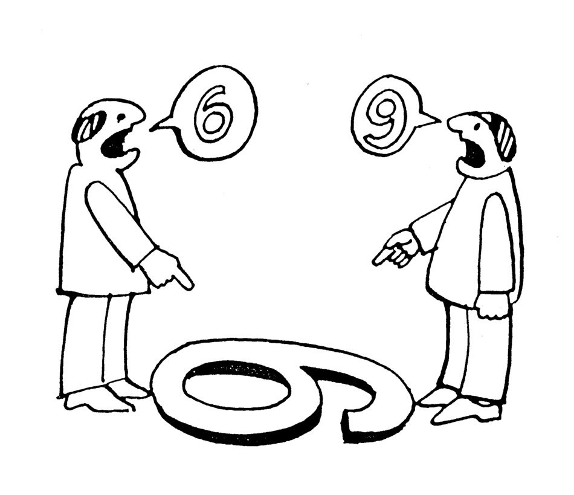
What does it mean to argue well?
Cognitively
Affectively

Slide 13
Collaborative Reasoning
Methodology

Slide 14
Topic

Slide 19
Discussion 1

Slide 20
Discussion 1
Discussion 2
Discussion 3
Discussion 4
Discussion 5
Discussion 6
Discussion 7
Discussion 8

Slide 21
Collaborative Reasoning Transfer Tasks

Slide 22
Pinewood Derby Essays
Collaborative Reasoning Transfer Tasks

Slide 23
Pinewood Derby Essays
Should whaling be allowed?
Collaborative Reasoning Transfer Tasks

Slide 24
Pinewood Derby Essays
Should whaling be allowed?
Group Problem Solving
Collaborative Reasoning Transfer Tasks

Slide 25
Pinewood Derby Essays
Should whaling be allowed?
Group Problem Solving
Attitudes about CR
Collaborative Reasoning Transfer Tasks

Slide 26
What does it mean to argue well?
COGNITIVELY
AFFECTIVELY

Slide 27
AFFECTIVE ELEMENTS
Pinewood Derby Essays
Should whaling be allowed?
Group Problem Solving
Attitudes about CR
Collaborative Reasoning Transfer Tasks

Slide 28
AFFECTIVE ELEMENTS
Seeing both sides of an argument
Seeing perspectives within the issue
Pinewood Derby Essays
Should whaling be allowed?
Group Problem Solving
Attitudes about CR
Collaborative Reasoning Transfer Tasks

Slide 29
AFFECTIVE ELEMENTS
Pinewood Derby Essays
Should whaling be allowed?
Group Problem Solving
Attitudes about CR
Collaborative Reasoning Transfer Tasks

Slide 30
AFFECTIVE ELEMENTS
Acceptance that alternate positions exist
Seek first to understand, before seeking to be understood (Covey 1989)
Pinewood Derby Essays
Should whaling be allowed?
Group Problem Solving
Attitudes about CR
Collaborative Reasoning Transfer Tasks

Slide 31
AFFECTIVE ELEMENTS
Pinewood Derby Essays
Should whaling be allowed?
Group Problem Solving
Attitudes about CR
Collaborative Reasoning Transfer Tasks

Slide 32
AFFECTIVE ELEMENTS
Making Choices
Considering Alternatives
Clarifying Ideas
Working Harmoniously
Pinewood Derby Essays
Should whaling be allowed?
Group Problem Solving
Attitudes about CR
Collaborative Reasoning Transfer Tasks

Slide 33
AFFECTIVE ELEMENTS
Pinewood Derby Essays
Should whaling be allowed?
Group Problem Solving
Attitudes about CR
Collaborative Reasoning Transfer Tasks

Slide 34
AFFECTIVE ELEMENTS
Agency
Co-Construction
Diversity
Listening and Empathy
Working Harmoniously
Pinewood Derby Essays
Should whaling be allowed?
Group Problem Solving
Attitudes about CR
Collaborative Reasoning Transfer Tasks

Slide 35
Should whaling be allowed?
Group Problem Solving
Attitudes about CR
Data Analysis

Slide 36
Should whaling be allowed?
Group Problem Solving
Attitudes about CR
Data Analysis

Slide 37
Study
Should whaling be allowed?
Class
Group
Group Problem Solving
Individual
Attitudes about CR
Data Analysis

Slide 38
Future Studies
Should whaling be allowed?
Group Problem Solving
Attitudes about CR

Slide 39
Future Studies
Pinewood Derby Essays
Should whaling be allowed?
Group Problem Solving
Attitudes about CR

Slide 40
Future Studies
Pinewood Derby Essays
Collaborative
Reasoning
Discussions
Should whaling be allowed?
Group Problem Solving
Attitudes about CR
Social Dynamics

Slide 41
Future Studies
Pinewood Derby Essays
Collaborative
Reasoning
Discussions
Should whaling be allowed?
Group Problem Solving
Attitudes about CR
Social Dynamics

