Slide 1
Layered
Lemons in Dutch Baroque Painting
Amanda Barr

Slide 2
Joannes van Deutecum
Claes Jansz Visscher
Leo Belgicus
1650
Double-page engraved map, contemporary outline color
440 X 545 mm
Sotheby’s

Slide 3
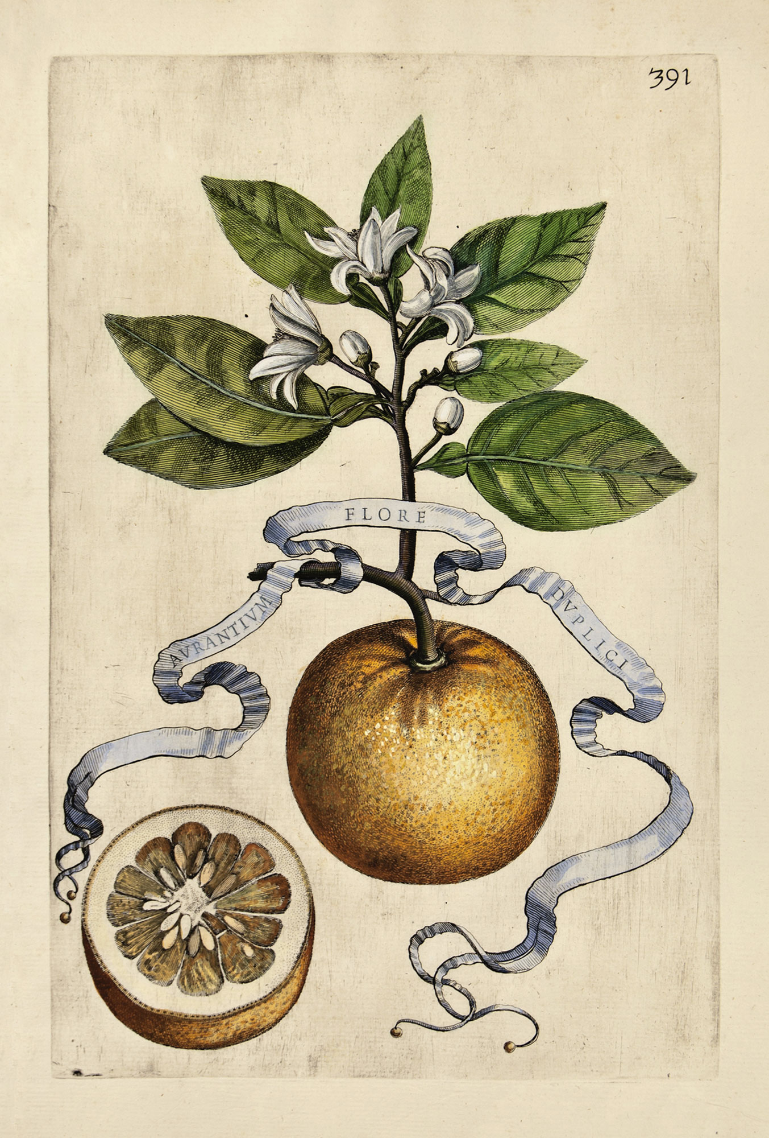
Giovanni Battista Ferrari (editor)
Likely engraved by Cornelis Bloemaert (Utrecht)
Aurantium Flore Dublici (Double-flowered Orange Blossom), pl 391
1646
Engraving with hand-coloring, in Hesperides siue de malorum aureorum cultura et vsu Libri quator Io. Baptistae Ferrarii Senensis e Societate Iesu, Romae: Sumptibus Hermanni Scheus
35 x 24.2 x 5 cm

Slide 4
Screenshot, unknown (Kristen…)
Text message
2013

Slide 5
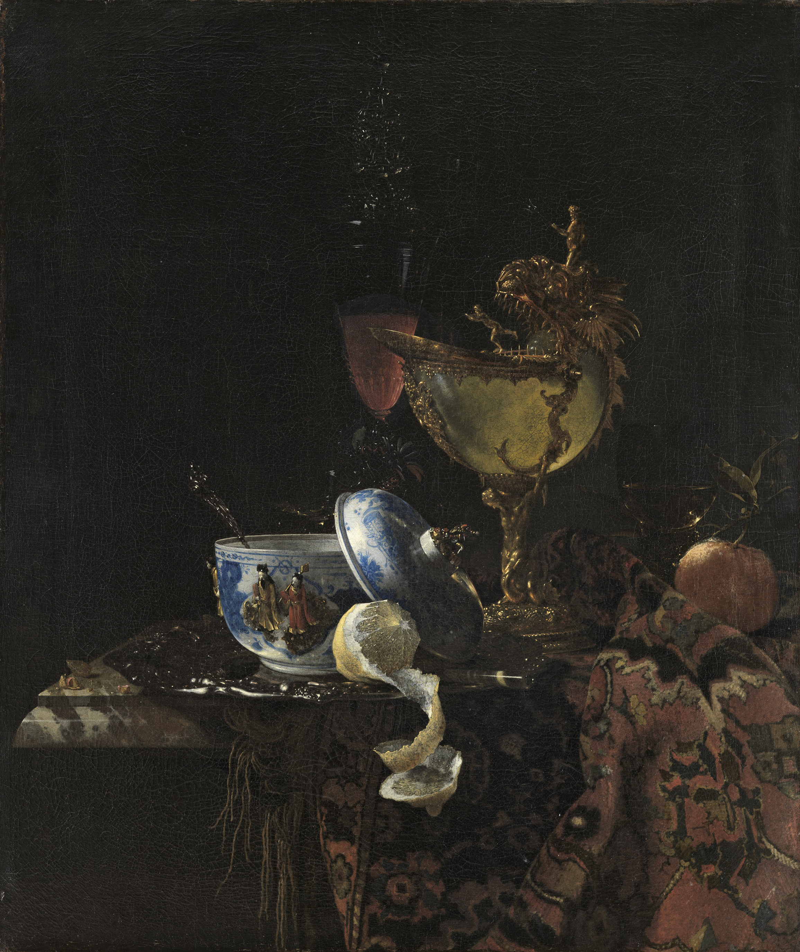
Willem Kalf (Rotterdam)
Still Life with a Chinese Bowl, Nautilus Cup and Other Objects
1662
Oil on canvas
79.4 x 67.3 cm
Museo Nacional Thyssen-Bornemisza, Madrid

Slide 6
Jan Jansz den Uyl (Amsterdam)
Pewter Jug and Silver Tazza on a Table
1633
Oil on panel
91 x 72cm
Private collection
1. Brian Wansink, Anupama Mukund, and Andrew Weislogel, “Food Art Does Not Reflect Reality: A Quantitative Content Analysis of Meals in Popular Paintings,” SAGE Open, (2016): 1-10.

Slide 7
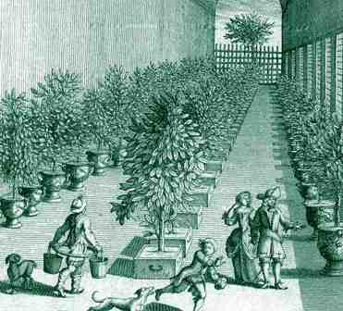
An Orangery Interior
c1700
unknown engraving

Slide 8
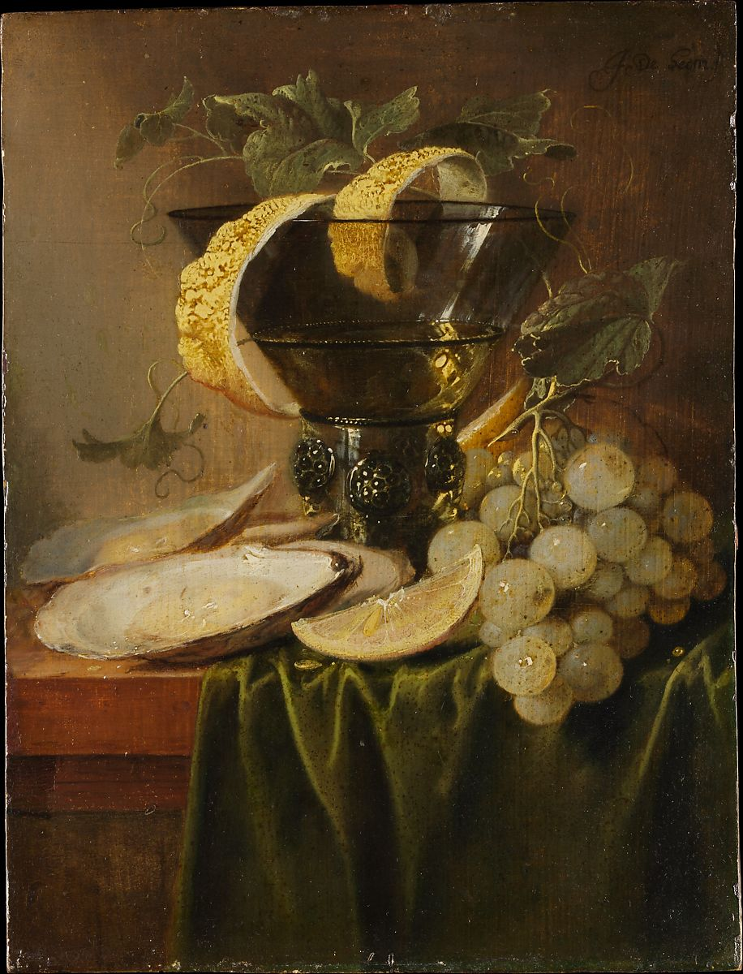
Jan Davidsz de Heem (Antwerp)
Still Life with a Glass and Oysters ca. 1640
Oil on wood
25.1 x 19.1 cm
Met Museum
2. Eddy de Jongh, Questions of meaning: Theme and motif in Dutch seventeenth-century painting, trans. Michael Hoyle (Leiden: Primavera Pers, 2000), 16-18.

Slide 9
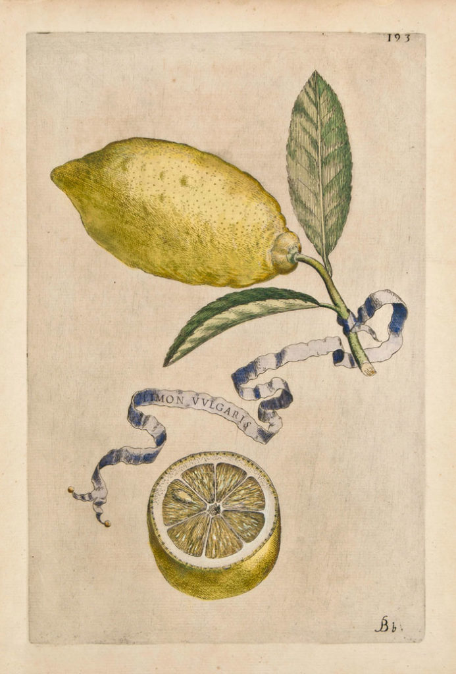
Giovanni Battista Ferrari (editor)
Likely engraved by Cornelis Bloemaert
Lemon Vulgaris, pl 193
1646
Engraving with hand-coloring, in Hesperides siue de malorum aureorum cultura et vsu Libri quator Io. Baptistae Ferrarii Senensis e Societate Iesu, Romae: Sumptibus Hermanni Scheus
35 x 24.2 x 5 cm

Slide 10
Abraham Hendricksz van Beyeren (Rotterdam)
Preparations for a Meal
1664
Oil on canvas
79.7 × 69.9 cm
Detroit Institute of Arts
3. Julie Hochstrasser, Still life and trade in the Dutch Golden Age, (New Haven: Yale University Press, 2007), 10.

Slide 11
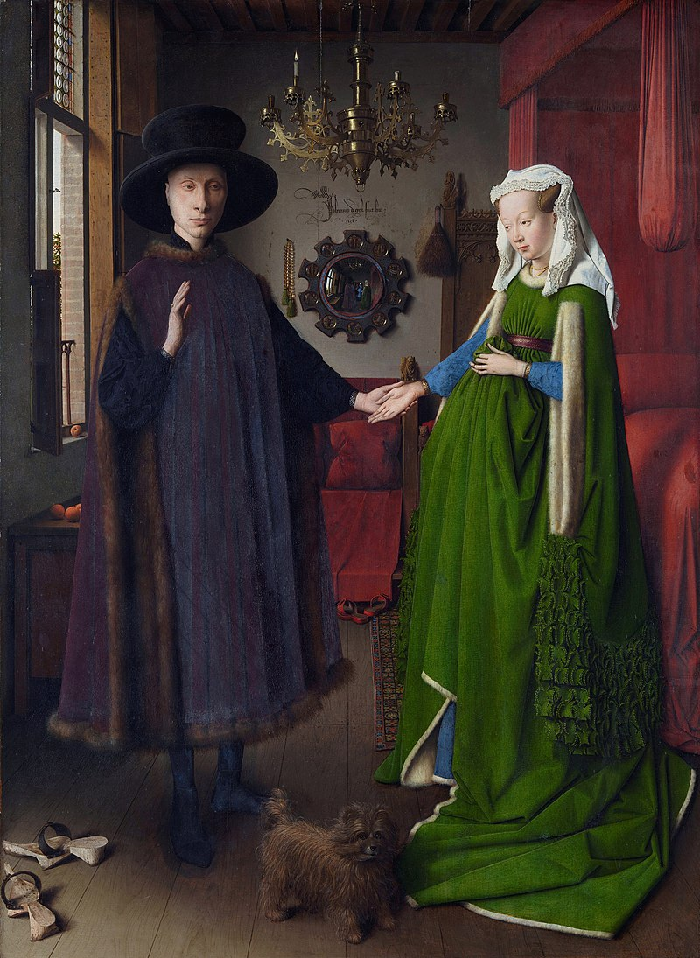
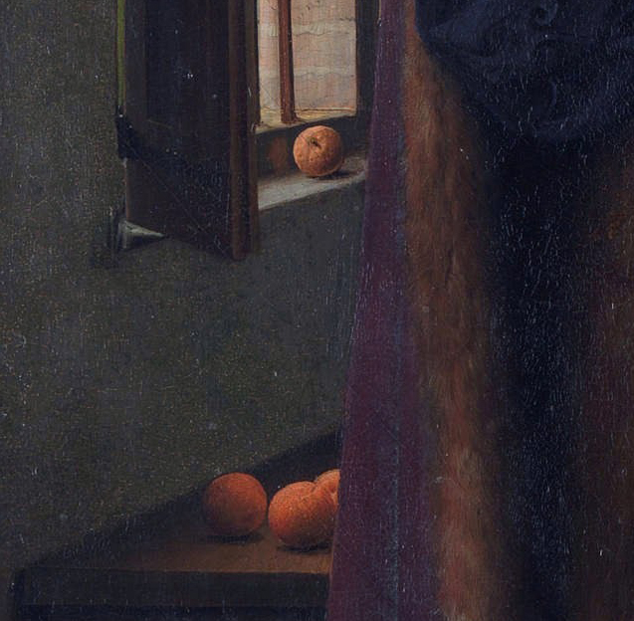
Jan van Eyck (The Hague)
The Arnolfini Portrait (Portrait of Giovanni Arnolfini and his Wife)
1434
Oil on oak. 82.2 x 60 cm
The National Gallery, London

Slide 12
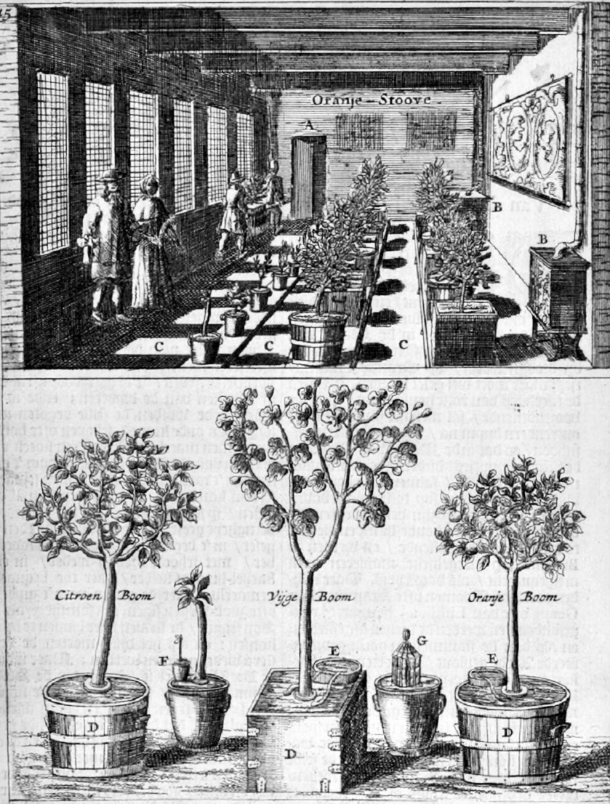
Jan van der Groen (author, gardener to Prince William III)
Designed by Gerbrand van den Eeckhout
Illustrated by P. Nyland
Orangery
in Den Nederlandtsen Hovenier
1699
Etching, woodcuts
New York Botanical Garden
4. Helena Attlee, The Land Where Lemons Grow: The Story of Italy and its Citrus Fruit, (London: Particular, 2014), 49.

Slide 13
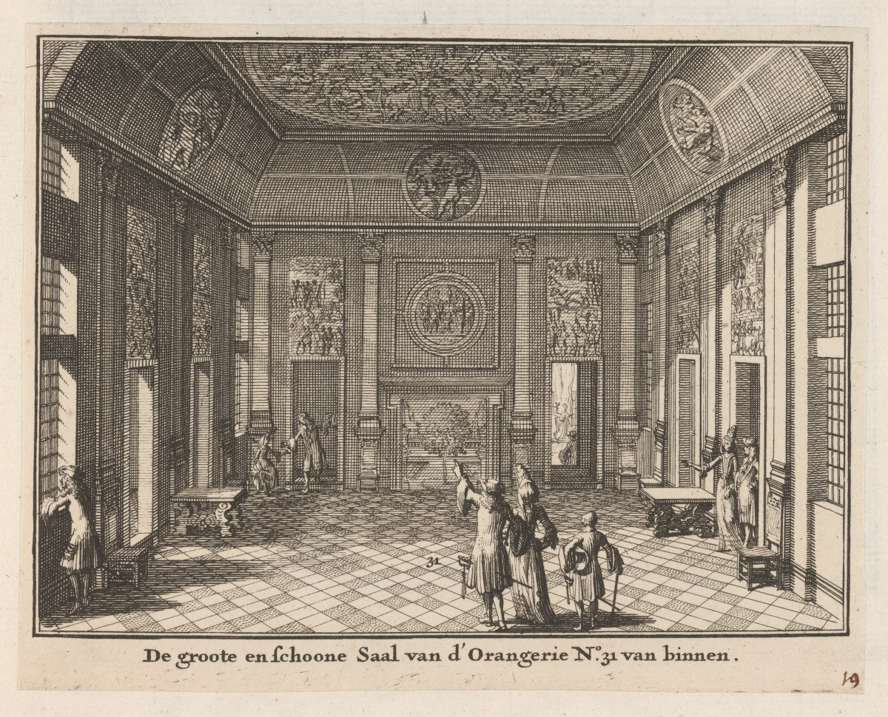
Unknown, commissioned by the Bentlick Family (The Hague)
Great Hall of the Orangery at Sorgvliet, Interior
(De groote enschoone Saal van d’Orangerie N.31 van binnen)
1690s
Etching
The Library of Trinity College, Dublin, Fagel Collection

Slide 14
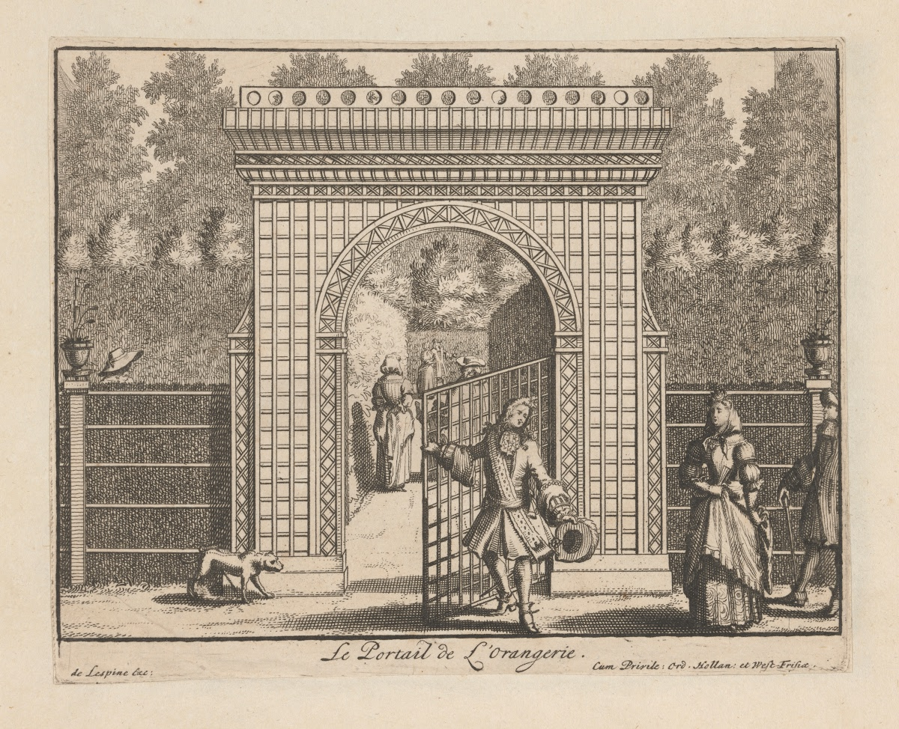
de Lespine
Orangery Gateway Gunterstein
ca. 1680s
The Gateway to the Orangery at Gunterstein Castle, in the province of Utrecht
From a series of prints commissioned by owner Magdelena Poulle (1626-1699).
From: Veues de Gunterstein
5. Billie Britz, “Environmental Provisions for Plants in Seventeenth-Century Northern Europe.” Journal of the Society of Architectural Historians, 22, no. 2 (1974) 133-44

Slide 15
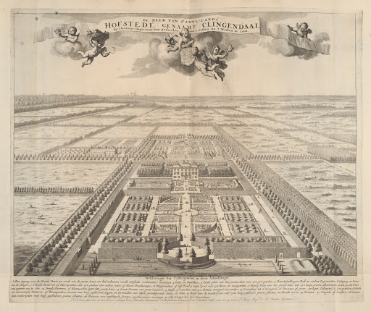
Unknown
Clingendael Garden Plan
ca. 1690s
Etching
Clingendael Estate in North Holland with plan of the garden (The Hague)
From: Views of Country Houses & Gardens of Holland
6. Vanessa Sellers. Courtly Gardens in Holland 1600-1650. (Amsterdam: Architectura & Natura Press, 2001), 13.

Slide 16
De Verstandige Kock
1683
The cover of the original De Verstandige Kock (1683) reprinted from The Sensible Cook (1989)
(Recipes included sourced from Flemish, French, Italian, Gent, and previous Dutch cookbooks)
7. Donna Barnes, “Dutch Paintings in the Seventeenth Century,” in Matters of Taste: Food and Drink in Seventeenth
Century Art and Life, ed. Donna Barnes and Peter Rose, (New York: Syracuse University Press, 2002), 10.

Slide 17
Adriaen van Utrecht (Antwerp)
Banquet Still Life
1644
Oil on canvas
185 x 242.5cm
Rijksmuseum
8. Mary Piepmeir, “The Appeal of Lemons: Appearance and Meaning in Mid Seventeenth-Century Dutch Paintings,” PhD diss., (UNC Chapel Hill, 2018), 23.

Slide 18
Jan Davidsz de Heem (Antwerp)
Still Life with a Glass and Oysters ca. 1640
Oil on wood
25.1 x 19.1 cm
Met Museum
9. Liana Cheney. “The Oyster in Dutch Genre Paintings: Moral or Erotic Symbolism.” Artibus et
Historiae 8, No. 15 (1987): 13.

Slide 19
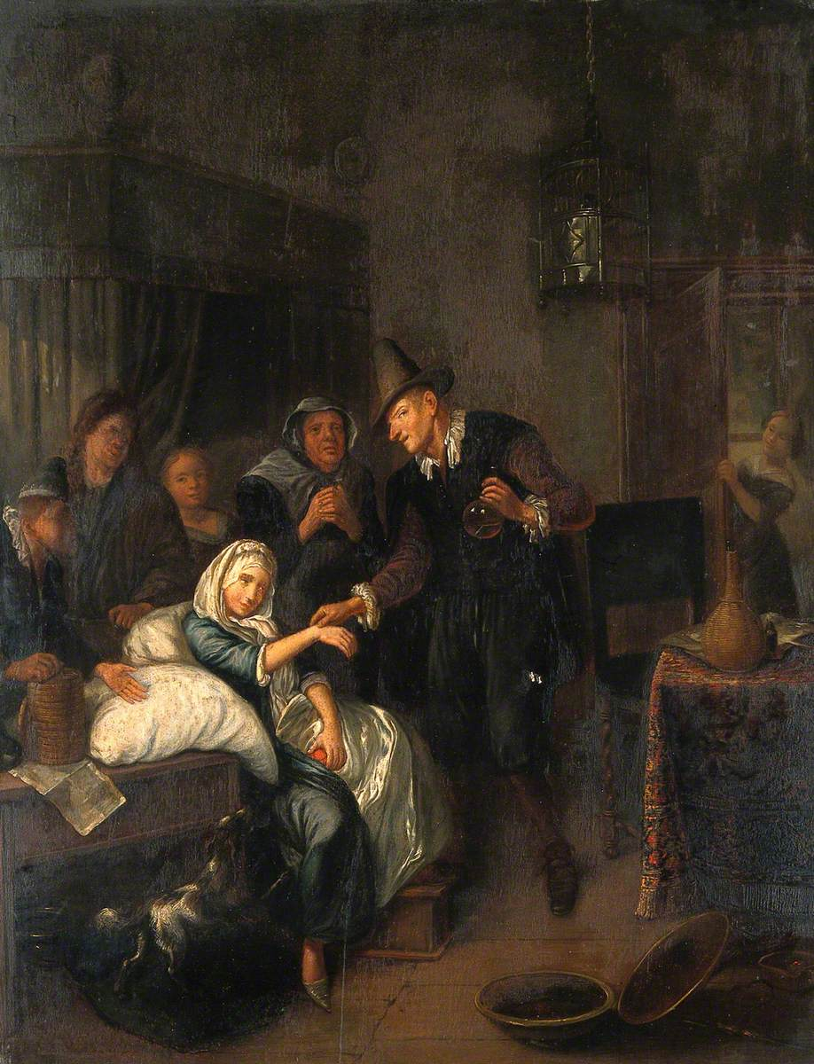
Richard Brakenburg after Jan Steen (London, Leiden)
A Medical Practitioner Taking a Girl's Pulse and Holding a Flask of Her Urine
Late seventeenth century
Oil on wood
51.4 x W 41.9 cm
Wellcome Library, UK
10. Jacques Ferrand, A Treatise on Lovesickness, trans. and ed. Donald Beecher and Massimo Ciavolella, (New York:
Syracuse University Press, 1990), 360.

Slide 20
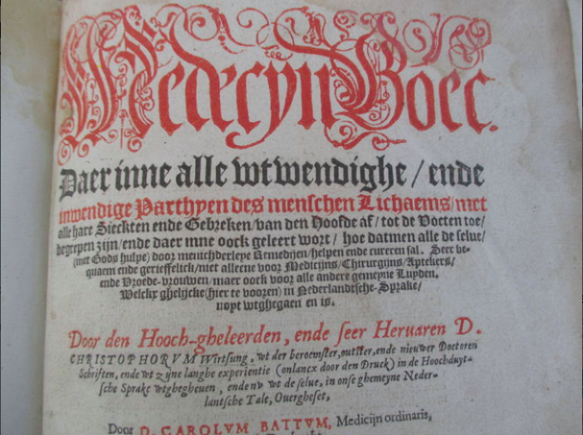
Wirsung Christoph, printer (German)
Carolus Baten, author (Ghent/Amsterdam)
Medecyn-Boec, Daer inne alle uyt-wendighe ende inwendighe partijen des menschen lichaems/ met alle hare Sieckten ende Geeken/ van den Hoofde af/ tot de voeten toe…
1589
Original leather stamped book, restored
Folio: 21 x 31 x 7 cm
11. Laurinda Dixon, Perilous Chastity: Women and Illness in Pre-Enlightenment Art and Medicine, (London: Cornell University Press, 1995), 159.

Slide 21
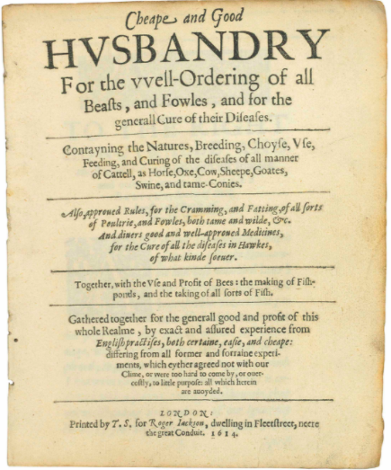
Gervase Markham (English)
Cheape and Good Husbandry for the well-ordering of All Beasts, and Fowles, and for the Generall Cure of Their Diseases
1614
Original leather stamped book
London: by Thomas Snodham for Roger Jackson.
Christie’s
12. Julie Hochstrasser. “Feasting the Eye: Painting and Reality in the Seventeenth-century ‘Bancketje.’” In Still-Life Paintings from the Netherlands 1550-1720, edited by Alan Chong and Wouter Kloek, 73-86. Zwolle: Waanders Publishers, 1999.
“as Athenaeus established with a strange example, of two criminals who were sentenced, according to the laws of Egypt, to be given over to the adders, and on the way a warden out of sympathy gave them a citron, which they ate up, and thereafter being bitten they suffered no harm from the sharp and poisonous snakes. Over which the judge was amazed, and learning that they had eaten a citron, the next day allowed the one to be given a citron, and the other one not, and… nothing happened to the one who had eaten the citron, but the other turned completely blue directly after the bit of the adder, and died immediately.”

Slide 22
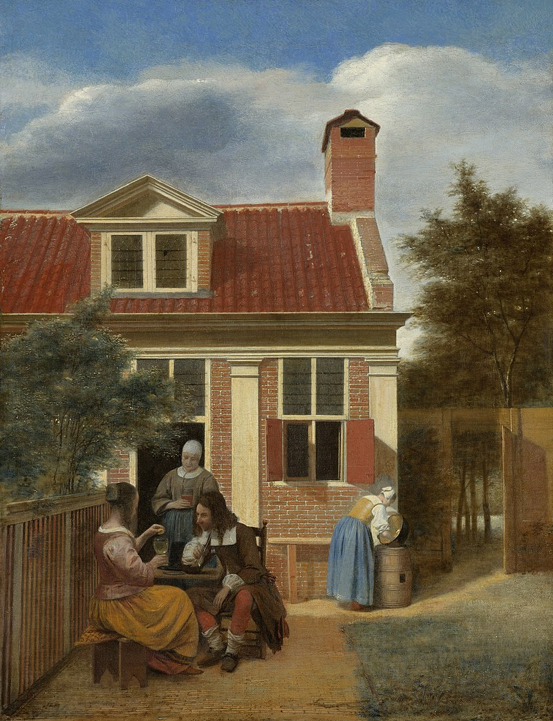
Pieter de Hooch (Rotterdam)
Figures in a Courtyard behind a House
c. 1663 - c. 1665
60cm - w 45.7cm
Oil on canvas
Rijksmuseum

Slide 23
Willem Kalf (Rotterdam)
Still Life with a Chinese Bowl, Nautilus Cup and Other Objects (detail)
1662
Oil on canvas. 79.4 x 67.3 cm
Museo Nacional Thyssen-Bornemisza, Madrid

Slide 24
Pieter Claesz (Antwerp)
Still Life with Lemons
1629
Oil on panel
44.5 x 61 cm
Private Collection
13. Mariët Westermann, A Worldly Art: The Dutch Republic 1585-1718. (New York: Harry N. Abrams, Incorporated, 1996), 15.

Slide 25
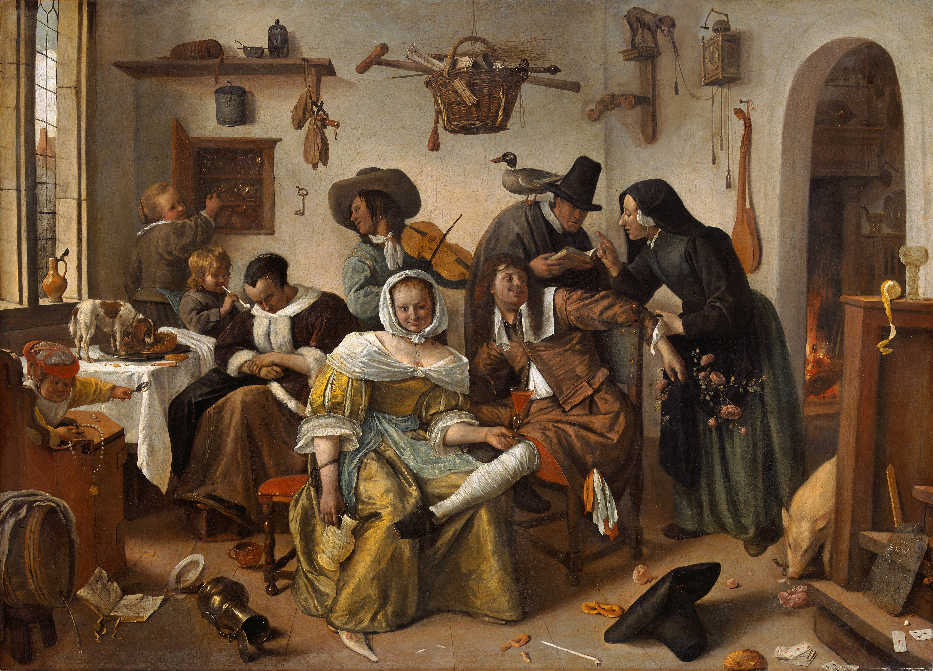
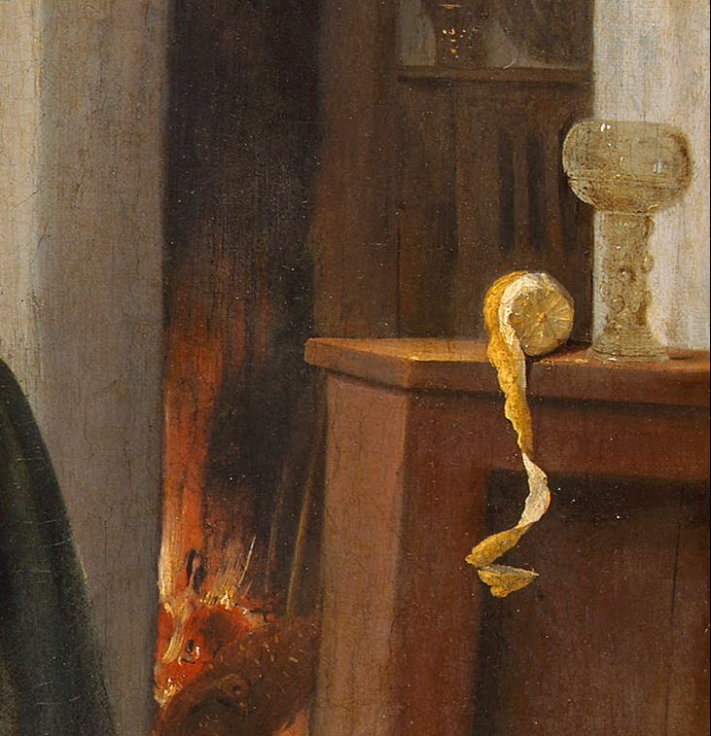
Jan Steen (Leiden)
Beware of Luxury (In Weelde Siet Toe)
1663
Oil on canvas
10.5 x 14.5 cm
Kunsthistorisches Museum, Vienna

Slide 26
Adriaen van Utrecht (Antwerp)
Banquet Still Life (detail)
1644
Oil on canvas
185 x 242.5cm
Rijksmuseum
14. Simon Schama, The Embarrassment of Riches: an Interpretation of Dutch Culture in the Golden Age (New York: Vintage Books, 2014).

Slide 27
Jan Jansz den Uyl (Amsterdam)
Pewter Jug and Silver Tazza on a Table
1633
Oil on panel
91 x 72cm
Private Collection
15. Alan Chong, “Contained Under the Name of Still Life: The Associations of Still-Life Painting.’” In Still-Life Paintings from the Netherlands 1550-1720, Edited by Alan Chong and Wouter Kloek. (Zwolle: Waanders Publishers, 1999) 29-31.

Slide 28
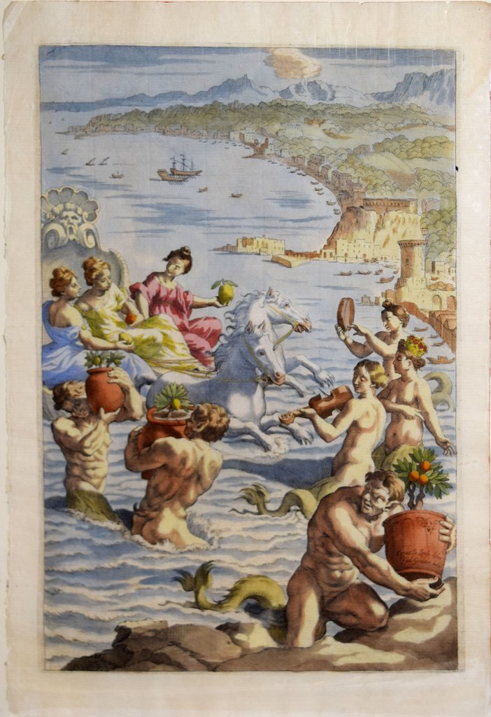
Johann Friedrich Greuter after Giovanni Lanfranco (German, Italian)
The Arrival of the Hesperides at Naples c. 1646
Engraving Plate: 30.9 x 21 cm, Sheet: 33.7 x 22.5 cm
Copperplate engraving of the Hesperides at Naples, with mermen carrying citrus plants. The Hesperides guarded the “golden apples” belonging to Hera, stolen by Hercules.

Slide 29
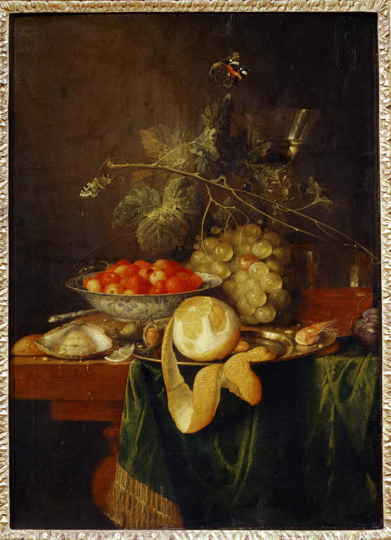
Jan Davidsz de Heem (Antwerp)
Still Life with a Glass and Oysters ca. 1640
Oil on wood
25.1 x 19.1 cm
Met Museum
16. Svetlana Alpers, The Art of Describing (Chicago: University of Chicago Press, 1983), 90-91.

Slide 30
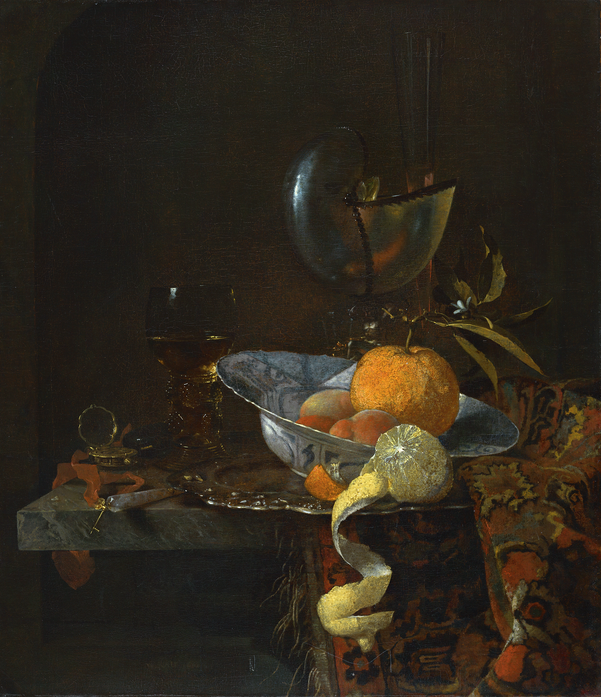
Willem Kalf (Rotterdam)
Still Life with porcelain Bowl and Nautilus Cup
1660
Oil on canvas
64.1 x 55.9 cm
Museo Nacional Thyssen-Bornemisza, Madrid

Slide 31
Willem Kalf (Rotterdam)
Still Life with a Chinese Bowl, Nautilus Cup and Other Objects
1662
Oil on canvas
79.4 x 67.3 cm
Museo Nacional Thyssen-Bornemisza, Madrid
17. Jan Bedaux. “Fruit and Fertility: Fruit Symbolism in Netherlandish Portraiture of the Sixteenth and Seventeenth Centuries.” Simiolus: Netherlands Quarterly for the History of Art 17, No. 2/3 (1987): 155

Slide 32
Jan Davidsz de Heem (Utrecht/Antwerp)
Still Life with a Glass and Oysters ca. 1640
Oil on wood
25.1 x 19.1 cm
Met museum

Slide 33
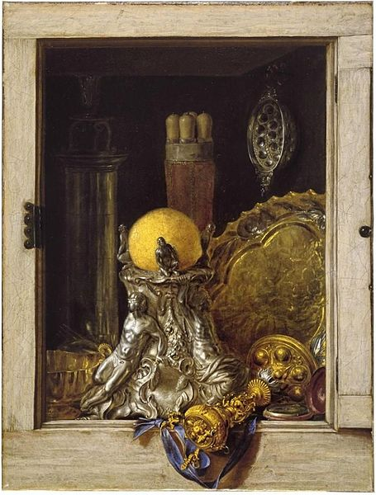
Cornelis Norbertus Gysbrechts
Silverware in an Open Cabinet
ca. 1670
Oil on canvas
62 x 47 cm
Museum of Fine Arts, Ghent

Slide 34
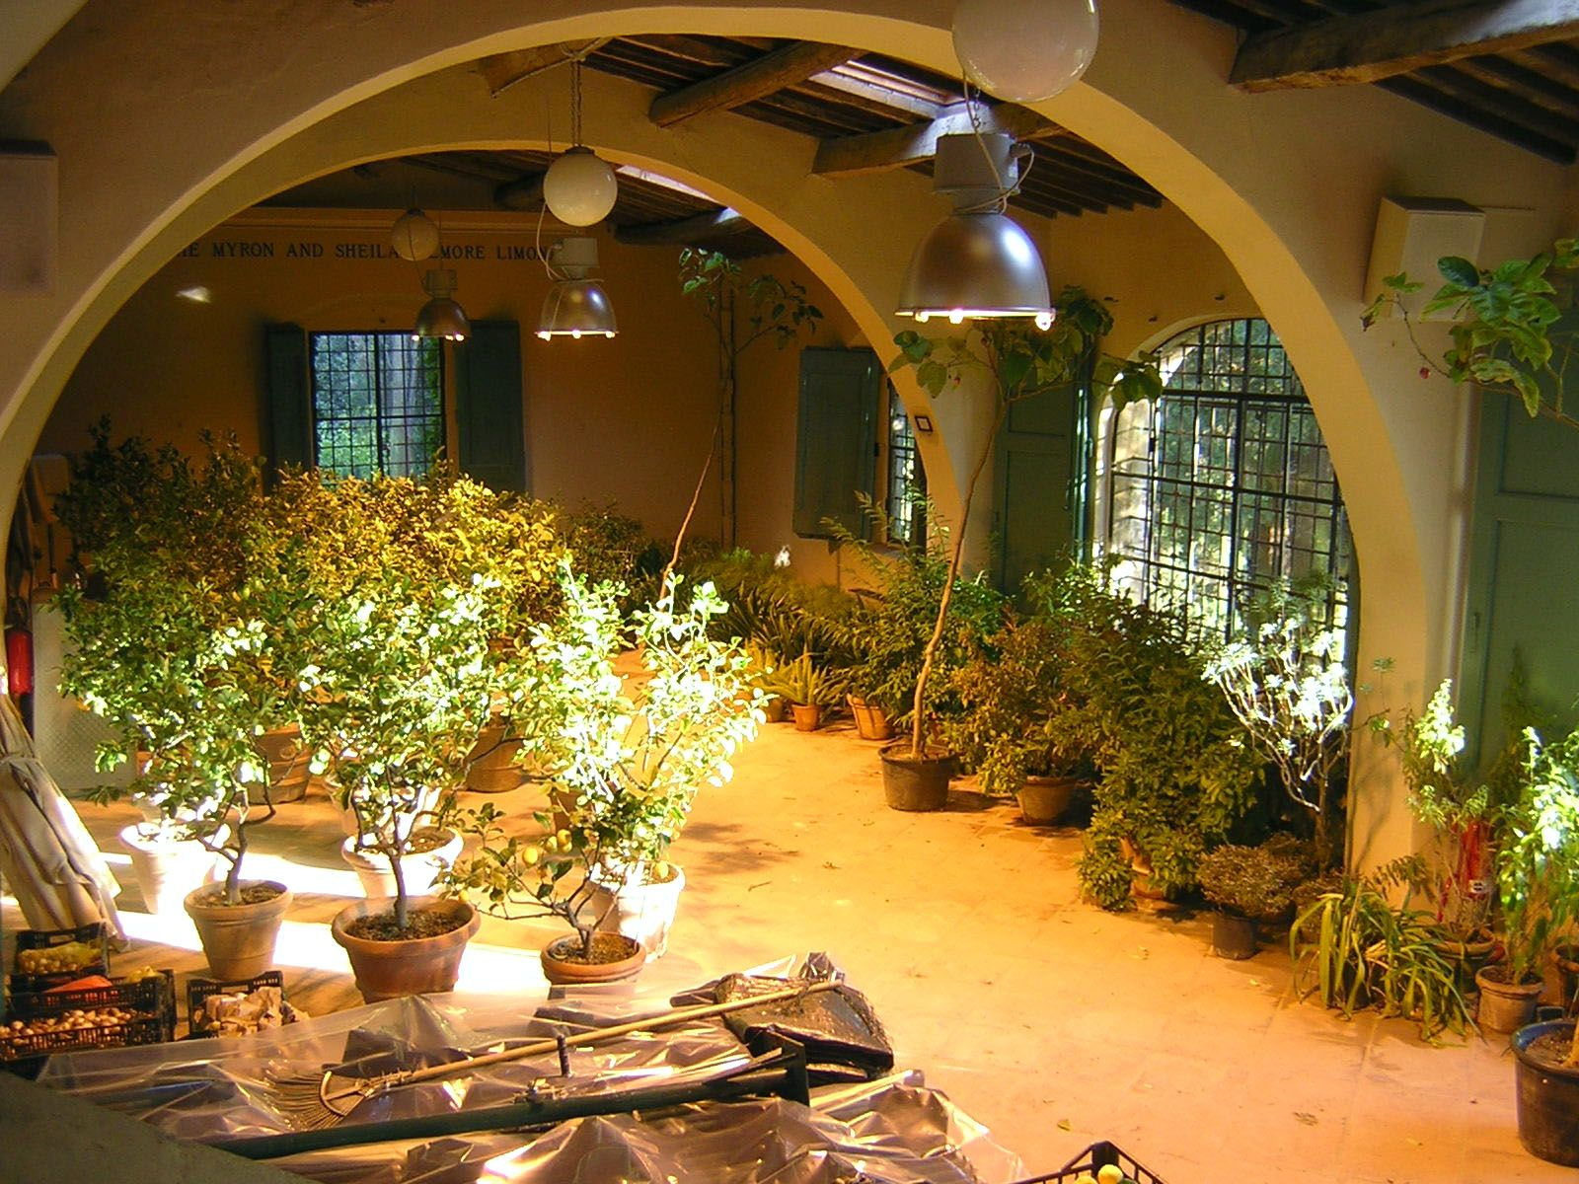
Ada Palmer
Limonaia, or Orangery
2016
Photograph, digital
Florence

Slide 35
Giovanni Battista Ferrari (editor)
Likely engraved by Cornelis Bloemaert (Utrecht)
Lemon Vulgaris, pl 193
1646
Engraving with hand-coloring, in Hesperides siue de malorum aureorum cultura et vsu Libri quator Io. Baptistae Ferrarii Senensis e Societate Iesu, Romae: Sumptibus Hermanni Scheus
35 x 24.2 x 5 cm

Slide 36
Recipe: Lemon Heart
A heart shaped large meatball- “take minced veal just like for meatballs, add it to nutmeg, pepper and salt as well as peels of a fresh lemon cut into small pieces, for each pound of meat an egg yolk, a crushed rusk and mix it all together, shape it in the form of a large meatball or a heart, stew it with little water citron. When done take off the fat, add verjuice, butter, and peels of a salted lemon, which has been boiled in water first. Let it come to a boil together, then dish up; a sauce is poured over made from verjuice beaten with egg yolks.” -De Verstandige Kock
Picking green grapes for making verjuice. Tacuinum Sanitatis (1474). Paris Bibliothèque nationale.

Slide 37
Frans Snyders (Antwerp)
Market Scene on a quay
ca 1635-1640
Oil on canvas
201.5 x 342.9 cm

Slide 38
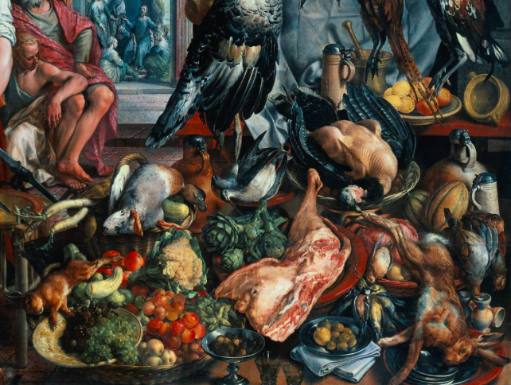
Joachim Beuckelaer (Antwerp), Kitchen Scene with Christ at Emmaus, ca. 1560-1565 (student of Aertson)
Oil on panel, 109.5 x 169cm
Maurishuis
Pieter Aertsen (Antwerp), The Vegetable Seller, 1567
Oil on panel, 111.2 x 111.6cm
Gemäldegalerie

Slide 39
V. Foulquier Corpses of Dutch scurvy victims
1636
Etching
Spitsbergen, Norway, from Il Giro del mondo, Journal of geography, travel and costumes, Volume IV, Issue 8, August 24, 1865.
Getty Images

Slide 40
“Prior to the Dutch maritime expansion of the 17th and 18th centuries, scurvy was known in the Low Countries as an endemic disease. From the end of the 16th century the disease started to draw much more attention due to increasing long sea journeys of sailors. Already in the Dutch medical literature of the 16th century, a strong relation was expressed between the prolonged taking of foodstuffs of poor quality and the risk of contracting scurvy. Although from that time, many Dutch physicians recommended oranges, scurvy grass and brook‐lime, it took 200 years before inadequate therapy on the fleet was replaced by systematic prevention. Why did the old time effective recommendations for the therapy of scurvy stay inadequate for mariners? To understand, maritime and medical history were unfolded and evaluated with respect to palaeopathological findings reported for 39 cases of active scurvy and one case of healed scurvy.”
-G.R. Maat. “Scurvy in adults and youngsters: the Dutch experience. A review of the history and pathology of a disregarded disease.” International Journal of Osteoarchaeology, Vol 14 no 2. March 2004.

