Slide 1
Will Freedom be our Demise?
Marxism and Constructivism on Covid-19
Annie Berget
November 28,2020

Slide 2
Question & Importance
Q:“Why are some countries being more adversely affected by this pandemic than others?
I: This question will help us understand what might be causing this disproportionate number of cases in different states. To understand this it is imperative we look at how Economic Freedom and Democratic Freedom have an impact on the number of Covid-19 Cases and Fatalities.

Slide 3
Marxism
Karl Marx and Freidrich Engels created the work Manifesto of the Communist Party. In this piece of literature, Marx and Engels describe the animosity between the proletariat, the bourgeoisie, and the Capitalist. The proletariat represent the working class, while the bourgeoisie represent the upper middle class such as shop owners, and the Capitalists . The Capitalist, the bourgeoisie and the proletariat engage in economic class battle with the working class being at the mercy of both the bourgeoisie and the Capitalist . The problem with the separation of classes is the strain it has on interpersonal relations. The rise of capitalism increases the gap between the working and upper middle class. Exploitation of the working class to increase revenue is what Marx and Engels contribute to the divide between classes.
The economic strife between classes is what I believe has led to an increase in Covid-19 cases. Covid-19 has created an international scare that has not been witnessed for decades. States are shutting down in efforts to mitigate the spread of this deadly disease. As Covid-19 cases continue to rise it is critical to view why some countries are experiencing a seemingly never ending increase in cases and fatalities, while other countries have faced little to no increase in terms of cases and fatalities. With state closures being lifted as the number of cases and fatalities continue to rise. This I believe can be directly attributed to a States focus on economic success, rather than human life.

Slide 4
Marxism Continued
To begin my research, I shall lay out what I have acquired as far as data. Using the Heritage Foundation (HF) Economic Freedom Score, I used the ranking of countries by their economic freedom. Now, not all states were ranked; Iraq, Libya, Liechtenstein, Somalia, Syria, and Yemen were not ranked by HF. Then using the World Health Organization (WHO), I found all of the accumulated cases and fatalities witnessed by each country as of 11/04/20. I was going to do the cases as of October 31st, however came across the issue of being able to easily access formerly written results in WHO. It was easier to use a single day's results and input the results as of that day. Using the Worldometer 2020, I imputed each state's population. After doing this I divided the number of fatalities by the population, then I had divided the number of cases by the population. This method has been criticized by many for failing to fairly assess the fatality rate of the virus. The research I am doing is not questioning how deadly this disease is but rather what could be contributing to its rate of spread. I will include in my data the fatality rate by country just to analyze if economic freedom has an affect on covid fatalities.

Slide 5
Constructivism
In Why a World State is Inevitable, Alexander Wendt discusses the likelihood of the international community transitioning into a World State and even argues that it is not only likely but inevitable as his title suggests. “Logic of anarchy” discusses our characteristic need for moving forward and coming together to be ruled. According to Wendt it is not a matter of if a World State is formed but rather when. It could be easily said that we are not only in a time of unipolation, but that we indeed are on track to see a World State formed. The United States goal of spreading democracy is by no means a revelation. In the wake of World War II and the efforts issued by the United States to increase ties with other nations: even those that were recent adversaries, alludes to the United States understanding how to secure its own power and position. The United Nations itself could be considered a democratic ploy to include and persuade non democratic states towards a democratic mindset. This spread of democracy could in turn lead to a World State governed in pursuit of an international democratic society. The question that is not often asked however, is whether or not this spread of democracy is adversely affecting those it comes in contact with. One would not often think that a state that is anticipated to adhere to the needs and wants of its citizens could be simultaneously putting them at risk.

Slide 6
Constructivism Continued
My second theory will be that states with more democratic freedom will witness an increase in Covid-19 cases. In my research for democracy’s effects on the pandemic I used Freedom House’s scoring of democratic freedom. Freedom house is a non-profit non-government affiliated organization that is dependent upon ranking and analyzing the freedom of countries around the world. To determine Freedom in the World, Freedom House analyzes a total of 210 countries and territories through research and statistics from a variety of sources, as well consultations and interviews with local contacts. Freedom in the world analyzes these topics to base their rankings off of; electoral process, political pluralism and participation, the functioning of the government, freedom of expression and of belief, associational and organizational rights, the rule of law, and personal autonomy and individual rights. Their research dates back all the way to 1972. It is important to emphasize that this organization is not affiliated with any government or particular organization.

Slide 7
Data Sources
Heritage Foundation
Rates Economic Freedom (of businesses and workers from government regulation) of states worldwide based on several criteria
Based on that, HF ranks states from 1 to 180 (no ties)
1 = Singapore, highest economic freedom
180 = North Korea, lowest economic freedom
Freedom House
Rates Political Freedom (of people to exercise individual civil and political rights) of states worldwide based on several criteria
Based on that, I ranked states from 1 to 210 (ignored ties)
1 = Finland, highest political freedom
210 = Syria, lowest economic freedom
World Health Organization
Cumulative number of covid cases in 186 states as of 11/4/2020
Cumulative number of covid fatalities in 186 states as of 11/4/2020

Slide 8
What are we testing?
Covid Cases Per Population
What: Will show us the percent of cases per population.
Why: To eliminate bias between population variables
Fatalities per Covid Cases
What: Will show us the percent of Covid Fatalities per Cases
Why: To measure the fatality rate of the virus
Fatalities per Population
What: Will show us fatality rate of each state's population as a whole
Why: To measure the security threat of this virus compared to other security threats

Slide 9
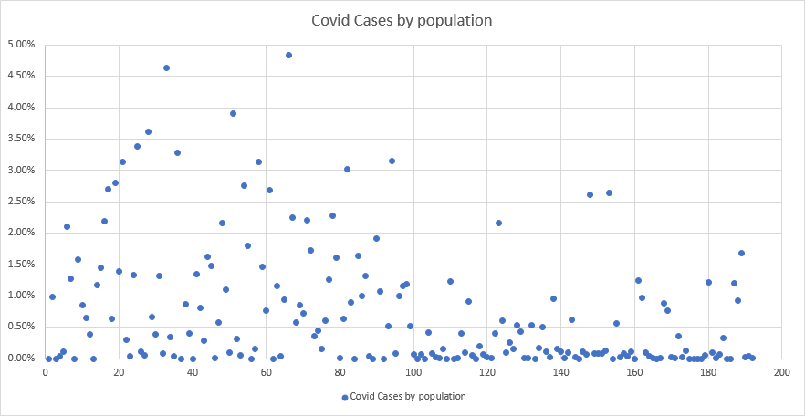
Marxism Test #1
a. Each blue dot represents one country, showing the relationship between its economic freedom (Heritage Foundation rank) and its cumulative covid cases per population as of 4 November 2020.
b. The red line shows the relationship Marxism predicts (more economic freedom -- > more covid cases)
c. The correlation coefficient for this data is 0.3587 and it is significant at the 0.05 level

Slide 10
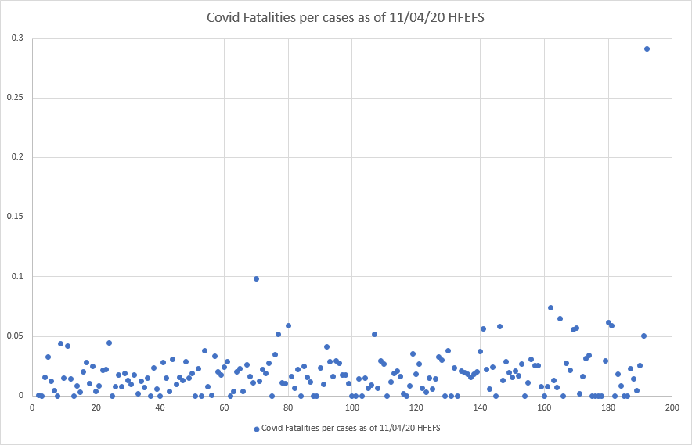
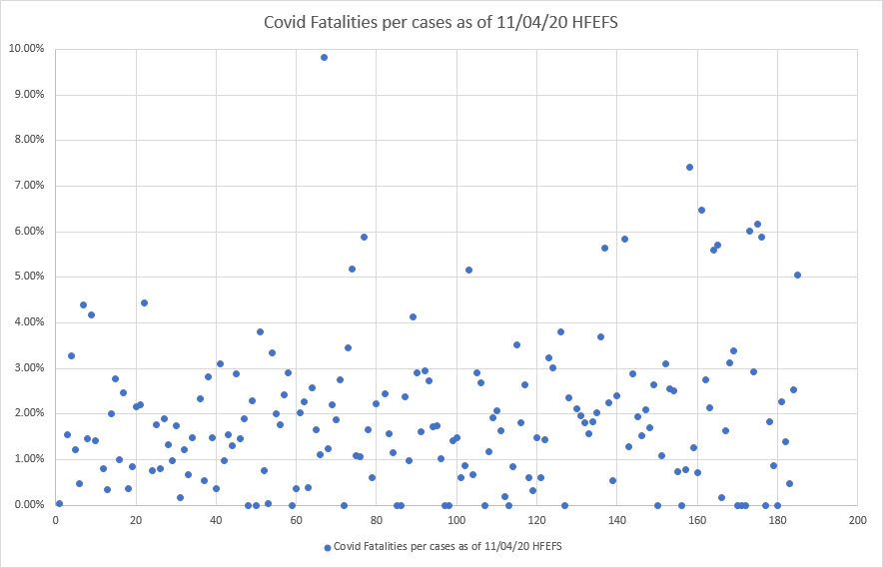
Marxism Test #2
In this top scatter plot we see Covid-19 fatalities including Yemen, and the bottom graph is excluding Yemen.
Yemen has been internationally recognized for being an outlier with an almost 30% fatality rate
This graph shows the relationship between economic freedom and covid fatalities per case as of 4 November 2020.
b. The red line shows the relationship Marxism predicts (more economic freedom -- > more covid fatalities)
c. The correlation coefficient for this data is -0.1585 and it is significant at the .05 level

Slide 11
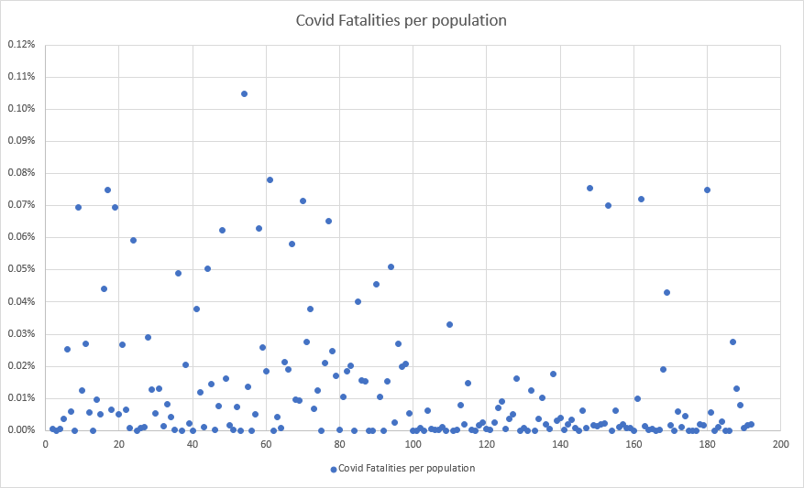
Marxism Test #3: Covid Fatalities by Population (number per 100,000
This graph shows the relationship between economic freedom and covid fatalities per population as of 4 November 2020.
b. The red line shows the relationship Marxism predicts (more economic freedom -- > more covid fatalities)
c. The correlation coefficient for this data is + 0.2133 and it is significant at the .05 level

Slide 12
Summary of Marxism Tests:
Average Covid Cases and Fatalities by Economic Freedom Category
Freedom | Average Covid Fatalities per cases as of 11/04/20 HFEFS | Average of Covid Fatalities per population | Average Covid Cases % pop
Free | 1.31% | 0.01% | 0.90%
Mostly Free | 1.67% | 0.02% | 1.30%
Moderately Free | 2.02% | 0.02% | 1.19%
Mostly Unfree | 2.10% | 0.01% | 0.36%
Unfree | 2.81% | 0.01% | 0.27%
Hypothesis | Contradict Hypothesis | Neutral | Support Hypothesis

Slide 13
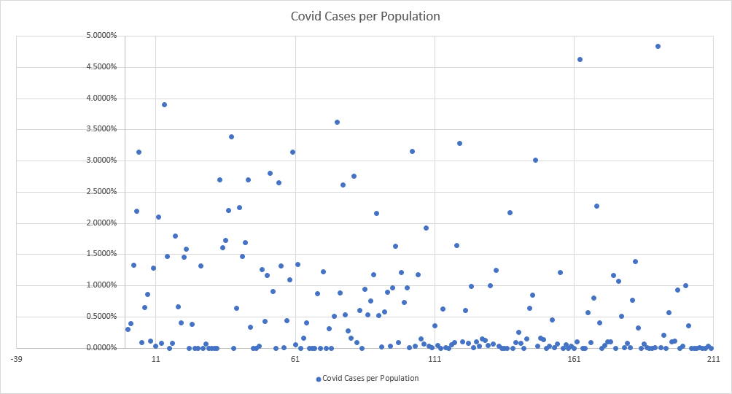
Constructivism Test #1: Covid Cases by Population (number per 100,000
Each blue dot represents one country, showing the relationship between its political freedom (my ranking based on Freedom House data) and its cumulative covid cases per population as of 4 November 2020.
b. The red line shows the relationship my constructivist hypothesis predicts (more political freedom -- > more covid cases)
c. The correlation coefficient for this data is .2664 and it is significant at the .05 level

Slide 14
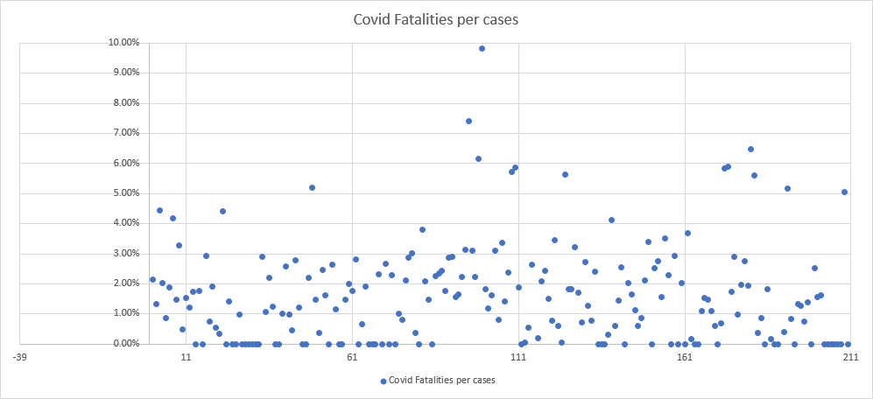
Constructivism Test #2: Covid Fatalities per case
a. This graph shows the relationship between political freedom and covid fatalities per case as of 4 November 2020.
b. The red line shows the relationship my constructivist hypothesis predicts (more political freedom -- > more covid fatalities)
C. The correlation coefficient for this data is -0.1405 and it is not significant at the .05 level

Slide 15
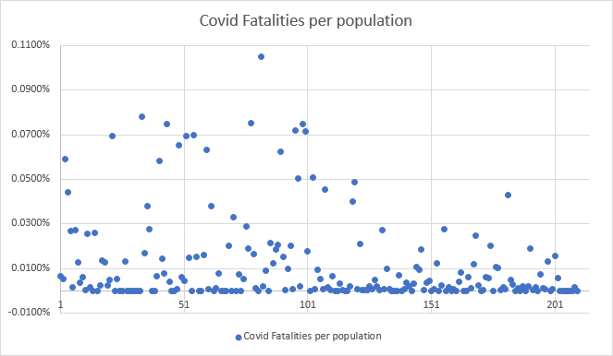
Constructivism Test #3: Covid Fatalities by Population (number per 100,000
a. This graph shows the relationship between political freedom and covid fatalities per population as of 4 November 2020.
b. The red line shows the relationship my constructivist hypothesis predicts (more political freedom -- > more covid fatalities)
c. The correlation coefficient for this data is .3079 and it is significant at the .05 level.

Slide 16
Summary of Constructivism Tests
Average Covid Cases and Fatalities by Political Freedom Category
Freedom | Average of Covid Fatalities per cases as of 11/04/20 HFEFS | Average of Covid Fatalities per population | Average of Covid Cases % pop
Free > 72 | 1.72% | 0.02% | 1.24%
Partly Free 36 - 72 | 2.25% | 0.01% | 0.67%
Not Free < 35 | 2.71% | 0.01% | 0.54%
Hypothesis | Contradicts Hypothesis | Matches Hypothesis | Matches Hypothesis

Slide 17
Comparing Marxism and Constructivism Result
Why are some countries being more adversely affected by this pandemic than others?
Neither test is more valuable than the other. On the contrary, it is imperative we have both tests to understand our results. Given that both Fatalities per Cases did not match our hypothesis it is evident that there are unaccounted variables in this test, such as health care capabilities between Free countries and Unfree countries.

Slide 18
Comparing Marxism and Constructivism Result Continued
To expand the study I could examine all excess deaths 2020 to reduce missing data issue.
Other variables to include in future research:
When each state got its first case
Median age of population
National healthcare capabilities
Reporting accuracy

Slide 19
Research by other Scholars
Some scholars have tested a hypo similar to this constructivist theory and have found that “cultural differences in our willingness to follow rules” is strongly associated with covid fatalities. This February 1st news article about the study, which analyzed data through October 2020, about the same time period as this study found similar results.
https://www.theguardian.com/world/commentisfree/2021/feb/01/loose-rule-breaking-culture-covid-deaths-societies-pandemic
A study done by the Lancet found that cultural looseness and cultural tightness showed that a society that did not have cultural norms that were strictly followed and enforced witnessed a higher number of Covid-19 Cases.
https://www.thelancet.com/journals/lanplh/article/PIIS2542-5196(20)30301-6/fulltext#seccestitle140

Slide 20
Policy Implications
My advice for policy makers, and citizens alike is to follow and listen to your local health department’s guidelines. “Freedom” is not always free. There are millions of people who have lost their lives, lost a loved one, and or are stuck on a ventilator fighting for their life, all because another individual chose to exercise personal “freedom”.. This is not groundbreaking advice. Numerous studies, including the studies on the previous slide offer the same advice.

Slide 21
Bibliography
“About The Index.” 2020 Index of Economic Freedom | The Heritage Foundation. Accessed November 28, 2020. https://www.heritage.org/index/about.
“Freedom in the World.” Freedom House. Accessed November 28, 2020. https://freedomhouse.org/report/freedom-world.
Gelfand, Michele. “Why Countries with 'Loose', Rule-Breaking Cultures Have Been Hit Harder by Covid | Michele Gelfand.” The Guardian, Guardian News and Media, 1 Feb. 2021, www.theguardian.com/world/commentisfree/2021/feb/01/loose-rule-breaking-culture-covid-deaths-societies-pandemic.
Gelfand, Michele. “Why Countries with 'Loose', Rule-Breaking Cultures Have Been Hit Harder by Covid | Michele Gelfand.” The Guardian, Guardian News and Media, 1 Feb. 2021, www.theguardian.com/world/commentisfree/2021/feb/01/loose-rule-breaking-culture-covid-deaths-societies-pandemic.
Wendt, Alexander. “Why a World State Is Inevitable.” European Journal of International Relations9, no. 4 (2003): 491–542. https://doi.org/10.1177/135406610394001.

