Slide 1
Cough Desensitization Treatment: A randomized controlled trial
PI: Laurie Slovarp, PhD
Presenters: Jane Reynolds, M.S., and Sarah Campbell, B.A.

Slide 2
Chronic cough
An overview of

Slide 3
When the coughing won’t stop
Coughing
Specialist
Treatment fails
Notes:
Cough is one of the most common complaints for which patients seek medical care (Chung & Pavord, 2008; Morice et al., 2004; Polverino et al., 2012) when a cough lasts longer than 8 weeks it is termed chronic cough. Approximately 11% of the US population is reported as having a chronic cough. Typically, coughing
10-20% of patients still coughing after medical treatment (Chung, 2011; Haque et al., 2005; Ryan et al., 2010)
Typically affects women more than men- age of onset 40-60 most common (Birring et al. 2003)

Slide 4
Cough hypersensitivity syndrome
Notes:
Cough hypersensitivity syndrome:
occurs after an illness where there was a cough, the cough remains- sometimes for many, many years.
sensory receptors called TRPV in the upper airway don’t down regulate to a normal sensitivity after the illness is gone (Morice et al. 2014)
Urge-to-cough: the strong feeling of needing to cough triggered by everyday scents and activities like perfume, strong smells, cold air, laughing, talking, and crumbly foods (Davenport, 2008)

Slide 5
Treatment for cough hypersensitivity syndrome
Learn to suppress urge to cough (don’t cough)
Reduce throat irritation
Education and training
Reduced coughing
Notes:
Standard of care: chest-xray, PFT, antibiotics, steroids, inhalers, reflux medication, nose sprays
Referred to voice specialized SLP: address voice and upper airway concerns. Work on desensitization of the cough reflex so that the sensory threshold that makes a person cough can return to normal.
Patients learn strategies to suppress their cough. The most important aspect is to try to NOT cough as this allows the hypersensitivity in the upper airway to go back to normal- it retrains the brain to not produce an urge-to-cough to normal activities.

Slide 6
A new treatment for RCC: Cough Desensitization Therapy
In our novel treatment approach, we combine cough suppression (behavioral techniques) with structured trials where the urge to cough sensation is elicited using small nebulized doses of capsaicin (a known cough stimulant).
Our hypothesis is that this specialized treatment will help patients who have not responded to behavioral cough suppression therapy alone.

Slide 7
Cough Desensitization Therapy: A randomized controlled trial

Slide 8
Participant Requirements
Cough that didn’t get all the way better from BCST
Over 18 - healthy otherwise
Have RCC - dry, unproductive cough with identifiable triggers
Participants recruited by SLPs and sometimes physicians after BCST hasn’t worked for them.

Slide 9
Methods
Experimental
Receives small doses of progressively increasing capsaicin (known cough stimulant)
Coached to suppress UTC with cough suppression techniques each trial
Placebo
Receives the same dose of capsaicin below their cough threshold
Coached to perform cough suppression techniques each trial

Slide 10
Methods Continued
Week 1
Baseline Testing
Weeks
2-4
Treatment sessions
Week 5
12 exposures/session
Week 7
Post-test one week after treatment
Post-test three weeks after treatment
3 months
Self-reported follow-up questionnaire

Slide 11
Baseline and Post-Test Evaluations
Cough sensitivity (challenge) testing
Urge-to-cough testing
Spirometry (pulmonary function testing)
Cough frequency measurement
24-hour audio recording
Patient reported questionnaire
Quality of life measures
Cough history
General Anxiety Disorder 7-item
(Spitzer et al., 2006)
Leceister Cough Questionnaire
(Birring et al., 2003)

Slide 12
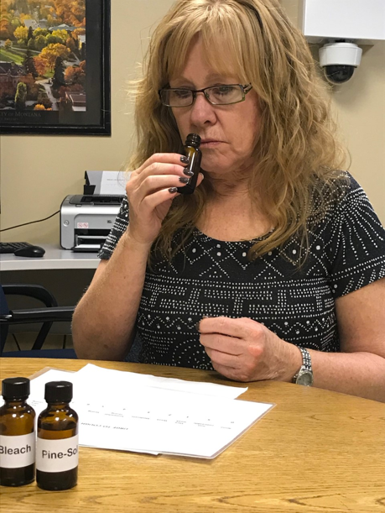
Urge-To-Cough Testing
URGE-TO-COUGH SCALE

Slide 13
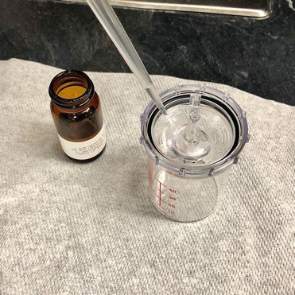
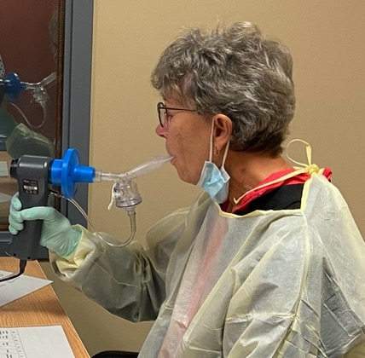
Cough Challenge Testing
Doubling doses of capsaicin vapor delivered on single inhales via nebulizer
.49 – 1000 μM
Record response up to dose that causes 5 or more coughs
Proper nebulizer set up essential for reliable results!
Notes:
Digidoser standardized deliver

Slide 14
Treatment Sessions
Exposed to experimental or placebo substance through inhaled vapor
Coached to suppress the urge to cough
Record Self-reported urge-to-cough (likert scale 0-10) & cough count per exposure
Spirometry before and after

Slide 15
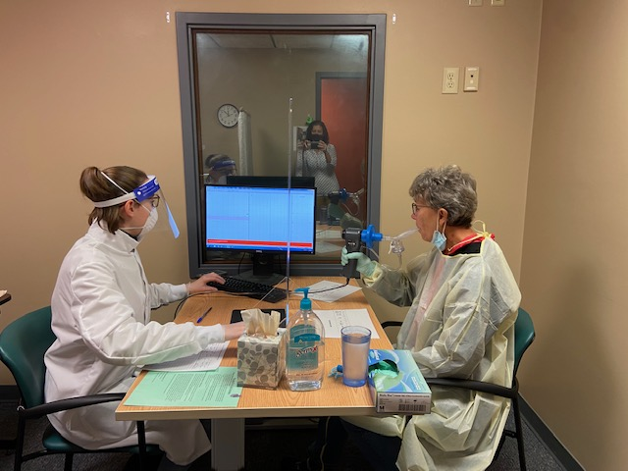

Slide 16
Results

Slide 17
Sample
Notes:
Pie chart

Slide 18
LCQ

Slide 19
UTC
Notes:
Outcome 2 - Cough counts during urge-to-cough (UTC) testing. A mixed effects generalized linear regression model revealed strong evidence of a difference over time between the treatment and control in total coughs during UTC testing (Chi-square(2)=18.0, p-value = 0.0001). Follow-up contrasts were conducted to estimate the change vs. baseline in each group. There was strong evidence of a change in mean cough counts during UTC testing for both groups at PT1 and PT2 (p-value <.0001 for all contrasts), with an 83% and 97% reduction in the treatment group, and 59% and 56% reduction in the control group, respectfully. Contrasts comparing the estimates of change between the two groups revealed moderate evidence of a different change in the treatment group (Z=-1.62, p-value =.11) at PT1 and very strong evidence of a different change in the treatment group at PT2 (Z=-4.1, p-value <.0001), with both changes in the direction of lower cough rates in the treatment group.

Slide 20
CCT
Notes:
Change in the log of C5 from baseline to PT1 moved in a positive direction indicating increased cough sensitivity threshold in 3/5 participants. Of these, all three were in the placebo-to-treatment group. From PT1 to PT2 there was further positive change for 2/3 same participants.

Slide 21
Limitations
Not true placebo
CCT with straw and baffle
Small n
Intervention likely withdrawn too soon

Slide 22
Future Directions
→ Pilot 2: increase frequency and duration
Increase to 3x week
Up to 12 sessions
True placebo (saline)
Not instructed to suppress between sessions
→Reliability of UTC testing
→Plans for multi-site trial

Slide 23
References
Birring, S., Brightling, C., Symon, F., Barlow, S., Wardlaw, A., & Pavord, I. (2003).Idiopathic chronic cough: Association with organ specific autoimmune disease and bronchoalveolar lymphocytosis. Thorax, 58, 1066-1070.
Birring, S., Prudon, B., Carr, A., Singh, S., Morgan, M. & Pavord, I.(2003) Development of a symptom specific health status measure for patients with chronic cough: Leicester Cough Questionnaire (LCQ). Thorax; 58(4), 339-343.
Brignall, K., Jayaraman, B., Birring, S. (2008). Quality of life and psychosocial aspects of cough. Lung, 186, S55-S58.
Chung, K. & Pavord, I. (2008). Prevalence, pathogenesis, and causes of chronic cough. Lancet, 371, 1364–1374.
Chung, K. (2011). Chronic ‘cough hypersensitivity syndrome’: A more precise label for chronic cough. Pulmonary and Pharmacological Theory, 24: 267–271.
Davenport, P. (2008). Urge-to-cough: What can it teach us about cough? Lung, 186, S107-S111.
Haque, R., Usmani, O., & Barnes, P. (2005). Chronic idiopathic cough a discrete clinical Entity? Chest, 127, 1710–1713
Morice, A., Fontana, G., & Sovijarvi, A. (2004). The diagnosis and management of chronic cough. European Respiratory Journal, 24, 481–492.
Morice, A., Millqvist, E., Belvisi, M., Bieksiene, K., Birring, S., Chung, K., Dal Negro, R., Dicpinigaitis, P., Kantar, A., McGarvey, L., Pacheco, A., Sakalauskas, & Smith, J. (2014). Expert opinion on the cough hypersensitivity syndrome in respiratory medicine. European Respiratory Journal, 44, 1132-1148.
Polverino, M., Polverino, F., & Fasolino, M. (2012). Anatomy and neuro-pathophysiology of the cough reflex arc. Multidisciplinary Respiratory Medicine, 7, 1–5.
Ryan, N., Vertigan, A., Bone, S. (2010). Cough reflex sensitivity improves with speech language pathology management of refractory chronic cough. Cough 6, 5.
Spitzer, R., Kroenke, K., Williams, J. & Lowe, B. (2006). A brief measure for assessing generalized anxiety disorder. Arch Inern Med. 166, 1092-1097.

