Slide 1
Pharmacogenetic Implementation in a Montana Children’s Psychiatric Center: A Case Study
Precision Medicine Project
Shayna Killam¹, Tianna Leitch¹,
Kirk Katseanes¹, Karen Brown¹ Susan Trinidad², Corbin Schwanke³,
Abdallah Elias³, and Erica Woodahl¹
¹Department of Biomedical and Pharmaceutical Sciences, University of Montana, Missoula, MT; ²Department of Bioethics and Humanities, University of Washington, Seattle, WA; ³Shodair Children’s Hospital, Helena, MT
Notes:
- State that you’re pharmacy students

Slide 2
Introduction
Precision Medicine is an emerging approach for disease treatment that accounts for individual variability in genes, environment, and lifestyle
Pharmacogenomics is the study of how people respond differently to medications based upon their genes
Pharmacogenetic testing seeks to determine the correct medication and dose that will be right for a given patient, based on their specific genes
Notes:
Briefly explain precision medicine and pharmacogenetics as history/background for our project

Slide 3
Pharmacogenetics for Rural Patients
So far, implementation strategies for pharmacogenetic testing have been limited to metropolitan areas and large health systems
Rural, community-based health systems, like those in Montana, are left behind in implementation efforts
Notes:
While pharmacogenetic testing has enabled providers to individualize patient therapies and optimize care outcomes in a variety of clinical settings, implementation has mostly been limited to major academic medical centers. Small, community-based facilities rarely have the opportunity to implement new technologies. More than half of the population in the United States lives outside a major metropolitan community, so medical advancements in pharmacogenomic medicine are often beyond reach. Over 2/3rds of patients living in the state of Montana reside in rural areas, and pharmacogenetic testing services are practically nonexistent in these settings. In a previous study, we found that many clinicians in rural Montana were enthusiastic about the prospect of precision medicine, but the implementation of these services has so far fallen short.
Based on this prior research, we established a partnership with Shodair Children’s hospital, who has expressed interested in offering pharmacogenetic testing.

Slide 4
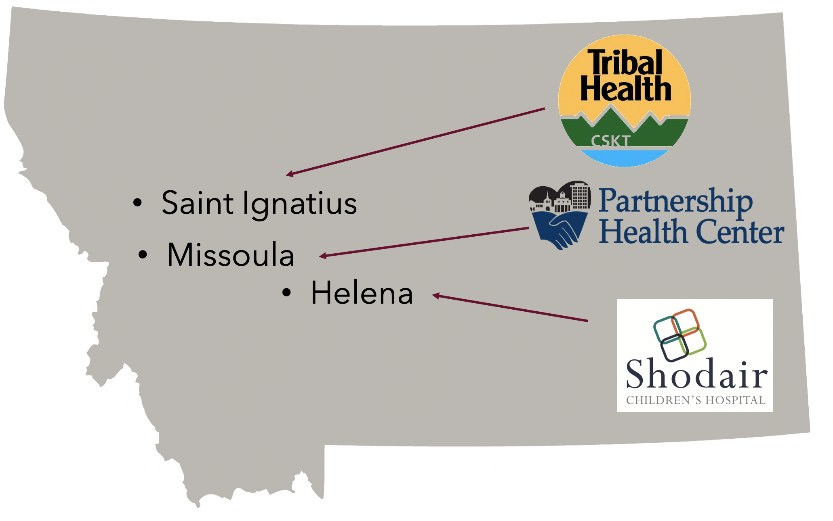
Purpose & Participants
Our vision is to be at the forefront of rural pharmacogenetic testing implementation by using telehealth technology and a centralized, statewide resource at the University of Montana.
Notes:
It is our goal is to successfully establish a centralized pharmacogenetic testing program at the University of Montana Skaggs School of Pharmacy. This centralized resource will utilize telehealth consultation services to provide rural patients and their physicians with counseling, recommendations, and result interpretation from trained pharmacogenetic specialists through a telehealth model, a technology that has been rapidly advancing due to the changes driven by the COVID-19 Pandemic. So far, we have partnered with several sites across the state. Highlighted, is Shodair Children’s Hospital in Helena, as the focus of our discussion today: they have a unique history with pharmacogenetic testing, a specialized patient population, and high probability in overall readiness to begin an implementation effort. Our hope is that this work could then provide a framework for other rural states or communities to implement similar programs. In order to achieve this, we collaborated with Shodair to run a needs assessment, establishing common barriers and concerns for an implementation effort. Participants included physicians, mid-level providers such as nurse practitioners, information technology professionals, lab technicians, and facility administrators at Shodair.

Slide 5
Shodair Children’s Hospital
Acute (Inpatient) Services
Medical Genetics
Outpatient Management
Notes:
Shodair Children’s Hospital (Shodair) is the only hospital in Montana that provides inpatient and outpatient specialized psychiatric care to children and adolescents in mental health crises, suffering from addiction, and needing long-term mental health services. Shodair is also home to Montana’s only comprehensive clinical genetics department, which provides genetic testing, clinical care, and expertise on genetic disease and treatment to patients across the state. The knowledge and resources available at Shodair established them as prime location to pilot pharmacogenetic testing services. Pharmacogenomic-guided therapy has been shown to be effective in the treatment of psychiatric disorders. There are guidelines and recommendations for pharmacogenetic testing services in the areas of mental health and psychiatric care, however, the research for pediatric patients has been limited.

Slide 6
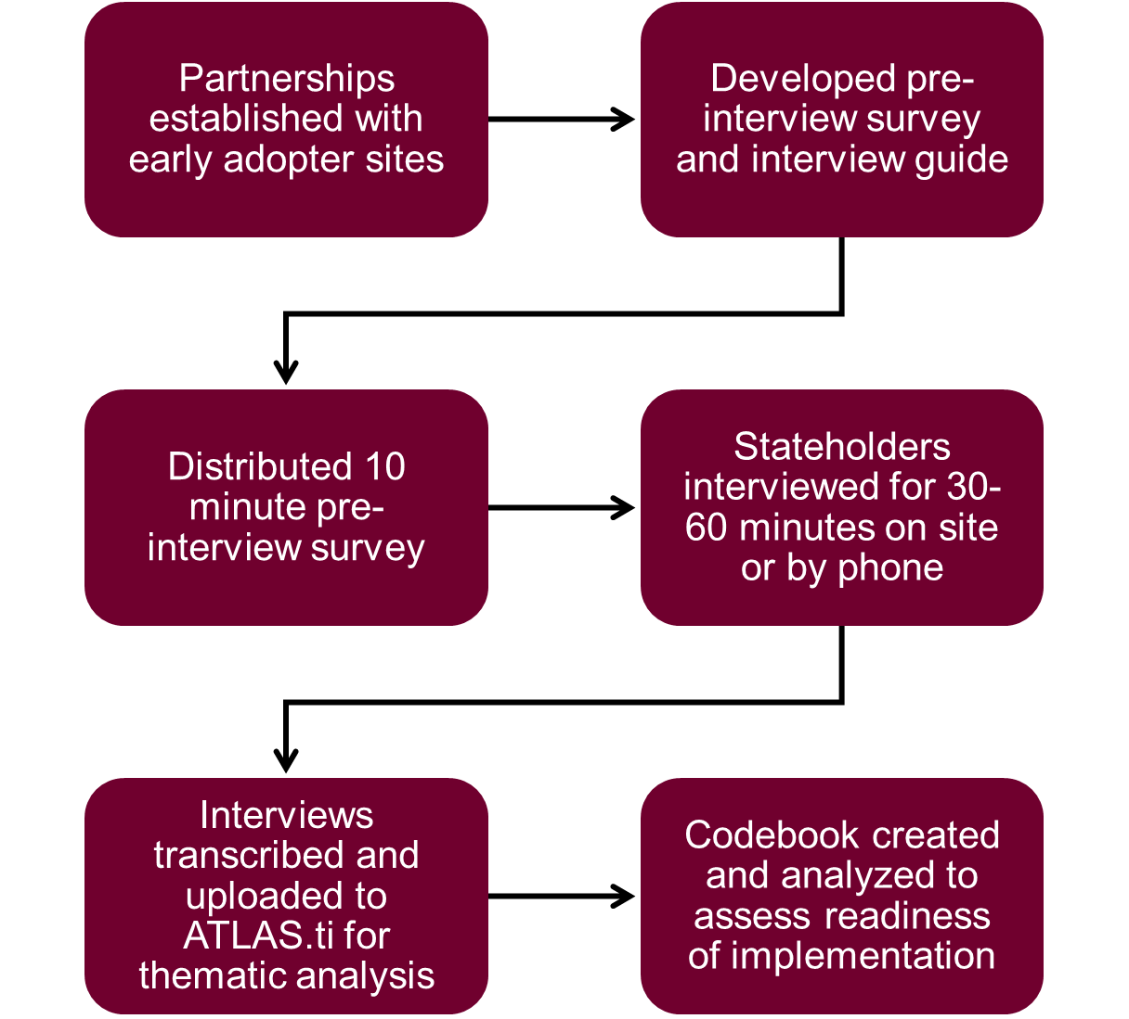
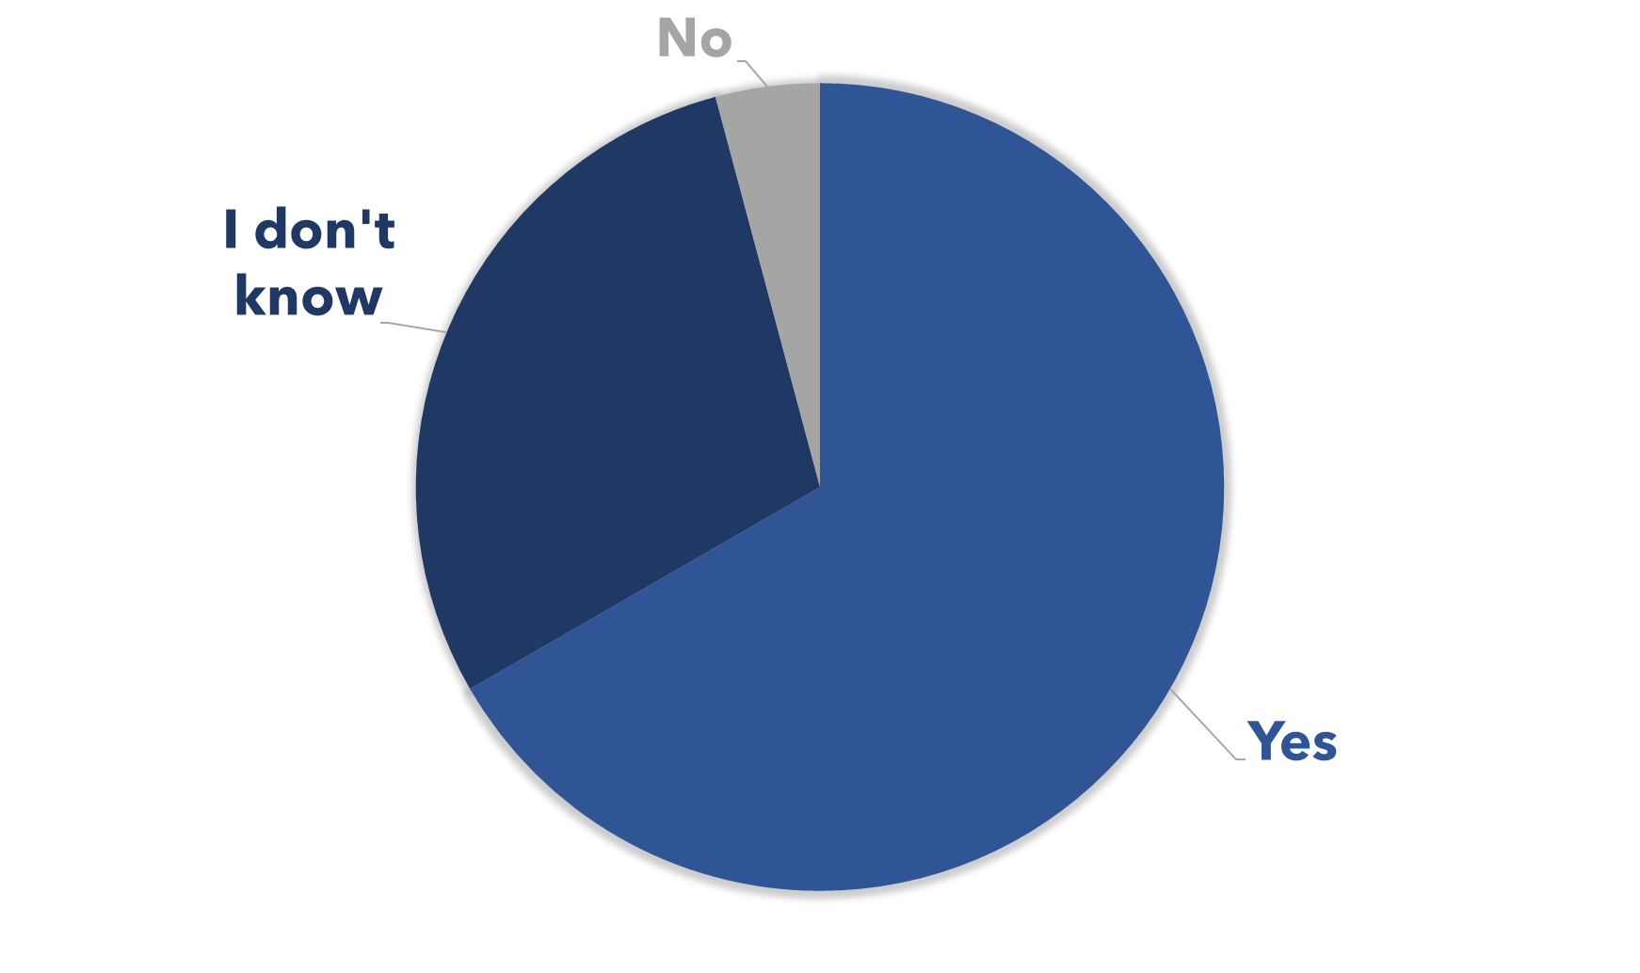
Methods
Survey Results
N=21
Q: Do you think there is value in implementing pharmacogenetic testing at your facility?
Notes:
We began with a 10–15-minute survey that gathered demographic information from participants, recorded information on their patient population, and used Likert scale questions to assess their experience and opinions on pharmacogenetic testing services. Upon completion of the survey, participants were then asked to participate in semi-structured interviews using a predetermined interview guide which included questions regarding the facility’s current medication management and prescribing practices, site priorities including the vision and mission of the facility, and outcome measures of interest for pharmacogenetic testing. The second half of the interview gathered participants’ perspectives regarding resources required for future implementation efforts. Preliminary survey results showed the majority of participants felt there was strong potential for pharmacogenetic testing to have utility, especially within adolescent psychiatry, and many felt pharmacogenetic testing implementation would be valuable to have at the facility.

Slide 7
Interview Themes:
Strong clinical utility among a pediatric, psychiatric patients
Necessary to address historical challenges and anticipated obstacles
Positive perceptions of a centralized telehealth service
“In family practice, my biggest challenge was a patient that came in with anxiety and depression and maybe some suicidal ideation and then you're just picking one of many [medications] out of a magic hat and saying, "All right, let's try it." […] and these medicines take so long to work, so you can't have them come back three days later and say, "Are you feeling better?" because that's not a reliable expectation of the medicine.”
“I think it was being over utilized, payment sources are hard, insurance couldn’t get paid for. I feel like we have to do better about deciding like you’re saying, who should get it in the first place?”
“Looking at providers around Montana, an outcome for me would be the opportunity to become a really valuable resource to rural frontier providers so that they can refer to us for a genetics consult. But, if they can refer for pharmacogenetic testing, and if we can do it in a timely cost-effective manner so they can make treatment decisions, then we become an invaluable partner to them.”
Notes:
The following themes were the strongest and most prevalent among our interviews:
Participants identified several key challenges in medication therapy management for their pediatric patients. According to participants a significant concern is the high number of psychiatric medications these patients are prescribed. They that expressed reducing the number of medications patients were taking could increase adherence upon discharge and provide an overall benefit to patients.
Another significant challenge mentioned was balancing prescription medications and potential side effects. The prevention of adverse drug reactions, while maximizing potential benefits of treatment was also a significant concern. Additionally, participants described patients with psychiatric disorders requiring inpatient treatment as ‘treatment resistant’ and cited a patient’s history with medication failures as potential cause for nonadherence following discharge and future readmittance. Ultimately, providers and staff at Shodair described the nature of treating psychiatric patients and the nature of psychiatric medications as a challenge in their everyday practice. One provider described the lack of clear, straightforward clinical guidelines which lead to a variety of trial-and-error prescribing practices, as seen in the first quote. Participants shared the belief that pharmacogenetic testing could allow for providers to strike a balance between maximizing therapeutic impact of patients’ medications and management potential side effects or adverse events in a time-sensitive manner.
Several participants had used pharmacogenetic testing during the initial implementation effort, so it was essential to gather clear expectations of a future attempt, in order to generate site-specific strategies for re-introduction of pharmacogenetic testing services. Common themes included needed education and resources for both providers and patients, set protocols for the ordering and utilization of the testing services, as well as a shift in focus from reactive testing to pre-emptive testing. They also expressed a need to shift testing from inpatient psychiatric care, to their outpatient program, where patients could be followed over a longer period of time. As seen in quote 2, there were also concerns that patients and providers may have higher expectations for the test than what the technology can ideally deliver.
Several practitioners interviewed identified pharmacists as potential “primary champions” for the integration of pharmacogenetic testing into treatment decisions and may also require additional education. Additionally, participants cited access to specialists and pharmacogenetic expertise as a key factor in the effective utilization of testing results in treatment decisions.
Participants were optimistic about the utilization of telehealth consultations for pharmacogenetic test results and expressed positive perceptions regarding access to a remote resource through the University of Montana Skaggs School of Pharmacy. Most participants expressed support for receiving telehealth consultations through a remote teleconference platform. Providers felt that the telehealth service would be a valuable service in a rural state like Montana and thought it could benefit providers and patients who would not otherwise have access to pharmacogenetic testing and resources for interpretation. One provider described the potential partnerships available if a telehealth model for consultation is utilized in quote #3.

Slide 8
“One of the things that I’m kind of intrigued by is we’re starting to develop outpatient telemedicine and the ability to discharge and manage kids, and specifically to manage their meds. If we could pair that with pharmacogenetic testing, that becomes a pretty powerful service to offer a rural state.”
- Provider, Shodair Children’s Hospital
Notes:
We would like to share one quote from a provider at this location that summarized the sentiments of several professionals interviewed. *Read quote*

Slide 9
Future Directions
Shodair Children’s Hospital is an ideal site to pilot pharmacogenetic testing services
Pediatric psychiatry paired with pharmacogenetic testing offers a unique opportunity to make impactful change for children in Montana
Future work will continue to improve and refine implementation strategies through experience gained with early adopter sites
Notes:
Future directions with the project will aim to begin pharmacogenetic testing services at Shodair Children’s Hospital. They are an ideal site to pilot testing services, and their unique patient population offers an open opportunity to make impactful change for the practice of pediatric psychiatry Montana. During the implementation process, we will continue to improve and refine our strategies through experience gained with early adopter sites. Changes driven by the COVID-19 pandemic create a perfect opportunity to begin a service utilizing a telehealth consultation framework.

Slide 10
Acknowledgements
Shodair Children’s Hospital
The providers and professionals who shared their perspectives and time for this project
Dr. Erica Woodahl and the Precision Medicine Project
Acknowledgements:
Notes:
Read acknowledgements

