Slide 1
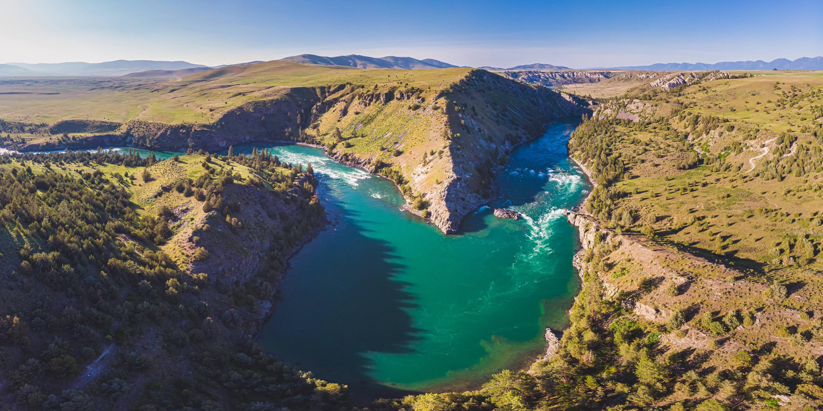
Damming Paradise
The Struggle for Good Jobs, Public Power, and Wild Rivers
in the Flathead Valley, 1948–1968
Jacob Schmidt
MA Student, History

Slide 2
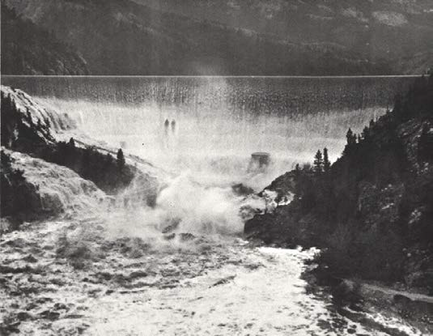
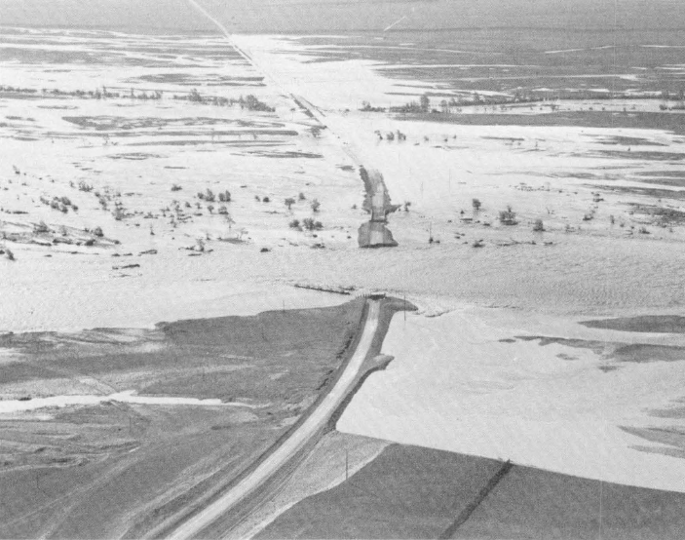
1964 Flood
Photos from USGS

Slide 3
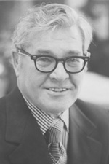
“Oratorical floods submerge facts.
In controversies, such as this, facts are sometimes swept out of mind by subsequent floods of oratory”
Public Power, 1962
Lee Metcalf
Congressman 1953–61
Senator 1961–78
Wikimedia Commons

Slide 4
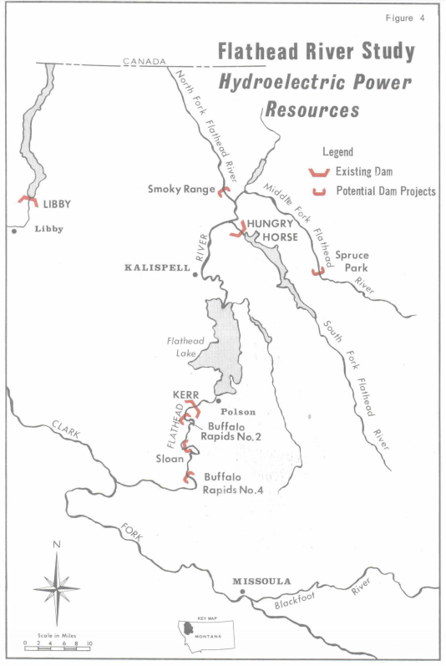
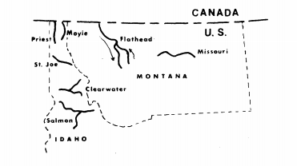
Flathead River Wild and Scenic Study, 1975
Flathead National Forest
Map of the Flathead Valley with dam sites marked.

Slide 5
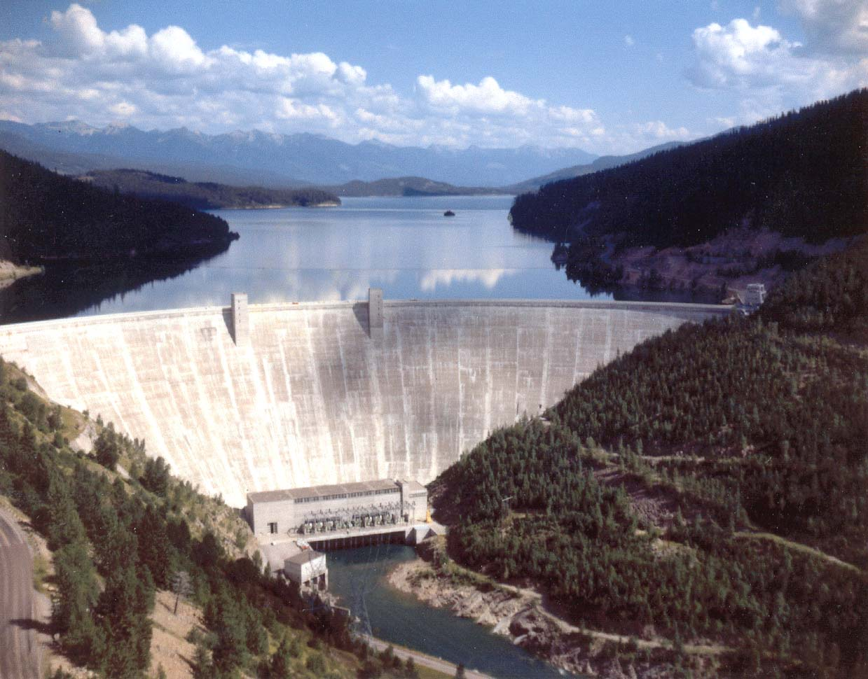
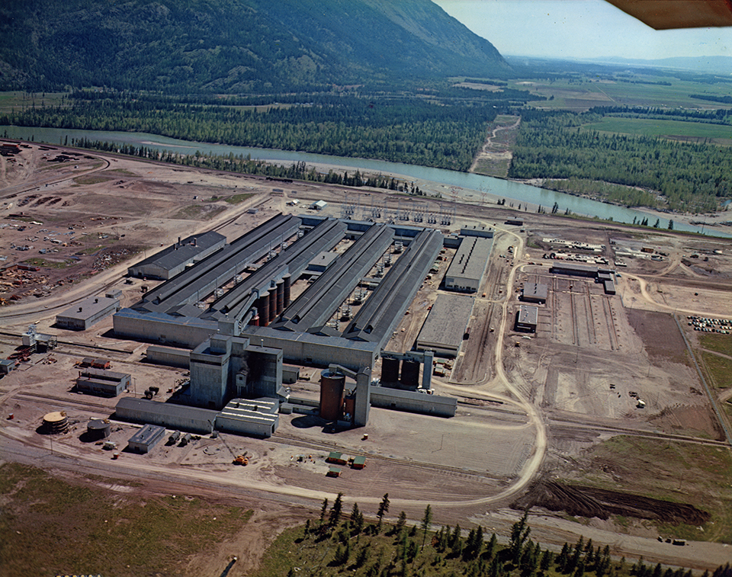
Hungry Horse Dam
and Columbia Falls Smelter
Photo from Archives and Special Collections, Mansfield Library, University of Montana

Slide 6
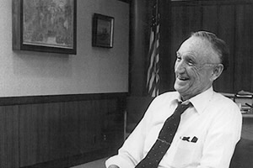
“All without harming anybody in the state of Montana, but as a matter of fact, helping everybody.”
Mike Mansfield
Mike Mansfield on Hungry Horse Dam 1959
Wikimedia Commons
Congressman 1943–53
Senator 1953–77

Slide 7
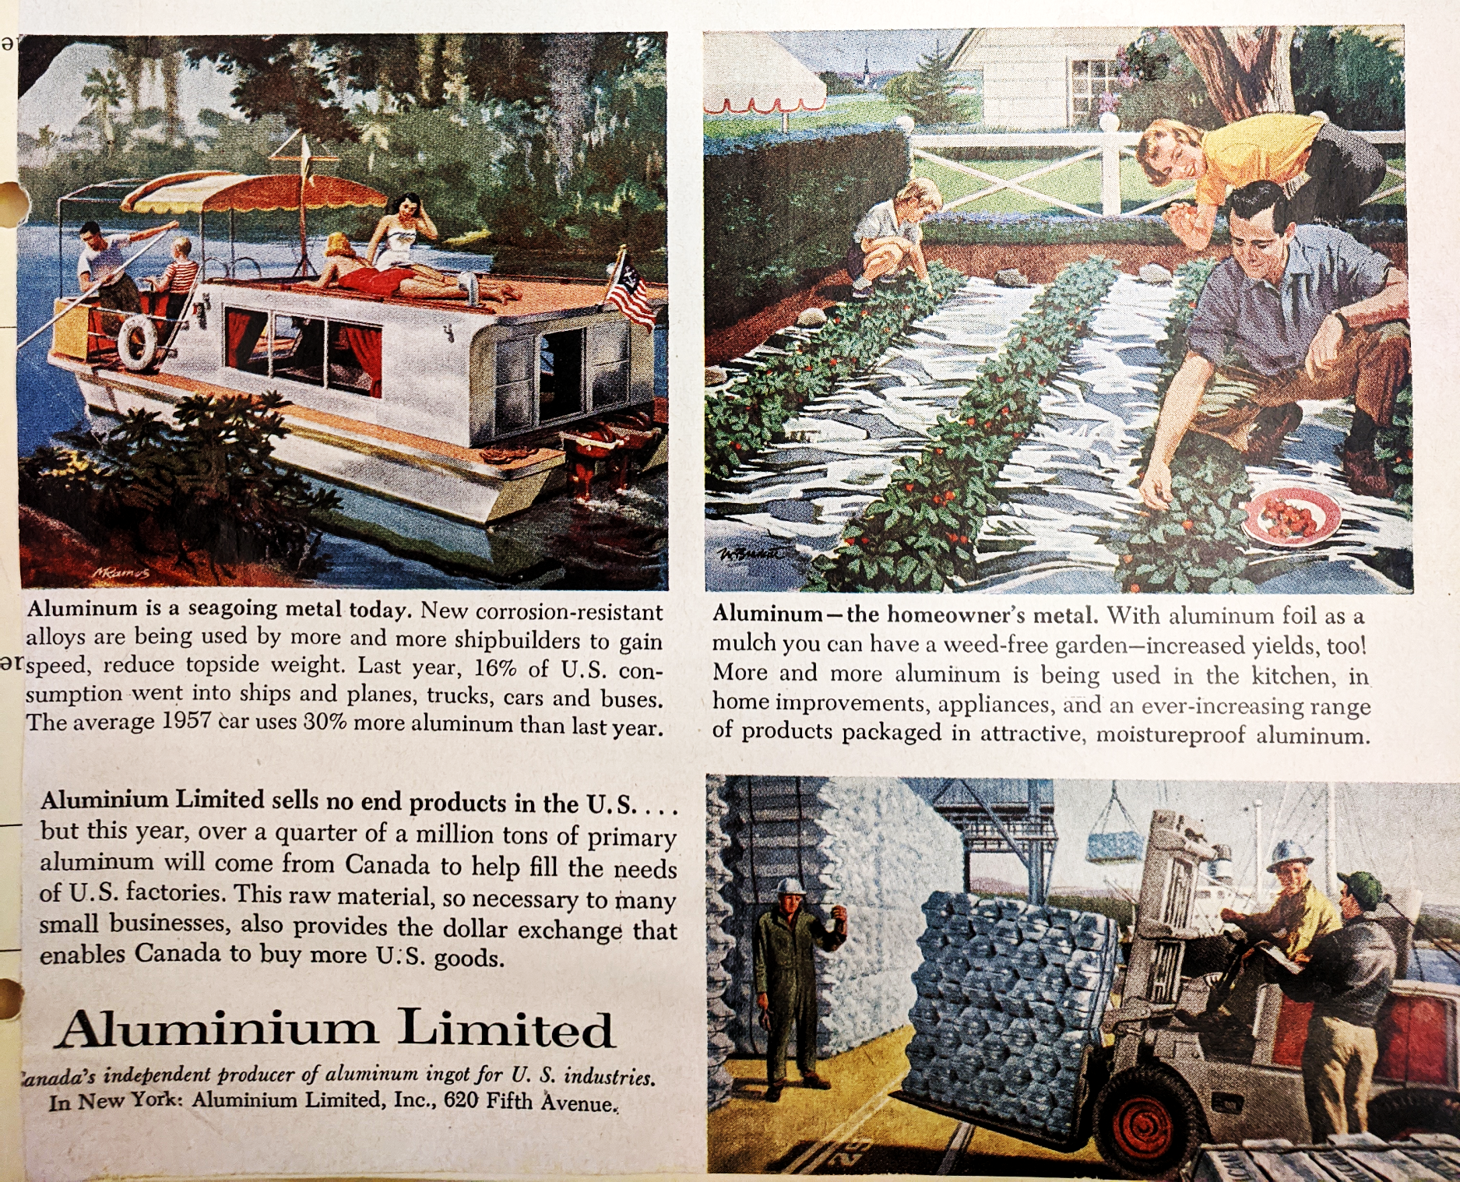
Aluminum in the 1950s
John R. Garber Papers
Box 1, Folder 1

Slide 8
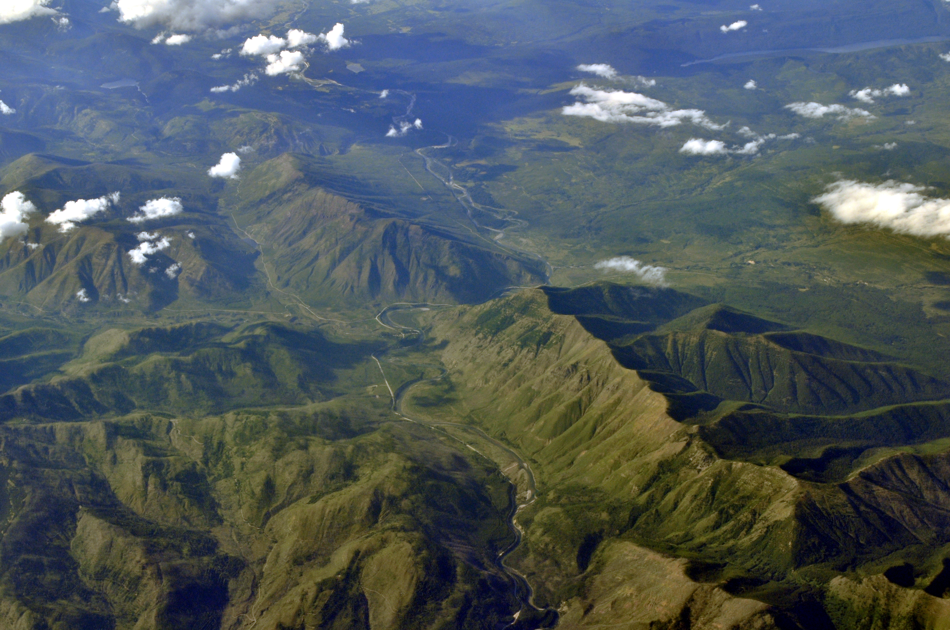
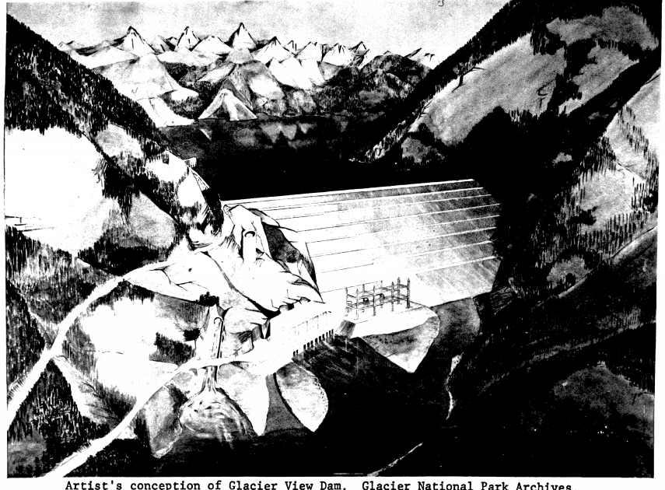
Wikimedia Commons
Glacier National Park Archives
Aerial View, Glacier View dam site Artist’s rendering of proposed dam

Slide 9
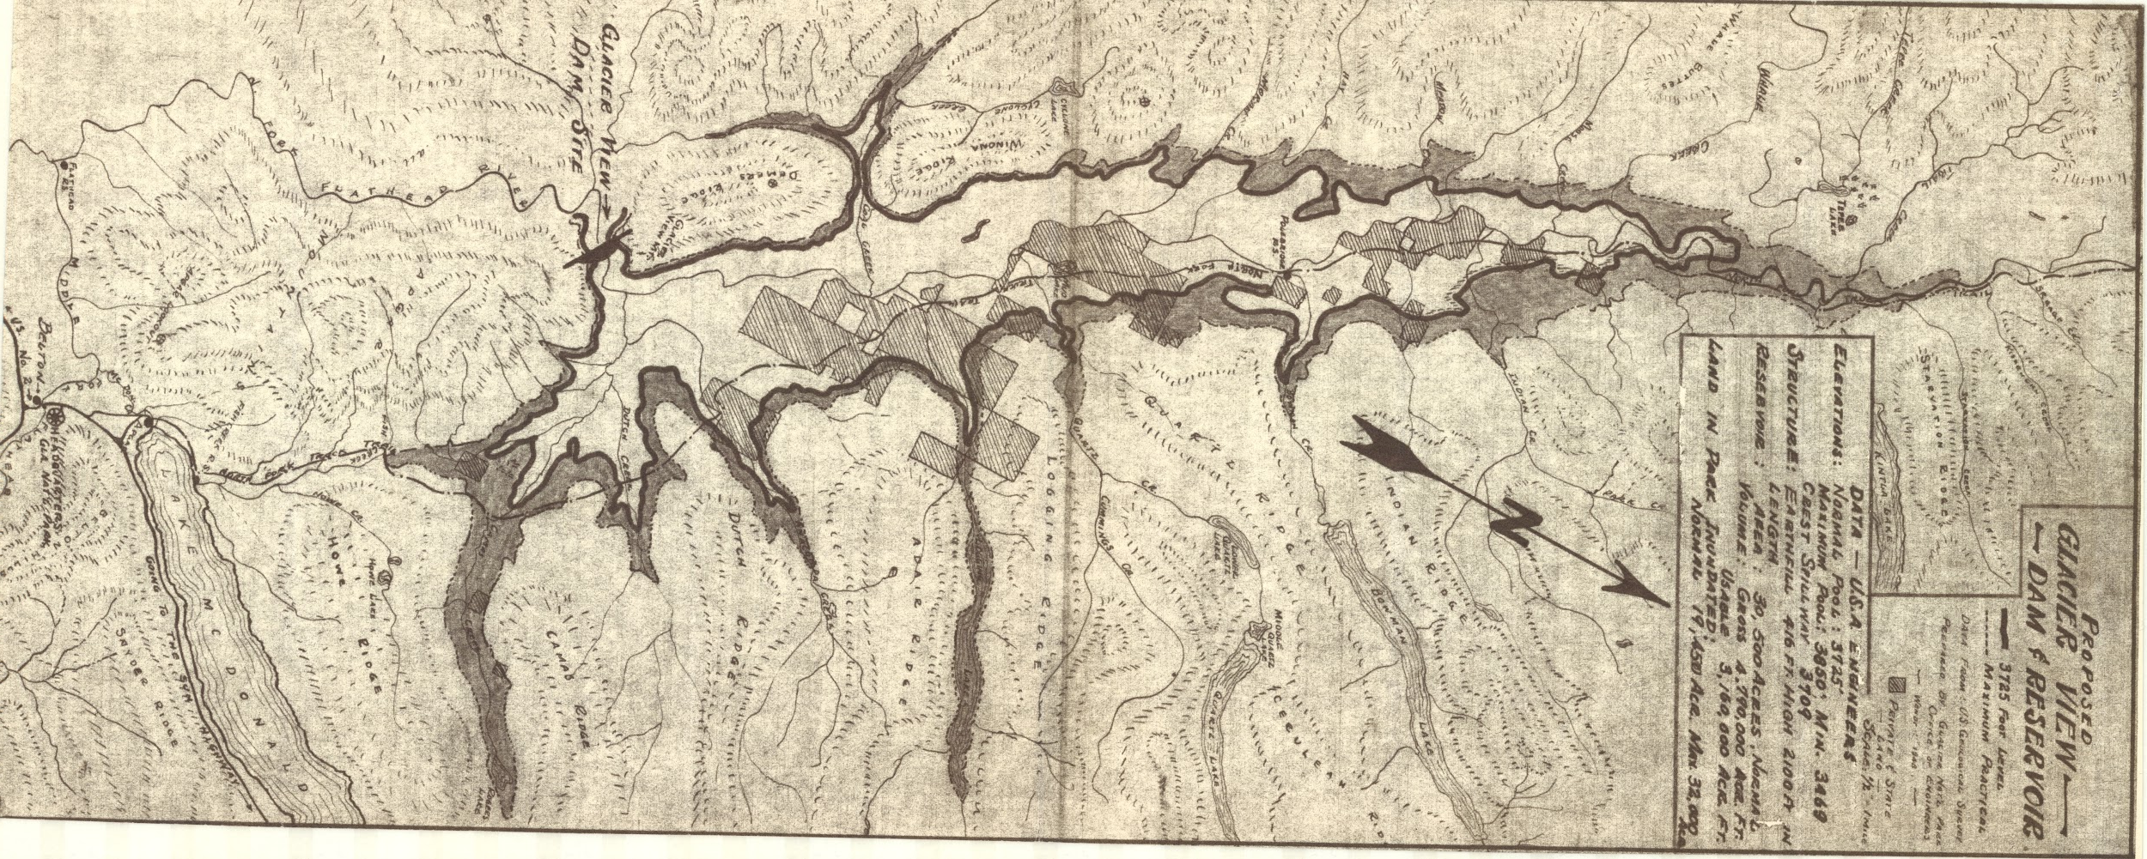
Mansfield Papers, Series 17, Box 233, Folder 1
Map of proposed Glacier View Lake

Slide 10
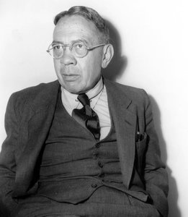
Bernard DeVoto
Wikimedia Commons, Mansfield Papers

Slide 11
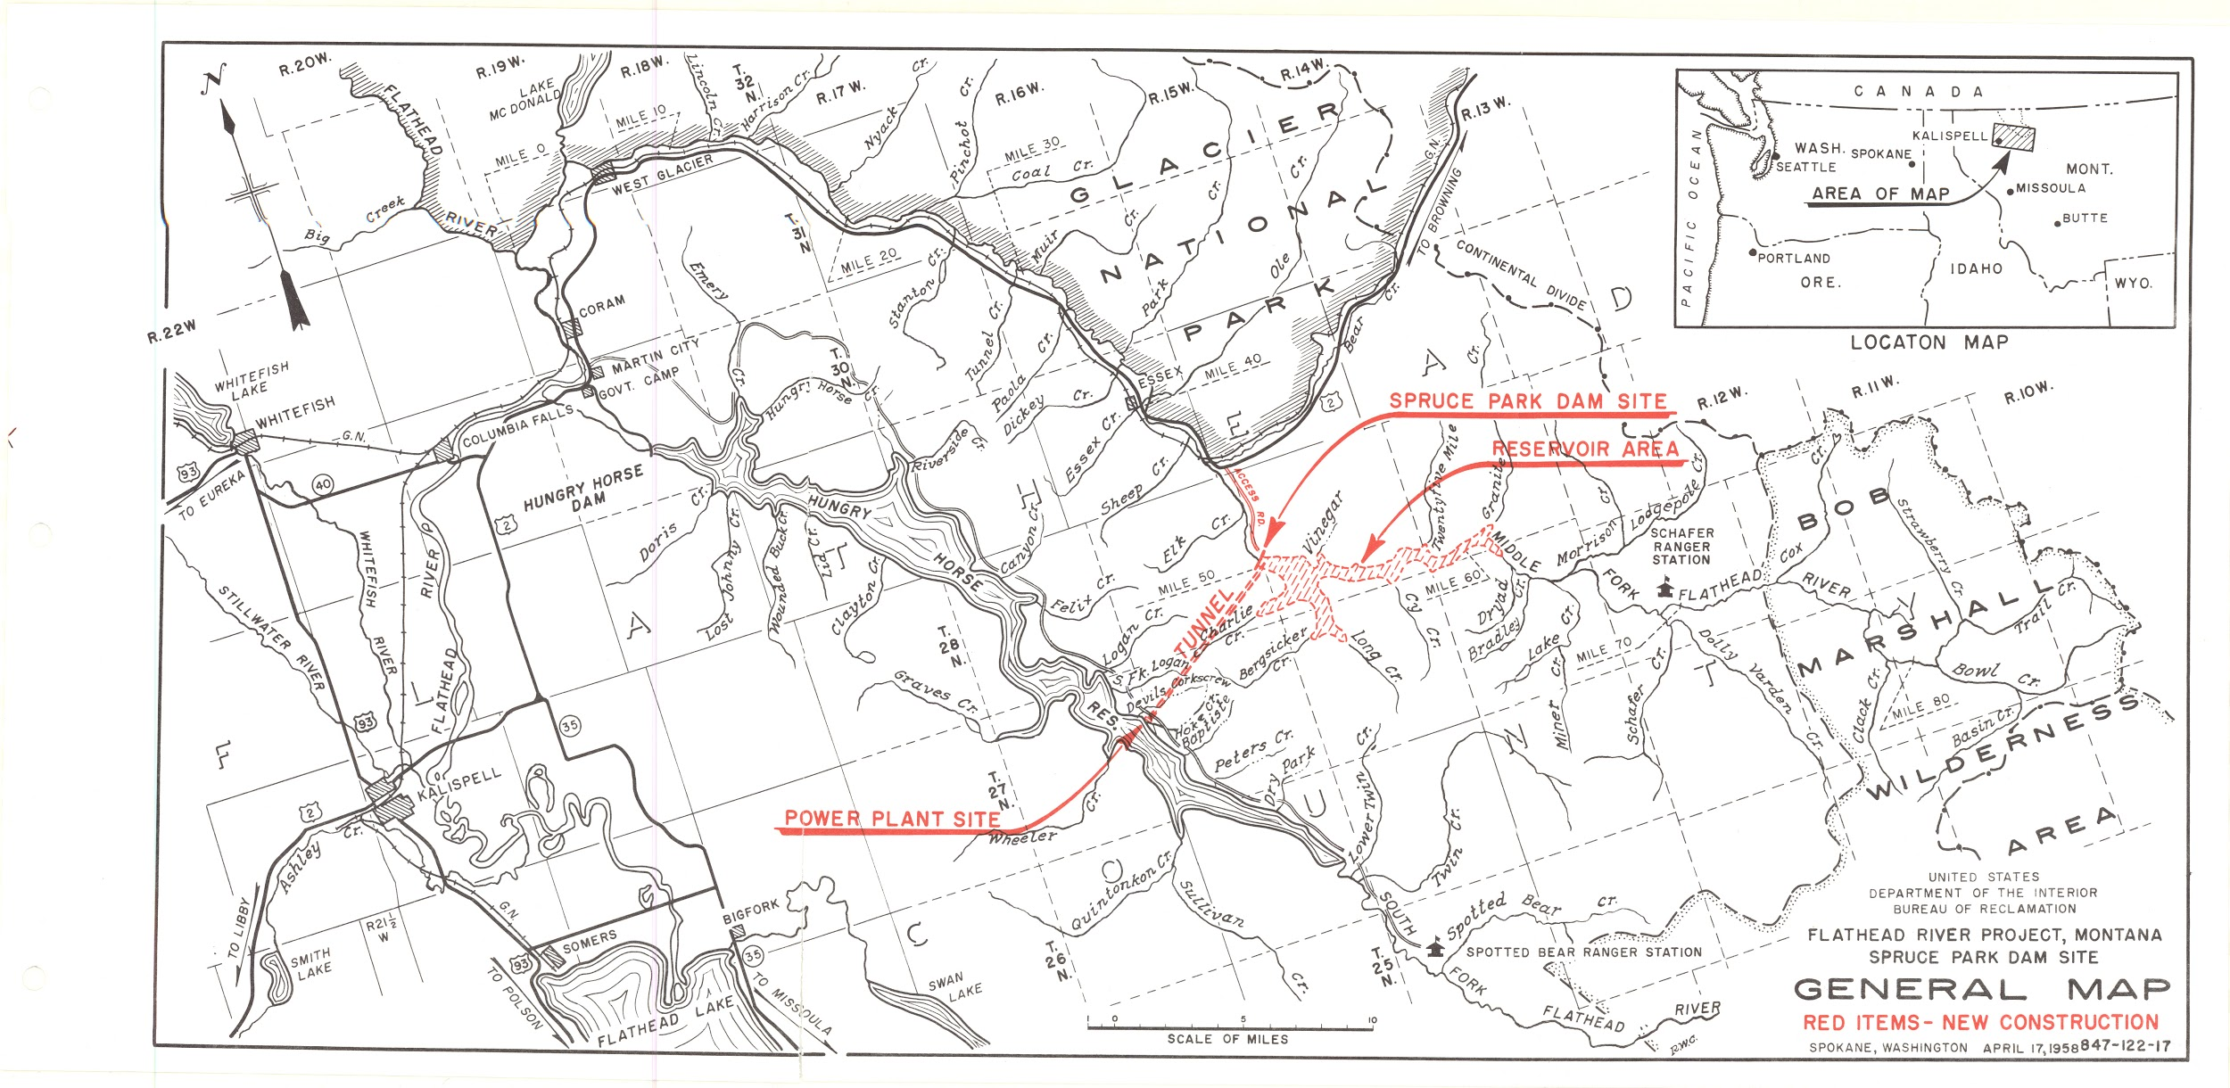
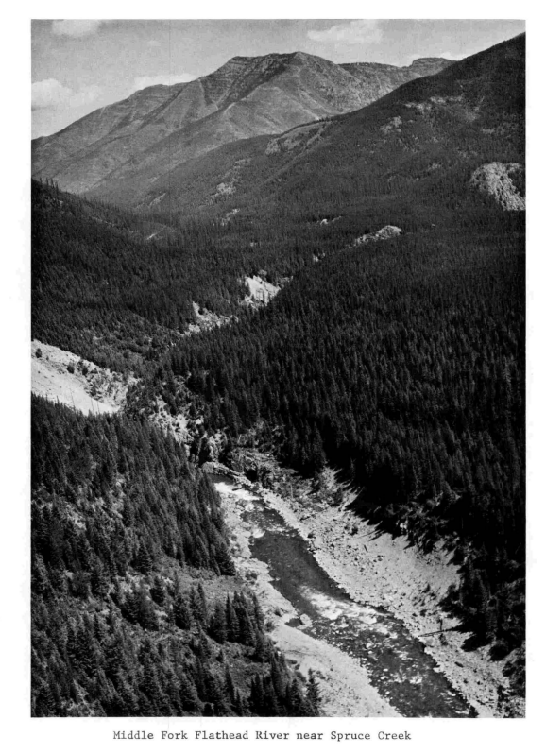
Mansfield Papers, Series 17, Box 233, Folder 7
Proposed Spruce Park Reservoir and Tunnel

Slide 12
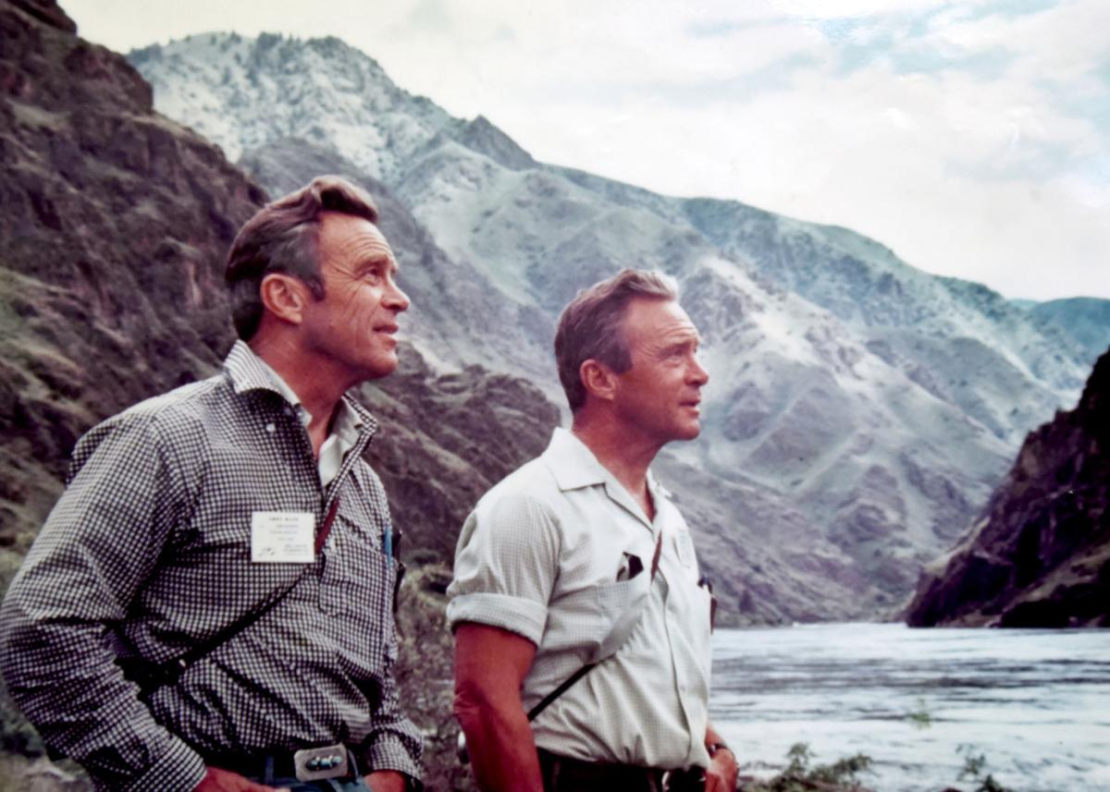
The Craighead Brothers, during a 1970 National Geographic trip down Idaho’s Middle Fork Salmon River
National Geographic Society

Slide 13
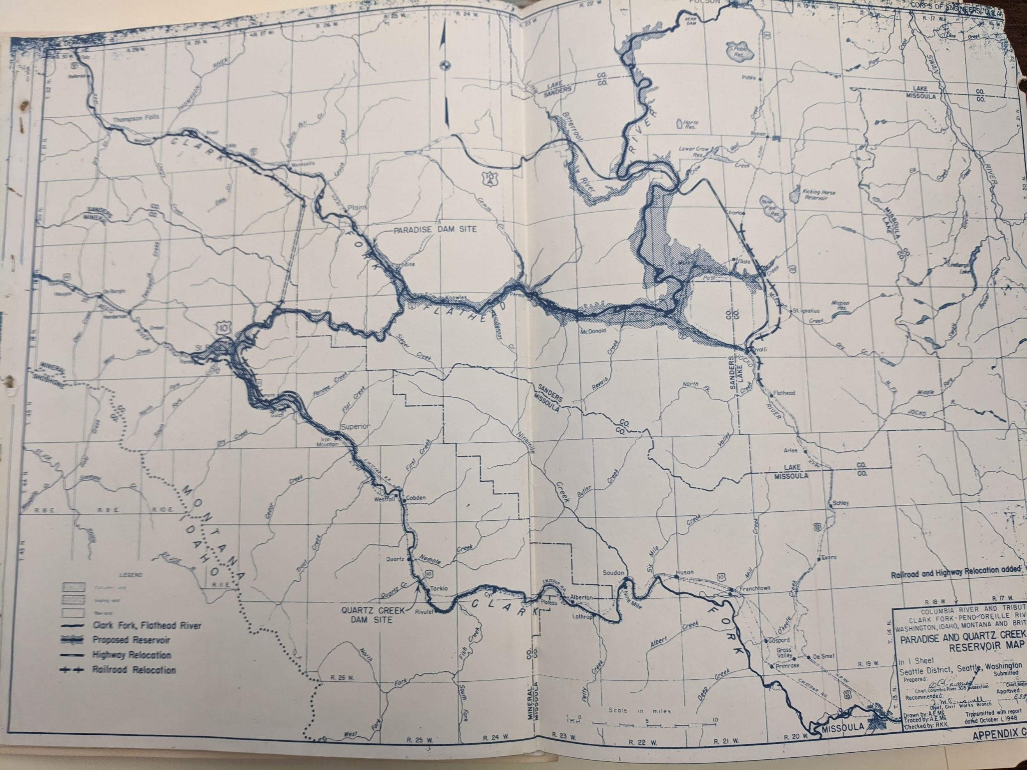
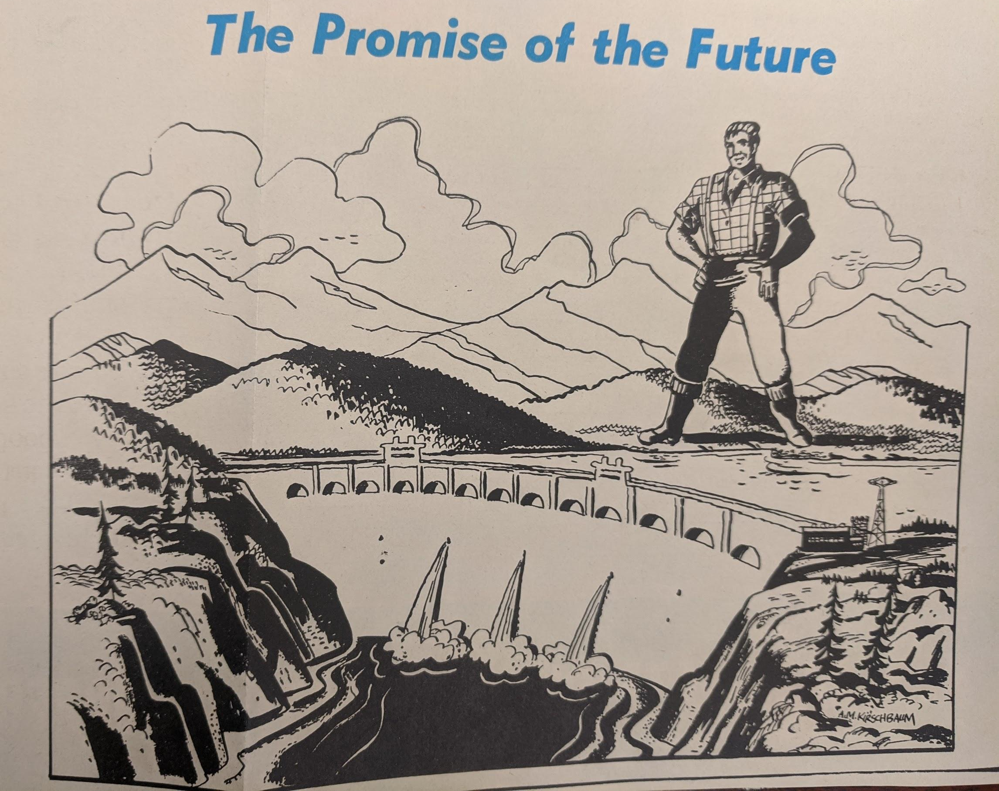
John Garber Papers, Box 1, Folder 1
Paradise Reservoir Map, Public Power advertisement

Slide 14
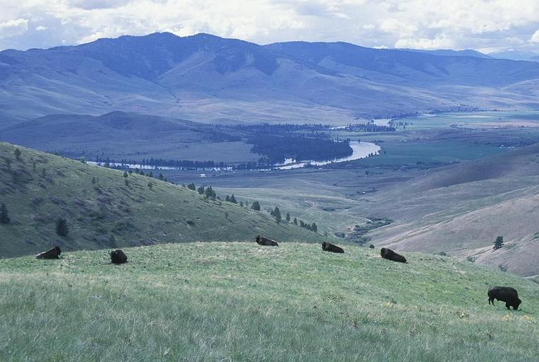
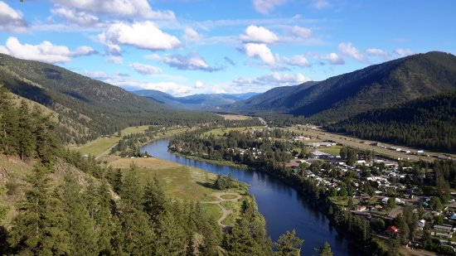
Dept of Interior, National Bison Range
Superior, Montana Office of the Mayor
Lower Flathead River through the National Bison Range
Town of Superior, which would have been submerged under Paradise Reservoir

Slide 15
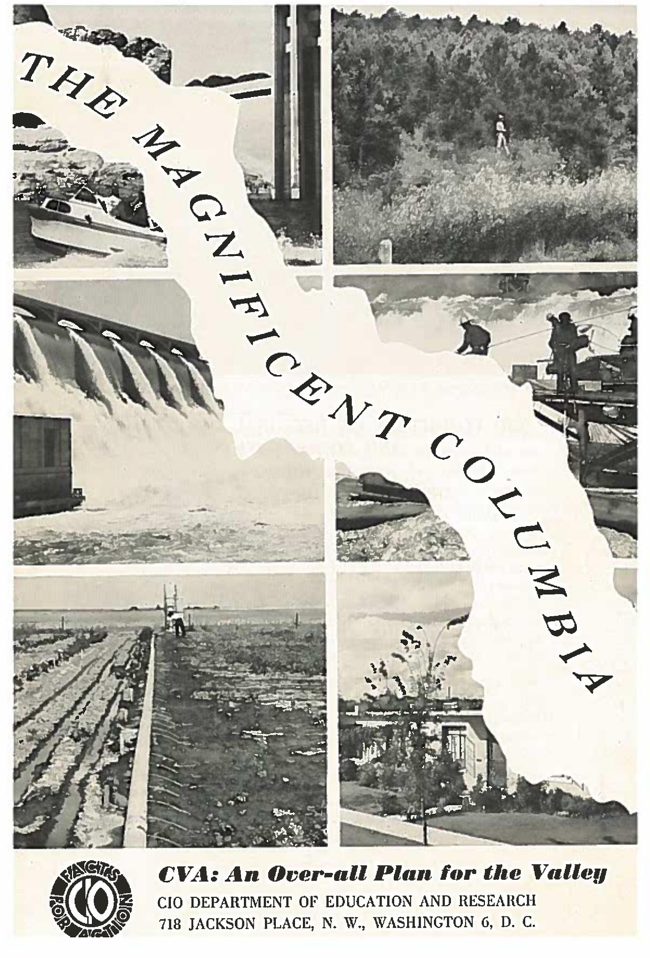
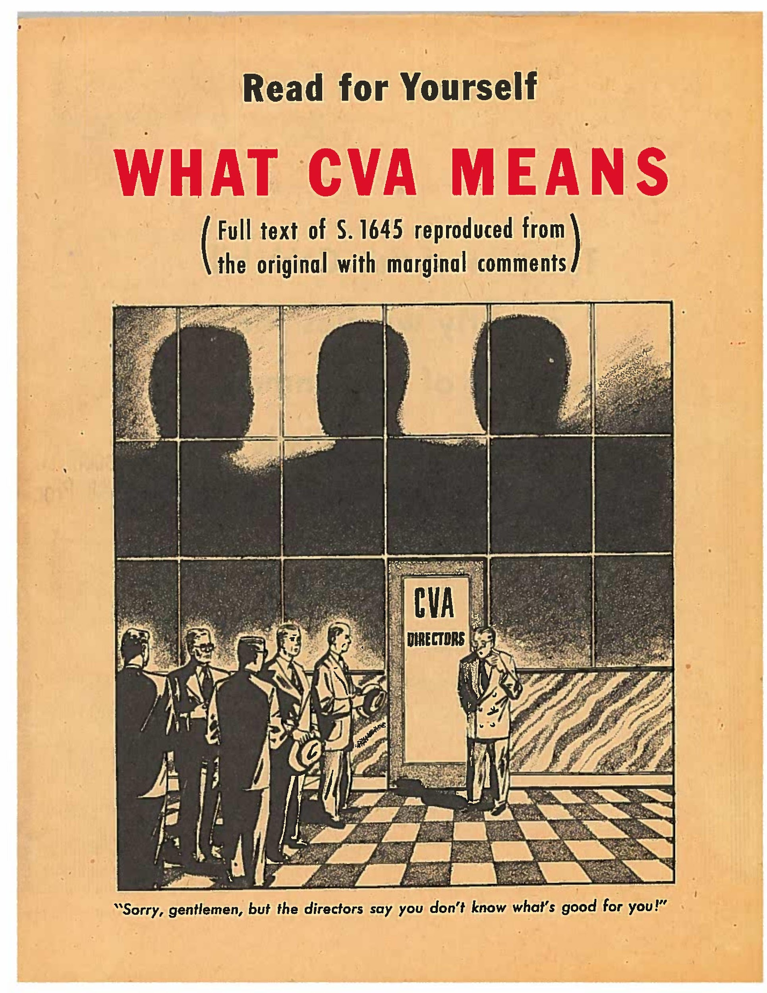
Mansfield Papers, Series 14, Box 12, Folder 10

Slide 16
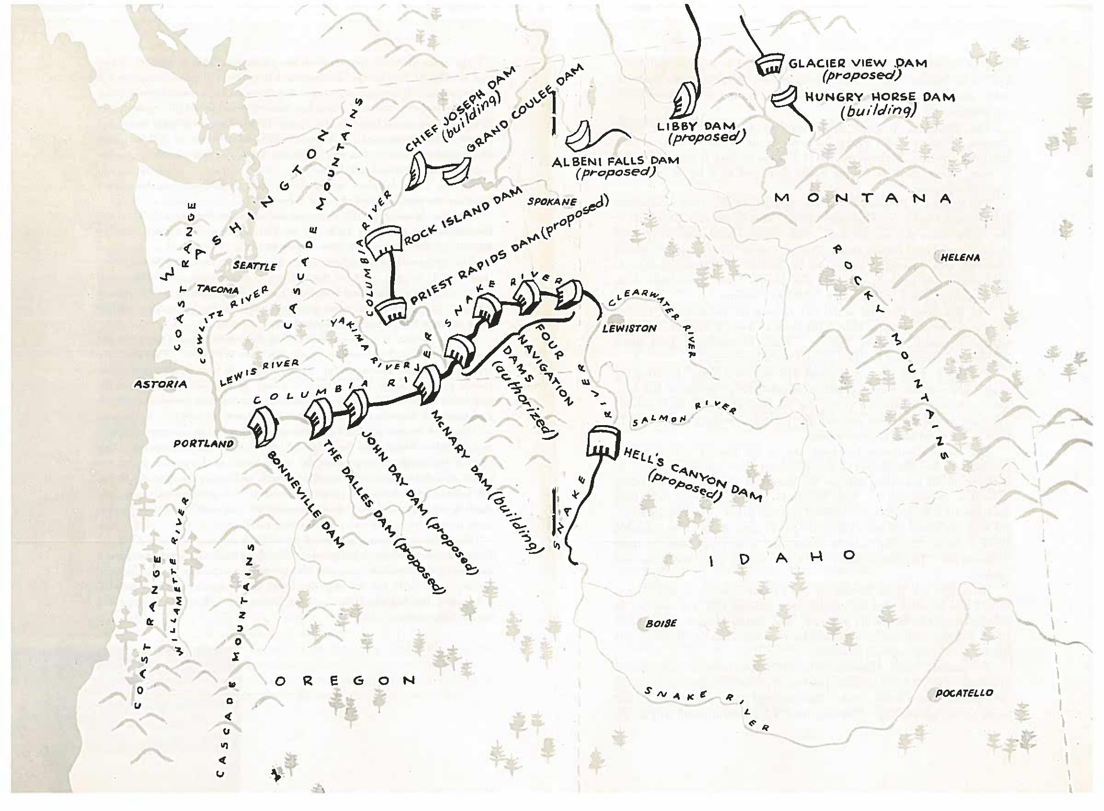

Slide 17
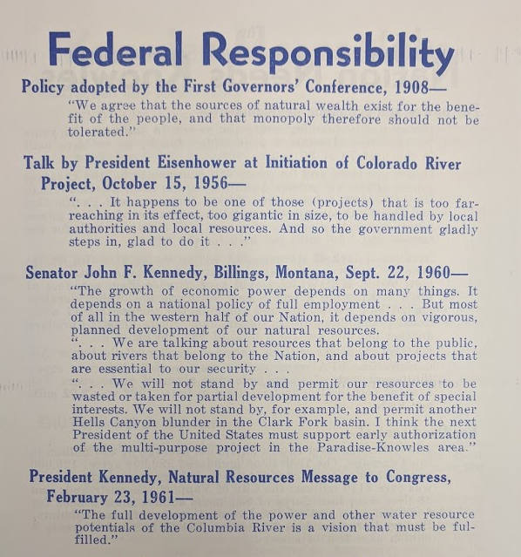
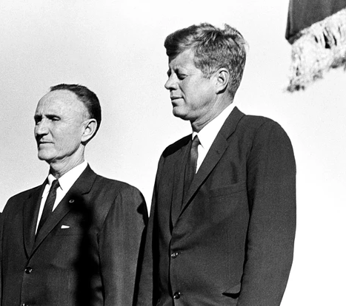
Mansfield and Kennedy, Billings 1960
John Garber Papers, Box 1, Folder 7

Slide 18
Flathead River Wild and Scenic Study, 1975
Flathead National Forest
Map of the Flathead Valley with dam sites marked.

Slide 19
Bibliography
Primary Sources
Archives and Special Collections of the Maureen and Mike Mansfield Library:
Clifton Merritt Papers, 1935–2008. Mss 700.
John R. Garber Papers, 1956–1968. Mss 787.
Mike Mansfield Papers, 1903–2002. Mss 065.
Newspapers
Daily Interlake
Hungry Horse News
The People’s Voice
Magazine Articles
Clifton Merritt. “Wilderness Water” Naturalist 9 no. 2 (1959). Natural History Society of Minnesota. 52-56
Craighead, Frank. “Outdoor Recreation Research” Naturalist 9 no. 2 (1959). Natural History Society of Minnesota. 23-27
Craighead, Frank and John. “River Systems” Naturalist 9 no. 2 (1962). Natural History Society of Minnesota. 2-17
Craighead, John. “Stream Abuse: a challenge to our effluent society” Naturalist 9 no. 3 (1962). Natural History Society of Minnesota. 1-11
DeVoto, Bernard. “Shall We Let Them Ruin Our National Parks?” DeVoto’s West. (Athens, Ohio, Swallow Press, 2005). page 189–202.
Secondary Scholarship
Bailey, Shawn Patrick. "WORTH A DAM: GLACIER VIEW AND THE PRESERVATION OF WILD AMERICA" (2020). Graduate Student Theses, Dissertations, & Professional Papers. 11669. https://scholarworks.umt.edu/etd/11669
Brooks, Karl Boyd., and William Cronon. Public Power, Private Dams: The Hells Canyon High Dam Controversy. University of Washington Press, 2009.
Crane, Jeff, and Michael Egan. Natural Protest: Essays on the History of American Environmentalism. Routledge, 2009.
Drake, Brian Allen. Loving Nature, Fearing the State: Environmentalism and Antigovernment Politics before Reagan. University of Washington Press, 2015.
Harvey, Mark W. T. Symbol of Wilderness: Echo Park and the American Conservation Movement. Univ Of Washington Press, 2015.
Lifset, Robert. Power on the Hudson Storm King Mountain and the Emergence of Modern American Environmentalism. University of Pittsburgh Press, 2014.
Palmer, Tim. Wild and Scenic Rivers of America. Island Press, 2013.
Reisner, Marc, and Lawrie Mott. Cadillac Desert: The American West and Its Disappearing Water. Penguin Books, 2017.
Sabin, Paul. "Environmental Law and the End of the New Deal Order." Law and History Review 33, no. 4 (2015): 965-1003. doi:10.1017/s0738248015000462.
Swanson, Frederick H. "Lee Metcalf and the Politics of Preservation: Part 1— A Positive Program of Development." Montana: The Magazine of Western History 63, no. 1 (2013): 3-91.

Slide 20
Contact
jacob1.schmidt@umontana.edu
View of Buffalo Rapids, Lower Flathead
Jacob Schmidt
MA Student, History

