Slide 1
The Reaction to Progressive Education in the Early Cold War, 1945-1959
Ben Yturri

Slide 2
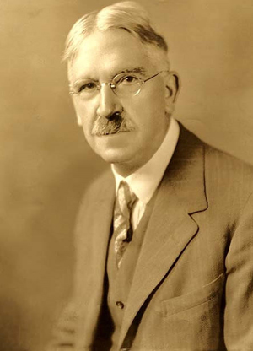
John Dewey
American Pragmatist
"Consider the practical effects of the objects of your conception. Then, your conception of those effects is the whole of your conception of the object." --Charles Sanders Peirce (1878)
My Pedagogic Creed (1897)
Educational “progress is not in the succession of studies, but in the development of new attitudes towards, and new interests in, experience.” (pp. 12-13)
Notes:
Tentative hypothesis, subject to change if new data should render it inadequate. The hypothesis is “true” to the extent that its consequences are favorable for furthering the investigation.

Slide 3
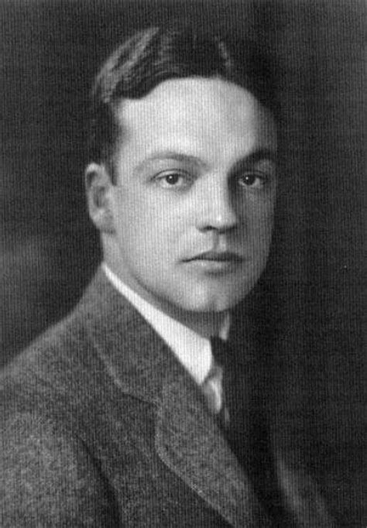
Robert Maynard Hutchins
President of Chicago University at age 30
Served as president from 1929-1945 and as chancellor from 1945-1951
Reformed the undergraduate college with an emphasis on Socratic dialogue, the Western literary canon, early entrance to college, and comprehensive examinations
This plan was abandoned shortly after Hutchins’ chancellery
The Conflict in Education (1953)

Slide 4
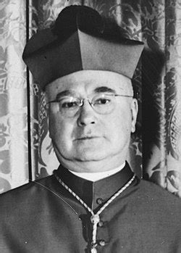
Cardinal Francis Spellman
Created a Cardinal in 1939 and made the sixth Archbishop of New York by Pope Pius XII
Worked with Joseph P. Kennedy in an attempt to stop “the radio priest,” Charles Coughlin, who expressed sympathies with Hitler and Mussolini
Eventually met with Mrs. Roosevelt to settle their public dispute over the church-state issue.

Slide 5
Rudolph Flesch (1911-1986)
Why Johnny Can’t Read (1955)
Believed sight-reading, or the “look-say” method, relied on the student’s ability to memorize words.
Advocated phonics to teach the pupil to sound out unfamiliar words
After reading Flesch's book, a Houghton Mifflin editor asked Dr. Seuss to write a story using only words that first-graders could recognize or sound out, inspiring The Cat in the Hat (1957)
Also published The Art of Clear Thinking in 1951.

Slide 6
Albert Lynd
Quackery in the Public Schools (1950)
“The Deweyan theory of knowledge turns on an insistence that...knowledge results from the interaction of the human organism with the environment. … The only test for truth in an idea, therefore, is in its consequences in the life activities to which it leads. … Truth...is always relative, because the consequences of an idea may change with time or place. (pp. 191-192)
“I am opposed to a philosophy of education which takes for granted the falsity of all gods. (p. 211)

Slide 7
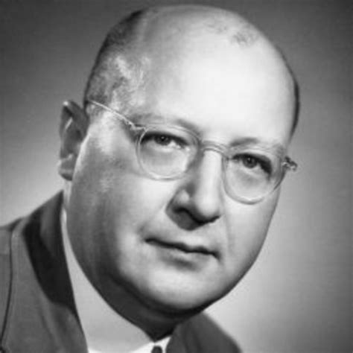
Arthur Bestor (1908-1994)
Educational Wastelands: The Retreat from Learning in our Public Schools (1953)
“Anti-Intellectualism”
The Restoration of Learning: A Program for Redeeming the Unfulfilled Promise of American Education (1955)
Emphasis on classics
Intellect over practical skills
Notes:
Bestor was one of the first specialists on American constitutional law to publicly call for the resignation of President Nixon in a piece published in The Nation.

Slide 8
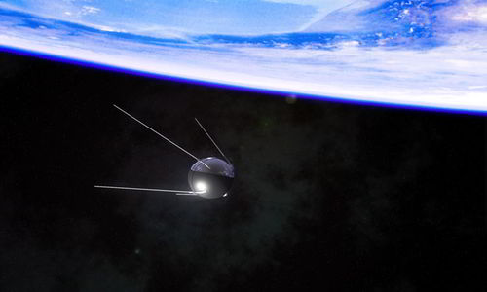
Sputnik I
October 4, 1957
Elliptical low-earth orbit
Orbited for about 4 months
Dead battery after 3 weeks
Seemed to validate Bestor’s concerns about the falling standards of education, and that progressive education taught toward the mean, therefore leaving the highest achieving students at a disadvantage.
Led to the National Defense Education Act (September 2, 1958)

